Slide 1
Paper Reading
Chen Xu
2021.5.13
Notes:
[读]
﻿Initially, nodes correspond to the concepts in Cx are given a score of 1 while other unvisited nodes are assigned with 0.
[举例] we use this node as an example, for each incoming neigbor, we use this neighbor score add the relevance score between this triple u r v and the context.
Because the node scores finally are the logits to generate concept distribution for the next word, so this score propagation should depend on the context.
[R] here is the similairy matrix to combine two different dimention vector into a scalar.

Slide 2

Overview
You Impress Me: Dialogue Generation via Mutual Persona Perception, ACL 2020
﻿Language Generation with Multi-Hop Reasoning on Commonsense Knowledge Graph, EMNLP 2020
Why paper 1:
Current SOTA baseline on personalized dialogue generation task with which we want to compare.
Inspired by this paper, we get an assumption about what is ﻿a high-quality conversation.
Why paper 2:
We want to mimic the paper's methodology about how to use KG in the generation task and apply it into the personalized dialogue generation task
Notes:
关于要分享的第一篇论文，做个说明。在之后的分享过程中我对原论文的 title 和 motivation 部分的表述进行了修改。原因是，论文一直强调他是从认知科学中借鉴过来的两个概念，一个是 Impression 一个是相互感知 mutual perception。然而当我读完方法后发现作者有些过度包装 idea，按照他的故事去看他的方法会非常牵强，产生干扰。所以我基于方法本身，把他的故事进行了修改，以便大家更好的理解。
[开场白]
[红色] The red words, these two questions, are what I will focus on and give the answers in this lecture.

Slide 3
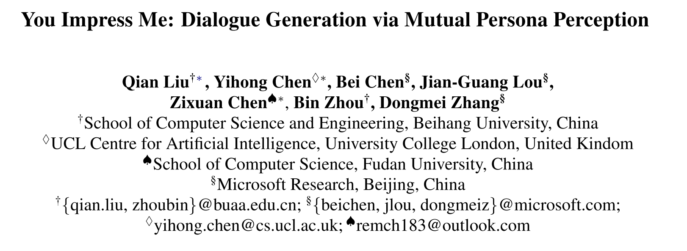

Slide 4
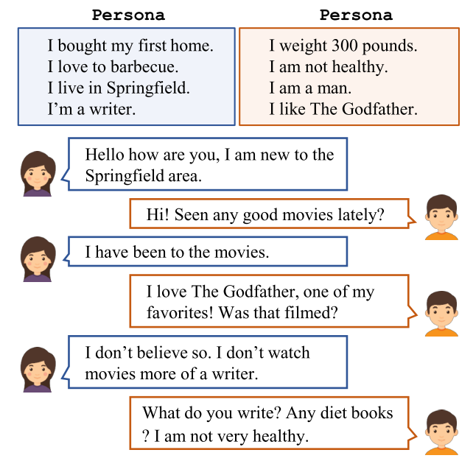


Background
Personalized Dialogue Generation: Making chit-chat more engaging and consistent by conditioning on persona information.
N-turn dialogue we need to model
Persona Chat Dataset
Notes:
[读]
[In a multi turn dialog, we need to model the probability of an utterance given the persona information and the dialog history.

Slide 5
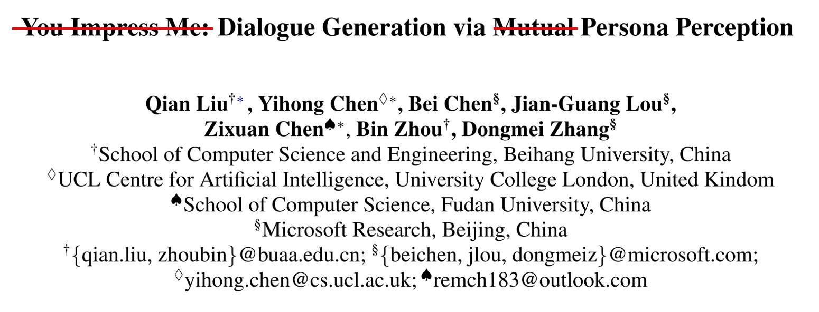
Motivation
Current works simply focus on mimicking human-like responses, leaving understudied the aspects of modeling understanding of whether or how much persona information has been expressed by its corresponding speaker.
The “understanding”is the concept “Persona Perception” in the title.
Notes:
[读]
[Understanding] This understanding is the meaning of the most important concept in the title, so called "Persona Perception".
[承上启下] I give an example to illustrate it.

Slide 6

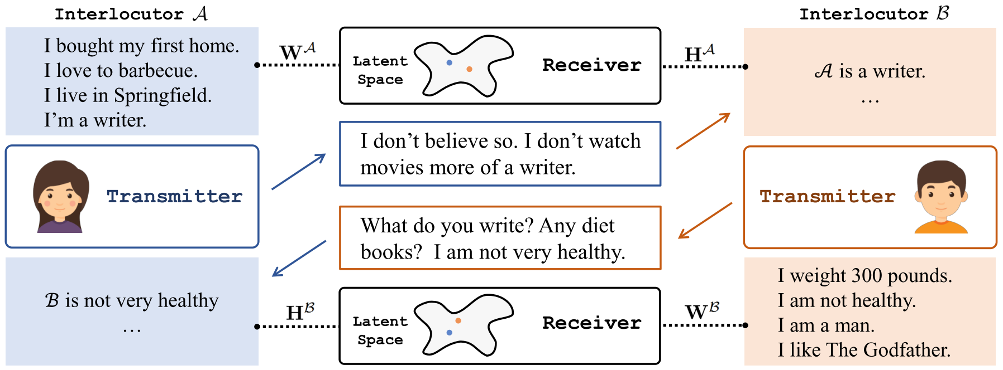
Persona Perception is just a relevance score between an utterance and persona sentences given by the Receiver (A third-party persona perceptron)
Persona Perception Score
Notes:
[念]
[图]So look at here, we first encode persona sentence into a latent space, one sentence one vector. And then when A speak, this utterance will be also encoded into the sample space, also one sentence one vector.
[X] 这里我插一句中文，这部分是作者虚拟出来的概念叫impression，在实现过程中根本不存在，是用来讲故事的。So we just drop it, what we need to know is that this utterance is directly encoded into the same space
[Receiver] And this score is given by the Receiver model, I think the name Receiver is also confused so I must give a note that We need to think of it as a third-party one. By third-party I mean that is doesnt belong to any speakers, it just a function or a tool to give a score.
So even the negative persona also can be fed in, like here, we pair the utterance A with the Persona C. Ofcourse this score should be very low, but this is allowed.

Slide 7
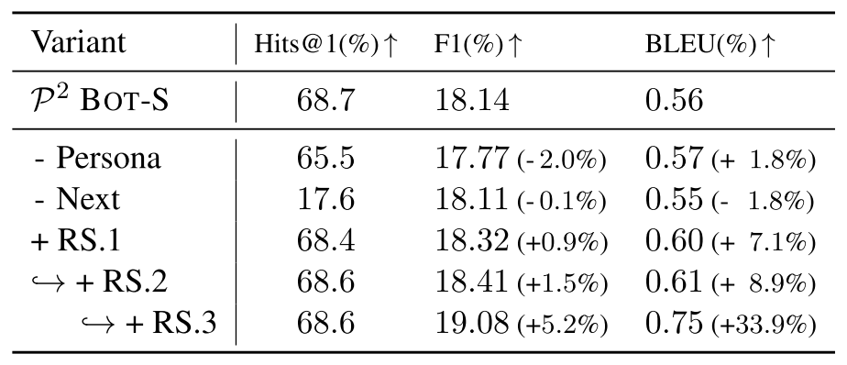
Motivation & Main Idea <Revised>
Current works simply focus on mimicking human-like responses, leaving understudied the aspects of modeling understanding of whether or how much persona information has been expressed by its corresponding speaker.
Persona Perception score(pp score) can be used to assess the quality of an utterance. But ..
Transmitter Receiver
B:“what are your hobbies?”
A:“My hobby is playing basketball.”
﻿What is a high-quality conversation: Both of interlocutor express their persona information: (A express persona A, B express persona B)
We need lookahead through the whole dialogue adding all PP scores to assess the current utterance B
--- Reinforcement Learning
Notes:
[念]
[PP] Ok so how could we use this score.+ 念
[Example] Look at this example here, how do we evaluate this utterance? Obviously, the persona perception score must be low because it didn’t express any perona information of the speaker B. But actually, it should be encouraged, because if we look at next response, we will find that B sacrifices his chance to express persona but it helps A to express A’s persona information.
[Assumption] 念
[]

Slide 8




Methodology
﻿The model comprises two components, Transmitter and Receiver
﻿Transmitter generates according to the distribution
The same process applies to keeping the conversation flowing.
How to train the transmitter:
Supervised Dialogue Generation:
RL Fine-tuning where persona perception reward is given by the Receiver
Notes:
[念]The model ..
[-]By this time, I think we have got some understanding about the receiver. Now I am gona talk about transmitter, and give relationship between them.
[念] h: entire dialogue history up to n-th turn
[念]
[last] We just talk about it on last slide.

Slide 9
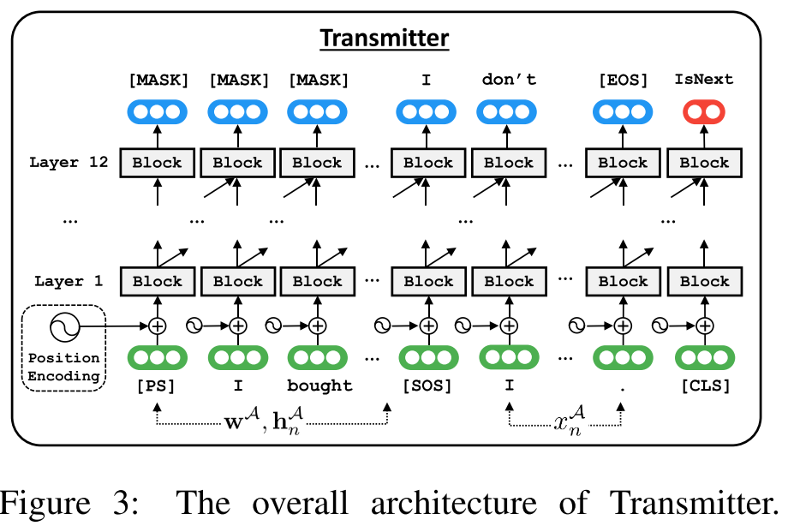
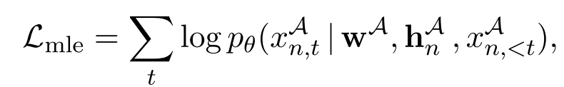
﻿Supervised Dialogue Generation
﻿1. Sequence Generation Task
2. ﻿Next Utterance Prediction Task
Notes:
[SOS] This is the overall architecture of Transmitter based on Transformer decoder.
[1] MLE
﻿[2] Apart from training Transmitter to generate responses, the author also train it to discriminate whether the response is the given context.
Concretely, the author append a special token to the tail. A binary classifier is built on top of this token’s final hidden states.
[3] I think this task is so important according the ablation study. If we drop it, there will be a big problem.

Slide 10
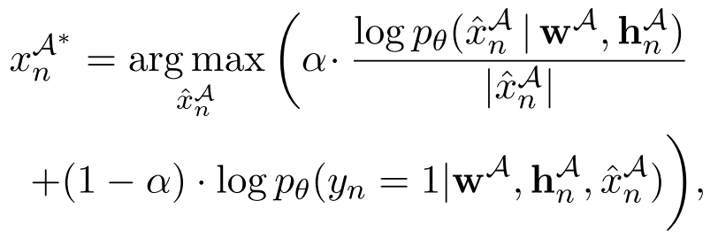
﻿Supervised Dialogue Generation
Inference time: beam search is applied to store top-ranked response candidates and ﻿the classifier is also used to rank response candidates together.
Notes:
[1] 念
[2] The first line likelihood score
[3]﻿ The second line is given by the classifier,
y = 1: means that the score indicating the generated response is predicted as the next

Slide 11
Methodology
﻿The model comprises two components, Transmitter and Receiver
﻿Transmitter generates according to the distribution
The same process applies to keeping the conversation flowing.
How to train the transmitter:
Supervised Dialogue Generation:
RL Fine-tuning where persona perception reward is given by the Receiver
Notes:
[念]The model ..
[-]By this time, I think we have got some understanding about the receiver. Now I am gona talk about transmitter, and give relationship between them.
[念] h: entire dialogue history up to n-th turn
[念]
[last] We just talk about it on last slide.

Slide 12





﻿Self-play RL Fine-tuning
Self-play: ﻿two Transmitters communicate with each other for several turns. One Transmitter serves as a user with the parameters frozen, while the other is a learnable agent, θ, is fine-tuned during the self-play.
RL Fine-tuning:
State:
Action:
Policy:
How to shape the Reward ?
Notes:
[SOS] I separate the slide title into two terms, and we explain them respectively.
[1] 念
[2] 念 Key elements to frame a RL problem.
[Note] B just a notation to indicate the current speaker, We can also use A C D.
[3] With the policy gradient and the log derivative trick, the theta is updated
[4] Now, the question how to shape the Reward Function?

Slide 13

Reward Shaping(RS)
﻿RS.1 Language Style﻿: evaluated by a pretrained LM
﻿RS.2 Discourse Coherence: evaluated by the Classifier.
﻿RS.3 Persona Perception: evaluated by the Receiver.
Notes:
【念】
【last】 I use the different font size to distinguish the efficiency according to the ablation study.
The third one is the most important thing. Let’s see more details.

Slide 14
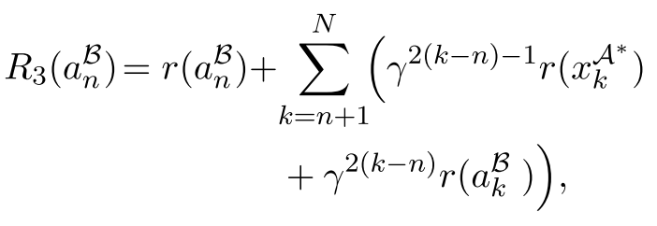
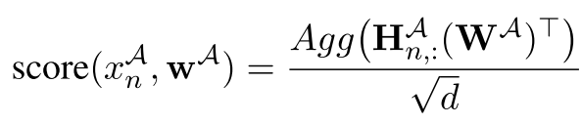


RS.3 Persona Perception
﻿Used to capture the assumption that: A high-quality chit-chat conversation should let both of interlocutor express their persona information.
Transmitter Receiver
B:“what are your hobbies?”
A:“My hobby is playing basketball.”
is the pp relevance score for an utterance of A(or B) to capture how much persona information has been expressed. In inference time:
Notes:
[念] This reward is for what is a high quality conversation.
[example] Remember this example we have used in the motivation section.
Here we just give the formulation.
The persona perception score is this lower case r in the formulation.
So in order to give an utterance a score, we need lookahead through the whole dialogue adding all PP scores together to assess the current utterance B
[念]
[分析公式]
[Now] So how to train the receiver to give the score?

Slide 15
Receiver Training
﻿Receiver is trained to measure the proximity between the utterances and persona sentences using negative sampling.
Negative sample
Notes:
[念]
[Negative] by negative sample I mean a random persona which is not consistent with the speaker.
[last]

Slide 16

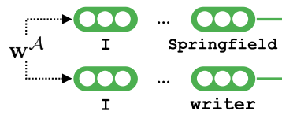
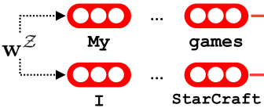


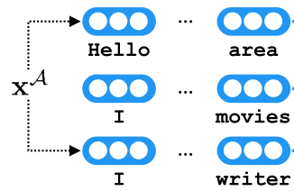



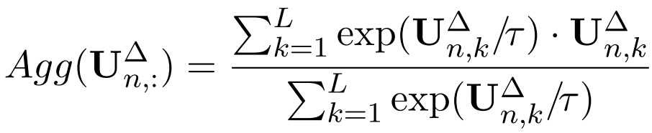
Receiver Training
Positive Persona
Negative Persona
﻿However, we do not have access to the golden fine-grained correlations.
﻿The only thing we know is that, left matrix should > right matrix (at a coarse granularity)
Utterance
Aggregation Function
We should not maximize all scores
Coarse -> Fine-grained
Notes:
[SOS]
[介绍]
﻿Receiver contains two different one for utterance and one persona respectively. So training receiver is to train these two encoders.
They are initialized by BERT both encoders provide deep contextualized representations for each token. Then average all the word representations, to get a fixed dimensional vector for each sentence.
[However] … fine-grained means that each point in this matrix, that is we don’t know which utterance corresponds to which persona.
[The only] 读
【Loss】So the author aggregate two matrix and designed a marginal loss to makes the left > right
But another problem raises, if we simply use the average as the aggregation function, every points in UA are maximized, including all those that should not be activated. Most time ﻿an utterance only relates to zero or one persona sentence.So the author uses two ways to solve this problem.
First, a regularization L1 is used to constrain the matrix making them sparse
Second, design a special aggregation function whose idea is similar to the softmax.
At the beginning tha temperature is large, so this function is just a average. Through the temperature decreases, ﻿the loss gradually focuses more on the point with the highest relevance score.
At last, in inference time, only the positive persona is given,we use the left matrix to give reward in the reinforcement fine-tuning.

Slide 17
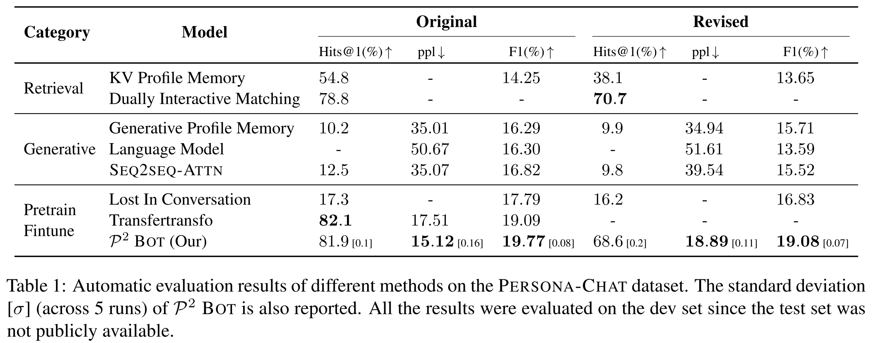
Experiments & Results
Baseline ﻿Comparison
Notes:
﻿As observed, the approach outperforms almost all baselines and achieves new SOTA performance on ppl and F1, with highly competitive performance on Hits@1.
Both on two version of persona-chat dataset.

Slide 18
Overview
<Revised Tittle>
You Impress Me: Dialogue Generation via Mutual Persona Perception, ACL 2020
﻿Language Generation with Multi-Hop Reasoning on Commonsense Knowledge Graph, EMNLP 2020
Why paper 1:
Current SOTA baseline on personalized dialogue generation task with which we want to compare.
Inspired by this paper, we get an assumption about what is ﻿a high-quality conversation.
Why paper 2:
We want to mimic the paper's methodology about how to use KG in the generation task and apply it into the personalized dialogue generation task
Notes:
关于要分享的第一篇论文，做个说明。在之后的分享过程中我对原论文的 title 和 motivation 部分的表述进行了修改。原因是，论文一直强调他是从认知科学中借鉴过来的两个概念，一个是 Impression 一个是相互感知 mutual perception。然而当我读完方法后发现作者有些过度包装 idea，按照他的故事去看他的方法会非常牵强，产生干扰。所以我基于方法本身，把他的故事进行了修改，以便大家更好的理解。
[开场白]
[红色] The red words, these two questions, are what I will focus on and give the answers in this lecture.

Slide 19
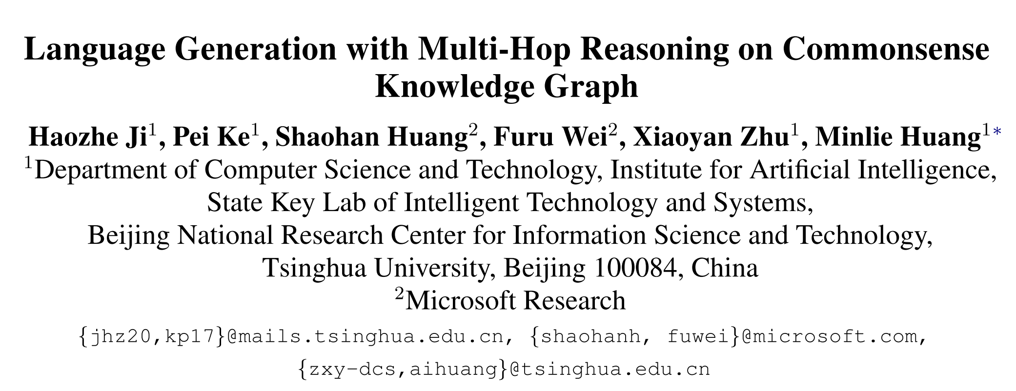

Slide 20
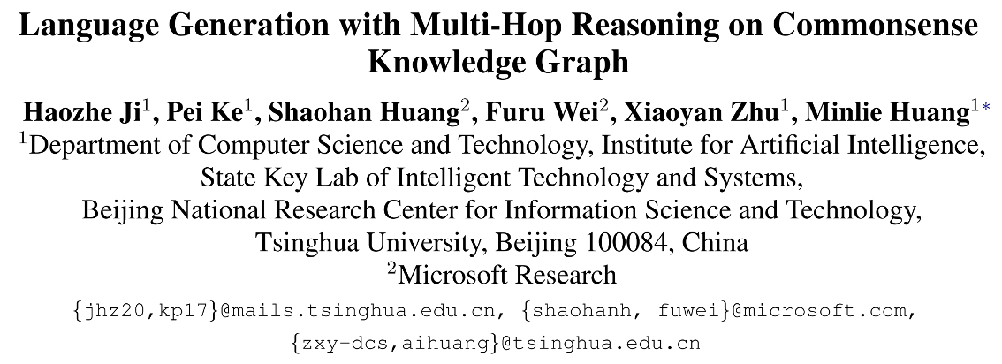
Motivation & Main Idea
﻿Existing approaches that integrate commonsense knowledge into pre-trained language models simply transfer relational knowledge by post-training on individual triples while ignoring rich structured knowledge within the KG.
E.g. Triples -> Readable natural language sentences -> Fine-tuning LMs
Multi-hop reasoning over multiple end-to-end triples makeing full use of this structured knowledge (connections in the graph) in the generation task.
Notes:
[读]
[e.g.]Existing method use template-based method to transform Commonsense triples into a readable natural language sentences, which are then used to fine-tune pretrained LMs, Use this way to inject commonsense into pre-trained models.
[red] I think the most important phrase “Multi-Hop Reasoning” is directly opposite to the phrase “individual triples”, and the author want to make full use of this structured knowledge in the generation task.
So what is the multi-hop reasoning, I give an example

Slide 21
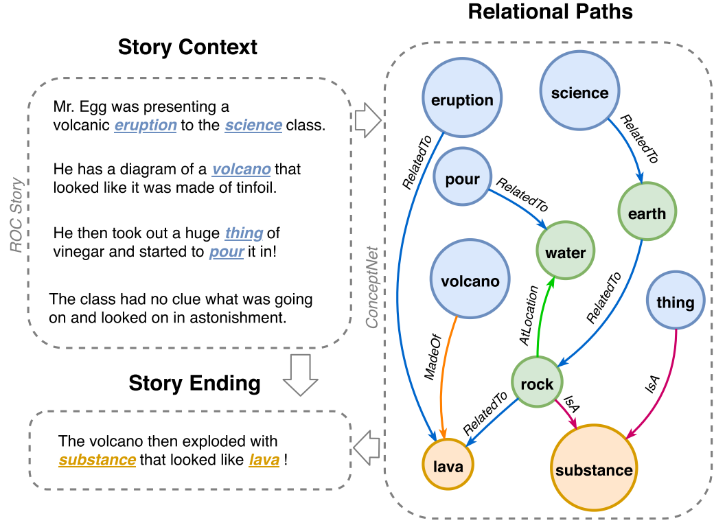
Motivation & Main Idea
Multi-hop reasoning over multiple end-to-end triples makeing full use of this structured knowledge (connections in the graph) in the generation task.
Notes:
[读] ﻿An example of using structural relational knowledge as commonsense grounding in story ending generation.
[] here model's input & output
Blue nodes correspond to the concepts in the context, orange nodes correspond to those in generated text and green nodes are intermediate concepts that connect the evidence chain.
[123] So start from this node, end up with this orange node across 123. This is the structured knowledge
[last] Now let's go into the methodologg to figure out How to construct such a graph and what is the model architecture.

Slide 22




Methodology
Problem Formulation:
How to construct the sub-graph?
is the sub-graph extracted from the , since direct reasoning on the complete graph﻿ is intractable.
Starts from concept nodes (Blue Nodes).
﻿Search for direct neighbors and preserve top-B nodes according to incoming degree in the current sub-graph.
﻿Iterate the above process for -hops.
Finally, we end up with the sub-graph consists of inter-connected -hop paths starting from the source concepts
﻿
Notes:
[左] We want to model the probability of text give the context x and the graph G.
[G] 念
[右]Cx are the nodes directly extracted from the context text, using the pipeline of tokenization, some preprocess and concept matching. We end up with a collection of initial concept nodes.
[incoming degree] ﻿Intuitively, this keeps salient concepts that are most commonly visited nodes and support information flow on the graph.

Slide 23
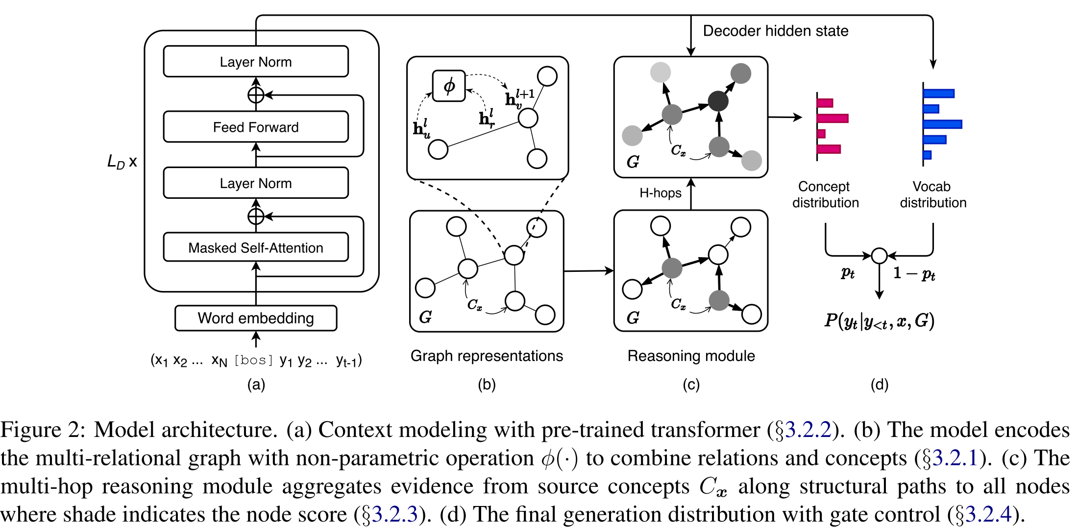
Model Architecture
Notes:
[SOS] From a high-level picture, there are four modules involved. So first we see here, the output of the model is a next word prediction given the previous words, context x and the subgraph
【a】First module here is the context modelingg with pre-trained transformer decoder, GPT2. And we end up with the final hidden states of the last token as the context representation. used to generate the distribution over the vocabulary.
【b】Second module is the Graph modeling, noting that this is the sub-graph extracted from the context x, not the global one. And a GCN is used to encoding the graph.
We need to note that, use this node as example, both the neighbor node embedding with relation embedding (the edge conncecting them) are aggregate into this node hidden states of the next layer. So finally, we end up with a collection of node hidden states also a collection of relation hidden states, these are fed into the reasoning module.
【c】here is the most important part in this paper, reasoning module. we initialize each nodes in the Cx with a score, and use the graph and the context representation, to propaggate these scores to the whole sub-graph, we end up a collection of node scores, just think of it as the logits to generate distribution over the these nodes.
【d】the last one is the gate module usd to combine both two distribution to predict the next word.
I think a module a b d are easy to understand, we only go deep into the reasoning module.

Slide 24
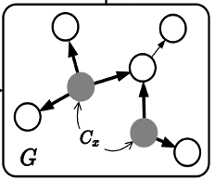

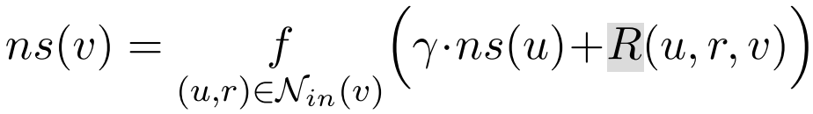
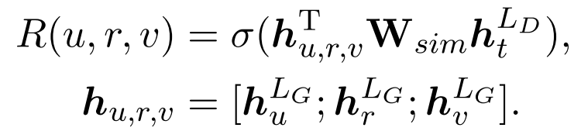

Reasoning Module
﻿Utilizes both structural patterns of the knowledge graph and contextual information to propagate evidence along relational paths at each decoding step.
1
0
Score Propagation:
For each unvisited , the node score is calculated by following
triple
We can think of as the bridge between the triple(score propagation edge) and the context.
finally all node scores (logits) are dependent on the context concept distribution likewise.
Notes:
[读]
﻿Initially, nodes correspond to the concepts in Cx are given a score of 1 while other unvisited nodes are assigned with 0.
[读]
[举例] we use this node as an example, for each incoming neigbor, we use this neighbor score add the relevance score between this triple u r v and the context.
Here is my understanding.读
[R] concretely here is the bridge, similairy matrix to combine two different dimention vector into a scalar.
[读]

Slide 25
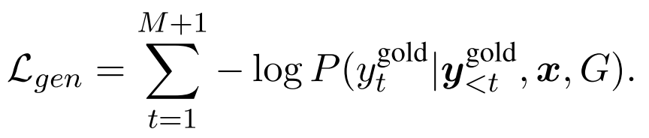

Training
Notes:
[读]
﻿Initially, nodes correspond to the concepts in Cx are given a score of 1 while other unvisited nodes are assigned with 0.
[举例] we use this node as an example, for each incoming neigbor, we use this neighbor score add the relevance score between this triple u r v and the context.
Because the node scores finally are the logits to generate concept distribution for the next word, so this score propagation should depend on the context.
[R] here is the similairy matrix to combine two different dimention vector into a scalar.

Slide 26
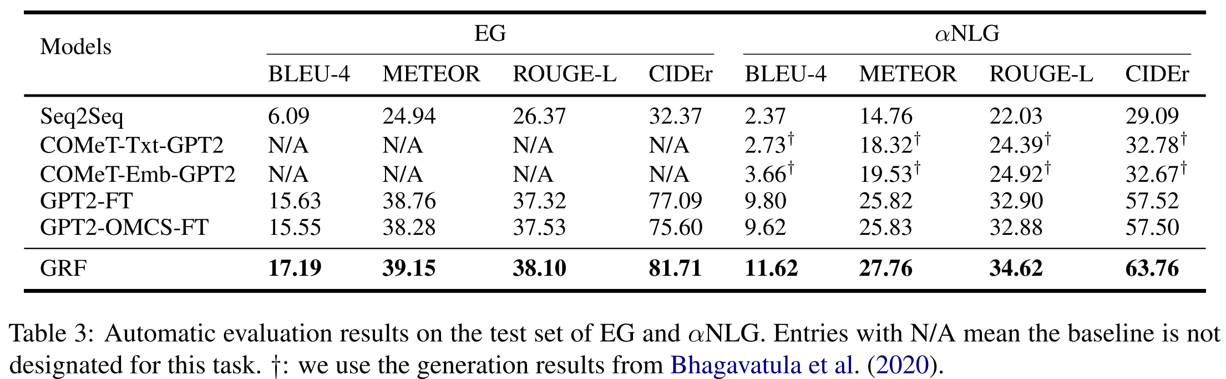
Result
Incorporating rich structural information of commonsense knowledge graphs can enhance the overall generation quality.
Notes:
﻿The model outperforms all the baselines that utilize pre-trained language models or incorporate external commonsense knowledge in terms of all evaluation metrics indicating that incorporating rich structural information of commonsense knowledge graphs can enhance the overall generation quality.

Slide 27
Thank You
Notes:
[读]
﻿Initially, nodes correspond to the concepts in Cx are given a score of 1 while other unvisited nodes are assigned with 0.
[举例] we use this node as an example, for each incoming neigbor, we use this neighbor score add the relevance score between this triple u r v and the context.
Because the node scores finally are the logits to generate concept distribution for the next word, so this score propagation should depend on the context.
[R] here is the similairy matrix to combine two different dimention vector into a scalar.

