Slide 1
Stock Price Prediction Using Python
Final Review
Presented By:
Mrinab Dey (180610026026)
Pankaj Kumar Sah (180610026032)
Guided By:
Nishant Bharti
Smita Sarma

Slide 2
Introduction to Stock Market
WHAT IS A STOCK?
A financial instrument that represents ownership in a company or corporation.
WHAT IS STOCK MARKET?
A place where investors come together to buy and sell shares publicly.
The price of a stock of one company is proportional to the performance of the company.
On buying a share whose price increases in the future, you make profit.

Slide 3
IMPORTANCE OF STOCK PRICE PREDICTION
Prediction of stock price is difficult as it depends upon a lot of parameters such as momentum, volatility, news with regard to stock, company performance, sector performance etc. and thus takes a lot of time.
Correct prediction of a stock price will allow us to know which companies to invest in to make significant profits.
As all the prediction is done by an AI model, you just need to sit and relax.

Slide 4
Objectives
What is Cloud Computing?
To collect past data of a stock as it is found to be crucial to its present performance.
To build an AI model that can take the past data on the performance of a stock and process it in order to predict the price accurately.
Analyze the performance of our model by testing it with a new set of data.
Make the model available for everyone to use by publishing it to the internet.

Slide 5
Area of Work
What is Cloud Computing?
Artificial intelligence is an enormous field with a variety of sub-fields. Machine learning is one of them.
Deep learning is one of the subset of machine learning and is the area of our work.
Deep learning is implemented through Artificial Neural Networks (ANN).
Recurrent Neural Networks (RNN) were the type of neural networks used.
An evolved form of RNN known as Long Short Term Memory (LSTM) was used to build the model as standard RNN did not suffice.

Slide 6
STANDARD RNN VS LSTM
Standard RNNs are preferred when we work with sequential data. RNNs use the previous information in the sequence to predict the current output.
RNNs face short-term memory problem which means that they cannot remember large amount of previous inputs.
Our project required a model that could remember past five years of data related to a stock.
LSTMs solved the problem as they are very efficient in remembering plenty of past data through the use of gates.

Slide 7

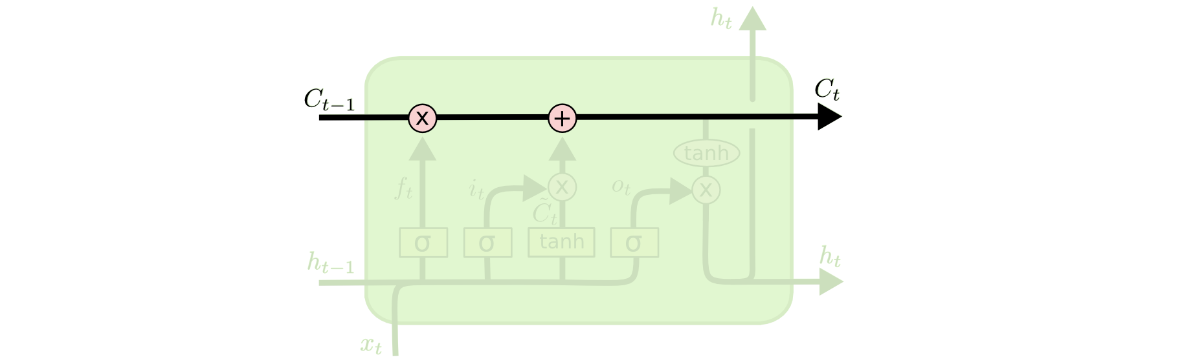
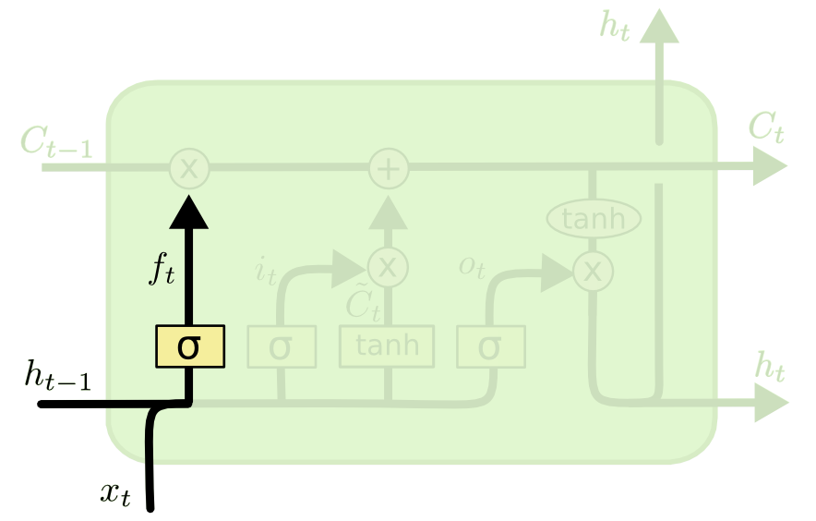
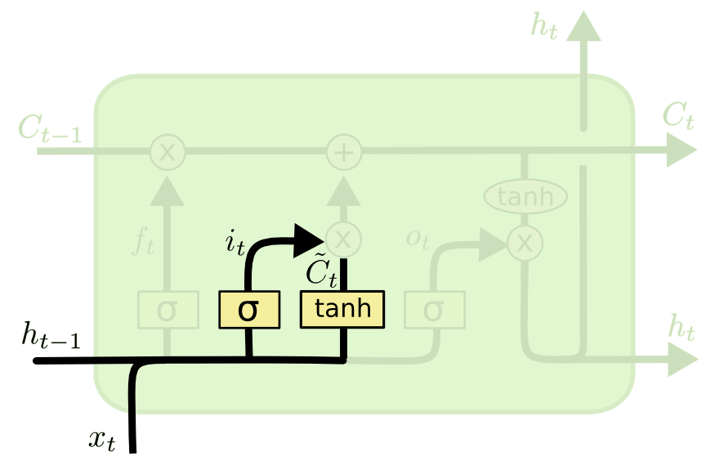
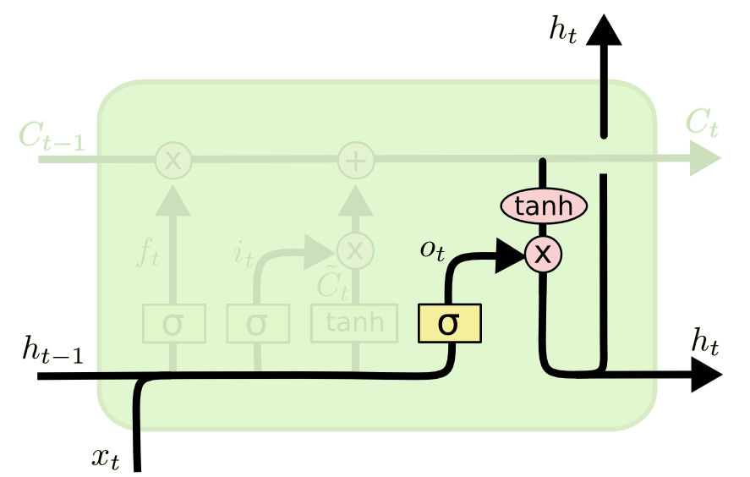
LSTM Architecture
Forget Gate
LSTM cell state
Output Gate
Input Gate

Slide 8
Working Block Diagram
Collecting Data
Data
Cleaning
Linear
to time series data
Making LSTM Model
Plotting the result
Hyperparameter
tuning
Predicting output
Training the model

Slide 9



Tools and Software Used
Programming language:
IDE :
Online Notebooks :

Slide 10
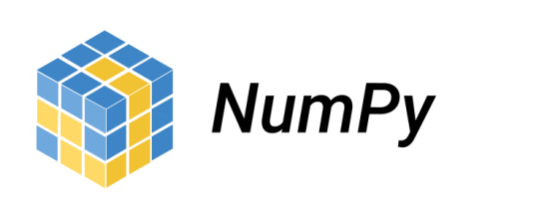




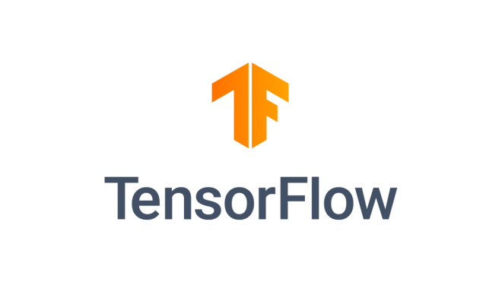

Python Libraries used
For data cleaning
and preprocessing :
For plotting graphs :
For making web app :
For making the model :

Slide 11
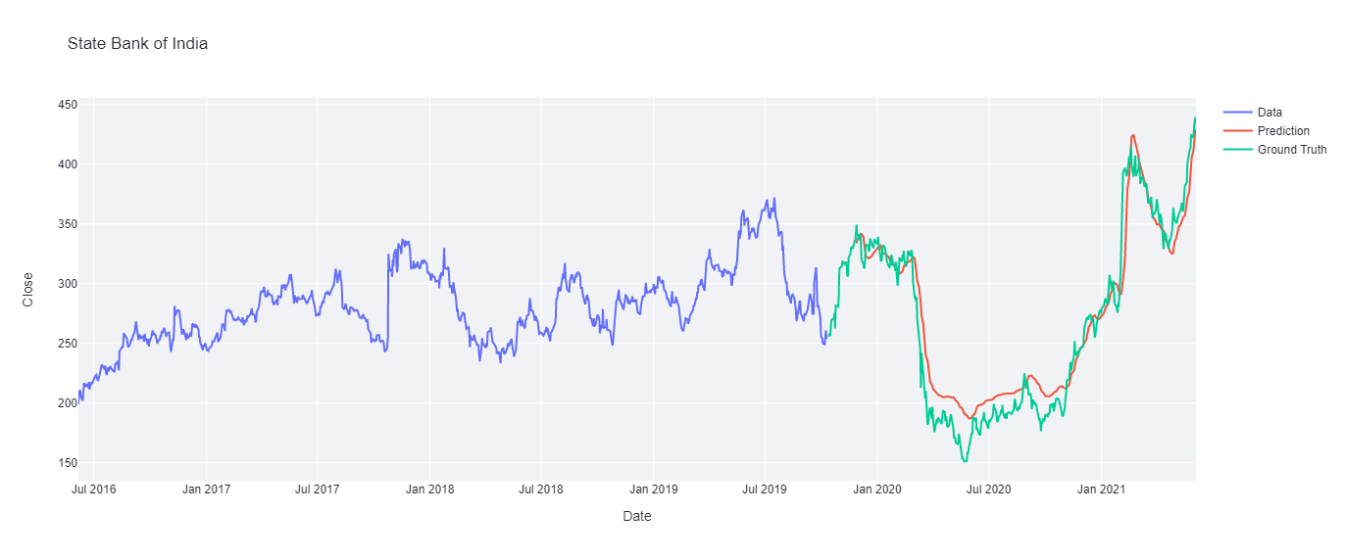
Result Analysis
What is Cloud Computing?
On demand delivery of computing services and
infrastructure.
Storing, processing and accessing data on
remote servers.
Why Cloud Computing?
Variety of services
Accessible from anywhere in the world
“Pay As You Go” model
Analyzing the results for SBI stock:
Fig. Past data and Predicted data

Slide 12
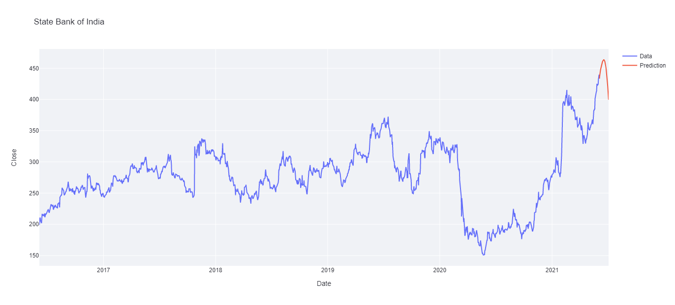
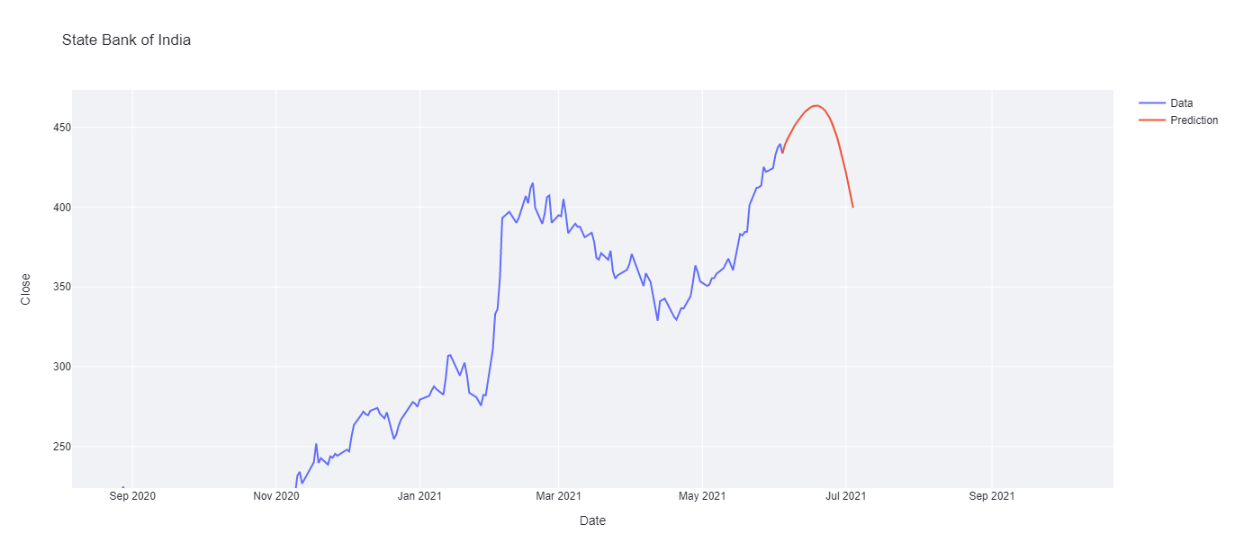
Forecasting prices
Fig. Forecasted price curve
Fig. Forecasted price curve – zoomed view

Slide 13
Conclusion
What is Cloud Computing?
On
After completing the project we received quite impressive results of the forecasted price as it showed familiar trend of actual stock market but the backlash was it wasn’t precise enough to make practical decisions out of it.
But on the positive side, with only time series data as our factor we were successful to scrap some information for future prices of stocks which was very impressive at this stage.
Moreover, by completing this project we got many insights from the field of Artificial Intelligence, Stock Market etc. We came to know about many python libraries which were alien to us eg., plotly and streamlit.

Slide 14
Future scope of the work
Predicting the stock market is a tough job to do and we made our utmost effort to do so by time series analysis of past stock prices. But we also realized that only time series data analysis won’t be enough for predicting the stock market, so, the plan is to take this project a level up by integrating NLP (Natural Language Processing ) algorithms for getting the sentiments out from the market news, twitter trends etc related to the stocks and integrating it into this project and making it more capable to predict precise trends/prices of the stocks.

Slide 15
References
Introduction
https://www.ibm.com/cloud/learn/deep-learning
Literature Review
https://link.springer.com/article/10.1007/s13042-020-01096-5#Sec3
Theoretical discussions
https://en.wikipedia.org/wiki/Deep_learning
LSTM architecture
https://colah.github.io/posts/2015-08-Understanding-LSTMs/
Time series forecasting
https://towardsdatascience.com/time-series-forecasting-with-recurrent-neural-networks-74674e289816
Forecasting future prices
https://www.youtube.com/watch?v=H6du_pfuznE
Time series prediction using deep learning
https://machinelearningmastery.com/time-series-prediction-with-deep-learning-in-python-with-keras/

Slide 16
Thank You

