Slide 1
STOCK PRICE PREDICTION USING PYTHON REVIEW-2
DONE BY –
Pankaj Kumar Sah
Mrinab Dey
GUIDE –
Nishant Bharti
Smita Sarma

Slide 2
Functional block diagram
Collecting Data
Data Preprocessing
Splitting Data
Predicting output
Training the model
Making LSTM Model
Checking accuracy of model
Comparing result

Slide 3
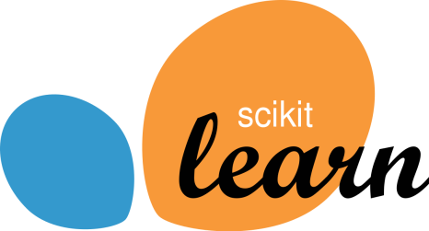
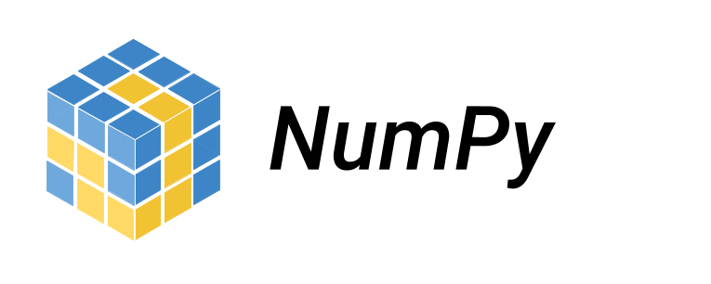

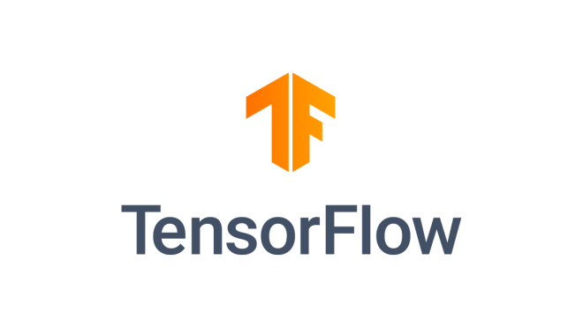


Appropriate Tools As Applicable

Slide 4
Specifications and Algorithms
Data Splitting
Splitting 67% data to training set and rest to the testing set
Total (100%) -1232
Train (67%) - 825
Test (23%) - 407
Data Scaling
Rescaling all the values from their original to a range of (0, 1)
For ease in calculations
Sklearn.preprocessing
MinMaxScaler()
Original Rescaled
143.449997 0.67158554
145.399994 0.68383042
147.949997 0.699843
... …
81.199997 0.28069072
81.800003 0.28445842
81.849998 0.28477236

Slide 5
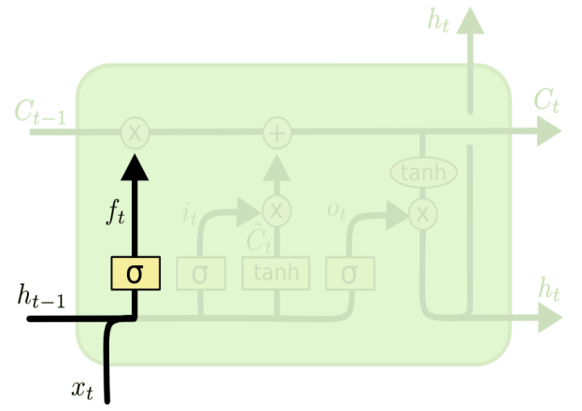
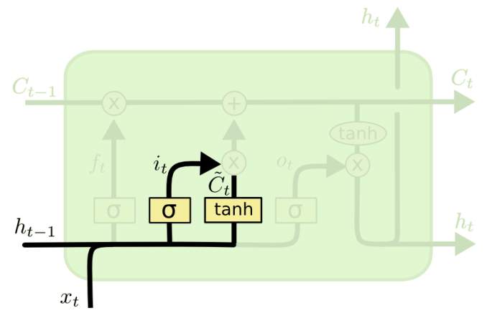
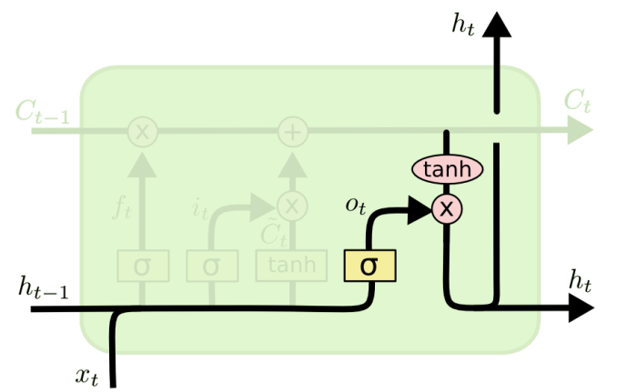
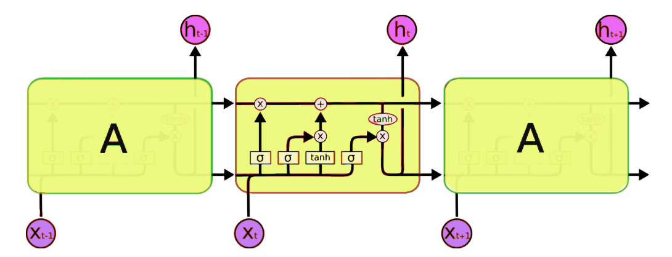
Specifications and Algorithms
Forming Model
Used Tensorflow and Keras libraries for forming the deep learning model.
LSTM Layers
Slightly tweaked version of RNN
Better than conventional RNNs
Selectively remembers or forgets things
Comprises of different memory blocks called cells
Training and Predicting
Running the model for a particular number of epochs and then predicting the result on testing data.
Data sequence
Using previous 100 days closing prices as the measure for predicting the output 101th day.
Then again taking the output as the input for the next sequence.
Input days Output for day
1, 2, 3 … 100 101
2, 3, 4 … 101 102
3, 4, 5 … 102 103
... …
... …
... …

Slide 6
Partial demonstration of results

Slide 7
Distribution of work
By Mrinab
Data Collection
Data Pre-processing
Forming data sequences
By Pankaj
Making ML model
Training model
Predicting results

Slide 8
Thank You!

