Slide 1
The Life of a Data Scientist May 23, 2012

Slide 2
About Me
jwills@cloudera.com and @josh_wills
Formerly of Google (2008 – 2011)
Worked on the ad auction
Led the team that build the data infrastructure for Google+
Before that: a bunch of startups
Sometimes as a software engineer, sometimes as a statistician
Math degree from Duke and a half-finished PhD from The University of Texas at Austin
Now: Director of Data Science at Cloudera
Copyright 2011 Cloudera Inc. All rights reserved
2
Notes:
2

Slide 3
@josh_wills, #hacker vs. @josh_wills, #ThoughtLeader

Slide 4
What is a Data Scientist?

Slide 5
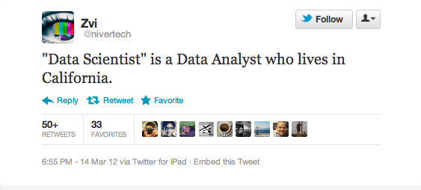
One Definition…

Slide 6
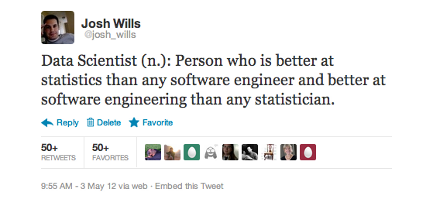
… versus Another

Slide 7
Why Is Everyone Talking About Them?

Slide 8

Because They Make Things Fun.

Slide 9





Data Scientists Power The Products You Love

Slide 10
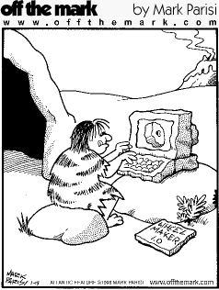
The Job Isn’t New. The Impact Is.

Slide 11
How Do I Become One?

Slide 12
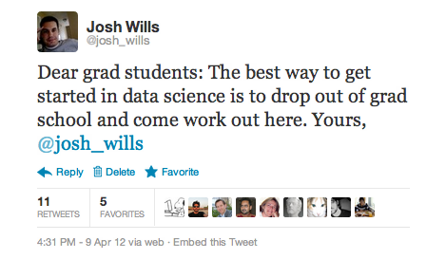
The Standard Reply

Slide 13

Personality Trait #1: Relentless, but in a Lazy Way
Notes:
It helps to be an actual scientist first.

Slide 14

Personality Trait #2: (Acquired) Humility

Slide 15

Step 1: Study Math

Slide 16
But…I didn’t study math.

Slide 17
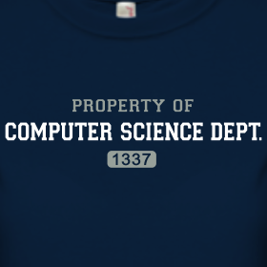
Alternate Step 1: Study (Computer) Science

Slide 18
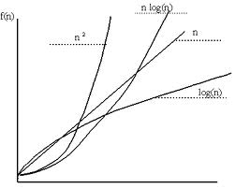
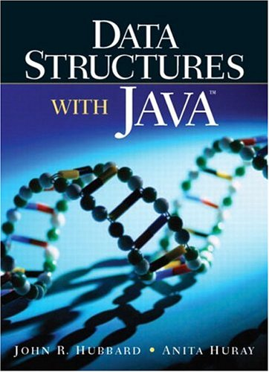
Things People Don’t Know About Computer Science

Slide 19
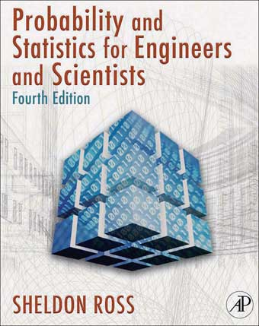
Things Scientists Don’t Know About Statistics

Slide 20

Problem Solving In Context

Slide 21
Phase 2: Stuff You Still Don’t Know

Slide 22

Statisticians: How to Work on a Engineering Team
Modular software design
Unit tests
Code reviews
Automated build and test infrastructure
Source code management

Slide 23
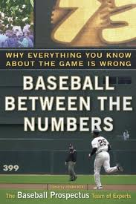
Software Engineers: How to Carry Out an Analysis
Notes:
In the talk I mention “Baseball By the Numbers” instead of this book– the one I really meant. ;)

Slide 24
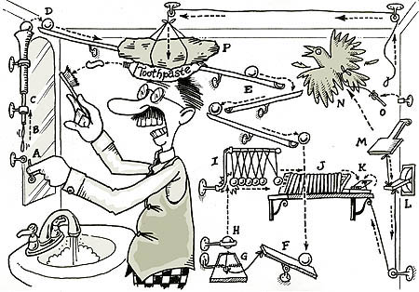
Industrial Machine Learning

Slide 25

Data Scientists and Hadoop

Slide 26
Data Analyst
“If my tools and data can’t answer a question, then the question doesn’t get answered.”

Slide 27
Data Scientist
“If my tools and data can’t answer a question, then I go get better tools and data.”

Slide 28
Incredibly Common Question
“When should I use Hadoop instead of a relational database?”

Slide 29
The Unit of Analysis Problem: Three Symptoms

Slide 30
First Symptom: COUNT DISTINCT

Slide 31
Second Symptom: Cursors

Slide 32
Third Symptom: ALTER TABLE OF_DOOM

Slide 33
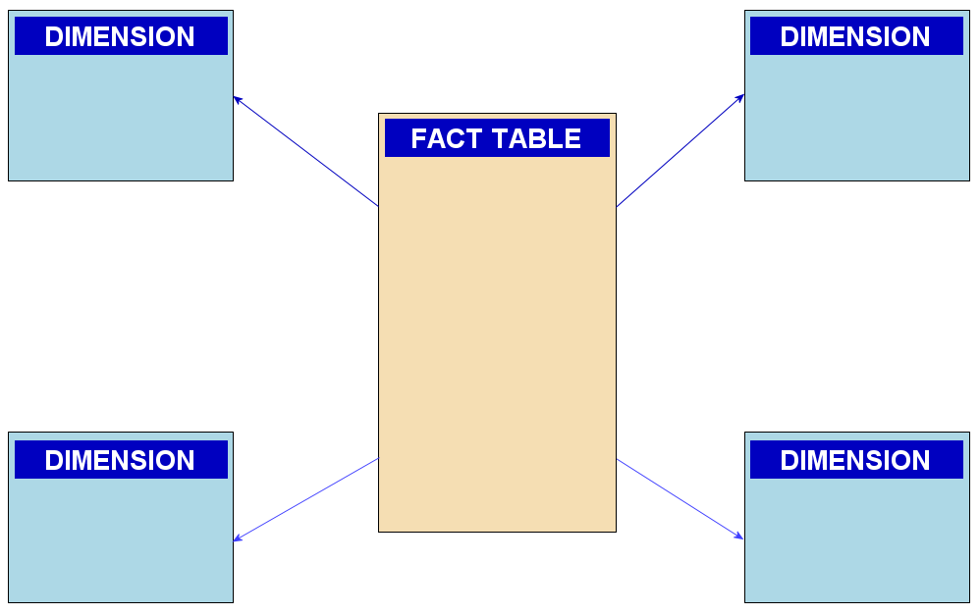
The Unit of Analysis Problem
Data warehouses are optimized to analyze transactions
Awesome for finance and ERP
Not ideal for product and marketing
A function of what databases are good at

Slide 34
What Are You Trying to Analyze?
Simple Entities
Complex Entities
Static attributes
Flat data structure
Transient
Examples
SKUs
Line items from an invoice
Log messages
Evolving attributes
Hierarchical data structure
Persistent
Examples
Customers
Suppliers
Website visitors

Slide 35



Choosing Our Own Data Format
We get to structure our data in the way that works best for the problem we are solving
Flexible
Evolvable
Compact
Fast serialization/deserialization

Slide 36
Spell Correction: The Drosophila of Data Science

Slide 37
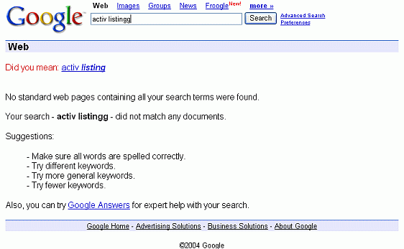
Simple Counts on Complex Objects

Slide 38

The Uncanny Valley for Statisticians on Hadoop

Slide 39
The Business of Data Science

Slide 40
Where You Should Work: The Two Options

Slide 41

A Startup

Slide 42

Close to the Money

Slide 43


Dealing for Data

Slide 44


Education and Growth

Slide 45
Questions? @josh_wills

