Slide 1
Optimization Modeling

Slide 2
Optimization Modeling
Linear programming
Applications
Assumptions
Sensitivity analysis
Potential pitfalls

Slide 3
Optimization Modeling
Suppose a company is trying to decide how many TV and radio commercials it should run each month. Each 30 second TV spot cost $2K to run and each 60 second radio spot cost $1K to run. To prevent wear out (due to overexposure), the company does not want to run more than 50 and 60 TV and radio spots, respectively. Each TV spot generates $32K in additional revenue while each radio spot generates an additional $21K in revenue.
If the company’s media budget is $120K, how many TV and radio spots should it run in order to maximize profit?

Slide 4
Optimization
Optimizing a linear function subject to several linear constraints
Linear constraints expressed as linear equalities or inequalities
Resulting system of linear equations is a model of the process of interest

Slide 5
Media Planning: Build Model
Profit
TV = 32 – 2 = 30
Radio = 21 – 1 = 20
Objective function
maximize 30T + 20R
Constraints
0 ≤ T ≤ 50 TV spot capacity
0 ≤ R ≤ 60 Radio spot capacity
2T + R ≤ 120 Budget constraint

Slide 6
Media Planning: Solve Graphically
Rearrange constraints as equalities
T = f(R) or
R = f(T)
0 ≤ T ≤ 50 T = 0, T = 50
0 ≤ R ≤ 60 R = 0, R = 60
2T + R ≤ 120 T = 60 – 0.5R

Slide 7
Media Planning: Solve Graphically
Graph constraints
Use arrows to indicate direction of inequalities
Radio max
60
TV max
TV
30
Budget constraint
30
60
90
120
Radio

Slide 8
Media Planning: Solve Graphically
Region where all constraints are simultaneously satisfied is the “feasible” region
Radio max
60
TV max
TV
30
Budget constraint
30
60
90
120
Radio

Slide 9
Media Planning: Solve Graphically
The maximum profit occurs at a “corner” of the feasible region: (0, 0) (0, 50) (20,50) (60, 30) (60,0)
Radio max
60
TV max
TV
30
Budget constraint
30
60
90
120
Radio

Slide 10
Media Planning: Solve Graphically
Evaluate objective function 30T + 20R at each corner: (0, 0) (0, 50) (20,50) (60, 30) (60,0)
Radio | 0 | 0 | 20 | 60 | 60
TV | 0 | 50 | 50 | 30 | 0
Profit | $0 | $1,000 | $1,900 | $2,100 | $1,200

Slide 11
Media Planning: Solve Graphically
60 Radio and 30 TV spots satisfies all constraints and yields the maximum profit, $2,100
Radio max
60
TV max
TV
30
Budget constraint
30
60
90
120
Radio

Slide 12
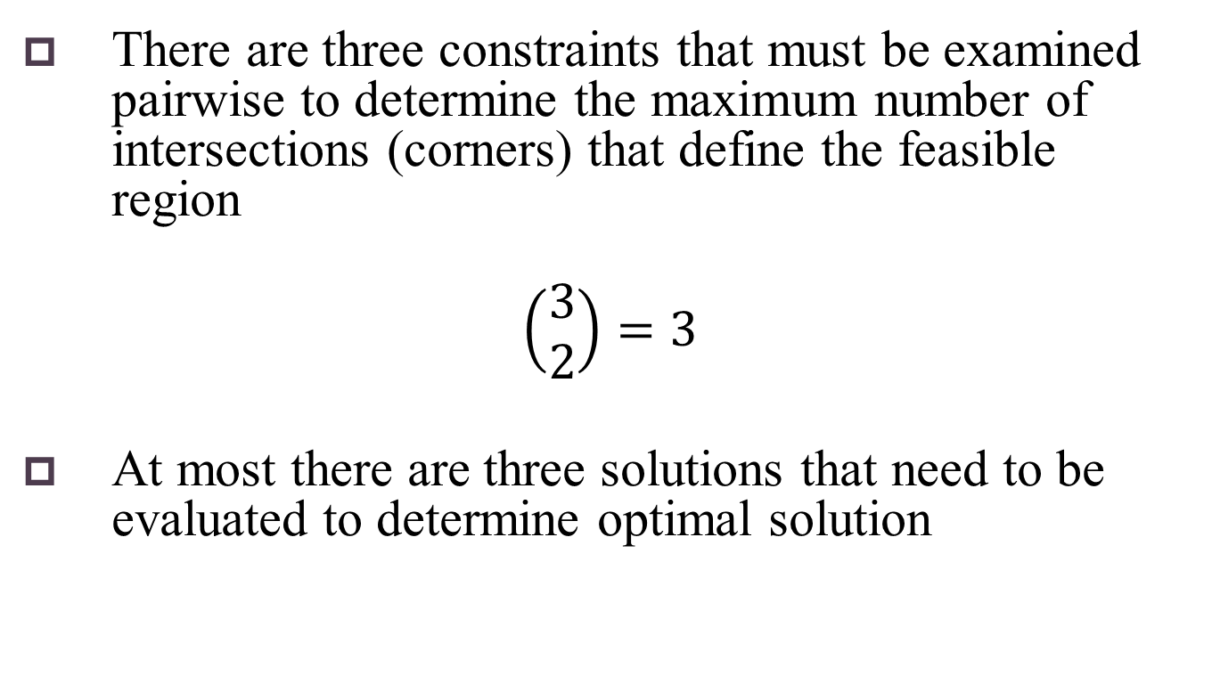
Media Planning: Solve Algebraically
There are three constraints that must be examined pairwise to determine the maximum number of intersections (corners) that define the feasible region
$$\left(\begin{matrix}3 \\ 2\end{matrix}\right)=3$$
At most there are three solutions that need to be evaluated to determine optimal solution

Slide 13
Media Planning: Solve Algebraically
Objective function 30T + 20R is maximized when R and T are as large as possible
By substitution
T = 60 – 0.5R
substitute T = 50 (max TV)
50 = 60 – 0.5R
R = 20
T = 60 – 0.5R
substitute R = 60 (max Radio)
T = 60 – 0.5(60)
T = 30

Slide 14
Media Planning: Solve Algebraically
Evaluate objective function 30T + 20R at
T = 50, R = 20
T = 30, R = 60
Maximum profit of $2,100K is achieved by running 60 radio spots and 30 TV spots
Radio | 20 | 60
TV | 50 | 30
Profit | $1,900 | $2,100

Slide 15
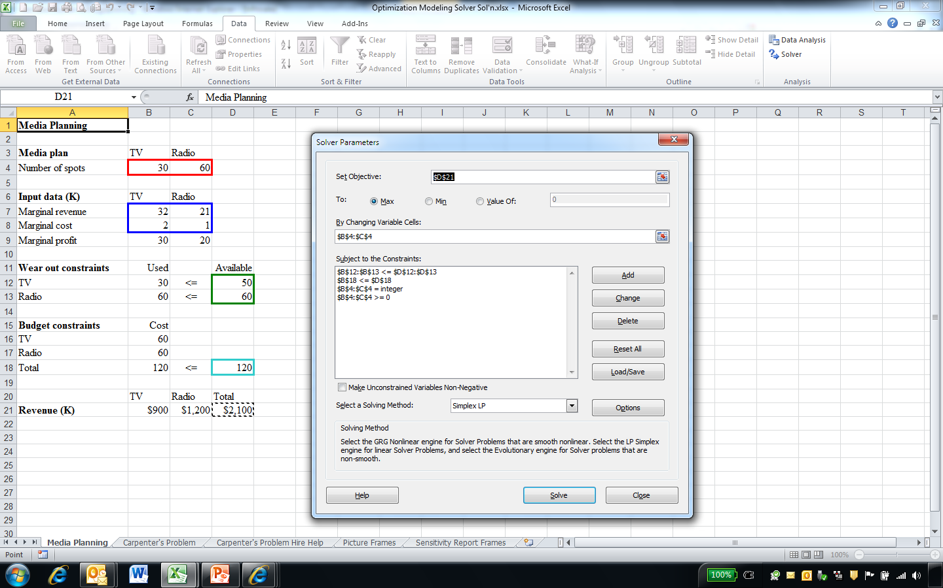
Media Planning: Use Solver
See Optimization.xlsx

Slide 16
Production Optimization
Suppose a carpenter makes only tables and chairs, which he sells at a local market, with a goal of maximizing his profits. He makes a profit of $5 on each table and $3 on each chair. It takes him 2 hours to make a table, 1 hour to make a chair, and he does not want to work more than 40 hours a week. A table requires 1 board-foot of material, a chair requires 2 board-feet, and he cannot purchase more than 50 board-feet in a week.
How many tables and chairs should the carpenter make in order to maximize his profits?
Suppose the carpenter can hire someone to help at a cost of $2 per hour. Should the carpenter hire him, and if yes, for how many hours?

Slide 17
Carpenter’s Problem: Build Model
Profit
Table = $5/table
Chair = $3/chair
Objective function
maximize 5T + 3C
Constraints
0 ≤ T ≤ 20 Table capacity
0 ≤ C ≤ 25 Chair capacity
2T + C ≤ 40 Labor constraint
T + 2C ≤ 50 Material constraint
T and C integer Integer constraint

Slide 18
Carpenter’s Problem: Solve Graphically
The maximum profit of $110 is the “corner” for 10 tables and 20 chairs
Redundant constraint—satisfied by other constraint(s)
Tables max
Labor constraint
40
30
Chairs max
X2 = Chairs
20
Material (binding) constraint
10
10
20
30
40
50
X1 = Tables

Slide 19
Carpenter’s Problem: Solve Algebraically
maximize 5T + 3C
2T + C = 40
C = 40 – 2T
T + 2C = 50 (use binding constraint)
T + 2(40 – 2T) = 50
80 – 3T = 50
T = 10
C = 40 – 2T
C = 40 – 2(10)
C = 20
Max profit: 5(10) + 3(20) = $110 if carpenter makes 10 tables and 20 chairs

Slide 20
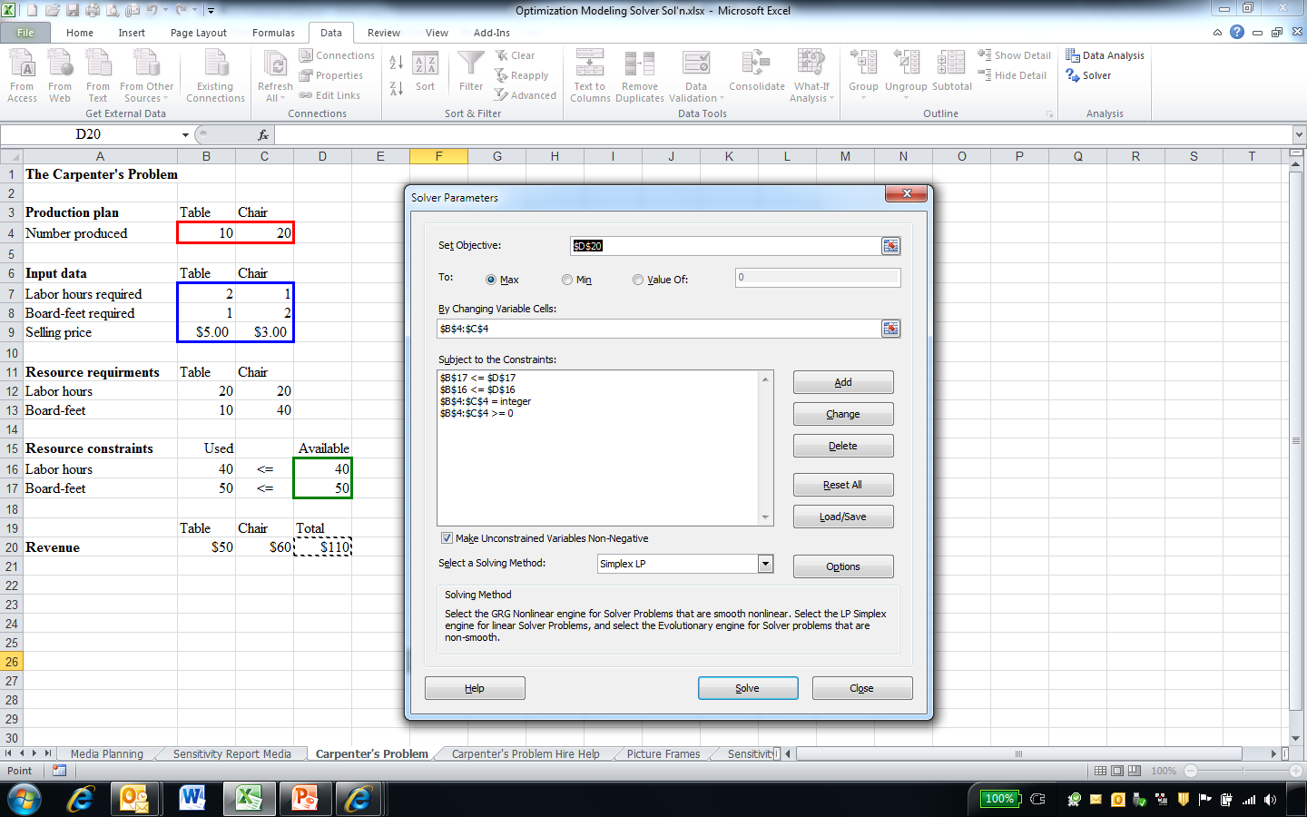
Carpenter’s Problem: Use Solver
See Optimization.xlsx

Slide 21
Carpenter’s Problem: Hire Help
Profit and costs
Table = $5/table
Chair = $3/chair
Help = $2/man-hour
Objective function
maximize 5T + 3C – 2H
Constraints
0 ≤ T ≤ 20 Table capacity
0 ≤ C ≤ 25 Chair capacity
2T + C ≤ 40 + H Labor constraint
T + 2C ≤ 50 Material constraint
T and C integer Integer constraint

Slide 22
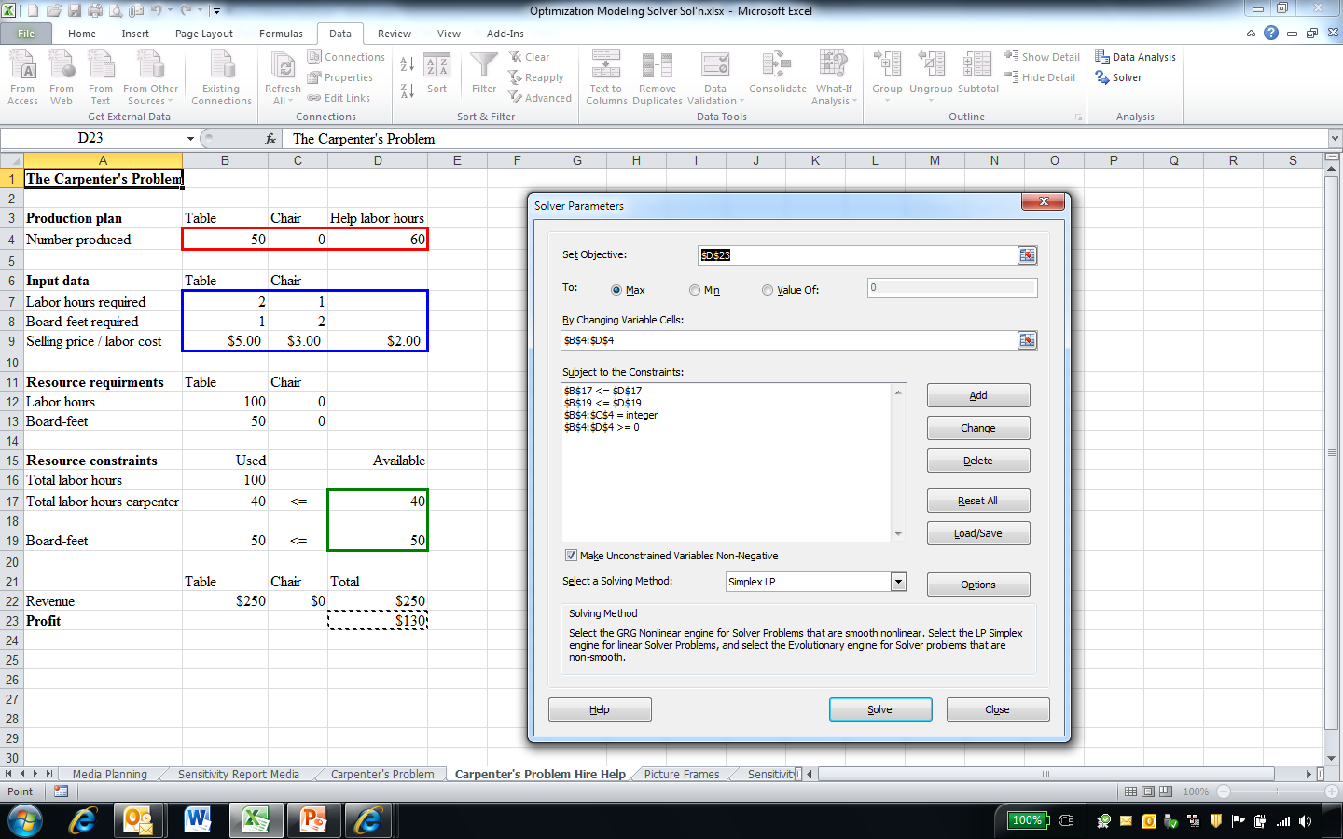
Carpenter’s Problem Hire Help: Use Solver
See Optimization.xlsx
Can increase profit to $130 with 60 hours labors, 50 tables, and no chairs

Slide 23
Example: Product Mix Optimization
Objective
Maximize profit by determining optimal product mix
Subject to (constraints)
Raw material costs and availability
Production limitations
Human resources and costs
Plant capacity
Demand for products

Slide 24
Producing Picture Frames
Deacon Industries, Inc. manufactures picture frames. Each frame is targeted to a different type of consumer, is priced to appeal its target market, and has different market demands. The manufacturing costs (labor and materials) differ for each frame.
Specifics for each frame are provided on the following slides.
If Deacon Industries wants to maximize its profit, how many of each frame should it produce?

Slide 25
Producing Picture Frames
Four types of frames produced and sold:
Frame 1
“Elite” $28.50
Frame 2
“Value conscious” $12.50
Frame 3
“Ultra” $29.25
Frame 4
“Good value” $21.50

Slide 26
Production Inputs
Labor (man-hours) and materials (ounces) to produce each frame
Frame Labor Metal Glass
1 2 4 6
2 1 2 2
3 3 1 1
4 2 2 2

Slide 27
Production Costs
Labor
$8/hour
Metal
$0.50/ounce
Glass
$0.75/ounce

Slide 28
Production Constraints
Have up to 4,000 man-hours of labor available
Can purchase up to 6,000 ounces of metal
Can purchase up to 10,000 ounces of glass

Slide 29
Market Demand
Sales constraints
Frame 1
Maximum demand of 1,000
Frame 2
Maximum demand of 2,000
Frame 3
Maximum demand of 500
Frame 4
Maximum demand of 1,000

Slide 30
Objective Function
Maximize total profit across, all four types of frames, subject to:
Labor and material cost and availability
Market demand

Slide 31
Unit Profit
By type of frame
Frame 1 = 28.50 – [2(8.00) + 4(.50) + 6(.75)]
= 6
Frame 2 = 12.50 – [1(8.00) + 2(.50) + 2(.75)]
= 2
Frame 3 = 29.25 – [3(8.00) + 1(.50) + 1(.75)]
= 4
Frame 4 = 21.50 – [2(8.00) + 2(.50) + 2(.75)]
= 3

Slide 32
Total Profit
Objective function
maximize 6x₁ + 2x₂ + 4x₃ + 3x₄
where
x₁ = number of frame 1’s produced
x₂ = number of frame 2’s produced
x₃ = number of frame 3’s produced
x₄ = number of frame 4’s produced

Slide 33
Production Constraints
Labor
2x₁ + 1x₂ + 3x₃ + 2x₄ ≤ 4000
Metal
4x₁ + 2x₂ + 1x₃ + 2x₄ ≤ 6000
Glass
6x₁ + 2x₂ + 1x₃ + 2x₄ ≤ 10000

Slide 34
Market Demand (Sales) Constraints
Frame 1
x₁ ≤ 1000
Frame 2
x₂ ≤ 2000
Frame 3
x₃ ≤ 500
Frame 4
x₄ ≤ 1000

Slide 35
Other Constraints
Ensure feasible solutions
x₁, x₂, x₃, x₄ ≥ 0
x₁, x₂, x₃, x₄ are integers

Slide 36
Naïve Solution
Intuitively, the frame with the highest profit margin should be maximally produced
1,000 frame 1s (demand limit)
$6,000 profit ($6/frame)
Utilizing
2,000 man-hours of labor (2,000 remaining)
4,000 ounces of metal (2,000 remaining)
6,000 ounces of glass (4,000 remaining)

Slide 37
Naïve Solution
The maximal number of frames with the next highest profit margin should next be produced
500 frame 3s (demand limit)
$2,000 profit ($4/frame)
Utilizing
1,500 man-hours of labor (500 remaining)
500 ounces of metal (1,500 remaining)
500 ounces of glass (3,500 remaining)

Slide 38
Naïve Solution
The maximal number of frames with the next highest profit margin should again next be produced
250 frame 4s (< demand limit due to labor constrains)
$750 profit ($3/frame)
Utilizing
500 man-hours of labor (0 remaining)
500 ounces of metal (1,000 remaining)
500 ounces of glass (3,000 remaining)

Slide 39
Naïve Solution
No frame 2s, with the lowest profit margin, can be produced since all labor resources have been used up
Labor is a “binding” constraint
Constraint that is met exactly, which limits objective function (bottleneck)
“Non-binding” constraint
Constraint that is not met exactly and provides slack in objective function

Slide 40
Naïve Solution
Production summary
Frame Prod Labor Metal Glass Profit
1 1000 2000 4000 6000 6000
2 0 0 0 0 0
3 500 1500 500 500 2000
4 250 500 500 500 750
Total 4000 5000 7000 8750

Slide 41
Naïve Solution
Although a good solution, the optimal solution is not guaranteed using this naïve process
Highest profit margin frame utilizes excessive resources that preclude other frames from being produced

Slide 42
Obtaining Optimal Solution
Simultaneously solve the following system of linear equations (model):
maximize 6x₁ + 2x₂ + 4x₃ + 3x₄
subject to 2x₁ + 1x₂ + 3x₃ + 2x₄ ≤ 4000
4x₁ + 2x₂ + 1x₃ + 2x₄ ≤ 6000
6x₁ + 2x₂ + 1x₃ + 2x₄ ≤ 10000
x₁ ≤ 1000
x₂ ≤ 2000
x₃ ≤ 500
x₄ ≤ 1000
x₁, x₂, x₃, x₄ ≥ 0
x₁, x₂, x₃, x₄ are integers

Slide 43
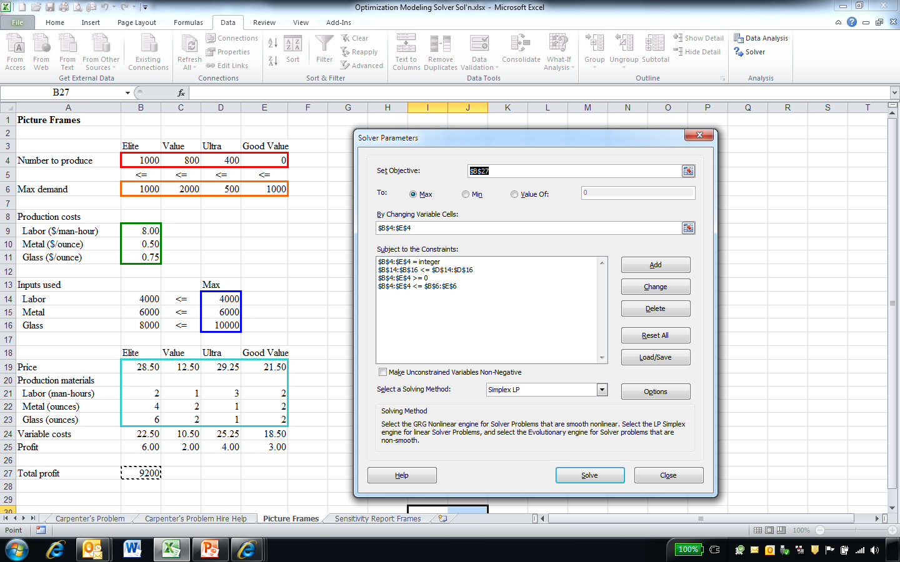
Optimal Solution
See Optimization.xlsx

Slide 44
Optimal Solution
Both the naïve and LP solutions are feasible (satisfy all constraints)
LP solution is optimal in that it maximizes objective function
Higher profit ($9,200 versus $8,750)
More efficient utilization of resources
Labor (0 remaining)
Metal (0 versus 1,000 ounces remaining)
Glass (2,000 versus 3,000 ounces remaining)

Slide 45
Jewel Thief (See Jewel Thief.xlsx)
Suppose an international jewel thief is making plans to steal precious metal from a jewelry store. To make it past customs inspection during his getaway, he will hide the loot in his shoe. The price he can get for each metal and the amount the store has in inventory are:
If the thief cannot hide more than 6.5 oz. of precious metal, how much of each metal should he steal?
Metal | $K/oz. | Inventory (oz.)
Gold dust | 1.54 | 3.00
Silver dust | 0.04 | 10.00
Platinum dust | 1.84 | 2.00
Palladium dust | 0.78 | 8.00

Slide 46
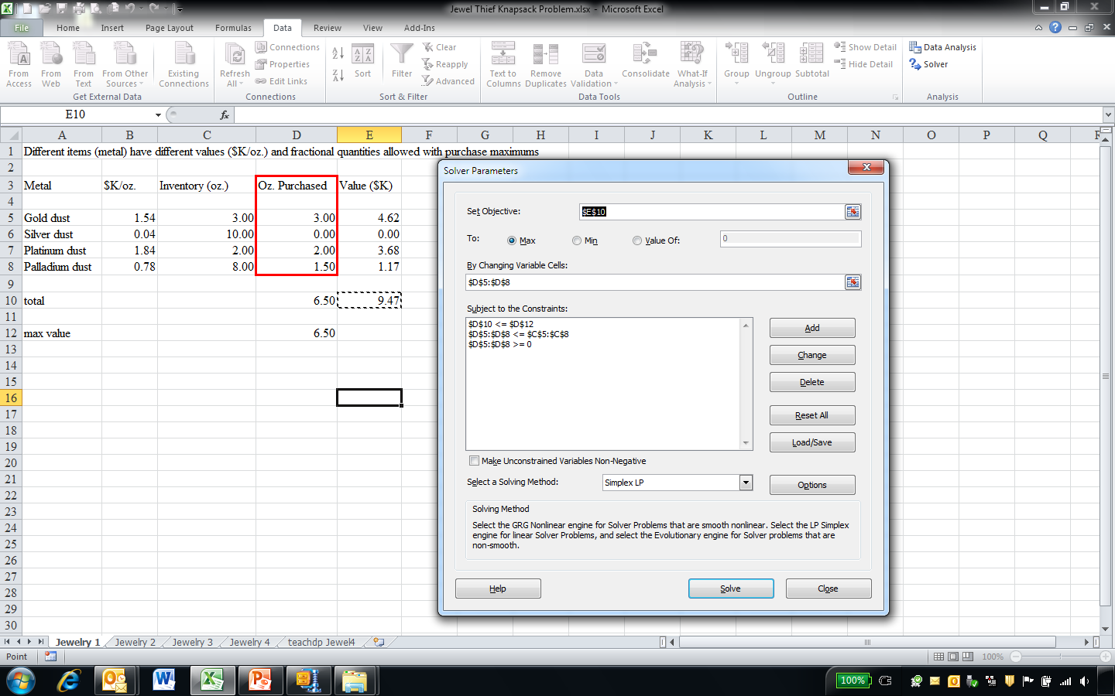
Jewel Thief
Jewelry 1 (easy)
Items can be divided up and only a portion taken
Sort and select items based on quantity available and capacity

Slide 47
Jewel Thief
The thief also plans on stealing some precious gemstones which he will hide in the lining of his coat. Each gemstone weights 2.00 carats. The price he can get for each gemstone and store inventory are:
If the thief cannot hide more than 12 carats, how many of each gemstone should he steal?
Gemstone | Carats | $K/carat | Inventory
Ruby | 2.00 | 2.62 | 3
Diamond | 2.00 | 3.87 | 2
Sapphire | 2.00 | 1.14 | 8
Emerald | 2.00 | 0.80 | 5

Slide 48
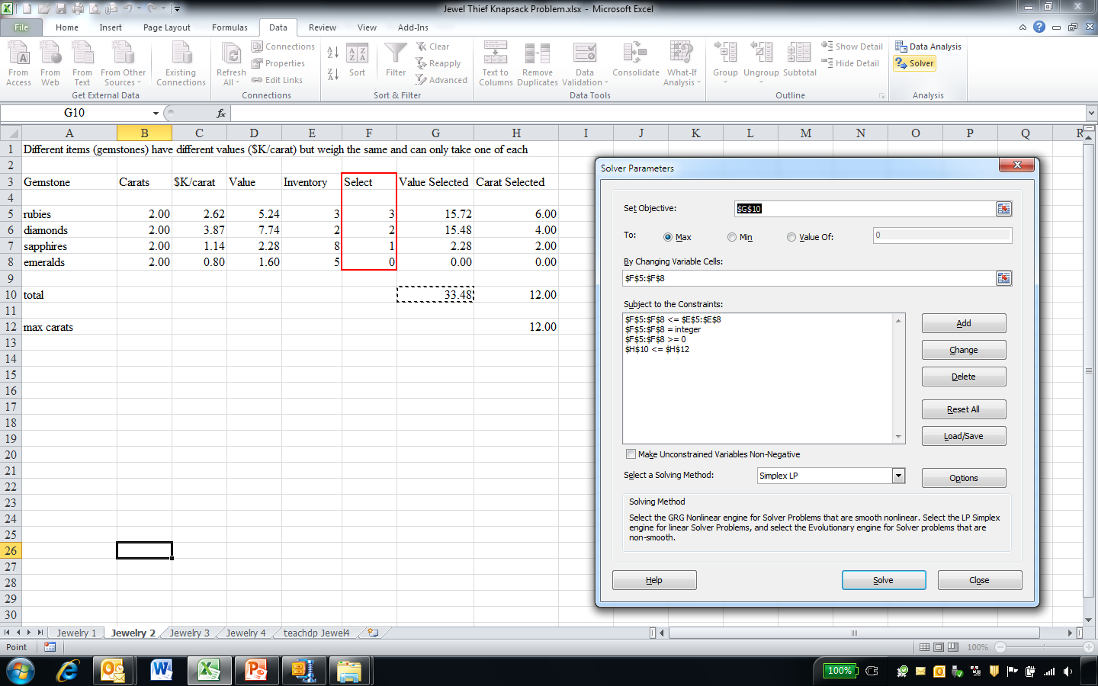
Jewel Thief
Jewelry 2 (easy)
Item quantities or values are identical
Sort and select items based on quantity available and capacity

Slide 49
Jewel Thief
While he’s at it, the thief thought he might as well steal some semi-precious opals, which he planned to conceal by swallowing them. The store just received a shipment of 13 opals with the following carat weights:
If the thief can sell the opals for $400/carat but cannot swallow more than 9.00 carats, which stones should he steal?
4.73 | 0.88 | 0.54 | 0.50
3.67 | 0.60 | 0.53 | 0.32
2.55 | 0.56 | 0.52 | 0.03
1.67

Slide 50
Jewel Thief
General class of resource allocation problem
Bin packing
Items have same value ($/carat)
Capacity constraints (time, weight, volume, etc.)
Solved by
Decision analysis (decision tree)
Number of items must be small (n! outcomes must be examined)
Examine resources available and values within each branch
Dynamic programming
Binary (0/1) constraints

Slide 51
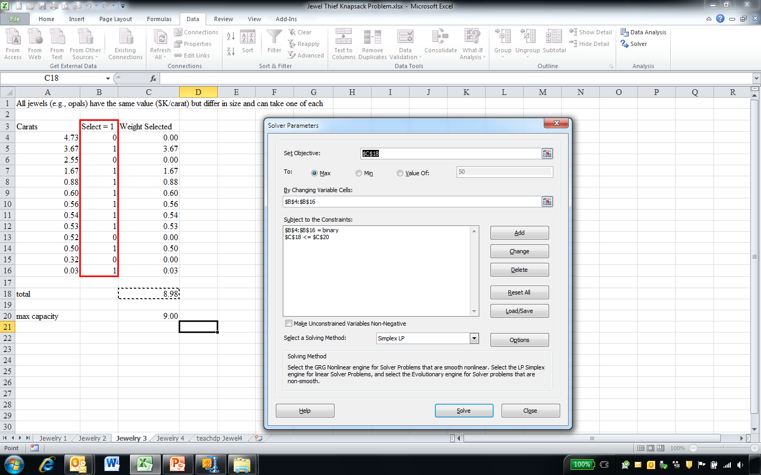
Jewel Thief
Jewelry 3 (somewhat harder)
Items have same value
Select items based on capacity

Slide 52
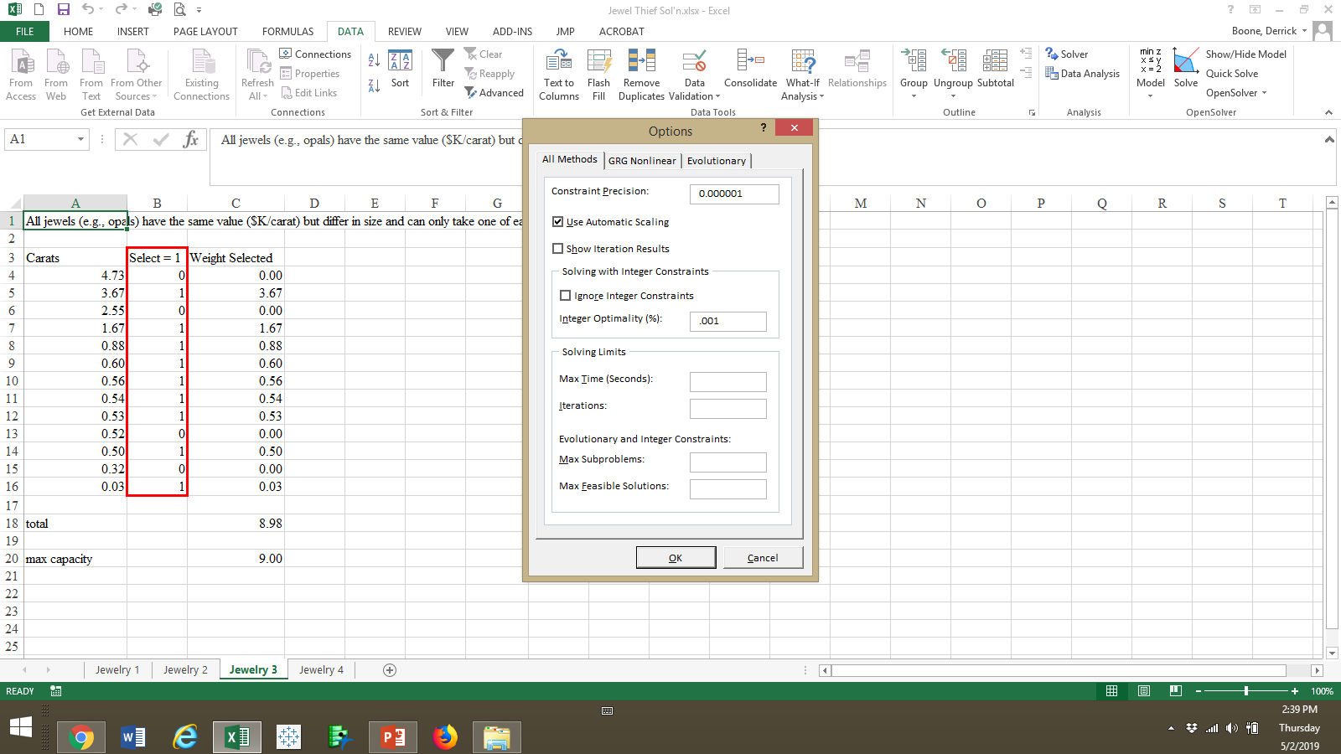
Jewel Thief
Solver Options
Make sure Ignore Integer Constraints is not checked
Decrease Integer Optimality (%) to improve solution

Slide 53
Integer Optimality
Visual inspection of Jewelry 3 optimal solution
4.73, 3.67, 0.60 = 9.00 carats
Solver solution 8.98 carats appears to be suboptimal
By default, Solver finds solution within ± one percent of optimal
Saves computing time
For more optimal answer
Data >> Solver >> Options >> Integer Optimality (%)
Reset default value 1 % to < 1 % (e.g., 0.1 %)
Improves answer but may increase computing time

Slide 54
Jewel Thief
The afternoon before the burglary, the thief is trying to decide what items he will need to pull of his heist. The weight and (subjective) value of items he thinks he needs is below:
There’s only one problem. His knapsack can only hold 10 lbs. What items should he take?
Item | Weight | Value
Flashlight | 3 | 55
Disguise | 2 | 45
Lock pick set | 1 | 100
Police scanner | 5 | 95
Gloves | 3 | 30

Slide 55
Jewel Thief
General class of resource allocation problem
Knapsack capacity is available amount of a resource (time, volume, money, weight, etc.)
Items are activities to which resources can be allocated (people, boxes, investments, etc.)
Solved by
Decision analysis (decision tree)
Number of items must be small (n! outcomes must be examined)
Examine resources available and values within each branch
Dynamic programming
Binary (0/1) constraints
0/1 Knapsack problem

Slide 56
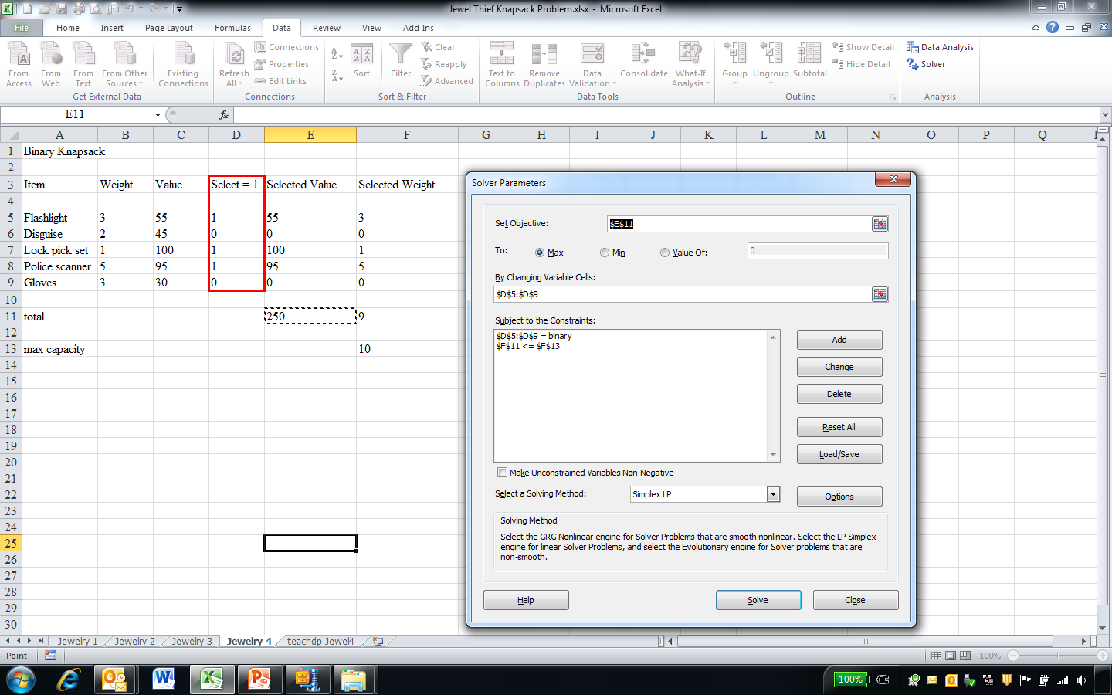
Jewel Thief
Jewelry 4 (hard)
Item values and resources are different, can only take at most one of each item, capacity constraints

Slide 57
Optimization Software
TeachDP
Operations Research and Methods (Jensen and Bard)
Optimization problems
Knapsack
Binary knapsack
Unbounded knapsack
Line partitioning (balancing)
Grid
Network
Sequence
Traveling salesman

Slide 58
Optimization Applications
Marketing
Maximization of reach (objective function)
Constraints
Advertising costs
Advertising effectiveness
Number of consumers

Slide 59
Optimization Applications
Human resources
Maximization of worker efficiency (scheduling) (objective function)
Constraints
Number of employees
Employee skills
Labor costs

Slide 60
Optimization Applications
Production
Minimization of scrap (production waste) (objective function)
Constraints
Capacity
Input combinations required to produce various products

Slide 61
General Approach to Problem Formulation
Identify objective (e.g., maximize or minimize some quantity)
Identify decision variables (i.e., what you need to decide (variables you will “change”) to meet objective
Write objective function and constraints in terms of decision variables
Use information in problem to determine coefficients
Be wary of extraneous information
Include other constraints as necessary
Non-negativity
Integer
Design spreadsheet
Do not “hardcode” coefficients

Slide 62
Optimization Assumptions
Proportionality
Linear relationship across variables
Additivity
The sum of the contributions from various activities equals the total contribution
Divisibility
Both integer and non-integer values are allowable
Scaling
All values are roughly the same magnitude

Slide 63
Potential Pitfalls
Infeasibility
Constraints cannot all be satisfied
Incorrect formulation of model
Overly constrained model for which no feasible solutions exist
Unboundedness
Objective function has no bounds (as small or large as we like)
Incorrect input
Lack of proper constraint

Slide 64

Under Armour
Suppose you are the production manager for Under Armour, a sports apparel company, and are responsible for manufacturing two shoes: the UA Hammer III (retail price $44.99) and the UA Fierce II (retail price $49.99). Labor and material to produce 100 pairs of shoes is:
Shoe Man hrs Upper Outsole
UA Hammer III 4.1 Synthetic (6.0k in²) Carbon Rubber (3.6k in²)
UA Fierce II 3.2 Leather (6.4k in²) Blown Rubber (4.1k in²)
The cost for synthetic and leather upper material is $1.64 and $2.36 per 100 in², respectively. Material costs for carbon and blown rubber outsole is $3.12 and $3.67 per 100 in², respectively. You run one eight-hour shift each day, five days a week, with two workers per shift whom you pay on average $17.50/hour. Also, you are authorized to spend up to $20k per month on material.
If you want to maximize monthly profits, how many pairs of each shoe should you produce and how much profit will you make?

