Slide 1

Application Delivery Process with DevOps-DevSecOps CI/CD Process
Ghanshyam Gupta
Principal Architect - Digital Transformation(DevOps, Cloud, Digital Strategy)
https://www.linkedin.com/in/ggupta007/
Notes:
1

Slide 2
Background
Emirates is a owner and operator of Airlines. It has 60,282 employees (March-2019) and revenue of 13.3 billion (Nov-2018)
Emirates is the world's fourth largest airline in scheduled revenue passenger-kilometers flown, the fourth-largest in terms of international passengers carried, and the second-largest in terms of freight tonne kilometers flown.
(Source - https://en.wikipedia.org/wiki/Emirates_(airline))
The Emirates airline is taking initiatives into digital transformation and build a new digital transformation - IT team – names “Future Airlines”–
To address the market and competitive forces.
key focus on building strong technology foundations and customer center capabilities.
Key potential of technologies changes - hybrid cloud (Cloud/On-premises) , data and analytics, Automation, DevOps-DevSecOps, Monolithic to Microservice Architecture, Could native Application and Site reliability practices.
Fundamentally changing –”how you operate and deliver value to customers”.
A cultural change that requires organizations to continuously work on
Tightly team collaboration
Quick feedback loop among all team to adopt frequent changes.
Notes:
2

Slide 3
Challenges
Initial application development process was labor intensive, taking an average of 5-6 months’ time to move one changes from development to production due to legacy IT culture(lack of team collaboration / IT Agility),
Mistakes.
Reviews.
Complex technology landscape.
Systemic issues around environments.
Rework of application configurations.
Repeatability due to its manual nature and culture.
Future Airline’s Digital engineering team take initiatives to build unified middleware service(UMSL) layer using microservices architecture to serve Omni channels (like desktop app, IOS/Android app and other services) but the changes to the products are moving too slowly.
“Business would come to IT team with a million ideas that would dazzle the end customer, and team had just tell them, out of your list, pick the two things you’d like to get in the next 6–12 months”. Business had tried hiring and outsourcing their way out of the problem, but nothing had worked.
“IF UMSL has to come off the critical path", Future Airline’s Digital engineering team was looking for
An end to end integrated process to maximize the automation of manual processes.
Adopt true IT agility to reduce legacy environmental cultural gap and
Improve deployment frequency by minimum of 5X times.
Notes:
3

Slide 4
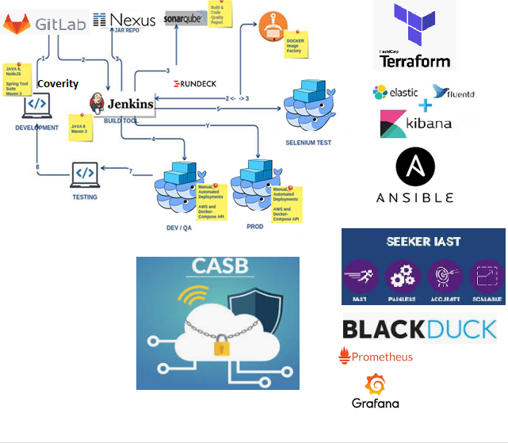
Solution -Architecture Diagram
Notes:
4

Slide 5
Solution
Considering the challenges faced by Emirates' Digital transformation team – “Future Airlines”, we considered DevOps-DevSecOps** methodology(tools) along with
DevOps-DevSecOps** -
Source - https://aws.amazon.com/devops/what-is-devops/
- https://www.gartner.com/it-glossary/devops
- https://www.gartner.com/en/conferences/la/infrastructure-operations-cloud-brazil/rn-devsecops
- https://devops.com/9-pillars-of-continuous-security-best-practices/
Hybrid cloud platform (Cloud/Onprem)
Infrastructure as a service (IaaS)
Platform as a service(PaaS)
Software as a service (SaaS)
Source - https://www.gartner.com/it-glossary/hybrid-cloud-computing
- https://www.gartner.com/smarterwithgartner/modernize-it-infrastructure-in-a-hybrid-world/
- https://aws.amazon.com/
- https://en.wikipedia.org/wiki/Cloud_computing
Notes:
5

Slide 6
Solution Continue ….
Infrastructure as code - provisioning tools(Terraform)
Source - https://www.gartner.com/en/documents/3823221/assessing-terraform-for-provisioning-cloud-infrastructur
- https://en.wikipedia.org/wiki/Terraform_(software)
- https://github.com/hashicorp/terraform
- https://en.wikipedia.org/wiki/HashiCorp
Truly distributed Application Architecture (Microservice-Could native Application Architecture)
The twelve-Factor App
Source - https://www.gartner.com/en/documents/3891779/how-to-design-microservices-for-agile-architecture
- https://blogs.gartner.com/gary-olliffe/2015/01/30/microservices-guts-on-the-outside/
- https://www.jhipster.tech/documentation-archive/v6.1.1/microservices-architecture/
- https://12factor.net/
Linux Container (LXC)
Source - https://www.gartner.com/en/documents/3826965
- https://en.wikipedia.org/wiki/Docker_(software)
- https://www.docker.com/
Notes:
6

Slide 7
Solution Continue ….
Site reliability practices
Auto scaling
Auto healing
Zero downtime deployment
Source - https://aws.amazon.com/autoscaling/
- https://aws.amazon.com/blogs/mt/tag/autohealing/
- https://blog.codeship.com/zero-downtime-deployment-with-aws-ecs-and-elb/
Continuous Integration Server (CI) – Jenkins
Source - https://en.wikipedia.org/wiki/Jenkins_(software)
- https://jenkins.io/
Source Code repository
Artifactory/Nexus Binary repository
Docker repository(On-Prem/Docker-Hub/AWS-ECR)
Automation testing - Selenium integration testing suites
Application Security testing
“Black duck OSS” – Open Source Vulnerability Assessment Security
Detect and manage open source risks in development and production.
Synopsys Coverity Static Application Security Testing (SAST)
Find and fix security vulnerabilities and quality issues in your code as it is being developed.
Synopsys Dynamic Application Security Testing (DAST)
Synopsys Seeker Interactive Application Security Testing (IAST)
Identify runtime vulnerabilities that expose sensitive data with near-zero false positives.
Notes:
7

Slide 8
Solution Continue ….
Code Quality Analysis tool – SonarQube
Source - https://en.wikipedia.org/wiki/SonarQube
- https://www.sonarqube.org/
Application Log analysis -Elasticsearch-Fluentd-Kibana (ELK)
Source - https://www.elastic.co/what-is/elk-stack
- https://www.fluentd.org/
- https://docs.docker.com/config/containers/logging/fluentd/
Log matrix monitoring – Grafana, Graphite, Prometheus
Source - https://en.wikipedia.org/wiki/Prometheus_(software)
- https://wiki.archlinux.org/index.php/Grafana
- https://en.wikipedia.org/wiki/Graphite
Environmental Security
Docker container security – Artifactory X-ray, Docker Inspector
WAF (Web Application firewall) setup
AWS – Private, Public subnet, Bastion setup, NAT, Internet gateway, Identity and Access Management (IAM)
Cloud Security - Cloud Access Security Broker (CASB) – Microsoft, Forcepoint
Source - https://en.wikipedia.org/wiki/Cloud_access_security_broker
Notes:
8

Slide 9
Solution Continue ….
as a good solution to integrate into the delivery process. This solution automate 99% of manual tasks providing considerable value to client to adopt quick changes in delivery process.
Hence, DevOps-Dev-Sec-Ops methodology along with above mentioned cutting-edge technologies/tools eventually Improve deployment frequency by minimum of 5X times by integrating process to maximize the automation of manual processes and adopt true IT agility to reduce legacy environmental cultural gap.
Today <Organizations Name>** uses Docker containers along with cloud formation template/Terraform as basic unit of IaaS. In the past they used VMware, which meant running just one application in a VM, but by leveraging Docker instead they now have on average 14 applications per container, a 14x improvement, giving them a much higher infrastructure density. With Docker, <Organization Name>** is able to support both their old legacy applications, as well as the newer applications they are running in the exact same environment. To top it off, <Organization Name>** embarked on a journey to migrate everything out of old datacentre to their new AWS cloud environment with in short span of time.
<Organizations Name>** - My IT clients
Notes:
9

Slide 10
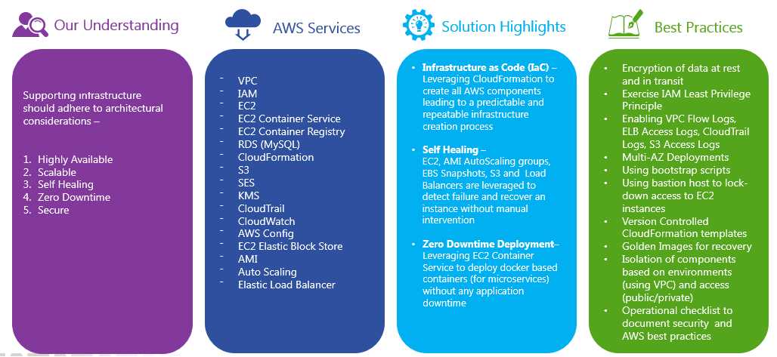
AWS Infrastructure Details
Notes:
10

Slide 11
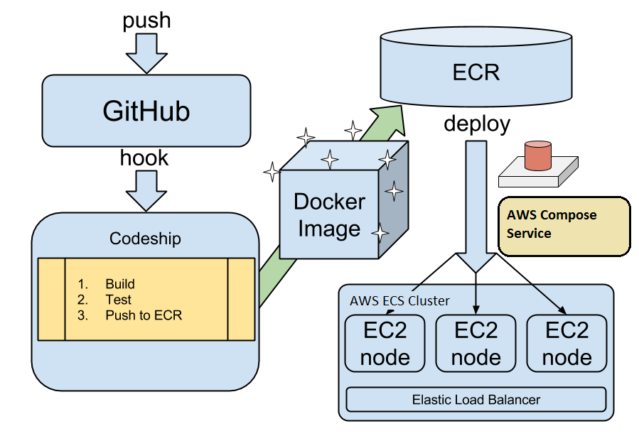
Docker Container life cycle
Notes:
11

Slide 12
Description
Automate the process of deployment at the point of code development itself. Jenkins, Sonar, Artifactory, and Docker Container on AWS cloud used to create whole CI/CD setup. To establishing the DevOps, all these tools need to communicate to each other on event based mechanism . Jenkins used to create job configure all environment at same place and preparing build with underlying build script(Maven),trigger Sonar engine, Artifactory and prepare Docker image and deploying it on required platform.
Implementation/SOP details
Please refer - Standard-Operation-Procedure-SOP-DevOps_UMSL.docx
Scope
DevOps is an agile principle for automating integrating the application, preparing build, checking code quality, testing and deploying the application in required environment. This document will define complete setup of DevOps with proper deployment process.
Notes:
12

