Slide 1
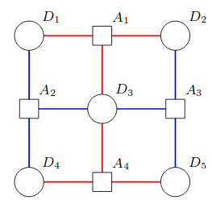
Stabilizers of
circles: Data Qubits
squares: Ancillary Qubits
red edges: CX gate connection
blue edges: CY gate connection
(Figure from J. Roffe's review paper, Figure 8a, https://arxiv.org/pdf/1907.11157.pdf#page=18)

Slide 2
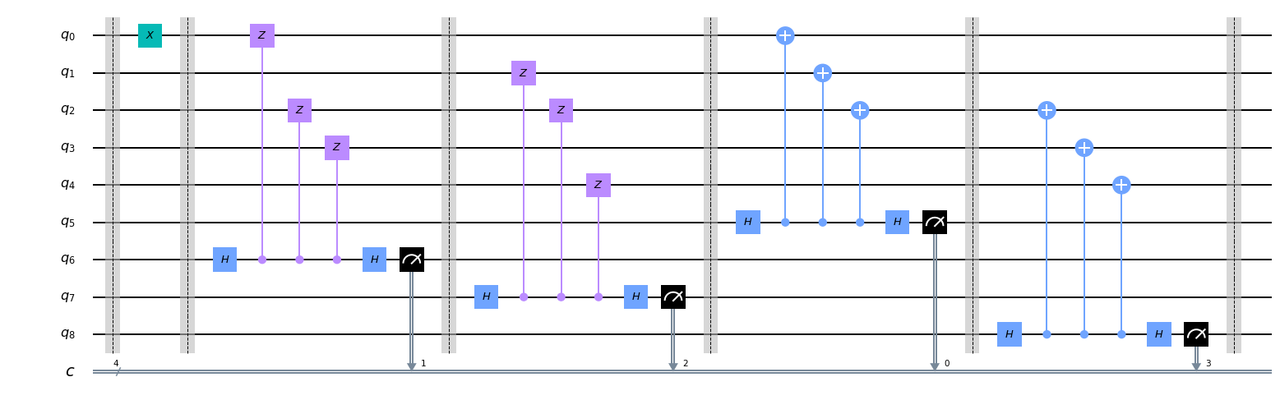
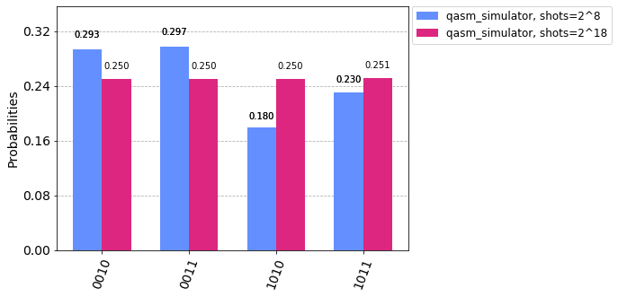
Stabilizers of
Backend:
qasm_simulator

Slide 3
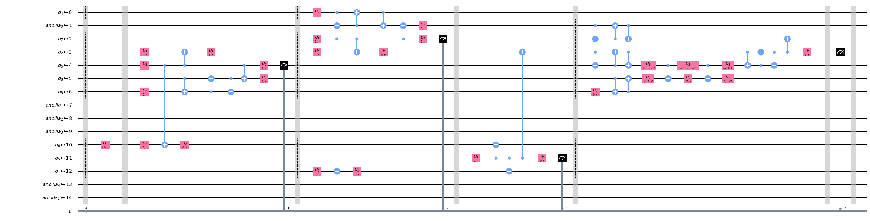
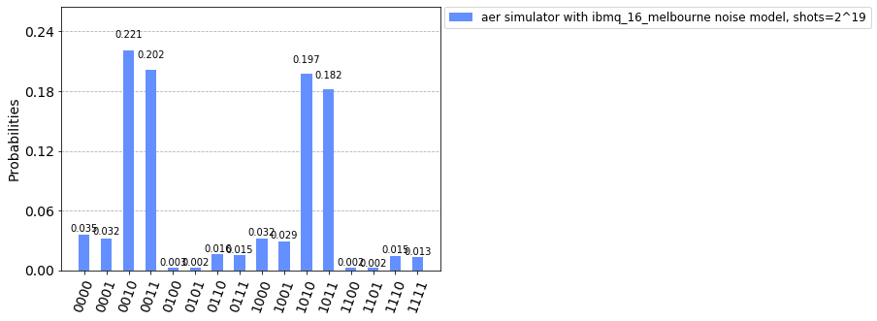
Stabilizers of
Backend:
Aer simulator,
ibmq_16_melbourne noise model

