Slide 1
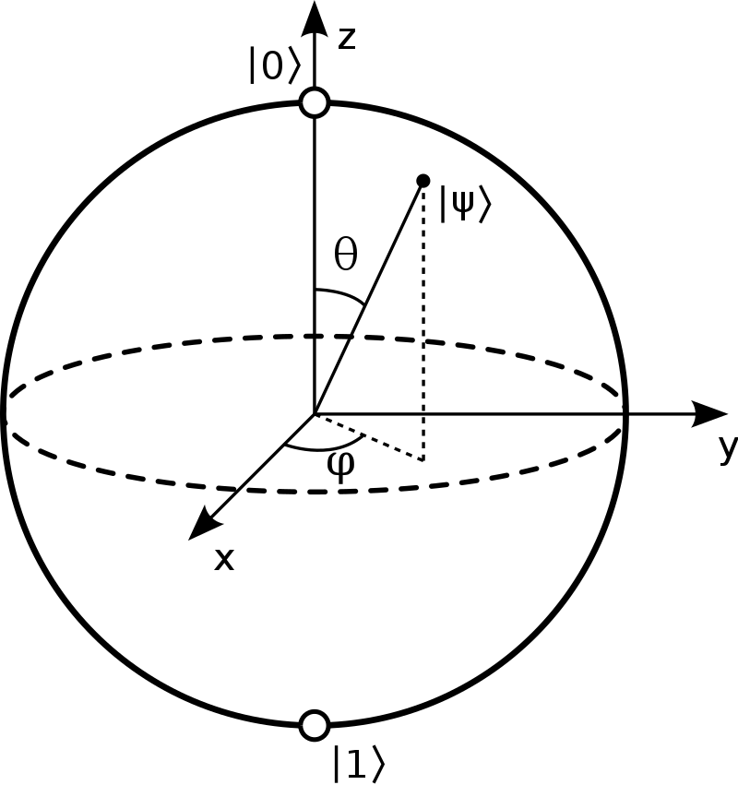
Basics
• Single Qubit:
• Bit and Phase information
- Measurement:
- formally: projection onto a basis
- Change
- Bit-Flip
- Phase-Flip

Slide 2
Bases
• Computational Basis
• Hadamard Basis
• Conversion

Slide 3
Basics
• Bloch Sphere:
• Rotations:

Slide 4
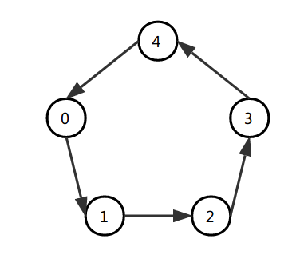
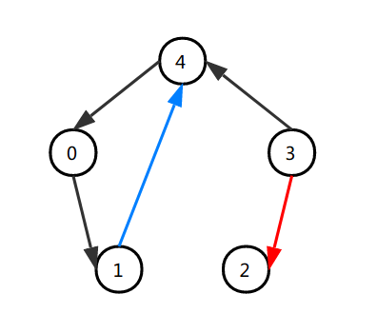

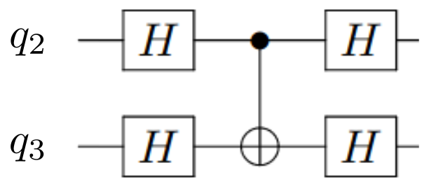
Running 2-Qubit Gates
& Connectivity
Suppose a device has this layout:
But we want to do this:
Wrong direction! Circumvent it with
[adaped from Zhang et al., arXiv:1807.01703, 2018]

Slide 5
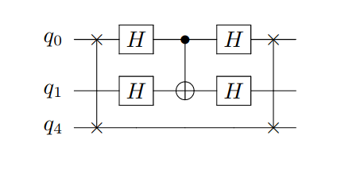
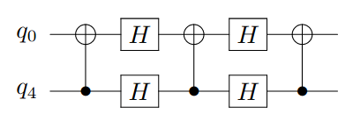
Running 2-Qubit Gates
& Connectivity
Suppose a device has this layout:
But we want to do this:
No direct connection available! Circumvent it with e.g.
SWAP(q0, q4)
SWAP, CNOT, SWAP
[adaped from Zhang et al., arXiv:1807.01703, 2018]

Slide 6
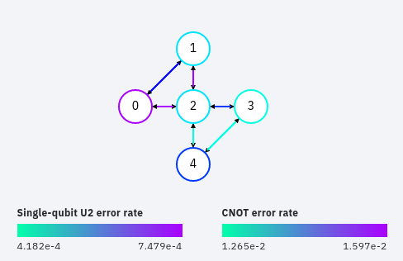
Running 2-Qubit Gates
& Connectivity
→ Minimize the cost for given quantum algorithm on a given hardware layout
• Software: Compilation/Transpilation
• Hardware: optimized layout for specific algorithms
Example:
- Device:
ibmqx2 (Yorktown)
- Algorithm:
GHZ state preparation

Slide 7
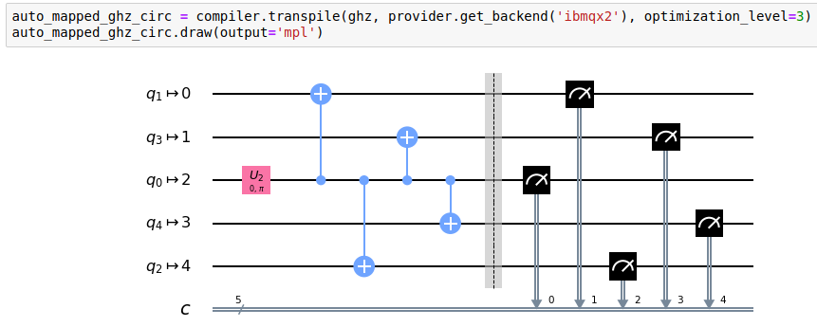
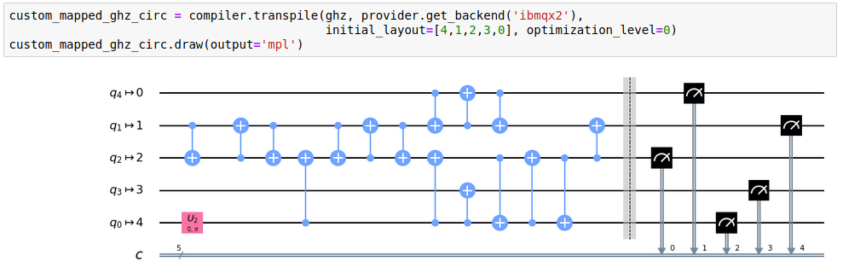

Slide 8
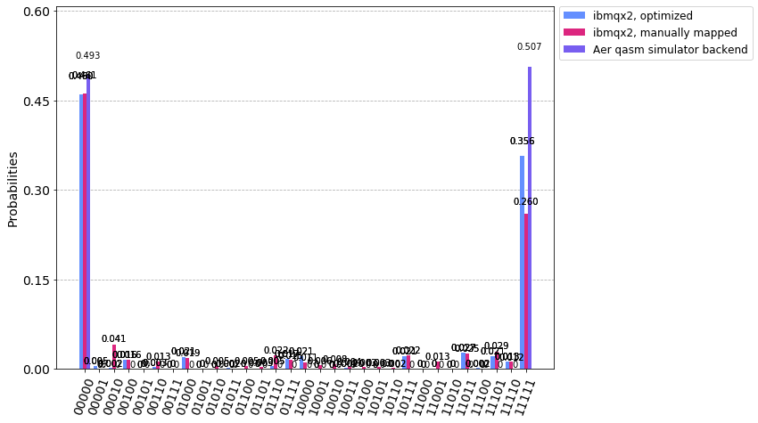
Running 2-Qubit Gates
& Connectivity
shots=1024
→ in this case: optimized circuit performed better

