Slide 1
Lighthouse Labs Final Project:
Predictive Technical Indicators for Trading
Sebastien Garneau
Notes:
Good day everybody, my name is Sebastien Garneau and today I’ll be presenting you my Final Project which consisted of building a Predictive Technical Indicator to be used for Trading.

Slide 2
Notes:
Before I begin, I’d like to quickly introduce myself.
So I got the majority of my professional experience in military intelligence, with over 13 years in the Canadian Armed Forces. I very recently retired from the military and joined H2 Analytics. I’ve included a link to this presentation if you want to know more about the company.
In terms of Data Science, this bootcamp is my first concrete exposure to this world and I find it fascinating.

Slide 3
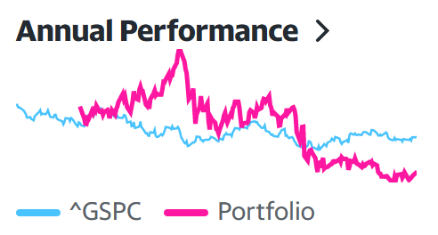
Notes:
Outside of work, a hobby of mine is to trade on the stock market.
I like the stock market because it’s a complex problem that is easily accessible and also because it’s easy to accurately measure your performance by measuring your returns.
My personal objective is to beat the performance of the S&P 500 every year. For those who don’t know, the S&P 500 is an index that features 500 leading publicly traded US companies which is often regarded as one of the best gauges of the stock market overall. In my opinion, if your investment strategy is beating the S&P 500, you’re doing something great.
I’ve decided to use this as my measure of performance for this project. For it to be successful, it needs to be useable in an investment strategy that produces a minimum annual return of 14%, as this represents the Average Return (Inflation Adjusted) of the SP500 of the last 10 years. I’ve decided to use 2022 as my evaluation year, which adds an additional layer of difficulty as the market was very bad that year and the S&P 500 had an annual return of -19%.

Slide 4
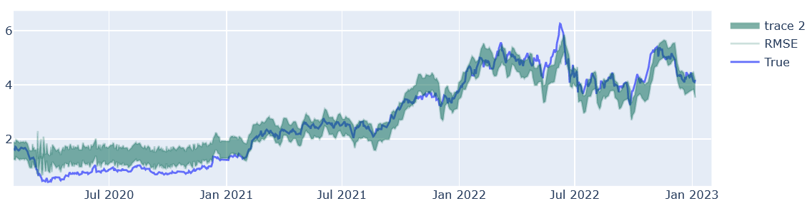
Notes:
The core of my project is a multitude of LSTM models.
The first model I trained was to predict the closing price of a stock called TVE on the Toronto Stock Exchange. The reason I picked this stock was that it was a fairly volatile stock in the last two years and so it would be a good way to measure the basic performance of an LSTM model.
In terms of feature engineering, I’ve added approximately 80 columns of technical indicators as well as the index price of commodities such as oil, natural gas, gold, etc. At first glance, it would appear the model performed well, but when we look more closely it is far from being accurate enough to be used as a technical indicator.
The RMSE represents an inaccuracy of *+/-10%, and stocks generally don’t move by that much every day. Ideally, we would need to bring that RMSE down to 3% or less.

Slide 5
Notes:
To increase the accuracy, it would be easy to say: the stock market is volatile and unpredictable, but some people have great success predicting change in trends using technical indicators, so there should be something there.
I analysed how LSTM learn and what could be throwing off the accuracy of the model and found two possible factors:
First: Lack of data. The data I’m using is from Yahoo Finance, which provides freely only *15 years of historical daily data, which means the model is trained on less than 4,000 lines of data and it’s closer to 3000 when you split into train and test set. When a stock has more than 15 years of history, providing the model with this additional data could increase the accuracy. As well, working with the hourly data, or even the minute rather than the day would significantly increase the size of the training set, but as this was not in the scope of my project, I didn’t try that avenue.
Secondly: LSTM learn and make prediction based on a window that we’re setting. In other words, we’re asking the model to predict the next day’s closing price, by looking at the data in the last 5, 20, 50 days. The problem is the values in each windows are inconsistent as the price fluctuate, even when we are scaling it. The solution I found to this problem is, for every window, I reset the value last value to 1, and the other before to a ratio to that value, which meant the training and prediction of the model remained consistent.

Slide 6
Notes:
With this discovery, trained a new model on the same stock and compared to the initial one. As you can see, the accuracy is drastically increased and is even within our 3% objective. So far so good.
I then trained a model to predict the next day’s close price, open price, as well as the high and low for every stock that I wanted to predict. I used a sample of 8x stocks, which means I trained over 30x different models.

Slide 7
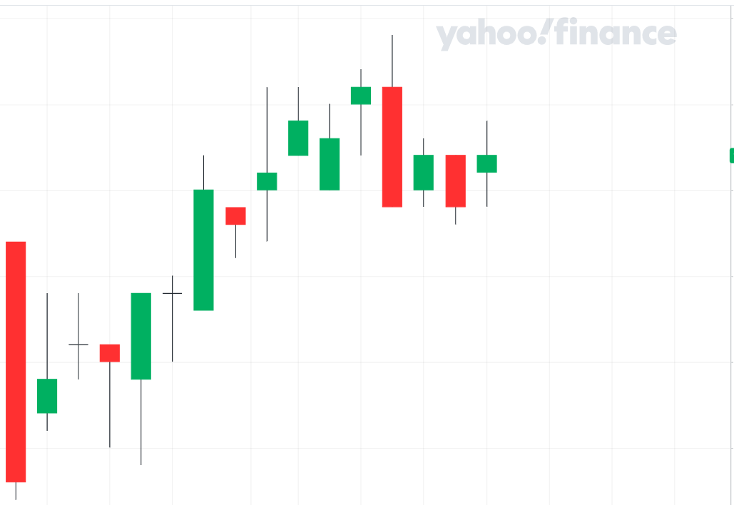
Notes:
So all that looks good, but how can you use this as a technical indicator?
It’s very simple, as we’re predicting the Open, High, Low and Closing price, we can easily add them to a chart as a predictive candle. Here’s an example of how it could work as well as a demonstration of the accuracy of the models, as these are real predictions.
As you can see, the predictions are not perfect and there’s still room for improvement. However, you can still trade using this method….

Slide 8
SELL
SELL
BUY
MISS
Or
LOSS
SELL
SELL
BUY
MISSED !
SELL
BUY
BUY
Notes:
For example, I could use this to set my buy and sell to these points. And then
Add commentary
Once you have a strategy, this is something that could be automated.

Slide 9
Notes:
So this is the investment strategy I fine-tuned and automated to evaluate the our performance against the S&P 500.
I applied this strategy to 8x different stocks from a multitude of sectors and market cap.
The results are.
As you can see. X outperformed the S&P500.
Add caveats bla bla bla

Slide 10
Notes:
Future development:
News. Likely the largest factor that could further increase the accuracy of the stock, as well as trigger a sell during the day.
Alternatively, an intraday indicator, where if the price closes significantly lower than predicted, it’s considered as a sale indicator.
We could also develop another one in the same realm to maximize profit when reaching the high

Slide 11
QUESTIONS ?

