Slide 1
Lighthouse Labs Final Project:
Predictive Technical Indicators for Trading
Sebastien Garneau
Notes:
Good day everybody, my name is Sebastien Garneau and today I’ll be presenting you my Final Project which consisted of building a Predictive Technical Indicator for Trading.

Slide 2
Notes:
Before I begin, I’d like to quickly introduce myself.
The majority of my background is in military intelligence. I spent over 13 years with the Canadian Armed Forces, six of those were with the Canadian Special Operations Forces Command. I very recently retired from the military and joined H2 Analytics, a company whose mission is to bridge the gap between intelligence and users by developing innovative solutions to maximize business, security and defense intelligence requirements.

Slide 3
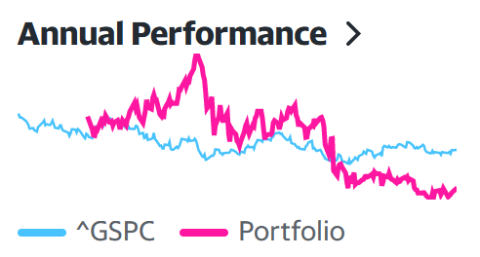
Notes:
Outside of work, a hobby of mine is to trade on the stock market.
I like investing on the stock market because it’s a complex problem that is easily accessible, especially in the last few years, and also because it’s easy to accurately measure your performance by measuring your returns.
My personal objective, is to beat the performance of the S&P 500 every year. For those who don’t know, the S&P 500 is an index that features 500 leading publicly traded companies in the US which is often regarded as one of the best gauges of the stock market overall.
In my opinion, if your investment strategy is beating the S&P 500, you’re doing something great.
So then began my journey of creating a trading strategy. In the first year, I spent countless hours reading on companies and investment sites and my returns significantly outperformed the SP500. However, in the last year, I started to decrease my research on stocks. To me, this is a form of passive income and I didn’t want to spend so much of my personal time on this hobby anymore. It was a choice, but the performance of my portfolio started to decrease as a consequence, to a point where, in 2022, I did not outperform the SP500. More specifically, the SP500 decreased by 19% that year while my portfolio decreased by 32%.
So this was my measure of performance for this project. This project needed to outperform the SP500, but I also raised the bar. As 2022 was not a good year, it would have been easy to simply say: I didn’t invest at all and beat the SP500 by 19%!
So, I’ve set the objective for my project to produce a minimum return of 15%, which would mean it would have outperformed the Average Return (Inflation Adjusted) of the SP500 in the last 10 years (14%)

Slide 4
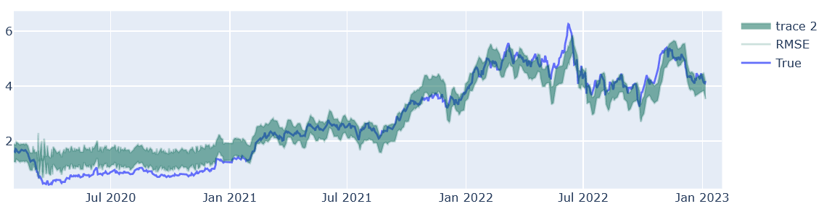
Notes:
The core of my project is a multitude of LSTM models.
The first model I trained was to predict the closing price of a stock called TVE.TO. The reason I picked this stock was that it was a fairly volatile stock in the last two years and so it would be a good way to measure the basic performance of an LSTM model.
In terms of feature engineering, I’ve added approximately 80 columns of technical indicators to the stock as well as the index price of commodities such as oil, natural gas, gold, etc. At first glance, it would appear the model performed well, but when we look more closely it is far from being accurate enough to use as a technical indicator.
*** For example

Slide 5
Notes:
I then analysed how LSTM learn and what could be throwing off the accuracy by so much and here’s what I concluded.
LSTM learn and make prediction based on a window that we’re setting.
The problem is the values of that window are inconsistent, even when we are scaling it.
My solution to this problem is, for every window, I reset the value to 1, and the other before to a ratio to that value, which meant the training and prediction of the model were significantly more consistent.

Slide 6
Notes:
Here’s a comparison of the same stock’s closing price. Compared to the initial one. As you can see, the accuracy is drastically increased.
With that, I dropped most of the feature engineering I had previously as I discovered they were not improving the accuracy of the model.
I then trained a model to predict the next day’s close price, open price, as well as the high and low for every stock that I wanted to predict. I had 8x, which means I trained over 30x different models.

Slide 7
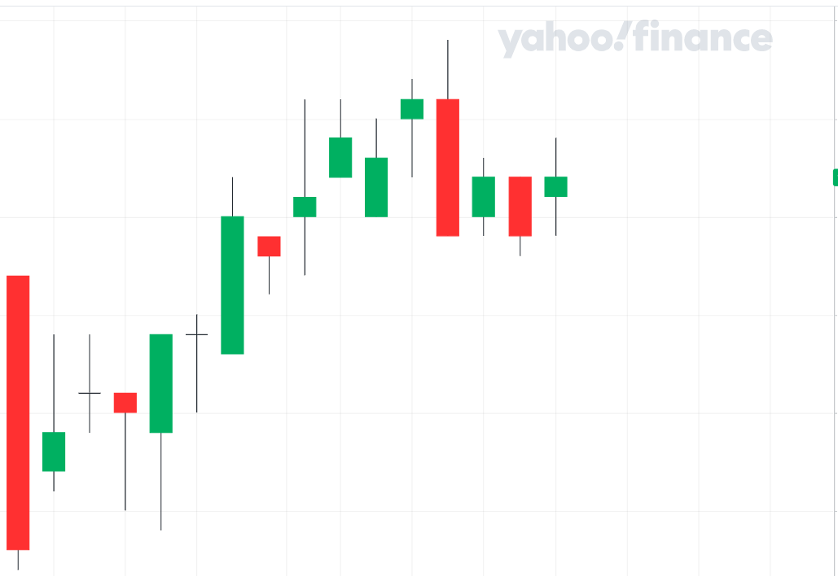
Notes:
So all that looks good, but how can we use this as a technical indicator?
It’s very simple, as we’re predicting the Open, High, Low and Closing price, we can easily add them to a chart as a predictive candle. Here’s an example of how it could work as well as a demonstration of the accuracy of the models, as these are real predictions.
As you can see, the predictions are not perfect. However, you can still trade using this method….

Slide 8
SELL
SELL
BUY
MISS
Or
LOSS
SELL
SELL
BUY
MISSED !
SELL
BUY
BUY
Notes:
For example, I could use this to set my buy and sell to these points. And then
Add commentary
Once you have a strategy, this is something that could be automated.

Slide 9
Notes:
After taking a look at this technical indicator in details, I developed a strategy
I applied this strategy to 8x different stocks from a multitude of sectors and market cap.
The results are.
As you can see. X outperformed the S&P500.
Add caveats bla bla bla

Slide 10
Notes:
Future development:
News. Likely the largest factor that could further increase the accuracy of the stock, as well as trigger a sell during the day.
Alternatively, an intraday indicator, where if the price closes significantly lower than predicted, it’s considered as a sale indicator.
We could also develop another one in the same realm to maximize profit when reaching the high

Slide 11
QUESTIONS ?

