Slide 1
Lighthouse Labs Final Project:
Predictive Technical Indicators for Trading
Sebastien Garneau
Notes:
Good day everybody, my name is Sebastien Garneau and today I’ll be presenting you my Final Project which consisted of building a Predictive Technical Indicator for Trading.

Slide 2
Notes:
However, before I begin, I’d like to quickly introduce myself.
My background is in military intelligence. I spent over 13 years with the Canadian Armed Forces, six of those were with the Canadian Special Operations Forces Command. I very recently retired from the military and joined H2 Analytics, a company whose mission is to bridge the gap between intelligence and users by developing innovative solutions to maximize business, security and defense intelligence requirements.

Slide 3
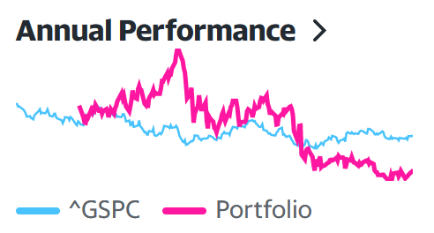
Notes:
Outside of work, a hobby of mine is trading on the stock market.
The reason it became a hobby of mine is in the last few years it became more accessible to everyone, as trading platforms decreased their trading fees and some even allow users to trade on the Canadian market for no fees.
It’s also easy to measure your performance. My personal objective is to beat the performance of the SP500. In my opinion, if your returns are better, you’re doing something great. If you’re not, don’t bother and just invest in the SP500!
So then began my journey of creating a trading strategy. In the first year, I spent countless hours reading on companies and investment sites and my returns completely outperformed the SP. However, in the last year, I started to decrease my research on stocks. To me, this is a form of passive income and I didn’t want to spend so much of my personal time anymore. It was a choice, but the performance of my portfolio started to decrease, to a point where, in 2022, I did not outperform the SP500.
#what are the exact numbers?
Portfolio: -32.05%
SP500: -19.44%
For this project, this will be my measure of performance for this project. Would I have had performed better using this technical indicator in 2022?

Slide 5
QUESTIONS ?

