Slide 1
Lighthouse Labs Final Project:
Predictive Technical Indicators for Trading
Sebastien Garneau
Notes:
Good day everybody, my name is Sebastien Garneau and today I’ll be presenting you my Final Project which consisted of building a Predictive Technical Indicator for Trading.

Slide 2
Notes:
Before I begin, I’d like to quickly introduce myself.
The majority of my background is in military intelligence. I spent over 13 years with the Canadian Armed Forces, six of those were with the Canadian Special Operations Forces Command. I very recently retired from the military and joined H2 Analytics, a company whose mission is to bridge the gap between intelligence and users by developing innovative solutions to maximize business, security and defense intelligence requirements.

Slide 3
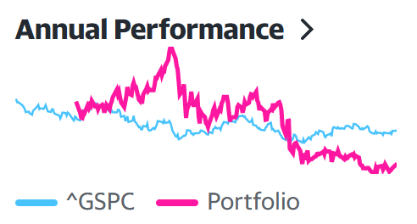
Notes:
Outside of work, a hobby of mine is to trade on the stock market.
I like investing on the stock market because it’s a complex problem that is easily accessible, especially in the last few years, and also because it’s easy to accurately measure your performance by measuring your returns.
My personal objective, is to beat the performance of the S&P 500 every year. For those who don’t know, the S&P 500 is an index that features 500 leading publicly traded companies in the US which is often regarded as one of the best gauges of the stock market overall.
In my opinion, if your investment strategy is beating the S&P 500, you’re doing something great.
So then began my journey of creating a trading strategy. In the first year, I spent countless hours reading on companies and investment sites and my returns significantly outperformed the SP500. However, in the last year, I started to decrease my research on stocks. To me, this is a form of passive income and I didn’t want to spend so much of my personal time on this hobby anymore. It was a choice, but the performance of my portfolio started to decrease as a consequence, to a point where, in 2022, I did not outperform the SP500. More specifically, the SP500 decreased by 19% that year while my portfolio decreased by 32%.
So this was my measure of performance for this project. This project needed to outperform the SP500, but I also raised the bar. As 2022 was not a good year, it would have been easy to simply say: I didn’t invest at all and beat the SP500 by 19%!
So, I’ve set the objective for my project to produce a minimum return of 15%, which would mean it would have outperformed the Average Return (Inflation Adjusted) of the SP500 in the last 10 years (14%)

Slide 4
Notes:
The core of my project is a multitude of LSTM models.
At the beginning of

Slide 5
QUESTIONS ?

