Slide 1

Introduction to MATLAB on Communication
Tutorial ①
Dr. Victor B. Lawrence
& Ghalib Alshammri
galshamm@stevens.edu
CPE654: Design and Analysis of Network Systems
2017 Fall, Thursday 06:15 – 08:45 PM

Slide 2

Purpose and Objectives
Learn about Communication Channel.
Discover MATLAB environment.
Learn about MATLAB features.
Discover Communication toolbox at MATLAB.
Develop a beginner level MATLAB application.

Slide 3
Outline
  MATLAB installation and activation.
    Using a MathWorks account.
    File Installation Key.
  MATLAB tour.
  Fundamental MATLAB.
    Data Types.
    Variables and Assignment.
    Operators and Functions.
  Summary.

Slide 4
MATLAB
Installation and Activation

Slide 5
System Requirements
Operating Systems | Processors | Disk Space | RAM | Graphics
Windows 7 and above Mac OS Linux | Any Intel or AMD x86-64 processor | 2.4 GB for MATLAB only, 4-6 GB for a typical installation | 2 GB with Simulink, 4 GB is required with Polyspace | No specific graphical card is required

Slide 6
Before you install
To run the installer, you need:
Your Stevens email address and your MathWorks account.
Correct permission to install the software.
Note:
If you do not have a MathWorks account, you can create an account during installation or use student activation key.

Slide 7
Permission to Install
To access the public software at Stevens, you need:
On-Campus | Out-Campus
Open ‘This PC’ explorer Click Map network drive In the Folder field, type the full path of shared drive \\storage01\ Select the connect using different Enter campus\username and password using Stevens Account | Create Tunneling All Traffic VPN Follow On-Campus Instructions

Slide 8
Creating VPN
Open Network and Sharing Center
  Click the Start icon, type Network and Sharing and click on Network and Sharing center
Click Set up a New Connection and Network
Choose to connect to a Workplace and click Next
Choose Use my Internet connection (VPN)
Configuring VPN
  For the internet address type: vpn.stevens.edu
  For the destination name type: Stevens VPN
Right click on Stevens VPN, and click Properties
Click on the Security tab and under Type of VPN, select Layer2Tunneling …
Click on Allow these protocols, then check off CHAP and MS-CHAP
Click on Advanced Setting, check off Use preshared key for authentication and enter SITvpn and click OK, then OK
Connecting VPN: enter CAMPUS\USERNAME and password

Slide 9
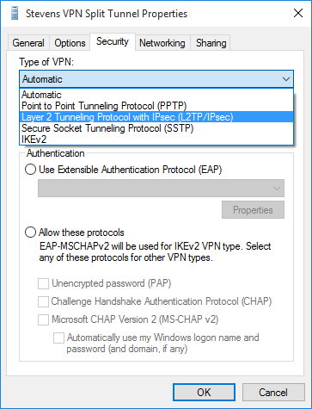
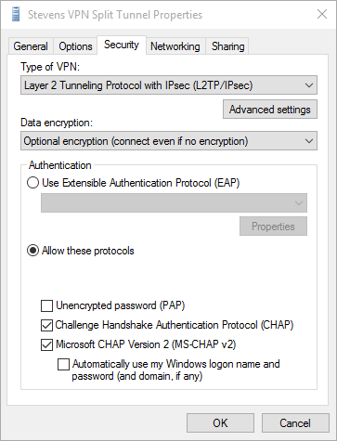
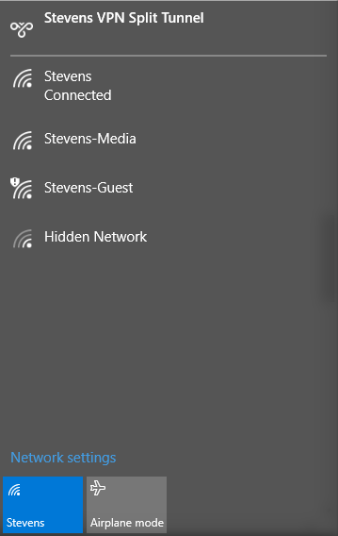
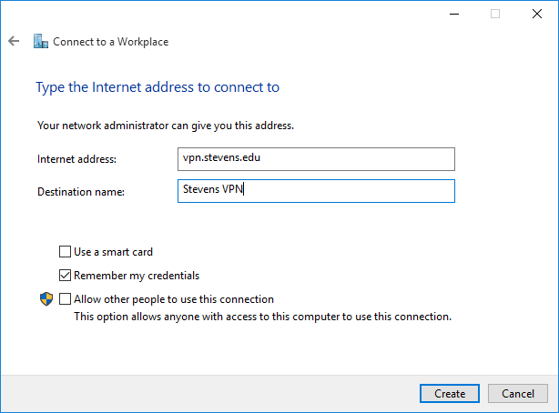
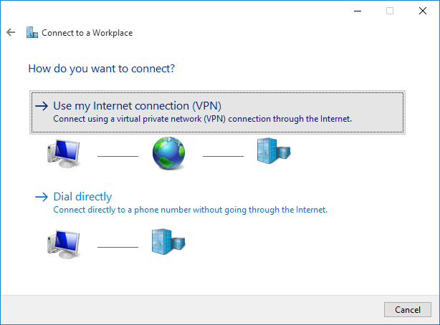
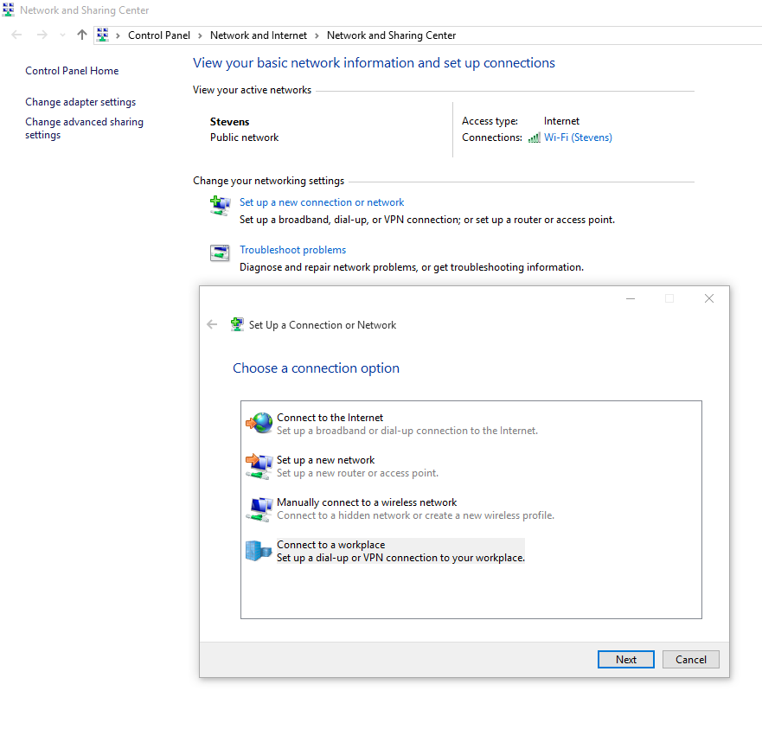
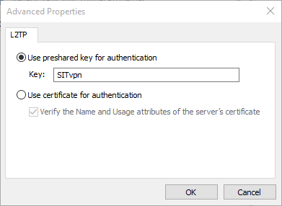
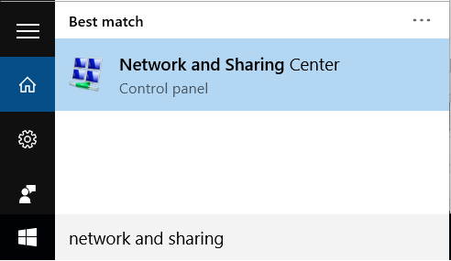
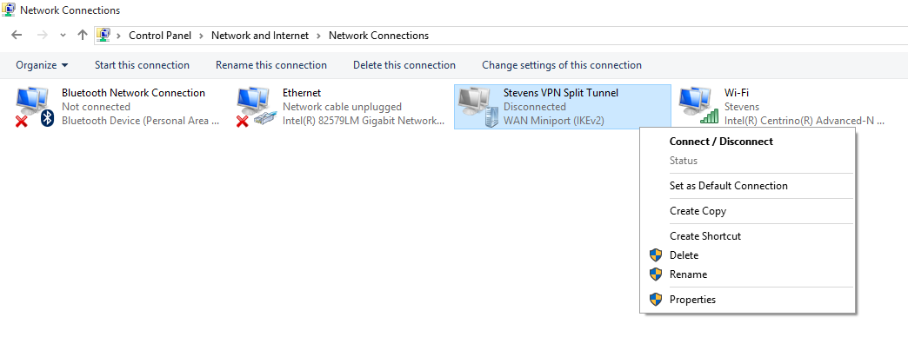
Creating VPN
Configuring VPN
  For the internet address type: vpn.stevens.edu
  For the destination name type: Stevens VPN
Click on Advanced Setting, check off Use preshared key for authentication and enter SITvpn and click OK, then OK
Choose to connect to a Workplace and click Next
Choose Use my Internet connection (VPN)
Open Network and Sharing Center
  Click the Start icon, type Network and Sharing and click on Network and Sharing center
Click Set up a New Connection and Network
Right click on Stevens VPN, and click Properties
Connecting VPN:
enter CAMPUS\USERNAME and password
Click on the Security tab and under Type of VPN, select Layer2Tunneling …
Click on Allow these protocols, then check off CHAP and MS-CHAP

Slide 10
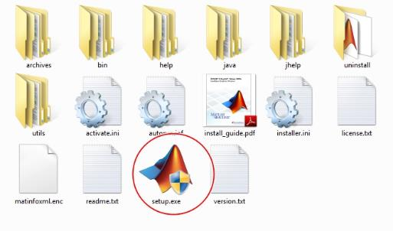
Start the Installer
Access to \\storage01\public\Matlab 2017a
Double-Click the Setup file

Slide 11
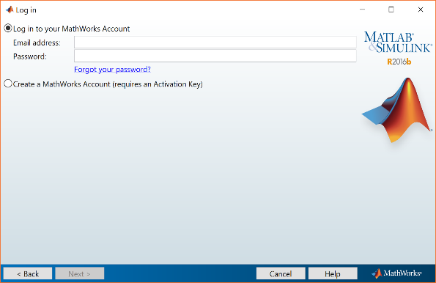
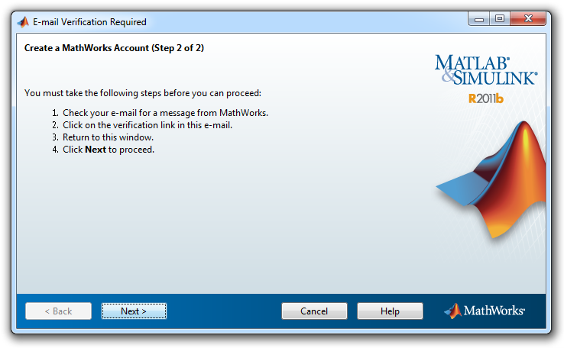
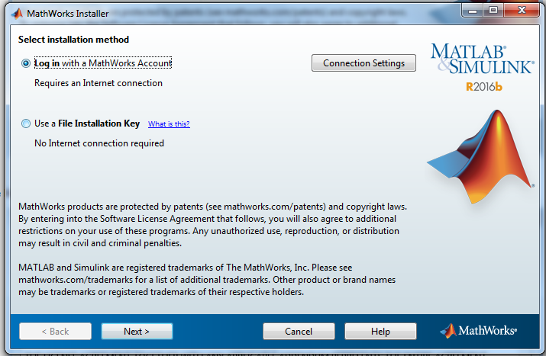
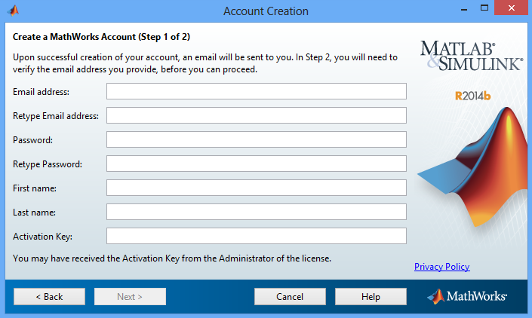
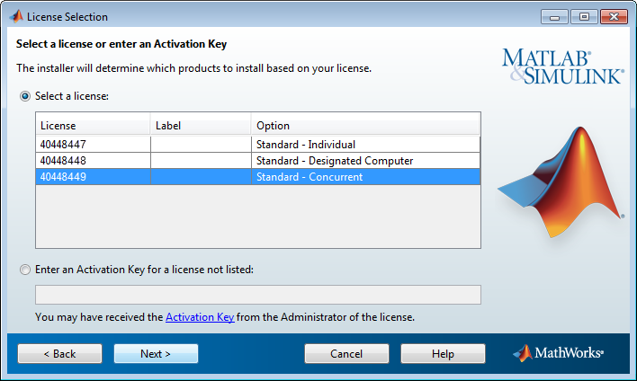
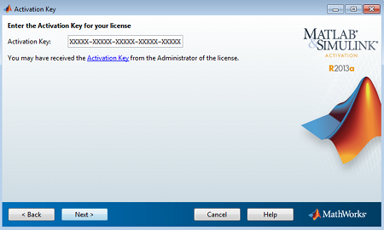
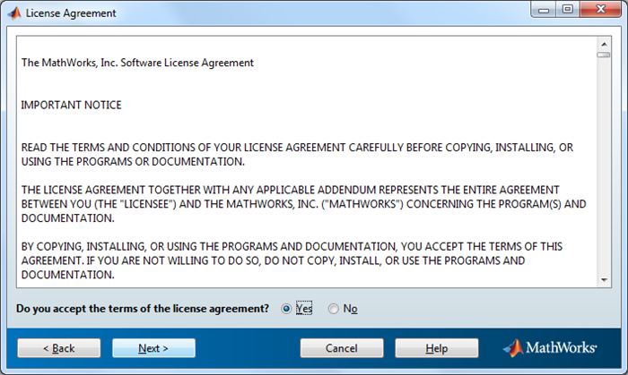
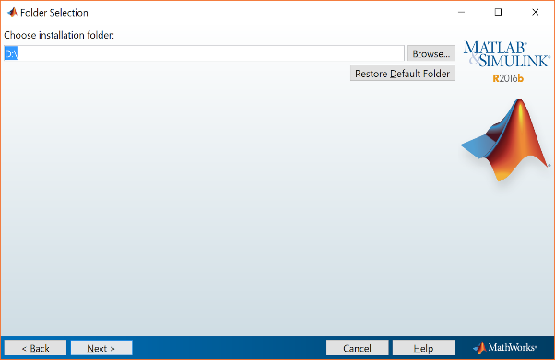
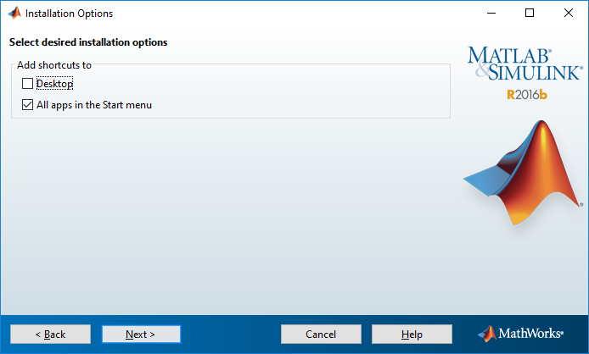
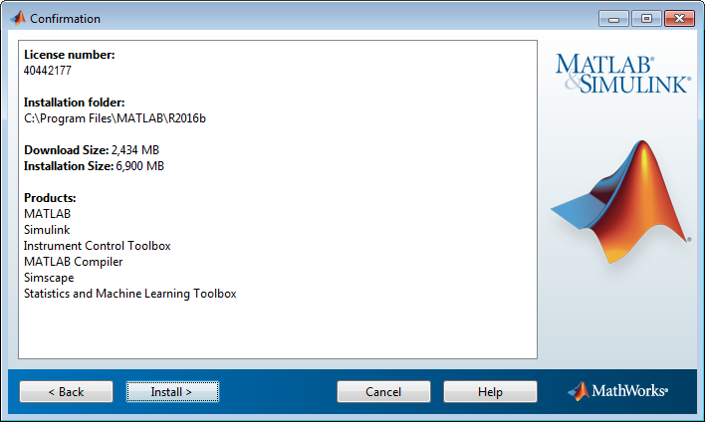
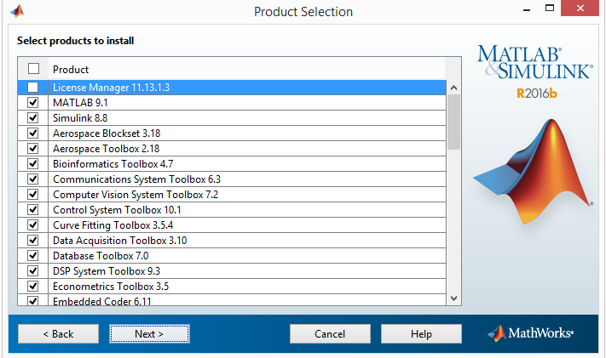
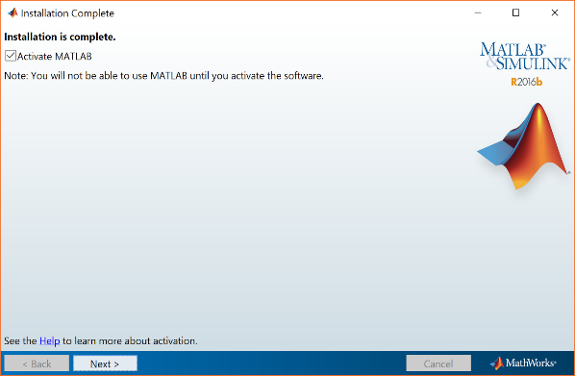
Install Using a MathWorks Account
Leave the log In with a MathWorks Account option selected.
Click Next
Review the Software License Agreement
Click Next
Log in or create a new account in MathWorks Account
Click Next
Click Next again
Select the license you want to install
Click Next
Specify an Activation Key
Click Next
Specify the Installation Folder
Click Next
Specify Products to Install
Click Next
Specify Installation Options
Click Next
Confirm your choices
Click Install
Complete the Installation
Click Next

Slide 12
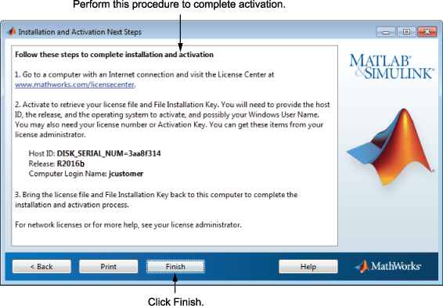
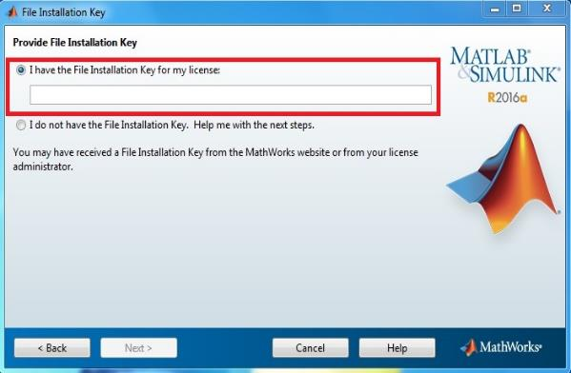
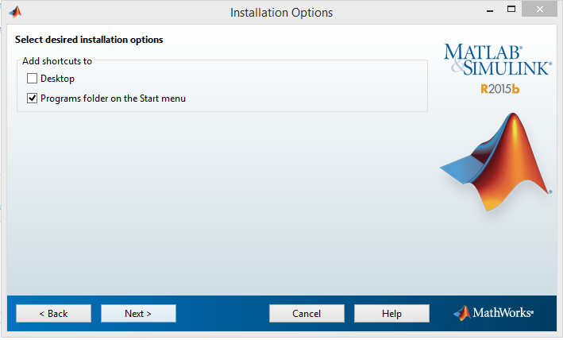
Install with a File
Installation Key
Review the Software License Agreement
Click Next
Specify the File Installation Key
Click Next
Leave the use a File Installation Key option selected.
Click Next
Installation and Activation Next Steps
Click Finish
Specify the Installation Folder
Click Next
Specify Products to Install
Click Next
Specify Installation Options
Click Next
Confirm your choices
Click Install
Complete the Installation
Click Next

Slide 13
MATLAB
Tour

Slide 14
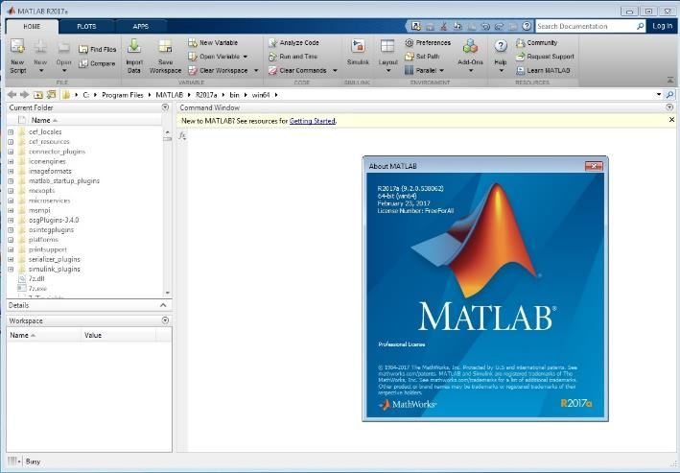
MATLAB Tour
File:
New
Open
Variable:
Import
New
Open
Clear
Command Window
Current Folder
MATLAB Status
Workshop

Slide 15
MATLAB Tour
- some tricks !
To know if you already used a variable name
  Use “ which”
To clear Command Window
  Use “clc”
To clear MATLAB memory
  Use “clear”
To know your variables
  Use “ who”
To know your variable's info
  Use “ whos”
To know your files
  Use “ what”

Slide 16
MATLAB Tour
If you needed Help:
Type “help” in Command window

Slide 17
MATLAB Tour
M-files
To store the code and execute later.
The file name will become a function, when we call it it will execute the file.
To open a new m-file , In the Command window , type
    “edit”

Slide 18
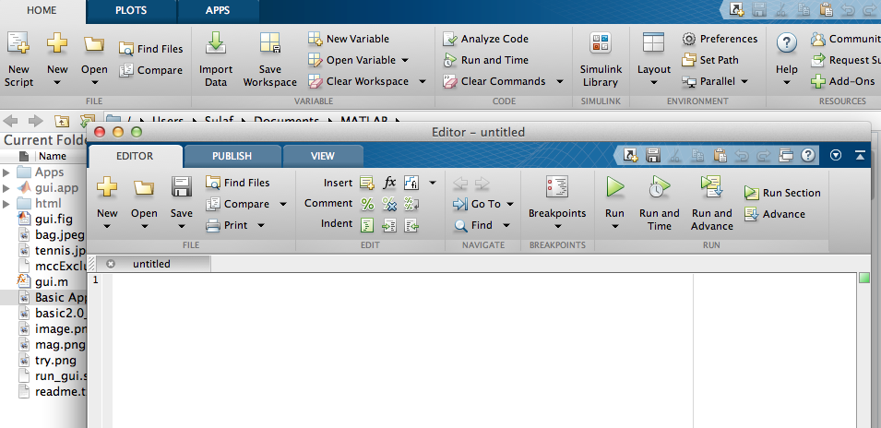
MATLAB Tour Editor
Or..

Slide 19
MATLAB Tour
GUI
MATLAB offers ‘ GUIDE’ tool to design graphic interface.
In the Command window , type
    guide

Slide 20
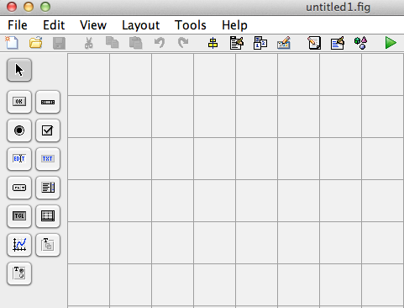
MATLAB Tour GUI
GUIDE tool

Slide 21
Fundamental MATLAB

Slide 22
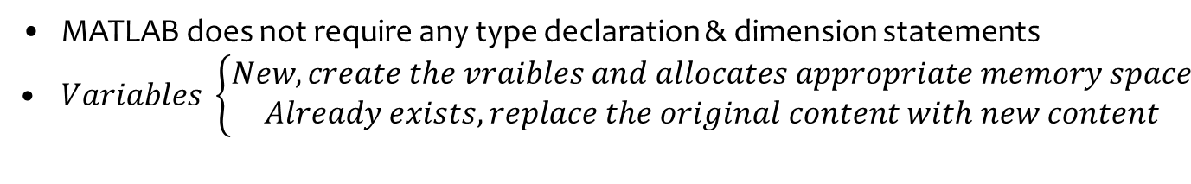
Data Types
MATLAB does not require any type declaration & dimension statements
$Variables \left\{\begin{aligned}New, create the vraibles &and allocates appropriate memory space \\ Already exists, replace the original content with new content\end{aligned}\right.$
Data Types | Description
int8, int16, int32 and int64 | 8, 16, 32 and 64 bit signed integer
uint8, uint16, uint32 and uint64 | 8, 16, 32 and 64 bit unsigned integer
single | Single precision numerical data, 8 decimal digits
double | Double precision numerical data, 16 decimal digits
logical | Logical values 0 or 1, represent false or true
char | Character data

Slide 23
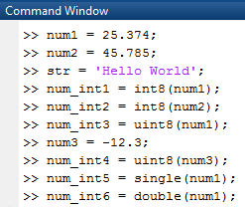
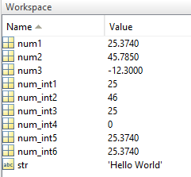
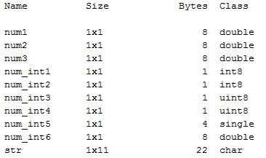
Data Types
Examples:

Slide 24
Variables and Assignment
In MATLAB environment, every variable is an array or matrix.
Assignment Types:
  Assign to values
  x = 3; %defining x and initializing it with value
  Assign to expression
  x = sqrt(16); %defining x and initializing it with expression
  x = 7 + 10 / 3 + 5 ^ 1.2;
  Multiple assignment
  a = 2;
  b = 7;
  c = a + b;
Note: you can use % for comments without any execution in MATLAB

Slide 25
Variables and Assignment
The command format
By default, MATLAB shows numbers with four decimal place values, this known as short format
  Bank format: command shows 2 digits after decimal part
  format bank
  x = 7 + 10 / 3 + 5 ^ 1.2;
  x will be 17.23
  Short format: command shows 4 digits after decimal part
  format short
  x = 7 + 10 / 3 + 5 ^ 1.2;
  x will be 17.2320
  Long format: command shows 16 digits after decimal part
  format long
  x = 7 + 10 / 3 + 5 ^ 1.2;
  x will be 17.231981640639408

Slide 26
Operators
Arithmetic Operators
Relational Operators
Logical Operators
Bitwise Operations

Slide 27
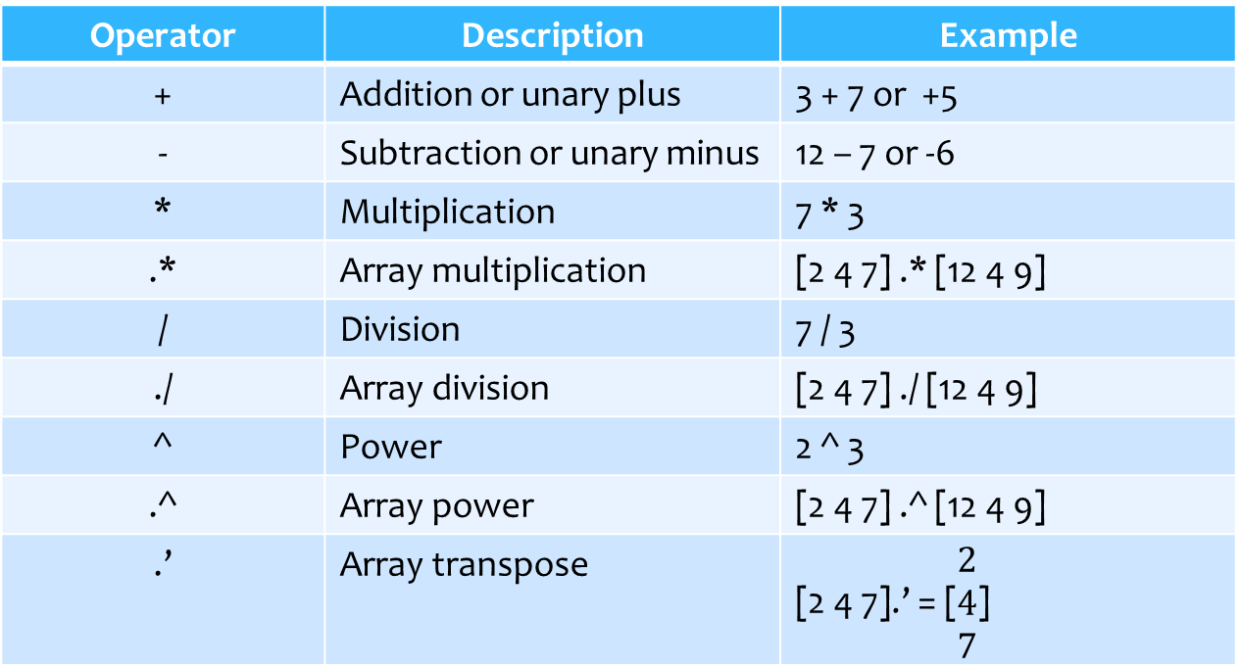
Arithmetic Operators
Operator | Description | Example
+ | Addition or unary plus | 3 + 7 or +5
- | Subtraction or unary minus | 12 – 7 or -6
* | Multiplication | 7 * 3
.* | Array multiplication | [2 4 7] .* [12 4 9]
/ | Division | 7 / 3
./ | Array division | [2 4 7] ./ [12 4 9]
^ | Power | 2 ^ 3
.^ | Array power | [2 4 7] .^ [12 4 9]
.’ | Array transpose | [2 4 7].’ = [$\begin{matrix}2 \\ 4 \\ 7\end{matrix}$]

Slide 28
Relational Operators
Operator | Description | Example
> | Greater than | 5 > 6 Answer is 0
< | Less than | 5 < 6 Answer is 1
>= | Greater than or equal | 14 >= 14 Answer is 1
<= | Less than or equal | 15 <= 4 Answer is 0
== | Equal | 7 == 4 Answer is 0
~= | Not equal | 7 == 4 Answer is 1

Slide 29
Logical Operators
Operator | Description | Example
&& and | Logical AND circuit | A & B and(A, B)
|| or | Logical OR circuit | A | B or(A, B)
~ not | Logical NOT circuit | ~A not(A)
xor | Logical exclusive OR circuit | xor(A, B)
== | Equal | 7 == 4
~= | Not equal | 7 ~= 4

Slide 30
Bitwise Operations
What is the different between & or && logical operators?
  p & q will evaluate both p and q.
  p && q will only evaluate q if p is true.
p | q | p & q | p | q | p ^ q | ~p
0 | 0 | 0 | 0 | 0 | 1
0 | 1 | 0 | 1 | 1 | 1
1 | 0 | 1 | 1 | 0 | 0
1 | 1 | 0 | 1 | 1 | 0

Slide 31
Functions
Data Type Conversion
Managing a Session
Working with the System
Input and Output Commands
fopen function
Mathematical Functions

Slide 32
Data Type Conversion
Functions | Description | Example
int2str num2str | Convert integer to string | A = int2str(555); Answer: A = ‘555’
str2num | Convert string to number | A = int2str(‘555’); Answer: A = 555
str2double | Convert string to double | A = int2str(‘214.74’); Answer: A = 214.7400
isinteger | Determine if input is integer array | A = isinteger(‘Hello’); Answer: A = 0
ischar | Determine if input is character array | A = ischar(‘Hello’); Answer: A = 1

Slide 33
Managing a Session
Functions | Description
clc | Clears command window
clear all | Removes all variables from memory
clear x | Removes variable x from memory
global x | Declares variable x to be global
quit | Stops MATLAB

Slide 34
Working with the System
Functions | Description
date | Displays current date
cd | Displays current folder
cd .. | Moves current folder one step back
cd ‘C:\Windows’ | Changes current folder to ‘C:\Windows’
delete ‘file path’ | Deletes a specific file
dir | Lists all files in current directory
pwd | Displays current path
type ‘file path’ | Displays contents of a file

Slide 35
Input and Output Commands
Functions | Description | Example
input | Display the text in prompt and waits for the user to input a value, then store it in x | x = input(prompt);
inputdlg | Creates dialog box that gathers user input | x = inputdlg(prompt, title);
sprintf | Performs formatted writes to screen | sprintf(string, variables);
fprintf | Performs formatted writes to file | fprintf(fileID, format,variables);
disp | Displays value of variable x | disp(x)
fscanf | Read formatted data from a file | x = fscanf(fileID, format);
sscanf | Read formatted data from string | x = sscanf(string, format);
fgetl | Read line by line form the file | x = fgetl(fileID);

Slide 36
Input and Output Commands
The format codes
in
the scan and print commands
Format Code | Description
%s | Format as a string
%d | Format as an integer
%f | Format as a float point value
\n | Insert a new line in the output string
\t | Insert a tab in the output string

Slide 37
fopen Function
Open file, or obtain information about open files
Syntax
fileID = fopen(file path, permissions);
……
……
fclose(fileID);
permission | Description
‘r’ | Open file for reading
‘w’ | Open and write new file for writing and discard existing contents
‘a’ | Open and write new file for writing and append data to the end of file
‘r+’ | Open file for reading and writing
‘w+’ | Open and write new file for reading and writing and discard existing contents
‘a+’ | Open and write new file for reading and writing and append data to the end of file

Slide 38
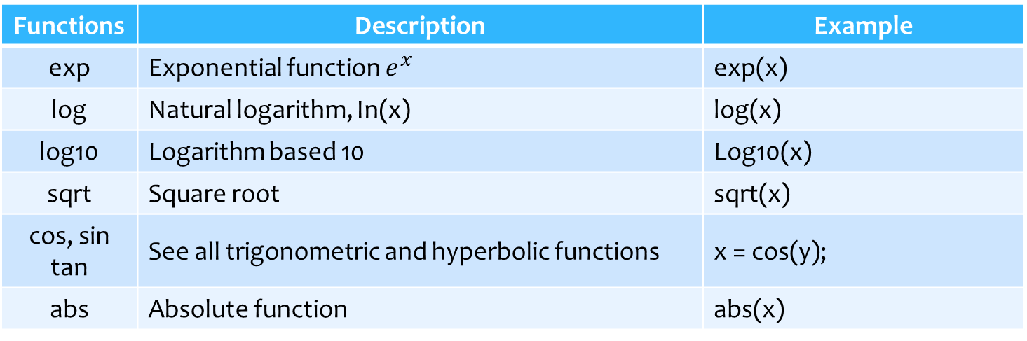
Mathematical Functions
Functions | Description | Example
exp | Exponential function $e^{x}$ | exp(x)
log | Natural logarithm, In(x) | log(x)
log10 | Logarithm based 10 | Log10(x)
sqrt | Square root | sqrt(x)
cos, sin tan | See all trigonometric and hyperbolic functions | x = cos(y);
abs | Absolute function | abs(x)

Slide 39
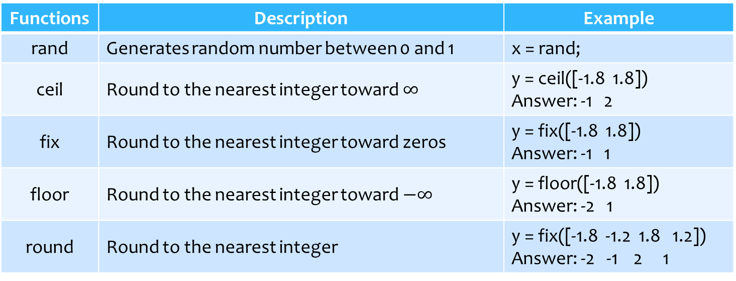
Mathematical Functions
Functions | Description | Example
rand | Generates random number between 0 and 1 | x = rand;
ceil | Round to the nearest integer toward $∞$ | y = ceil([-1.8 1.8]) Answer: -1 2
fix | Round to the nearest integer toward zeros | y = fix([-1.8 1.8]) Answer: -1 1
floor | Round to the nearest integer toward $−∞$ | y = floor([-1.8 1.8]) Answer: -2 1
round | Round to the nearest integer | y = fix([-1.8 -1.2 1.8 1.2]) Answer: -2 -1 2 1

Slide 40
Summary
We learn:
Installation and Activation MATLAB
Basic Concepts in MATLAB
  Data Types
  Variables and Assignment
  Operators
  Functions
  Note that it is brief in MATLAB concepts.

