Slide 1
Applications Of Stack
Infix to Postfix Conversion
Method Calls

Slide 2

Infix to Postfix Conversion
Stack can be used to convert from infix to postfix
infix expression : a + b * c + ( d * e + f ) * g
postfix expression : abc*+de*f+g*+

Slide 3




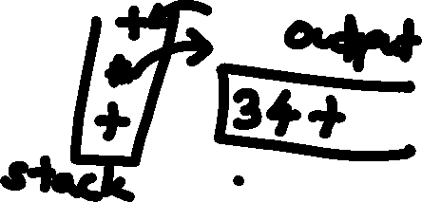
Algorithm
Stack is initially empty
When an operand is read it is immediately placed onto the output.
If we see a right parenthesis, then we pop stack writing symbols until we see left parenthesis which is popped but not output.
if we see any other symbol (, +, *, then we pop the entire stack until we see lower priority one exception is we never remove ( unless we encounter )

Slide 4
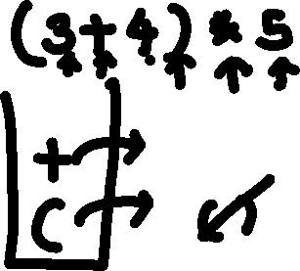
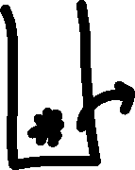

Conversion Algorithm
Output operands as encountered
Stack left parentheses
When ‘)’
repeat
pop stack, output symbol
until ‘(‘
‘(‘ is poped but not output
If symbol +, *, or ‘(‘
pop stack until entry of lower priority or ‘(‘
‘(‘ removed only when matching ‘)’ is processed
push symbol into stack
At end of input, pop stack until empty

Slide 5



a + b * c + ( d * e + f ) * g
a
a
a
a
+
a
ab
+
a
ab
*
+

Slide 6





a + b * c + ( d * e + f ) * g
a
abc
*
+
a
abc*+
+
a
abc*+
+
a
abc*+
(
+

Slide 7

a + b * c + ( d * e + f ) * g
a
abc*+d
(
+
*
(
+
a
abc*+d
*
(
+
a
abc*+de
+
(
+
a
abc*+de*

Slide 8









a + b * c + ( d * e + f ) * g
+
(
+
a
abc*+de*f
a
abc*+de*f+
+
a
abc*+de*f+
*
+
a
abc*+de*f+g
+
abc*+de*f+g*+

Slide 9
Method Calls
Problem: When a call is made to a new method all the local variables and current location, arguments need to be saved. This is achieved by pushing onto the stack.
Method call and method return are same as an open and closed parenthesis.
Stack is used by the programming language in implementing recursion
Notes:
Method calls can be implemented by using a stack.
Each call pushes the arguments, local variables and return address onto the stack.
This information is often called an “activation record” or a “stack frame”.

Slide 10

