Slide 1
CHAPTER 1
Data Structures and Algorithm Analysis in Java 3rd Edition by Mark Allen Weiss
Reference to Anjum Chida’s Slides

Slide 2
AIMS AND OBJECTIVES OF THE COURSE
Aim of the course: understanding of issues involved in program design; good working knowledge of common algorithms and data structures
Objectives:
• Be able to identify the functionality required of the program in order to solve the task at hand;
• Design data structures and algorithms which express this functionality in an efficient way;
• Be able to evaluate a given implementation in terms of its efficiency and correctness.

Slide 3
DATA
Data as a general concept refers to the fact that some existing information or knowledge is represented or coded in some form suitable for better usage or processing.

Slide 4
DATA
Representing information is fundamental to computer science.
The primary purpose of most computer programs is not to perform calculations, but to store and retrieve information — usually as fast as possible.
Notes:
To
answer questions like these, it is not enough to have the necessary information. We
must organize that information in a way that allows us to find the answers in time
to satisfy our needs.
For this reason, the study of
data structures and the algorithms that manipulate them is at the heart of computer
science. And that is what this book is about — helping you to understand how to
structure information to support efficient processing.

Slide 5
DATA STRUCTURE
In the most general sense, a data structure is any data representation and its associated operations.
sorted list of integers stored in an array is an example of such a structuring.
Notes:
As we develop more powerful computers, our history so far has always been to
use that additional computing power to tackle more complex problems, be it in the
form of more sophisticated user interfaces, bigger problem sizes, or new problems
previously deemed computationally infeasible. More complex problems demand
more computation, making the need for efficient programs even greater. Worse yet,
as tasks become more complex, they become less like our everyday experience.
Today’s computer scientists must be trained to have a thorough understanding of the
principles behind efficient program design, because their ordinary life experiences
often do not apply when designing computer programs.

Slide 6
ALGORITHM
In mathematics and computer science, an algorithm is a self-contained step-by-step set of operations to be performed
Notes:
The concept of algorithm has existed for centuries,

Slide 7
Analysis of algorithms
Correctness
Termination
Time analysis: How many instructions does the algorithm execute?
Space analysis: How much memory does the algorithm need to execute?

Slide 8
Relation to Algorithms
Most data structures have associated algorithms to perform operations, such as search, insert, or balance, that maintain the properties of the data structure
Algorithms and data structures should be thought of as a unit, neither one making sense without the other.

Slide 9







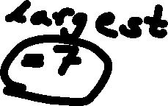




Example
Algorithm LargestNumber
Input: A list of numbers L.
Output: The largest number in the list L.
if L.size = 0 return null
largest ← L[0]
for each item in L, do
if item > largest,
then largest ← item
return largest

Slide 10
Objectives
This chapter reviews some pre-requisite material
This shall be a review as it is assumed you have already learned this material in earlier courses.
Notes:
Previous courses such as discrete math.

Slide 11
Mathematical Review
Exponents
Logarithms
Series
Recursive Definitions
Proofs
Counterexample
Contradiction
Induction

Slide 12







Exponents
Rules
X⁰ = 1 by definition
XªX^{b} = X ^{(a+b)}
Xª / X^{b} = X ^{(a-b)}
Show that: X^{-n} = 1 / X^{n}
(Xª )^{b} = X^{ab}
X^{N} + X^{N} = 2X^{N ≠} X^{2N}
2^{N} + 2^{N} = 2^{N+1}
Examples
3^{2 *} 3⁴ = 3⁽²⁺⁴⁾ = 3⁶
3⁶ / 3³ = 3⁽⁶⁻³⁾ = 3³
(3² )³ = 3⁶
4² + 4² = 2(4)²
2² + 2² = 2³

Slide 13
Logarithms
log_{x}B = A ⬄ X^{A} = B
E.g: log₂8 = 3; 2³ = 8
log_{x}1 = 0 because x⁰ = 1
logA means log₂A
lgA means log₁₀A
lnA means log_{e}A,
where ‘e’ is the natural
number

Slide 14
Logarithms
log_{a} (AB) = log_{a} A + log_{a} B; A,B > 0
log₁₀ (3*4) = log₁₀ 3 + log₁₀ 4 = 1.079
log_{a}(A/B) = log_{a}A – log_{a}B
log₁₀ 4/3 = log₁₀ 4 – log₁₀ 3 = .125
log_{a}(A^{n}) = nlog_{a}A
log₁₀ 3⁴ = 4 log₁₀ 3 = 4(.477) = 1.908

Slide 15

Logarithms
log_{A} B = (log₂ B)/ (log₂A)
log₁₀ 5 = (log₂ 5)/ (log₂10) = 0.699
logX < X for all X > 0
Normally ln is base e, and log is base 10.
In our textbook, log is always base 2.
log 1 = 0, log 2 = 1,
log 1024 = 10, log 1048576 = 20

Slide 16












Series
Sum of 2^{i} of first N integers:
Sum of A^{i} of first N integers:
These are geometric series
Notes:
Sum of 2^{i} of first N integers:
N
∑ 2^{i} = 2^{N+1} - 1
i=0
Sum of A^{i} of first N integers:
N
∑ A^{i} = (A^{N+1} - 1) / A-1
i=0

Slide 17
Series
if 0<A<1 for sum of A^{i} of first N integers :
N
∑ A^{i} ≤ 1 / (1-A)
i=0
As N →∞, the sum approaches 1/(1-A).
Proof:
S = 1 + A + A² + A³ + A⁴ + A⁵ + …
Multiply by A:
AS = A + A² + A³ + A⁴ + A⁵ + …
Subtract AS from S (permitted if convergent):
S – AS = 1
So S = 1/(1-A)
Notes:
Sum of 2^{i} of first N integers:
N
∑ 2^{i} = 2^{N+1} - 1
i=0
Sum of A^{i} of first N integers:
N
∑ A^{i} = (A^{N+1} - 1) / A-1
i=0

Slide 18
Series
Sum of first N integers:
N
∑ i = N(N+1)/2 ≈ N²/2
i=1
To find the sum of 2 + 5 + 8 + … + 3k-1
Rewrite as: 3(1+2+3+…+k) – (1+1+1+…+1)
= 3(k(k+1)/2) – k
Notes:
Another way to remember this is to add the first and last terms total 3k+1
2 + 3k -1 = 3k +1
The second and next to last terms (total 3k +1)
5 + 3k
and so on…. Since there are k/2 of these pairs , the total sum is k(3k+1) /2
?? 3(k(k+1)/2) – k = k(3k+1)/2

Slide 19



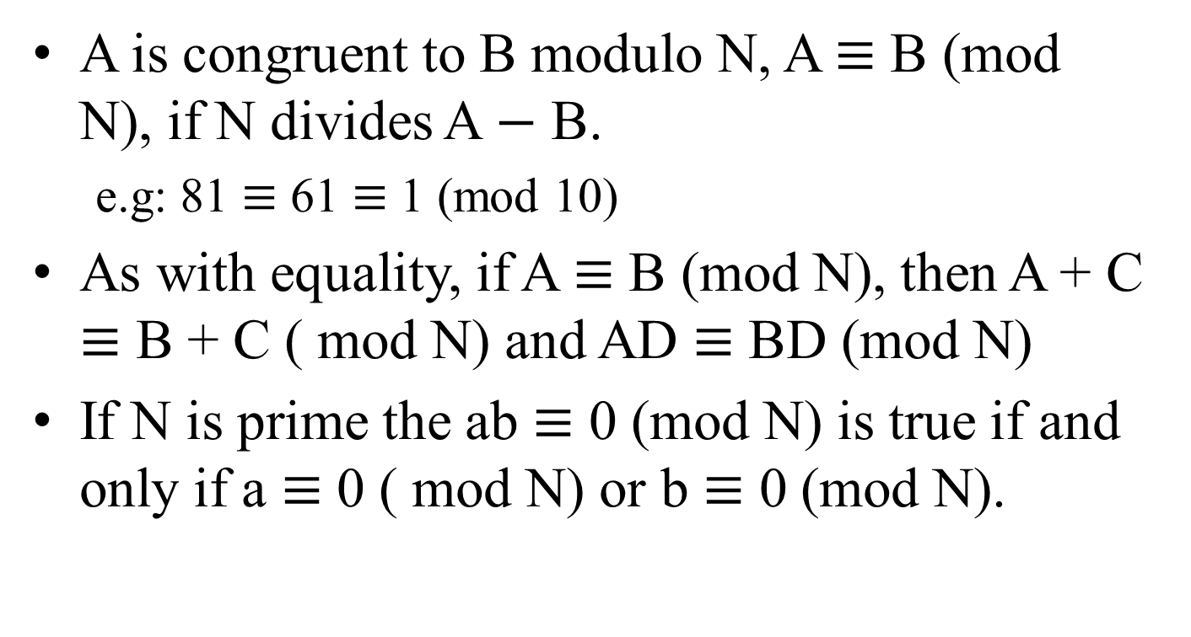

Modular Arithmetic
A is congruent to B modulo N, A $≡$ B (mod N), if N divides A $−$ B.
e.g: 81 $≡$ 61 $≡$ 1 (mod 10)
As with equality, if A $≡$ B (mod N), then A + C $≡$ B + C ( mod N) and AD $≡$ BD (mod N)
If N is prime the ab $≡$ 0 (mod N) is true if and only if a $≡$ 0 ( mod N) or b $≡$ 0 (mod N).
Notes:
This mean that the reminder is the same when either A or B is divided by N
As with equality
In other words, if a prime number N divides a product of two numbers, it divides at least one of the two numbers.

Slide 20
Recursive Definitions
Basic idea: To define objects, processes and properties in terms of simpler objects,
simpler processes or
properties of simpler objects/processes.

Slide 21
Recursive Definitions
Terminating rule - defining the object explicitly.
Recursive rules - defining the object in terms of a simpler object.
A function defined in terms of itself is recursive.
For example: x^{n} = x * x^{n-1}
x! = x * (x-1)!
Notes:
Clearly, we can see that these examples are naturally recursive

Slide 22
























Examples
Write recursive function to compute factorials N!
f(n) = n!
f(0) = 1 i.e. 0! = 1 //base case
f(n) = n * f(n-1) i.e. n! = n * (n-1)! //recursive call

Slide 23
Examples
Write recursive function to compute factorials N!
factorial(n) = n!
public static int factorial(int n)
{
if (n = = 0) // base case i.e. 0! = 1
return 1;
else
return n * factorial(n-1); // recursive call
// i.e. n! = n * (n-1)!
}
https://www.javatpoint.com/recursion-in-java

Slide 24
Example Cont’
factorial(5)
public static int factorial(int n)
{
if (n = = 1)
return 1;
else
return n * factorial(n-1);
}
factorial(5)
5 * factorial(4)
4 * factorial(3)
3 * factorial(2)
2 * factorial(1)
return 1
return 2*1 = 2
return 3*2 = 6
return 4*6 = 24
return 5*24 = 120
https://www.javatpoint.com/recursion-in-java

Slide 25


Examples
Fibonacci numbers
F(0) = 1 //base case
F(1) = 1
F(k+1) = F(k) + F(k-1) //recursive call
1, 1, 2, 3, 5, 8, ….
Notes:
We will walk through in next slides

Slide 26
RULES OF RECURSION
Base Case : You must always have some base case which can be solved without recursion
Making Progress: For the cases that are to be solved recursively, the recursive call must always be to a case that makes progress towards the base case
Design rule: Assume that all recursive calls work.
Compound interest rule: Never duplicate work by solving the same instance of a problem in separate recursive calls.
Notes:
Four Basic rules

Slide 27
Principles and Rules
Base cases: you must always have some base cases, which can be solved without recursion.
Solving the recursive function f(n) = f(n-1) + f(n-2)
Example 1
Note a base case generally kills the recursion by not allowing future recursive calls.
fib( int n) {
if (n <= 1)
return 1;
else
return fib(n-1) + fib(n-2);
}
Base Case: since at this point recursion is not needed to determine a return value.

Slide 28
Principles and Rules Cont...
Making progress: For the cases that are solved recursively, the recursive call must always be to a case that makes progress toward a base case
fib( int n) {
if (n <= 1)
return 1;
else
return fib(n-1) + fib(n-2);
}
n is reduced toward the base case.

Slide 29
Principles and Rules Cont.
Design rule: Assume that all recursive calls work.
In general the machine uses its own stack to organize the calls.
Very difficult to trace the calls.
Important to ensure the code adheres to the first two principles, this rule then takes care of itself.

Slide 30
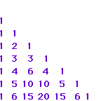
Principles and Rules Cont.
Compound interest rule: Never duplicate work by solving the same instance of a problem in separate recursive calls.
1
1
2
3
5
8
13
fib( int n) {
if (n <= 1)
return 1;
else
return fib(n-1) + fib(n-2);
}
Notes:
The reason for the poor performance is heavy push-pop of the stack memory in each recursive call.
As a result it is bad idea to use recursion to evaluate simple mathematical functions like Fibonacci numbers.
Alternative will be using iterators.

Slide 31
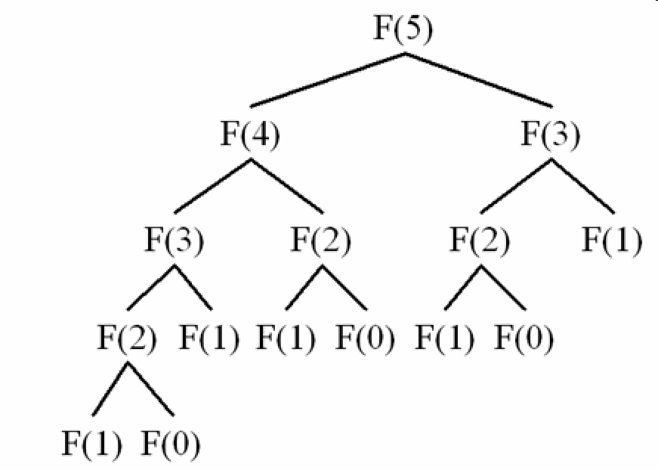
Principles and Rules Cont.
Notice:
fib(1) is recalculated.
Results in:
Slow algorithms
Increases the magnitude unnecessarily

Slide 32
END OF LECTURE 1

