Slide 1
Lecture 3 CHAPTER II Algorithm Analysis
Data Structures and Algorithm Analysis in Java 3rd Edition by Mark Allen Weiss
Notes:
Algorithms is set of instructions to solve a specific problem.
There might multiple ways to solve the problem…
And all the ways correctly solve the problem.
so before jumping into code it is worthwhile to analyze algorithm based on resources needed to solve the problem
in terms of time or space based on input

Slide 2
What is An Algorithm?
Step-by-step instructions to solve a specific problem
There can give multiple algorithms to solve a problem
How do you determine which one is best?
Time
Space
Asymptotic Notation
Notes:
Algorithmic bottlenecks.
For the same problem, one algorithm may take several days to finish, while another may only take several seconds.
Asymptotic Notation: how much time it will take as the input is getting bigger and bigger and almost going to infinity

Slide 3
Big-Oh and Other Notations in Algorithm Analysis
Classifying Functions by Their Asymptotic Growth
Theta, Little oh, Little omega
Big Oh, Big Omega
Rules to manipulate Big-Oh expressions
Typical Growth Rates

Slide 4
Classifying Functions by Their Asymptotic Growth
Asymptotic growth : The growth rate of a function
Given a particular differentiable function f(n), all other differentiable functions fall into three classes:
.growing with the same rate
.growing faster
.growing slower
Notes:
Here we are just talking about math not about the algorithm aspects
Same rate as f(x)

Slide 5
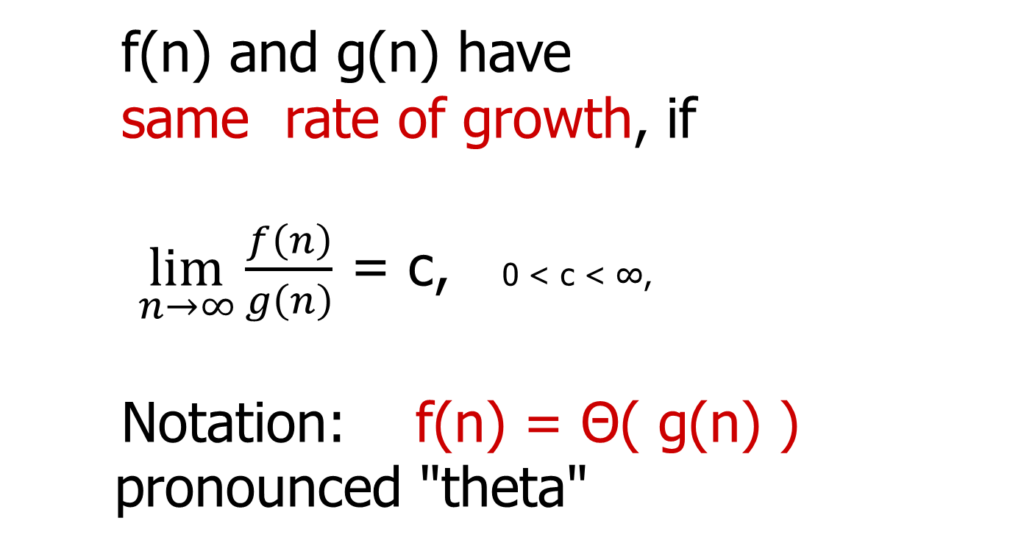
Theta
f(n) and g(n) have
same rate of growth, if
$\lim_{n→∞}\frac{f\left(n\right)}{g\left(n\right)}$ = c, 0 < c < ∞,
Notation: f(n) = Θ( g(n) )
pronounced "theta"
Notes:
If the output is constat

Slide 6
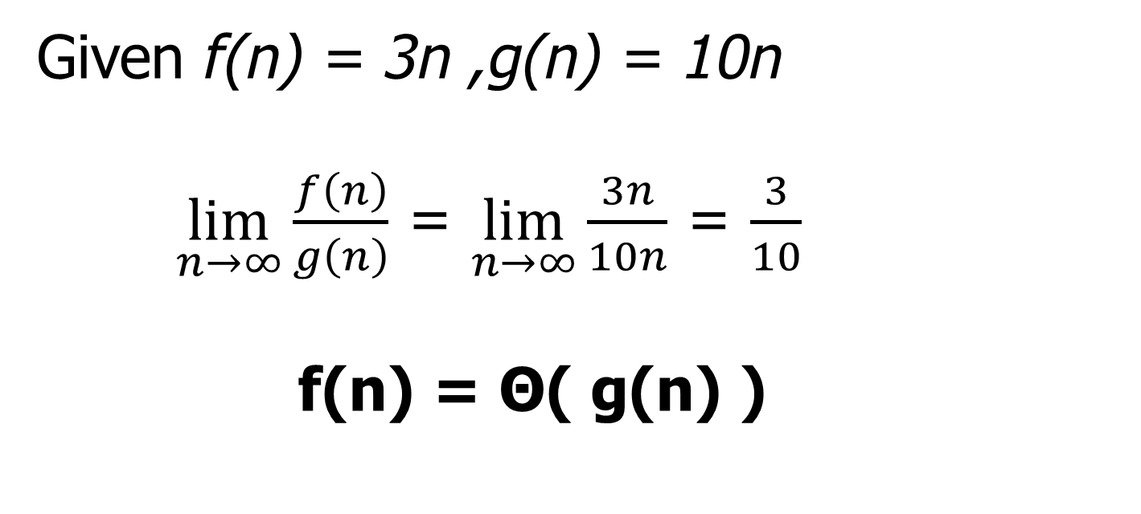
Theta
Given f(n) = 3n ,g(n) = 10n
$\lim_{n→∞}\frac{f\left(n\right)}{g\left(n\right)}$ = $\lim_{n→∞}\frac{3n}{10n}$ = $\frac{3}{10}$
f(n) = Θ( g(n) )
Notes:
If the output is constat

Slide 7
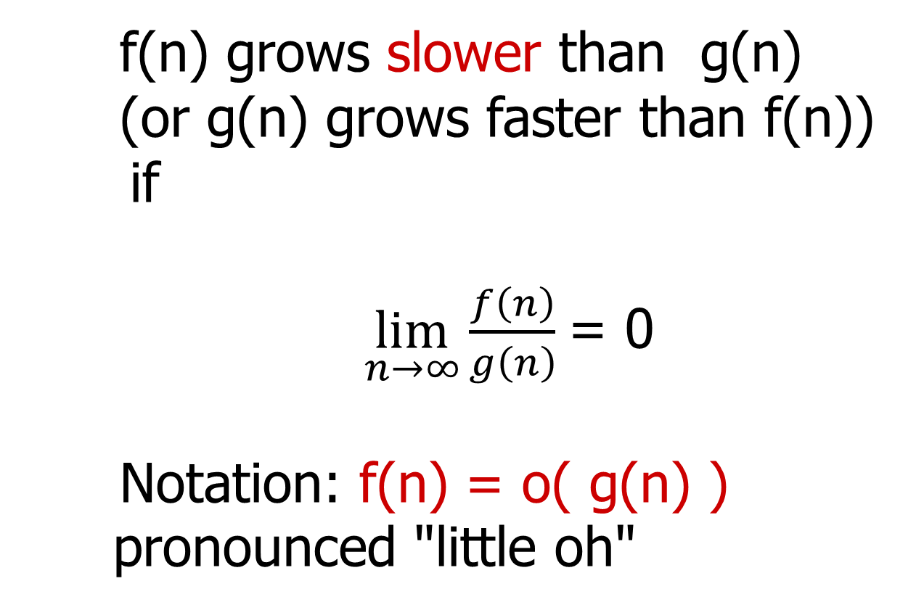
Little oh
f(n) grows slower than g(n)
(or g(n) grows faster than f(n))
if
$\lim_{n→∞}\frac{f\left(n\right)}{g\left(n\right)}$= 0
Notation: f(n) = o( g(n) )
pronounced "little oh"
Notes:
G(n) is faster.. F(n) is sovler

Slide 8
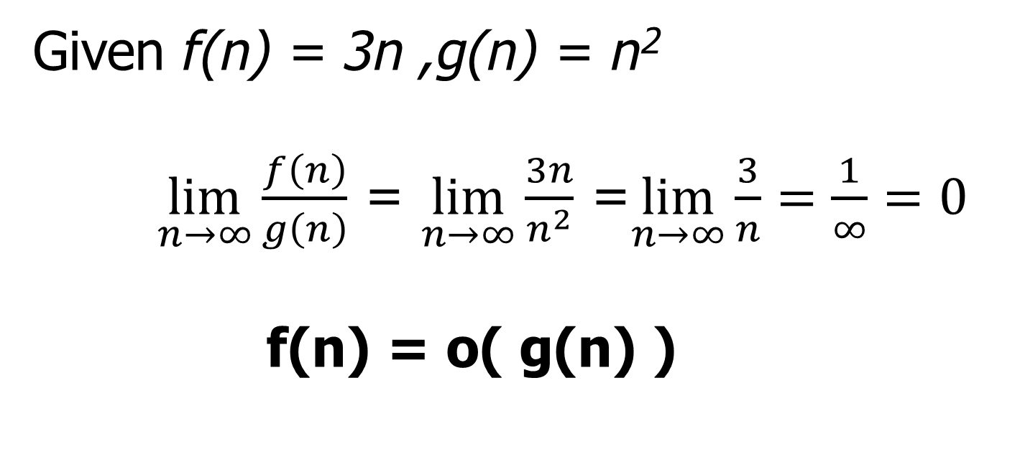
Little oh
Given f(n) = 3n ,g(n) = n²
$\lim_{n→∞}\frac{f\left(n\right)}{g\left(n\right)}$ = $\lim_{n→∞}\frac{3n}{n^{2}}$ =$\lim_{n→∞}\frac{3}{n}=\frac{1}{∞}=0$
f(n) = o( g(n) )
Notes:
G(n) is faster.. F(n) is sovler

Slide 9
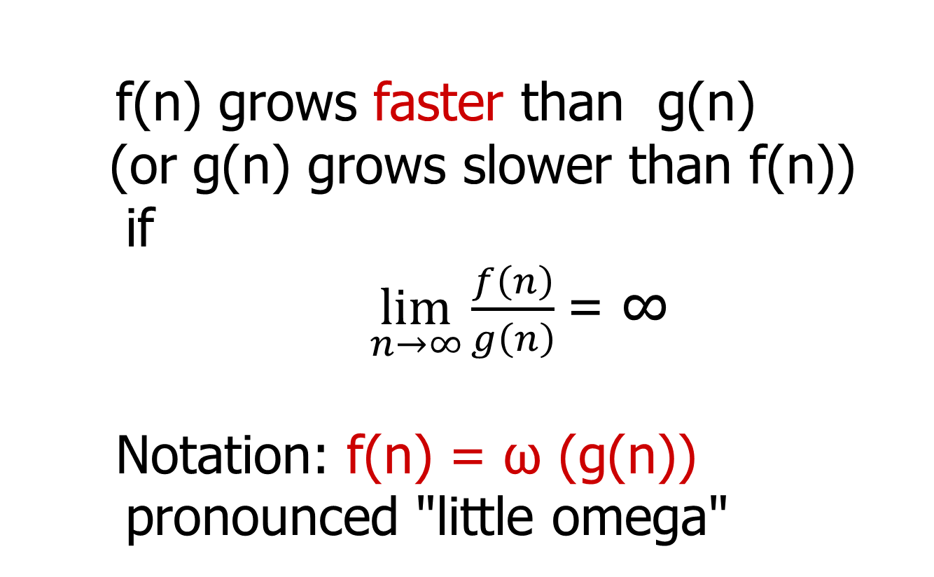
Little omega
f(n) grows faster than g(n)
(or g(n) grows slower than f(n))
if
$\lim_{n→∞}\frac{f\left(n\right)}{g\left(n\right)}$= ∞
Notation: f(n) = ω (g(n))
pronounced "little omega"
Notes:
As computer

Slide 10
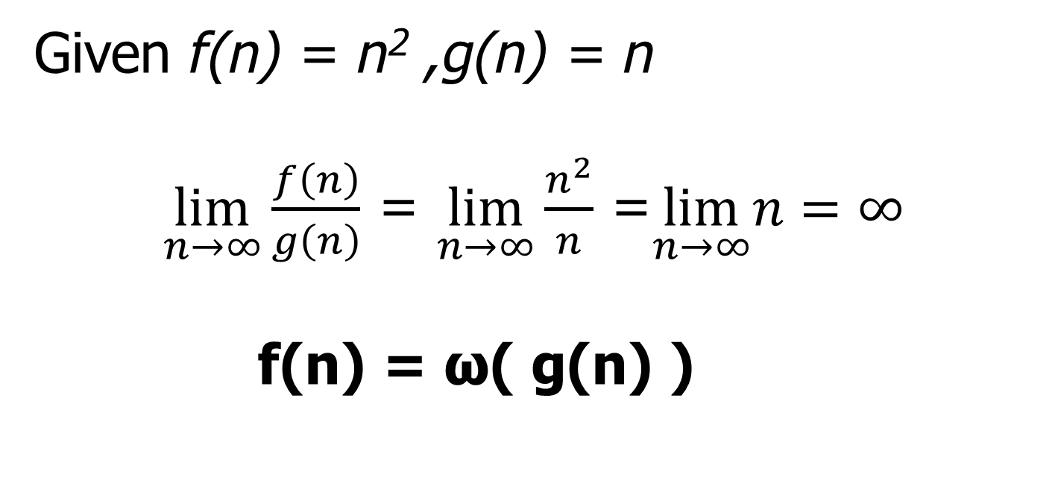
Little omega
Given f(n) = n² ,g(n) = n
$\lim_{n→∞}\frac{f\left(n\right)}{g\left(n\right)}$ = $\lim_{n→∞}\frac{n^{2}}{n}$ =$\lim_{n→∞}n=∞$
f(n) = ω( g(n) )
Notes:
This is mirror of small oh
f(n) is faster.. g(n) is slower

Slide 11
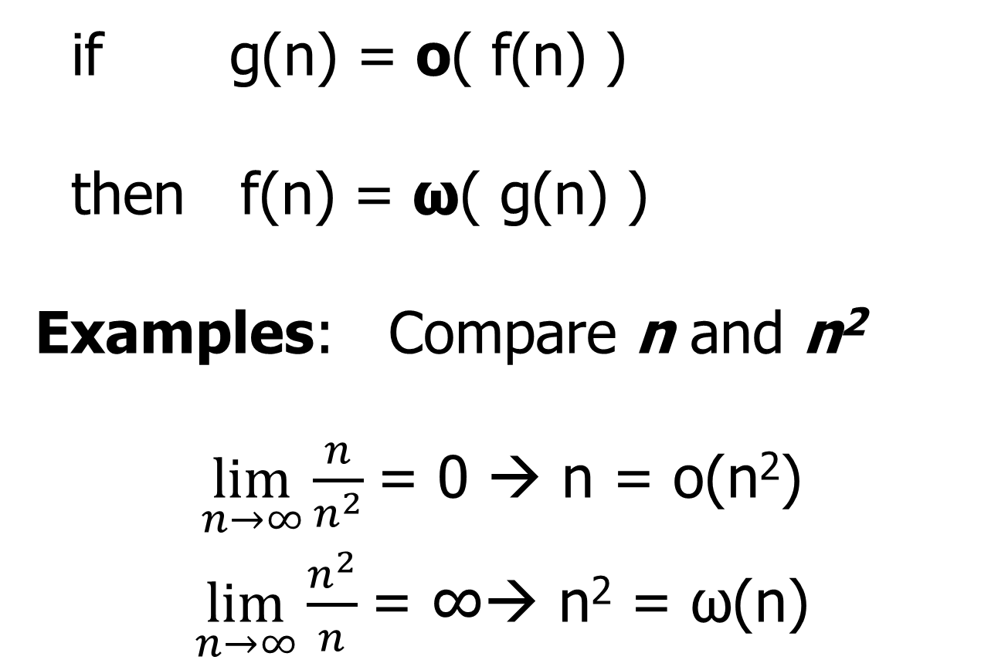
Little omega and Little oh
if g(n) = o( f(n) )
then f(n) = ω( g(n) )
Examples: Compare n and n²
$\lim_{n→∞}\frac{n}{n^{2}}$= 0 → n = o(n²)
$\lim_{n→∞}\frac{n^{2}}{n}$= ∞→ n² = ω(n)
Notes:
Oh faster inside and omega slower inside… mirror image

Slide 12
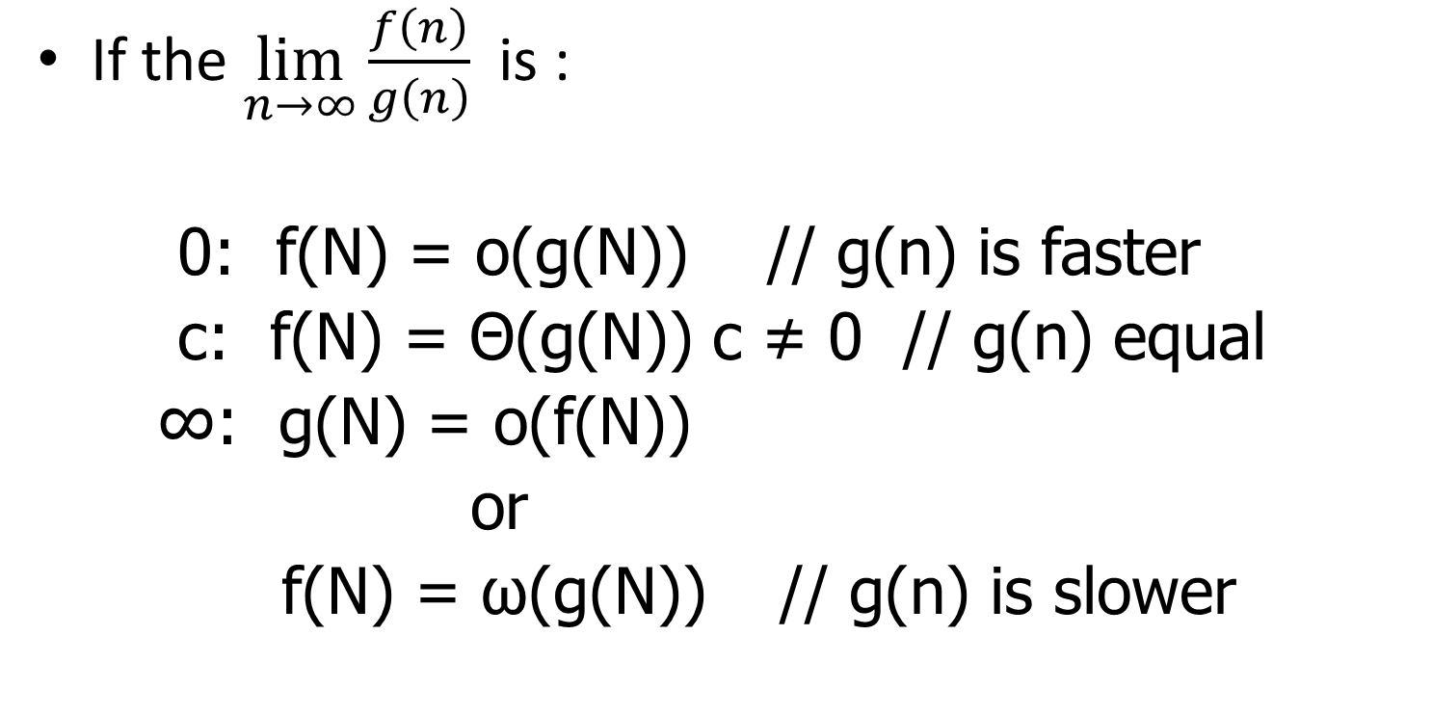
Summary of Relative Growth Rates
If the $\lim_{n→∞}\frac{f\left(n\right)}{g\left(n\right)}$ is :
0: f(N) = o(g(N)) // g(n) is faster
c: f(N) = Θ(g(N)) c ≠ 0 // g(n) equal
∞: g(N) = o(f(N))
or
f(N) = ω(g(N)) // g(n) is slower

Slide 13
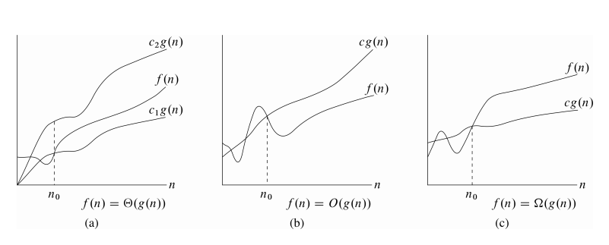
Mathematical Background
cs.utsa.edu/~bylander/
Notes:
We use mathematical approach to estimate the resource use of an algorithm.
Omega mirror of Big O

Slide 14
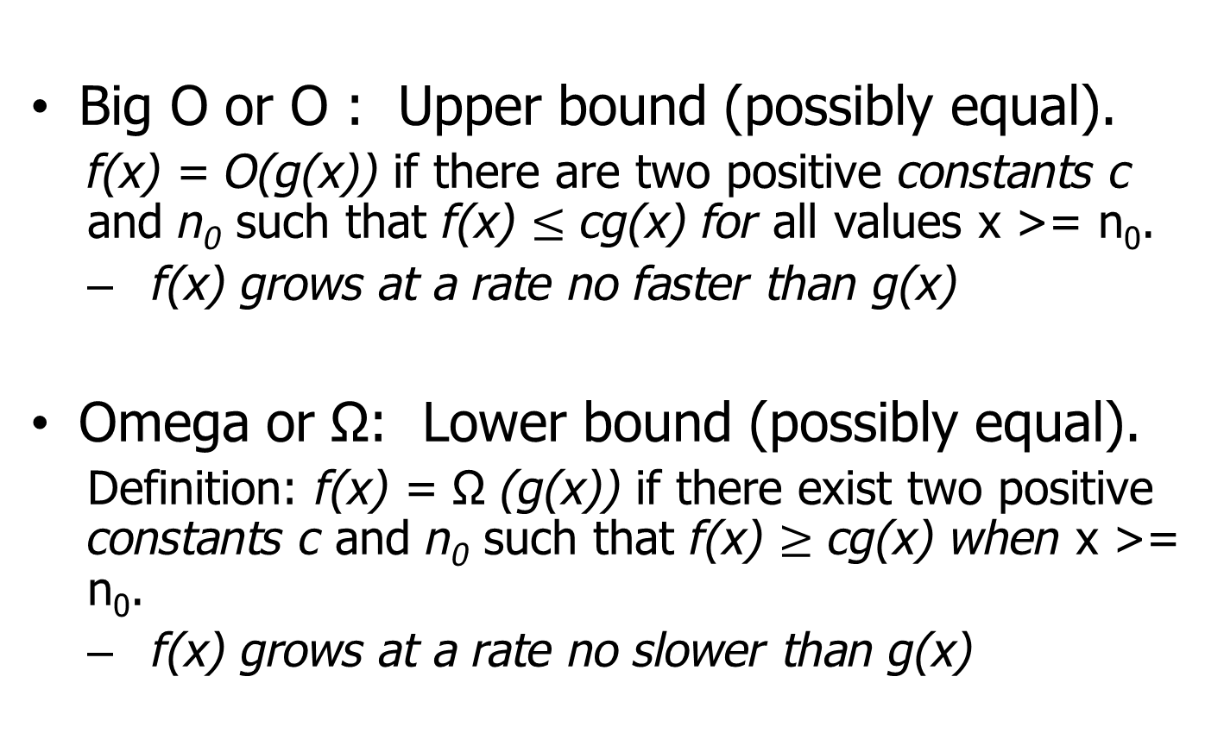
Mathematical Background
Big O or O : Upper bound (possibly equal).
f(x) = O(g(x)) if there are two positive constants c and n₀ such that f(x) $≤$ cg(x) for all values x >= n₀.
f(x) grows at a rate no faster than g(x)
Omega or Ω: Lower bound (possibly equal).
Definition: f(x) = Ω (g(x)) if there exist two positive constants c and n₀ such that f(x) $≥$ cg(x) when x >= n₀.
f(x) grows at a rate no slower than g(x)
Notes:
We use mathematical approach to estimate the resource use of an algorithm.
Omega mirror of Big O

Slide 15
Mathematical Background
Big O or O : Upper bound (possibly equal).
f(x) = O(g(x)) if there are two positive constants c and n₀ such that f(x) $≤$ cg(x) for all values x >= n₀.
f(x) grows at a rate no faster than g(x)
Omega or Ω: Lower bound (possibly equal).
Definition: f(x) = Ω (g(x)) if there exist two positive constants c and n₀ such that f(x) $≥$ cg(x) when x >= n₀.
f(x) grows at a rate no slower than g(x)
Notes:
We use mathematical approach to estimate the resource use of an algorithm.
Omega mirror of Big O

Slide 16
Mathematical Background
Theta or Θ Growth rates are equal.
Definition: f(x) = Θ (g(x)) if there exists three constants c1>0,c2>0, n₀ ≥0 such that
c₁g(x) ≤ f(x) ≤ c₂g(x) for x >= n₀.
Little o or o. Upper bound (not equal).
Definition: f(x) = o(g(x)) if f(x) = O(g(x)) and f(x) = Θ(g(x))
g(x) is faster then f(x) growth
Notes:
We use mathematical approach to estimate the resource use of an algorithm.
Theta and little o are tighest

Slide 17
Theta: Relation of Equivalence
R: "having the same rate of growth":
relation of equivalence,
gives a partition over the set of all differentiable functions - classes of equivalence.
Functions in one and the same class are equivalent with respect to their growth.
Notes:
skipped

Slide 18
Algorithms with Same Complexity
Two algorithms have same complexity,
if the functions representing the number of operations have
same rate of growth.
Among all functions with same rate of growth we choose the simplest one to represent the complexity.

Slide 19
Examples
Compare n and (n+1)/2
lim( n / ((n+1)/2 )) = 2,
same rate of growth
(n+1)/2 = Θ(n)
- rate of growth of a linear function
Notes:
Simiplest form… so additive or multiplication constant are eliminated..
for

Slide 20
Examples
Compare n² and n²+ 6n
lim( n² / (n²+ 6n ) )= 1
same rate of growth.
n²+6n = Θ(n²)
rate of growth of a quadratic function

Slide 21
Examples
Compare log n and log n²
lim( log n / log n² ) = 1/2
same rate of growth.
log n² = Θ(log n)
logarithmic rate of growth
Notes:
Because of the constant rule

Slide 22
Examples
Θ(n³): n³
5n³+ 4n
105n³+ 4n² + 6n
Θ(n²): n²
5n²+ 4n + 6
n² + 5
Θ(log n): log n
log n²
log (n + n³)
Notes:
Omit the constat… as we are interested in big number going to infinity

Slide 23
Comparing Functions
same rate of growth: g(n) = Θ(f(n))
different rate of growth:
either g(n) = o (f(n))
g(n) grows slower than f(n),
and hence f(n) = ω(g(n))
or g(n) = ω (f(n))
g(n) grows faster than f(n),
and hence f(n) = o(g(n))

Slide 24
The Big-Oh Notation
f(n) = O(g(n))
if f(n) grows with
same rate or slower than g(n).
f(n) = Θ(g(n)) or
f(n) = o(g(n))
Notes:
Small oh, small omega and theta → specific and clear
BigOh and Big little bit ambuniogous

Slide 25
Example
n+5 = Θ(n) = O(n) = O(n²)
= O(n³) = O(n⁵)
the closest estimation: n+5 = Θ(n)
the general practice is to use
the Big-Oh notation:
n+5 = O(n)
Notes:
Big Oh same or faster.
Theta will give tightest specific →theta(n).
… practice to give tigest one

Slide 26
The Big-Omega Notation
The inverse of Big-Oh is Ω
If g(n) = O(f(n)),
then f(n) = Ω (g(n))
f(n) grows faster or with the same rate as g(n): f(n) = Ω (g(n))
Notes:
Big Oh and Big Omega are ambiguous same or faster growth

Slide 27
Rules to manipulate Big-Oh expressions
Rule 1:
a. If T1 (N) = O(f(N)) and T2(N) = O(g(N))
then
T1(N) + T2(N) = max( O( f (N) ), O( g(N) ) )
Eg: n² +10 = O(n²)
50n³ +45n⁵+60n+100 = O(n⁵)
Notes:
Examples ..c n^2+10 +20 -→ O(n^2)
50n3 +45n^5+60n+100 → O(n3)
50n2logn +…. -> O(
b. When you multiple two functions Big Oh will be be multiplied

Slide 28
Rules to manipulate Big-Oh expressions
b. If T1(N) = O( f(N) ) and T2(N) = O( g(N) )
then
T1(N) * T2(N) = O( f(N)* g(N) )
Eg: 10n² * 10n² = O(n⁵)
Notes:
Examples ..c n^2+10 +20 -→ O(n^2)
50n3 +45n^5+60n+100 → O(n3)
50n2logn +…. -> O(
b. When you multiple two functions Big Oh will be be multiplied

Slide 29
Rules to manipulate Big-Oh expressions
Rule 2:
If T(N) is a polynomial of degree k,
then
T(N) = Θ( N^{k} )
Rule 3:
log ^{k} N = O(N) for any constant k.
Notes:
28 min recoding
Rule 3: tell us that logarithms grow very slowly

Slide 30
Examples
n² + n = O(n²)
we disregard any lower-order term
nlog(n) = O(nlog(n))
n² + nlog(n) = O(n²)
Notes:
2nd …. Multiplication holds
Addition.. We will take largest

Slide 31
Typical Growth Rates
C constant, we write O(1)
logN logarithmic
log²N log-squared
N linear
NlogN
N² quadratic
N³ cubic
2^{N} exponential
N! factorial
Notes:
Example of constant algorithm:
Datastrcuture … given arraylist… to retrieve by index… it doesn’t matter if there 10 or 100 or 1000000 the retreiveing always be constant
Any logarithm algorithm that constant → binary search Tree
Linear algorithm → iterate through array .. Search through a array O(N) because it is not sorted… best time will O(1)
NlogN → lot of sorting such as mergesort.. Heapsort
N^2 → some sorting
2^N → exponential algorithms → tower of Hanoi with three columns and disks to sort
N! → eight queen problem → on chess board .. So safely place queen on chess, if not safe backtraverse.. 8 queens so → 8!

Slide 32
Problems
N² = O(N²) true
2N = O(N²) true
N = O(N²) true
N² = O(N) false
2N = O(N) true
N = O(N) true

Slide 33
Problems
N² = Θ (N²) true
2N = Θ (N²) false
N = Θ (N²) false
N² = Θ (N) false
2N = Θ (N) true
N = Θ (N) true
Notes:
Equal… neither bigger or smaller
stop

Slide 34
Style
Lower-order terms are ignored: 3N³ + N² + N + 6 is O(N³)
Why? Because the 3N³ causes the function to grow at a cubic rate. The N² , N and 5 contribute some but the growth rate is cubic.

Slide 35
Model
To analyze algorithms, we use a conceptual model of a computer.
In this model, all operations take one unit of time, and model has infinite memory.
With this the analysis is focused on the algorithm, independent of any machine.
Of course, other factors may be important in an actual implementation such reading data, which is bottleneck.
Notes:
All operations will be assignment, addition, substraction.

Slide 36
What to Analyze
The most important thing to analyze is running time.
Algorithm
Size of the input
Two Functions can be calculated on an algorithm on input of size N:
T_{avg}(N)
T_{worst}(N)
Typically we analyze worst-case, Big Oh, performance since it bound for all possible inputs.
Best-case is less useful since it probably is rare
Average-case is much more difficult to analyze since it may be hard to define what data would be considered average.
Notes:
The really bounds will be focused on algorithm and input size rather than the program language that is used.

Slide 37
What to Analyze
Running Time
Algorithm
Input
Two Functions can be calculated on an algorithm on input of size N:
T_{avg}(N)
T_{worst}(N)
Notes:
We are dealing with a theoretical model of a computer with fixed size integers and there are no fancy operations like matrix inverse or sorting. We assume infinite memory.
Often time it is difficult to analyze average time. Best case is of little interest. Worst case performance represents a guarantee Avg case reflects typical behavior.

Slide 38
What to Analyze
We use Java code in the examples but the analysis really should be language-independent.
Notice that for small inputs, the difference between algorithms may not matter.
Also, in an actual setting, the time to read the input may be the bottleneck.

Slide 39

Maximum Subsequent Sum Problem
Given integers A₁, A₂,…., A_{N}, find the maximum value of
Ex: For input -2, 11, -4, 13,-5, -2
Maximum subsequence sum is 20 from
-2, 11, -4, 13,-5, -2
Four algorithmic solution with different running time : O(N³), O(N²), O(NlogN) and O(N)
Notes:
For convenience, the maximum subsequence sum is 0 if all the integers are negative.
Next time use this example style: https://www.google.com/search?q=maximum+subsequence+sum&tbm=isch&source=iu&ictx=1&fir=YPCy8GggaOXTxM%253A%252C9nBXj3qD_6El3M%252C_&vet=1&usg=AI4_-kRnQTOZX9bThoMhGNxVbJ6kF-CRuQ&sa=X&ved=2ahUKEwialrnBmrfkAhVJMqwKHReTBJoQ9QEwAHoECAcQAw#imgrc=0t6etkE9ifaFoM:&vet=1

Slide 40
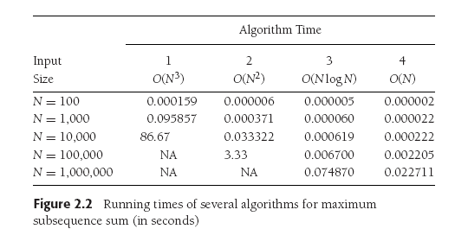
Notes:
For a small amount of input, the algorithms all run quick.
If we expect small inputs all time, it is silly to expend a great deal to get most efficient algorithm.
However, with large markets and data, a lot of software jobs are focused on rewriting existing program that are no –longer valid assumption of small input size.

Slide 41
Notes:
Algorithm 4 Linear increase in input size by 10 will increase run time by 10
Algorithm2: 10 times increase in input → 100 fold increase in run time
Algorithm 1: 10 times increase in input → 1000 fold increase in run time
Although Nlog N seems linear… remember this is small values.

Slide 42
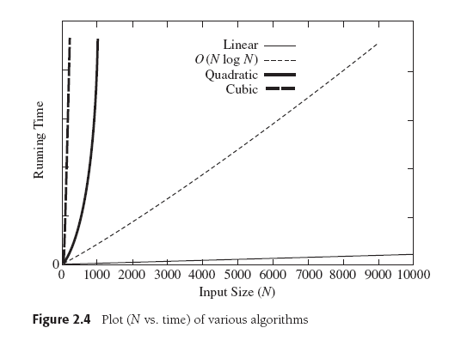
Notes:
Shows clear different how algorithm 4 is best and others are inefficient for large input size

Slide 43
Running Time Calculation
Algorithmic ideas and run time calculation will provide insights in to designing efficient algorithms
Running time analysis can be done by calculating Big Oh running time.
Ignore leading constants
Ignore low-order terms
Big Oh guarantees that the program will terminate within a certain time period as it is upper bound.

Slide 44
Example
Sample Program to calculate
public static int sum( int n) {
int partialSum;
partialSum = 0;
for(int i =1; i <=n ; i++)
partialSum += i * i * i ;
return partialSum;
}
1
2
3
4
//1 unit
// 1 + (n+1) + n
// 4 units * n
//1 unit
the result is O(n) : 1 + (2n+2) + 4n + 1 = 6n+4
Notes:
Line 1 and 4: one unit of time = 2
Line 3: 4 units for each iteration : 2 multiplocaiton , 1 addition, and 1 assignment and it will executed N times = 4N
The for statement : 2N + 2 , costs one for initializing , N+1 for testing, N times incrementing , = 2N+2
2 multipilcation and one addition and one assignment = 4 performed N times = 4N
Line 1 and 4 1 each so total of 6N+4
Which is O(N)

Slide 45
General Rules
Rule 1 : for loops:
Rule 2: Nested loops
Rule 3: Consecutive Statements
Rule 4- if/else

Slide 46
Rule 1: for loops
Running time of a for loop =
running time of statements inside the loop
*
number of iterations

Slide 47
Rule 2: Nested Loops
Analyze inside out
Running time of statements inside times the product of loop sizes.
Example
for(i=0; i < n ; i++)
for(j=0; j<n ; j++)
k++;
The program fragment is O(N²)
Notes:
Total running time of a statement inside a group of nested loops is the running time of the statement multiplied by the product of the sizes of all the loops

Slide 48
Rule 3: Consecutive Statements
Add them, which means take the maximum
for(i=0; i < n; i++)
a[i] = 0;
for(i=0; i<n; i++)
for(j=0; j <n; j++)
a[i] += a[j] +i +j;
O(N) work followed by O(N²) work, so use the maximum

Slide 49
O(N) Calculation
Let T1(N) and T2(N) be the number of operations necessary to run two program segments respectively, and let T1 = O(g1(N)), T2 = O(g2(N)).
T1(N) + T2(N) = max(O(g1(N)), O(g2(N)))
where max(O(g1(N)), O(g2(N))) is determined in the following way:
If g1(N) = O(g2(N)), then max(O(g1(N)), O(g2(N))) = O(g2(N)) If g2(N) = O(g1(N)), then max(O(g1(N)), O(g2(N))) = O(g1(N))
Example: max(O(n²),O(n³)) = O(n³).

Slide 50
Rule 4 : if/else
For Example
if (condition)
S1
else
S2
Running time = running time of the test + max running time of S1&S2

Slide 51



















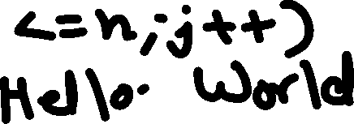


















Slide 52






























Slide 53











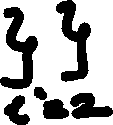
















































Slide 54




















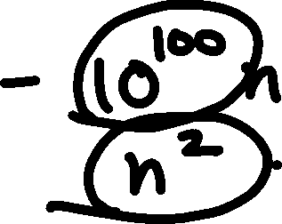






Slide 55























































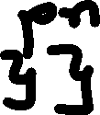





Slide 56
































Slide 57









































Slide 58




