Slide 1
CHAPTER 3
Data Structures and Algorithm Analysis in Java 3rd Edition by Mark Allen Weiss

Slide 2
ABSTRACT DATA TYPES
An abstract data type is a set of objects with a set of operations.
Focused on defining the operations but not the implementation of the operations.
Classes implement ADTs, separating the interface from the implementation.
Objects such as lists, sets and graphs, along with their operations can be viewed as ADTs.
ADTs is focused on what should happen not how the implementation of operations.
Notes:
Like Integer , Boolean have operation

Slide 3
ADTs
The List ADT
The Stack ADT
The Queue ADT
Notes:
Primary examples of ADT

Slide 4
The List ADT
General List : A₀, A₁, A₂,…A_{i-1}, A_{i}, A_{i+1}, … ,A_{N-1} Size = N
List of size zero is called empty list
The Position of element A_{i} in a list is i
Notes:
Ordered set of elements

Slide 5
Operations on List ADT
printList
makeEmpty
Find
returns position of first occurrence
Insert
Insert element at a specific position
Remove
remove element at a specific position
findKth
Return element at kth position
Notes:
Operations or methods

Slide 6
Example
List : 34, 12, 52, 16, 12
find(52) = 2
insert(60,2) will make list : insert and shift to right
34, 12, 60, 52, 16, 12
remove (52) will make list: remove and shift to the left
34, 12, 60, 16, 12
Notes:
We are showing what should happened… how it happened will depend on the user implementation

Slide 7
Array Implementation of List
int [] arr = new int[10];
…
//Later on we decide arr needs to be large.
int [] newArr = new int[arr.length*2];
for(i=0; i<arr.length; i++)
newArr[i] = arr[i];
arr = newArr

Slide 8
Array Implementation of List
The findKth operation takes constant time, O(1).
Similarly, removing and adding from the end of array is constant time, O(1).
An array implementation allows printList to be carried out in Linear Time O(N)
insertion and deletion takes O(N)
If insertion and deletion occur throughout the list including at the front of the list, then the array is not a good option.
Notes:
Insertion and deletion → need to shift existing values.. O(N-1) or (N+1) → O(N)

Slide 9
Array Implementation of List
An array implementation allows printList to be carried out in Linear Time O(N)
insertion and deletion takes O(N)
Worst case move all elements. (index = 0)
If insertion and deletion occur throughout the list including at the front of the list, then the array is not a good option.
Notes:
Insertion and deletion → need to shift existing values.. O(N-1) or (N+1) → O(N)

Slide 10

LINKED LIST
The linked list consist of series of nodes which are not necessarily adjacent in the memory.

Slide 11
Linked List
printList and find(X) are O(N)
Linked List not indexed, need to traverse the list from beginning to end.
findKth(i) takes O(i)

Slide 12
remove
The remove method can be executed in one next reference change.
Notes:
Other why it will take + time to go to the particular node.

Slide 13
insert
The insert method requires obtaining a new node from system by using a new call and then executing two reference maneuvers.

Slide 14
DOUBLY LINKED LIST
We have every node maintain a link to its previous node in the list and one pointing to next node in the list.
Storage cost increase because of extra pointer
Notes:
More advantage → bidirectional
Disadvantage → more space ( because two pointer prev and tail)

Slide 15
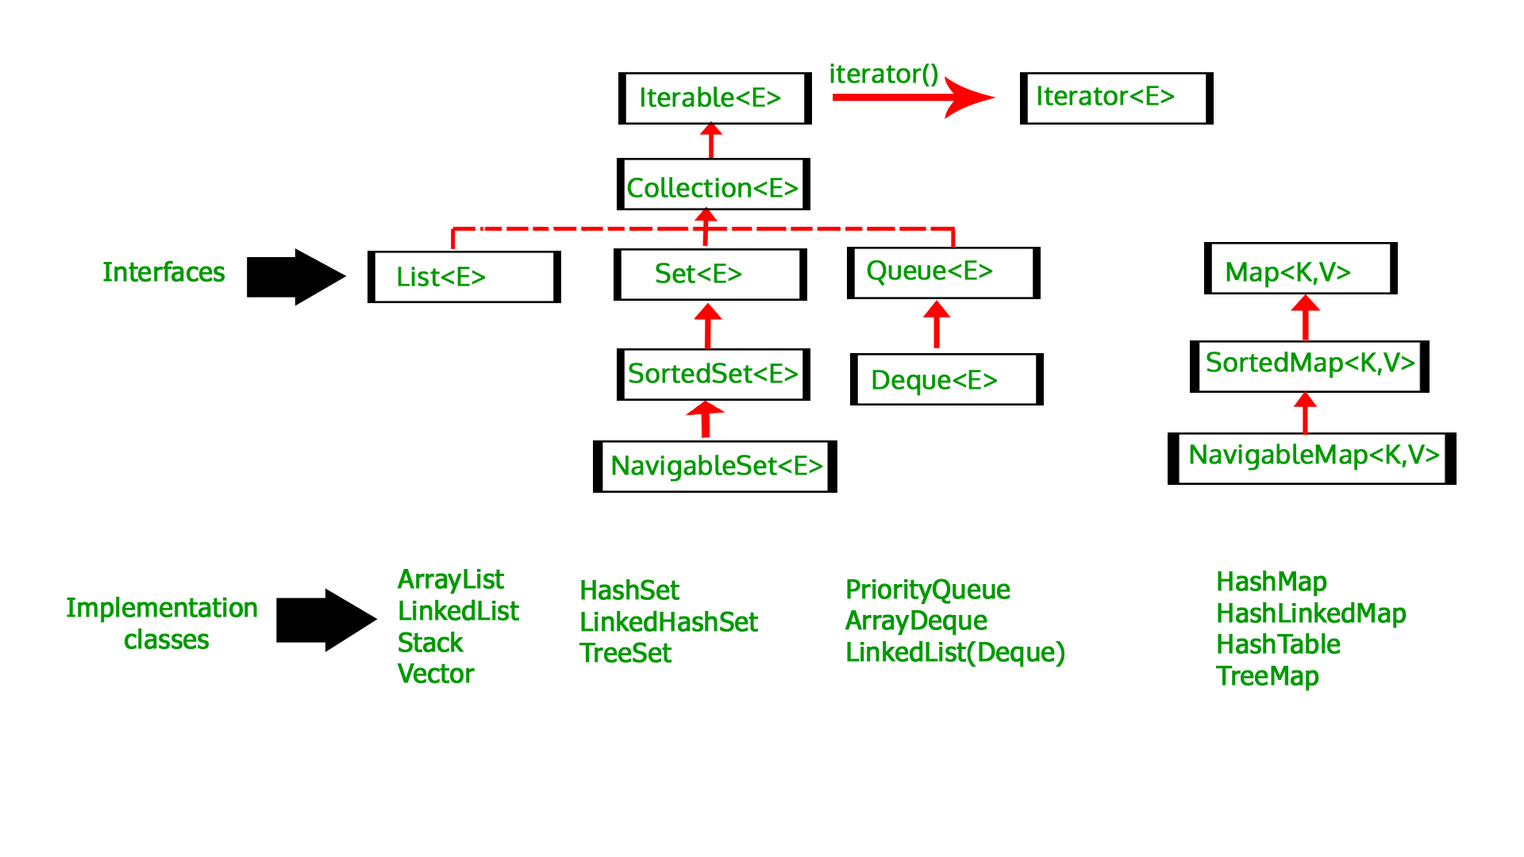
Java Collections API
The Java language includes, in its library, an implementation of common data structures.
This part of the language is popularly known as the Collection API.
The List ADT is one of the data structures implemented in Collection API
Notes:
We will look how they are implemented using Java Collection.
It has List interface and Array

Slide 16
Collection Interface
The Collection API resides in the package java.util.
A collection stores objects of same type
It has methods like
isEmpty
size
contains
add
remove
The Collection interface extends Iterable interface for iterating through the collection.
Notes:
Include image of Collection API what is part of it.
All abstract methods so Collection in interfaces.
IMP collection extends to Iterable

Slide 17
Notes:
We will look how they are implemented using Java Collection.
It has List interface and Array

Slide 18
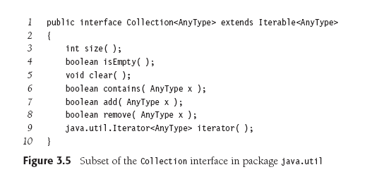
Collections Interface
Interface inheritance from interface → extends
Notes:
Generics.
Class inheritance for interface → extends
Interface inheritance from interface → extends

Slide 19
Iterable Interface
The Collection interface extends Iterable interface.
Classes that implement Iterable interface can have enhanced for loop.
Collections that implement Iterable interface must provide a method named Iterator that returns an object of type Iterator.
Notes:
Another interface → one abstract method Iterator with

Slide 20
Iterator Interface
Notes:
What should happen.
Implementation depends on either using arraylist or linkedlist
Iterator will start from beginning of the list and iterate or traverse through the list
When using next()-→ start with beginning of the list → return 1st element and moves the pointer… no change to list
*When using iterator can’t make modification to list using collection list… collection methods will work but will invalidate iterator and can no logner can be used:
board

Slide 21
Iterators
Enhanced for-loops use iterators.
The remove method on an iterator is preferred over the remove method of a collection because the iterator already has the item’s position.
An iterator’s remove will remove the last item returned by the iterator’s next() method.
You must then call next() again before calling remove().

Slide 22
Iterator Interface
Limited number of methods.
The remove method on an iterator is preferred over the remove method of a collection because the iterator already has the item’s position.
remove : can remove the last item returned by next ( after which you cannot call remove again until after another call to next)
Fundamental rule: If the collection is changed using its own methods, it invalidates the iterator.
This is another advantage of calling the remove() method of an iterator, as it does not invalidate the iterator.

Slide 23
Enhanced for loop
Notes:
For any collections → for each loop → for every element in the given collections
This type of loop can only be used Iterable object.
Always starts at the beginning of collection goes one by one. Won’t work if you want skip some elements

Slide 24
Enhanced for loop in Iterable type

Slide 25
List Interface, ArrayList and LinkedList
The List interface extends Collection interface.
it contains all methods in Collection and few others.
get
set
add
remove
listIterator()
Notes:
Sub interface of Collection.
listIterator()is sub interface of iterator and will have more methods..then the 3 methods from Iterator interface

Slide 26
List interface

Slide 27
List Interface
add will add an item at the index location, pushing other members down the list.
An add at position 0 adds to the front of the list.

Slide 28
Implementation of List ADT
ArrayList provides a growable array implementation of List.
Advantage: get() and set() are constant time
Disadvantage: insertion and deletion are expensive
Especially at the beginning
LinkedList
doubly linked list implementation
Advantage: insertion and removing is cheap
Disadvantage: get() and set() are expensive O(N)
Especially at the beginning

Slide 29
Comparing ArrayList and LinkedList
public static void makeList1(List<integer> lst, int N)
{
lst.clear();
for( int i = 0; i< N; i++)
lst.add( i ) ;
}
ArrayList will take O(N) because the end can be referenced in constant time, and the loop has N iterations.
LinkedList is O(N) since it has a reference to the last node, so references to the end take constant time, with N iterations.
Notes:
Need to give what is worst case for Arraylist and LinkedList(double).
Space isn’t a issue
For both of them O(N) constant. Add to end of the list.

Slide 30
Comparing ArrayList and LinkedList
public static void makeList2(List<integer> lst, int N)
{
lst.clear();
for( int i = 0; i< N; i++)
lst.add( 0, i ); //add to front of list
}
ArrayList will take O(N²) because the adding to the front requires moving the other elements down, which takes O(N) time, and there are N iterations.
LinkedList will take O(N) since adding to the front only requires O(1) time, with N iterations.
Notes:
Add at the beginning of list
Arraylist: each add will be expensive as need to push elements in the list .. Each add (n) and n times O(N^2)
Linked list O(N)

Slide 31
Comparing ArrayList and LinkedList
public static int sum(List<integer> lst)
{
int total = 0 ;
for( int i = 0; i < N; i++)
total = total + lst.get( i ) ;
}
ArrayList will take O(N) because getting a value at an index position is O(1), with O(N) iterations.
LinkedList will take O(N²) since getting the ith value takes O(N) time, with O(N) iterations.
Notes:
Compute the sum of the numbers
Just the get method Arraylist : O(N) // each get is constant and we will do for N elements
LinkedList O(N^2) → n jumps to different memory locations

Slide 32
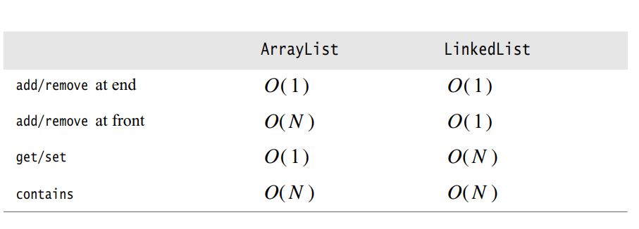
Comparing ArrayList and LinkedList
Data Structures and Algorithm Analysis in JAVA 4th edition by Mark Weiss
Notes:
Compute the sum of the numbers
Just the get method Arraylist : O(N) // each get is constant and we will do for N elements
LinkedList O(N^2) → n jumps to different memory locations

