Slide 1
Prediction Model of Graduate Enrollment Rate Based on Improved Random Forest
Yumin Zhen, Bincheng Xu, Hui Zhong
18126362, 18126341, 18126363

Slide 2
01.Project Introduction
02.Data Set Introduction
Directory
03.Data Analysis
04.Algorithms And Techniques
05. Experimental Results And Analysis
06. Conclusion

Slide 3
Project Introduction
01
PART ONE

Slide 4
Project Introduction
01
Background:
The research direction of this paper is to forecast the admission rate of graduate students based on the actual needs of students applying for postgraduate study in the United States. Through data mining technology, students’ performance data are taken as eigenvectors, so that students can have a fair understanding of their own opportunities to be recognized by a university, thus providing decision support for their choice of admission.

Slide 5
Project Introduction
01
The Idea of The Project Implementation:
We select the decision trees with good classification performance in the random forest model for similarity calculation, and form a new random forest model according to the decision trees with different similarity. On this basis, we carried out parameter tuning through the depth of different random forests, and used SMOTE technology to analyze a small number of samples and artificially synthesize new samples according to a small number of samples and add them to the data set, so as to achieve our final random forest improvement and improve the prediction ability of graduate admission.

Slide 6
Dataset introduction
02
PART TWO

Slide 7
02
Dataset Introduction
Data set source：
https://www.kaggle.com/mohansacharya/graduate-admissions
Mohan S Acharya, Asfia Armaan, Aneeta S Antony : A Comparison of Regression Models for Prediction of Graduate Admissions, IEEE International Conference on Computational Intelligence in Data Science 2019

Slide 8
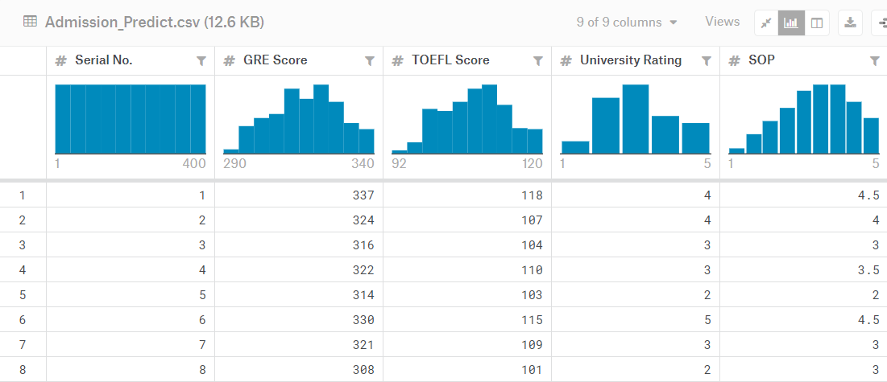
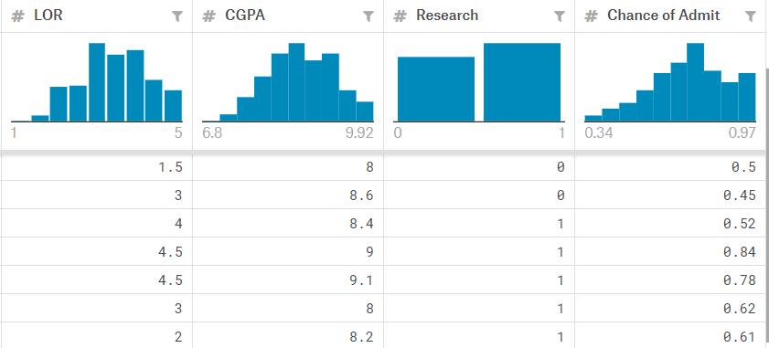
02
Dataset Introduction

Slide 9
02
Dataset introduction
The dataset contains several parameters which are considered important during the application for Masters Programs.
The parameters included are :
1. GRE Scores ( out of 340 )
2. TOEFL Scores ( out of 120 )
3. University Rating ( out of 5 )
4. Statement of Purpose and Letter of Recommendation Strength ( out of 5 )
5. Undergraduate GPA ( out of 10 )
6. Research Experience ( either 0 or 1 )
7. Chance of Admit ( ranging from 0 to 1 )

Slide 10
Data Analysis
03
PART THREE

Slide 11
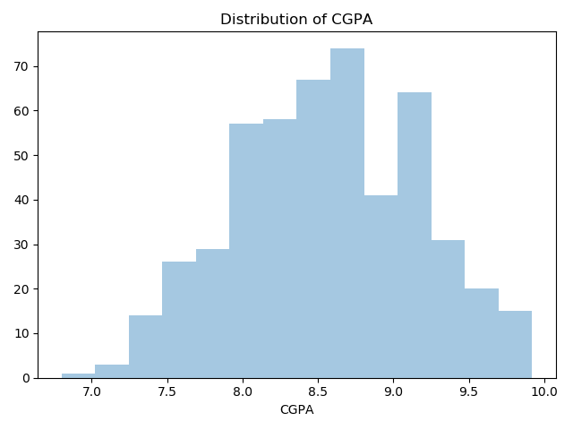
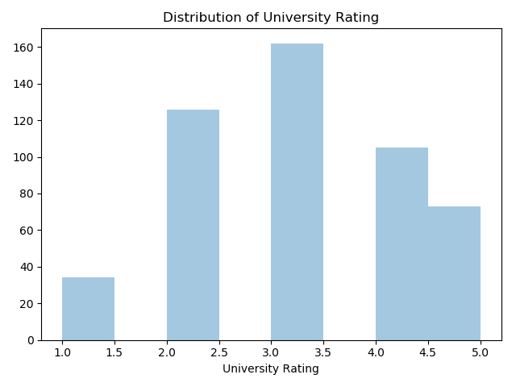
03
Data Analysis
Distribution of GRE Scores
Distribution of University Rating
Distribution of CGPA

Slide 12
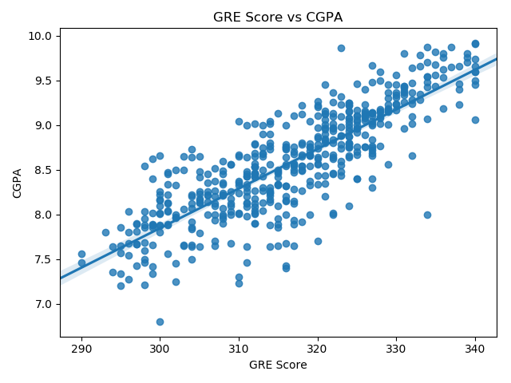
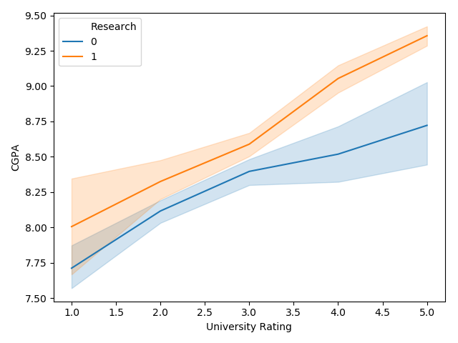
03
Data Analysis
The relationship between University Rating, CGPA and Research
GRE Scores VS CGPA

Slide 13
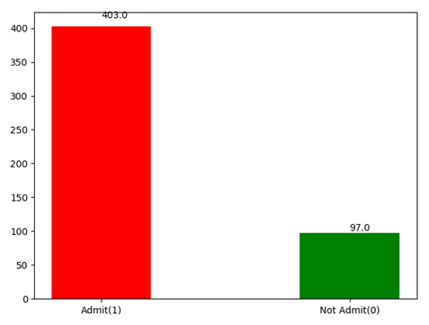
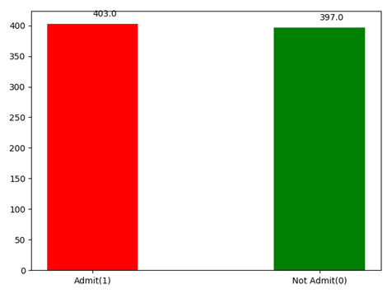
03
Data Analysis
The original data
The optimized data
SMOTE

Slide 14
Algorithms and techniques
04
PART FOUR

Slide 15
04
Algorithms And Techniques——SMOTE
Set a sampling ratio according to the unbalanced proportion of samples to determine the sampling ratio N. For each small number of samples a, select a number of samples randomly from its k-nearest neighbor, and assume that the selected nearest neighbor is b. For each randomly selected neighbour b, respectively, and the original sample according to the following formula to build a new sample: c=a+rand(0,1)∗|a−b|

Slide 16
04
Algorithms And Techniques——Random Forest Algorithm
Bagging algorithm is used to conduct K times of put back random sampling of the original training set, so as to obtain K training subsets, each training subset corresponding to a tree.In the process of generating the decision tree, for each node, M features are selected from the feature set as the feature subset each time. When splitting features, the optimal features are selected from the feature subset as the node.All the decision trees generated are combined to form a random forest.

Slide 17
04
Algorithms And Techniques——Classification Performance And Correlation
The confusion matrix
Pred_lable/True_lable | Positive | Negative
Positive | TP | FP
Negative | FN | TN
The horizontal axis of ROC curve is FPR(False Postive Rate) and the vertical axis is TPR(True Postive Rate)：
FPR= FP/(FP+TN)
TPR=TP/(TP+FN)

Slide 18
04
Algorithms And Techniques——Classification Performance And Correlation
We need to calculate the AUC value of each decision tree, sort the AUC in descending order, select some decision trees with high AUC, and form a new random forest. Since the training samples generated by each decision tree are random and the selection of node features is also random, there is a certain correlation between decision trees. The greater the correlation between any two trees in the forest, the greater the error rate.

Slide 19
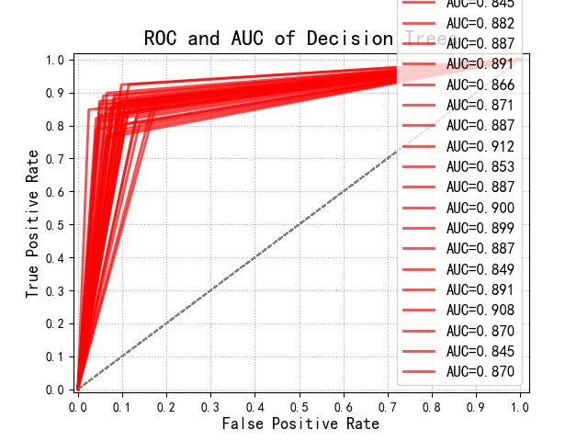
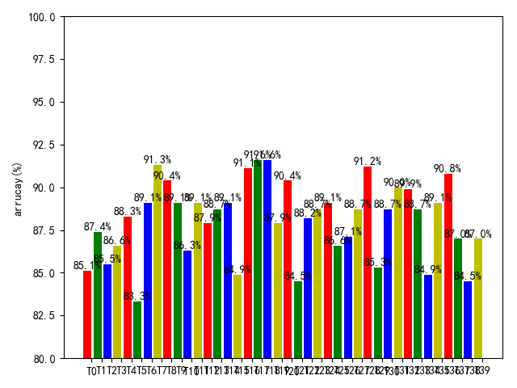
04
Algorithms And Techniques——Classification Performance And Correlation
(a). ROC of each decision tree.
(b). AUC distribution for each decision tree.
Description of ROC and AUC

Slide 20
04
Algorithms And Techniques——Classification Performance And Correlation
The parent-child inner product computation is as follows:
the parent node:
parent ⃗=(index_p,value_p )^T，
the child node:
child ⃗=(index_c,value_c )^T
then the inner product calculation formula is as follows:
Inner product=parent^T•child

Slide 21
04
Algorithms And Techniques——Parameter tuning
The method we adopted is to select the optimal depth value of the tree as the final depth value before formally generating the random forest model. In other words, the traditional random forest algorithm is used to generate different random forest models for different depth parameters, and the depth values with higher model accuracy and smaller depth are taken as the parameters of the prediction algorithm in this paper. This ensures that the parameters used each time the model is generated are optimal.

Slide 22
Experimental Results And Analysis
05
PART FIVE

Slide 23
05
Experimental Results And Analysis
In the process of the experiment, we set the number of different decision trees as 20, 30, 40, 50, 60, 70 and 80 respectively. We first tested the improved random forest, and then tested the improved random forest. By comparing the correct rate, we found that the improved random forest had the highest correct rate of 3.96% improvement. Overall, the improved random forest classification performance is better.

Slide 24
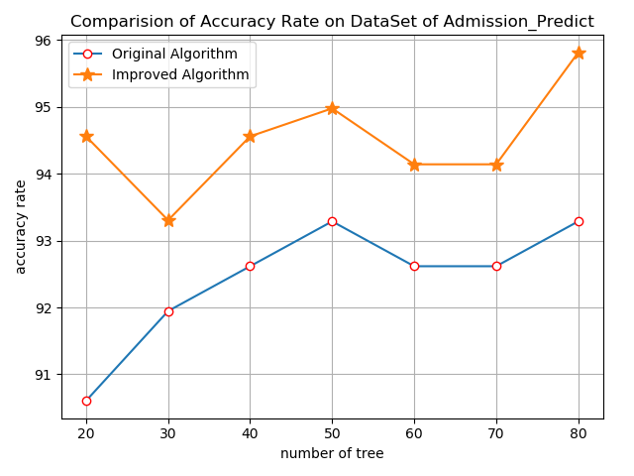
05
Experimental Results And Analysis
Number of decision trees | Random forests of the original one（%） | The improved random forests（%）
20 | 90.60 | 94.56
30 | 91.95 | 93.31
40 | 92.62 | 94.56
50 | 93.29 | 94.98
60 | 92.62 | 94.14
70 | 92.62 | 94.14
80 | 93.29 | 95.82
The comparison of classification accuracy
The comparision of Accuracy Rate on DataSet of Admission_Predict

Slide 25
Conclusion
06
PART SIX

Slide 26
06
Conclusion
In this study, on the basis of improving the random forest, we conducted SMOTE processing on the data and adjusted the depth parameters of the random forest, so as to obtain the random forest model with higher prediction accuracy. Therefore, we can draw a conclusion that in the process of model training, the accuracy of the model can be improved more effectively through data preprocessing and model parameter optimization.

Slide 27
THANKS!

