Slide 1
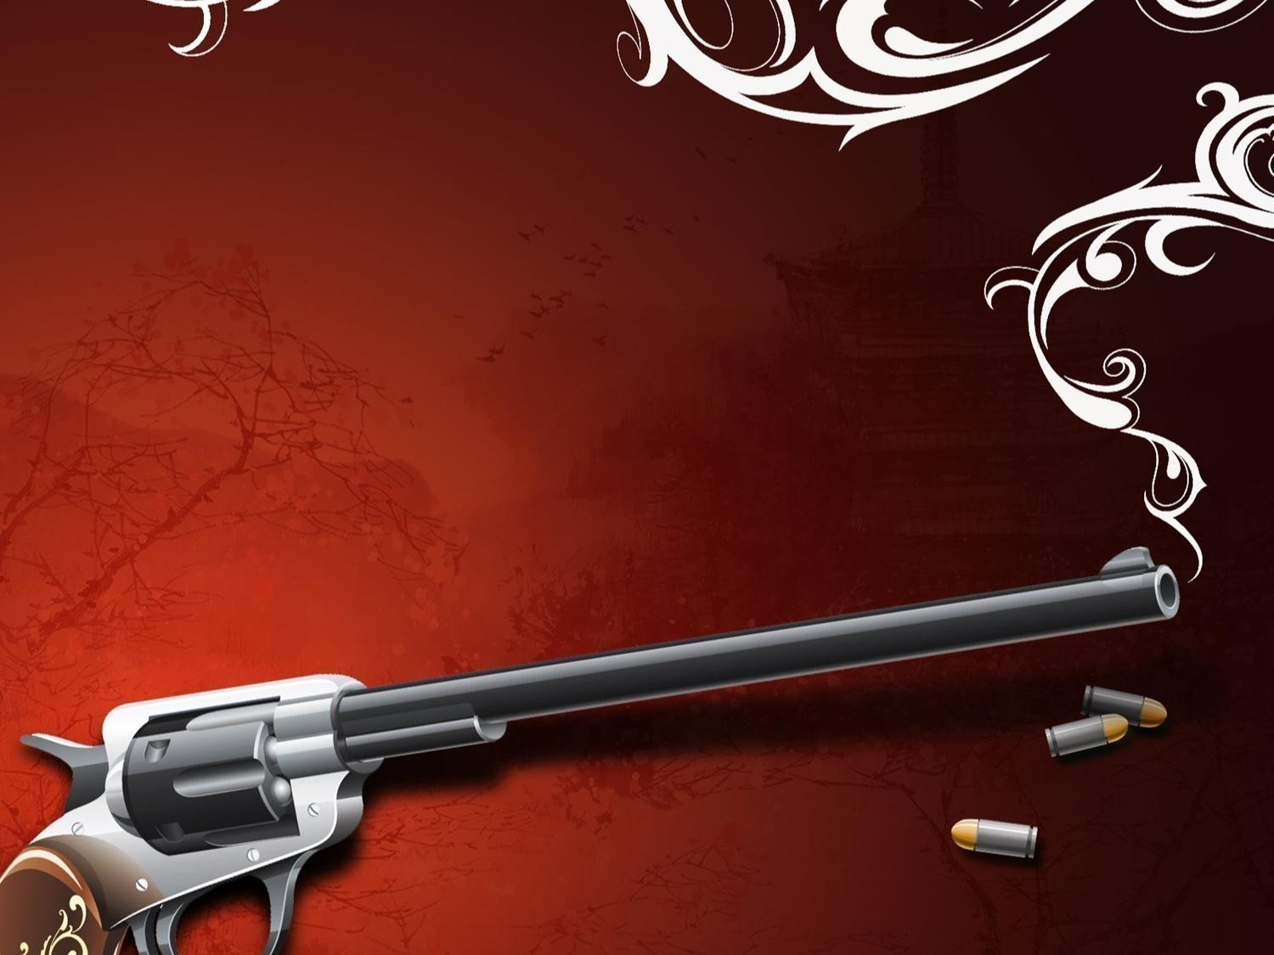
How фукпфукп Throw Out a Challenge
aegaerg

Slide 2
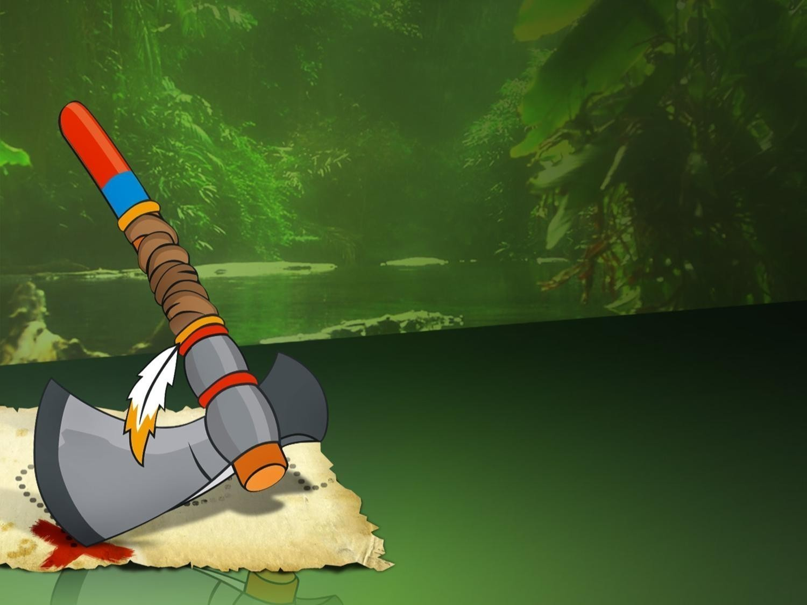
укпфукпфукпфукпNative Americans (XVII century)
put a tomahawk
on the ground in the rival’s camp

Slide 3
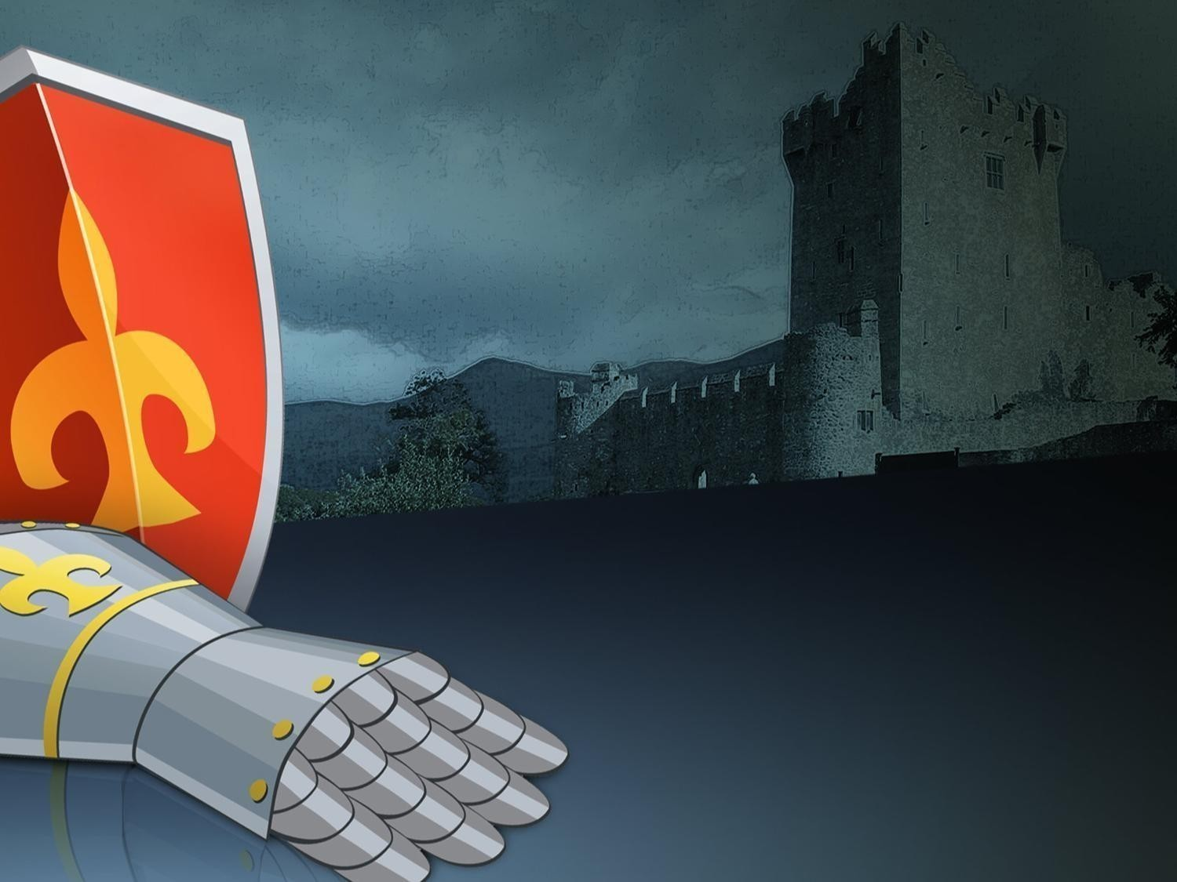
European Knights (XII-XVI centuries)
threw a glove
in the rival’s face

Slide 4
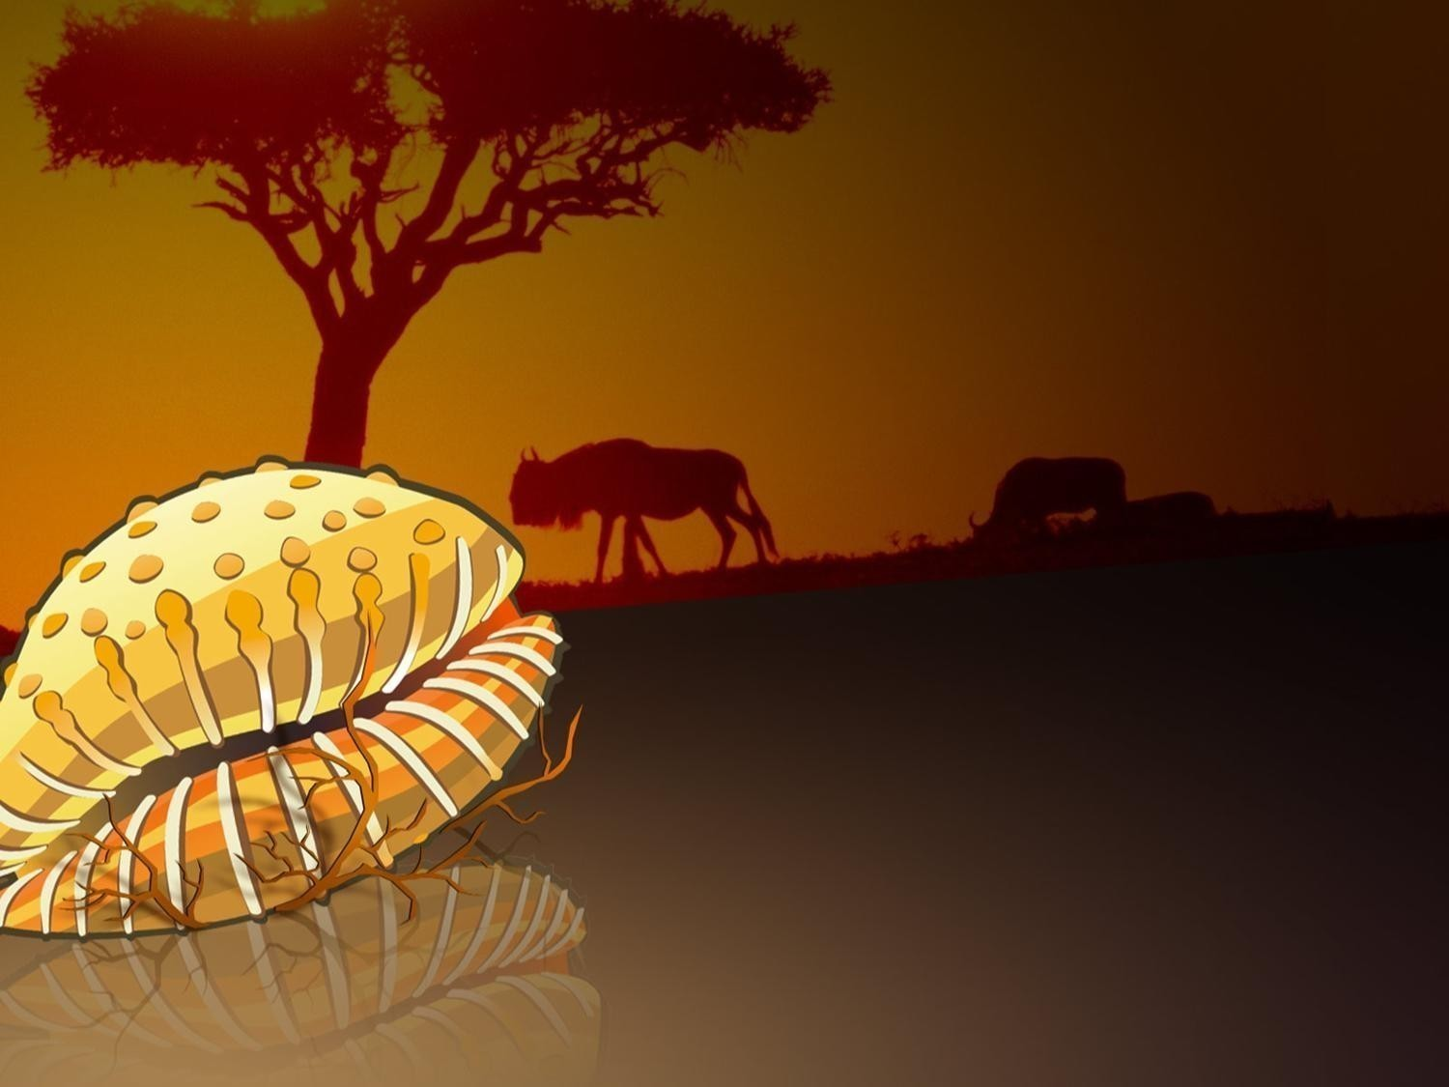
African Yoruba tribes
sent a single
Cypraea shell
to the rivals

Slide 5
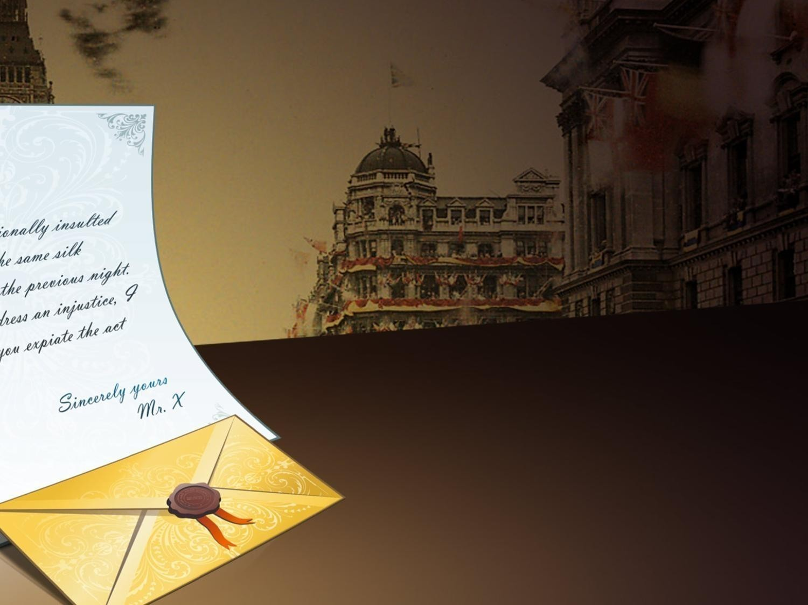
English gentlemen (XVII century)
sent a polite note
with the challenge

Slide 6
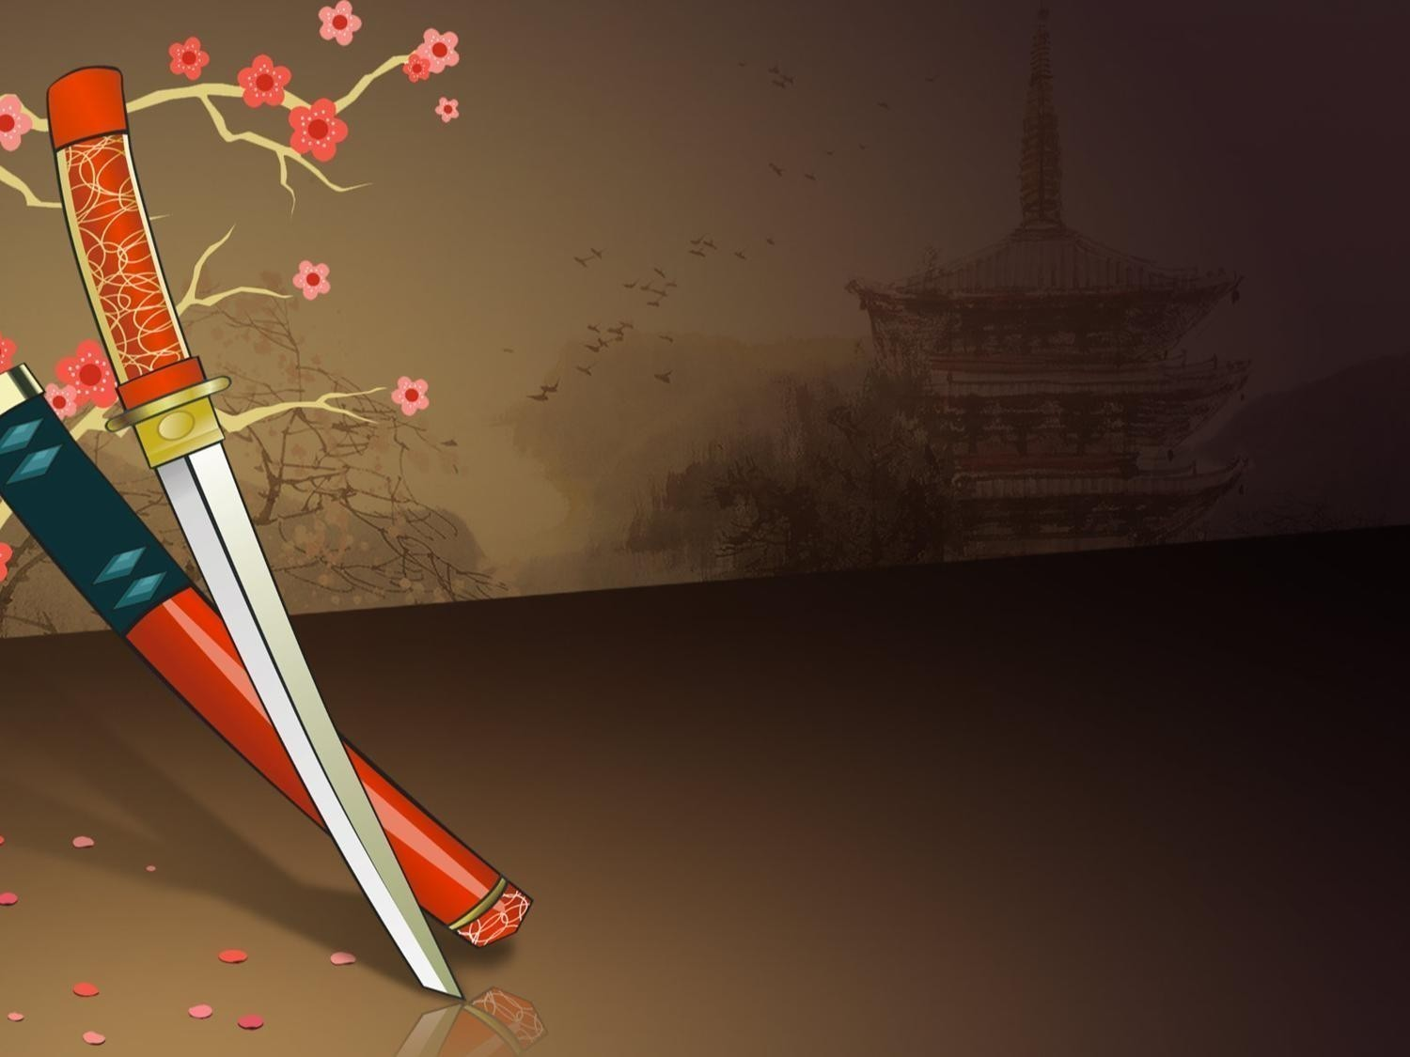
Japan samurais (XII-XVII centuries)
clattered their guards
against sheath to attract
the rival’s attention

Slide 7
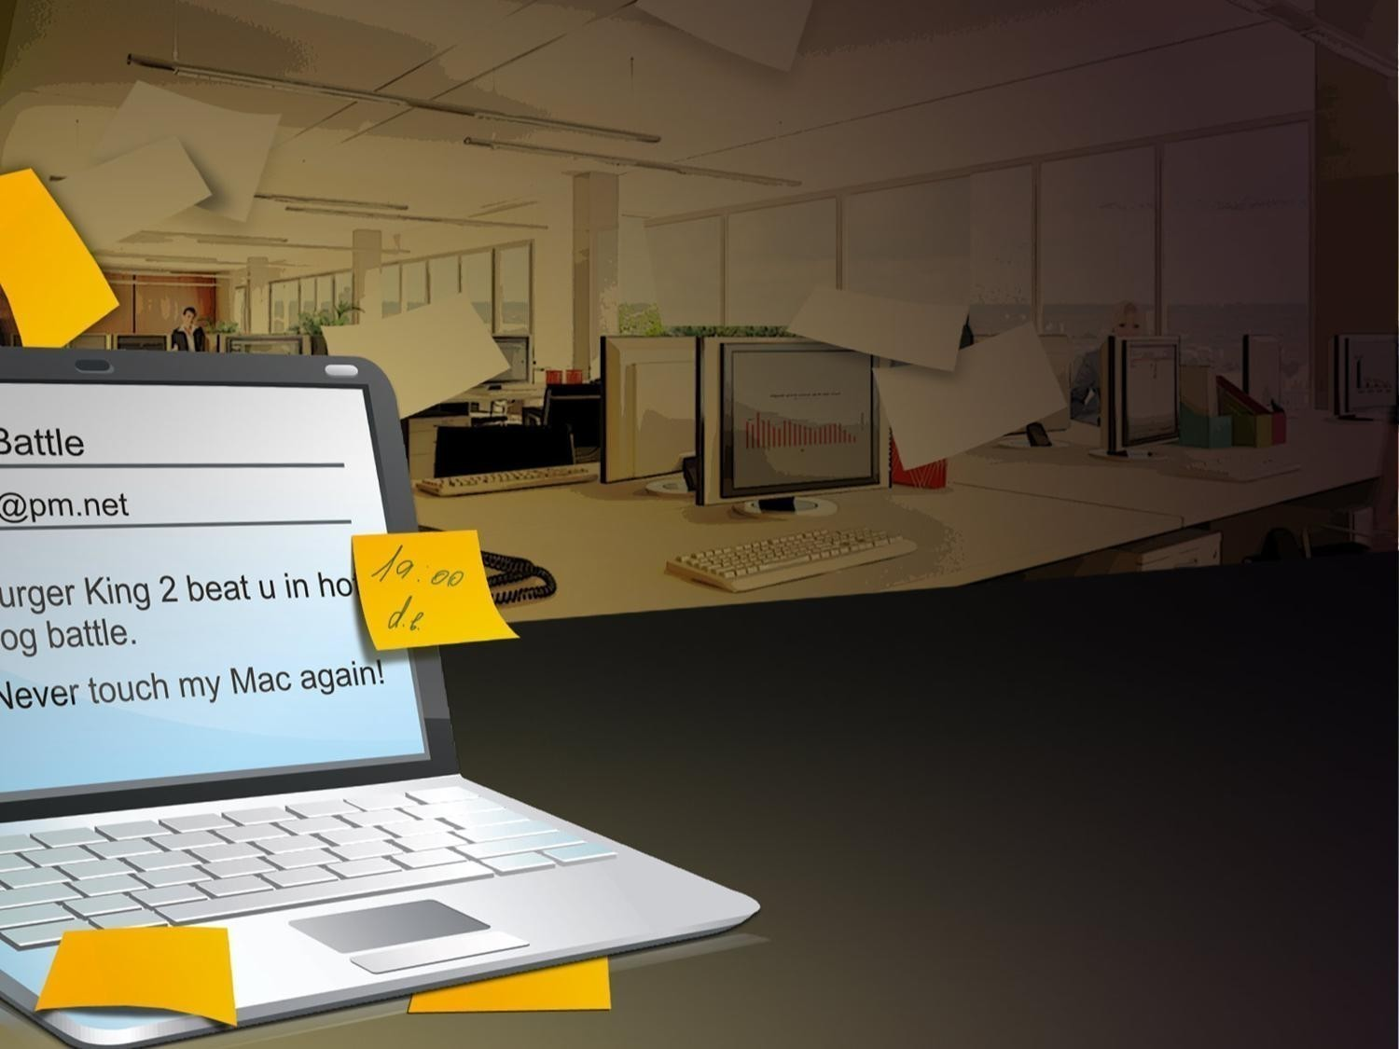
Office plankton (XXI century)
send emails with
the Challenge subject
to their competitors

Slide 8
ONLYOFFICE stands for Peace
www.onlyoffice.com

