Slide 1
Influence of Dipole-Dipole Interaction on Electron Dynamics in Cold Rydberg Gas
Tao Zhou

Slide 2
Defense Outline
Rydberg Atoms and Dipole-Dipole Interactions
Experimental Setup
Decay in Cold Rydberg Atoms
Wavepackets Evolution and DD Interaction
Coherence Transfer through DD Interaction
Conclusion and Prospect

Slide 3



Rydberg Atoms and Dipole-Dipole Interaction What is A Rydberg Atom
$$e^{−}$$
High orbit
Long radiative lifetime
Easy to be affected by external field
…..
[*]
$${Rb}^{+}$$
+q
-q
Could be viewed as a dipole
$$\vec{μ}=q\vec{r}$$
Thomas F. Gallagher. Rydberg Atoms. Cambridge University Press 1994.
Notes:
At first let me introduce some background. My research target is Rydberg atoms. So what are Rydberg atoms. Here is a semiclassic picture of a Rydberg atom. It has one electron which has a very high principal number. So this electron is having a very orbit. It has other properties brought be the high orbit feature. And the most interesting thing is that, from this picture, we can see the electron spends most of its orbit time far from the core. So we can simplify this picture to a classic dipole picture like this. And the dipole defination is u equals q r, direction is the direction from the positive charge to the negative charge.

Slide 4
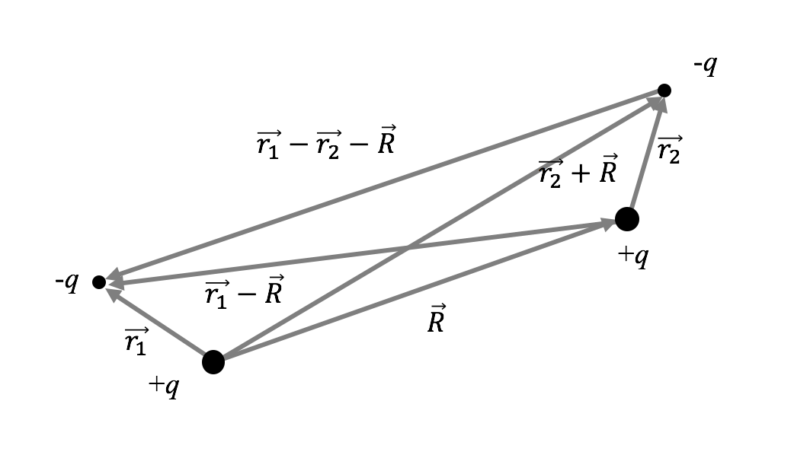
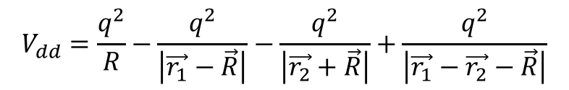
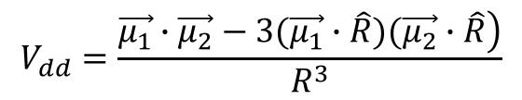
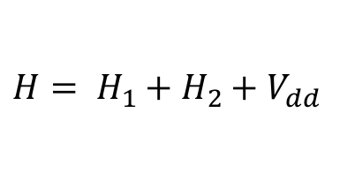
Rydberg Atoms and Dipole-Dipole Interaction What is Dipole-Dipole Interaction
A classical picture
$H= H_{1}+H_{2}+V_{dd}$
$$V_{dd}=\frac{q^{2}}{R}−\frac{q^{2}}{\left|\vec{r_{1}}−\vec{R}\right|}−\frac{q^{2}}{\left|\vec{r_{2}}+\vec{R}\right|}+\frac{q^{2}}{\left|\vec{r_{1}}−\vec{r_{2}}−\vec{R}\right|}$$
$$V_{dd}=\frac{\left.\vec{μ_{1}}∙\vec{μ_{2}}−3(\vec{μ_{1}}∙\hat{R})(\vec{μ_{2}}∙\hat{R}\right)}{R^{3}}$$
[*]
F. Robicheaux, J. V. Hernández, T. Topçu,1 and L. D. Noordam, Phys. Rev. A. 70, 042703 (2004).
Notes:
Now if two dipoles are moving close to each other, they can affect each other. The interaction is the so called “dipole-dipole” interaction and it is the main interaction we are interested in. There are force between these four charges. And the potential caused by dipole-dipole interaction in this double-dipole system could be expressed as this equation. This is from classic view to look at dipole-dipole interaction. How about from the quantum view?

Slide 5
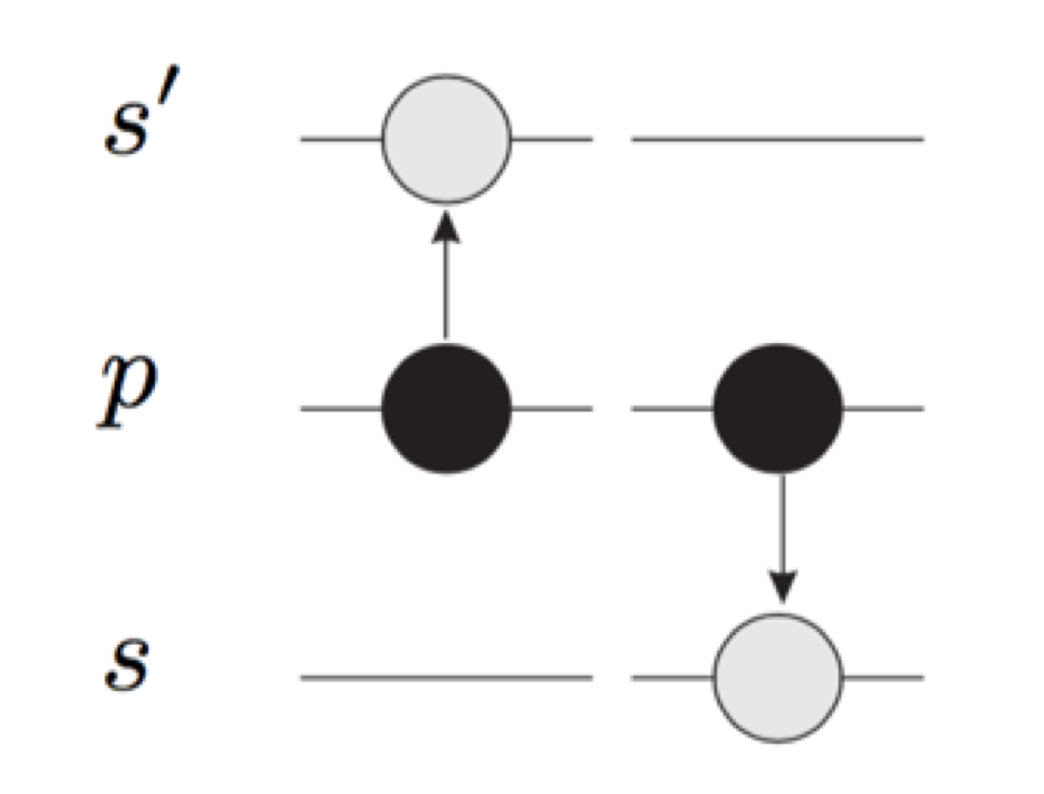
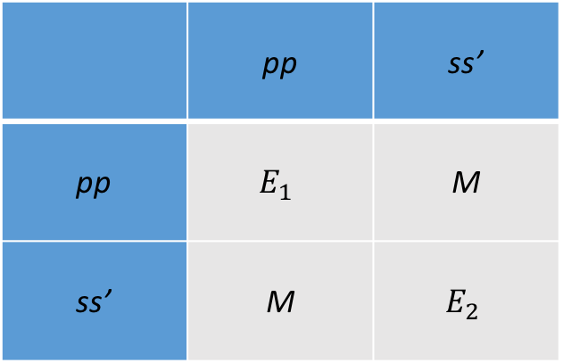

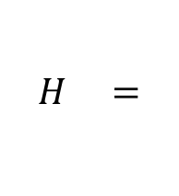
Rydberg Atoms and Dipole-Dipole Interaction What is Dipole-Dipole Interaction
A quantum picture
Resonant energy transfer
 | pp | ss’
pp | $$E_{1}$$ | M
ss’ | M | $$E_{2}$$
[*]
$$H =$$
p + p -> s + s’
$$M=\left|\left\langle pp | V_{dd} | ss^{′}\right\rangle \right|∝\left|\left\langle p | \vec{r_{1}} | s\right\rangle \right|∙\left|\left\langle p | \vec{r_{2}} | s^{′}\right\rangle \right|=\left|\vec{μ_{ps}}\right|∙\left|\vec{μ_{ps′}}\right|$$
$\vec{μ_{ps}}$ = $\left\langle p | \vec{r_{1}} | s\right\rangle$ transition dipole moment
S. Westermann, T. Amthor, A.L. de Oliveira, J. Deiglmayr, M. Reetz-Lamour, and M. Weidemuller, Eur. Phys. J. D 40, 37–43 (2006).
Notes:
Dipole-Dipole interaction take a very important role in resonant energy transfer. Let’s look at this simple process. P + P -> S + S’. If we write down the matrix, we would get this. And from this matrix we can see the dipole-dipole interaction is contributing off-diagonal matrix element. So the dipole-dipole interaction in quantum mechanics is expressed as matrix elements. The M from this example is expressed as this. And the ups or u ps’ is no longer the dipole moment in classical picture. We call them transition dipole moment.

Slide 6

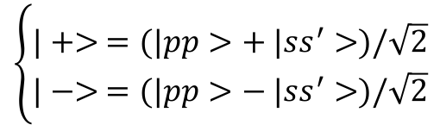


Rydberg Atoms and Dipole-Dipole Interaction What is Dipole-Dipole Interaction
Quantum picture
$$H= \left(\begin{matrix}E & M \\ M & E\end{matrix}\right)$$
$$\left\{\begin{matrix}E_{+}=E+M \\ E_{−}=E−M\end{matrix}\right.$$
$$\left\{\begin{matrix}|+> =(|pp>+ |ss^{′}>)/\sqrt{2} \\ |−> =(|pp>− |ss^{′}>)/\sqrt{2}\end{matrix}\right.$$
$$\&$$
|+>
2M
pp
ss’
|->
Notes:
Lets’ continue this example. Now consider a resonant process in which pp and ss’ have exactly the same energy. So that E1=E2. Then from this matrix, we can get new eigen energies E plus = E + M and E minus = E – M and new eigen states plus and minus. If we draw the effect out, we can see the degenerate energy states have been split into two states with different energies.

Slide 7
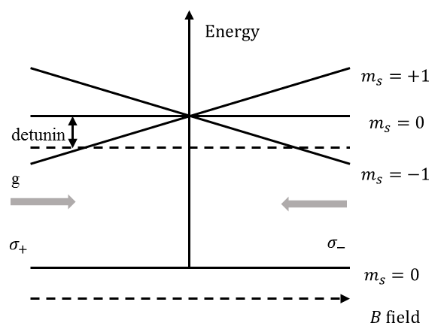




Experiment Setup Magneto-Optical Trap (MOT)
1 dimensional 2 state Model
3 Dimensional setup
[*]
$$σ_{−}$$
$$σ_{−}$$
$$σ_{+}$$
$$σ_{−}$$
$$σ_{+}$$
$$σ_{+}$$
Harold J. Metchalf and Peter van der Straten. Laser Cooling and Trapping. Springer (1999).
Notes:
Now let me give you a brief introduction about the general experimental setup used in the experiments. I will also provide the unique information about experimental setup for each project in the later discussion.
We are using cold atoms, which are generated by Magneto-Optical Trap or MOT. This is the one dimensional model to give you an idea how the cooling technology works. It only has two states: ground states and excitation state. The excitation states has 3 degenerate states which have different angular momentum along the z axis. Now We generation gradient Magnetic field along the z axis. Because of the Zeeman effect, the degenerate excitation states will be split to 3 states as shown in the picture. Then we shoot counter-propagating beams at the atoms and the beam has been detuned a little bit from the resonance. So for atoms escaping from the center, its excitation state will be tilted and it will absorb a photon, which pushes it back to the center. This is the basic idea of magneto-optical cooling technology. And this is a diagram showing the 3d setup of the MOT.

Slide 8
Experiment Setup State-Selective Field Ionization (SSFI)
Electric field tilt Coulomb potential
Ionization signal
32S and 31P
Notes:
The MOT traps the atoms but we still new methods to detect what’s going on to the atoms. A common way is to ionize the elections of the atoms and measure the population of each state. The ionization method is usually implemented as State-Selective Field Ionization method. The idea is this. If we apply an external electric field to the atoms, the coulomb potential which traps the electron will be tilted. And if the electric field is large enough, starting from high orbit ones, the electrons will escape the coulomb well and be ionized. The ionized electrons are collected by Micro-Channel-Plates. The signal is like this. This an example. The peak located in the gate is the ionization signal composed of state 32s and 31p.

Slide 9
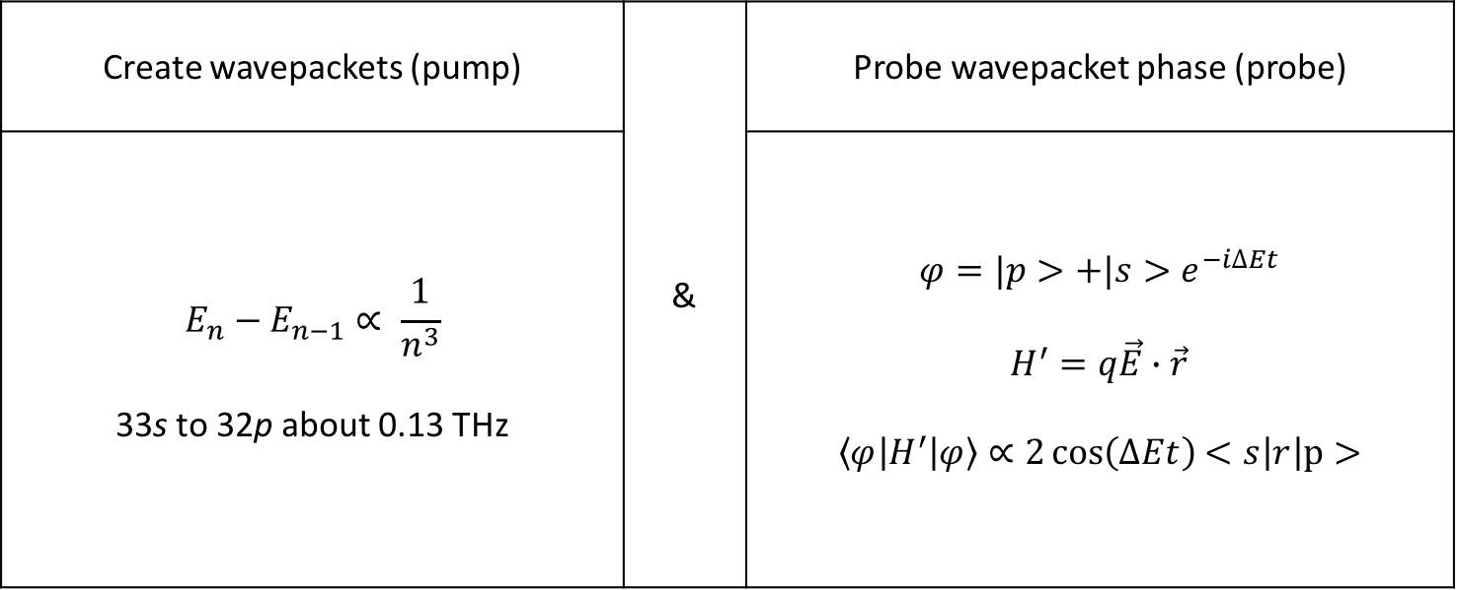
Experiment Setup THz radiations
Create wavepackets (pump) | & | Probe wavepacket phase (probe)
$$E_{n}−E_{n−1}∝ \frac{1}{n^{3}}$$ 33s to 32p about 0.13 THz |  | $$φ=|p>+|s>e^{−i∆Et}$$ $$H^{′}=q\vec{E}∙\vec{r}$$ $$\left\langle φ | H^{′} | φ\right\rangle ∝2\cos\left(∆Et\right)<s\left|r\right|p>$$
Notes:
But SSFI can only detect the population of each state. It has to be combined with other setup to be useful in our experiment. We use THz pulses in our lab. There are two main reasons to use THz. First, for higher Rydberg atoms, the energy gap between adjust states is roughly of the THz order. For example…. So the Thz pulse can redistribute population of Rydberg atoms on states. The second reason is that it could be used as a wavepacket phase probe. If we shoot a THz pulse at the atoms, it could be viewed as a pertubation. From this we can see the pertubation depends on the phase of the wavepacket.

Slide 10
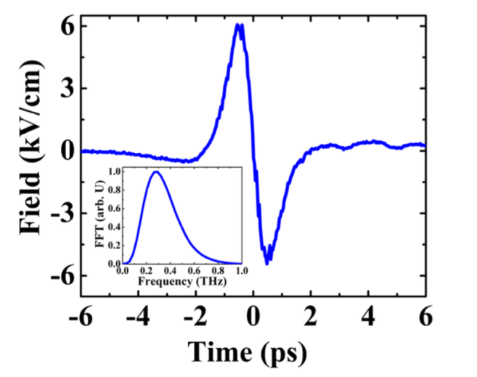



Experiment Setup THz Pulses Generation
Tilted-Pulse-Front-Pumping (TPFP) optical rectification
Properties
[*]
grating
LiNb$O_{3}$
$$V_{THz}$$
fs,780nm, laser
$$V_{NIR}^{group}$$
[*] work done by Sha Li in our lab
Notes:
To generate THz pulses, we used the so called Tilted-Pulse-Front-Pumping (TPFP) optical rectification technology. Lisa was the first one in our lab to use this method to generate Thz pulse. I’ve stolen her setup and built my own THz generator. And this is the property of the THz pulse. The duration is a few femoto seconds and the frequency is sub THz, which is what I want.

Slide 11



Decay in Cold Rydberg Atoms Superradiance Emission
spontaneous emission
superradiance emission
high P
λ
$$hv$$
d
low S
$photon emission rate ∝N^{2}$
$$photon emission rate ∝N$$
R.H. Dicke, Physics Review. 93, 99 (1954)
M. Gross, P. Goy, C. Fabre, S. Haroche, and J. M. Raimond, Phys. Rev. Lett. 43, 343 (1979)
Notes:
Suppose I have a two level system and one atom starts on the high level. In one unit time delta t, the atom can decay from high state to the low state and emit one photon, which has an energy of hv. This is a very normal decay for one individual atoms and the radiance rate is roughly 1/delta t. Now if I have a cloud, composed of N atoms, and all of them are in the high state at first. We would expect the atoms to jump from the high state to the low state and emit N photos in delta t. The radiance speed for this system is proportional to N. But if the diameter of this cloud is much smaller than the wavelength of the photons and some other critical criteria have been satisfied, this emission speed would be accelerated and this radiance speed would be proportional to N square. Such a process is called Superradiance. And Superradiance is what I mean for “collective decay”. If our eyes can see the photons from this cloud, we would see that this cloud flashes in a short time and then dies quickly.
Superradiance is observed in many systems but was not observed in the cold Rydberg atoms until 2007. One paper developed one medal of the criteria of superradiance and used superradiance to explain the experiment result in the paper.

Slide 12


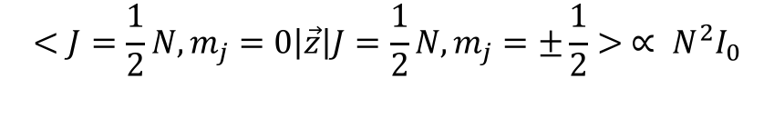
Decay in Cold Rydberg Atoms Dicke States
$$J=\frac{1}{2}, m_{j}= +\frac{1}{2}$$
…...
$$I_{0}$$
$$J, m_{j}$$
$$J=\frac{1}{2}, m_{j}=−\frac{1}{2}$$
…...
$$<J=\frac{1}{2}N, m_{j}=0\left|\vec{z}\right|J=\frac{1}{2}N, m_{j}=±\frac{1}{2}> ∝ N^{2}I_{0}$$

Slide 13
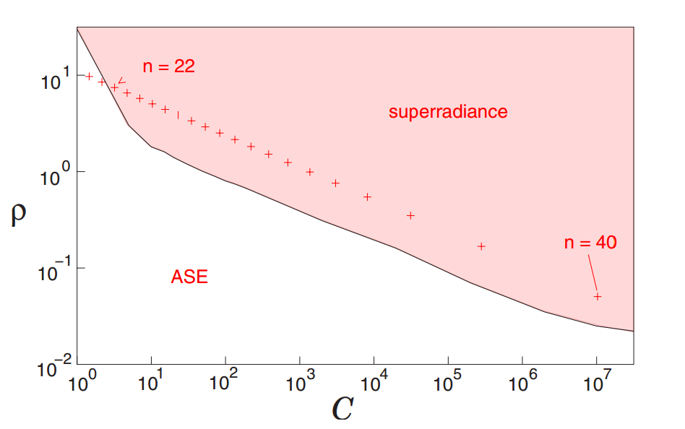
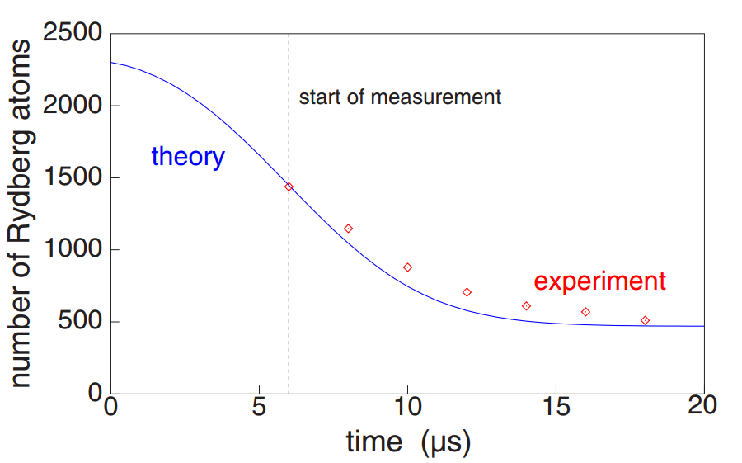
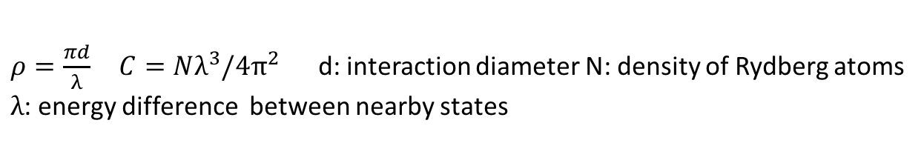
Decay in Cold Rydberg Atoms Superradiance in Cold Rydberg Atoms?
Condition?
Ionization signal for atoms starting from 43P
n = 26
n = 32
n = 40
$ρ=\frac{πd}{λ} C=Nλ^{3}/4π^{2}$ d: interaction diameter N: density of Rydberg atoms
$λ$: energy difference between nearby states
T. Wang, S.F. Yelin, R. Cote, and etc. Physics Review A 75, 033802(2007)
also see: J. O. Day, E. Brekke, and T. G. Walker. Physics Review A 77, 052712(2008)
Notes:
The model’s mathematic form is very sophisticated. Fortunately, the paper provided two parameters to help us to determine whether Superradiance would happen in cold Rydberg atoms. The two parameters are rho and c.
From the first plot, we see for Rydberg states from 22 to 40, if rho and C are locating in the red area, Superradiance should happen. The second plot is the ionization signal for atoms starting from 43P. The number of Rydberg atoms means atoms with Rydberg states higher than 27, not only atoms on state 43P. In our lab, we can produce cold Rydberg atoms. We also have selective ionization field, so we can see the population on 40P directly. We want to repeat this superradiance experiment.
In the following experiment, we tested stated of 26, 32 and 40.

Slide 14
Decay in Cold Rydberg Atoms Experiment Procedure
Signal
MCP
Cold atoms
_
SSFI
+
d
T
Laser beam
Notes:
The process is pretty simple and straightforward. The following is the setup and experiment process.
First, we generate a cloud of cold atoms using Magneto Optical Trap. The atoms we use are Rubidium 85.
2nd, we use a laser beam to transfer the cold atoms to Rydberg states. The focal point of the laser beam is almost inside the atom cloud and produced a cigar shaped interaction area. In the interaction area, atoms will be excited to ns or np state from 5p. To generated np states, we also need to apply a weak field.
Then the Rydberg atoms have been left to emit photons and decay themselves. After time T, a selective ionization field has been applied to the atoms and ionize the atoms at different Rydberg state. The ionization signal shows how many atoms are on each Rydberg states.

Slide 15
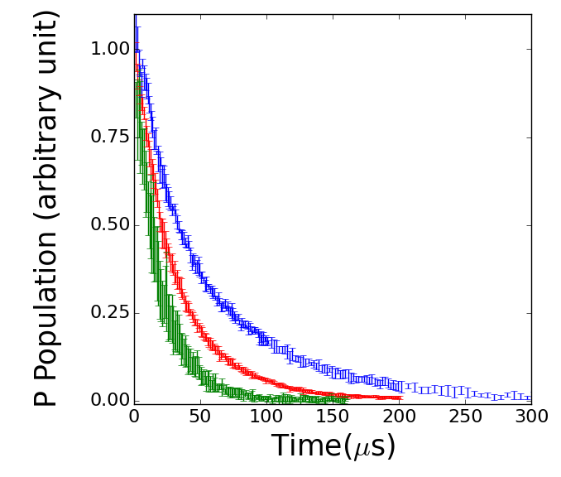
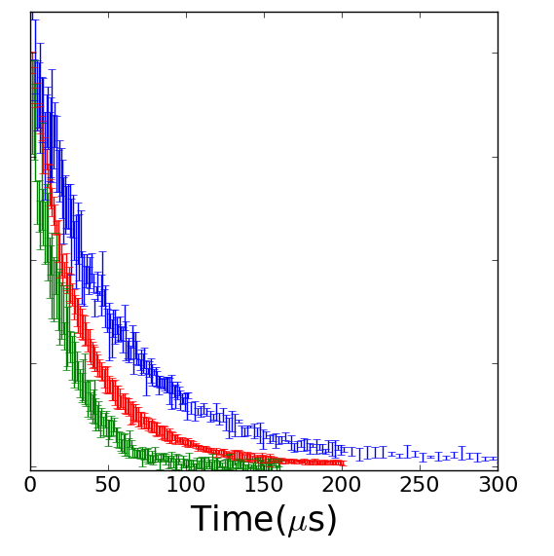


Decay in Cold Rydberg Atoms Experiment Result
$$3.0×{10}^{9}{cm}^{−3}$$
1$.5×{10}^{9}{cm}^{−3}$
I: n = 40 $τ_{spon}≈150us$
I: n = 32 $τ_{spon}≈70us$
I: n = 26 $τ_{spon}≈40us$
Notes:
To explore more, first, I tested other P states at low density. I tested 32P and 26P. And this is the result. Blue is 40P, red is 32p and green line is 26P. We see p population is decaying, but the decay time is still larger than a few us, which means there is no Superradiance.
Then how about increasing the density? The largest density our lab can get is about 3 time 10 to the 9th order per cm cube. Now if the atoms get that density, I got this plot.
There is basically no difference from the low density case.
Now what if the staring Rydberg states are S states?

Slide 16
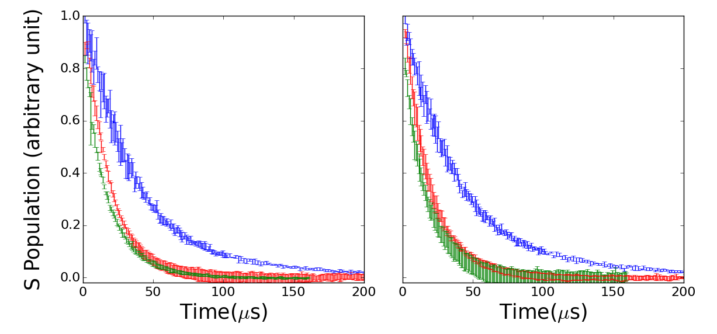
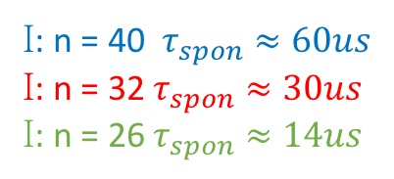

Decay in Cold Rydberg Atoms Experiment Result
$$3.0×{10}^{9}{cm}^{−3}$$
$$1.5×{10}^{9}{cm}^{−3}$$
I: n = 40 $τ_{spon}≈60us$
I: n = 32 $τ_{spon}≈30us$
I: n = 26 $τ_{spon}≈14us$
Notes:
For Rydberg atoms starting from s states, we found that decay time of s states are still larger than a few seconds, and changing density does not change the decay time. There is basically no difference from the result on P state.

Slide 17
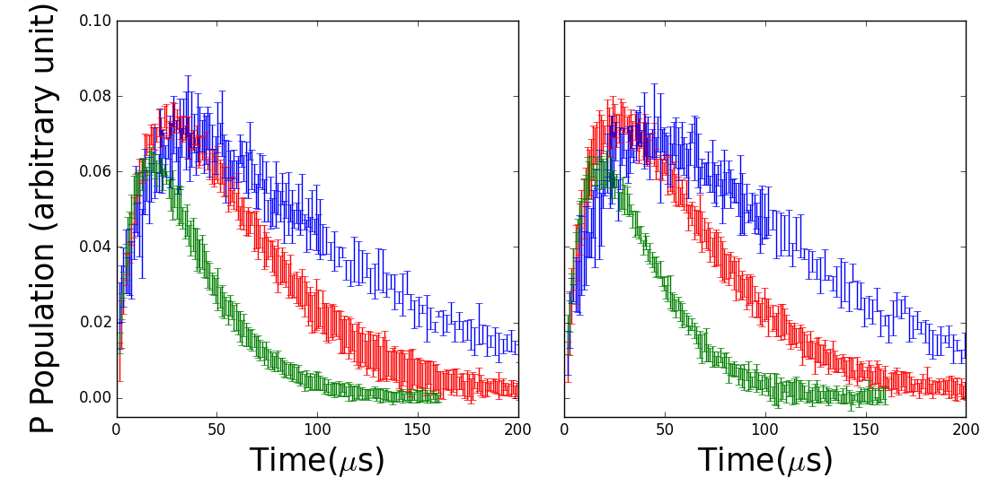


Decay in Cold Rydberg Atoms Experiment Result
$$3.0×{10}^{9}{cm}^{−3}$$
$$1.5×{10}^{9}{cm}^{−3}$$
I: n = 40
I: n = 32
I: n = 26
Notes:
But due to black body radiation, which comes from external environment, atoms from s states could be transferred to higher p and low p states. Due to the limitation of our system, we could not detect the lower p states. The two plots are the population of higher P states. We see that the population is first increasing, due to black body radiation. Then the population decreases, because of spontaneous decay. The decay time is still larger than a few us.

Slide 18
Decay in Cold Rydberg Atoms Model Considering Blackbody Radiation and Spontaneous Decay
41S
39D
B
S
B
40P
S
B
B
40S
S
B
38D
B
S
39P
S
B
S
B
39S
37D
S
S
Notes:
Knowing the blackbody radiation, we can combine the spontaneous radiation and blackbody radiation and build such a simplified model. The red dash line between two states means there is blackbody stimulated transition between these two states. The blue dash wiggles mean the spontaneous decay from one state to many other states. This plot is using the atoms starting from Rydberg state 40S as an example. For other starting states, they each use a very similar model.

Slide 19
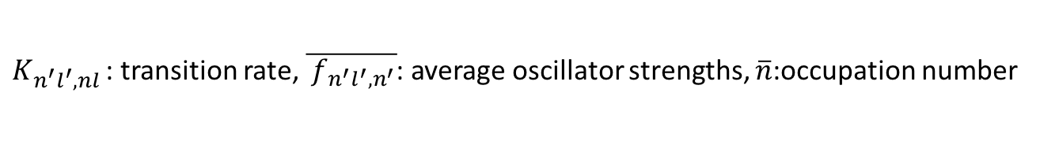


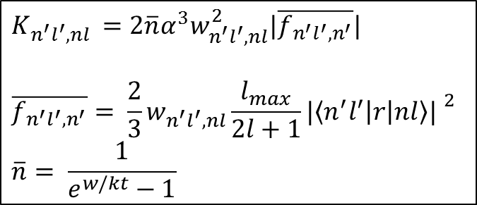
Decay in Cold Rydberg Atoms Calculation
Blackbody radiation induced transition rate
$$n^{′}l′$$
[*]
$$K_{n^{′}l^{′},nl }=2\overline{n}α^{3}w_{n^{′}l^{′},nl}^{2}|\overline{f_{n^{′}l^{′},n^{′}}}|$$
$$\overline{f_{n^{′}l^{′},n^{′}}}= \frac{2}{3}w_{n^{′}l^{′}, nl}\frac{l_{max}}{2l+1}{|\left\langle n^{′}l^{′} | r | nl\right\rangle | }^{2}$$
$$\overline{n}= \frac{1}{e^{w/kt}−1}$$
$$nl$$
$K_{n^{′}l^{′},nl }$: transition rate, $\overline{{ f}_{n^{′}l^{′},n^{′}}}$: average oscillator strengths, $\overline{n}$:occupation number
[*] Thomas F. Gallagher, Rydberg Atoms, Cambridge University Press 1994.

Slide 20
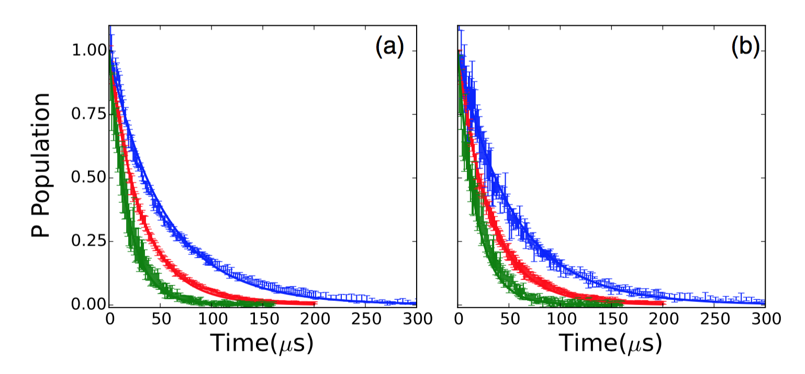


Decay in Cold Rydberg Atoms Calculation Result
Results for P states
$$3.0×{10}^{9}{cm}^{−3}$$
$$1.5×{10}^{9}{cm}^{−3}$$

Slide 21
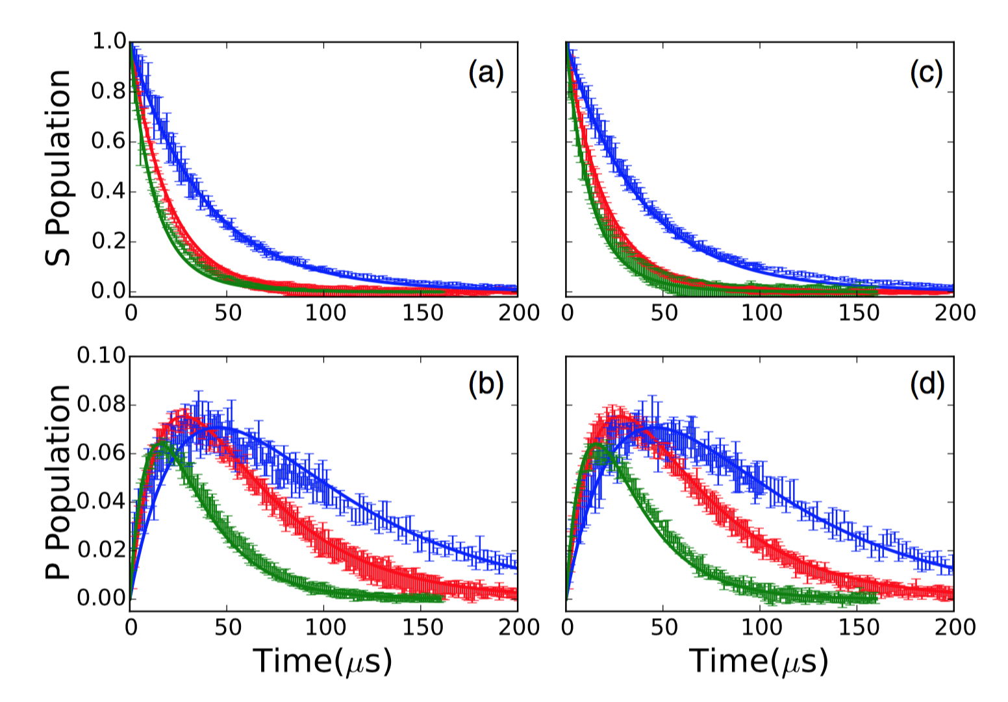


Decay in Cold Rydberg Atoms Calculation Result
Results for S states
$$3.0×{10}^{9}{cm}^{−3}$$
$$1.5×{10}^{9}{cm}^{−3}$$

Slide 22


















Decay in Cold Rydberg Atoms Analysis and Discussion
Suppress formation of Dicke states and superradiance.
$$|111>$$
$$J=\frac{3}{2}, m_{j}=\frac{3}{2}$$
$$|111>$$
$$|011>$$
$$|101>$$
$$|110>$$
$$|011>$$
$$|101>$$
$$J=\frac{3}{2}, m_{j}=\frac{1}{2}$$
$$|110>$$
$$J=\frac{3}{2}, m_{j}=−\frac{1}{2}$$
$$|100>$$
$$|001>$$
$$|010>$$
$$|100>$$
$$|001>$$
$$|010>$$
$$|000>$$
$$J=\frac{3}{2}, m_{j}=0$$
$$|000>$$

Slide 23
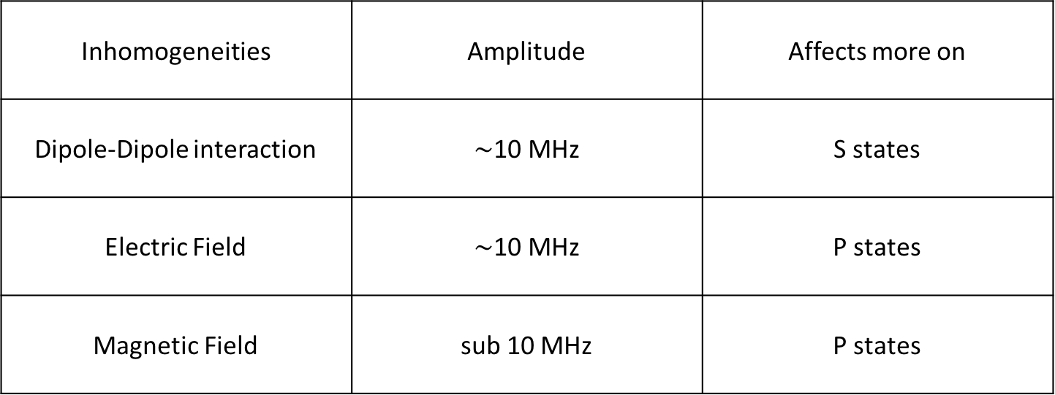
Decay in Cold Rydberg Atoms Analysis and Discussion
Suppress formation of Dicke states and superradiance.
Inhomogeneities | Amplitude | Affects more on
Dipole-Dipole interaction | $\sim$10 MHz | S states
Electric Field | $\sim$10 MHz | P states
Magnetic Field | sub 10 MHz | P states

Slide 24

Wavepackets evolution and DD Interaction Experiment
32p
32s
31p
T
$$∆T$$
5p
THz 1
THz 2
Time Line

Slide 25
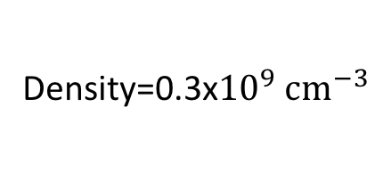
Wavepackets evolution and DD Interaction Experiment Result
Density=0.3x${10}^{9} {cm}^{−3}$

Slide 26
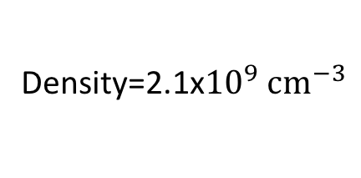
Wavepackets evolution and DD Interaction Experiment Result
Density=2.1x${10}^{9} {cm}^{−3}$

Slide 27
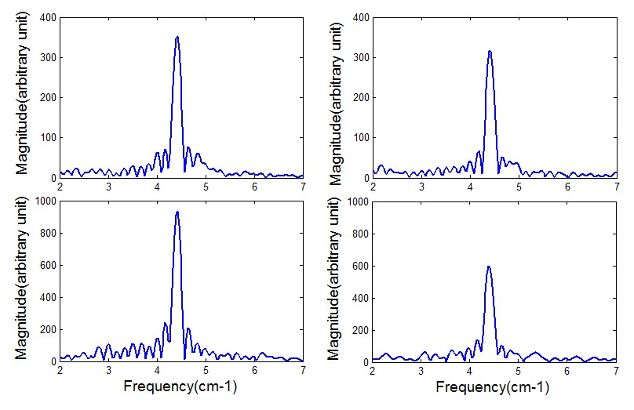
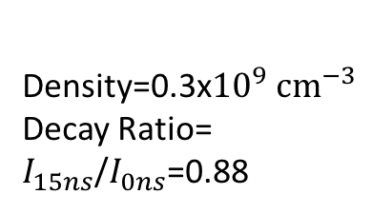
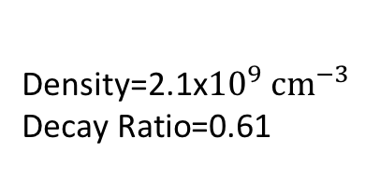
Wavepackets evolution and DD Interaction Experiment Result
Density=0.3x${10}^{9} {cm}^{−3}$
Decay Ratio=
$I_{15ns}$/$I_{0ns}$=0.88
Density=2.1x${10}^{9} {cm}^{−3}$
$$\text{Decay} \text{Ratio}\text{=0.61 }$$

Slide 28
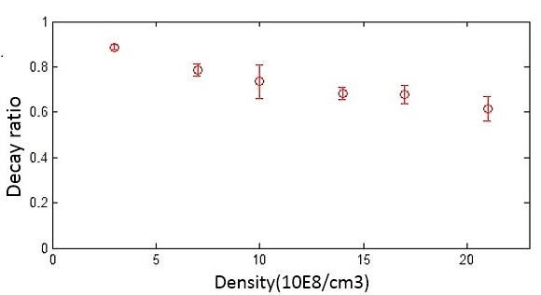

Wavepackets evolution and DD Interaction Experiment Result
Decay ratio at different densities
Density(${10}^{8}/{cm}^{3})$

Slide 29





Wavepackets evolution and DD Interaction Analysis
32s+32p↔32p+32s
ps
sp
|1>=|ps>+|sp>
2M
|2>=|ps>-|sp>
$$E_{0}$$
$$E_{0}+M$$
$$∆E+M_{1}$$
$$∆E+M_{2}$$
$$∆E+M_{3}$$
<ss|z|2>=0
ss

Slide 30


Wavepackets evolution and DD Interaction Analysis
Two Pairs
Many Many Pairs
$$∆E_{1}$$
$$∆E_{1}$$
$$∆E_{2}$$
$∆E_{1}$…$∆E_{n}$

Slide 31
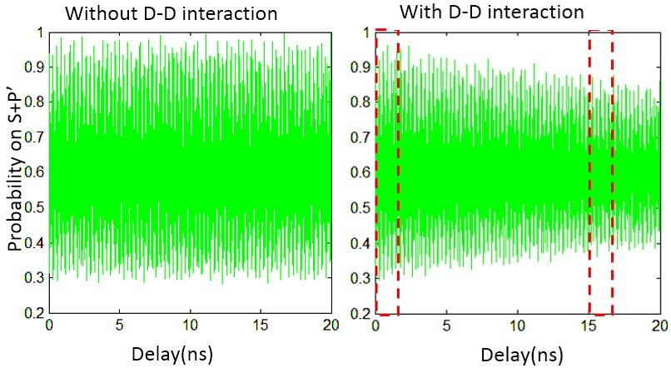
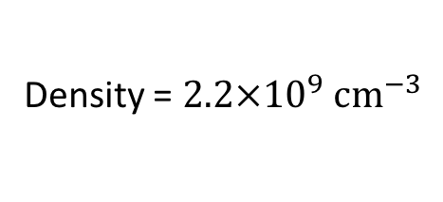
Wavepackets evolution and DD Interaction Simulation
Density = $2.2×{10}^{9} {cm}^{−3}$

Slide 32
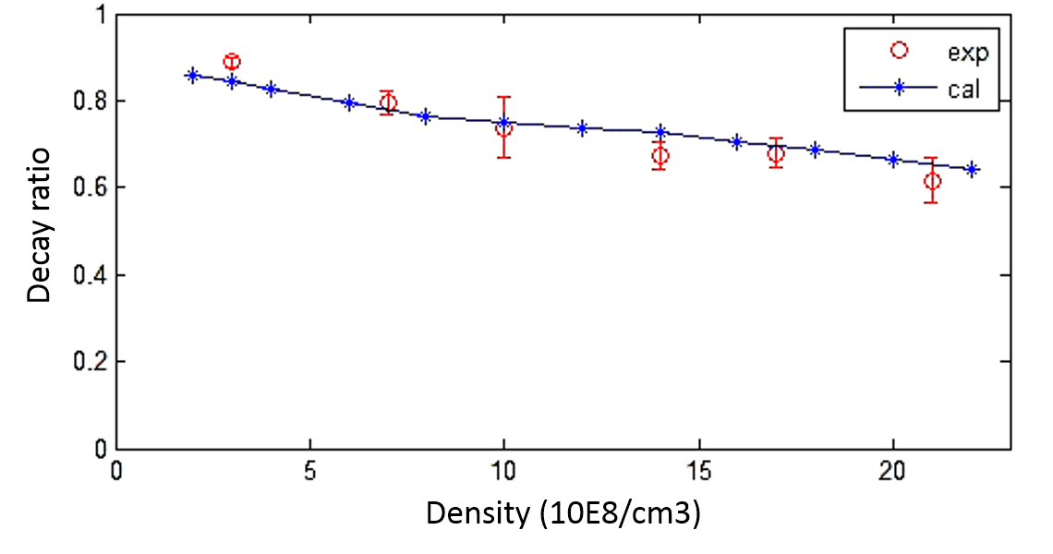

Wavepackets evolution and DD Interaction Simulation Result
Simulation result for different densitie
Density(${10}^{8}/{cm}^{3})$

Slide 33


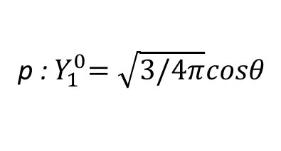
Coherence Transfer through DD Interaction Dipole Moment Oscillation
s: $Y_{0}^{0}=1/\sqrt{4π}$
p :${ Y}_{1}^{0}=\sqrt{3/4π}cosθ$
z
z
z
?
$φ=s+pe^{iΔEt}$:

Slide 34
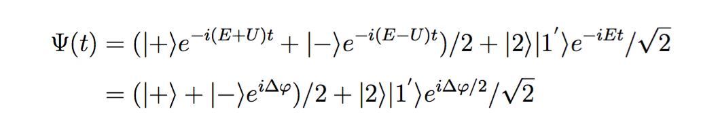
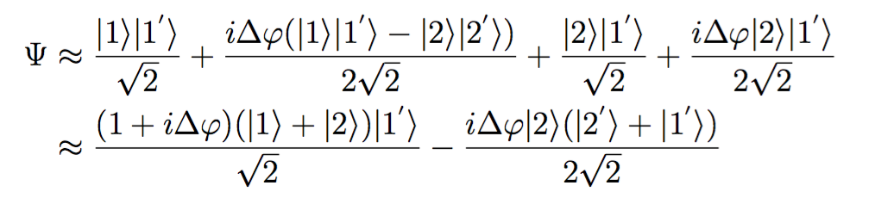
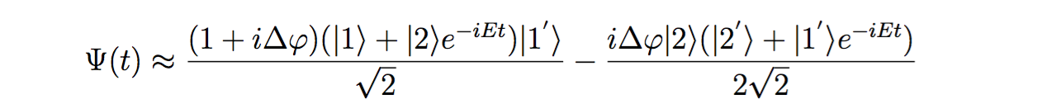
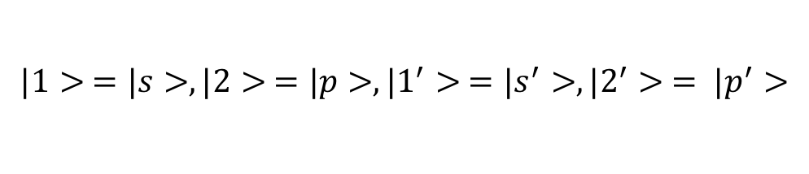
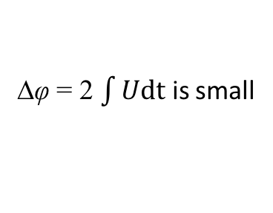
Coherence Transfer through DD Interaction Coherence Transfer
$$|1> =|s>,|2> =|p>,|1^{′}> =|s^{′}>, |2^{′}> = |p^{′}>$$
Initial:
∆φ = 2 $\int{Udt}$ is small
After DD:

Slide 35
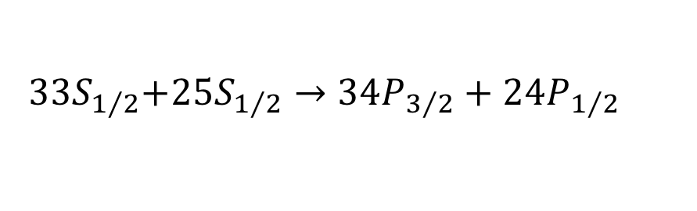
Coherence Transfer through DD Interaction Coherence Transfer
$${ 33S}_{1/2}+{25S}_{1/2}→{34P}_{3/2}+{24P}_{1/2}$$
25S+24P
33S
D-D
25S+24P
33S+34P
D-D
25S+24P$e^{iφ}$
33S+34P$e^{iθ}$

Slide 36
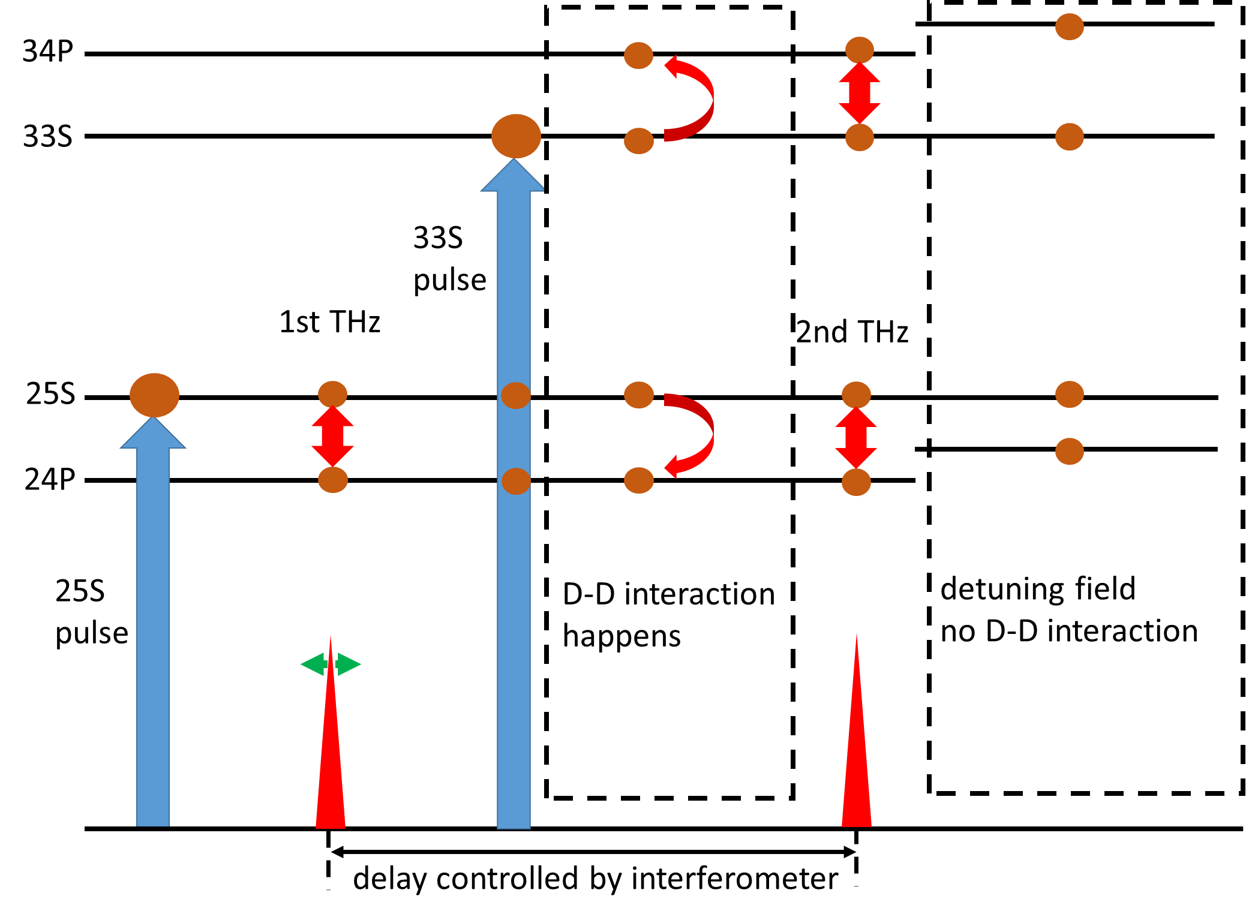
Coherence Transfer through DD Interaction Experiment
33S
34P
SSFI
T

Slide 37

Coherence Transfer through DD Interaction Experiment Result
T=0
T=600 ns
$$∆θ={21}^{0}$$

Slide 38
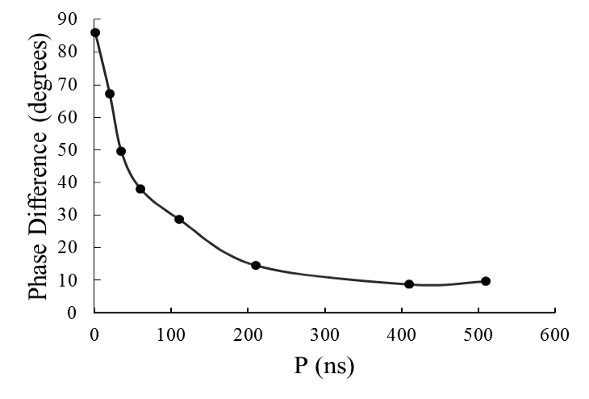
Coherence Transfer through DD Interaction Calculation Result

Slide 39
Coherence Transfer through DD Interaction Analysis
Sources of difference from expectation
Dipole-Dipole effect could not be large -- our calculation built on that, nor be large -- 34P signal could not be detected.
THz pulse simulation -- shape undetermined, amplitude undetermined.
Phase difference decay fast.

Slide 40
Coherence Transfer through DD Interaction Analysis
Dipole-Dipole effect could not be large -- our calculation built on that, nor be large -- 34P signal could not be detected.
THz pulse simulation -- shape undetermined, amplitude undetermined.
Phase difference decay fast.

Slide 41
Conclusion and Prospect What I’ve Done
Explored the influence of Dipole-Dipole interaction and other effect on the collective lifetime of a cold gas.
Explored the influence of Dipole-Dipole interaction on wavepackets evolution.
Explored the coherence transfer from one atom to another through Dipole-Dipole interaction.

Slide 42
Conclusion and Prospect What could be done
Unify the distance between nearest neighbors in an ensemble and check the influence of Dipole-Dipole interaction again.
Explore the usage of coherence transfer through D-D interaction.
And more.

