Slide 1
Influence of Dipole-Dipole Interaction on Electron Dynamics in Cold Rydberg Gas
Tao Zhou

Slide 2
Defense Outline
Rydberg Atoms and Dipole-Dipole Interaction
Experiment Setup
Decay in Cold Rydberg Atoms
Wavepackets Evolution and DD Interaction
Coherence Transfer through DD Interaction
Conclusion and Prospect

Slide 3

Rydberg Atoms and Dipole-Dipole Interaction What is A Rydberg Atom
High orbit
Long lifetime
Easy to be affected by external field
Large collision section
…..
+q
-q
Could be viewed as a dipole
$$\vec{μ}=q\vec{r}$$

Slide 4
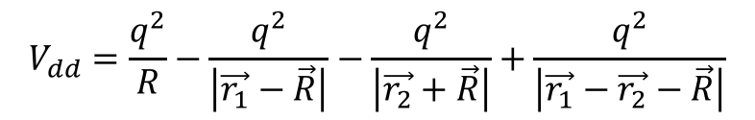
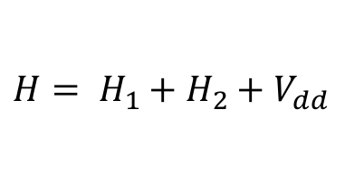
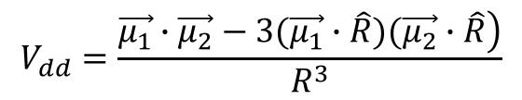
Rydberg Atoms and Dipole-Dipole Interaction What is Dipole-Dipole Interaction
Classic picture
$H= H_{1}+H_{2}+V_{dd}$
$$V_{dd}=\frac{q^{2}}{R}−\frac{q^{2}}{\left|\vec{r_{1}}−\vec{R}\right|}−\frac{q^{2}}{\left|\vec{r_{2}}+\vec{R}\right|}+\frac{q^{2}}{\left|\vec{r_{1}}−\vec{r_{2}}−\vec{R}\right|}$$
$$V_{dd}=\frac{\left.\vec{μ_{1}}∙\vec{μ_{2}}−3(\vec{μ_{1}}∙\hat{R})(\vec{μ_{2}}∙\hat{R}\right)}{R^{3}}$$

Slide 5
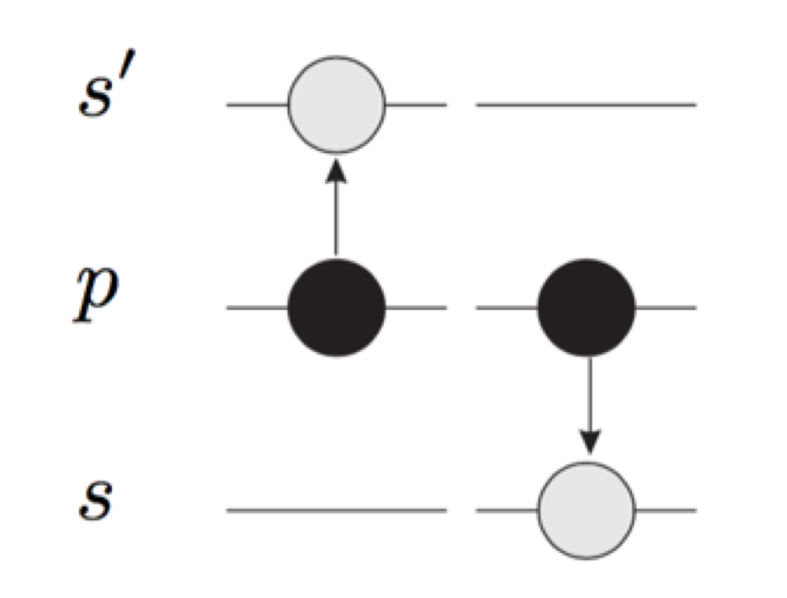
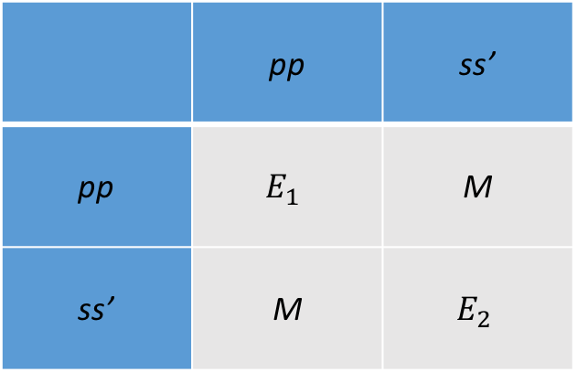
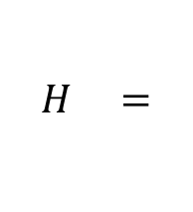
Rydberg Atoms and Dipole-Dipole Interaction What is Dipole-Dipole Interaction
Quantum picture
 | pp | ss’
pp | $$E_{1}$$ | M
ss’ | M | $$E_{2}$$
$$H =$$
$$M=\left|\left\langle pp | V_{dd} | ss^{′}\right\rangle \right|∝\left|\left\langle p | r_{1} | s\right\rangle \right|∙\left|\left\langle p | r_{2} | s^{′}\right\rangle \right|=\left|μ_{ps}μ_{ps^{′}}\right|$$

Slide 6



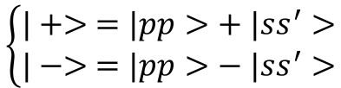
Rydberg Atoms and Dipole-Dipole Interaction What is Dipole-Dipole Interaction
Quantum picture
$$H= \left(\begin{matrix}E & M \\ M & E\end{matrix}\right)$$
$$\left\{\begin{matrix}E_{1}=E+M \\ E_{2}=E−M\end{matrix}\right.$$
$$\left\{\begin{matrix}|+> =|pp>+ |ss^{′}> \\ |−> =|pp>− |ss^{′}>\end{matrix}\right.$$
$$\&$$
|+>
2M
pp
ss’
|->

Slide 7




Experiment Setup Magneto-Optical Trap (MOT)
1 D model
3 D model
$$σ_{−}$$
$$σ_{−}$$
$$σ_{+}$$
$$σ_{−}$$
$$σ_{+}$$
$$σ_{+}$$

Slide 8
Experiment Setup State-Selective Field Ionization (SSFI)
Electric field tilt Coulomb potential
Ionization signal

Slide 9
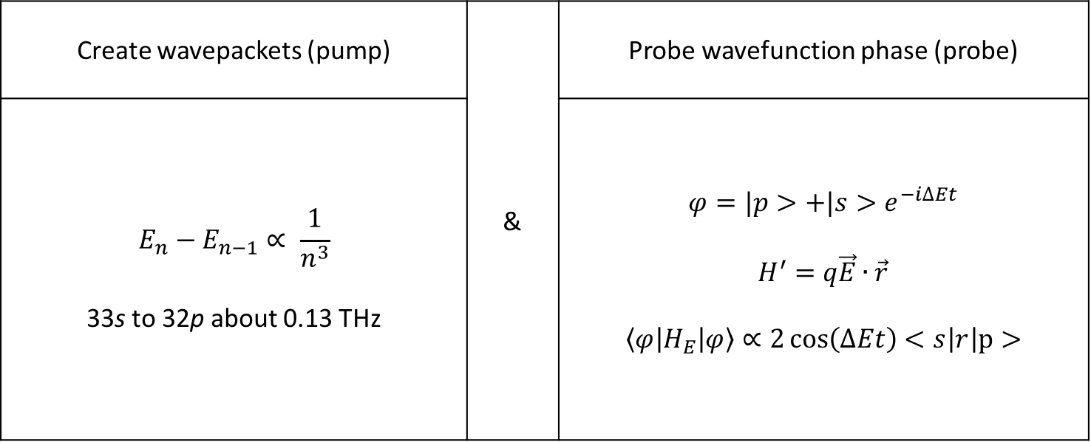
Experiment Setup Why Use THz pulses
Create wavepackets (pump) | & | Probe wavefunction phase (probe)
$$E_{n}−E_{n−1}∝ \frac{1}{n^{3}}$$ 33s to 32p about 0.13 THz |  | $$φ=|p>+|s>e^{−i∆Et}$$ $$H^{′}=q\vec{E}∙\vec{r}$$ $$\left\langle φ | H_{E} | φ\right\rangle ∝2\cos\left(∆Et\right)<s\left|r\right|p>$$

Slide 10
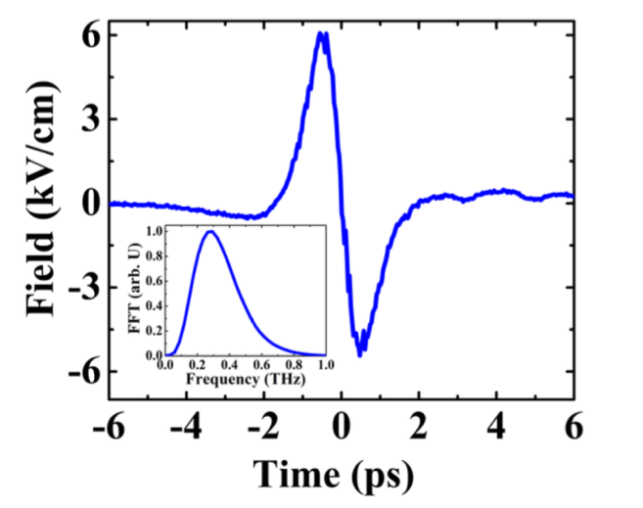

Experiment Setup THz Pulses Generation
Tilted-Pulse-Front-Pumping (TPFP) optical rectification
Properties
[*]
grating
LiNb$O_{3}$
fs,780nm, laser
[*] work done by Sha Li in our lab

Slide 11



Decay in Cold Rydberg Atoms Superradiance Emission
spontaneous emission
superradiance emission
high P
λ
$$hv$$
d
low S
$photon emission rate ∝N^{2}$
$$photon emission rate ∝N$$
R.H. Dicke, Physics Review. 93, 99 (1954)
M. Gross, P. Goy, C. Fabre, S. Haroche, and J. M. Raimond, Phys. Rev. Lett. 43, 343 (1979)

Slide 12
Decay in Cold Rydberg Atoms Superradiance Emission
R.H. Dicke, Physics Review. 93, 99 (1954)
M. Gross, P. Goy, C. Fabre, S. Haroche, and J. M. Raimond, Phys. Rev. Lett. 43, 343 (1979)

Slide 13
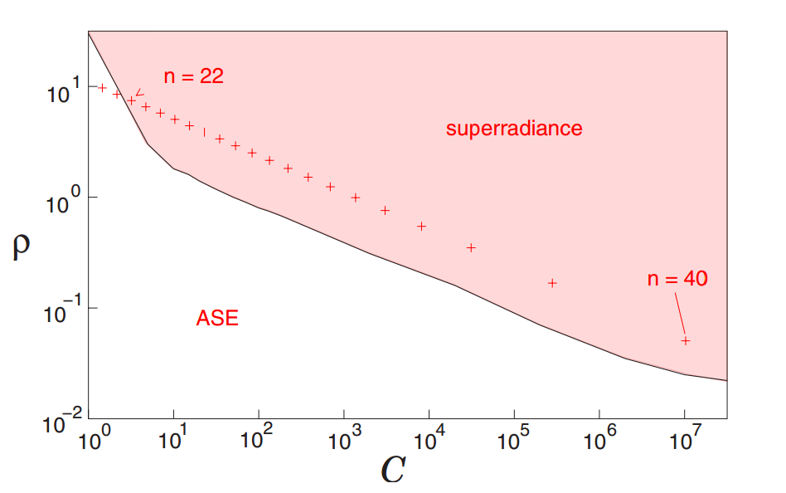
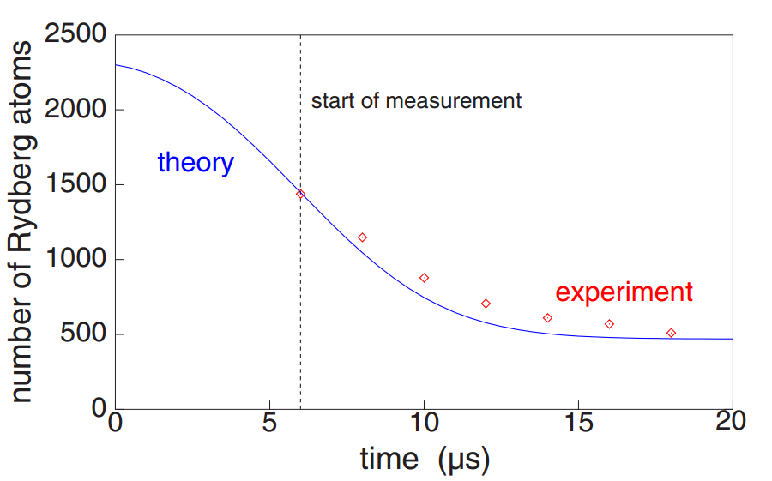
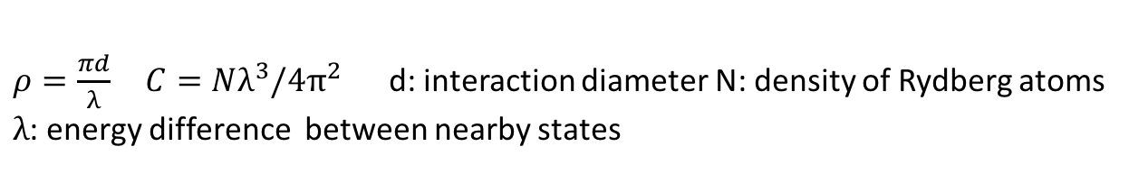
Decay in Cold Rydberg Atoms Superradiance in Cold Rydberg Atoms?
Condition?
Ionization signal for atoms starting from 43P
n = 26
n = 32
n = 40
$ρ=\frac{πd}{λ} C=Nλ^{3}/4π^{2}$ d: interaction diameter N: density of Rydberg atoms
$λ$: energy difference between nearby states
T. Wang, S.F. Yelin, R. Cote, and etc. Physics Review A 75, 033802(2007)
also see: J. O. Day, E. Brekke, and T. G. Walker. Physics Review A 77, 052712(2008)

Slide 14
Decay in Cold Rydberg Atoms Experiment Procedure
Signal
MCP
Cold atoms
_
SSFI
+
d
T
Laser beam

Slide 15
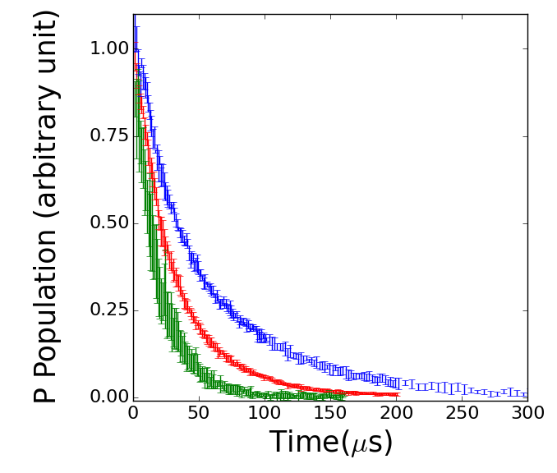
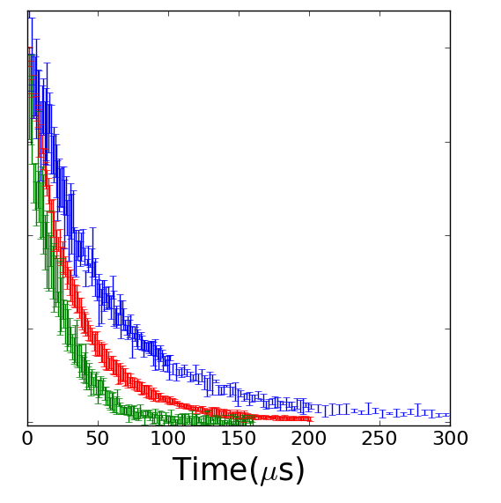


Decay in Cold Rydberg Atoms Experiment Result
$$3.0×{10}^{9}{cm}^{−3}$$
1$.5×{10}^{9}{cm}^{−3}$
I: n = 40 $τ_{spon}≈150us$
I: n = 32 $τ_{spon}≈70us$
I: n = 26 $τ_{spon}≈40us$

Slide 16
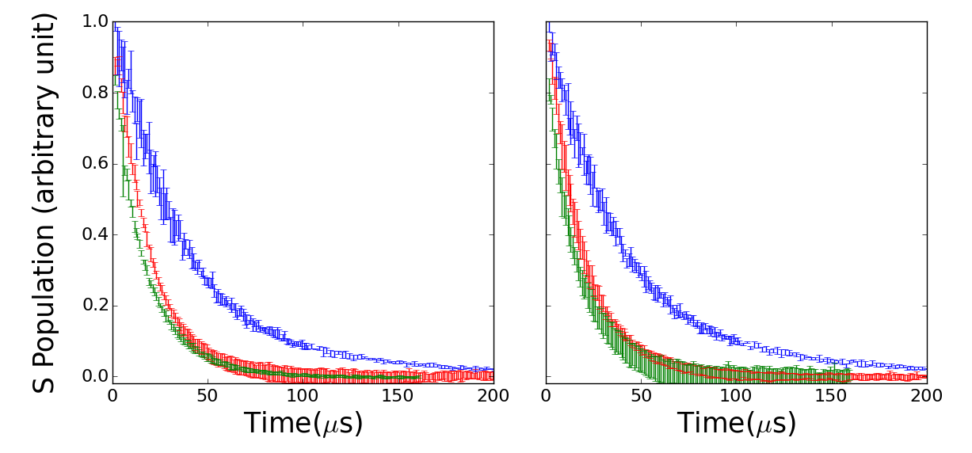

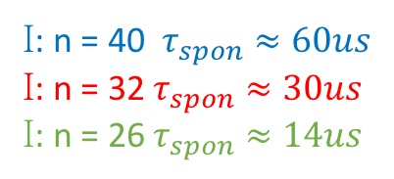
Decay in Cold Rydberg Atoms Experiment Result
$$3.0×{10}^{9}{cm}^{−3}$$
$$1.5×{10}^{9}{cm}^{−3}$$
I: n = 40 $τ_{spon}≈60us$
I: n = 32 $τ_{spon}≈30us$
I: n = 26 $τ_{spon}≈14us$

Slide 17
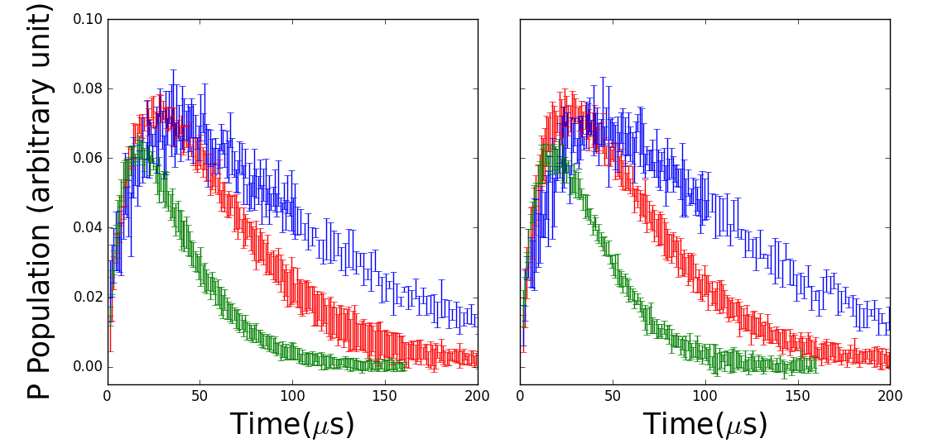


Decay in Cold Rydberg Atoms Experiment Result
$$1.5×{10}^{9}{cm}^{−3}$$
$$3.0×{10}^{9}{cm}^{−3}$$
I: n = 40
I: n = 32
I: n = 26

Slide 18
Decay in Cold Rydberg Atoms Model Considering Blackbody Radiation and Spontaneous Decay
41S
39D
B
S
B
40P
S
B
B
40S
S
B
38D
B
S
39P
S
B
S
B
39S
37D
S
S

Slide 19
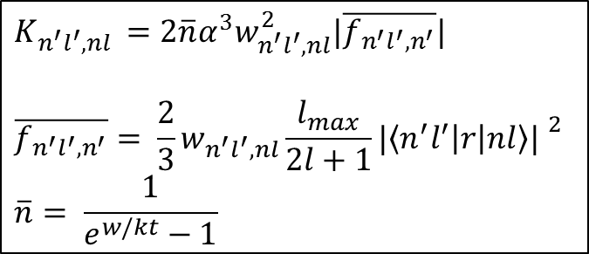


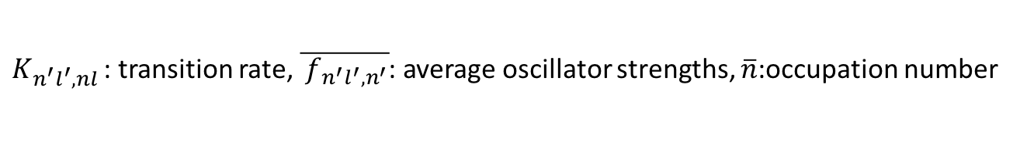
Decay in Cold Rydberg Atoms Calculation
Blackbody radiation induced transition rate
$$n^{′}l′$$
[*]
$$K_{n^{′}l^{′},nl }=2\overline{n}α^{3}w_{n^{′}l^{′},nl}^{2}|\overline{f_{n^{′}l^{′},n^{′}}}|$$
$$\overline{f_{n^{′}l^{′},n^{′}}}= \frac{2}{3}w_{n^{′}l^{′}, nl}\frac{l_{max}}{2l+1}{|\left\langle n^{′}l^{′} | r | nl\right\rangle | }^{2}$$
$$\overline{n}= \frac{1}{e^{w/kt}−1}$$
$$nl$$
$K_{n^{′}l^{′},nl }$: transition rate, $\overline{{ f}_{n^{′}l^{′},n^{′}}}$: average oscillator strengths, $\overline{n}$:occupation number
[*] Rydberg atoms. Thomas F. Gallagher, Rydberg Atoms, Cambridge University Press 1994.

Slide 20
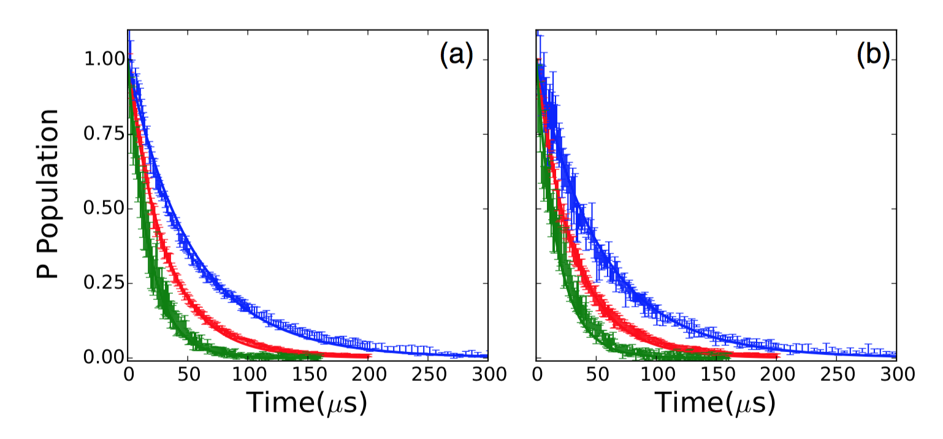
Decay in Cold Rydberg Atoms Calculation Result
Results for P states
$$3.0×{10}^{9}{cm}^{−3}$$
$$1.5×{10}^{9}{cm}^{−3}$$

Slide 21
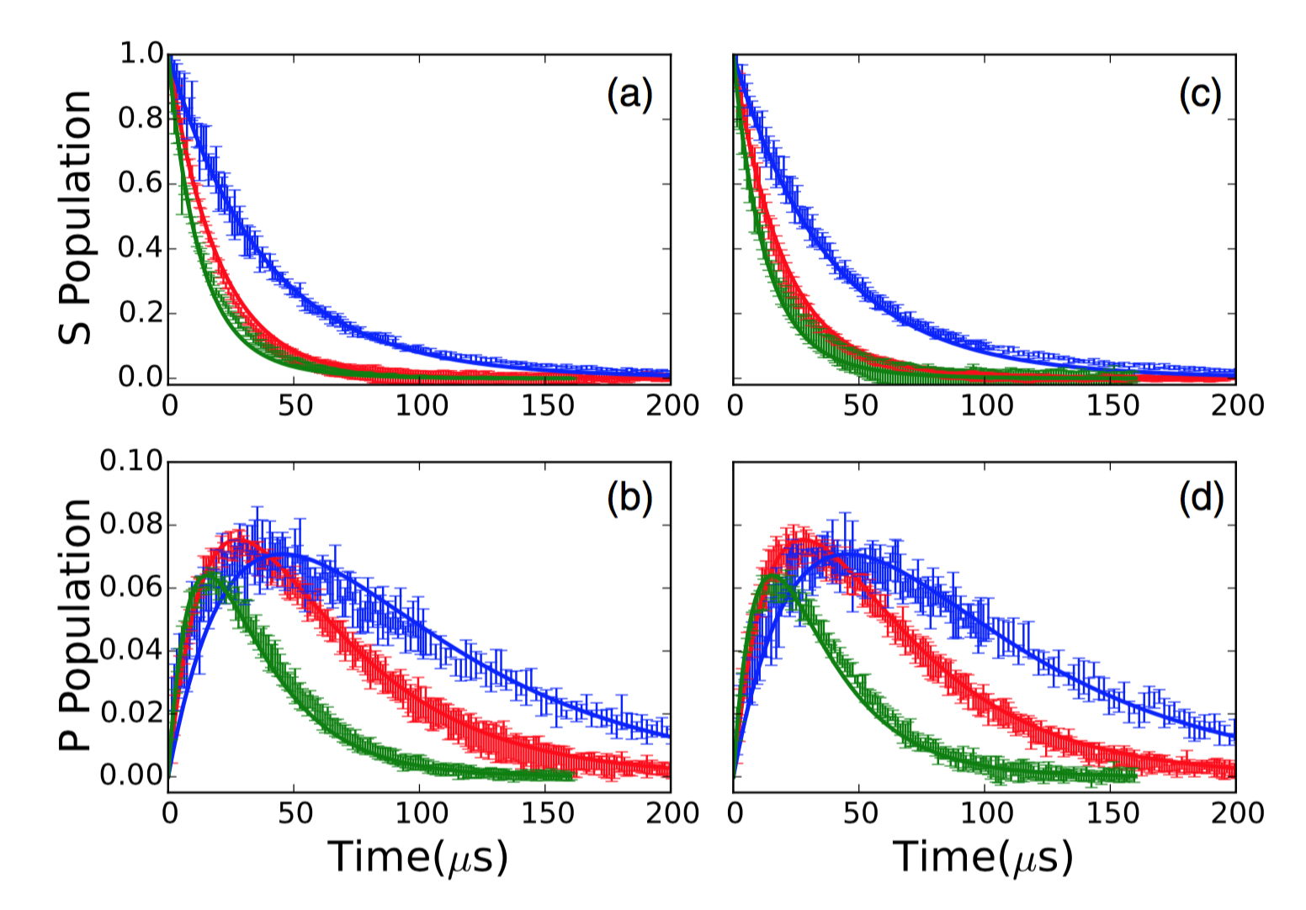


Decay in Cold Rydberg Atoms Calculation Result
Results for S states
$$3.0×{10}^{9}{cm}^{−3}$$
$$1.5×{10}^{9}{cm}^{−3}$$

Slide 22
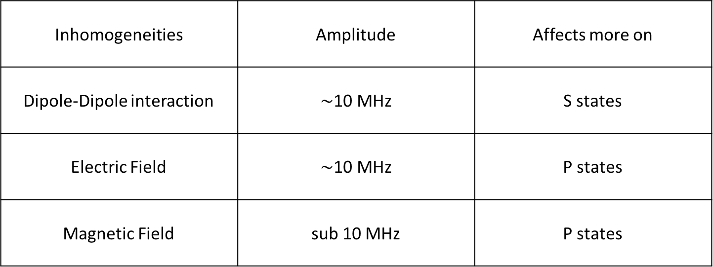
Decay in Cold Rydberg Atoms Analysis and Discussion
Suppress formation of Dicke states and superradiance.
Inhomogeneities | Amplitude | Affects more on
Dipole-Dipole interaction | $\sim$10 MHz | S states
Electric Field | $\sim$10 MHz | P states
Magnetic Field | sub 10 MHz | P states
Notes:
It is well established that superradiance is suppressed by inhomogeneities in transition energies across a sample of emitters.

Slide 23

Wavepackets evolution and DD Interaction Experiment
32p
32s
31p
T
$$∆T$$
5p
THz 1
THz 2
Time Line

Slide 24
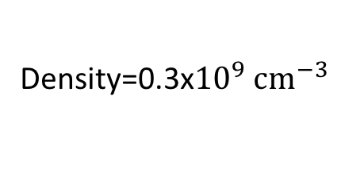
Wavepackets evolution and DD Interaction Experiment Result
Density=0.3x${10}^{9} {cm}^{−3}$

Slide 25
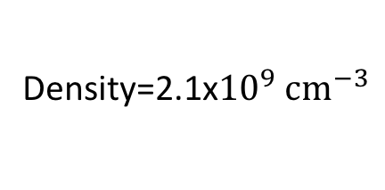
Wavepackets evolution and DD Interaction Experiment Result
Density=2.1x${10}^{9} {cm}^{−3}$

Slide 26
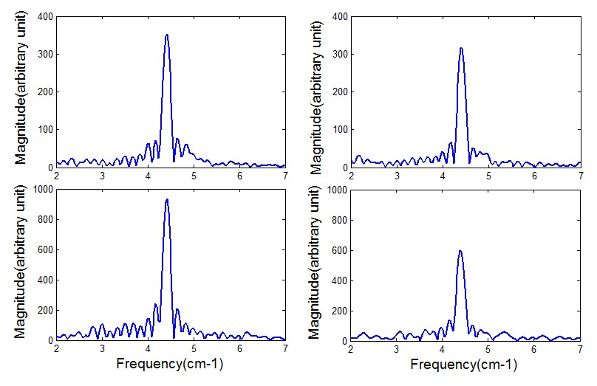
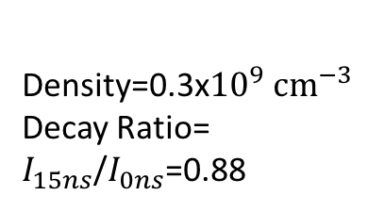
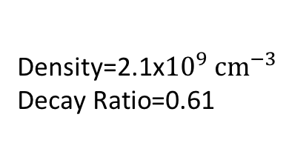
Wavepackets evolution and DD Interaction Experiment Result
Density=0.3x${10}^{9} {cm}^{−3}$
Decay Ratio=
$I_{15ns}$/$I_{0ns}$=0.88
Density=2.1x${10}^{9} {cm}^{−3}$
$$\text{Decay} \text{Ratio}\text{=0.61 }$$

Slide 27
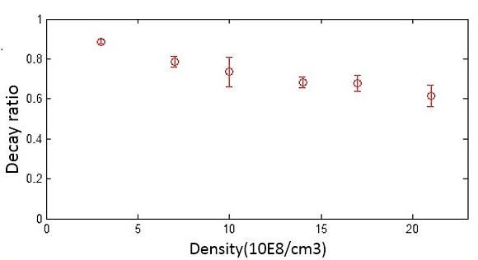

Wavepackets evolution and DD Interaction Experiment Result
Decay ratio at different densities
Density(${10}^{8}/{cm}^{3})$

Slide 28





Wavepackets evolution and DD Interaction Analysis
32s+32p↔32p+32s
ps
sp
|1>=|ps>+|sp>
2M
|2>=|ps>-|sp>
$$E_{0}$$
$$E_{0}+M$$
$$∆E+M_{1}$$
$$∆E+M_{2}$$
$$∆E+M_{3}$$
<ss|z|2>=0
ss

Slide 29


Wavepackets evolution and DD Interaction Analysis
Two Pairs
Many Many Pairs
$$∆E_{1}$$
$$∆E_{1}$$
$$∆E_{2}$$
$∆E_{1}$…$∆E_{n}$

Slide 30
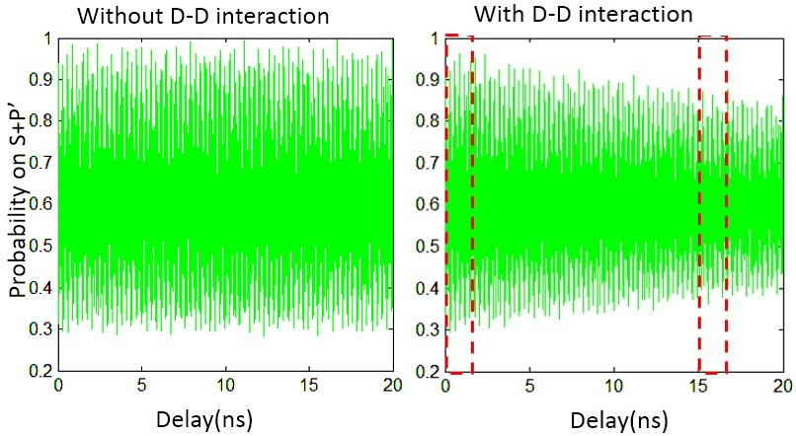
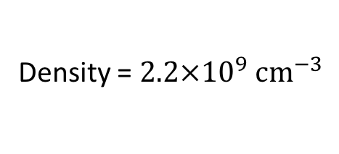
Wavepackets evolution and DD Interaction Simulation
Density = $2.2×{10}^{9} {cm}^{−3}$

Slide 31
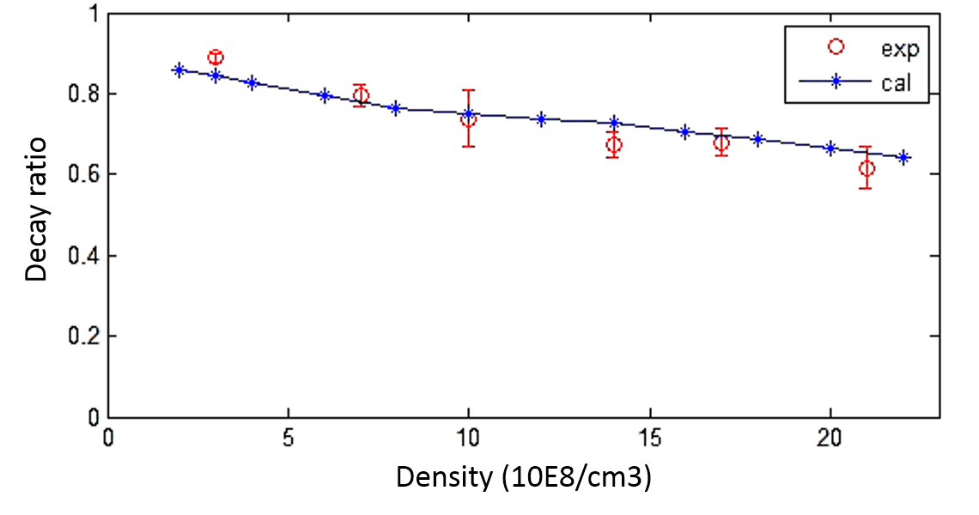

Wavepackets evolution and DD Interaction Simulation Result
Simulation result for different densitie
Density(${10}^{8}/{cm}^{3})$

Slide 32

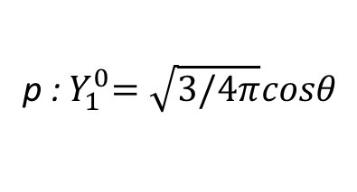

Coherence Transfer through DD Interaction Dipole Moment Oscillation
s: $Y_{0}^{0}=1/\sqrt{4π}$
p :${ Y}_{1}^{0}=\sqrt{3/4π}cosθ$
z
z
z
?
$φ=s+pe^{iΔEt}$:

Slide 33
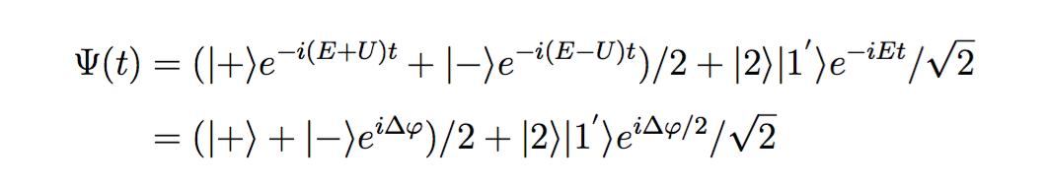
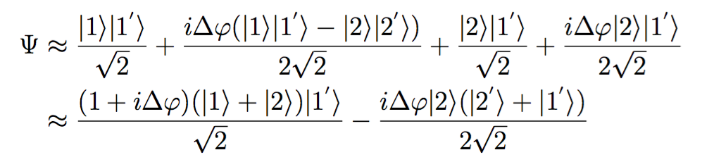
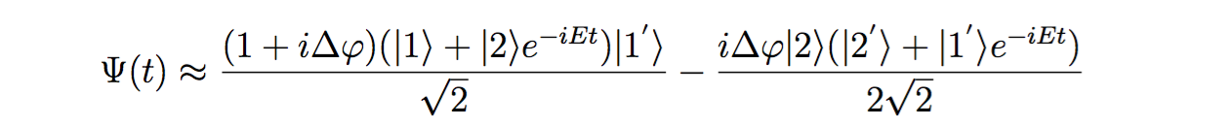
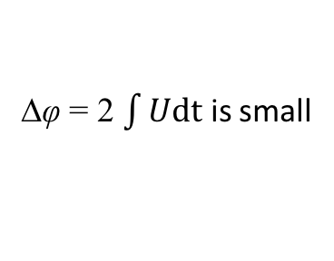
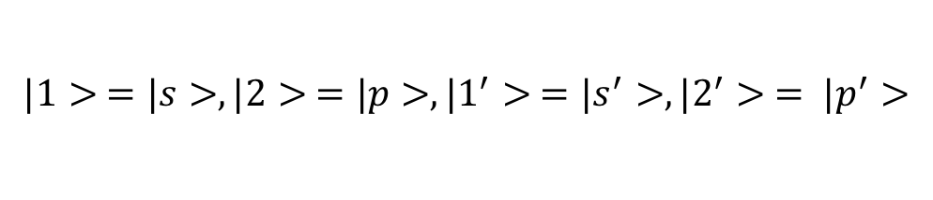
Coherence Transfer through DD Interaction Coherence Transfer
$$|1> =|s>,|2> =|p>,|1^{′}> =|s^{′}>, |2^{′}> = |p^{′}>$$
Initial:
∆φ = 2 $\int{Udt}$ is small
After DD:

Slide 34
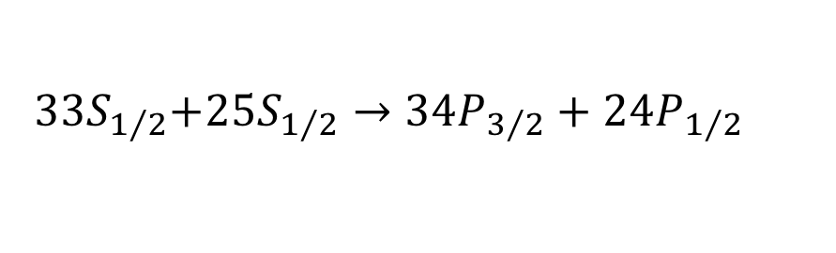
Coherence Transfer through DD Interaction Coherence Transfer
$${ 33S}_{1/2}+{25S}_{1/2}→{34P}_{3/2}+{24P}_{1/2}$$
25S+24P
33S
D-D
25S+24P
33S+34P
D-D
25S+24P$e^{iφ}$
33S+34P$e^{iθ}$

Slide 35
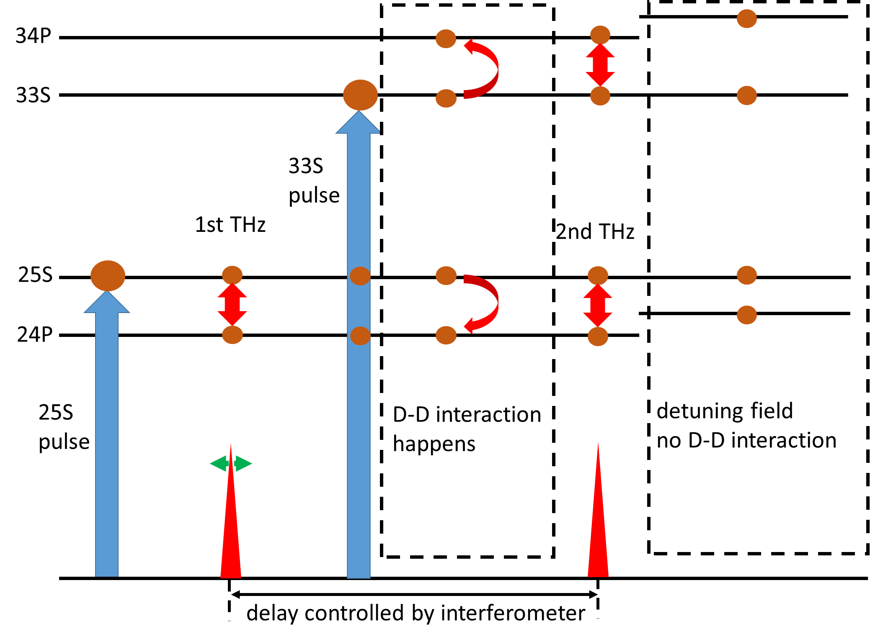
Coherence Transfer through DD Interaction Experiment
33S
34P
SSFI
T

Slide 36

Coherence Transfer through DD Interaction Experiment Result
T=0
T=600 ns
$$∆θ={21}^{0}$$

Slide 37
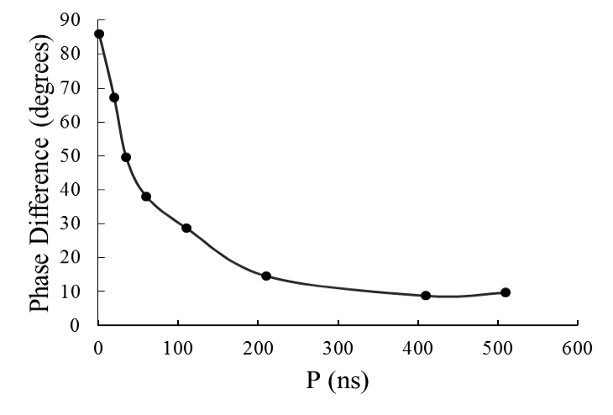
Coherence Transfer through DD Interaction Calculation Result

Slide 38
Coherence Transfer through DD Interaction Analysis
Sources of difference from expectation
Dipole-Dipole effect could not be large -- our calculation built on that, nor be large -- 34P signal could not be detected.
THz pulse simulation -- shape undetermined, amplitude undetermined.
Phase difference decay fast.

Slide 39
Conclusion and Prospect What I’ve Done
Explored the influence of Dipole-Dipole interaction and other effect on the collective lifetime of a cold gas.
Explored the influence of Dipole-Dipole interaction on wavepackets evolution.
Explored the coherence transfer from one atom to another through Dipole-Dipole interaction.

Slide 40
Conclusion and Prospect What could be done
Unify the distance between nearest neighbors in an ensemble and check the influence of Dipole-Dipole interaction again.
Explore the usage of coherence transfer through D-D interaction.
And more.

