Slide 1

Freescale
HCS12 微控制器
MC9S12DP256
2005年8月

Slide 2
使用 HCS12的第一步
1) HCS12 技术概述
2) Operating Modes工作模式
3) Resource Mapping资源映射
4) External Bus Interface外部总线接口
5) Port Integration Module端口集成模块
6) Background Debug Mode背景调试模块

Slide 3
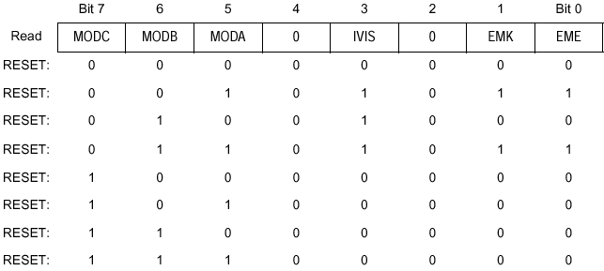
工作模式
CLOCK
/RESET
MODA
MODB
MODC
MODA
MODB
MODC/BKGD
RESET
HCS12
Mode Pins are sampled and latched
on rising edge of Reset .
Sample Latch
Mode Register
$_0B
Special Single Chip
Emulation Exp Narrow
Special Test
Emulation Exp Wide
Normal Single Chip
Normal Exp Narrow
Peripheral
Normal Exp Wide

Slide 4
Modes of Operation
MODC
MODB
MODA
MODE
ADDR
DATA
BDM
0
0
0
Special Single Chip
0
0
Active
0
0
1
Special Expanded Narrow
16
8
Allowed
0
1
0
Special Test
16
16
Allowed
0
1
1
Emulation Expanded Wide
16
16
Allowed
1
0
0
Normal Single Chip
0
0
Allowed
1
0
1
Expanded Narrow
16
8
Allowed
1
1
0
Peripheral Mode
---
---
---
1
1
1
Expanded Wide
16
16
Allowed
MODA and MODB have active pulldowns during reset.
MODC has the pull-up on the pin enabled after reset.
Mode Pins are sampled and latched on rising edge of Reset
Notes:
Normal Operating Modes: These modes provide three operating configurations. Background Debug is available in all three modes, but must first be enabled for some operations by means of a BDM background command, then activated.
Normal Single-Chip Mode — There is no external expansion bus in this mode. All pins of Ports A, B and E are configured as general purpose I/O pins Port E bits 1 and 0 are available as general purpose input only pins with internal pullups enabled. All other pins of Port E are bidirectional I/O pins that are initially configured as high-impedance inputs with internal pullups enabled. Ports A and B are configured as high-impedance inputs with their internal pullups disabled.
Normal Expanded Wide Mode
Normal Expanded Narrow Mode
Special Operating Modes: There are two special operating modes that correspond to normal operating modes. These operating modes are commonly used in factory testing and system development.
Special Single-Chip Mode — When the MCU is reset in this mode, the background debug mode is enabled and “active”. The MCU does not fetch the reset vector and execute application code as it would in other modes. Instead the active background mode is in control of CPU execution and BDM firmware is waiting for additional serial commands through the BKGD pin. When a serial command instructs the MCU to return to normal execution, the system will be configured as described below unless the reset states of internal control registers have been changed through background commands after the MCU was reset.
Special Test Mode — In expanded wide modes, Ports A and B are configured as a 16-bit multiplexed address and data bus and Port E provides bus control and status signals. In special test Mode, the write protection of many control bits is lifted so that they can be thoroughly tested without needing to go through reset.

Slide 5
MODC, MODB, MODA Write Capability
MODC
MODB
MODA
MODE
MODx Write Capability
0
0
0
Special Single Chip
MODC, B, A write anytime but not to 110
0
0
1
Special Expanded Narrow
no write
0
1
0
Special Test
MODC, B, A write anytime but not to 110
0
1
1
Emulation Expanded Wide
no write
1
0
0
Normal Single Chip
MODB, A write once but not to 110
1
0
1
Expanded Narrow
no write
1
1
0
Peripheral Mode
no write
1
1
1
Expanded Wide
no write

Slide 6
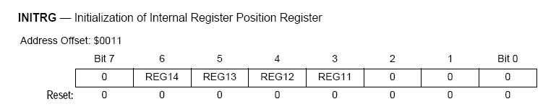
内部存储器映射-寄存器
寄存器,RAM,EEPROM可以通过设置INITRG,INITRM,INITEE来重新分配他们的位置。
这些寄存器只能写一次，建议在初始化分配寄存器，RAM,EEPROM的位置。对每个INITxx赋值后，在其指令后需插入一空指令。
如果映射有冲突，寄存器具有最高优先级，与其重叠的RAM和EEPROM此时无效。
复位后，寄存器从0x0000开始，但可以被映射到64K空间内的前32K的范围内，而且映射的地址必须是2K的整数倍。
内部寄存器位置初始化寄存器
15 14 13 12 11 10 9 8 7 6 5 4 3 2 1 0
0 0 0 1 0 0 0 0 0 0 0 0 0 0 0 0 0x1000

Slide 7
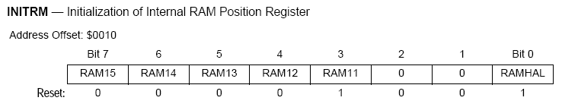
内部存储器映射-RAM
1、复位后RAM区从0x1000开始，但可以被映射到64K字节空间内的任何16K字节块内。
比如从$0000-$3FFF,$4000-$7FFF.
2、RAM15-14用来决定RAM区映射到哪个16K的字节块中。RAM13-11不起作用
3、RAMHAL用来决定12KRAM是放在16K的后12K区域还是前12K区域
比如INITRM=9,则RAM从$9000到$BFFF共12K
内部RAM位置初始化寄存器

Slide 8
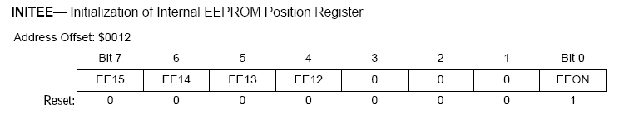
内部存储器映射-EEPROM
DP256有4K的EEPROM，通过INITEE的EEON位来使能
复位后，EEPROM区域从$0000开始，但可被映射任意64K空间中的4K字节块内。
EE15-12决定16位EEPROM区域地址的前4位
比如：INITEE=0x11,则地址是从$1000开始
内部EEPROM位置初始化寄存器
EEON
1 = EEPROM IS ENABLED
0 = EEPROM IS DISABLED

Slide 9
映射优先级
如果资源映射时，发生重叠，则优先级高的资源有效
优先级
资 源
BDM space (Internal) when BDM is active
this 256 byte block of registers and ROM
appear at $FF00 – $FFFF
最高
Register Space (Internal) – 1K bytes fully
blocked for registers
...
...
RAM (Internal) – 12K bytes
...
EEPROM – 4K bytes
...
On-Chip Flash EEPROM – 256K bytes
最低
Remaining external
在扩展模式下，所有没有被内部资源用到的地址空间将被默认为外部存储器

Slide 10
强烈建议！
尽量使用默认的资源映射设置！
需要对资源映射时，注意不要使地址重叠，导致异常错误

Slide 11
存储器映射 & 工作模式
$0000
$0400
$1000
$4000
$FF00
$FFFF
Registers
Registers
Registers
$0000
Registers
$03FF
Mappable to any 2K Block
within the first 32K.
Mappable to any 4K Block
12K Mappable to any 16K
Block and alignable to top
or bottom
4K EEPROM
4K EEPROM
4K EEPROM
$0000
EEPROM
$0FFF
$1000
$3FFF
12K RAM
12K RAM
12K RAM
Page $3E
$4000
Flash
$7FFF
16K
Flash
(Fixed)
16K
Flash
(Fixed)
16K
Flash
(Fixed)
16Kx16
internal Flash
Pages
(Windowed)
16Kx16
Flash
Pages
(Windowed)
16Kx16
Flash
Pages
(Windowed)
$8000
Flash
$BFFF
16Kx48
external Flash
Pages
(Windowed)
16K
Flash
(Fixed)
16K
Flash
(Fixed)
Page $3F
$C000
Flash
(Page 63)
$FFFF
16K
Flash
(Fixed)
BDM
(If Active)
VECTORS
扩展
VECTORS
单 片
$FF00
$FFFF
特殊单片模式

Slide 12
FLASH
$4000–$FFFF间的存储数据是可以访问的。
由于Flash 模块的地址范围超出了 HCS12 的64K (16-bit)地址空间，所以从 $8000–$BFFF被映射到若干16K字节大小的页框中。 由PPAGE寄存器决定在当前访问的是哪一页。
$8000 - $BFFF间共有64个可访问的页。 使用PPAGE寄存器可以访问到地址在$8000–$BFFF间的所有共16页的16K字节。
Flash模块中每个块包含许多行控制和状态寄存器，它们都位于的相同地址空间 INITRG + $100 - INITRG + $10F。通过Flash 配置寄存器选择有效的某行寄存器。
MC9S12DP256 有7个引脚端口， 端口K，用来仿真或者作为通用 I/O。其余六个端口用来决定哪一个Flash页正在被访问。 其余的地址位放在 PPAGE 寄存器中。

Slide 13
FLASH
除了硬件的分页机制外，另外增加了两条指令，用来调用页内函数。
CALL指令类似于JSR，除了把分页窗返回地址放到堆栈中，它还会在CALL指令把新的8位的数据写到PPAGE之前，把PPAGE的当前值放到堆栈中。
调用CALL指令，需要用RTC指令返回
程序继续执行时，把PPAGE的值和分页窗口的地从堆栈中调出
MC9S12DP256的PPAGE有6位，可以有1M的寻址范围
低地址范围的768K通过PPAGE $00到$2F来访问，它被保留用作外部存储器（当使用扩展模式时）
高地址范围的256K由PPAGE的$30到$3F来访问，用作内部FLASH存储区

Slide 14
FLASH分页机制
所有的256K的FLASH可以通过16K的PPAGE窗口来访问，其中两个16K的页也可以通过固定地址（$4000-7FFF, $C000-FFFF）来访问。
$4000-$7FFF与$3E相对应，$C000-$FFFF与$3F相对应
这两个固定页克服了内存分页机制的一些缺点
采用分页机制，在某一页中的函数无法直接访问访问另一页中的数据
需要被其它页的函数访问的数据应该放在固定页中，或只有固定页的函数才能访问其他页的数据
因为复位和中断向量表只有16位，所以所有的中断服务程序和复位初始化程序必须从固定页中开始执行。
大部分中断服务程序可以放在非固定页中，部分的中断服务程序尤其起始部分要放在固定页中。通过CALL来调用非固定页中的函数，最后用RTI指令返回

Slide 15
FLASH-Codewarrior
Codewarrior引入两个关键字：near, far
Near函数用JSR或BSR来调用
Far函数用CALL来调用
比如：void far func1(void); //func1函数放在非固定页中，可以被其他页的函数调用
const int *far ptr; //指向常量的指针放在非固定页中，这个指针可以用来指向非固定页中的变量

Slide 16
Codewarrior内存模型
Codewarrior支持3种不同的内存模型：
SMALL（默认），平面的64K的地址空间。所有的函数都是near
BANKED，即采用分页地址。所有的用户的函数都被默认为far
far类型的数据指针可以在SMALL和BANKED中使用
LARGE， 默认为数据和代码均为分页模式。所有的函数和数据指针都是far类型。这种内存模型运行时间比较长，因此很少使用
MC9S12DP256最常用的是BANKED内存模型

Slide 17
Codewarrior分段
代码和数据可以被分组被Linker放在特定的存储区中
#pragma用来给代码段或数据段命名并分配属性
#pragma CODE_SEG定义一个代码段。
NEAR规定本段中的函数用JSR来调用，即只能被本页函数调用，除非把它放在固定页中
FAR规定本段中的函数用CALL来调用
如果没有规定NEAR或FAR,函数的类型由内存模型来决定
如果没有规定段，则代码放在DEFAULT_ROM中
所有跟在#pragma CODE_SEG后面的函数回放在该段中，直到下一个#pragma CODE_SEG出现，因此在头文件中，声明函数原型时，必须使用#pragma CODE_SEG
#pragma CODE_SEG [NEAR|FAR] <segment_name>
#include "functions.h"
#pragma CODE_SEG FUNCTIONS
void func1(void)
{
/* code */
};
void func2(void)
{
/* code */
};
#pragma CODE_SEG DEFAULT
#pragma CODE_SEG FUNCTIONS
void func1(void);
void func2(void);
#pragma CODE_SEG DEFAULT

Slide 18
Codewarrior-数据段
#pragma DATA_SEG把全局变量发到一个特定的段中
SHORT规定本段中的全局变量采用直接寻址方式。但是这段变量必须放在$0000到$00FF中
如果没有#pragma DATA_SEG，全局变量将会被放到DEFAULT_RAM段中
所有跟在#pragma DATA_SEG后面的函数回放在该段中，直到下一个#pragma DATA_SEG出现
如果全局变量被其他文件使用，则在其他文件中声明变量时，必须重复使用相同的#pragma DATA_SEG
#pragma DATA_SEG [SHORT] <segment_name>

Slide 19
Codewarrior-常数段
#pragma CONST_SEG定义了一个常数段
PPAGE规定常数的访问要通过PPAGE, 常数可以放在非固定页
如果没有PPAGE,变量应该放在固定页
如果没有#pragma CONST_SEG，常数会被放在ROM_VAR
所有跟在#pragma CONST_SEG后面的函数回放在该段中，直到下一个#pragma CONST_SEG出现
如果全局变量被其他文件使用，则在其他文件中声明变量时，必须重复使用相同的#pragma CONST_SEG
#pragma CONST_SEG [PPAGE] <segment_name>
#pragma CONST_SEG B
extern const int var2;
#pragma CONST_SEG DEFAULT

Slide 20
Codewarrior-中断函数
中断函数需要放在固定页
#pragma TRAP_PROC表示以下的函数将用RTI指令返回
如果使用interrupt关键字，则不必再写#pragma TRAP_PROC
__NEAR_SEG显性地表示这段代码放在固定页
#pragma CODE_SEG __NEAR_SEG NON_BANKED
#pragma TRAP_PROC
void interrupt_func1(void)
{
/* code */
};
#pragma CODE_SEG DEFAULT
#pragma CODE_SEG __NEAR_SEG NON_BANKED
void interrupt interrupt_func1(void)
{
/* code */
};
#pragma CODE_SEG DEFAULT

Slide 21
Memory Map
$0000
$0400
$1000
$4000
$8000
$C000
$FF00
$FFFF
Registers
$0000
$0400
$1000
$4000
$8000
$C000
$FF00
$FFFF
Registers
$0000
$0400
$1000
$4000
$8000
$C000
$FF00
$FFFF
Registers
Registers- Mappable to any 2k Block
within the first 32kByte.
EEPROM- Mappable to any 4k Block
RAM- 12k Mappable to any 16k
Block and alignable to top
or bottom.
EEPROM
EEPROM
EEPROM
RAM
RAM
RAM
16kByte
fixed
Flash
16kByte
fixed
Flash
External
Memory
16kByte
paged
Flash
16kByte
paged
Flash
16kByte
fixed
Flash
16kByte
fixed
Flash
Vectors
Vectors
BDM
Expanded
Mode
Normal
Single Chip Mode
Special
Single Chip Mode

Slide 22
External Bus Interface
A/D[15:0]
R/W
ECLK
LSTRB
HCS12
AD[15:0] - Address/Data Bus
ECLK - E clock 1/2 Xtal Frequency
-> used for demultiplexing and external bus timing
LSTRB - Low byte strobe signal
-> used to enable data on the low byte of the address bus
R/W - Read=1, Write= 0
-> used to determine the data bus direction
Notes:
Normal Expanded Wide Mode — In expanded wide modes, Ports A and B are configured as a 16-bit multiplexed address and Data bus and Port E bit 4 is configured as the E clock output signal.
These signals allow external memory and peripheral devices to be interfaced to the MCU.
Normal Expanded Narrow Mode — This mode is used for lower cost production systems that use 8-bit wide external EPROMs or RAMs. Such systems take extra bus cycles to access 16-bit locations but this may be preferred over the extra cost of additional external memory devices.
Ports A and B are configured as a 16-bit address bus and Port A is multiplexed with data. Internal visibility is not available in this mode because the internal cycles would need to be split into two 8-bit cycles.
Since the PEAR register can only be written one time in this mode, use care to set all bits to the desired states during the single allowed write.

Slide 23
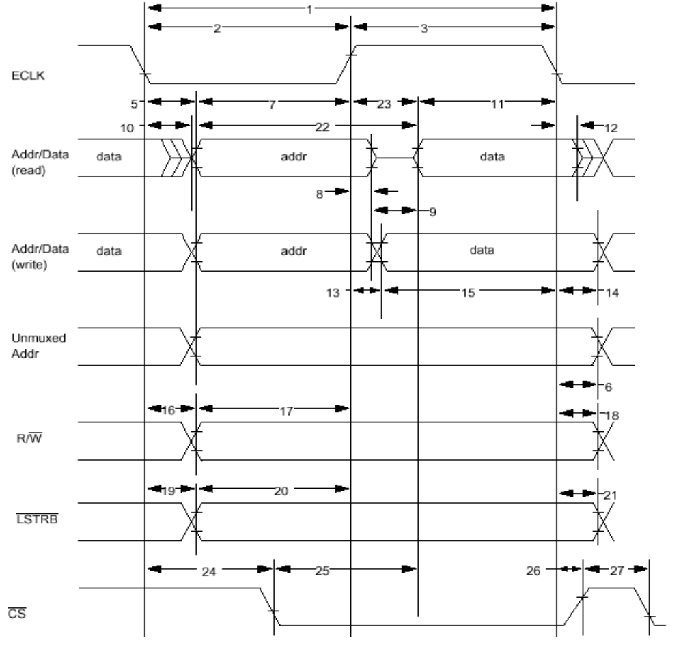
Read/Write Bus Cycle
Latch Address

Slide 24
Memory Interface Example
TO OTHER
DEVICES
ECLK
CE
OE
[D15:8]
R/W
CE
OE
Address
Latch
&
Decode
Logic
8Kx8
RAM
8Kx8
RAM
[D7:0]
LSTRB
HCS12
AD [15:0 ]
WE WE
ADDR [A12:1]
DATA [15:0]
ADDRESS
B15 B8 B7 B0
MUXED_BUS
WIDE_MODE
0000
-
-
-
-
FFFE
.
.
.
.
.
.
.
.
.
.
.
.
0001
-
-
-
-
FFFF
D15 - D8
D7 - D0

Slide 25
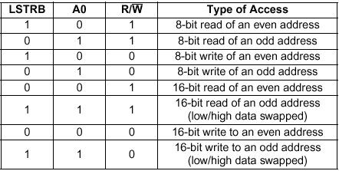
Byte Select Logic
ADDR_BUS
CS
LOGIC
CE
CE
A0
LSTRB
R/W
ECLK
OE
OE
EVEN
ODD
WE
WE
MEM
INT.
D15-8
DATA BUS
D7-0

Slide 26
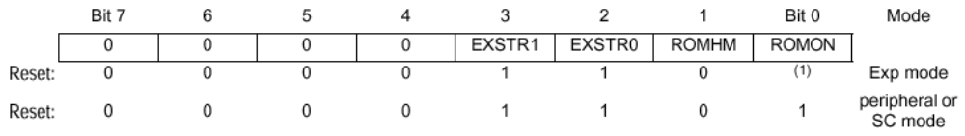

资源映射
MISC - Miscellaneous Mapping Control Register 综合映射控制寄存器
Address Offset
$0013
EXSTR BIT DEFINITION FOR
EXTERNAL ADDRESS SPACE
ROMON
1 = Enable Flash in memory map
0 =Disable Flash in memory map
EXSTR1 EXSTR0 NUMBER OF CLKS
0 0 0
0 1 1
1 0 2
1 1 3
ROMHM
1 = Disable 16K Flash Direct Access @$4000 - $7FFF
0 = 16K Flash page $3E accessible @$4000 - $7FFF
(Note: This page can still be accessed
through the Program Page Window)
EBICTL - External Bus Interface Control
Address Offset
$000E
ESTR - E CLK Stretch Enable
1 = E Clock Stretches High High on External Accesses
0 = E Clock Stretches Disabled

Slide 27
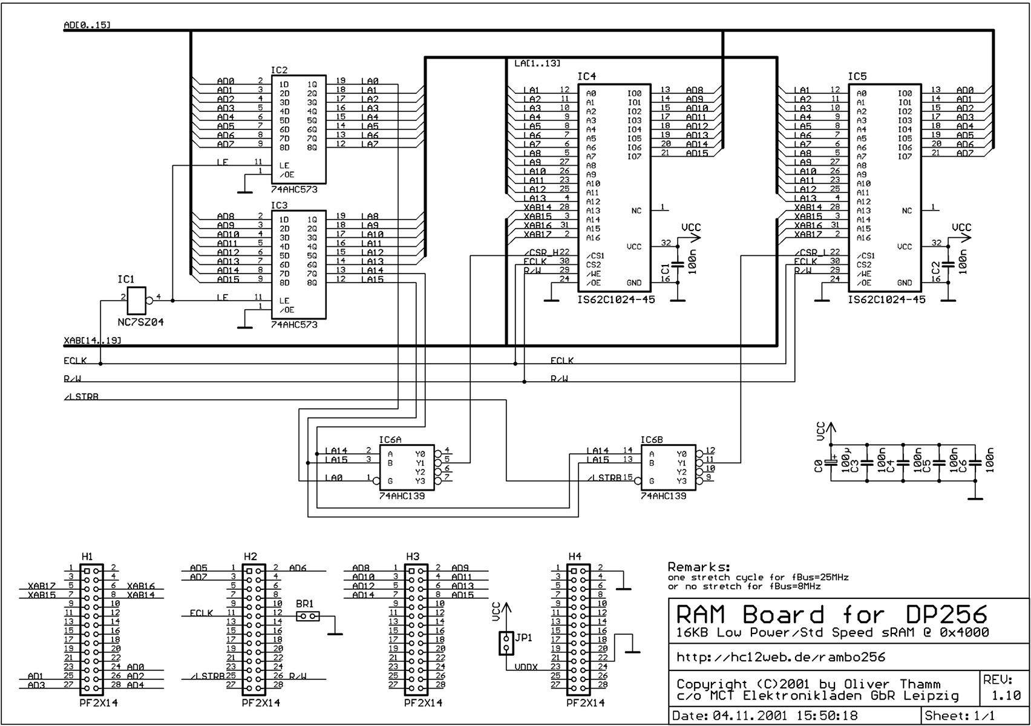
External RAM at MC9S12DP256

Slide 28
GP I/O PORTS
Mux Ports
Multiplexed Address/Data Bus
DDRA
DDRB
PORT A
PORT B
DDRx 1 = PIN IS OUTPUT
0 = PINIS INPUT
DDRA - Port A Data Direction Register
DDRB - Port B Data Direction Register
7.......………………....................................................0
7............………..............................................0
Address Offset
$0003
Read/write
Address Offset
$0002
Read/write
RST: 0……..……………………………………………………..0
RST: 0..................………..........................................0
PORTA - Port A Data Register
PORTB - Port B Data Register
7..…………………........................................................0
$0000
7..........……………..................................................0
Read/write
Read/write
$0001
RST: U…….…………………………………………………..….U
RST: U…….…………………………………………………..….U
Expanded ADDR15/ ADDR14/ ADDR13/ ADDR12 /ADDR11/ ADDR10/ ADDR9/ ADDR8/
& Periph: DATA15 DATA14 DATA13 DATA12 DATA11 DATA10 DATA9 DATA8
Expanded ADDR15/ ADDR14/ ADDR13/ ADDR12/ ADDR11/ ADDR10/ ADDR9/ ADDR8/
Narrow DATA15/ DATA14/ DATA13/ DATA12/ DATA11/ DATA10/ DATA9/ DATA8/
DATA7 DATA6 DATA5 DATA4 DATA3 DATA2 DATA1 DATA0
Expanded ADDR7/ ADDR6/ ADDR5/ ADDR4 /ADDR3/ ADDR2/ ADDR1/ ADDR0/
& Periph: DATA7 DATA6 DATA5 DATA4 DATA3 DATA2 DAT1 DATA0
Expanded
ADDR7/ ADDR6/ ADDR5/ ADDR4 /ADDR3/ ADDR2/ ADDR1/ ADDR0/
Narrow

Slide 29
PORTE Registers
PORTE - PORTE Register
Address Offset
$0008
Reset: Unaffected
Alt. Pin Function XCLKS/ MODB/ MODA LSTRB R/W IRQ XIRQ
NOACC IPIPE1/ IPIE0 ECLK TAGLO
SCGTO RCRTO
XCLKS - External Clock
This pin is sampled on the rising edge of Reset to select the device clock source.
NOACC - No Access
This output signal indicates the current access is unused or free cycle.
TAGLO - Instruction Low Byte Tagging
This output signal may be used to tag the low byte of the instruction.
DDRE - PORTE Data Direction Register
Address Offset
$0009
Reset: 0 0 0 0 0 0 0 0
DDREx =0 pin is input
=1 pin is output

Slide 30
PORTE Assignments
PEAR - PORTE Assignment Register
Address Offset
$000A
Reset: 0 0 0 0 0 0 0 0 Special single chip
Reset: 0 0 1 0 1 1 0 0 Special Test
Reset: 0 0 0 0 0 0 0 0 Peripheral
Reset: 1 0 1 0 1 1 0 0 Emulation Exp Nar
Reset: 1 0 1 0 1 1 0 0 Emulation Exp Wide
Reset: 0 0 0 1 0 0 0 0 Normal Single Chip
Reset: 0 0 0 0 0 0 0 0 Normal Exp Nar
Reset: 0 0 0 0 0 0 0 0 Normal Exp Wide
PORTE Assignment Register may be used to choose between bus control or GPI/O functions.
NOACCE - CPU no Access Output Enable (Write once)
1 = Port E Pin 7 is output which indicates CPU free cycle
0 = Port E Pin 7 is GPI/O
PIPOE - Pipe Status Signal Output Enable (Write once)
1 = Port E Pins[6:5] are used as IPIPE1 and IPIPE0 for instruction queue tracking
0 = Port E Pins[6:5] are used as GPI/O
NECLK - No External E Clock (Write anytime)
1 = Port E Pin 4 used as GPI/O
0 = Port E Pin 4 is E Clock output pin
LSTRE - Low Strobe(LSTRB) Enable (Write once)
1 = Port E Pin 3 is used as LSTRB bus control signal
0 = Port E Pin 3 is used as GPI/O
RDWE - Read/Write Enable (Write once)
1 = Port E Pin 2 is configured as R/W bus control signal
0 = Port E Pin 2 Is configured as GPI/O

Slide 31
HCS12 Device Identification
The part ID is located in two 8-bit registers PARTIDH and PARTIDL. The read-only value is a unique part ID for each revision of the die.
The coding is as follows:
Bit 15-12: Major family identifier
Bit 11-8: Minor family identifier
Bit 7-4: Major mask set revision number including FAB transfers
Bit 3-0: Minor - non full - mask set revision

Slide 32

HCS12 Memory Identification
The device memory sizes are located in two 8-bit registers MEMSIZ0
and MEMSIZ1.
Also reference - EB386 “Family Compatibility Considerations” for information
on how to configure a larger derivative to act as a smaller part.

Slide 33
配置举例
如何设置系统
- 选择工作模式 (硬件 / 软件)
- 资源映射 (内部 / 外部)
- 设置时钟
- 设置PIM
- 初始化外设…

Slide 34
配置举例
创建一个带全局变量的工程文件
编译后，打开调试界面
在component菜单中打开一个新的Memory窗口
Memory：1窗口中修改0x0010：INITRM
09 → 49 → 40 →89 → 80
Memory：2窗口中显示不同地址中的内容
1000 → 5000 → 4000 →9000 → 8000
当INITRM的值改变时，变量在RAM中的位置也会改变

Slide 35
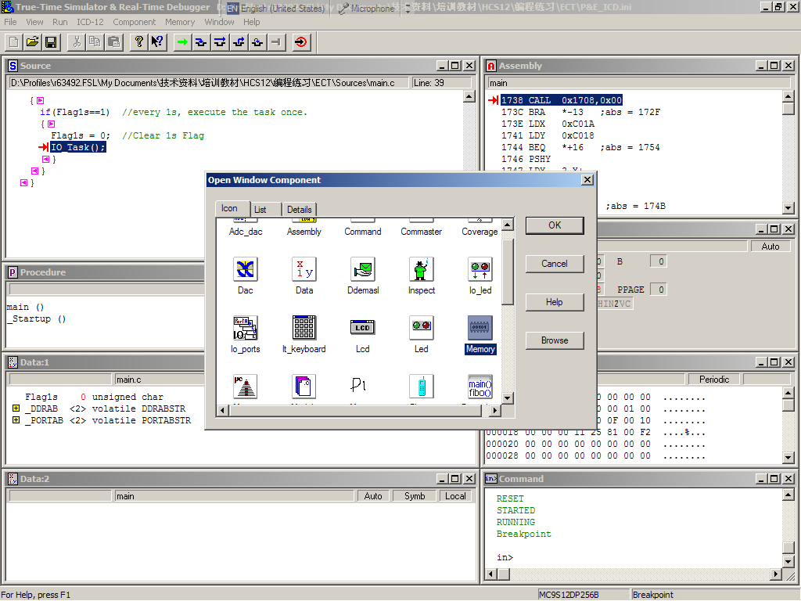
在component菜单中打开一个Memory窗口

Slide 36
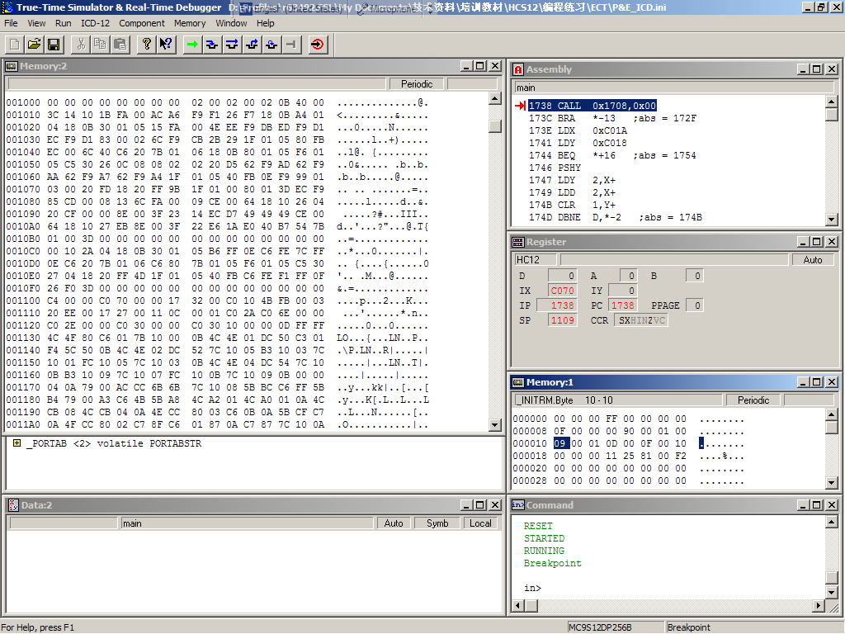
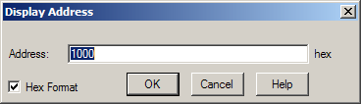
Memory：2窗口中
显示不同地址中的内容
1000 → 5000 → 4000 →9000 → 8000
Memory：1窗口中
修改0x0010：INITRM
09 → 49 → 40 →89 → 80

