Slide 1

Freescale
HCS12 微控制器
MC9S12DP256
2005年8月

Slide 2
Enhanced Capture Timer Module
增强型捕捉定时器模块
Notes:
PURPOSE
- To explain how to configure and use the Enhanced Capture Timer Interface Module in common applications
OBJECTIVES:
Be able to configure and select the ECT clocks.
Identify the steps to set up and implement an output compare function.
Identify the steps to set up and implement an input capture function.
Be able to set up ECT to measure very short pulses.
Use some timer channels for pulse accumulator function
Understand ECT Queue and Latch modes

Slide 3
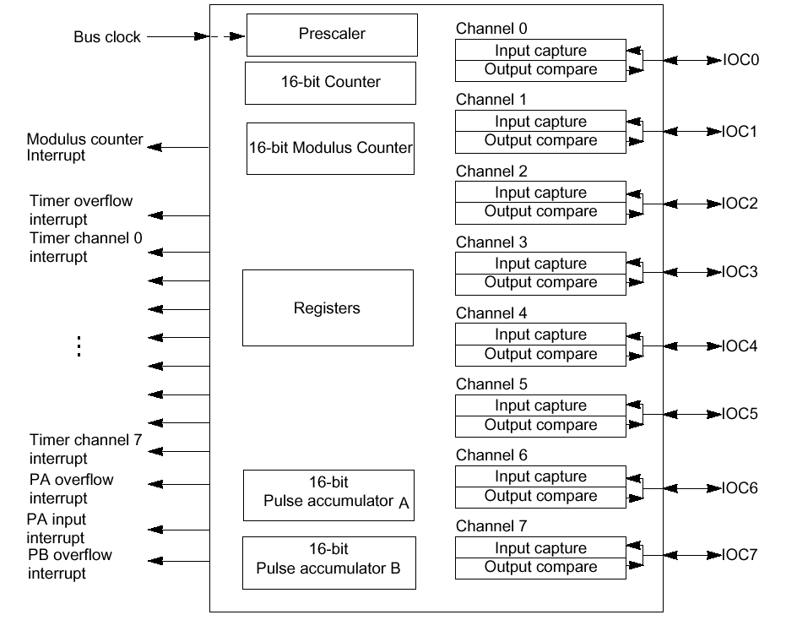
ECT 模块结构
一个16位向上带可编程预分频的主计数器.
一个16位的带可编程预分频的模数向下计数器
8个独立的定时器通道，每个通道具备输入捕捉和输出比较功能
4个8位脉冲累加器，也可设置成2个16位脉冲累加器.
通过对寄存器编程可以实现不同的功能
Notes:
Let’s begin our discussion with the main features and the conceptual overview of the Enhanced Capture Timer (ECT).
The HCS12 Enhanced Capture Timer module has the features of the HC12 Standard Timer module enhanced by additional features in order to enlarge the field of applications, in particular for automotive ABS applications.
The basic timer consists of a 16-bit, software-programmable counter driven by a prescaler. This timer can be used for many purposes, including input waveform measurements while simultaneously generating an output waveform.
The (ECT) has 8 user selectable timer channels instead of the traditional dedicated input capture and output compare functions. Each channel can be user programmed to perform either an input capture function, or output compare function. Four 8-Bit Pulse Accumulators with 8-bit buffer registers associated with the four buffered IC channels configurable also as two16-Bit Pulse Accumulators.
These functions provide the flexibility to configure the timer exactly as needed for specific applications. You can also reconfigure the channels in an application to perform different subtasks
The Input Capture and Output Compare functions share the same time base and referred to as Timer Counter or TCNT.
The ECT provides the user with many registers allowing full control of various timing applications and configurations.
.

Slide 4
定时器结构
模块时钟
计时器溢出时，对溢出标志位置位，如允许中断，则向CPU发出中断请求
M Clock
预分频选择
PR[2:0]
$FFFE
$FFFF
$0000
*******
******
**
****
TOF
1 2 4 8 16 32 64 128
计数器寄存器
TCNT
CLK
15...........................................0
.
Address Offset
$0004, 05
TCNT
B0.......……...B7 B8……..........B15
TEN
PIN
脉冲累加器
DATA BUS
TSCR1 -定时器控制寄存器
TEN TSWAI TSFRZ TFFCA
R
R
R
R
$0006
RST: 0 0 0 0 0 0 0 0
R = Reserved
1 – 计数器使能
0 – 计数器禁止
Notes:
The Timer Counter (TCNT) is a 16-bit free running counter that derives it’s clock from either the prescaled version of the Module Clock which can be in the range of M-Clock frequency to M-Clock/128.
The TCNT clock can also be derived from the Pulse Accumulator (PA) input pin directly, PA input/256 or PA input/65536 as shown in the above diagram.
From reset, the TCNT is disabled and clear to $0000 and begins to count up only after the TEN bit in TSCR1 is set. When the TCNT overflows from $FFFF to $0000, a Timer Over Flow flag gets set and the timer may generate interrupt request to the CPU, if enabled.
The prescaler provides the 16-bit counter with a clock value derived from the M-Clock and a divide-by ratio. Using PRS[2:0] bit field in the Timer Status Control Register 2 (TSCR2) we can set the divide-by ratio to one of seven values: divide-by-1, divide-by-2, or any other binary division up to divide-by-128. We can also select an external clock source.
In its highest resolution mode (divide-by-1), the TCNT supports a resolution of 62.5ns when the M-Clock is operating at frequency of 16MHz (1 divided by 16 MHz). To clock the 16-bit reference at a slower rate, the prescaler can further divide down the internal bus frequency, as slow as divide-by-128.

Slide 5
定时器，预分频，计数器
寄存器:
16 位自由运行/模计数器
B15............................................................................................................................…B0
1. TCNT
Address Offset
$0004, $0005
RST: 0........................................................................................................................0
B7......................................................................B0
TOF 0 0 0 0 0 0 0
$000F
标志寄存器
2. TFLG2
RST: 0 0 0 0 0 0 0 0
定时器溢出标志位，写 ‘1’ 清零
B7....................................................................................B0
3. TSCR2
TOI 0 0 0 TCRE PR2 PR1 PR0
$000D
预分频系数选择
RST: 0 0 0 0 0 0 0 0
PR2 PR1 PR0
除以
1 – 定时器由OC7比较符合时复位
0 – 定时器自由运行
0
0
0
0
1
1
1
1
0
0
1
1
0
0
1
1
0
1
0
1
0
1
0
1
1
2
4
8
16
32
64
128
1 – 定时器溢出中断使能
0 – 定时器中断禁止
TCRE - 允许使用PWM功能
Notes:
When the TCNT transitions from $FFFF to $0000, a Timer Overflow (TOF) flag will set and an interrupt is signaled to the CPU if the Timer Overflow Interrupt enable (TOI) bit is set in the TSCR2. The interrupt must be cleared by writing the TOF flag with a logic ‘1’.
As mentioned before, the TCNT clock frequency can be as high as the Module clock frequency.
For a 16MHZ M-Clock frequency, the TCNT finest resolution will be 62.5ns. When the counter is enabled, an over flow will occur once every 4.09 milliseconds. The overflow generation signals the application task the amount of time that has elapsed. The elapsed time may be used to calculate the exact length of a pulse or period.
The counter register is arranged to allow a ‘double byte read’ (ex. LDD $100E)
The low byte of the count is always passing through a transparent latch which is normally open(transparent). Reads of this byte alone just give you the current low order count. If you read the high byte, this latch locks for the next cycle so in a double byte read you get a high order and low order halves that belong to the same count state. Imagine what would happen otherwise if the high byte read happened at a count of say $1FFF and the low order read at $2000 - You would get $1000 which would be erroneous.

Slide 6
定时器编程步骤
用途： 产生周期中断
初始化
  设定预分频系数
  定时器溢出中断使能
  定时器使能
中断函数
  清标志位
  用户自己的代码
void ECT_Init(void)
{
TSCR2_PR = 7; //prescale factor is 8, bus clock/128=8Mhz/8
TSCR2_TOI = 1; //timer overflow interrupt enable
TSCR1_TEN = 1; //timer enable
}
#pragma CODE_SEG NON_BANKED
#pragma TRAP_PROC
void Int_TimerOverFlow(void)
{
TFLG2_TOF = 1; //clear timer overflow flag
//用户自己的代码
…………….
}
#pragma CODE_SEG DEFAULT
在PRM文件中，加入
VECTOR ADDRESS 0xFFDE Int_TimerOverFlow

Slide 7
输出比较功能
• 在特定的时刻输出一个信号
TCNT
16位自由运行计数器
当比较寄存器的值和计数
器的值相等时，采取行动
比如：当TCNT=0x5678
置位
清零
翻转
OR
OR
比较
相等
Pin
OCx
比较器
引脚控制逻辑
TOCx
16位输出比较寄存器 比如：0x5678
软件可以修改
OCxF
状态标志位置位，
当比较发生时（值相等时）
中断屏蔽
(通过软件使能)
中断请求
OCxI
• 共有8个输出比较通道
• 每个通道有自己的向量表和控制寄存器
Notes:
Now let’s take a closer look at output compare function.
The output compare function may be used for a variety of common embedded control timing functions such as stepper and servo motor control, a single shot pulse or complex waveform generation such as PWM.
To initially set up a timer channel for output compare, simply read the current value of the TCNT, add some delay to that value and write into the OC register.
An OCx event is initiated by the timer when a match of the free running counter (TCNT) equals the OCx register, causing the TCx flag to set. The OC event may cause the timer channel pinx to transition from high to low or from low to high or simply toggle the output pin, in addition an interrupt will be requested if enabled.
When the CPU services an output compare interrupt, it calculates a new output compare value by reading the OC register (Not the TCNT), adds a new Output Compare value, writes it in the OC register and clears the interrupt request before resuming normal processing.
Using the output pin set, clear, and toggle options, you can implement a single pulse output with variable width. Using the same techniques, you can generate a variable output frequency or a pulse width modulated signal.
Output compares may also be used as software timers and don’t need to control any pins. For example say you wanted to time an EEPROM programming operation. You would start programming or erase operation and set an output compare to give you an INTERRUPT in 10mS. This frees the CPU to process other tasks during EE programming operation and when the 10mS time elapses, an output compare INTERRUPT will occur and you can terminate the EE operation.

Slide 8
输出比较寄存器
16 位捕捉/比较寄存器 (TC7)
Address Offset
$0010 - $0011
-
-
$001E - $001F
1. TC7 – TC0
-
-
16 位捕捉/比较寄存器 (TC0)
B7
B6
B5
B4
B3
B2
B1
B0
比较/捕捉标志位
写 ‘1’清除中断状态标志位
C7F C6F C5F C4F C3F C2F C1F C0F
$000E
2. TFLG1
RST: 0 0 0 0 0 0 0 0
B7
B6
B5
B4
B3
B2
B1
B0
$000C
比较/捕捉屏蔽位
0 = 屏蔽中断请求
1 = 中断请求允许
3. TIE
C7F C6F C5F C4F C3F C2F C1F C0F
RST: 0 0 0 0 0 0 0 0
B7
B6
B5
B4
B3
B2
B1
B0
OM7
OL7
OM6
OL6
OM5
OL5
OM4
OL4
$0008
输出模式和输出电平 (O7–OC0)
4. TCTL1
RST: 0 0 0 0 0 0 0 0
OMX
OLX
Action on OCx
B7
B6
B5
B4
B3
B2
B1
B0
0
0
No Action OCx
0
1
Toggle OCx
5. TCTL2
OM3
OL3
OM2
OL2
OM1
OL1
OM0
OL0
$0009
1
0
Drive OCx LO
1
1
Drive OCx HI
RST: 0 0 0 0 0 0 0 0
B7 B6 B5 B4 B3 B2 B1 B0
6. CFORC
FOC7 FOC6 FOC5 FOC4 FOC3 FOC2 FOC1 FOC0
$0001
RST: 0 0 0 0 0 0 0 0
Notes:
This shows the pin controls for OC0-OC7 and the interrupt enables and flags for all 8 OC functions. From the control bits shown here it should be obvious that the OC functions are independent of each other.
Each timer channel has the resources necessary to allow the user software a full control of the channel timing task.
Channel Resources:
TCNT
TCx
CxF
CxI
The Timer is a common resource for all channels
and used as the time base for all timing task.
Timer Compare register is compared with TCNT on
Every timer clock. A match causes an OC event to occur.
Channel Flag is set when the OC match event occurs.
Mask bit enables an interrupt to occur when set
Output Mode and Output Level control the pin action upon a compare.
Force Output used to establish the initial pin state or change the level on the pin
immediately
Where x is the channel number that may be in the range of 0 –7.
OMx OLx
Timer
FOCx

Slide 9
输出比较, OC7-OC0
中断:
清除中断，对TFLG1 其中的OCxF写’1’
不要使用位操作
使用OC7-OC0向量表
复位条件：
自由运行计数器(TCNT)被初始化为$0000，并且被禁止
输出比较寄存器被初始化为$0000
捕捉/比较引脚与比较功能断开
中断被禁止
标志位被清零
强制比较位被清零
•
Notes:
The ECT provides a unique vector for each channel to minimize the number of instruction in the interrupt handler.
Upon entry to interrupt service routine, the user software typically handles the event, clears the interrupt status flag and restore the machine to it’s previous state by executing a return from interrupt, (RFI).
To clear an interrupt flag, write with a logic ‘1’. Do not use BSET instruction or any other read/modify/write operation to prevent the timer from clearing multiple request flags.
Use the following example to clear a Timer Channel Flag.
LDAA #$20 ; LDAA with bit 5 set
STAA TFLG1 ; Write a ‘1’ to clear timer channel flag 5

Slide 10
输出比较, 通道7 OC7 (1 of 2)
用途:
1、多个输出比较引脚的控制
2、通过2个输出比较来控制1个引脚，可以输出短脉冲
在每个时钟周期内，输出比较寄存器7和自由运行的计数器进行比较
如果它们的值相等，则：
1、中断标志位被置1
2、输出引脚OC7-OC0的状态被改变 或/和 产生中断
OC7可以影响多个引脚（OC7-OC0）
当OC7和OC7-OC0某个引脚的动作有冲突时，OC7的动作将被执行
Notes:
Using OC7 for Short Pulse Generation:
Output compare functions are often used to directly control a pin because they can force a precisely controlled pin change independent of what the CPU is doing at the time when the pin should change. Using software to change a pin is subject to instruction and INTERRUPT latencies and only allows output events to be positioned to within a few dozen E-cycles of where you want them. The timer OC mechanism can place them with a resolution of 1 E-clock.
Output Compare 7 can control any combination of the 8 channels timer output compare pins.
- In conjunction with another compare (OC0-OC6) - You might control the leading edge of a pulse with one compare and the trailing edge with another. This permits controlled pulses as short as one E-cycle.
- Instead of the other compare(OC0-OC6) - To allow one output to control several pins at once. Also output compares that are not controlling pins can still be used as software timers.
By using OC7 AND another OCx function to control the same pin it is possible to generate pulses as short as one E-cycle. It is also possible to use OC7 to control say four OCx pins in addition to controlling those pins with OC0-OC6. This allows you to setup phased outputs as follows. You could use OC7 to force all four pins high at the start of a control cycle and then use OC0-OC6 to force the pins low after various delays creating a staircase pattern on the outputs. Or you could use the same setup to generate four PWM outputs with a common period and separate duty cycles.
The ability to control several outputs with OC7 might be used to gain automatic timer control of pins when another OCx function is being used as a software timer. Or this capability can allow a single output compare function to control several outputs which are intimately related thus freeing the other OCx functions for use as software timers. Consider the case where the timer system is being used to create two signals that are 90 º out of phase with each other - why use up two separate timer functions - just use OC0 to generate both signals.
When OC7 and another OCx function are both controlling the same pin and both try to change the pin at the same time, OC7 takes priority and the other action is ignored.

Slide 11
输出比较 7 (2 of 2)
1 - TC7 -16 位比较寄存器7.
B15...............................................................................................................................................................B0
2. TCNT - 16-位计数器
$0004, $05
RST: 0..................................................................................................................................................0
3. TFLG1 – 标志位
B7.............................................................................................B0
$000E
C7F C6F C5F C4F C3F C2F C1F C0F
RST: 0 0 0 0 0 0 0 0
4. TIE – 定时器中断允许使能
B7.............................................................................................B0
$000C
C7I C6F C5F C4F C3F C2F C1F C0F
RST: 0 0 0 0 0 0 0 0
5. OC7M - OC7MASK
B7.............................................................................................B0
$0002
OC7MASK 根据寄存器的设置，可以控制任意一路或全部输出比较引脚
OC7M7 OC7M6 OC7M5 OC7M4 OC7M3 OC7M2 OC7M1 OC7M0
RST: 0 0 0 0 0 0 0 0
6. OC7D - OC7DATA
B7.............................................................................................B0
OC7D7 OC7D6 OC7D5 OC7D4 OC7D3 OC7D2 OC7D1 OC7D0
OC7DATA 当OC7比较事件发生时，引脚的逻辑电平
$0003
RST: 0 0 0 0 0 0 0 0
Notes:
The OC7 has two additional registers associated with it to implement this function, OC7MASK and OC7DATA. OC7MASK allow control of any or all Output Compare pins depending on which bit or bits are set in this register. The OC7DATA contains the logic level the pin is driven with upon OC7 compare event.
When OC7 output compare match event occurs, the C7F will set and may signal an interrupt request to the CPU if enabled by the OC7 mask (C7I) bit. The interrupt service routine must clear the C7F by writing with a logic ‘1’.

Slide 12
定时器溢出时电平翻转
1. TTOV -定时器溢出时电平翻转寄存器
TOV7 TOV6 TOV5 TOV4 TOV3 TOV2 TOV1 TOV0
Address Offset
$0007
RST: 0……………………………………………………………….…..0
TOVx – 定时器溢出时，电平翻转
只有当通道被配置成输出比较时，才有效
2. TSCR2 – 定时器系统控制寄存器
B7.....................................……………..............................................B0
TOI 0 0 0 TCRE PR2 PR1 PR0
$000D
RST: 0 0 0 0 0 0 0 0
1 – 定时器由 OC7 比较事件发生来复位
0 – 定时器自由运行
Notes:
Using Timer Counter Reset Enable function to generate PWM signal:
This bit TCRE bit in the TSCR2 enables the timer counter to be reset by a successful Output Compare 7 event. This mode of operation is similar to an up-counting modulus counter.
The Timer Toggle On Overflow provides a control of the channel pin when an OC7 compare event occurs. This feature is sometimes useful for PWM generation on one or more channels. This may be accomplished by writing the PWM period in output compare 7 register and the duty cycle(s) in the channel(s) compare register(s).
When a match of the duty cycle register(s) and the TCNT occurs, the pin(s) will transition from high to low and when a match occurs between OC7 register and the TCNT, the pin transitions to a high level completing the current PWM period. The process will be repeated again and again as long as the OC timer functions are enabled.

Slide 13
输入捕捉, IC7-IC0 (1 of 3)
用途:
1、测量事件发生的间隔时间
2、对实时时间进行响应
输入捕捉能感应到引脚上的电平的变化
如果发现电平变化，则：
1、计数器的值被保存到到输入捕捉寄存器中，状态标志位被置1
2、如果中断允许，则向CPU发出中断请求
Notes:
Next, let’s look at another important ECT function, input capture
The Input Capture function may be used for a variety of common embedded control timing functions. We can used the input capture function to perform absolute time reference to an external event, measure the width of an input pulse or period. The function is sometimes used to provide an average period or pulse width measurement, additional external interrupt request and event counting.
The function captures a time stamp when the programmed edge is detected on the channel input pin, a channel flag is set and interrupt may be requested to the CPU.
Next we’ll look at a more detailed example of the input capture function.

Slide 14
输入捕捉功能
当外部事件发生时，或外部信号输入发生变化时，记录当前时间
TCNT
比较/捕捉 单元
16位自由运行计数器
OR
OR
上升/下降沿
TICx
沿选择
检测
延时
计数器
Edge
16位输入捕捉锁存器
引脚
ICx
16位保持寄存器
• 共有8个输入捕捉通道
• 每个通道有自己的向量表和控制寄存器
ICxF
捕捉发生时，状态位置1
向CPU发出中断请求
可选中断屏蔽
ICxI
DLYCT – 延时计数器控制寄存器
Bit 7 6 5 4 3 2 1 0
Address Offset
$0029
0 0 0 0 0 0 DLY1 DLY0
应用: ABS 刹车. 雷达测距，发动机
注: 如果输入信号电平和跳变之前的电平相反时，
延时计数器在当前时钟计数时刻产生一个脉冲，
它用来去除噪声
DLY[1:0] - Delay Counter Values
00 = Disabled
01 = 256 M Clocks
10 = 512 M Clocks
11 = 1024 M Clocks
Notes:
The ECT allows the user to configure any or all 8 channels for input capture function. Each channel is able to generate an interrupt request with a unique vector to minimize interrupt latency.
The input capture function uses the free-running 16-bit counter, a 16-bit capture latch, an input pin with edge select and detect logic, and interrupt logic. This function allows external timing events to be referenced to the 16-bit free running counter.
You can configure the input pin to look for a rising edge, a falling edge, or either edge. In this example we will select falling and rising edges.
Once the selected edge is detected, the input capture latch (ICx) is loaded with the value of the free-running counter, recording a time-stamp of when the event occurred.
A status flag is set and an interrupt can optionally be generated, if enabled.
Upon a reception of interrupt, the CPU reads the time stamp captured in the ICx register and optionally saves it in memory and then clears the interrupt request by writing it with a logic ‘1’.
The input capture function also implements Delay Counter and holding register, The delay counter is used to filter out noise or glitches that may appear at the input pin. The delay counter is a filter that produces a Pulse at preset clock count of 256, 512, or 1024 M-Clock cycles if the level of the input signal is the opposite of the level before the transition.
The Holding Register may be used to allow a double action of the input capture channel that is, the value of the IC register will be transferred to its holding register and the IC register memorizes the new timer value when the second transition occurs on the input pin. The functionality of the holding register is software selectable that can be enabled or disabled.

Slide 15
输入捕捉, IC7-IC0 (2 of 3)
1. TC7 – TC0
16 位捕捉/比较寄存器 (TC7)
Address Offset
$0010 - $0011
-
-
$001E - $001F
-
-
16 位捕捉比较寄存器 (TC0)
B7
B6
B5
B4
B3
B2
B1
B0
C7F C6F C5F C4F C3F C2F C1F C0F
$000E
比较/捕捉标志位
写 ‘1’清除中断状态标志位
2. TFLG1
B2
B1
B0
RST: 0 0 0 0 0 0 0 0
B7
B6
B5
B4
B3
B2
B1
B0
比较/捕捉屏蔽位
0 = 屏蔽中断请求
1 = 中断请求允许
3. TMSK1
C7I C6I C5I C4I C3I C2I C1I C0I
$000C
RST: 0 0 0 0 0 0 0 0
B7
B6
B5
B4
B3
B2
B1
B0
4. TCTL3
EDG7B EDG7A EDG6B EDG6A EDG5B EDG5A EDG4B EDG4A
$000A
RST: 0 0 0 0 0 0 0 0
输入捕捉沿控制(IC7–IC0)
B7
B6
B5
B4
B3
B2
B1
B0
EDGxB
EDGxA
ICx EDGE
5. TCTL4
EDG3B EDG3A EDG2B EDG2A EDG1B EDG1A EDG0B EDG0A
$000B
0
0
1
1
0
1
0
1
无边沿 – ICx 禁止
上升沿
下降沿
任何沿
RST: 0 0 0 0 0 0 0 0
Notes:
This shows the pin controls for IC0-IC7 and the interrupt enables and flags for all 8 IC functions. From the control bits shown here it should be obvious that the IC functions are independent of each other.
Each timer channel has the resources necessary to allow the user software a full control of the channel timing task.
IC Channel Resources:
TCNT
TCx
CxF
CxI
The Timer is a common resource for all channels
and used as the time base for all timing task.
Timer Capture register x used to capture the time stamp
When the programmed edge is detected.
Channel Flag is set when the selected edge occurs on the input capture pin.
Mask bit enables an interrupt to occur when set
Pin Input Mode, select rising, falling or either edge.
Where x is the channel number that may be in the range of 0 –7.
Timer
EDGxB EDGxA

Slide 16
输入捕捉/输出比较选择
TIOS – 定时器输入捕捉/输出比较选择寄存器
B7
B6
B5
B4
B3
B2
B1
B0
IOSx = 1 输出比较功能
= 0 输入捕捉功能
IOS7 IOS6 IOS5 IOS4 IOS3 IOS2 IOS1 IOS0
$0000
RST: 0 0 0 0 0 0 0 0
TSCR – 定时器系统控制寄存器
TEN TSWAI TSFRZ TFFCA Reserved
$0006
RST: 0……………………………………………………………………………0
TFFCA – 定时器快速标志位清除使能
0 = 定时器标志位正常清零
1 = 输入捕捉时读取寄存器, 输出比较时写寄存器，可以对相应通道标志位清零
TSBCK – 在DEBUG模式时， 定时器停止
0 = 不停止
1 = 停止
TSWAI – 在WAIT模式时，定时器停止
0 = 不停止
1 = 停止
TIMER 定时器使能
1 – 计数器使能
0 – 计数器禁止
Notes:
The input capture and output compare function is selected for the channel by clearing or setting the corresponding bit in the Timer Input Capture/Output Compare select (TIOS) register. For input capture and output compare functions selection, clear and set the channel corresponding bit in the TIOS register, respectively.
The HCS12 can handle clearing of the interrupt requests in one of two methods:
1- Interrupts may be cleared normally by writing the channel flag with a logic one, or
2- Set the Timer Fast Flag Clear Enable (TFFCA) bit in the TSCR1 register. Setting the TFFCA bit causes the interrupt flag to be cleared when the channel IC/OC register is accessed. This method is preferable since less instructions used in the interrupt handler, thus minimizing interrupt latency.

Slide 17
脉冲累加模式
PA7/PAI
8 – 位计数器
对事件计数模式，PEDGE 选择哪个PAI的沿用来增加 PACNT寄存器
脉冲累加器输入引脚
事件计数模式
引脚作为计数器时钟
软件选择以什么沿来计数
计数器溢出时，产生中断（可选）
在PAI引脚每个主动电平将产生中断
PA7/PAI
8 位计数器
脉冲累加器输入引脚
自由运行E/64时钟
时间累加模式
引脚作为计数器
对门累加模式，PEDGE选择哪个PAI 状态用来禁止计数
(比如. PEDGE = 1 --→ 禁止计数 当PAI = HI).
软件选择主动电平作为门的输入
当计数器溢出时产生中断
在使能的引脚上后面的边缘时产生中断
Notes:
The event counting mode works as expected where the pin is the clock input to the counter and you can pick either edge to trigger counting. The system can also be operated in a “time accumulation” mode where the pin is an enable for an internal E/64 free running clock. This accumulation mode would usually be used to generate an INTERRUPT after a certain amount of time and the input would be tied active; however, it could be used to keep track of the accumulated amount of time the pin was in a selected state.
Since gated accumulation mode will only increment PACNT every 64 E clocks, waveforms with gated times less than 64 E clocks are not guaranteed to be detected. The measured gated time of any waveform is only accurate to within 64 E clocks for each counting state on the PAI pin.
The pulse Accumulator generates status flags for ‘overflow of the 8-bit count from $FF to $00 and at the selected active edge on the input pin. In gated time accumulation mode the same bit that was used to select the triggering edge on the input also selects the level which is used to enable counting. The definition is such that the trailing edge of an enable signal will be the triggering edge so you can get an INTERRUPT and go look to see how much time has accumulated so far.
Notice that the clock source to the pulse Accumulator is free running and E/64 so the timing resolution of this time Accumulator is pretty gross compared to the input capture function of the main timer. Also some users mistakenly think that the E/64 clock is synchronized to the start of each new enable signal and it is NOT.

Slide 18
脉冲累加结构
TCx PIN
Logic
Delay
Counter
D
A
T
A
B
U
S
POLARITY
CONTROL
PTx
Edge
Detector
PIN
8/16 BIT CNTR
+
IRQ
DIV by 64
SELECTED
CLOCK
Holding Register
Control Reg.
注 1: PTx 可以被用作脉冲累加，
输入捕捉或输出比较
这里 PTx = PT0 - PT3
DLYCT - Delay Counter Control Register
Bit 7 6 5 4 3 2 1 0
Address Offset
$0029
0 0 0 0 0 0 DLY1 DLY0
DLY[1:0] - Delay Counter Values
00 = Disabled
01 = 256 M Clocks
10 = 512 M Clocks
11 = 1024 M Clocks
注: 如果输入信号电平和跳变之前的电平相反时，
延时计数器在当前时钟计数时刻产生一个脉冲，
它用来去除噪声
Notes:
The shows the block diagram of the PA which consists of pin logic, edge detector, delay counter, divide by 64 prescaler and the PA 8 or 16-bit counter.
The Pulse Accumulator function also implements Delay Counter and holding register, The delay counter is used to filter out noise or glitches that may appear at the input pin. The delay counter is a filter that produces a Pulse at preset clock count of 256, 512, or 1024 M-Clock cycles as programmed in DLY bits 1:0, if the level of the input signal is the opposite of the level before the transition.
The PA also implements a holding register which may be used in either Pulse Accumulator latch mode or Pulse Accumulator queue mode.
In the latch Mode,the value of the pulse accumulator is transferred to its holding register when the modulus down-counter reaches zero, a write $0000 to the
modulus counter or when the force latch control bit ICLAT is written. At the same time the pulse accumulator is cleared.
In the Pulse Accumulator queue mode, reads of an input capture holding register
will transfer the contents of the associated pulse accumulator to its
holding register. At the same time the pulse accumulator is cleared.

Slide 19
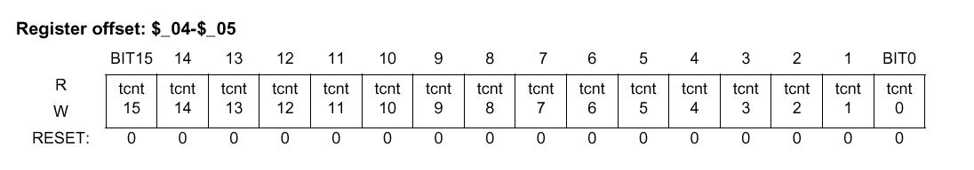
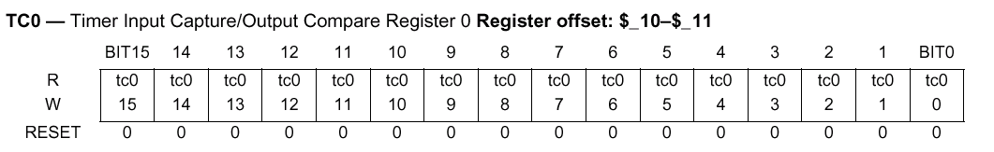
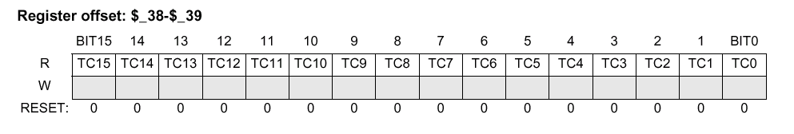
增强型捕捉
ECT比标准的TIM增强的特点
4个输入捕捉通道有16位缓冲寄存器
4个8位 / 2个16位脉冲累加器
16位带4位预分频的模数向下计数器
4个用户选择的延时计数器用来消除噪声
主定时器预分频扩展至7位
队列和锁定模式
外部事件
外部事件
主定时器
读取数据
拷贝
拷贝
输入捕捉寄存器
读取数据
拷贝
保持寄存器
Notes:
The main ECT enhanced features are listed above and animation is provided to depict the double action functionality of the input capture channels.
The input capture may be used in double action mode operation allowing the capture of two time stamps before an interrupt is signaled to the CPU. This action relieves the CPU from being interrupt with every capture event. Enabling this function may be achieved by setting the TFMOD bit in the ICSYS register ($2B) in conjunction with the use of the ICOVW register ($2A). This action allow a timer interrupt generation after capturing two values in the capture and holding registers instead of generating an interrupt for every capture.

Slide 20
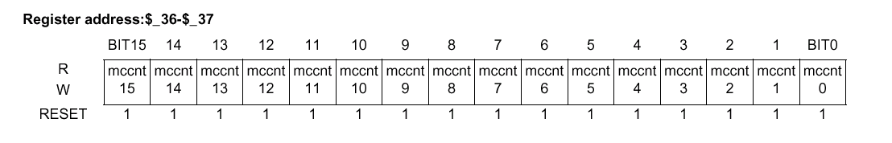
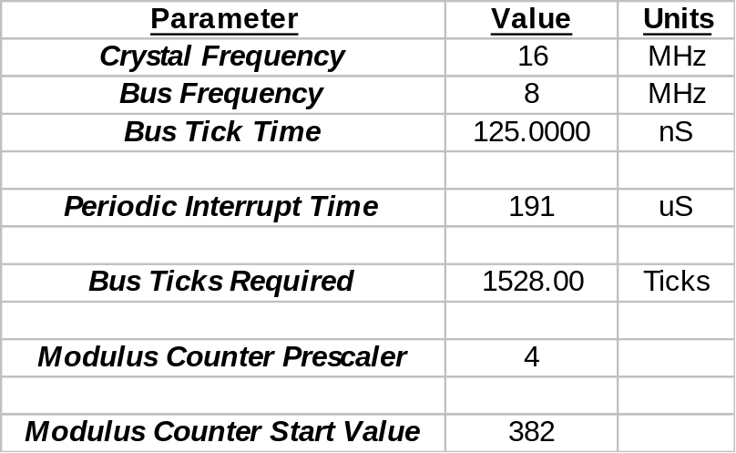
模向下计数器
向下计数至0
装载
执行动作
二进制向下计数器. 可以完全控制计数起始值
应用于精确事件计时-用于产生周期性的标志位和中断
主定时器单独运行。时钟来自总线时钟，并经过预分频。
可以被设置为定时中断或产生标志位。或装载初始值后向下计数到$0000。
Notes:
The modulus down-counter can be used as a time base to generate a
periodic interrupt. It can also be used to latch the values of the IC
registers and the pulse accumulators to their holding registers.
The action of latching can be programmed to be periodic or only once.

Slide 21
ABS 应用举例
如果左右轮速脉冲周期不等
左前轮
右前轮
左后轮
右后轮
则
SENSOR 1
SIGNAL
CONDITIONING
LOGIC
PT0
IC/PA
H
C
S
1
2
SENSOR 2
SIGNAL
CONDITIONING
LOGIC
PT1
IC/PA
SENSOR 3
SIGNAL
CONDITIONING
LOGIC
PT2
IC/PA
SENSOR 4
SIGNAL
CONDITIONING
LOGIC
PT3
调节电磁阀
IC/PA
TIMER
PB1
BRAKE
PB2
FLUID
PB3
PUMP
SYSTEM
PB4
定时器输入捕捉测量车轮转速
发送命令到刹车压力调节阀来调节压力
Notes:
Now let’s look at a real application example by using Input Capture function.
The basic concept of Anti-Skid Breaking system is to measure the front wheels rotation and compare the average periods between the two wheels. If one of the front wheels average period measured is much smaller than the other, it means the wheel is receiving a lot of pressure and rotating slower than the other wheel. The pressure can be adjusted so that the pressure applied to both front wheels are equal. To release the pressure the MCU simply turns off the break fluid pump associated with the wheel that is rotating slowly ensuring maximum safety.
To implement ABS function, each wheel will have a sensor in order to sample the wheel rotation on periodic bases. The period is measured between samples, and after the required number of samples have been captured, the function provide an average period measurement on each wheel. The periods captured for the two front wheels are compared and then adjustment is made until the average periods measured are equal. The same procedure is applied to the back wheels.

Slide 22
低功耗模式
TSCR – 定时器系统控制寄存器
TEN TSWAI TSFRZ TFFCA Reserved
$0006
RST: 0……………………………………………………………………………0
TFFCA – 定时器快速标志位清除使能
0 = 定时器标志位正常清零
1 = 输入捕捉时读取寄存器, 输出比较时写寄存器，可以对相应通道标志位清零
TSBCK – 在DEBUG模式时， 定时器停止
0 = 不停止
1 = 停止
TSWAI – 在WAIT模式时，定时器停止
0 = 不停止
1 = 停止
Notes:
The ECT clocks are shut down out of reset and is enabled by setting the Timer Enable (TE) bit in the TSCR.
In the stop mode, the timer and modulus counter are off since clocks are stopped.
In the freeze mode, the timer and modulus counter keep on running, unless
TSFRZ in TSCR($06) is set to one.
In the Wait mode, the counters keep on running, unless TSWAI in TSCR ($06) is set to one.
NORMAL: Timer and modulus counter keep on running, unless TEN
in TSCR($06) is cleared.
RESET CONDITIONS:
TCNT IS INITIALIZED TO ALL ZEROES AND Disabled
TIMER OVERFLOW INTERRUPTS ARE Disabled
TC7-TC0 Interrupts and Masks are cleared
TC7 - TC0 REGISTERS ARE CLEARED
TIMER OVERFLOW FLAG IS CLEARED
TIMER Channels C7-C0 are inputs
PULSE ACCUMULATORS ARE DISABLED AND THEIR RESPECTIVE COUNTERS ARE CLEARED.
PRESCALER IS 1

Slide 23
PULSE WIDTH
MODULATION
(PWM)
脉宽调制模块

Slide 24

什么是PWM?
T_{on}
T_{off}
占空比=高电平时间/周期
=Ton/Tperiod
Average
T_{period}
0 %
应用:
10 %
D/A转换
马达控制
音调生成
正弦波生成
50 %
90 %
99 %
Notes:
PWM Concept:
A pulse width modulated signal is a square wave with a specified high level time (Ton) and low level time (Toff). The sum of both is the period of the PWM signal (Tperiod). The PWM is dedicated by the pulse width ratio: Ton / Tperiod.
The pulse witdth ratio can also be said as the percentage of the Ton to the period.
The PWM is used for digital to analog conversion, for electrical motor control and for wave form generation (sinus waveform generation).

Slide 25
PWM信号的产生(边缘对齐)
开始
T_{PWM}
时钟
8-bit Counter
PWMCNTx
Reset
周期 T_{PWM}
8-bit Compare =
Pin
占空比 T_{Duty}
PWMDTYx
PWMDTYx
PWMPERx
PWMPERx
8-bit Compare =
PWMPERx
当8位计数器的值等于PWMDTY(duty cycle寄存器)时，电平从有效跳到无效；
当8位计数器的值等于PWMPER（周期寄存器）时，电平从无效跳到有效，然后计数器清0，重新开始计数
0x00
0x00
f_{Clock}, T_{Clock}
Notes:
The PWM module which generates the PWM (edge aligned) consists of an 8-bit counter which counts upwards starting from zero. There are two 8-bit compare registers: PWMDTYx and PWMPERx. The x is the number of the channel. Both compare registers compare the value from the register with the value in the counter register.
Polarity Bit = 1 (seen on the slide):
If there is a match between the PWMDTYx and PWMCNTx the output pin is reset. If there is a match between the PWMPERx and PWMCNTx the output pin is set and the counter is reset to zero.
Polarity Bit = 0 (not seen here):
If there is a match between the PWMDTYx and PWMCNTx the output pin is set. If there is a match between the PWMPERx and PWMCNTx the output pin is reset and the counter is reset to zero.

Slide 26
PWM 模块特点
 8个带周期占空比可程控的PWM独立通道
 4个可程控选择的时钟源
 每个PWM通道有专用的计数器
 PWM每个通道脉冲极性可以选择
 每个PWM通道可使能/禁止
 周期和占空比双缓冲
 每个通道有中心对齐和边缘对齐方式
 分辨率: 8位 (8通道), 16位 (4通道)
 带中断功能的紧急切断
 工作模式
Notes:
Shown here are the features of the PWM module.
Overview
Each of the eight channels has a programmable period and duty cycle as well as a dedicated counter. A flexible clock select scheme allows a total of four different clock sources to be used with the counters. Each of the modulators can create independent continuous waveforms with software-selectable duty rates from 0% to 100%. The PWM outputs can be programmed as left aligned outputs or centre-aligned outputs.
Features
The block includes these distinctive features:
• Eight independent PWM channels with programmable period and duty cycle.
• Dedicated counter for each PWM channel.
• Programmable PWM enable/disable for each channel.
• Software selection of PWM duty pulse polarity for each channel.
• Period and duty cycle are double buffered. Change takes effect when the end of the effective period is reached (PWM counter reaches zero) or when the channel is disabled.
• Programmable centre or left aligned outputs on individual channels.
• Eight 8-bit channel or four 16-bit channel PWM resolution.
• Four clock sources (A, B, SA and SB) provide for a wide range of frequencies.
• Programmable Clock Select Logic.
• Emergency shutdown.

Slide 27
PWM 结构框图
通道 7
管脚
周期和占空比
计数器
通道 6
管脚
周期和占空比
计数器
...
使能选择
通道 0
管脚
极性选择
周期和占空比
计数器
对齐方式选择
Notes:
Each PWM channel has it’s own dedicated pin which is used to output the PWM waveform to the outside world when NOT configured in the concatenated mode.
When two channels are concatenated, the higher number channel pin is used to drive the PWM waveform.

Slide 28
PWM 初始化步骤
禁止PWM Disable PWM
PWME
选择时钟 Select clock (prescaler and scale) for the PWM
PWMPRCLK, PWMSCLA, PWMSCLB, PWMCLK
选择极性 Select polarity
PWMPOL
选择对齐模式 Select center or left aligned mode
PWMCAE
对占空比和周期编程Program duty cycle and period
PWMDTYx, PWMPERx
使能PWM通道 Enable used PWM channels
PWME
Notes:
The user can quickly configure the PWM channels by following the steps outlined above.

Slide 29
PWM 时钟选择 (1 of 4)
4个时钟源:
Clock A (Ch 0, Ch 1, Ch 4, Ch 5)
Clock SA (scaled A; Ch 0, Ch 1, Ch 4, Ch 5)
Clock B (Ch 2, Ch 3, Ch 6, Ch 7)
Clock SB (scaled B; Ch 2, Ch 3, Ch 6, Ch 7)
Clock A
PWMSCLA @ $_08
Further Division of the clock:
PWMPRCLK @ $_03
2
4
6
8
...
512
Clock SA
Divide by Prescaler Taps:
Bus Clock
2
4
8
16
32
64
128
PWMSCLB @ $_09
Further Division of the clock:
2
4
6
8
...
512
Clock SB
Clock B
预分频
分频
Notes:
Clock Select
There are four available clocks called clock A, clock B, clock SA (Scaled A), and clock SB (Scaled B). These four clocks are based on the bus clock.
Clock A and B can be software selected to be 1, 1/2, 1/4, 1/8,..., 1/64, 1/128 times the bus clock. Clock SA uses clock A as an input and divides it further with a reloadable counter. Similarly, Clock SB uses clock B as an input and divides it further with a reloadable counter. The rates available for clock SA are software selectable to be clock A divided by 2, 4, 6, 8,..., or 512 in increments of divide by 2. Similar rates are available for clock SB. Each PWM channel has the capability of selecting one of two clocks, either the pre-scaled clock (clock A or B) or the scaled clock (clock SA or SB).
Clock Scale
The scaled A clock uses clock A as an input and divides it further with a user programmable value and then divides this by 2. The scaled B clock uses clock B as an input and divides it further with a user programmable value and then divides this by 2. The rates available for clock SA are software selectable to be clock A divided by 2, 4, 6, 8,..., or 512 in increments of divide by 2. Similar rates are available for clock SB.
Clock A is used as an input to an 8-bit down counter. This down counter loads a user programmable scale value from the scale register (PWMSCLA). When the down counter reaches one, two things happen; a pulse is output and the 8-bit counter is re-loaded. The output signal from this circuit is further divided by two. This gives a greater range with only a slight reduction in granularity. Clock SA equals Clock A divided by two times the value in the PWMSCLA register.
NOTE: Clock SA = Clock A / (2 * PWMSCLA)
When PWMSCLA = $00, PWMSCLA value is considered a full scale value of 256. Clock A is thus divided by 512.
Similarly, Clock B is used as an input to an 8-bit down counter followed by a divide by two producing clock SB. Thus, clock SB equals Clock B divided by two times the value in the PWMSCLB register.
NOTE: Clock SB = Clock B / (2 * PWMSCLB)
When PWMSCLB = $00, PWMSCLB value is considered a full scale value of 256. Clock B is thus divided by 512.
As an example, consider the case in which the user writes $FF into the PWMSCLA register. Clock A for this case will be E divided by 4. A pulse will occur at a rate of once every 255x4 E cycles. Passing this through the divide by two circuit produces a clock signal at an E divided by 2040 rate. Similarly, a value of $01 in the PWMSCLA register when clock A is E divided by 4 will produce a clock at an E divided by 8 rate.
Writing to PWMSCLA or PWMSCLB causes the associated 8-bit down counter to be re-loaded. Otherwise, when changing rates the counter would have to count down to $01 before counting at the proper rate. Forcing the associated counter to re-load the scale register value every time PWMSCLA or PWMSCLB is written prevents this.
NOTE: Writing to the scale registers while channels are operating can cause irregularities in the PWM outputs.

Slide 30
PWM 时钟选择 – 预分频寄存器 (2 of 4)
PWMPRCLK @ $_03
Bit 0
Bit 6
Bit 5
Bit 4
Bit 3
Bit 2
Bit 1
Bit 0
R
0
PCKB2
PCKB1
PCKB0
0
PCKA2
PCKA1
PCKA0
W
Reset:
0
0
0
0
0
0
0
0
= Unimplemented or Reserved
PCKx2 | PCKx1 | PCKx0 | Value of Clock x
0 | 0 | 0 | Bus Clock
0 | 0 | 1 | Bus Clock / 2
0 | 1 | 0 | Bus Clock / 4
0 | 1 | 1 | Bus Clock / 8
1 | 0 | 0 | Bus Clock / 16
1 | 0 | 1 | Bus Clock / 32
1 | 1 | 0 | Bus Clock / 64
1 | 1 | 1 | Bus Clock / 128
可在任意时刻读写!
x = A or B
Software Examples
设置 PRESCALE 寄存器:
PWMPRCLK = 0x22; // B= Bus/4, A = Bus/4
PWMPRCLK = 0x07; // B = Bus, A = Bus/128
Notes:
Prescale
The input clock to the PWM prescaler is the bus clock. It can be disabled whenever the part is in freeze mode by setting the PFRZ bit in the PWMCTL register. If this bit is set, whenever the MCU is in freeze mode (Freeze Mode Signal active) the input clock to the prescaler is disabled. This is useful for emulation in order to freeze the PWM. The input clock can also be disabled when all eight PWM channels are disabled (PWME7-0=0). This is useful for reducing power by disabling the prescale counter.
Clock A and clock B are scaled values of the input clock. The value is software selectable for both clock A and clock B and has options of 1, 1/2, 1/4, 1/8, 1/16, 1/32, 1/64, or 1/128 times the bus clock. The value selected for clock A is determined by the PCKA2, PCKA1, PCKA0 bits in the PWMPRCLK register. The value selected for clock B is determined by the PCKB2, PCKB1, PCKB0 bits also in the PWMPRCLK register.
PWM Prescale Clock Select Register (PWMPRCLK)
This register selects the prescale clock source for clocks A and B independently.
NOTE: PCKB2-0 and PCKA2-0 register bits can be written anytime. If the clock pre-scale is changed while a PWM signal is being generated, a truncated or stretched pulse can occur during the transition.
PCKB2 - PCKB0 — Prescaler Select for Clock B
Clock B is one of two clock sources which can be used for channels 2, 3, 6 or 7. These three bits determine the rate of clock B, as shown in the following table.
PCKA2 - PCKA0 — Prescaler Select for Clock A
Clock A is one of two clock sources which can be used for channels 0, 1, 4 or 5. These three bits determine the rate of clock A, as shown in the following table.

Slide 31
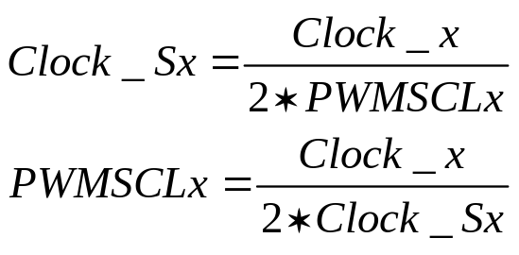
PWM 时钟选择 – 分频寄存器(3 of 4)
PWMSCLB @ $_09
PWMSCLA @ $_08
分频值
PWMSCLx
PWMPRCLK @ $_03
Divide by Prescaler Taps:
Clock x
8-Bit Down Counter
总线时钟
f_{Bus}
2
4
8
16
32
64
128
Bit 7
Bit 6
Bit 5
Bit 4
Bit 3
Bit 2
Bit 1
Bit 0
Clock x = f_{Bus} / PWMPRCLK
Count = 1
/ 2
Clock Sx
例如:
要求: Clock Sx = 1 kHz
总线时钟 = 16 MHz
Prescaler = 128 → Prescaler = 64
Clock x = 125 kHz Clock x = 250 kHz
PWMSCLx = 63 → PWMSCLx = 125 →
Clock Sx = 992 Hz Clock Sx = 1000 Hz
PWMSCLx = $00 → PWMSCLx value is 256
可在任意时刻读写!
x = A or B
Notes:
Clock Scale
The scaled A clock uses clock A as an input and divides it further with a user programmable value and then divides this by 2. The scaled B clock uses clock B as an input and divides it further with a user programmable value and then divides this by 2. The rates available for clock SA are software selectable to be clock A divided by 2, 4, 6, 8,..., or 512 in increments of divide by 2. Similar rates are available for clock SB.
Clock A is used as an input to an 8-bit down counter. This down counter loads a user programmable scale value from the scale register (PWMSCLA). When the down counter reaches one, two things happen; a pulse is output and the 8-bit counter is re-loaded. The output signal from this circuit is further divided by two. This gives a greater range with only a slight reduction in granularity. Clock SA equals Clock A divided by two times the value in the PWMSCLA register.
NOTE: Clock SA = Clock A / (2 * PWMSCLA)
When PWMSCLA = $00, PWMSCLA value is considered a full scale value of 256. Clock A is thus divided by 512.
Similarly, Clock B is used as an input to an 8-bit down counter followed by a divide by two producing clock SB. Thus, clock SB equals Clock B divided by two times the value in the PWMSCLB register.
NOTE: Clock SB = Clock B / (2 * PWMSCLB)
When PWMSCLB = $00, PWMSCLB value is considered a full scale value of 256. Clock B is thus divided by 512.
As an example, consider the case in which the user writes $FF into the PWMSCLA register. Clock A for this case will be E divided by 4. A pulse will occur at a rate of once every 255x4 E cycles. Passing this through the divide by two circuit produces a clock signal at an E divided by 2040 rate. Similarly, a value of $01 in the PWMSCLA register when clock A is E divided by 4 will produce a clock at an E divided by 8 rate.
Writing to PWMSCLA or PWMSCLB causes the associated 8-bit down counter to be re-loaded. Otherwise, when changing rates the counter would have to count down to $01 before counting at the proper rate. Forcing the associated counter to re-load the scale register value every time PWMSCLA or PWMSCLB is written prevents this.
NOTE: Writing to the scale registers while channels are operating can cause irregularities in the PWM outputs.

Slide 32
PWM 时钟选择寄存器 (4 of 4)
PWMCLK @ $_02
Bit 0
Bit 6
Bit 5
Bit 4
Bit 3
Bit 2
Bit 1
Bit 0
R
PCLK7
PCLK6
PCLK5
PCLK4
PCLK3
PCLK2
PCLK1
PCLK0
W
Reset:
0
0
0
0
0
0
0
0
PCLK7 — 通道 7时钟选择
1 = 通道7的时钟源为SB
0 =通道7的时钟源为B.
PCLK6 —通道 6时钟选择
1 =时钟源为SB.
0 =时钟源为B
PCLK5 —通道 5时钟选择
1 =时钟源为SA
0 =时钟源为A
PCLK4 —通道 4时钟选择
1 =时钟源为SA
0 =时钟源为A
PCLK3 —通道 3时钟选择
1 =时钟源为SB.
0 =时钟源为B
PCLK2 —通道 2时钟选择
1 =时钟源为SB
0 =时钟源为B
PCLK1 —通道 1时钟选择
1 =时钟源为SA
0 =时钟源为A
PCLK0 —通道 0时钟选择
1 =时钟源为SA
0 =时钟源为A
软件示例
选择时钟源:
PCLK0 = 1; // SA is source of ch 0
PCLK6 = 0; // B is source of ch 6
PWMCLK = 0x11; // all channels
Notes:
Clock Select
Each PWM channel has the capability of selecting one of two clocks. For channels 0, 1, 4, and 5 the clock choices are clock A or clock SA. For channels 2, 3, 6, and 7 the choices are clock B or clock SB. The clock selection is done with the PCLKx control bits in the PWMCLK register.
NOTE: Changing clock control bits while channels are operating can cause irregularities in the PWM outputs.
PWM Clock Select Register (PWMCLK)
Each PWM channel has a choice of two clocks to use as the clock source for that channel as described below.
NOTE: Register bits PCLK0 to PCLK7 can be written anytime. If a clock select is changed while a PWM signal is being generated, a truncated or stretched pulse can occur during the transition.

Slide 33
PWM 计时器通道

极性位Polarity Bit = 1
→ Duty = High Time
Double
Buffered
PWMDTY0 @ $_1C
PWMDTY1 @ $_1D
PWMDTY2 @ $_1E
PWMDTY3 @ $_1F
PWMDTY4 @ $_20
PWMDTY5 @ $_21
PWMDTY6 @ $_22
PWMDTY7 @ $_23
占空比寄存器
8-Bit Compare =
PWMDTYx
PWMDTYx
Channel x
x = 0 ... 7
8-Bit Counter
PWMDTYx
PWMCNTx
PWMPERx
PWMCNT0 @ $_0C
PWMCNT1 @ $_0D
PWMCNT2 @ $_0E
PWMCNT3 @ $_0F
PWMCNT4 @ $_10
PWMCNT5 @ $_11
PWMCNT6 @ $_12
PWMCNT7 @ $_13
PWMPER0 @ $_14
PWMPER1 @ $_15
PWMPER2 @ $_16
PWMPER3 @ $_17
PWMPER4 @ $_18
PWMPER5 @ $_19
PWMPER6 @ $_1A
PWMPER7 @ $_1B
周期寄存器
8-Bit Compare =
PWMPERx
PWMPERx
Double
Buffered
Notes:
PWM Timer Counters
Each channel has a dedicated 8-bit up/down counter which runs at the rate of the selected clock source. The counter compares to two registers, a duty register and a period register. When the PWM counter matches the duty register the output flip-flop changes state causing the PWM waveform to also change state. A match between the PWM counter and the period register behaves differently depending on what output mode is selected.
Each channel counter can be read at anytime without affecting the count or the operation of the PWM channel.
Any value written to the counter causes the counter to reset to $00, the counter direction to be set to up, the immediate load of both duty and period registers with values from the buffers, and the output to change according to the polarity bit. When the channel is disabled (PWMEx=0), the counter stops. When a channel becomes enabled (PWMEx=1), the associated PWM counter continues from the count in the PWMCNTx register. This allows the waveform to continue where it left off when the channel is re-enabled. When the channel is disabled, writing “0” to the period register will cause the counter to reset on the next selected clock.
NOTE: If the user wants to start a new “clean” PWMwaveform without any “history” from the old waveform, the user must write to channel counter (PWMCNTx) prior to enabling the PWM channel (PWMEx=1).
Generally, writes to the counter are done prior to enabling a channel in order to start from a known state. However, writing a counter can also be done while the PWM channel is enabled (counting). The effect is similar to writing the counter when the channel is disabled except that the new period is started immediately with the output set according to the polarity bit.
NOTE: Writing to the counter while the channel is enabled can cause an irregular PWM cycle to occur.
The counter is cleared at the end of the effective period.

Slide 34
使能/禁止 PWM
PWME @ $_00
Bit 0
Bit 6
Bit 5
Bit 4
Bit 3
Bit 2
Bit 1
Bit 0
R
PWME7
PWME6
PWME5
PWME4
PWME3
PWME2
PWME1
PWME0
W
Reset:
0
0
0
0
0
0
0
0
通道7
通道6
...
通道 0
1 = 通道 x 使能. 下一个时钟开始输出PWM
0 = 通道x禁止
软件示例
使能/禁止 PWM 通道:
PWME5 = 1; // Enable PWM channel 5
PWME3 = 0; // Disable PWM channel 3
PWME = 0xFF // Enable all 8 PWM channels
PWME = 0; // Disable all 8 PWM channels
Notes:
PWM Enable Register (PWME)
Each PWM channel has an enable bit (PWMEx) to start its waveform output. When any of the PWMEx bits are set (PWMEx=1), the associated PWM output is enabled immediately. However, the actual PWM waveform is not available on the associated PWM output until its clock source begins its next cycle due to the synchronization of PWMEx and the clock source.
NOTE: The first PWM cycle after enabling the channel can be irregular.
An exception to this is when channels are concatenated. Once concatenated mode is enabled (CONxx bits set in PWMCTL register) then enabling/disabling the corresponding 16-bit PWM channel is controlled by the low order PWMEx bit.In this case, the high order bytes PWMEx bits have no effect and their corresponding PWM output lines are disabled.
While in run mode, if all eight PWM channels are disabled (PWME7-0=0), the prescaler counter shuts off for power savings.
PWMEx — Pulse Width Channel x Enable
1 = Pulse Width channel x is enabled. The pulse modulated signal becomes available at PWM
output bitx when its clock source begins its next cycle.
0 = Pulse Width channel x is disabled.
Note: Where x = a value from 0 –7.

Slide 35
PWM 极性选择寄存器
PWME @ $_00
Bit 0
Bit 6
Bit 5
Bit 4
Bit 3
Bit 2
Bit 1
Bit 0
R
PPOL7
PPOL6
PPOL5
PPOL4
PPOL3
PPOL2
PPOL1
PPOL0
W
Reset:
0
0
0
0
0
0
0
0
通道7
通道6
...
通道 0
1 = 在周期开始时，PWM通道输出为高电平，当计数器等于占空比寄存器的值时，输出为低电平
0 =在周期开始时，PWM通道输出为低电平，当计数器等于占空比寄存器的值时，输出为高电平
PWMPERx
PWMDTYx
PPOLx = 1
PWMPERx
PPOLx = 0
PWMDTYx
Notes:
PWM Polarity Register (PWMPOL)
The starting polarity of each PWM channel waveform is determined by the associated PPOLx bit in the PWMPOL register. If the polarity bit is one, the PWM channel output is high at the beginning of the cycle and then goes low when the duty count is reached. Conversely, if the polarity bit is zero, the output starts low and then goes high when the duty count is reached.
NOTE: PPOLx register bits can be written anytime. If the polarity is changed while a PWM signal is being generated, a truncated or stretched pulse can occur during the transition
PPOLx — Pulse Width Channel x Polarity
1 = PWMchannel x output is high at the beginning of the period, then goes low when the duty count is reached.
0 = PWMchannel x output is low at the beginning of the period, then goes high when the duty count is reached.
Note: Where x = a value from 0 –7.

Slide 36
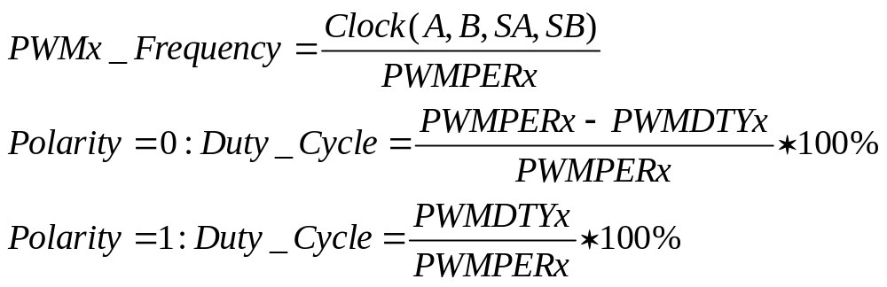
对齐方式选择-左对齐 (1 of 3)
Start
Duty Cycle
= 75 %
Clock Source
E = 100 ns
Period
= 400 ns
分辨率？
时钟源 = E = 10 MHz (100 ns period)
PPOLx = 0
PWMPERx = 4
PWMDTYx = 1
PWMx 频率 = 10 MHz/4 = 2.5 MHz
PWMx 周期 = 400 ns
PWMx 占空比 = ¾*100% = 75%
→
Notes:
Left Aligned Outputs
The PWMtimer provides the choice of two types of outputs, Left Aligned or Center Aligned outputs. They are selected with the CAEx bits in the PWMCAE register. If the CAEx bit is cleared (CAEx=0), the corresponding PWM output will be left aligned.
In left aligned output mode, the 8-bit counter is configured as an up counter only. It compares to two registers, a duty register and a period register. When the PWM counter matches the duty register the output flip-flop changes state causing the PWM waveform to also change state. A match between the PWM counter and the period register resets the counter and the output flip-flop as well as performing a load from the double buffer period and duty register to the associated registers. The counter counts from 0 to the value in the period register - 1.
NOTE: Changing the PWM output mode from Left Aligned Output to Center Aligned Output (or vice versa) while channels are operating can cause irregularities in the PWM output. It is recommended to program the output mode before enabling the PWM channel.
To calculate the output frequency in left aligned output mode for a particular channel, take the selected clock source frequency for the channel (A, B, SA, or SB) and divide it by the value in the period register for that channel.
• PWMx Frequency = Clock(A, B, SA, or SB) / PWMPERx
• PWMx Duty Cycle (high time as a% of period):
– Polarity = 0 (PPOLx=0)
Duty Cycle = [(PWMPERx-PWMDTYx)/PWMPERx] * 100%
– Polarity = 1 (PPOLx=1)
Duty Cycle = [PWMDTYx / PWMPERx] * 100%
As an example of a left aligned output, consider the following case:
Clock Source = E, where E=10MHz (100ns period)
PPOLx = 0
PWMPERx = 4
PWMDTYx = 1
PWMx Frequency = 10MHz/4 = 2.5MHz
PWMx Period = 400ns
PWMx Duty Cycle = 3/4 *100% = 75%

Slide 37
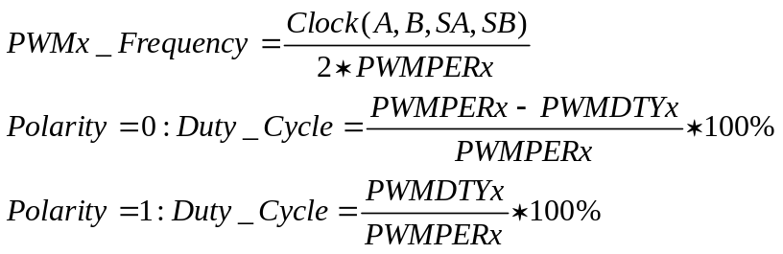
对齐方式选择-中央对齐 (2 of 3)
Start
Duty Cycle = 75%
PWMDTYx
E = 100ns
PWMDTYx
E = 100ns
PWMPERx
PWMPERx
Period = PWMPERx*2
= 800 ns
时钟源 = E = 10 MHz (100 ns period)
PPOLx = 0
PWMPERx = 4
PWMDTYx = 1
PWMx 频率 = 10 MHz/8 = 1.25 MHz
PWMx 周期 = 800 ns
PWMx 占空比 = ¾*100% = 75%
→
Notes:
Center Aligned Outputs
For Center Aligned Output Mode selection, set the CAEx bit (CAEx=1) in the PWMCAE register and the corresponding PWM output will be center aligned.
The 8-bit counter operates as an up/down counter in this mode and is set to up whenever the counter is equal to $00. The counter compares to two registers, a duty register and a period register. When the PWM counter matches the duty register the output flip-flop changes state causing the PWM waveform to also change state. A match between the PWM counter and the period register changes the counter direction from an up-count to a down-count. When the PWM counter decrements and matches the duty register again, the output flip-flop changes state causing the PWM output to also change state. When the PWM counter decrements and reaches zero, the counter direction changes from a down-count back to an up-count and a load from the double buffer period and duty registers to the associated registers is performed. The counter counts from 0 up to the value in the period register and then back down to 0. Thus the effective period is PWMPERx*2.
NOTE: Changing the PWM output mode from Left Aligned Output to Center Aligned Output (or vice versa) while channels are operating can cause irregularities in the PWM output. It is recommended to program the output mode before enabling the PWM channel.
To calculate the output frequency in center aligned output mode for a particular channel, take the selected clock source frequency for the channel (A, B, SA, or SB) and divide it by twice the value in the period register for that channel.
• PWMx Frequency = Clock(A, B, SA, or SB) / (2*PWMPERx)
• PWMx Duty Cycle (high time as a% of period):
– Polarity = 0 (PPOLx=0)
Duty Cycle = [(PWMPERx-PWMDTYx)/PWMPERx] * 100%
– Polarity = 1 (PPOLx=1)
Duty Cycle = [PWMDTYx / PWMPERx] * 100%
As an example of a center aligned output, consider the following case:
Clock Source = E, where E=10MHz (100ns period)
PPOLx = 0
PWMPERx = 4
PWMDTYx = 1
PWMx Frequency = 10MHz/8 = 1.25MHz
PWMx Period = 800ns
PWMx Duty Cycle = 3/4 *100% = 75%

Slide 38
PWM 中央对齐使能寄存器 (3 of 3)
PWMCAE @ $_04
Bit 0
Bit 6
Bit 5
Bit 4
Bit 3
Bit 2
Bit 1
Bit 0
R
CAE7
CAE6
CAE5
CAE4
CAE3
CAE2
CAE1
CAE0
W
Reset:
0
0
0
0
0
0
0
0
通道7
通道6
...
通道 0
CAEx – 中心对齐模式选择，通道 x
1 = 通道 x 中心对齐输出
0 = 通道 x 左边对齐输出
Notes:
PWM Center Align Enable Register (PWMCAE)
The PWMCAE register contains eight control bits for the selection of center aligned outputs or left aligned outputs for each PWM channel. If the CAEx bit is set to a one, the corresponding PWM output will be center aligned. If the CAEx bit is cleared, the corresponding PWM output will be left aligned.
NOTE: Write these bits only when the corresponding channel is disabled.
CAE7 — Center Aligned Output Mode on channel 7
1 = Channel x operates in Center Aligned Output Mode.
0 = Channel x operates in Left Aligned Output Mode.
Note: Where x = a value from 0 –7.

Slide 39
16位分辨率
两个8位PWM通道可以组合成一个16位PWM通道
Clock Source 7
PWMCNT6
PWMCNT7
Period/Duty Compare
PWM7
CONxx | PWMEx | PPOLx | PCLKx | CAEx | PWMx OUTPUT
CON67 | PWME7 | PPOL7 | PCLK7 | CAE7 | PWM7
CON45 | PWME5 | PPOL5 | PCLK5 | CAE5 | PWM5
CON23 | PWME3 | PPOL3 | PCLK3 | CAE3 | PWM3
CON01 | PWME1 | PPOL1 | PCLK1 | CAE1 | PWM1
Notes:
PWM 16-Bit Functions
The PWM timer also has the option of generating 8-channels of 8-bits or 4-channels of 16-bits for greater PWM resolution. This 16-bit channel option is achieved through the concatenation of two 8-bit channels. The PWMCTL register contains four control bits, each of which is used to concatenate a pair of PWM channels into one 16-bit channel. Channels 6 and 7 are concatenated with the CON67 bit, channels 4 and 5 are concatenated with the CON45 bit, channels 2 and 3 are concatenated with the CON23 bit, and channels 0 and 1 are concatenated with the CON01 bit.
NOTE: Change these bits only when both corresponding channels are disabled.
When channels 6 and 7 are concatenated, channel 6 registers become the high order bytes of the double byte channel. Similarly, when channels 4 and 5 are concatenated, channel 4 registers become the high order bytes of the double byte channel and so on.
When using the 16-bit concatenated mode, the clock source is determined by the low order 8-bit channel clock select control bits. That is channel 7 when channels 6 and 7 are concatenated, channel 5 when channels 4 and 5 are concatenated, and so on. The resulting PWMis output to the pins of the corresponding low order 8-bit channel. The polarity of the resulting PWM output is controlled by the PPOLx bit of the corresponding low order 8-bit channel as well.
Once concatenated mode is enabled (CONxx bits set in PWMCTL register) then enabling/disabling the corresponding 16-bit PWM channel is controlled by the low order PWMEx bit. In this case, the high order bytes PWMEx bits have no effect and their corresponding PWM output is disabled. In concatenated mode, writes to the 16-bit counter by using a 16-bit access or writes to either the low or high order byte of the counter will reset the 16-bit counter. Reads of the 16-bit counter must be made by 16-bit access to maintain data coherency.
Either left aligned or center aligned output mode can be used in concatenated mode and is controlled by the low order CAEx bit. The high order CAEx bit has no effect.

Slide 40
16位 PWM 组合
CLOCK SOURCE
7
PWCNT 6 PWCNT 7
PERIOD/DUTY COMPARE
PWM7
CLOCK SOURCE
5
PWCNT 4 PWCNT 5
PERIOD/DUTY COMPARE
PWM5
CLOCK SOURCE
3
PWCNT 2 PWCNT 3
PERIOD/DUTY COMPARE
PWM3
CLOCK SOURCE
1
PWCNT 0 PWCNT 1
软件可选择通道组合.
在组合模式下，可以左对齐或中心对齐输出
增加了分辨率，周期可以更长
PERIOD/DUTY COMPARE
PWM1

Slide 41
紧急关闭
故障输入
信号
紧急关闭通道 7
PWMLVL=1
PWMLVL=0
Channel 6
PWM7INL=1
Period and Duty
Counter
PWMLVL=0
Channel 5
Period and Duty
Counter
...
Channel 0
Period and Duty
Counter
PWMIE
Interrupt
PWMIF
Notes:
Interrupt Operation
The PWM module has only one interrupt which is generated at the time of emergency shutdown, if the corresponding enable bit (PWMIE) is set. This bit is the enable for the interrupt. The interrupt flag PWMIF is set whenever the input level of the PWM7 channel changes while PWM7ENA=1 or when PWMENA is being asserted while the level at PWM7 is active.
The PWM block only generates the interrupt and does not service it. The interrupt signal name is PWM
Interrupt Signal.

Slide 42
PWM 关闭寄存器
PWMSDN @ $_24
Bit 0
Bit 6
Bit 5
Bit 4
Bit 3
Bit 2
Bit 1
Bit 0
R
PWMIF
PWMIE
0
PWMLVL
0
PWM7IN
PWM7INL
PWM7EN
W
PWMR
STRT
Reset:
0
0
0
0
0
0
0
0
= Unimplemented or Reserved
Initialisation
设置关闭有效电平
PWM7INL
设置关闭时的输出电平
PWMLVL
中断使能
PWMIE
使能紧急关闭
PWM7ENA
Notes:
The PWMSDN register provides for the shutdown functionality of the PWM module in the emergency cases.
PWM7ENA — PWM emergency shutdown Enable
If this bit is logic 1 the pin associated with channel 7 is forced to input and the emergency shutdown feature is enabled. All the other bits in this register are meaningful only if PWM7ENA = 1. This feature is enabled by setting this bit to a logic ‘1’.
PWM7INL — PWM shutdown active input level for channel 7.
If the emergency shutdown feature is enabled (PWM7ENA = 1), this bit determines the active level of the PWM7channel pin.
PWM7IN — PWM channel 7 input status. This reflects the current status of the PWM7 pin.
PWMLVL — PWM shutdown output Level.
If active level as defined by the PWM7IN input, gets asserted all enabled PWM channels are immediately driven to the level defined by PWMLVL.
1 = PWM outputs are forced to 1. 0 = PWM outputs are forced to 0.
PWMRSTRT — PWM Restart.
The PWM can only be restarted if the PWM channel input 7 is de-asserted. After writing a logic 1 to the PWMRSTRT bit (trigger event) the PWM channels start running after the corresponding counter passes next “counter == 0” phase. Also if the PWM7ENA bit is reset to 0, the PWM do not start before the counter passes $00. The bit is always read as “0”.
PWMIE — Generates a PWM Interrupt if this bit is set.
PWMIF — PWM Interrupt Flag
Any change from passive to asserted (active) state or from active to passive state will be flagged by setting the PWMIF flag = 1. The flag is cleared by writing a logic 1 to it. Writing a 0 has no effect.

Slide 43
工作模式
等待模式
冻结模式
PSWAI
=
0
1
PFRZ
=
0
1
在WAIT模式下，允许输入时钟到预分频器
在WAIT模式下，停止输入时钟到预分频器
在FREEZE模式下，PWM计数器继续
在FREEZE模式下，PWM计数器停止
PWMCTL @ $_05
Bit 0
Bit 6
Bit 5
Bit 4
Bit 3
Bit 2
Bit 1
Bit 0
R
CON67
CON45
CON23
CON01
PSWAI
PFRZ
0
0
W
使能/禁止时钟
在WAIT模式时
PFRZ — PWM计数器停止在
Freeze模式时
Notes:
PSWAI — PWM Stops in Wait Mode
Enabling this bit allows for lower power consumption in Wait Mode by disabling the input clock to the prescaler.
1 = Stop the input clock to the prescaler whenever the MCU is in Wait Mode.
0 = Allow the clock to the prescaler to continue while in wait mode.
PFRZ — PWM Counters Stop in Freeze Mode
In Freeze Mode, there is an option to disable the input clock to the prescaler by setting the PFRZ bit in the PWMCTL register. If this bit is set, whenever the MCU is in freeze mode the input clock to the prescaler is disabled. This feature is useful during emulation as it allows the PWM function to be suspended. In this way, the counters of the PWM can be stopped while in freeze mode so that once
normal program flow is continued, the counters are re-enabled to simulate real-time operations. Since the registers can still be accessed in this mode, to re-enable the prescaler clock, either disable the PFRZ bit or exit freeze mode.
1 = Disable PWM input clock to the prescaler whenever the part is in freeze mode. This is useful for emulation.
0 = Allow PWM to continue while in freeze mode.

Slide 44
PWM 控制寄存器
PWMCTL @ $_05
Bit 0
Bit 6
Bit 5
Bit 4
Bit 3
Bit 2
Bit 1
Bit 0
R
CON67
CON45
CON23
CON01
PSWAI
PFRZ
0
0
W
Reset:
0
0
0
0
0
0
0
0
Bits[1:0]= Unimplemented or Reserved
16 位工作模式
Notes:
The PWMCTL register provides for various control of the PWM module.
There are four control bits for concatenation, each of which is used to concatenate a pair of PWM channels into one 16-bit channel. When channels 6 and 7are concatenated, channel 6 registers become the high order bytes of the double byte channel. When channels 4 and 5 are concatenated, channel 4 registers become the high order bytes of the double byte channel. When channels 2 and 3 are concatenated, channel 2 registers become the high order bytes of the double byte channel. When channels 0 and 1 are
concatenated, channel 0 registers become the high order bytes of the double byte channel.
NOTE: Change these bits only when both corresponding channels are disabled.
CONxy — Concatenate channels x and y
1 = Channels x and y are concatenated to create one 16-bit PWM channel. Channel x becomes the high order byte and channel y becomes the low order byte. Channel y output pin is used as the output for this 16-bit PWM (bit 7 of port PWMP). Channel y clock select control-bit determines the clock source, channel y polarity bit determines the polarity, channel y enable bit enables the output and channel y center aligned enable bit determines the output mode.
0 = Channels x and y are separate 8-bit PWM channelss.
Note: Where x = channel 0, 2, 4 or 6
Where y = channel 1, 3, 5 or 7

Slide 45
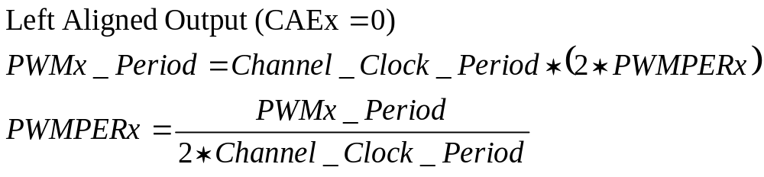
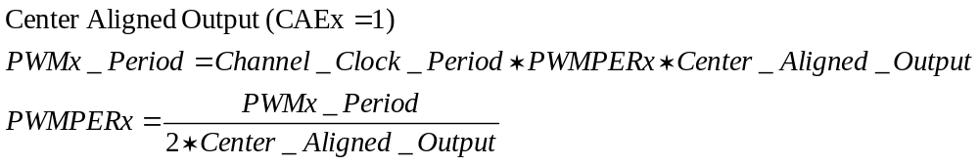
PWM 通道周期寄存器-周期计算
PWMPERx @ $_14-_1B
Bit 0
Bit 6
Bit 5
Bit 4
Bit 3
Bit 2
Bit 1
Bit 0
R
Bit 7
Bit 6
Bit 5
Bit 4
Bit 3
Bit 2
Bit 1
Bit 0
W
Reset:
1
1
1
1
1
1
1
1
左对齐输出
中心对齐输出
Notes:
PWM Period and Duty
Dedicated period and duty registers exist for each channel and are double buffered so that if they change while the channel is enabled, the change will NOT take effect until one of the following occurs:
• The effective period ends
• The counter is written (counter resets to $00)
• The channel is disabled
In this way, the output of the PWM will always be either the old waveform or the new waveform, not some variation in between. If the channel is not enabled, then writes to the period and duty registers will go directly to the latches as well as the buffer.
A change in duty or period can be forced into effect “immediately” by writing the new value to the duty and/or period registers and then writing to the counter. This forces the counter to reset and the new duty and/or period values to be latched. In addition, since the counter is readable it is possible to know where the count is with respect to the duty value and software can be used to make adjustments
NOTE: When forcing a new period or duty into effect immediately, an irregular PWM cycle can occur.
NOTE: Depending on the polarity bit, the duty registers will contain the count of either the high time or the low time.
PWM Channel Period Registers (PWMPERx)
There is a dedicated period register for each channel. The value in this register determines the period of the associated PWM channel. The period registers for each channel are double buffered so that if they change while the channel is enabled, the change will NOT take effect until one of the following occurs:
• The effective period ends
• The counter is written (counter resets to $00)
• The channel is disabled
In this way, the output of the PWMwill always be either the old waveform or the new waveform, not some variation in between. If the channel is not enabled, then writes to the period register will go directly to the latches as well as the buffer.
NOTE: Reads of this register return the most recent value written. Reads do not necessarily return the value of the currently active period due to the double buffering scheme.
To calculate the output period, take the selected clock source period for the channel of interest (A, B, SA, or SB) and multiply it by the value in the period register for that channel:
• Left Aligned Output (CAEx=0)
• PWMxPeriod =ChannelClockPeriod *PWMPERxCenterAlignedOutput(CAEx=1)
• PWMx Period = Channel Clock Period * (2 * PWMPERx)

Slide 46
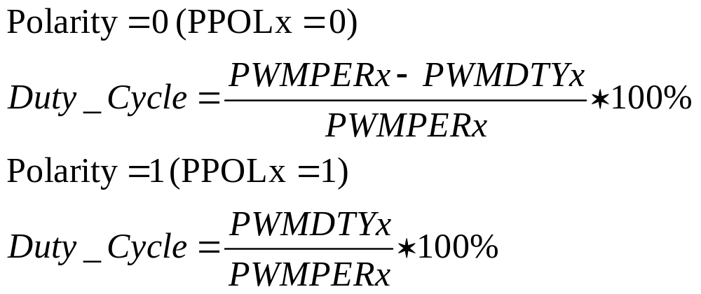
PWM 通道占空比寄存器-占空比计算
PWMDTYx @ $_1C-_23
Bit 0
Bit 6
Bit 5
Bit 4
Bit 3
Bit 2
Bit 1
Bit 0
R
Bit 7
Bit 6
Bit 5
Bit 4
Bit 3
Bit 2
Bit 1
Bit 0
W
Reset:
1
1
1
1
1
1
1
1
极性 = 0
极性 = 1
Notes:
PWM Period and Duty
Dedicated period and duty registers exist for each channel and are double buffered so that if they change while the channel is enabled, the change will NOT take effect until one of the following occurs:
• The effective period ends
• The counter is written (counter resets to $00)
• The channel is disabled
In this way, the output of the PWM will always be either the old waveform or the new waveform, not some variation in between. If the channel is not enabled, then writes to the period and duty registers will go directly to the latches as well as the buffer.
A change in duty or period can be forced into effect “immediately” by writing the new value to the duty and/or period registers and then writing to the counter. This forces the counter to reset and the new duty and/or period values to be latched. In addition, since the counter is readable it is possible to know where the count is with respect to the duty value and software can be used to make adjustments
NOTE: When forcing a new period or duty into effect immediately, an irregular PWM cycle can occur.
NOTE: Depending on the polarity bit, the duty registers will contain the count of either the high time or the low time.
PWM Channel Duty Registers (PWMDTYx)
There is a dedicated duty register for each channel. The value in this register determines the duty of the associated PWM channel. The duty value is compared to the counter and if it is equal to the counter value a match occurs and the output changes state.
The duty registers for each channel are double buffered so that if they change while the channel is enabled, the change will NOT take effect until one of the following occurs:
• The effective period ends
• The counter is written (counter resets to $00)
• The channel is disabled
In this way, the output of the PWMwill always be either the old duty waveform or the new duty waveform, not some variation in between. If the channel is not enabled, then writes to the duty register will go directly to the latches as well as the buffer.
NOTE: Reads of this register return the most recent value written. Reads do not necessarily return the value of the currently active duty due to the double buffering scheme.
NOTE: Depending on the polarity bit, the duty registers will contain the count of either the high time or the low time. If the polarity bit is one, the output starts high and then goes low when the duty count is reached, so the duty registers contain a count of the high time. If the polarity bit is zero, the output starts low and then goes high when the duty count is reached, so the duty registers contain a count of the low time.
To calculate the output duty cycle (high time as a% of period) for a particular channel:
• Polarity = 0 (PPOLx=0)
Duty Cycle = [(PWMPERx-PWMDTYx)/PWMPERx] * 100%
• Polarity = 1 (PPOLx=1)
Duty Cycle = [PWMDTYx / PWMPERx] * 100%

