Slide 1
Ontario Marginalization Index
Kenny Qibo Wang
May 29 2019

Slide 2
Outline
What is OMI
Four Dimensions
Database Updates
Uses for OMI
OMI for Our Research

Slide 3
What is the OMI?
Marginalization: A process that creates inequalities along multiple axes of social differentiation.
OMI: A census and geographically based index that seeks to:
show differences in marginalization between areas;
understand inequalities in various measures of health and social well-being.
Notes:
Causes of marginalization
1) Nationality (global level)
2) ethnicity (global and country level)
3) caste (southeast asian countries, jews)
4) race (read one drop rule from america)
5) tradition exclusion and custom exclusion (global)
6) gender (global)
7) religion (global)

Slide 4
ON-Marg is multifaceted, allowing researchers and policy and program analysts to explore multiple dimensions of marginalization in urban and rural Ontario.
It has been demonstrated to be stable across time periods and across different geographic areas(e.g. cities and rural areas).
It has also been demonstrated to be associated with health outcomes including hypertension, depression, youth smoking, alcohol consumption, injuries, body mass index and infant birthweight.
*Source from ON-Marg_user_guide_1.0_FINAL_MAY2012
Notes:
Correlations

Slide 5

Four Dimensions
Residential instability
Material deprivation
Ethnic concentration
Dependency
Notes:
Domains/ columns names/aspects

Slide 6
DAUID: dissemination area unique ID.
Table data
DAUID
Pop2016
Instability_DA16
Deprivation_DA16
Dependency_DA16
Ethniccon_DA16
Instability_q_DA16
Deprivation_q_DA16
Dependency_q_DA16
Ethniccon_q_DA16
- Similar to postal codes, all of Canada is divided into dissemination areas (DA). It is the smallest standard geographic area for which all census data are disseminated.
- ON-Marg applies to areas, not individual people.

Slide 7

Factor scores (interval scale)
Constructed from the principal component factor analysis.
42 variables were selected from the 2001 Canadian.
Lower scores means less marginalized.
Higher scores means more marginalized.
Table data
DAUID
Pop2016
Instability_DA16
Deprivation_DA16
Dependency_DA16
Ethniccon_DA16
Instability_q_DA16
Deprivation_q_DA16
Dependency_q_DA16
Ethniccon_q_DA16
Quintiles (ordinal scale)
Created by sorting the marginalization data into five groups, ranked from 1 (least marginalized) to 5 (most marginalized).
Each group contains a fifth of the geographic units. For example, if an area has a value of 5 on the material deprivation scale, it means it is in the most deprived 20 percent of areas in Ontario.
Notes:
example

Slide 8
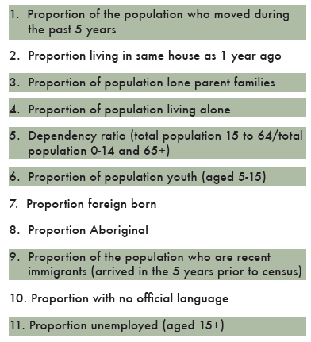
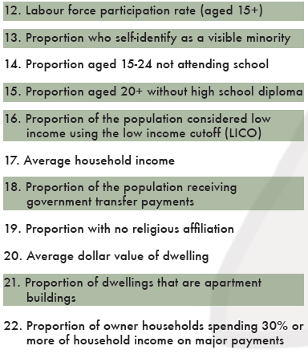
Census Variables I
*Source from ON-Marg_user_guide_1.0_FINAL_MAY2012

Slide 9
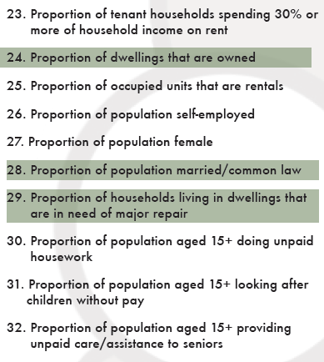
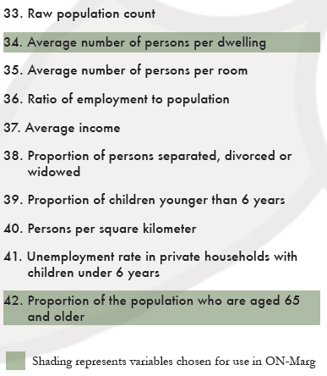
Census Variables II
*Source from ON-Marg_user_guide_1.0_FINAL_MAY2012

Slide 10
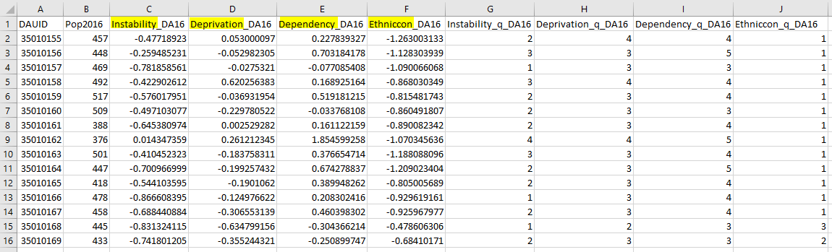
Notes:
Drawing after this slide

Slide 11
Database Updates
DA (Dissemination Area) and PCODE6 (6-digit Postal Code) linking
PCODE6 to PCODE3 (6-digit Postal Code)
Notes:
1. Service gaps
2. Funds
3. Areas for improvement
4. Marginalization & health Outcomes e.g., mortality rates, disease

Slide 12
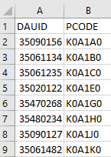
Table data
DAUID
Pop2016
Instability_DA16
Deprivation_DA16
Dependency_DA16
Ethniccon_DA16
Quintiles…
DA and PCODE6 Linking
Data update (2006 VS 2016)
- 10% increased data preservation
- data not collected in some areas in 2006
- DA/PCODE6 change
Linking (Data extraction)
Not one to one (Data selection)
Linking data

Slide 13
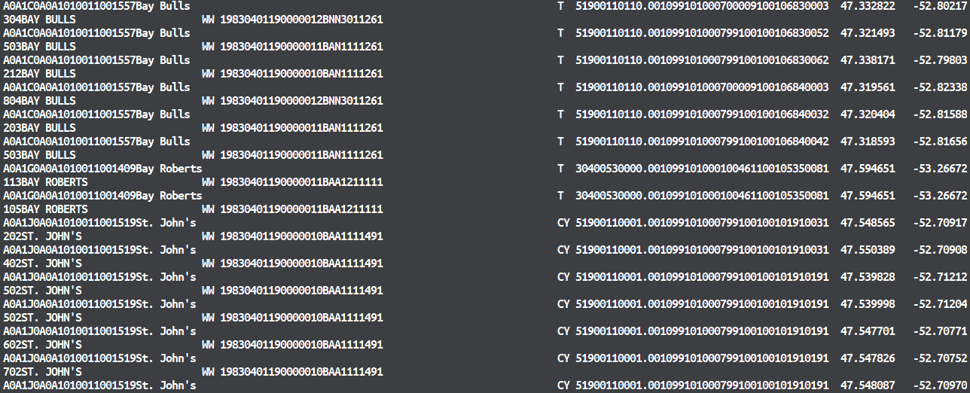
DA and PCODE6 Linking (Data extraction)
*Source from Postal CodeOM Conversion File Plus (PCCF+) Version 7A
Notes:
File sources
Highlight PCODE6 and DA
Pictures to verify

Slide 14
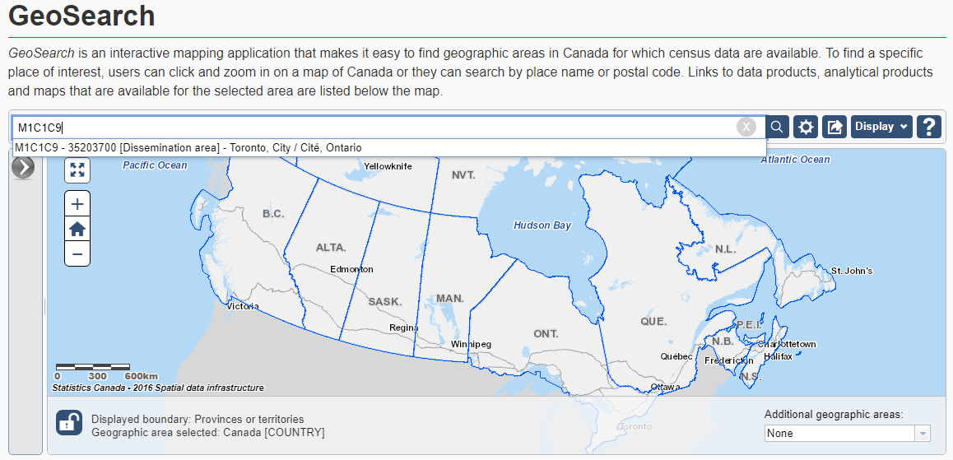
Data extraction Verification
*Source from Statistics Canada (https://www12.statcan.gc.ca/census-recensement/2016/geo/geosearch-georecherche/index-eng.cfm)

Slide 15
DA and PCODE6 Linking – Data Selection
PCODE6: A#A #A#
The first segment is called the 'forward sortation area' (FSA) and is used to identify the geographic location of the address.
The second segment is called the 'location delivery unit' (LDU) and represents either a specific address or group of addresses.

Slide 16

DA and PCODE6 Linking - Data Selection
A#A #A#
Not one to one
PCODE3
General
Specific
DA
DA
PCODE6
PCODE6
DA
DA
DA

Slide 17
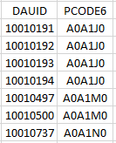
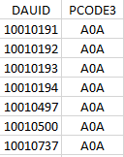
A#A #A#
Table data
DAUID
Pop2016
Instability_DA16
Deprivation_DA16
Dependency_DA16
Ethniccon_DA16
Quintiles…
PCODE6 to PCODE3
Why do this?
- We only collect PCODE3 from patients for confidentiality
reasons because PCODE6 can be used to locate patients
General
Specific
Notes:
Show pcode6

Slide 18
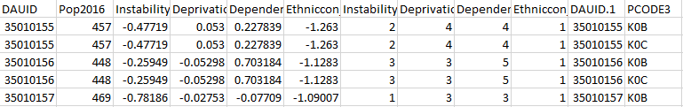
Linking data
Table data
DAUID
Pop2016
Instability_DA16
Deprivation_DA16
Dependency_DA16
Ethniccon_DA16
Quintiles…
PCODE6 to PCODE3
How to do this?
- Empty Rate:
(2016) 23177 – 168 (0.7%)
(2006) 23177 – 2730 (11.8%)
10% increased data preservation
Notes:
Show pcode6

Slide 19
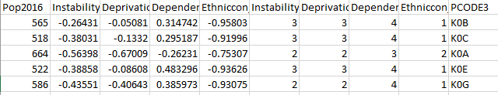
Linking data
Table data
DAUID
Pop2016
Instability_DA16
Deprivation_DA16
Dependency_DA16
Ethniccon_DA16
Quintiles…
PCODE6 to PCODE3
How to do this?
- Average
- Opinions/Discussion
Notes:
Question!!!! How to do other than average???

Slide 20
Uses for OMI
Planning & Needs Assessment
Resource Allocation
Monitoring of inequities
Research

Slide 21
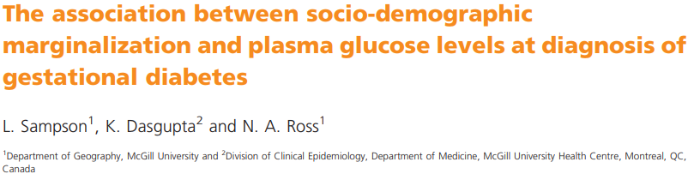
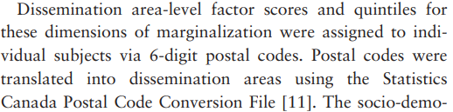

Some cool research examples using OMI
Tried to find how other researchers use the data, no luck so far. Besides, 6 to 3 conversion is a special case for us as well.
Notes:
Is there 6 to 3 use???

Slide 22
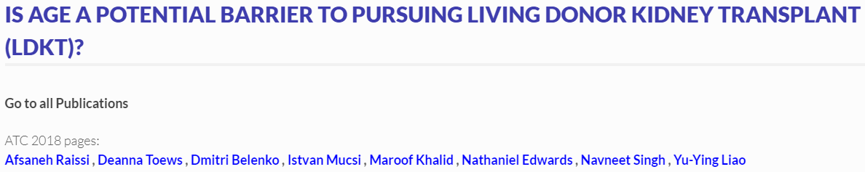
How about us using OMI
Is it different among different ethic groups?
Is it because older people have higher dependency?
Is it …?

Slide 23
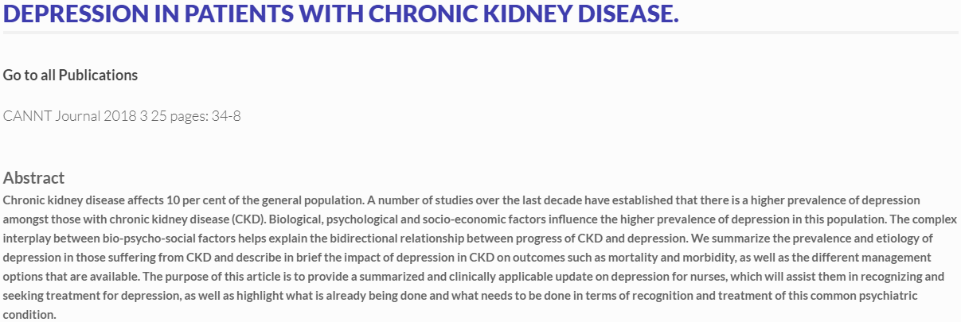
OMI for Our Research
Does depression lead to higher instability?
Or perhaps the other way around?
And more…

Slide 24
Thank you.
Ideas and Q&A

