Slide 1
Ontario Marginalization Index
March 1 2017

Slide 2
Outline
What is OMI
Uses
Sources & Development
4 Dimensions
Interpreting
Limitations
Literature

Slide 3
Marginalization
A process that creates inequalities along multiple axes of social differentiation

Slide 4
What is the OMI?
A census- and geographically based index that seeks to:
show differences in marginalization between areas; and
understand inequalities in various measures of health and social well-being
Notes:
either between population groups or between geographical areas.

Slide 5
Uses for OMI
Planning & Needs Assessment
Resource Allocation
Monitoring of inequities
Research
Notes:
1. Service gaps
2. Funds
3. Areas for improvement
4. Marginalization & health Outcomes e.g., mortality rates, disease

Slide 6
Where does OMI come from?
CANmarg Index
Goes beyond traditional ’area based deprivation indices”
Includes 4 dimensions
Literature review → 42 census variables
Principal component factor analysis
18 included in the four factors
Separate index created for each factor
Notes:
Beyond – because most ABDI’s focus on material deprivation (income, car or home ownership) whereas over the past few decades, other areas of inequalities are just as important for health.

Slide 7
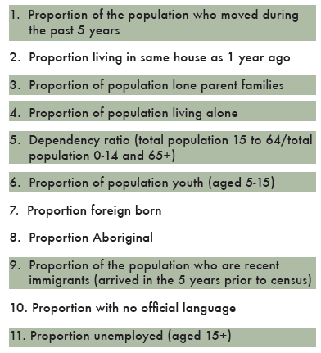
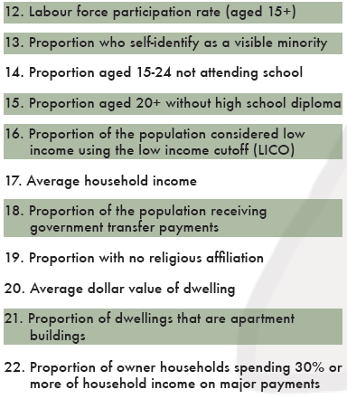
Census Variables I

Slide 8
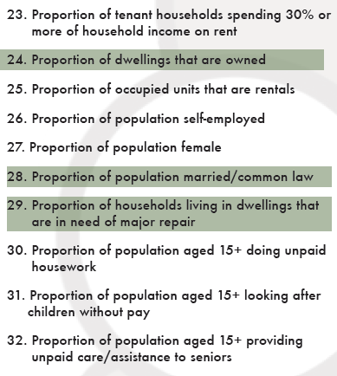
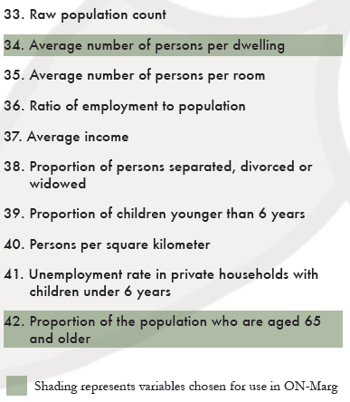
Census Variables II

Slide 9
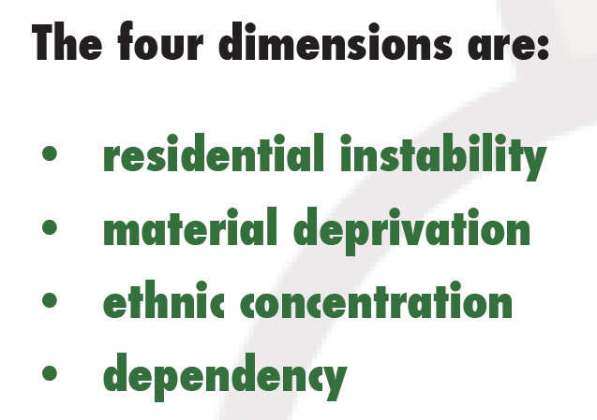

Slide 10
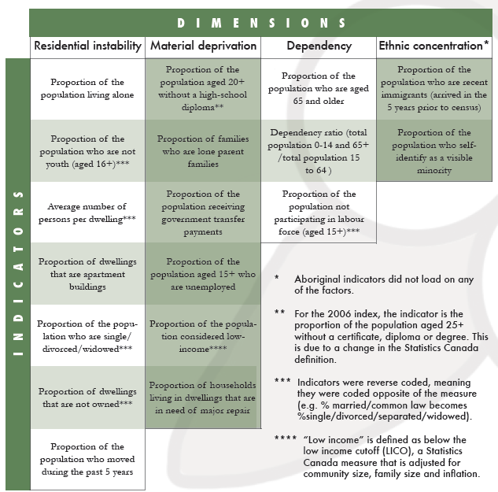

Slide 11
Interpreting the OMI
ON-Marg applies to areas
not individual people
Factor Scores from PCFA
Quintiles (ordinal scale)
Marginalization data sorted into 5 groups
ranked from 1 (least) to 5 (most)
Each group contains a fifth of the geographic units
Summated score *
Notes:
For example, if an area has a value of 5 on the material deprivation scale, it means it is in the most deprived 20 percent of areas in Ontario.

Slide 12
Limitations
Missing data
Data suppression (e.g., income)
Time period of data
2001/06 vs Outcome data collection dates
Coverage of Census
ONmarg may not be sensitive for some populations, undercounted in the census

Slide 13
OMI in the current literature?

Slide 14

Associations between marginalization and health/behavioural outcomes
OMI vs. Health & Behavioural Outcomes
Source: Canadian Community Health Survey (CCHS)
a cross-sectional nationally representative survey that provides detailed information on health determinants and outcomes for individuals.
Notes:
Canadian Community Health Survey (CCHS),
a cross-sectional nationally representative survey that provides
detailed information on health determinants and outcomes for
individuals.23

Slide 15
Residential Instability (RI)
Higher RI was significantly associated with greater health/behavioural problems
binge drinking, smoking, disability, chronic diseases, low physical activity, and poor self-rated physical/mental health.
Higher RI was associated with:
Lower likelihood of being overweight
Greater likelihood of having had a flu shot
Matheson et al., 2012 (Development of the Canadian Marginalization Index: A New Tool for the Study of Inequality)

Slide 16
Material Deprivation (MD)
Higher MD was significantly associated with:
Worse physical and mental health outcomes
Being overweight, physically inactive, smoking, binge drinking, disability
Lower likelihood of having flu shot
Lower self perceived stress
Matheson et al., 2012 (Development of the Canadian Marginalization Index: A New Tool for the Study of Inequality)

Slide 17
Dependency
Higher dependency was positively associated with:
Being overweight, having disability, an inactive lifestyle
having had a flu shot in the previous year
Greater risk of reporting chronic physical health problems and poor self-rated physical and mental health
Lower risk of self-perceived stress, smoking, and having a mood/anxiety disorder
Matheson et al., 2012 (Development of the Canadian Marginalization Index: A New Tool for the Study of Inequality)

Slide 18
Ethnic Concentration (EC)
Different than other dimensions
Higher EC was significantly associated with better health outcomes and more healthy behaviours:
particularly for binge drinking, smoking, disability, chronic physical and mental health, and self-rated physical health.
In cases of high self-perceived stress and poor self-rated mental health, higher EC was associated with poorer health.
Matheson et al., 2012 (Development of the Canadian Marginalization Index: A New Tool for the Study of Inequality)

Slide 19
Community Belonging
RI, MD and EC were negatively related to strong sense of community belonging
Dependency showed the reverse
Higher dependency was associated with a greater sense of community belonging.
Matheson et al., 2012 (Development of the Canadian Marginalization Index: A New Tool for the Study of Inequality)

Slide 20
Linking OMI to our data
Scores for each dimension are available for every census tract and dissemination area (DA) in Ontario
DA is the smallest, relatively stable geographic unit where the census distributed
Postal Code linked to DA via census data
Use as linker between our data and OMI data

Slide 21
CANmarg
It was then empirically derived using principal components factor analysis.
Stable across time periods and across different geographic areas (e.g. cities and rural areas).
Associated with health outcomes including hypertension, depression, youth smoking, alcohol consumption, injuries, BMI

