Slide 1
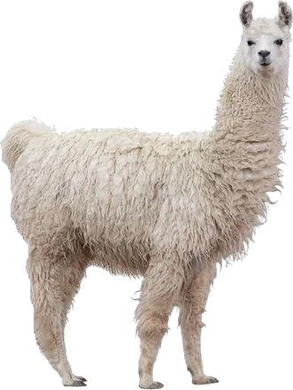


Compression Algorithms
llmc
Inference Backends
Large Language Model
AWQ, OS+, SpQR…
Lightllm, TensorRT-LLM…
Perplexity Score
Compressed Large Language Model

