Slide 1
Plant Disease Detection

Slide 2
Abstract
Agricultural productivity is something on which economy highly depends. If proper care is not taken in this area then it causes serious effects on plants and due to which respective product quality, quantity or productivity is affected. Detection of plant disease through some automatic technique is beneficial as it reduces a large work of monitoring in big farms of crops, and Algorithm for image segmentation technique which is used for automatic detection and classification of plant leaf diseases, is done by using genetic algorithm.

Slide 3
Introduction
Automatic detection of the diseases by just seeing the symptoms on the plant leaves makes it easier also machine vision to provide image based automatic process control.
Image segmentation is grouping an image into different parts. In this Thresholding process is advanced color method. This process is based on various features found in the image.
Genetic algorithm searches from a large sampling of the cost surface. Large number of variables can be processed and Gives a number of optimum solutions, different image segmentation results can be obtained.

Slide 4
Problem Statement
To develop computational methods which will make the process of disease detection and classification using leaf images automatic, with maximum accuracy.

Slide 5
Objectives
To process the data of the leaf picture from plant dataset.
Extract the feature from pre-processed data.
Accurately classify the leaf disease.
Evaluate performance analysis

Slide 6
Existing System and Its Disadvantages
The existing method for plant disease detection is simply naked eye observation by experts through which identification and detection of plant diseases done.
Disadvantages
We need large team of experts to detect diseases.
Continuous monitoring of plants is required.
Cost of existing system is high when we implemented for large farms.
Farmers do not have proper facilities.

Slide 7
Proposed System and Its Advantages
The proposed method is using ResNet (CNN model)
Advantages
At very early stage itself it detects the symptoms of
disease.
Automatic detection of the diseases by just seeing the
symptoms.
Also supports machine vision to provide image based
automatic process .

Slide 8
Dataset Used
Images were taken from the new plant disease dataset from Kaggle. This dataset is recreated using offline augmentation from the original dataset which is plant village dataset. This dataset consists of about 87K RGB images of healthy and diseased crop leaves which is categorized into 38 different classes. The plants that are considered in this dataset are Orange, Grape, Raspberry, Tomato, Peach, Apple, Cherry (including sour), Soybean, Pepper bell, Corn(maize), Potato, Blueberry, Squash and Strawberry.
https://www.kaggle.com/datasets/vipoooool/new-plant-diseases-dataset

Slide 9
Methodology

Slide 10
Septs Involved
Loading necessary modules – Phase 1
Dataset preparation – Phase 2
Modelling CNN – Phase 3
Architecture – Phase 4
Notes:
We began by loading necessary modules such as os (for interacting with files), NumPy (for numerical calculations), pandas (for working with data frames), torch (for pytorch module), and matplotlib (for charting information). Google Colab was used throughout the whole project.
The image data were imported using torch vision. ImageFolder was then used to convert the pixel values (0-255) of each picture to 0-1, since neural networks operate best with normalized input. . In forward propagating of a CNN, the batch length is the no of pictures delivered as input all at once. Batch size essentially specifies the number of images which would be transmitted over a network. Here, a batch size of 32 was chosen. The following image shows the photos used for the first round of training.
GPUs are recommended when working with image datasets as CPUs are best for general-purpose processing, whereas GPUs are suited for training deep learning as they can perform multiple calculations simultaneously.

Slide 11
Need for ResNet
Mostly in order to solve a complex problem, we stack some additional layers in the Deep Neural Networks which results in improved accuracy and performance. The intuition behind adding more layers is that these layers progressively learn more complex features. For example, in case of recognizing images, the first layer may learn to detect edges, the second layer may learn to identify textures and similarly the third layer can learn to detect objects and so on.
Notes:
We used ResNet (particularly ResNet9), which has been one of the most significant advances in computer vision since its introduction in 2015.

Slide 12
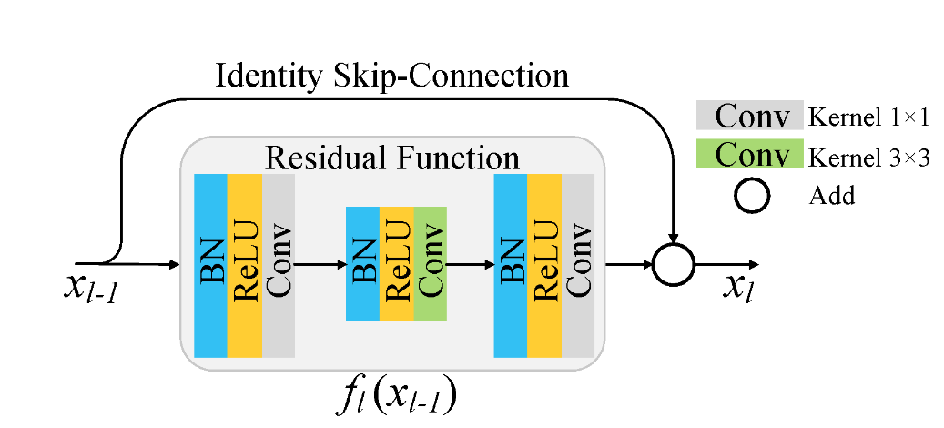
Residual Block
In ResNet, unlike in traditional neural networks, each layer feeds into the next layer, we use a network with residual blocks, each layer feeds into the next layer and directly into the layers about 2–3 hops away, to avoid over-fitting (a situation when validation loss stop decreasing at a point and then keeps increasing while training loss still decreases). This also helps in preventing “Vanishing Gradient” and allow us to train deep neural networks.
Notes:
We used ResNet for one more reason
which is we can overcome vanishing gradient problem.
Vanishing gradient:
It occurs while training deep neural networks, where the gradients that are used to update network be come very small or vanish.

Slide 13
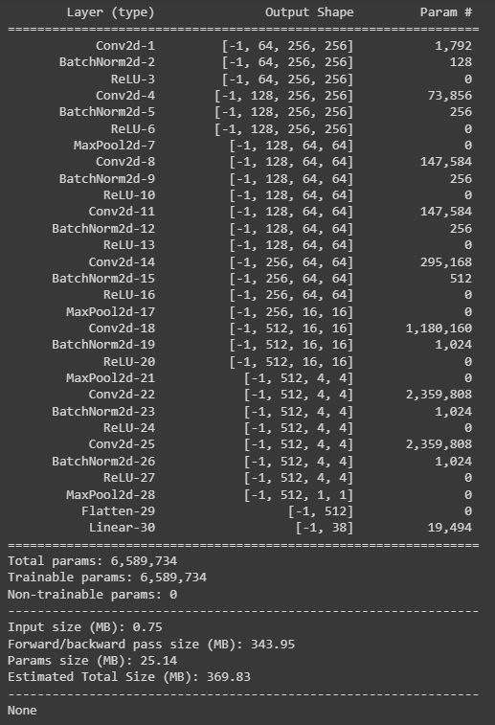
conv1->conv2->RES1->conv3->conv4->RES2->classifier

Slide 14
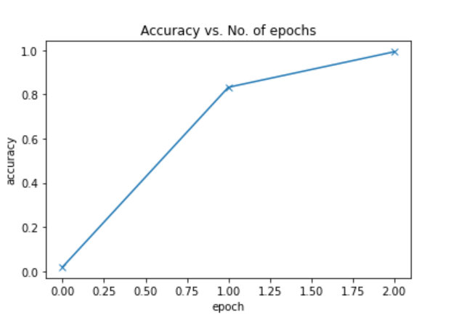
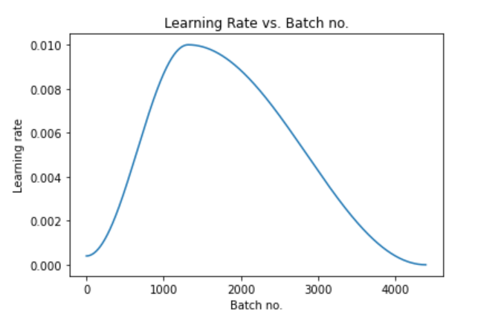
Results
Notes:
After training, we examined the precision of the validation data and found that it was 99.1% accurate.
Accuracy vs No of epochs
Learning rate vs Batch Number

Slide 15
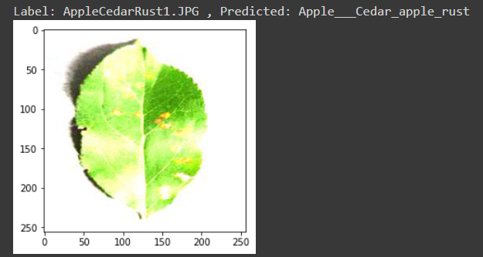
Notes:
First, we took a single leaf image from the test dataset and gave it as an input to the model for predicting.

Slide 16
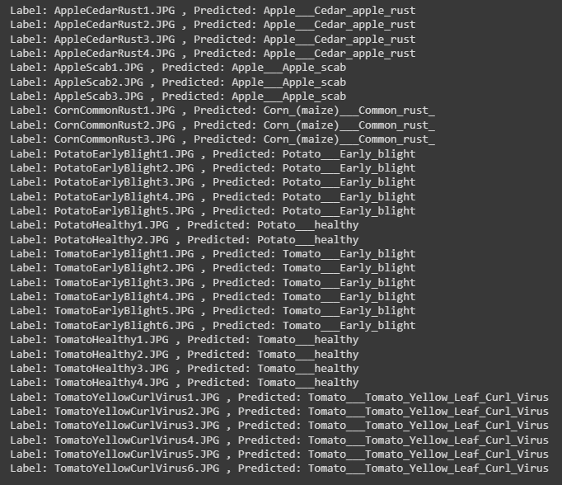
Notes:
Later we evaluated the model on all images it predicted the exact disease for each plant.

Slide 17
Timeline
29-8-2023 – 24-9-2023
1. Dataset preparation
2. Model building
3. Results extraction
26-9-2023 – 4-10-2023
1. Documentation
2. Editing’s
7-10-2023 – 11-11-2023 (Tentatively)
1. Project report
After 11-11-2023
1. Evaluation and Submission

Slide 18
THANKYOU

