Slide 1

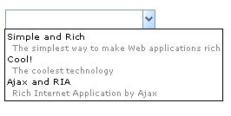
Auxhead
span.combobox
span. rbtnbk
div.comboboxpp
.comboboxpp td
.comboboxpp td span

Slide 2

div.head-cell-inner
div grid-head th

