Slide 1
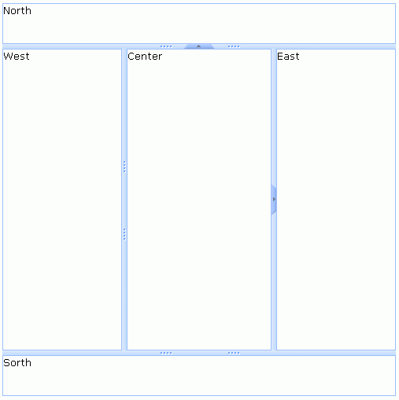
div. layout-container

Slide 2

div. layout-region,
div.layout-region-normal,
div.layout-region-north
div. layout-region-body
div.layout-split ,
div.layout-split-v
span. layout-split-btn-t

Slide 3

div.layout-split ,
div.layout-split-v-ns
span. layout-split-btn-b
div. layout-region-body
div. layout-region,
div.layout-region-normal,
div.layout-region-south

Slide 4
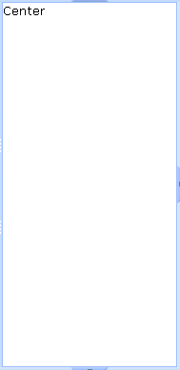
div. layout-region,
div.layout-region-normal,
div.layout-region-center
div. layout-region-body

Slide 5
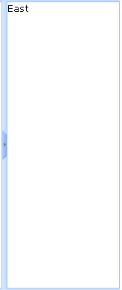
div. layout-region,
div.layout-region-normal,
div.layout-region-east
div.layout-split ,
div.layout-split-h-ns
div. layout-region-body
span. layout-split-btn-r

Slide 6
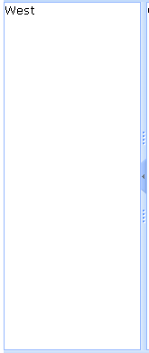
div. layout-region,
div.layout-region-normal,
div.layout-region-west
div. layout-region-body
div.layout-split ,
div.layout-split-h
span. layout-split-btn-l

