Slide 1
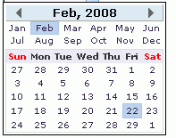
div.dateboxpp
span. datebox
span. rbtnbk
. dateboxinp
. text-invalid

