Slide 1
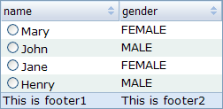
div.listbox
div.listbox-head tr
div.listbox-body
div.listbox-foot
div. listbox-pgi
a
span
Notes:
1

Slide 2
div.listbox-head th
div.listbox-head tr
div.head-cell-inner
div.listbox-head th.sort div.head-cell-inner
Notes:
2

Slide 3
div.listbox-head th
div.head-cell-inner
div.listbox-head th.sort div.head-cell-inner
Notes:
3

Slide 4
div.listbox-head th
div.listbox-head tr
div.head-cell-inner
div.listbox-head th.sort div.head-cell-inner
Notes:
4

Slide 5

table. listbox-btable
div. listbox-body
tr.listbox
td.gc
div.gc, div.cell-inner

Slide 6
div. foot-cell-inner
div.listbox-foot
div. grid-pgi
div. paging
a
span

