Slide 1
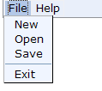

td.seld
menu
table.calmon td
table.calyear td
tr.caldow td
tr.caldow
tr.calday td
td.seld
tr.calday td.dis

