Slide 1
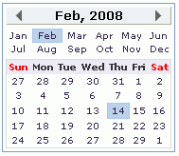

table.calendar
table.calyear
td.seld
table.calmon
table.calmon td
table.calday
table.calyear td
tr.caldow td
tr.caldow
tr.calday td
td.seld
tr.calday td.dis

