Slide 1
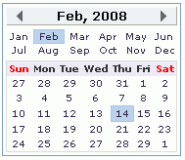

table.calendar
table.calmon td
table.calmon
td.seld
table.calyear td
table.calyear
tr.caldow td
table.calday
tr.calday td

