Slide 1
HAND MOTION-BASED SYSTEM CONTROLS MANAGER
Under the guidance of:
K. BALACHANDRA REDDY, M. Tech, (Ph.D.)
Assistant Professor (Ad hoc),
Department of CSE,
JNTUACEP, Pulivendula. .
Team Members:
Ramavath Balaji Naik(20191A0552)
Sunkara Chaithanya Krishna(20191A0555)
.

Slide 2
Table of contents
1. | Introduction
2. | Problem Statement
3. | Technical Support
4. | Literature Survey
5. | Features of the project
6. | Implementation

Slide 3
Introduction:
Why do we need a virtual system-controls manager using Hand motion/gestures??
How does it serve current needs??

Slide 4
Problem Statement:
To develop an efficient Hand Motion-based System Controls Manager for accurate interpretation of hand gestures for precise control over wide range of system functions, also to address challenges in current gesture-based control systems. Our approach leverages computer vision and machine learning to enhance user interaction virtually. By implementing a 5-bit binary number-based approach for gesture classification, we seek to improve user experience and reduce reliance on traditional input devices.

Slide 5




Technical Support:
PyCharm
OpenCV
Media-Pipe
InDepth sensor-equipped webcam

Slide 6
Literature Survey:

Slide 7
SL.No. | Title | Author(s) | Year | Proposed System | Future Scope
1. | AI -Virtual Mouse using Hand Gestures | V. Kavitha, G. Amrutha, N. Mahithosh, N. Venkata Subba Rao, K. Shalem Raj | 2022 | The research paper presents a method to perform actions typically associated with mouse control, such as cursor movement, clicking, and scrolling, using intuitive hand gestures. | They encountered challenges with precise left-right clicks at specific positions and dragging and text selection using the cursor.
2. | Design And Implementation of Virtual Mouse With Volume/Brightness Control Using Hand Gestures | Jaspreet Kaur, Silky Khurana, Kamal | 2023 | The research paper introduced a method for manipulating the cursor's position, adjusting volume, and controlling brightness solely through one hand gestures. | They have faced challenges with integrating more gestures with both hands. They were failed at implementing zoom controller.

Slide 8
SL.No. | Title | Author(s) | Year | Proposed System | Future Scope
3. | Virtual Mouse Implementation using Open CV | Gubbala Durga Prasanth, P. Srinivasa Reddy | 2020 | The research paper presents a method for implementing a virtual mouse using OpenCV, enabling control through hand gestures captured by a camera. | Can be integrated with other system controls like volume, brightness etc.
4. | Hand Gesture Recognition Based on Computer Vision | Munir Oudah, Ali-Al-Naji and Javaan Chahl | 2020 | Investigates the use of computer vision techniques in detecting and tracking moving objects within dynamic scenes. It focuses on enhancing real-time object recognition and tracking capabilities. | It involves usage of sensor based data glove, which is used as an object to identify gestures. It can be updated to natural hand gesture detection.

Slide 9
Features of the project:

Slide 10
Modules | Existing features | Proposed features
Tabs controller | - | Tab Minimization, Tabs Swapping , Tab closing
Zoom Controller | - | Window Zoom in-Zoom out , Document or Pdf Zoom in-Zoom out using area of the Present Bounding box wrt area of previous bounding box.
Copy & Paste | - | Copying of images or text, Pasting of images or text.

Slide 11
Modules | Existing features | Proposed features
Volume controller | Controlling volume using Pinch gesture | Added gesture detection based on hand’s bounding box area, Set volume based on pinky finger
Brightness Controller | Controlling brightness using Pinch gesture | Added gesture detection based on hand’s bounding box area, Set brightness based on [11111] gesture
Mouse | Curser Movement, Right click, Left Click, Scroll-up & Scroll-down | Locking Curser , Text Selection.

Slide 12
Implementation:

Slide 13
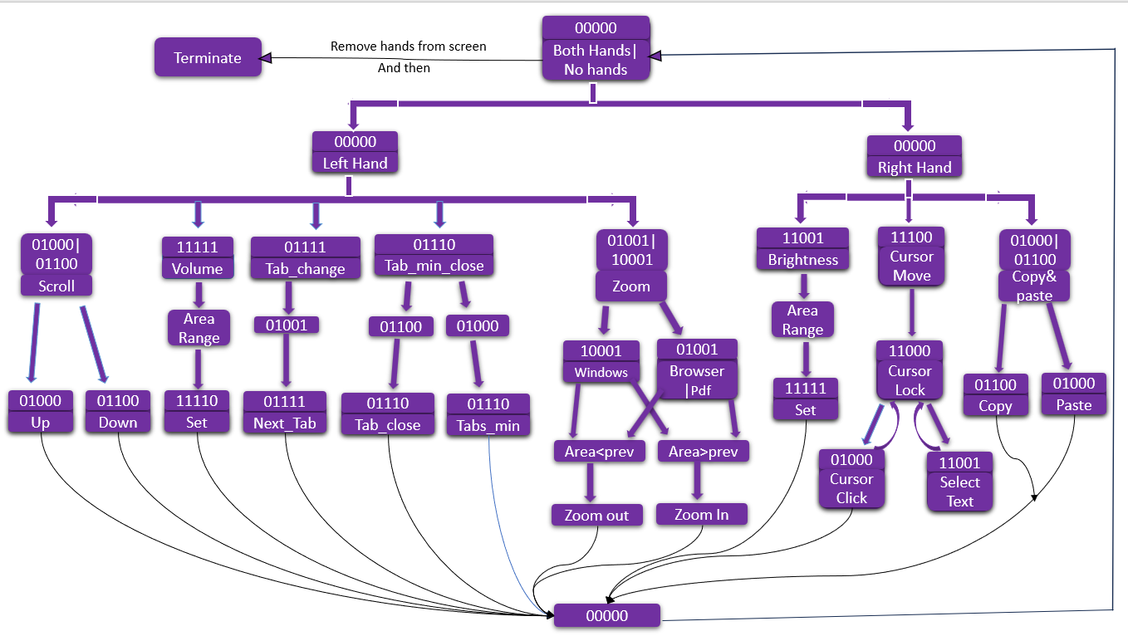

Slide 14
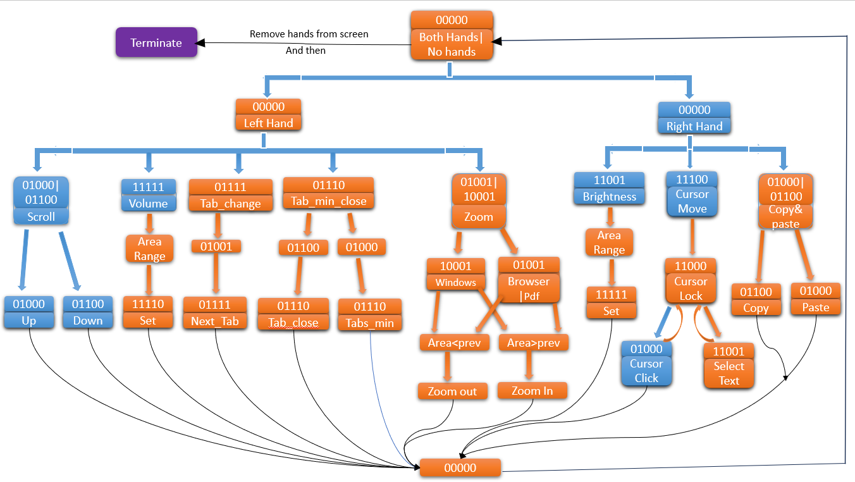

Slide 15
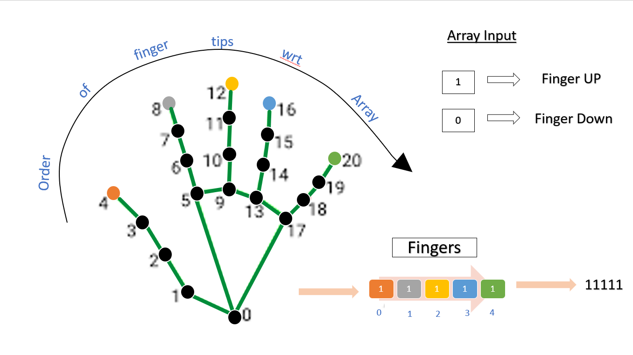
Encoding

Slide 16
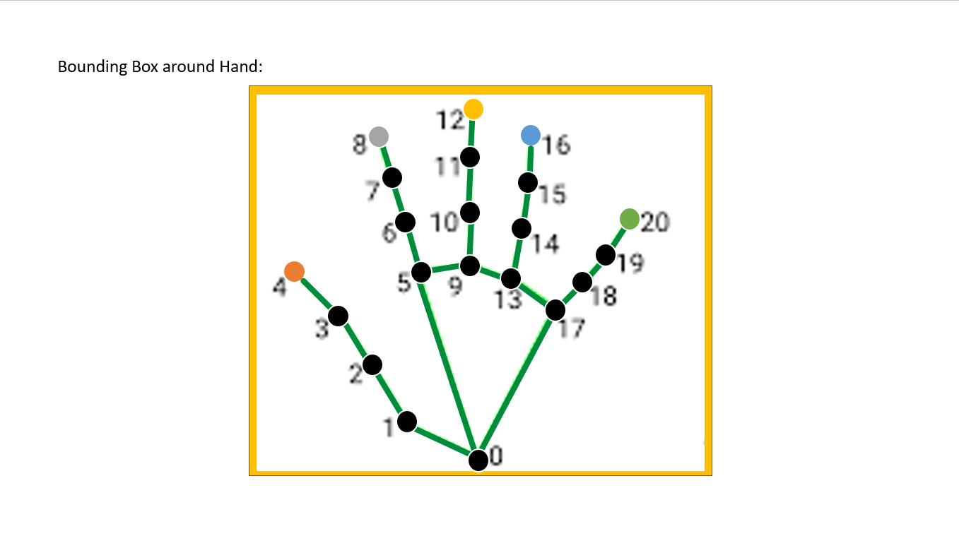

Slide 17
Conclusion:
The main objective of our proposed system is to make Laptop input controls virtually as much as we can, using unique hand gesture based encoding for each module, such that laptop system can be more and more interactive and in turn proposed system is helpful to reduce the complexity involving production of hardware devices like mouse, keyboard to some extent. Also our model has overcome most of limitations of existing systems.

Slide 18
Thank You

Slide 19
Any Queries?

