Slide 1
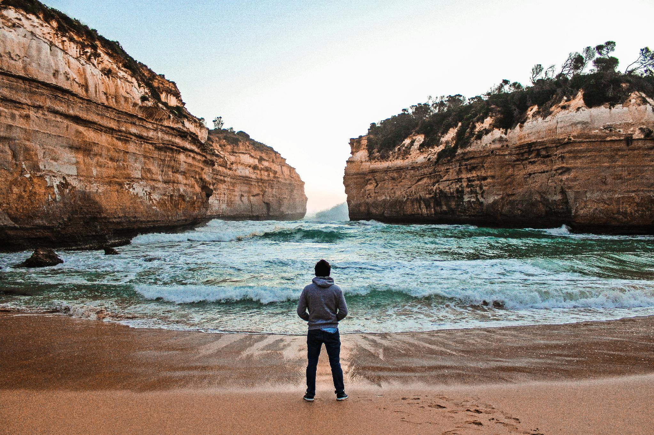

Digital
Pathways

Slide 2

Journey
A story, a pathway,
and a destination.

Slide 3
Jesus
The chief orchestrator
of journeys & pathways

Slide 4
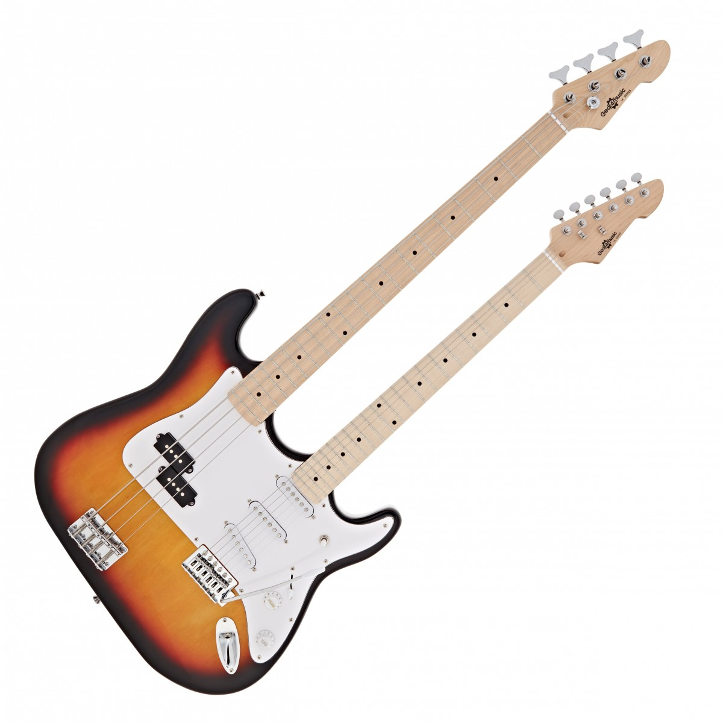

Slide 5
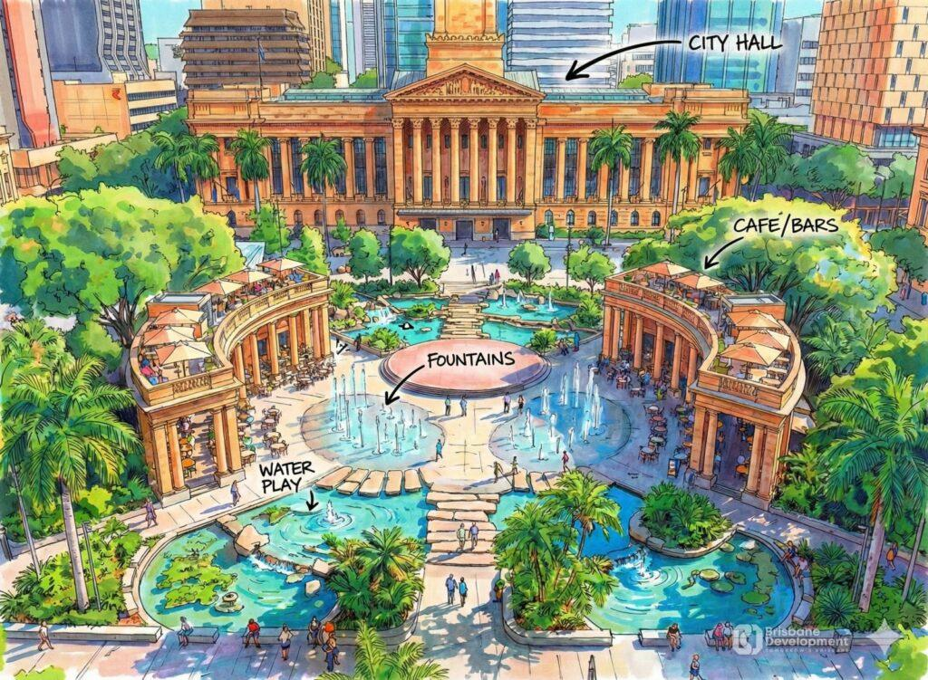

Slide 6
MEDIA & AI
TRIGGERS
OPPORTUNITIES
STRATEGIES

Slide 7
Three
Triggers

Slide 8
1
INTERRUPTION
2
INVESTIGATION
3
INTERACTION

Slide 9
Saul
David
Peter
Paul
INTERRUPTION

Slide 10

PATTERN INTERRUPT

Slide 11
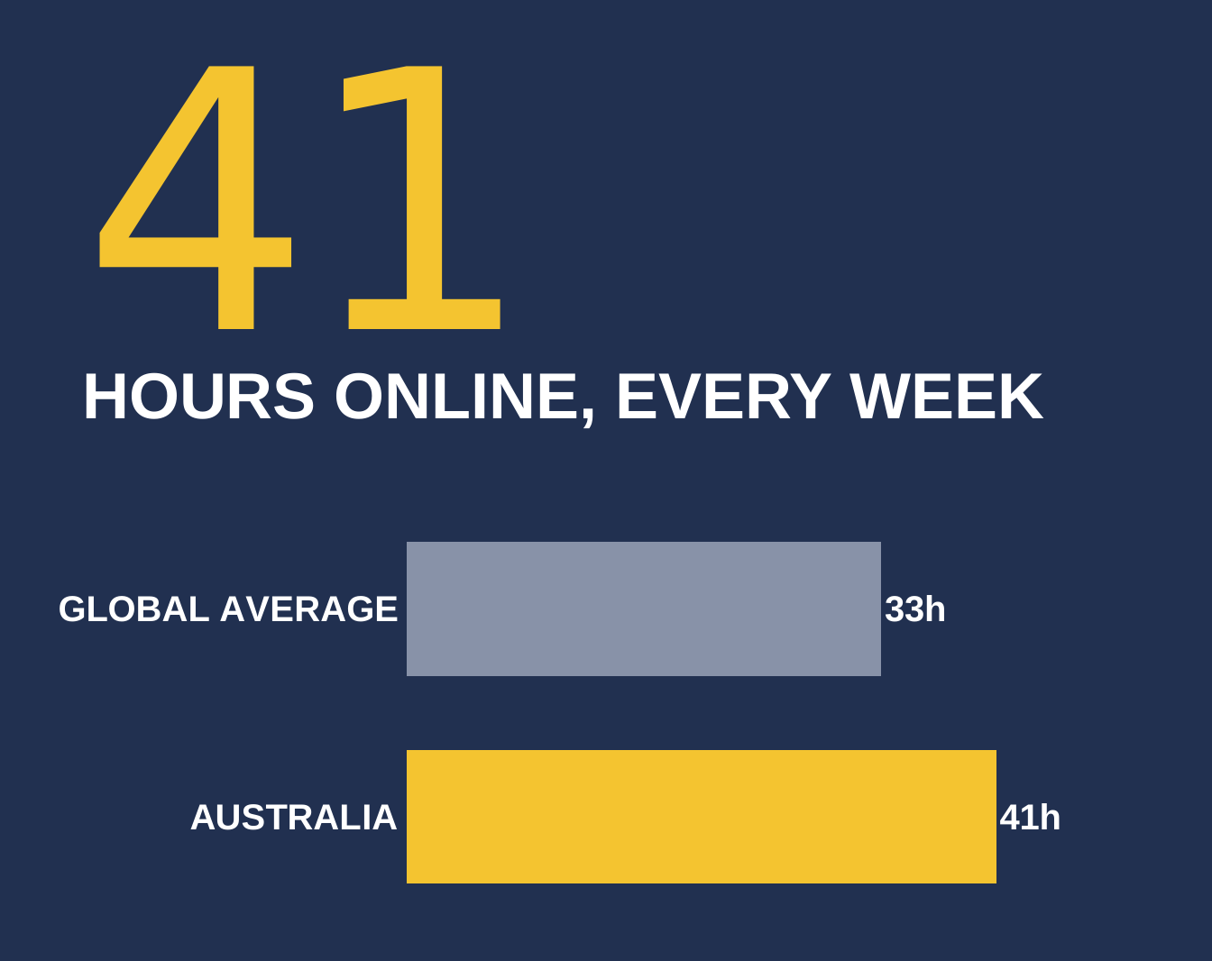

Slide 12
Nearly 50% of online time is on social media
18 Hours
on Social

Slide 13
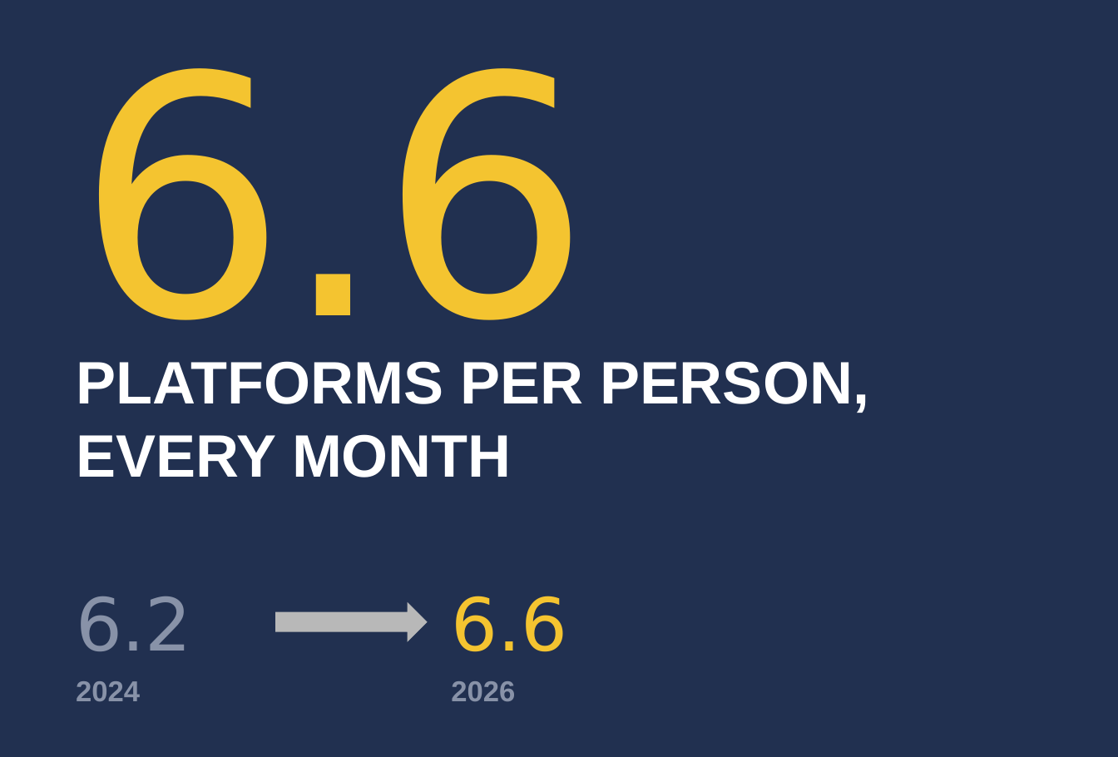

Slide 14
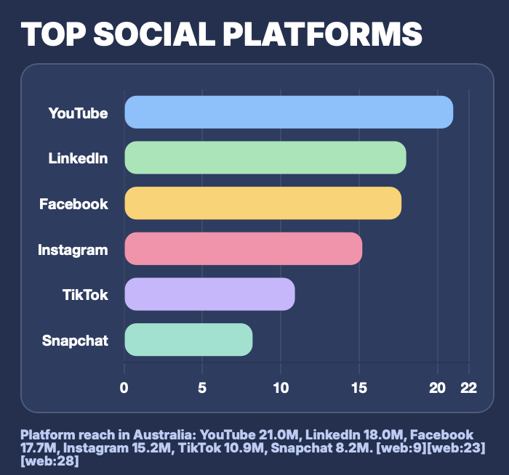

Slide 15
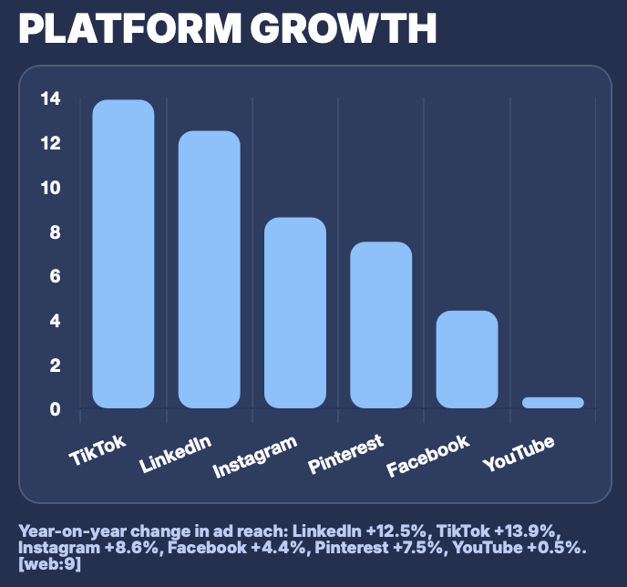

Slide 16
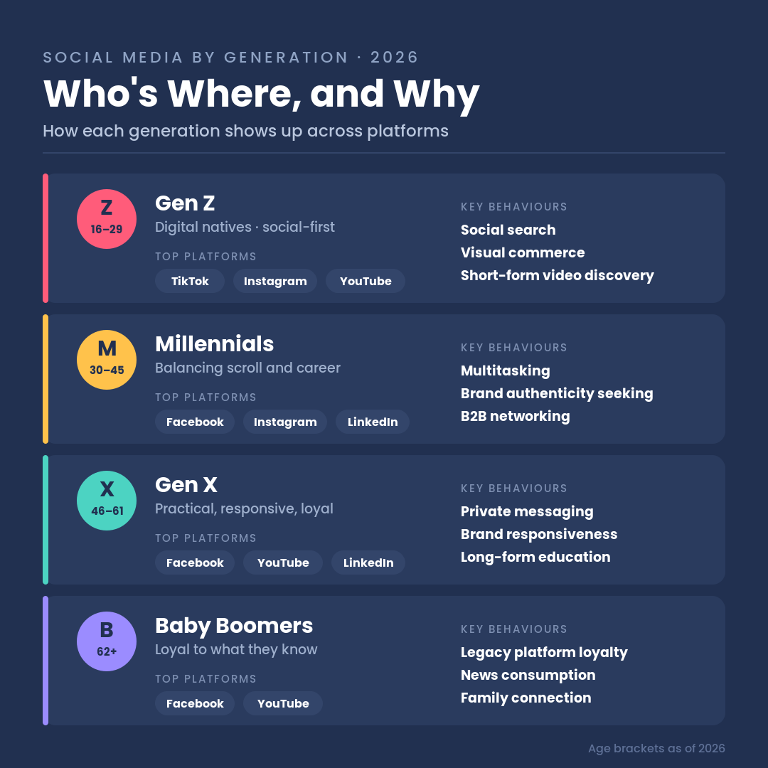

Slide 17
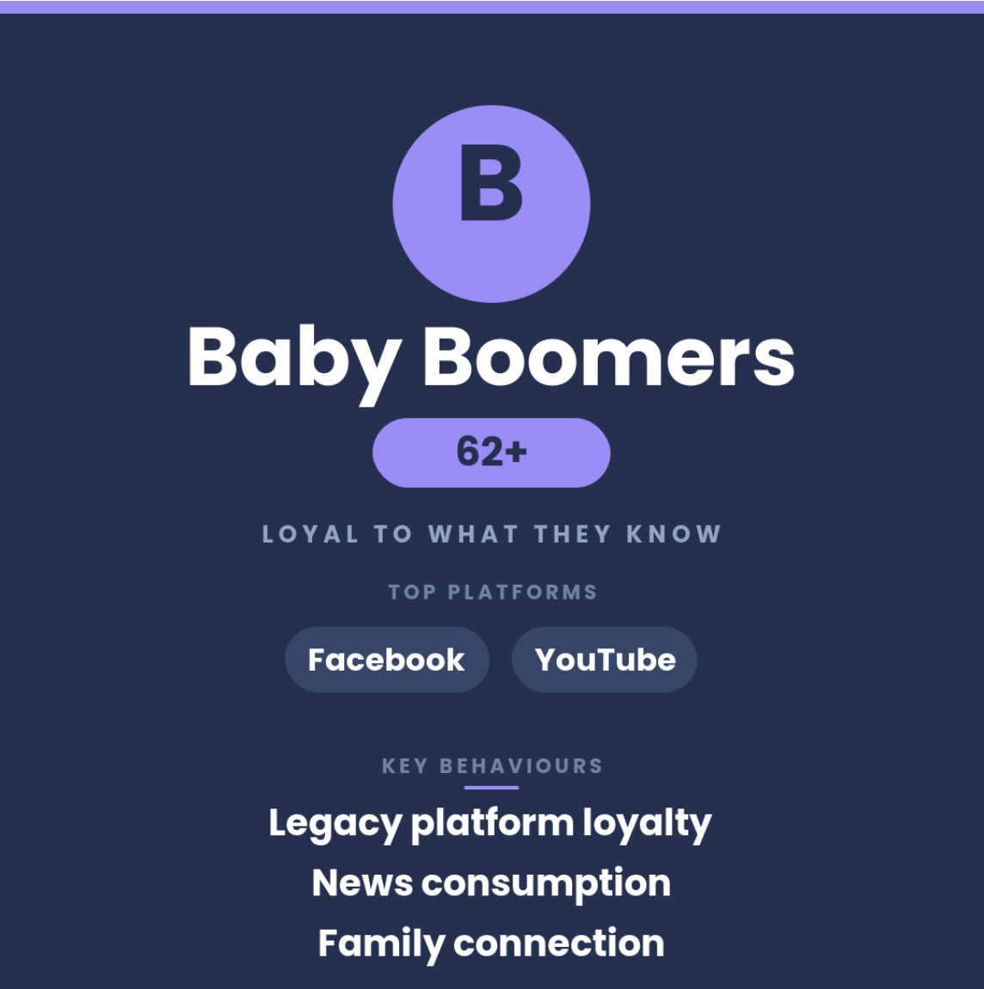

Slide 18
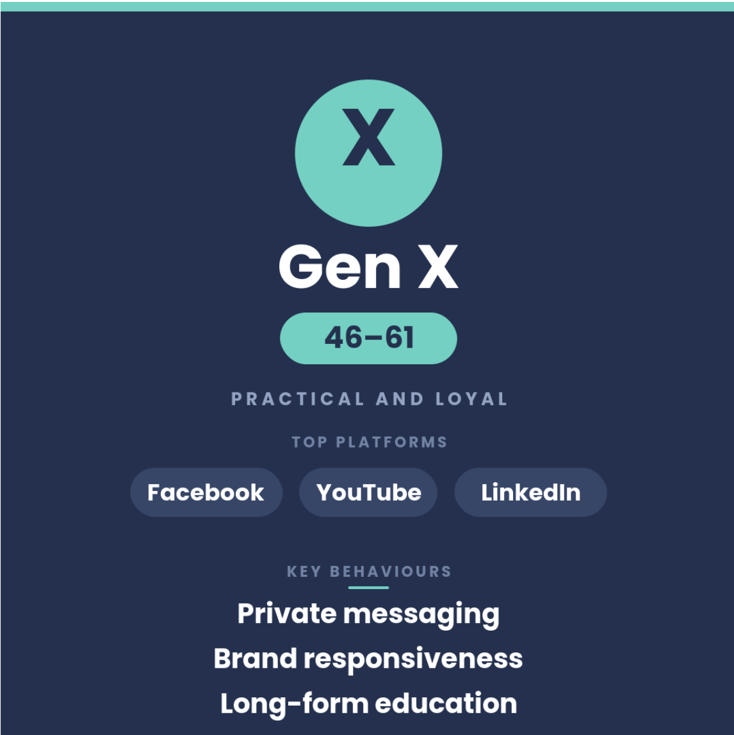

Slide 19
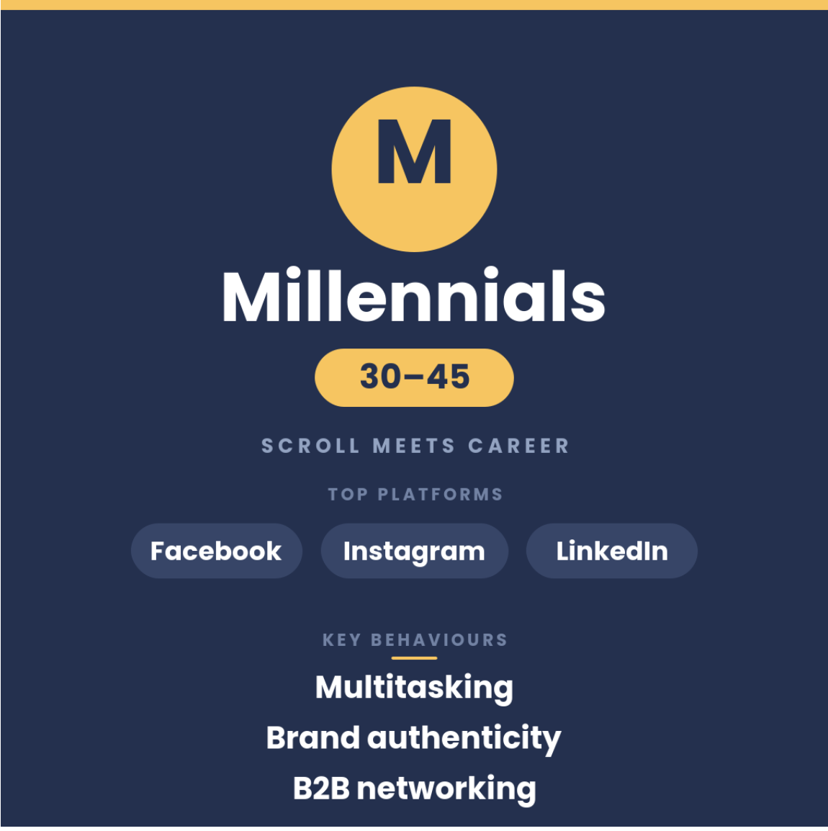

Slide 20
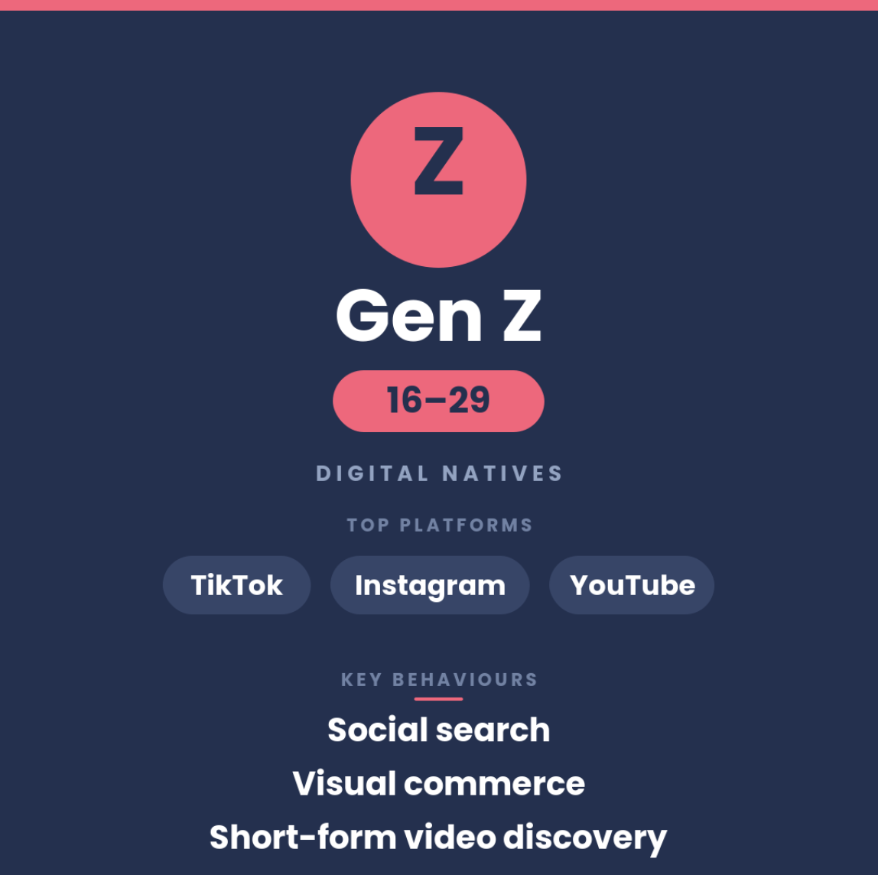

Slide 21
Fragmented
& Distributed
ATTENTION

Slide 22
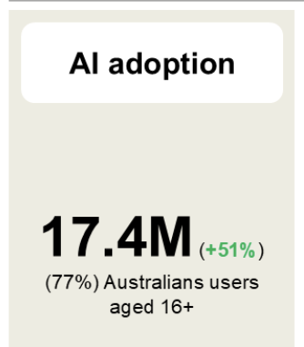

Slide 23
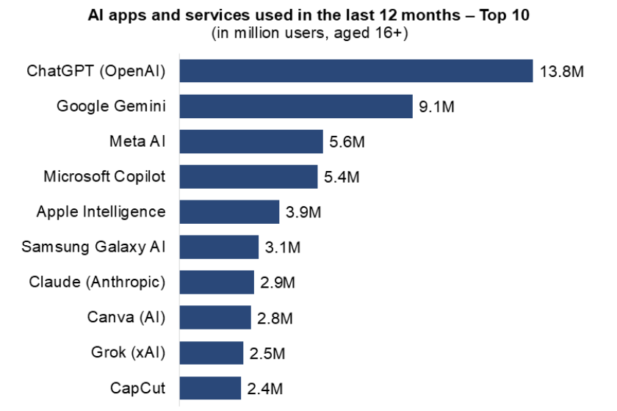

Slide 24
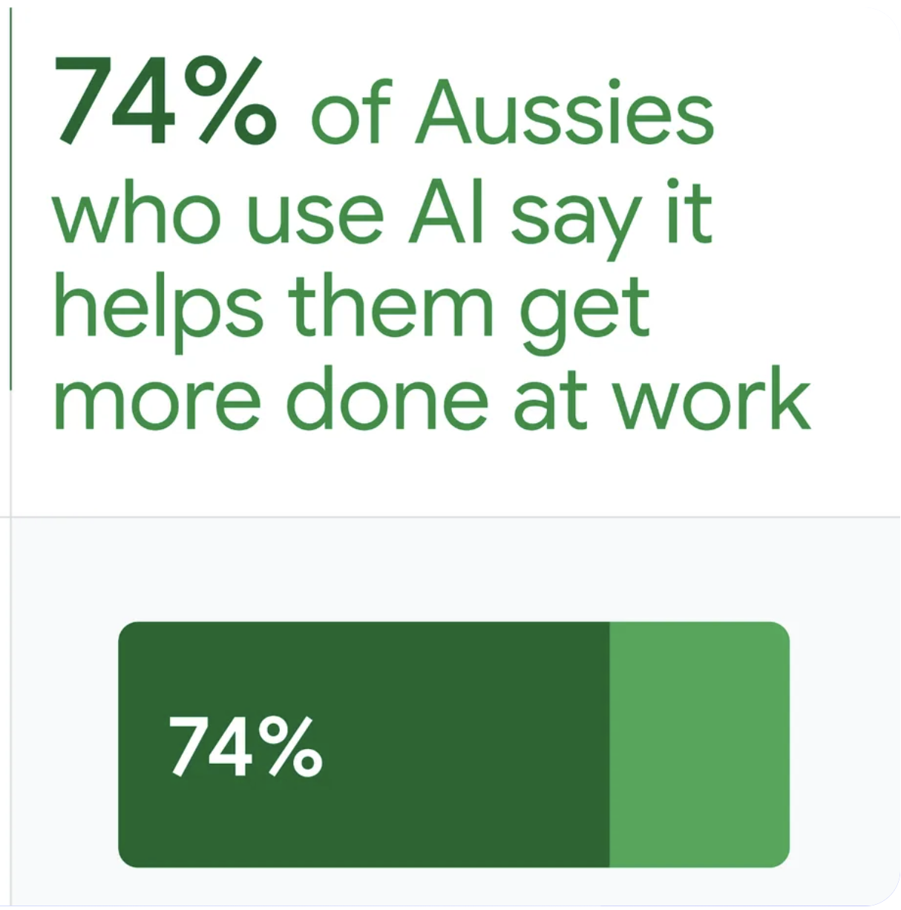

Slide 25
SO, HOW WILL YOU INTERRUPT?

Slide 26
HOW WILL YOU DISRUPT?

Slide 27
HOW WILL YOU GET THEIR ATTENTION?

Slide 28
King Nebuchadnezzar
The Ethiopian Officer
2. INVESTIGATION

Slide 29
SEARCH
& SOCIAL?

Slide 30
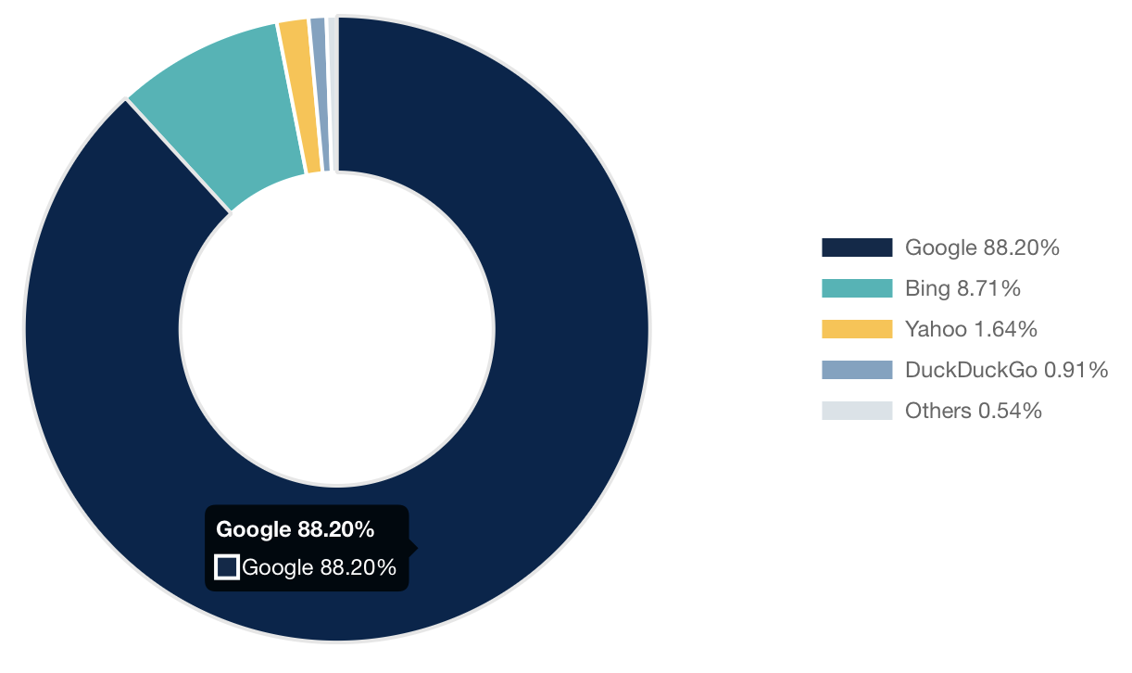

Slide 31
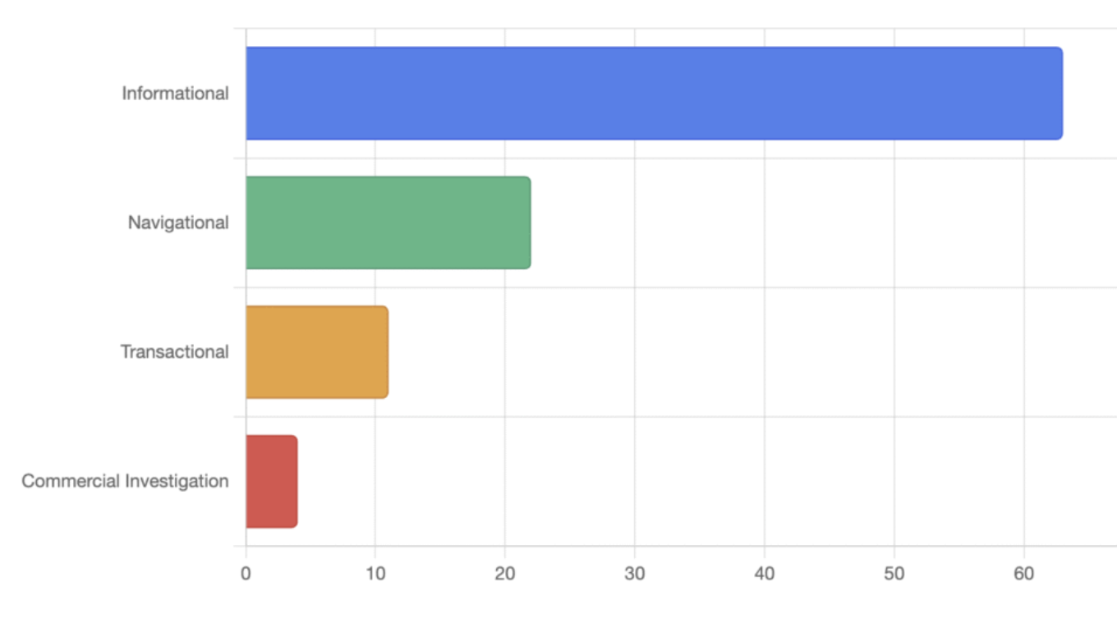

Slide 32
Source: Sprout Social

Slide 33
Source: Sprout Social

Slide 34
Source: Sprout Social

Slide 35
Source: Sprout Social

Slide 36
Source: Sprout Social

Slide 38
HOW VISIBLE ARE YOU ON SEARCH
& SOCIAL?

Slide 39
The Invisible Middleman
AI

Slide 40





SOCIAL & AI

Slide 41
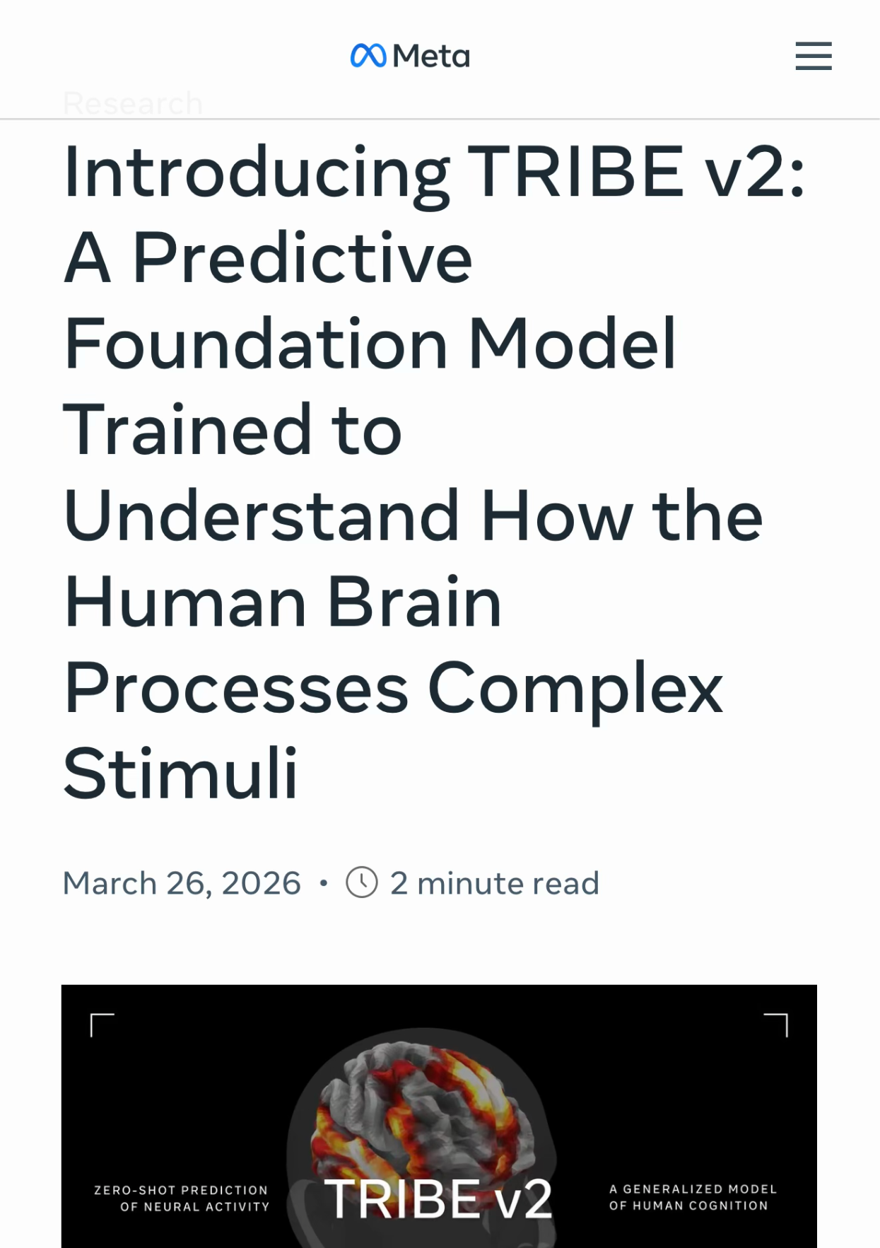

Slide 42
60-65% of
Google searches now end
without a click
A New Era

Slide 43
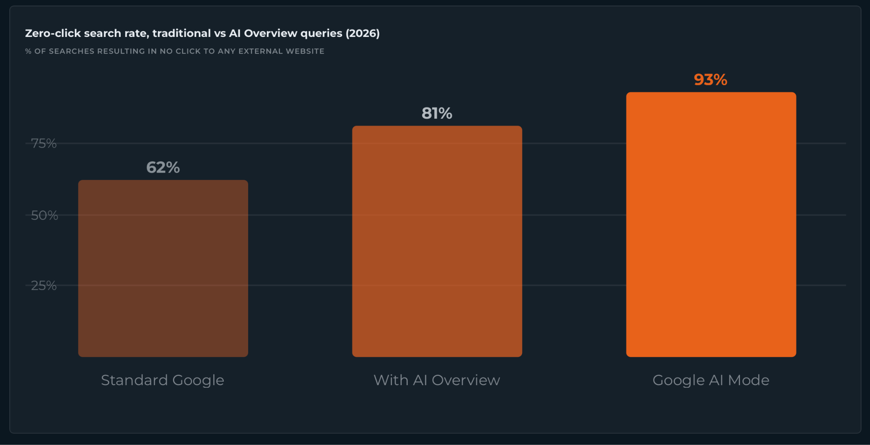
SEARCH & AI

Slide 45
HOW WILL YOU BUILD VISIBILITY ON SEARCH
& SOCIAL?

Slide 46
3. INTERACTION

Slide 47
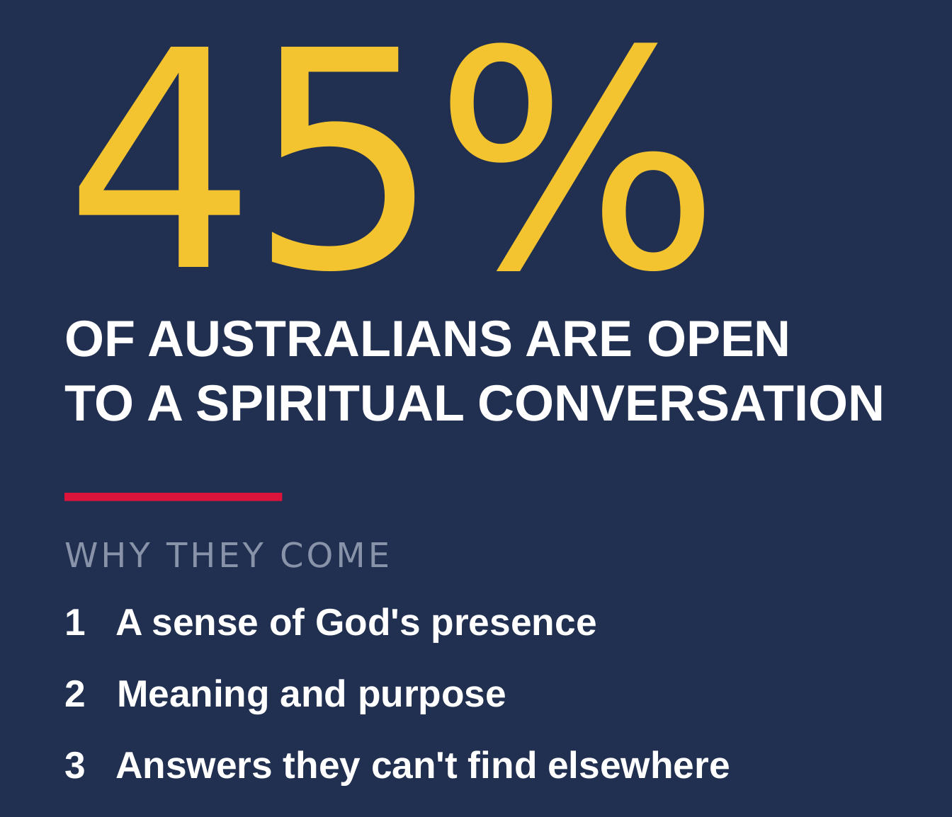

Slide 48
Trusted Sources
Influencers
BUT, A CONVERSATION WITH WHO?

Slide 49
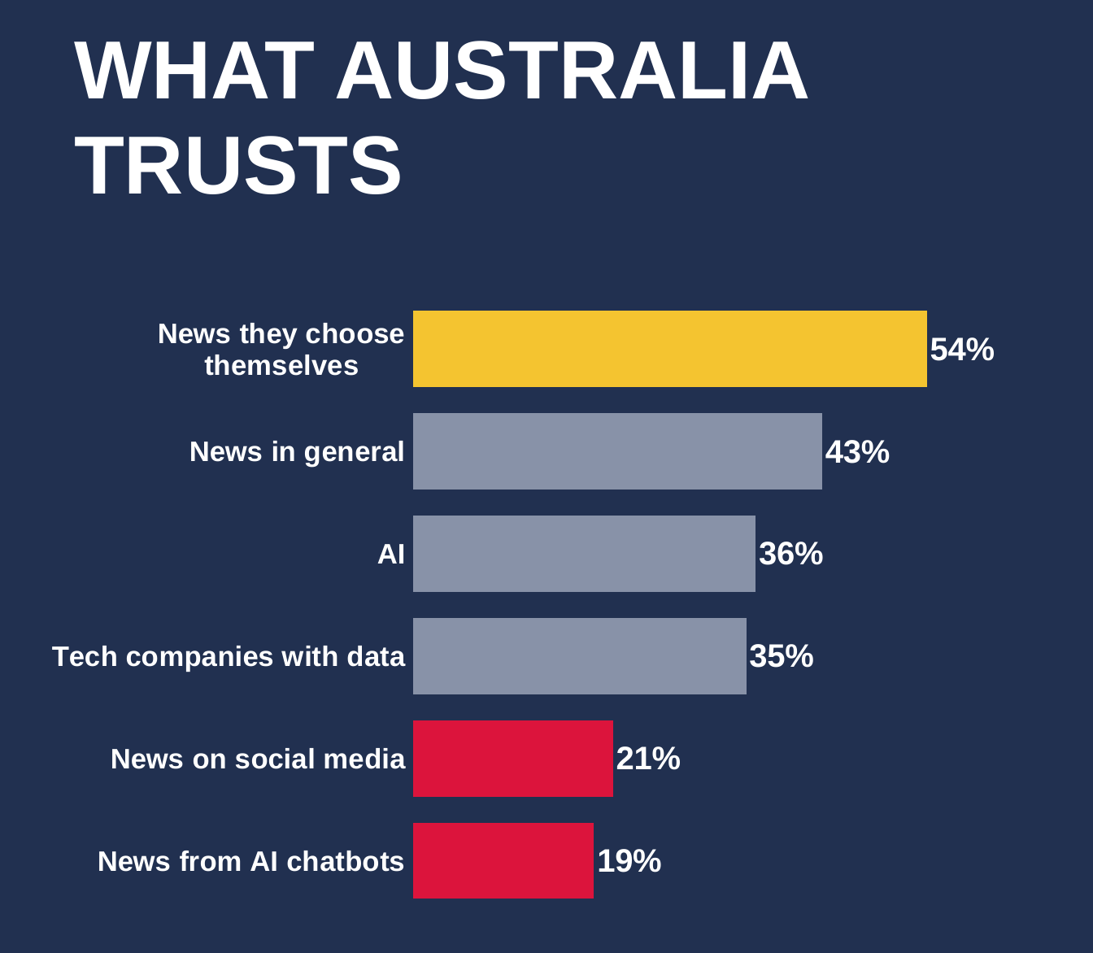
Source: FORBES AUSTRALIA May 2026

Slide 50
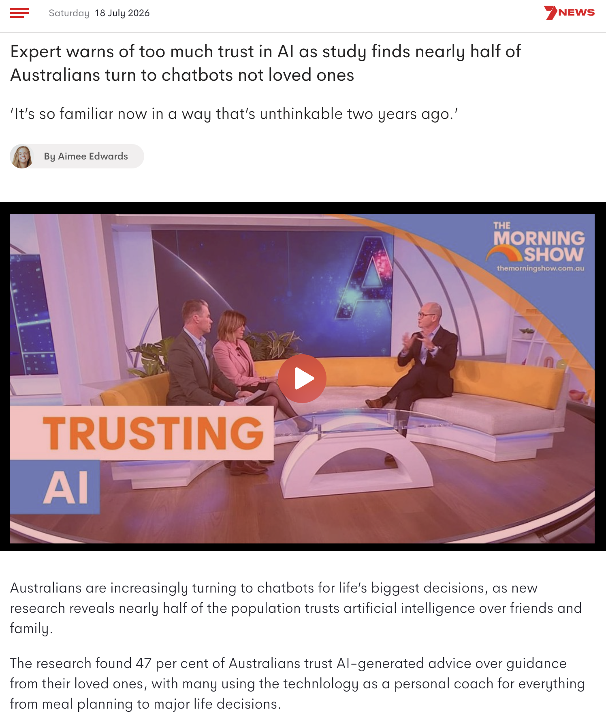

Slide 52
“...47% trust
AI Advice
over Loved Ones…”
A KEY SHIFT

Slide 53
The New Currency
TRUST

Slide 54
HOW WILL YOU BUILD TRUST?

Slide 55
I
INTERRUPTION
2
INVESTIGATION
3
INTERACTION

Slide 56
LET US DISCUSS
HOW WILL YOU INTERRUPT & DISRUPT?
HOW WILL YOU
BUILD VISIBILITY?
HOW WILL YOU
BUILD TRUST?

Slide 57
Digital
Pathways

