Slide 1
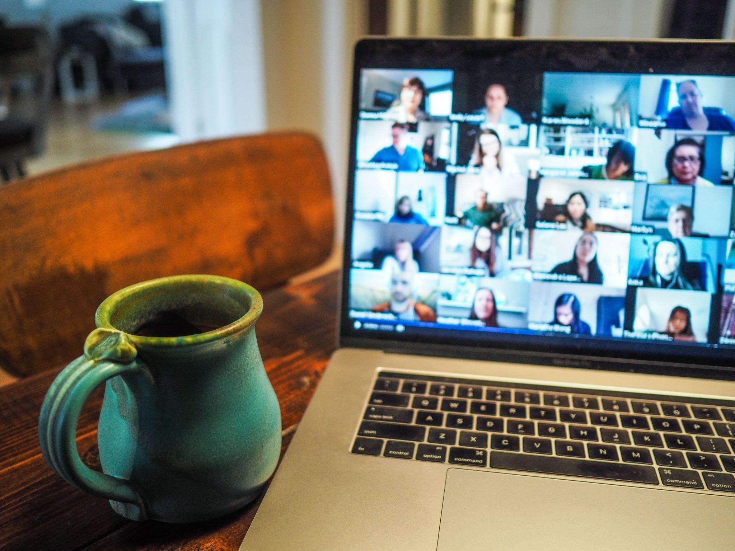
TECHNOLOGY & THE CHURCH
Online Church
A short history of the church and its tech — and one pastor's front-row seat building it.
ONLINE CHURCH
A DIGITAL MINISTRY STORY
Notes:
Opening. This is the story of how the church keeps crossing into new territory — a short history of technology and the church, and my own experience helping build it.

Slide 2
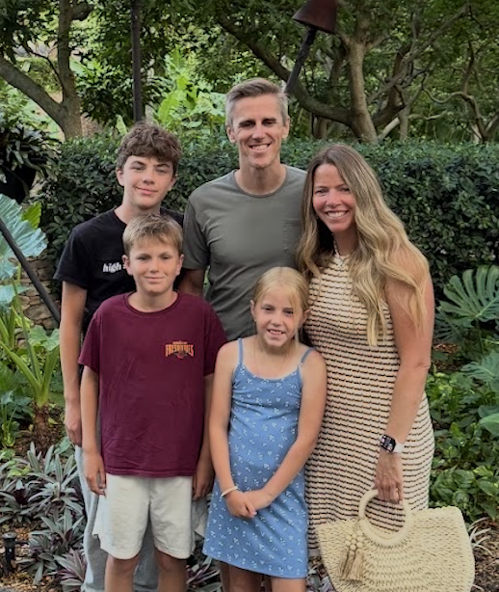
My Family
ONLINE CHURCH
A DIGITAL MINISTRY STORY
Notes:
Churches are amazing at preserving truth, but the flip side of that strength is we can be slow to change. We do embrace new tech — but we are super discerning.

Slide 3
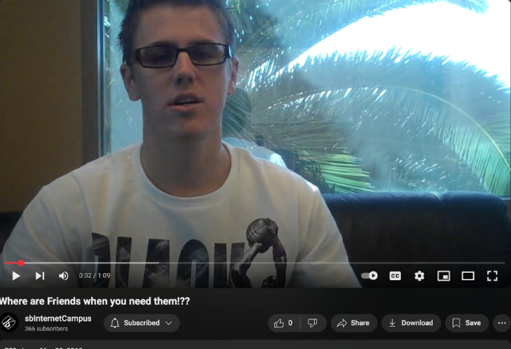
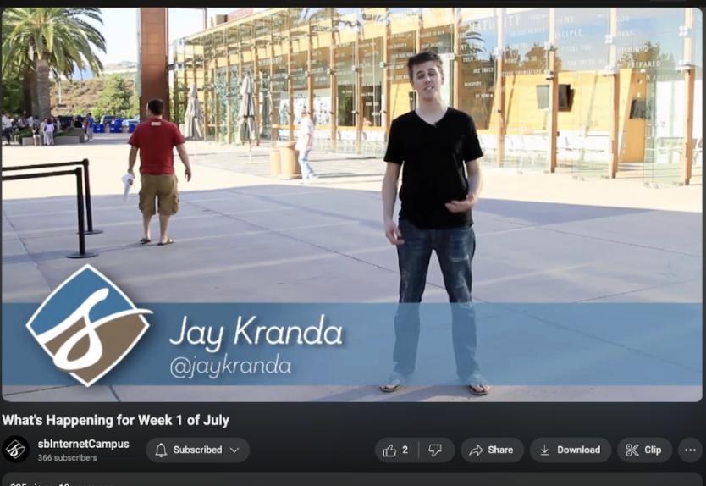
Online Pastor
2010
2011
ONLINE CHURCH
A DIGITAL MINISTRY STORY
Notes:
Churches are amazing at preserving truth, but the flip side of that strength is we can be slow to change. We do embrace new tech — but we are super discerning.

Slide 4
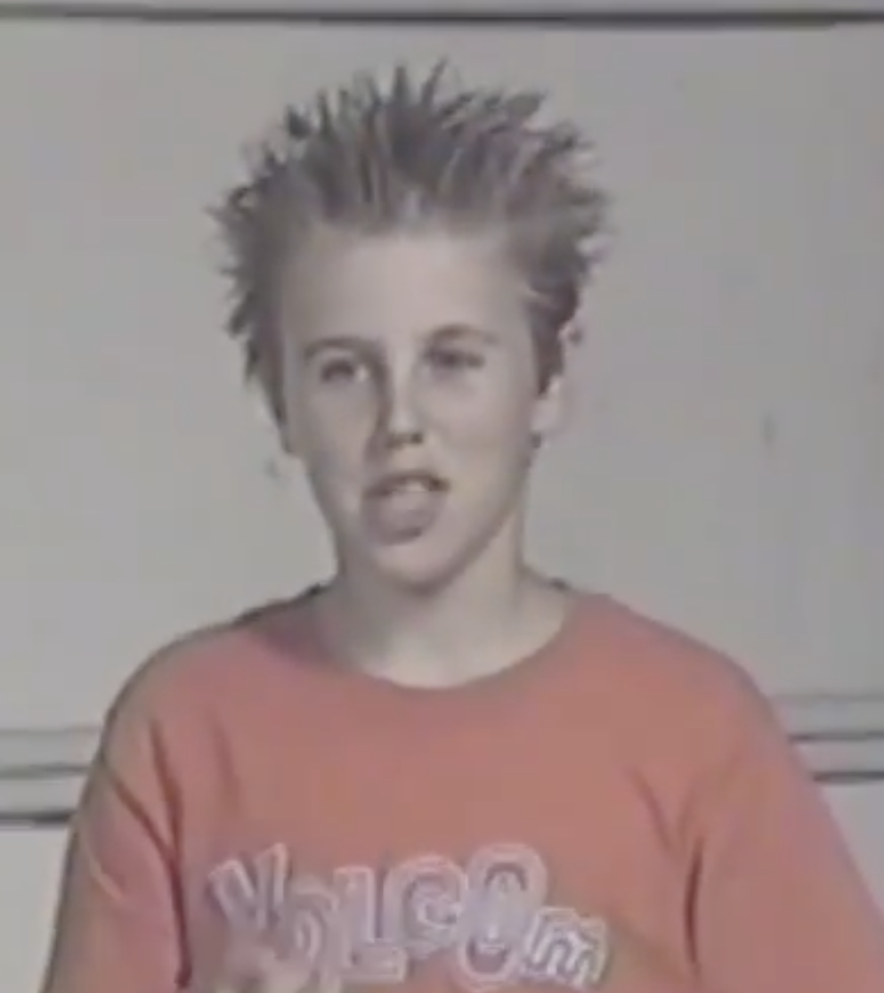
My Story… I wasn’t rushing to church at the time
ONLINE CHURCH
A DIGITAL MINISTRY STORY
Notes:
Churches are amazing at preserving truth, but the flip side of that strength is we can be slow to change. We do embrace new tech — but we are super discerning.

Slide 5
WHERE WE START
We're amazing at preserving truth.
The flip side: we can be slow to change.
We do embrace new tech — but we are deeply, deliberately discerning about it.
ONLINE CHURCH
A DIGITAL MINISTRY STORY
Notes:
Churches are amazing at preserving truth, but the flip side of that strength is we can be slow to change. We do embrace new tech — but we are super discerning.

Slide 6
THE OPPORTUNITY
We are in this moment —
and not another.
The question isn't whether to engage, but how — given who God has pointed to our hearts, and what each of us is called to do.
ONLINE CHURCH
A DIGITAL MINISTRY STORY
Notes:
We are in this moment and not another. The question is how we capitalize on it — considering who God has pointed to our heart and what you are called to do.

Slide 7
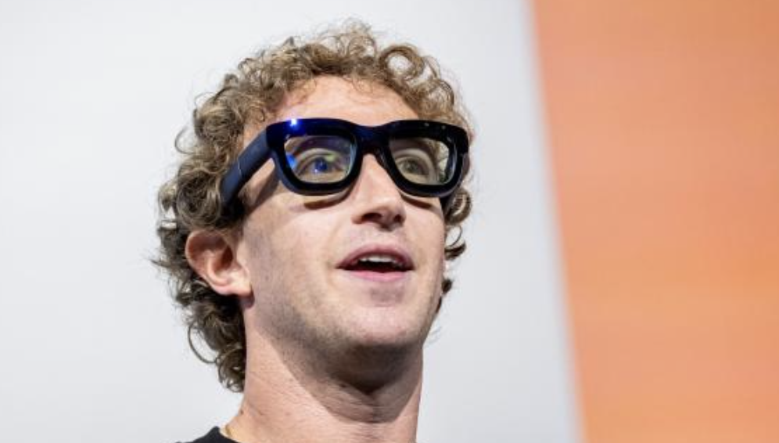
“
We love to talk about the new thing. Our job is to focus on the helpful thing.
ONLINE CHURCH
A DIGITAL MINISTRY STORY
Notes:
We love to talk about the new thing — but we focus on the helpful thing.

Slide 8
A DECADE-BY-DECADE STORY
01
A History Lesson
ONLINE CHURCH
A DIGITAL MINISTRY STORY
Notes:
Section one: a short history lesson — how technology and the church have moved together, era by era.

Slide 9
HISTORY LESSON · PART ONE
From the airwaves to the app store.
LATE '70S–'80S BROADCAST ERA
Televangelism and the “electronic church.”
Huge reach — and the first reach-versus-rootedness debate, ending in the late-'80s scandals.
MID-'80S–'90S DESKTOP ERA
Computers enter the church office.
Projection software retires the hymnal; the first church-management databases arrive.
MID-'90S–2000S WEB ERA
The website becomes the new front door.
Sermon podcasts spread, and Life.Church launches one of the first true online campuses (2006).
2007–2016 SOCIAL & MOBILE
The iPhone and the YouVersion Bible App.
The app is now on hundreds of millions of devices. Social media as ministry; digital giving.
ONLINE CHURCH
A DIGITAL MINISTRY STORY
Notes:
Broadcast Era (late '70s-'80s): televangelism and the electronic church. Desktop Era (mid-'80s-'90s): computers enter the office — projection software and the first ChMS databases. Web Era (mid-'90s-2000s): church websites as the new front door, sermon podcasts, and Life.Church launching one of the first true online campuses in 2006. Social & Mobile Era (2007-2016): the iPhone, the YouVersion Bible App (2008), social media as ministry, digital giving.

Slide 10
HISTORY LESSON · PART TWO
Then everything accelerated.
2015–2020 CLOUD & PLATFORM
All-in-one systems go mainstream.
Planning Center and live streaming become standard equipment for the local church.
2020 PANDEMIC INFLECTION
Every church became an online church overnight.
Hybrid church is normalized permanently — and the “presence” question is forced on everyone.
2023–2026 AI ERA
Generative AI, adopted remarkably fast.
Theological and misinformation concerns follow close behind.
ONLINE CHURCH
A DIGITAL MINISTRY STORY
Notes:
Cloud & Platform Era (2015-2020): all-in-one systems like Planning Center and streaming going mainstream. Pandemic Inflection (2020): every church became an online church overnight — permanently normalizing hybrid church and forcing the presence question. AI Era (2023-2026): generative AI adopted remarkably fast, with theological and misinformation concerns close behind.

Slide 11
THE AI ERA, RIGHT NOW
6 in 10
pastors now use generative AI every week.
Adoption is moving faster than almost any tech before it — with theological and misinformation concerns following close behind.
ONLINE CHURCH
A DIGITAL MINISTRY STORY
Notes:
Generative AI has been adopted remarkably fast — around 6 in 10 pastors now using it weekly, with theological and misinformation concerns close behind.

Slide 12
A HISTORY OF RISK
02
My Church
ONLINE CHURCH
A DIGITAL MINISTRY STORY
Notes:
Section two: my church — a long history of risking to look foolish for the sake of the mission.

Slide 13
1981
$14,000
Three computers. Two resignations.
Barely a year old, our church bet $14,000 on three computers. The treasurer and council chairman quit — “This church will never need three computers!”
Thirty years later, at Angel Stadium, Rick invited them back. They wept: “We were so shortsighted. Please forgive us.”
ONLINE CHURCH
A DIGITAL MINISTRY STORY
Notes:
1981 — Three computers, two resignations. When the church was barely a year old, Rick Warren convinced the congregation to spend $14,000 on three computers. The treasurer and council chairman quit over it — 'There's no way this church will ever need three computers!' At our thirtieth anniversary at Angel Stadium in 2010, Rick invited those two men back, and they wept: 'We were so shortsighted. Please forgive us.' That's the story I tell to explain why our church has always risked looking foolish for the sake of the mission.

Slide 14
1983
“The Fax of Life.”
One of the first churches to use a fax machine for workplace evangelism — and among the first to put a flatscreen on every staff desk.
ONLINE CHURCH
A DIGITAL MINISTRY STORY
Notes:
1983 — 'The Fax of Life.' One of the first churches to use a fax machine for workplace evangelism. We were also among the first to put flatscreens on every staff desk and hand out iPods for staff training.

Slide 15
1980S – 1993
Online before “online.”
Tech-skilled members had us on the internet before the Web even launched in 1991 — SMTP, IRC and FTP in the '80s, Mosaic by '93. First the audio of Rick's messages, then video.
ONLINE CHURCH
A DIGITAL MINISTRY STORY
Notes:
1980s-1993 — Online before 'online.' A handful of tech-skilled members had us on the internet before the World Wide Web launched in 1991 — SMTP, IRC, WAIS, FTP in the '80s; Archie in 1990, Gopher in '91, Veronica in '92, Mosaic in '93. First audio of Rick's messages, then video.

Slide 16
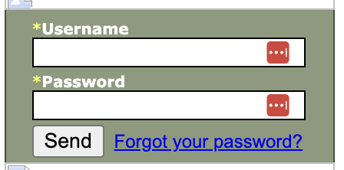
2001
We started streaming.
Live weekend services — but behind a password. Partly the cost of bandwidth, partly Rick not wanting other congregations watching our service (bandwidth issue) The password got shared. A lot.
ONLINE CHURCH
A DIGITAL MINISTRY STORY
Notes:
2001 — We started streaming. Live weekend services, but behind a password (partly bandwidth cost, partly Rick not wanting other congregations watching our message notes). The password reportedly got shared a lot.

Slide 17
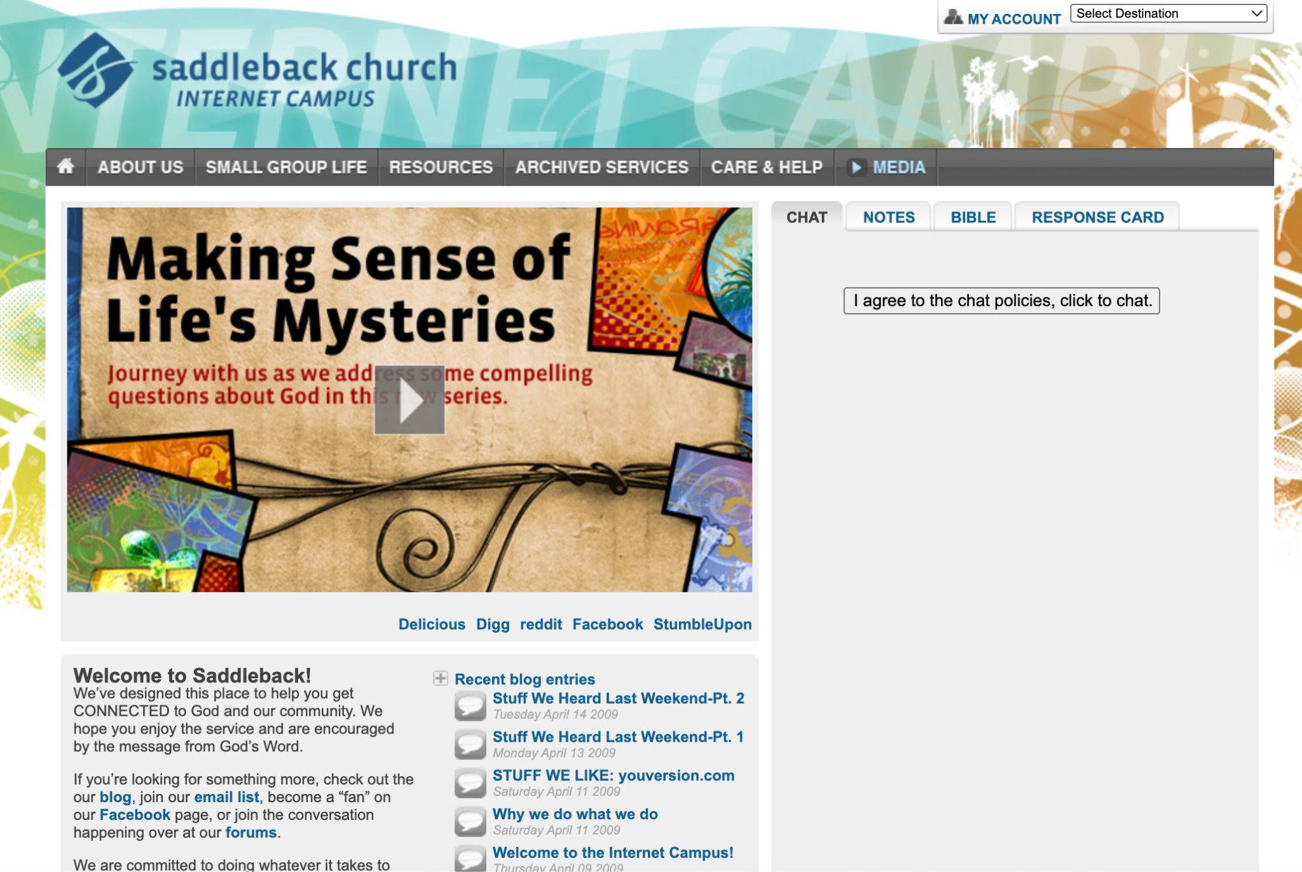
2009
A volunteer, & newspaper ads.
We were still running newspaper wrap ads for Easter and Christmas. I came on as a volunteer in online ministry — and one of my first wins was killing the newspaper wrap and moving that budget to Facebook and website banners.
ONLINE CHURCH
A DIGITAL MINISTRY STORY
Notes:
2009 — Newspaper ads and a volunteer. We were still running newspaper wrap ads for Easter and Christmas. I came on as a volunteer in online ministry, and I've watched our weekend online attendance every week since. One of my early 'big shift' moments was helping us kill the newspaper wrap and move that budget to Facebook and website banner ads.

Slide 18
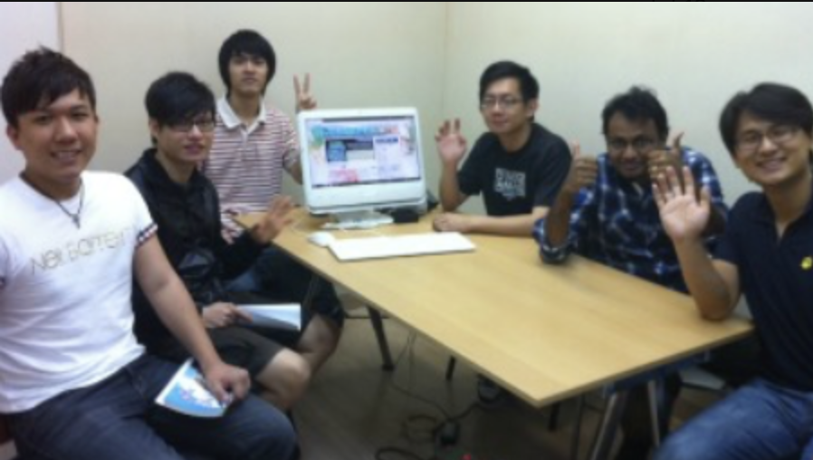
2010
A photo from Hong Kong.
A college student emailed a picture: classmates huddled around one computer, watching our service and doing a small-group study together. Faraway people were quietly becoming our people.
ONLINE CHURCH
A DIGITAL MINISTRY STORY
Notes:
2010 — The photo from Hong Kong. A college student emailed a picture of students huddled around one computer, watching our service and doing a small-group study together. Faraway people were quietly becoming our people.

Slide 19
2012 · THE AHA MOMENT
It stopped being a broadcast —
and started being a strategy.
We connected our online worship service to an experimental online small group experience. Service plus group — that link is when everything changed.
ONLINE CHURCH
A DIGITAL MINISTRY STORY
Notes:
2012 — The aha moment. We connected our online worship service to an experimental online small-group experience. That link — service plus group — is when online ministry stopped being a broadcast and started being a strategy.

Slide 20
AUGUST 2012
Full-time, & a better name.
I was officially hired as online campus pastor. My first decision was to rename our “Internet Campus” to the “Online Campus” — because the original name was terrible.
ONLINE CHURCH
A DIGITAL MINISTRY STORY
Notes:
August 2012 — Full-time, and a rename. I was officially hired as online campus pastor, and my first decision was to rename our 'Internet Campus' to the 'Online Campus' because the original name was terrible. Around the same time we introduced online communion (amid plenty of 'is this even biblical?' debate) and phased out the DVDs we used to ship to group hosts. Everything went digital.

Slide 21
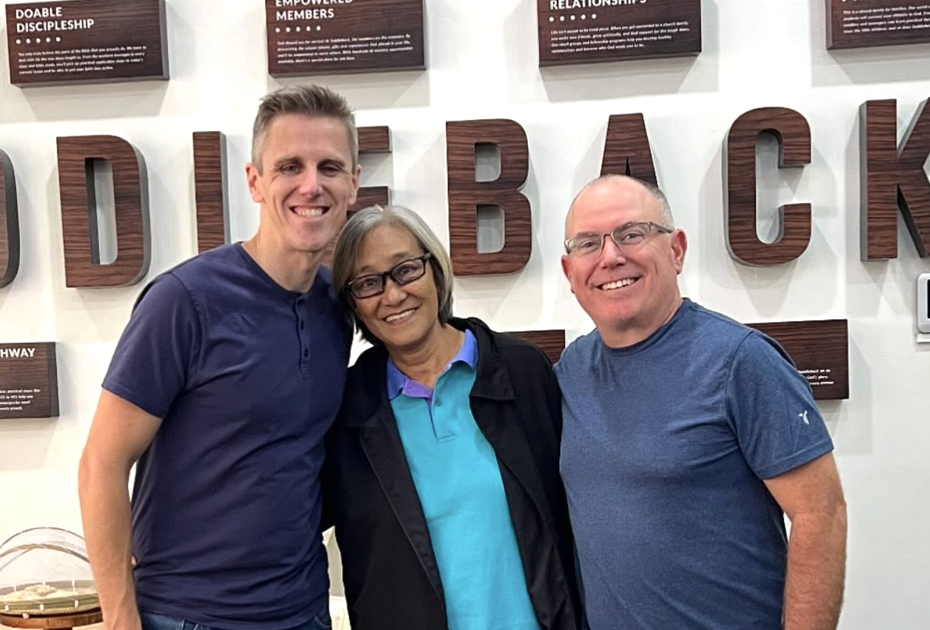
~2015 · GRACE
900+
gather weekly — inside a prison.
Grace found our Online Community and asked for small-group training. I coached her over Skype — then saw twenty other faces behind her. She started weekly worship inside a Philippine prison.When people tell me online church can't work, I think of Grace.
ONLINE CHURCH
A DIGITAL MINISTRY STORY
Notes:
~2015 — Grace, and a prison in the Philippines. Grace found our Online Community, asked for small-group training, and I coached her over Skype — then saw twenty other faces behind her. She started weekly worship services inside a prison. Today over nine hundred people gather there weekly. When people tell me online church can't work, I think of Grace.

Slide 22
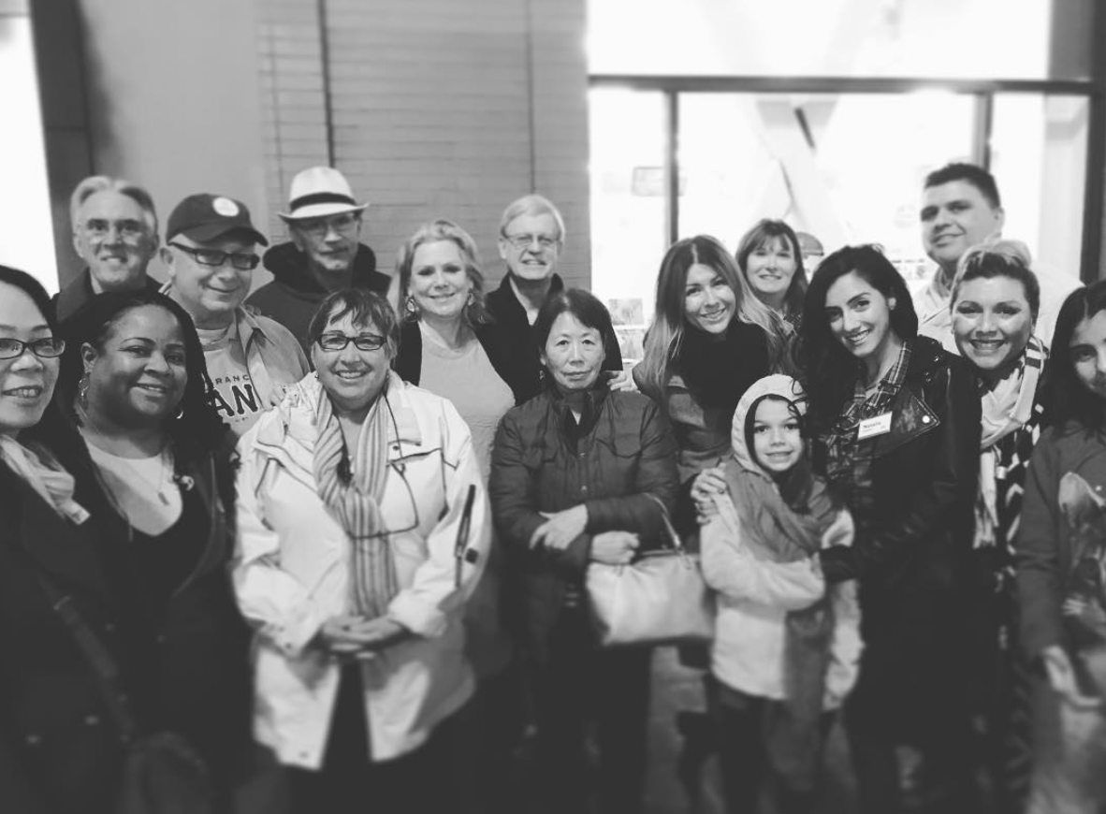
DECEMBER 4, 2015 · THE FIRST MEETUP
25
showed up on a Friday night.
I tacked an extra day onto a trip and tried gathering online attenders at a San Francisco burger joint. I was sure nobody would come. That night launched everything that followed.
ONLINE CHURCH
A DIGITAL MINISTRY STORY
Notes:
December 4, 2015 — The first Meetup. I tacked an extra day onto a trip and tried gathering online attenders at a San Francisco burger joint. I was sure nobody would come on a Friday night. Twenty-five showed up. That night launched everything that followed.

Slide 23
2015–2016 · A HARD LESSON
A formative failure.
I flew up monthly to host services in Bay Area hotels — nearly a hundred people some Sundays. It drained my budget and eventually stopped. I'd grossly misread whether we were ready to plant there. Hard, and necessary.
ONLINE CHURCH
A DIGITAL MINISTRY STORY
Notes:
2015-2016 — The Bay Area experiment (that I misread). I flew up monthly to host services in hotels — Oakland, Fremont, San Jose — and drew almost a hundred people some Sundays. It drained my budget and eventually stopped, because I'd 'grossly misread' whether my church was ready to plant there. A hard, formative failure.

Slide 24
MEETUPS BECAME EXTENSIONS
Homes. A library. A barn.
A prison. A cruise.
Multi-city Meetups — Dallas, Austin, the East Coast — grew into a house-church network. It's been a graveyard of names, but we landed on Extensions: 10 to 100+ people, led by volunteer lay pastors under our elders.
We also renamed the Online Campus to the Online Community — so locals never felt detached, and faraway watchers felt pointed toward starting an Extension.
ONLINE CHURCH
A DIGITAL MINISTRY STORY
Notes:
Multi-city Meetups became Extensions. Dallas/Austin/San Antonio, then six Meetups in five states on the East Coast. Out of it came our house-church network — a 'graveyard of names' (microsites, house churches) before we landed on Extensions. They meet in homes, a library, workspaces, a barn, prisons, even a cruise; 10 to 100+ people; volunteer lay pastors under our elders. We also renamed Online Campus to Online Community on purpose: so locals didn't feel detached from their campus, and faraway watchers were pointed toward starting an Extension. A Zoom Meetup even produced a Singapore worship service in a country I'd never visited.

Slide 25
A COUNTERINTUITIVE MOVE
We added friction —
on purpose.
We stopped streaming live on Facebook and YouTube and moved to our own site and apps. Streaming itself went from live to mostly on-demand. Friction that pushes people toward in-person — and toward Extensions.
ONLINE CHURCH
A DIGITAL MINISTRY STORY
Notes:
Adding friction on purpose. We stopped streaming live on Facebook and YouTube, moved the live local service to our own site and apps, and posted a custom Online Community service instead — friction that pushes people toward in-person and toward Extensions. Our streaming itself evolved: a few services, then one every two hours, now primarily on-demand.

Slide 26
HOW WE MEASURE IT
30 min
watched, in a 7-day window.
For over ten years, that's been our core metric — reverse-engineered from ushers counting the room at the 30-minute mark. I built a dashboard on a cheap TV and emailed the number to my boss every Monday.
ONLINE CHURCH
A DIGITAL MINISTRY STORY
Notes:
Measuring it. For over ten years our core metric has been how many people watch at least thirty minutes in a seven-day window (we reverse-engineered it from ushers counting the room at the 30-minute mark). I built a dashboard on a cheap TV with a browser and emailed the numbers to my boss every Monday.

Slide 27
TODAY
Seamless in person.
Delightful online.
The tension I live in as Innovative Tech Pastor: build killer in-person experiences that make everything seamless for reaching new people — while delighting our members digitally.
ONLINE CHURCH
A DIGITAL MINISTRY STORY
Notes:
Today — Innovative Tech Pastor, and the tension of having killer in-person experiences that make it all seamless for reaching new people and delighting members digitally.

Slide 28
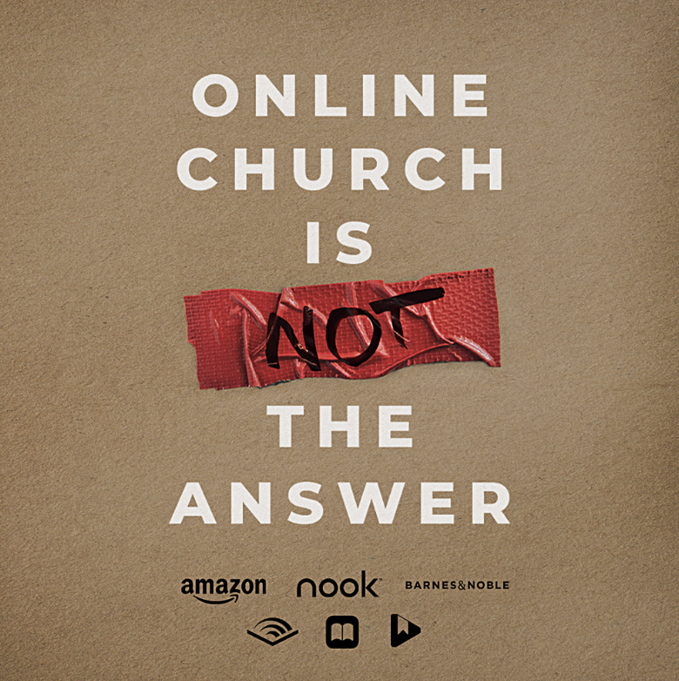
Extra Resource
Check out my book!
Amazon, Audible, Apple Books, or JayKranda.com
ONLINE CHURCH
A DIGITAL MINISTRY STORY
Notes:
Today — Innovative Tech Pastor, and the tension of having killer in-person experiences that make it all seamless for reaching new people and delighting members digitally.

Slide 29
TECHNOLOGY & THE CHURCH
Online Church
A short history of the church and its tech — and one pastor's front-row seat building it.
ONLINE CHURCH
A DIGITAL MINISTRY STORY
Notes:
Opening. This is the story of how the church keeps crossing into new territory — a short history of technology and the church, and my own experience helping build it.

