Slide 1
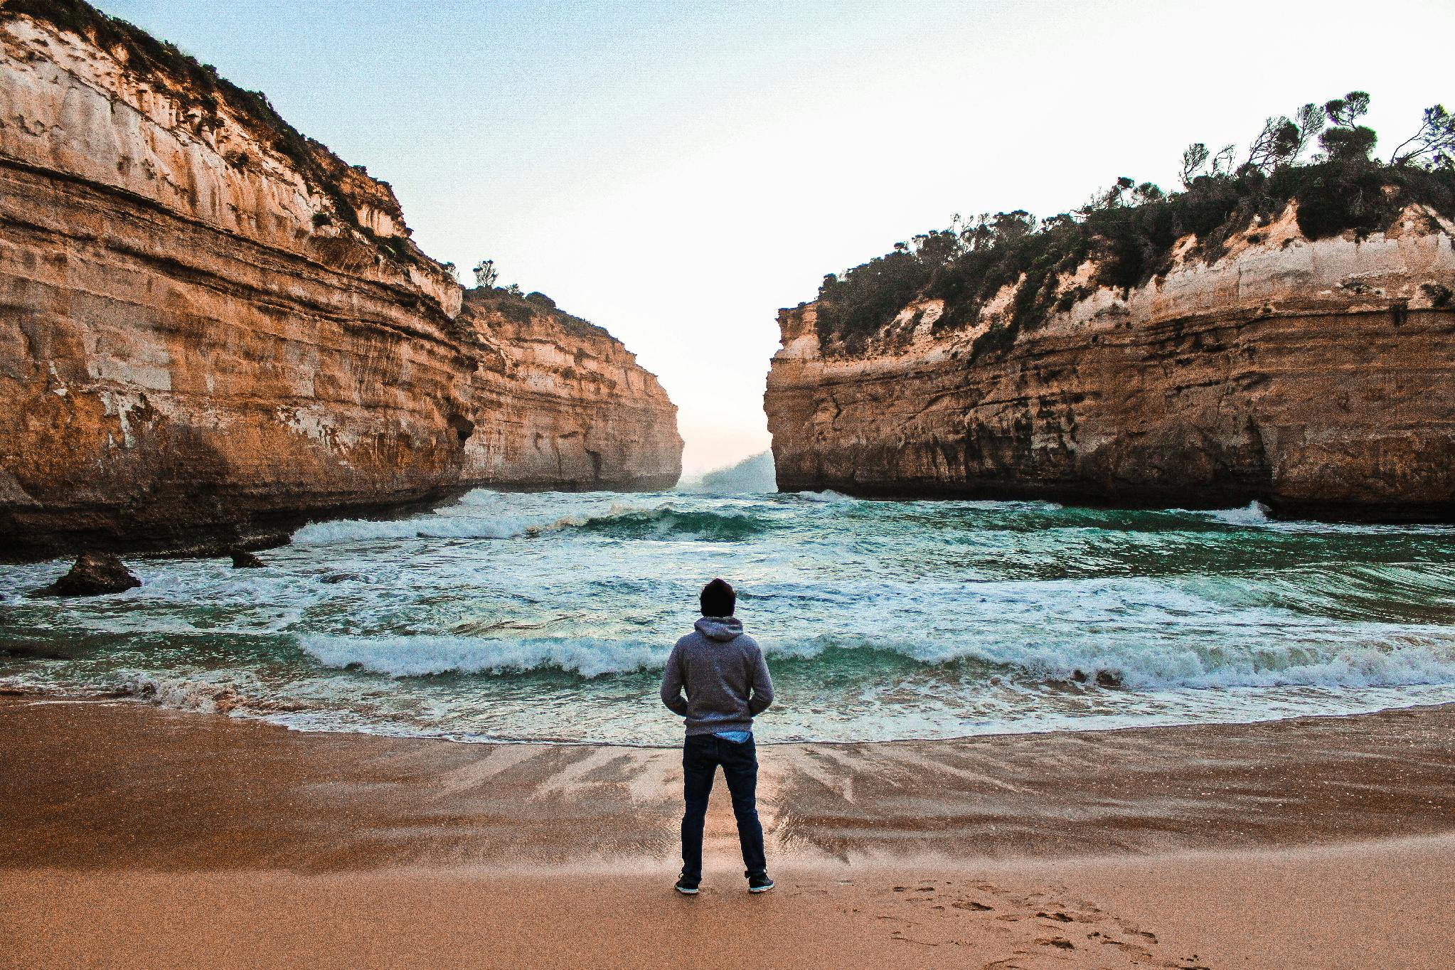

Foundations &
The Future
Notes:
Welcome. Frame the two days as the entry point to the full MII partnership.

Slide 2

I
AUDIENCE
2
BRANDING
3
CHANNELS

Slide 3
The one
you are called to serve
PERSONA

Slide 4
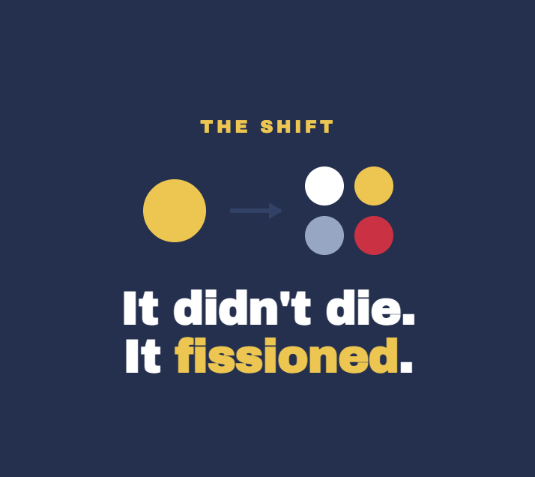
PERSONA BUILDING

Slide 5
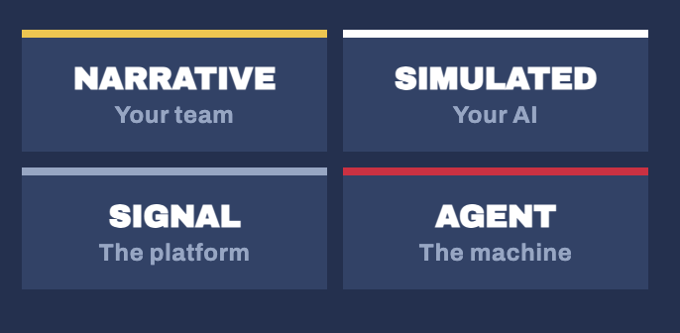
PERSONA BUILDING

Slide 6

PERSONA BUILDING
Built by you
& your team

Slide 7
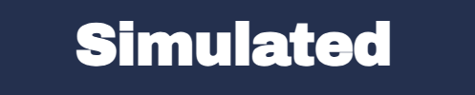
PERSONA BUILDING
Built by you
& your AI

Slide 8
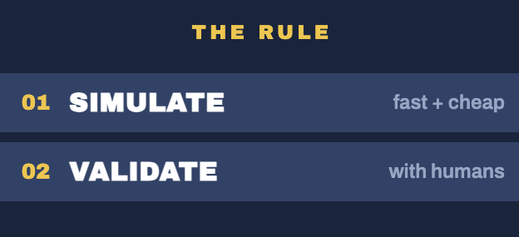

Slide 9
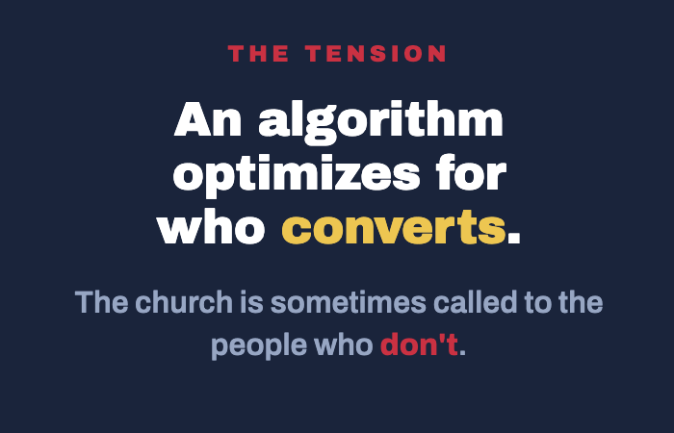

Slide 10
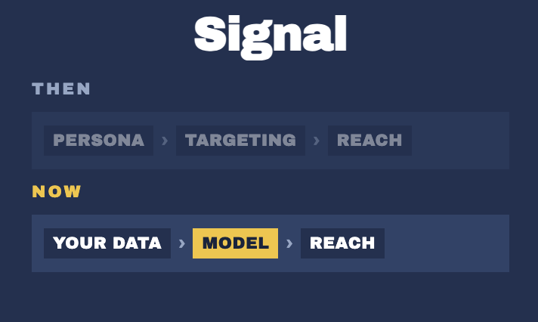
PERSONA BUILDING
Built with real data
for AI Models

Slide 12
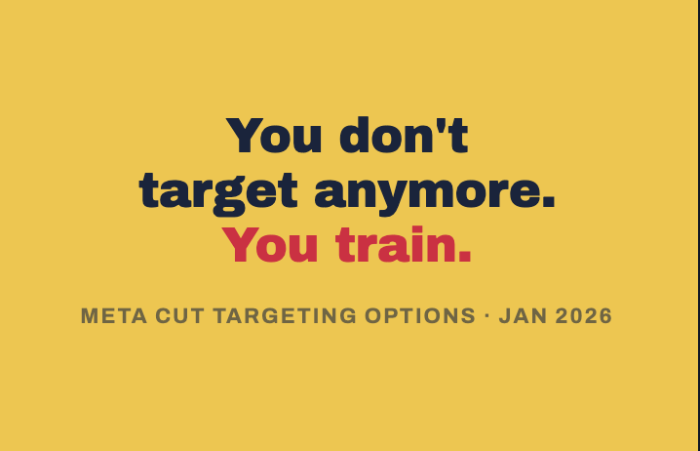

Slide 13
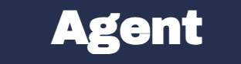
PERSONA
Built for AI Agents used by your audience

Slide 14
PERSONA BUILDING

Slide 15

TIME TO REFRESH YOUR PERSONAS

Slide 16
Your voice,
in the ears of your audience
BRAND VOICE

Slide 17



Slide 18
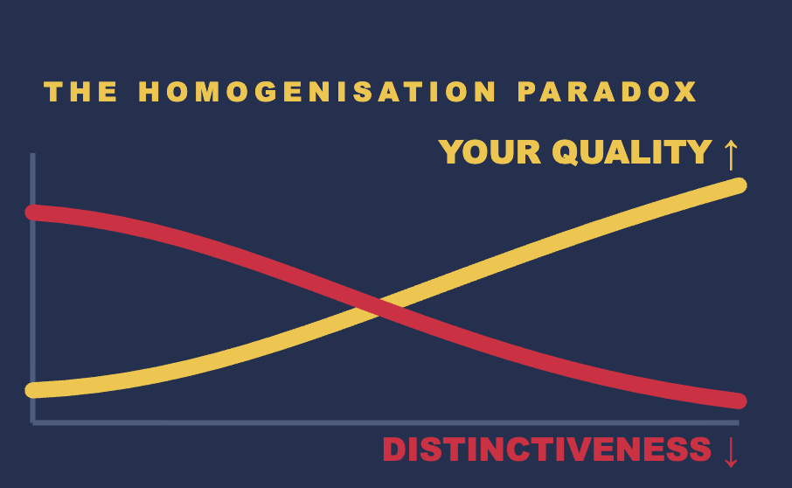

Slide 19
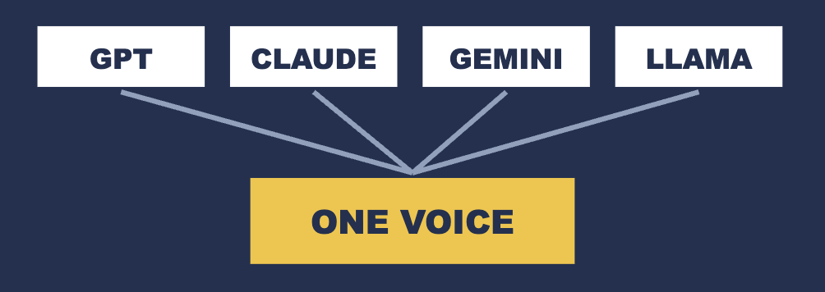

Slide 20

INSTITUTION
INDIVIDUALS

Slide 21
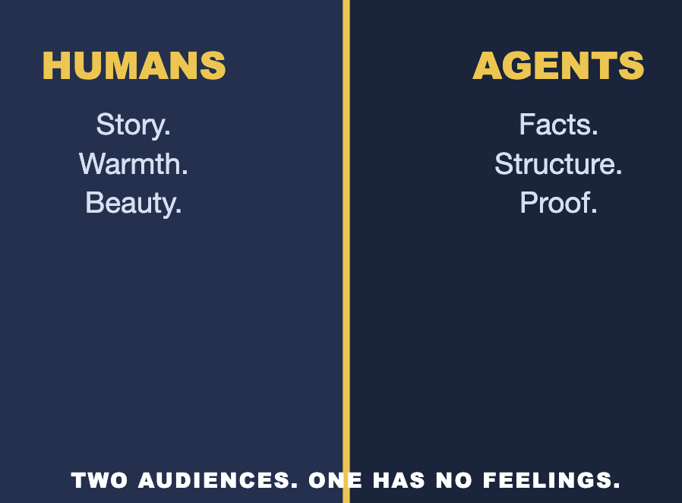

Slide 22
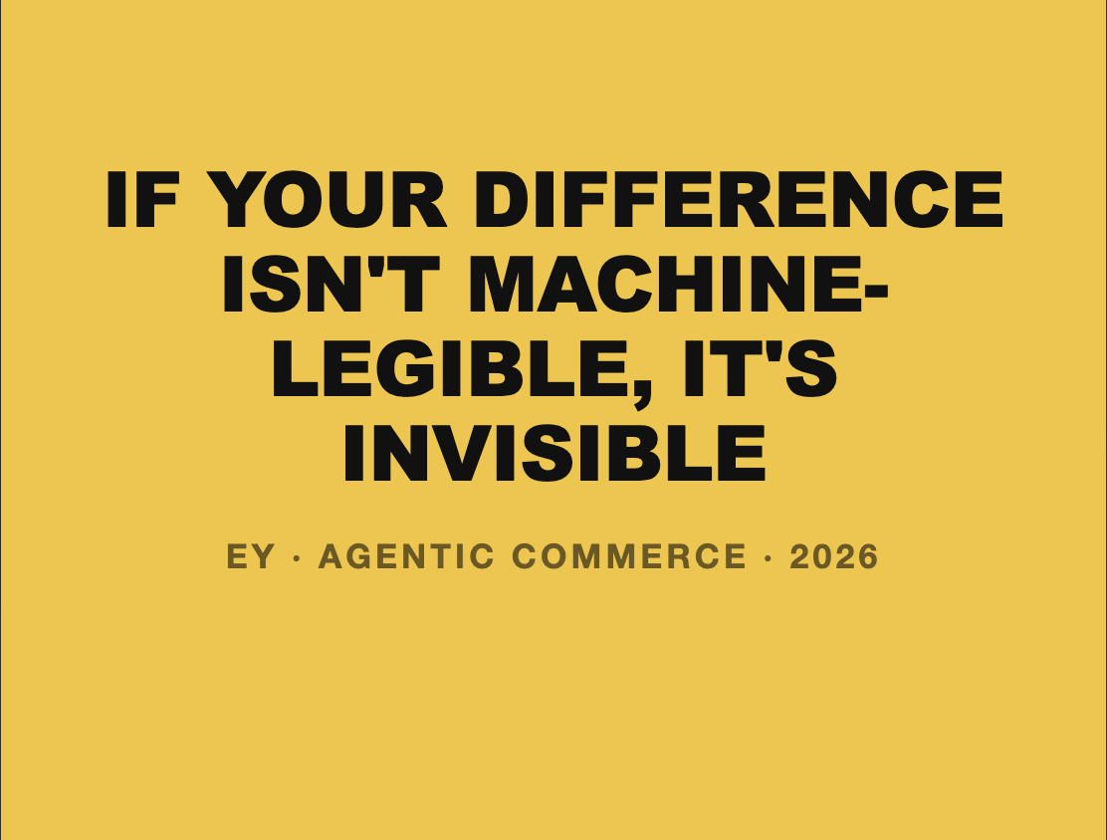

Slide 23
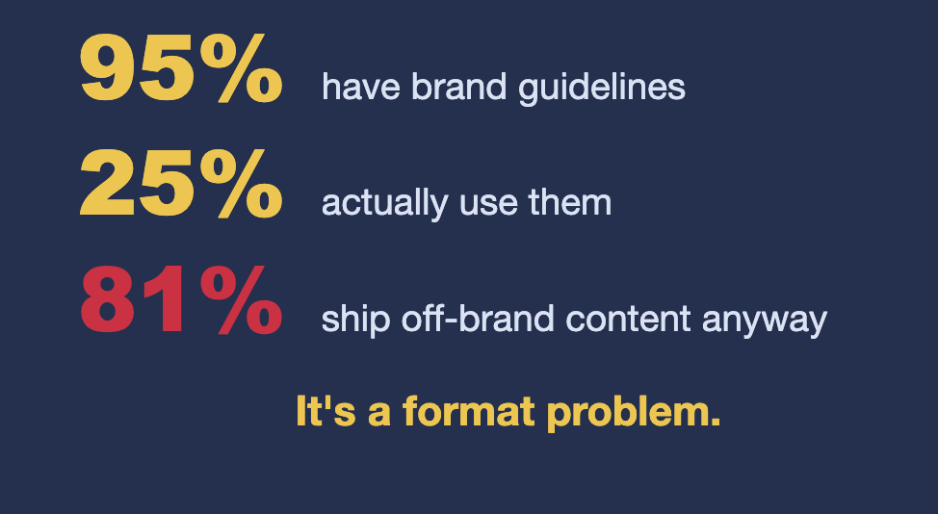


Slide 24


Slide 25
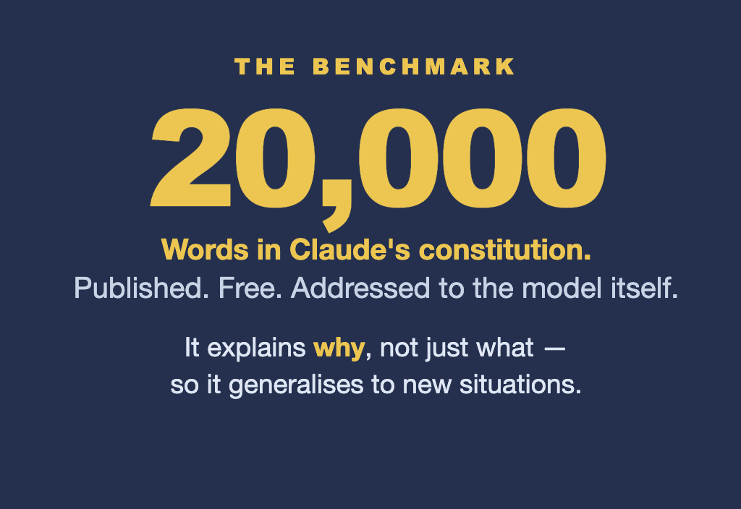

Slide 26






Your Brand Voice
now lives in 3 locations

Slide 27

CHANNEL DYNAMICS

Slide 28
CHANNEL(s) FOR
REACH & DISCOVERY
CHANNEL(s) FOR BUILDING COMMUNITY
OWNED VS RENTED CHANNELS
CHANNEL(s) FOR AEO/GEO
& AGENTS

Slide 29
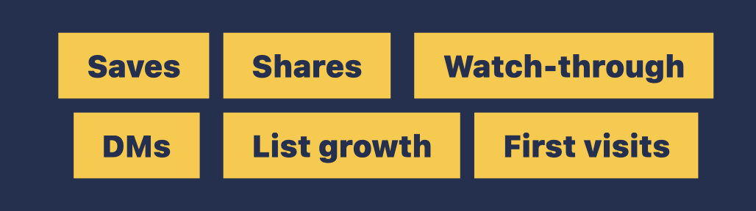
NEW CHANNEL METRICS

Slide 30
I
PERSONA
2
BRAND VOICE
3
CHANNELS

Slide 31
Foundations &
The Future
Notes:
Welcome. Frame the two days as the entry point to the full MII partnership.

