Slide 1
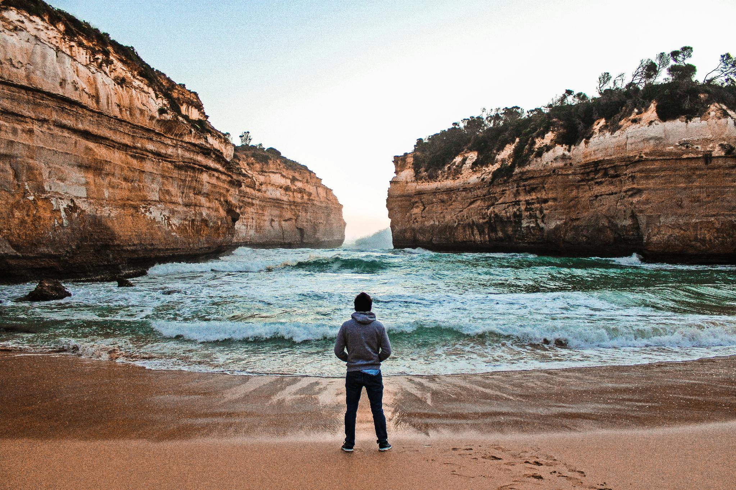

How to Talk to Strangers
DANIEL HALL
SAINTS CHURCH · MELBOURNE
Notes:
COLD OPEN. The framing question from the original talk: how would Jesus do customer service? Sounds irreverent — it isn't. Every church is already doing customer service with strangers every day: the DM inbox, the comment section, the front door. The question is what posture we do it in. Today: a framework from social psychology, what Jesus does with it, and then the stranger nobody wants — the troll.

Slide 2
01
Warmth & Competence
Every stranger runs two checks before you finish your first sentence.
Notes:
PART 1 — Warmth & Competence. Fiske and Cuddy's research from social psychology: every human sizes up every interaction on two axes, in seconds, before you finish your first sentence. It's how strangers read people — and how they read brands, and churches.

Slide 3
WARMTH · INTENTIONS
“Are you for me?”
Kind, friendly, good-natured
Sincere, honest, moral, trustworthy
Helpful, tolerant, fair, generous, understanding
INTENTIONS
Read through tone, empathy, staying present.
Notes:
Warmth is a read on your INTENTIONS: kind, sincere, honest, trustworthy, generous, understanding — are you for me? Competence is a read on your ABILITY: efficient, capable, skillful, knowledgeable — can you actually help? Both are perceived instantly, from tone, empathy, confidence and follow-through.

Slide 4
COMPETENCE · ABILITY
“Do you know your stuff?”
Efficient, capable, skillful, clever, knowledgeable
Confidence, appearance of ability to carry out their work
Read through answers, confidence, follow-through.
Notes:
Warmth is a read on your INTENTIONS: kind, sincere, honest, trustworthy, generous, understanding — are you for me? Competence is a read on your ABILITY: efficient, capable, skillful, knowledgeable — can you actually help? Both are perceived instantly, from tone, empathy, confidence and follow-through.

Slide 5
WARM · INCOMPETENT
WARM · COMPETENT
Sympathy & Neglect
Admiration & Loyalty
← WARMTH →
Lovely people. Nobody trusts them with anything.
The only combination that earns trust.
COLD · INCOMPETENT
COLD · COMPETENT
Contempt & Rejection
Envy & Distrust
Slick - what do they want from me? The default read strangers give churches.
Written off. Disassociated from.
← COMPETENCE →
Notes:
The four combinations. High warmth + high competence is the only one that earns admiration and loyalty — think Toyota, Rolex done right. Competent but cold earns envy and distrust — the read strangers give slick brands, and slick churches. Warm but incompetent earns sympathy and neglect. Cold and incompetent earns contempt and rejection. There is only one quadrant worth building for.

Slide 6
WARM · INCOMPETENT
WARM · COMPETENT
Salvation Army
McDonalds
Humane Society
Tylenol
Amazon
Postal Service
← WARMTH →
Honda
Public Transport
COLD · INCOMPETENT
COLD · COMPETENT
Mercedes
Toyota
Gucci
Shell
Rolex
Porsche
BP
Rolls Royce
Marlboro
← COMPETENCE →
Notes:
The four combinations. High warmth + high competence is the only one that earns admiration and loyalty — think Toyota, Rolex done right. Competent but cold earns envy and distrust — the read strangers give slick brands, and slick churches. Warm but incompetent earns sympathy and neglect. Cold and incompetent earns contempt and rejection. There is only one quadrant worth building for.

Slide 7
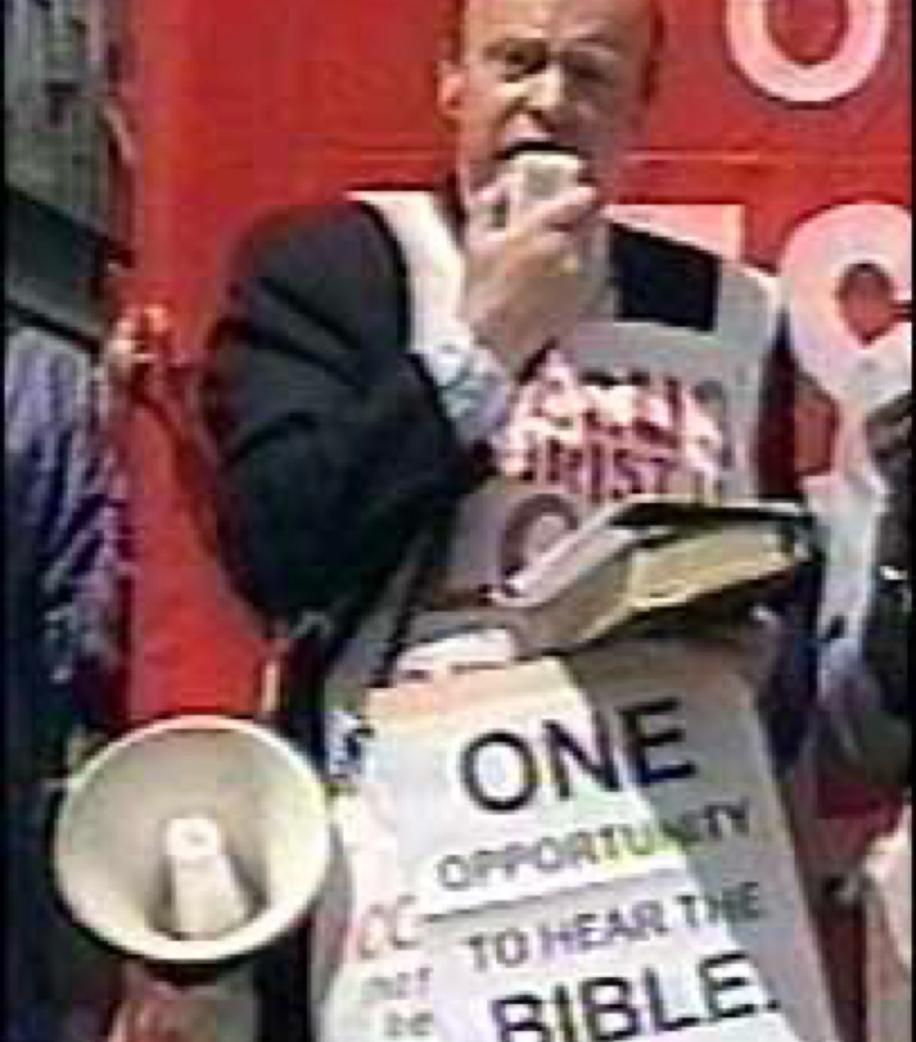
Notes:
W.W.J.D — what would Jesus do with a stranger? Every gospel encounter: high warmth AND high competence. The woman at the well, Zacchaeus, the rich young ruler. Contrast: the street preacher — full competence signalling, zero warmth. Same message, opposite quadrant. Ask the room for examples of Jesus being both at once.

Slide 8
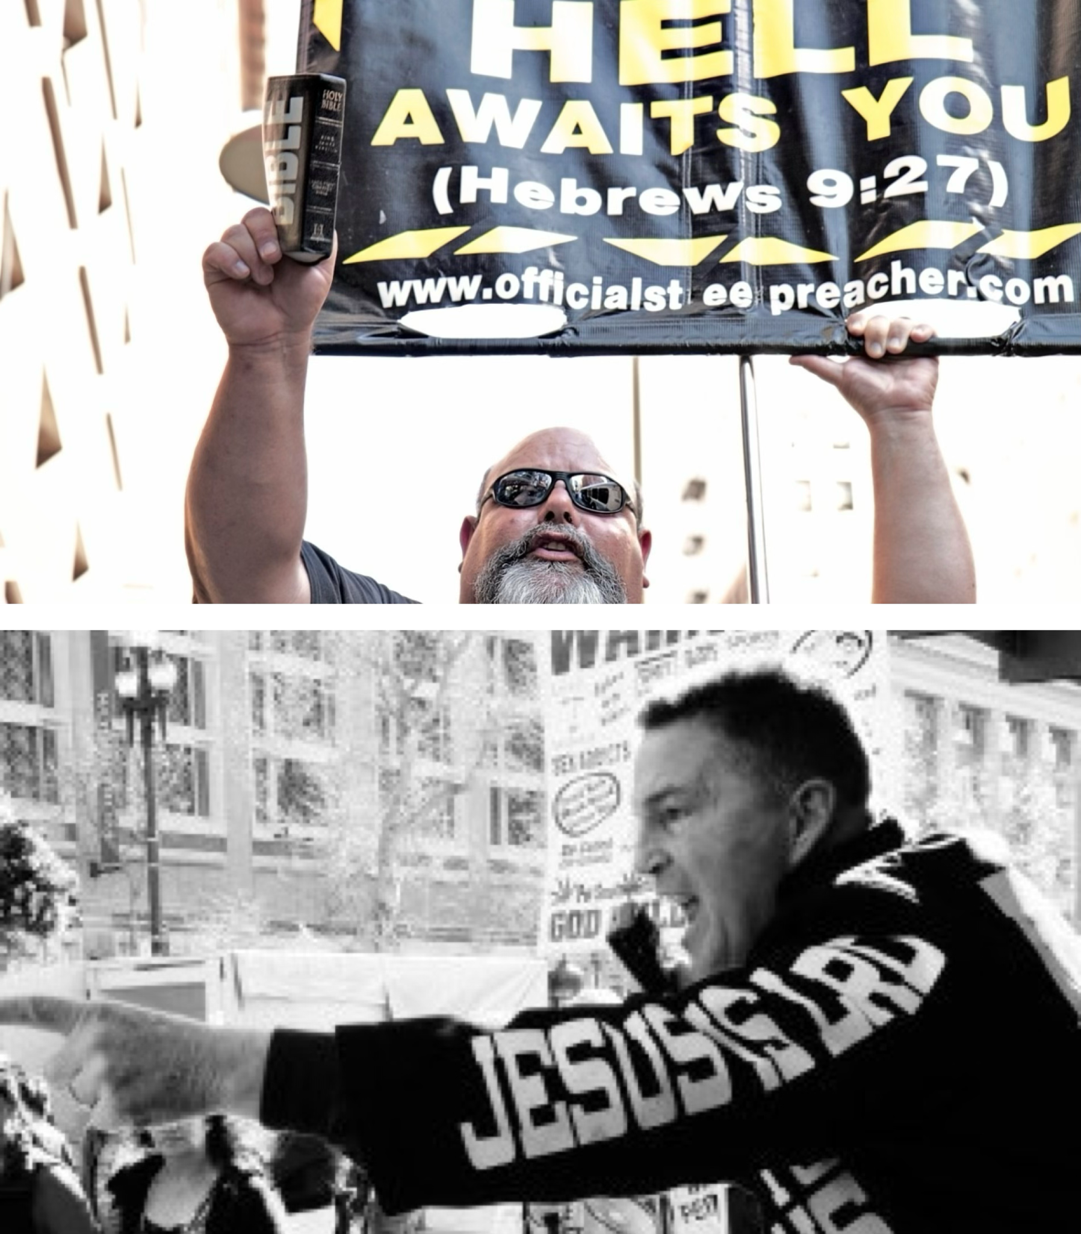
Notes:
W.W.J.D — what would Jesus do with a stranger? Every gospel encounter: high warmth AND high competence. The woman at the well, Zacchaeus, the rich young ruler. Contrast: the street preacher — full competence signalling, zero warmth. Same message, opposite quadrant. Ask the room for examples of Jesus being both at once.

Slide 9
Jesus
Warm and Competent.
Jesus or street preacher?
Similar message - opposite quadrant.
HOW TO TALK TO STRANGERS
DANIEL HALL
Notes:
W.W.J.D — what would Jesus do with a stranger? Every gospel encounter: high warmth AND high competence. The woman at the well, Zacchaeus, the rich young ruler. Contrast: the street preacher — full competence signalling, zero warmth. Same message, opposite quadrant. Ask the room for examples of Jesus being both at once.

Slide 10
“
We are therefore Christ’s ambassadors, as though God were making his appeal through us.
2 Corinthians 5:20
Notes:
2 Corinthians 5:20. If God is making his appeal THROUGH us, then we are — bluntly — Christ's customer service representatives. The stranger's read on you becomes their read on him. That's why the quadrant matters: it isn't brand strategy, it's ambassadorship.

Slide 11
Christ’s
Customer Service Representatives
Notes:
The hinge of the whole talk. Land it slowly. This is where Act 1 hands over to Act 2: if warmth has to come first — then the real test isn't the seeker who arrives polite. It's the stranger who arrives kicking.

Slide 12

They don’t care what you know until they know that you care.
Notes:
The hinge of the whole talk. Land it slowly. This is where Act 1 hands over to Act 2: if warmth has to come first — then the real test isn't the seeker who arrives polite. It's the stranger who arrives kicking.

Slide 13
02
Trolls are people too.
The troll isn’t the opposite of a seeker. The troll is a seeker who’s been hurt daring the church to love them anyway.
Notes:
PART 2 — The Stranger Who Comes In Kicking (the Trolls material begins). So if warmth comes first: what about the angry comment on your Easter reel? The DM calling your church a tax dodge? Every instinct — and every AI moderation tool — says delete, block, protect the brand. Hold that instinct up against the quadrant we just built.

Slide 14
A graveyard.
Gentile territory.
Naked. Violent.
Possessed.
“Legion -
for we are many.”
HOW TO TALK TO STRANGERS
DANIEL HALL
Notes:
Luke 8:26–39. Tell it, don't read it. A graveyard, Gentile territory, pigs nearby. A man so violent chains couldn't hold him. Naked. When Jesus asked his name: 'Legion — for we are many.' Jesus got out of the boat and walked straight toward him. Healed him, clothed him, gave his mind back. Then: 'Return home and tell how much God has done for you.' The first person Jesus ever sent on mission — before the Twelve. Pause before advancing.

Slide 15
Before the Twelve. Before Pentecost.
The first person Jesus ever sent on mission.
HOW TO TALK TO STRANGERS
DANIEL HALL
Notes:
Luke 8:26–39. Tell it, don't read it. A graveyard, Gentile territory, pigs nearby. A man so violent chains couldn't hold him. Naked. When Jesus asked his name: 'Legion — for we are many.' Jesus got out of the boat and walked straight toward him. Healed him, clothed him, gave his mind back. Then: 'Return home and tell how much God has done for you.' The first person Jesus ever sent on mission — before the Twelve. Pause before advancing.

Slide 16
If Legion came into our chat, commented on a post, called the hotline…
our intake systems and strategy often blocks him in the first message.
The filter is not neutral. The filter is a cultural statement.
HOW TO TALK TO STRANGERS
DANIEL HALL
Notes:
If Legion came into your chat tonight, your intake system would block him in the first message. And here's the uncomfortable part: the filter is not neutral. It's a theological statement — it encodes who you believe deserves a real human response. Your own toolkit already knows: the Trolling type 'wants to be heard.' Origen: inside every person, a second universe. That's who your filter routes out.

Slide 17
The Upper Room.
He washed all of them.
Including Judas.
He didn’t filter the hard one out. He knelt down in front of the person about to destroy him and served him.
Notes:
John 13, the night before the cross. Jesus knows who will betray him. He gets up, takes the towel, pours the water — and washes all of them. Including Judas. He didn't filter the hard one out; he knelt in front of the person about to destroy him. You may not be the one in the chat. But you decide whether your team has a basin, warm water, and a towel ready.

Slide 18
You may not be the one overseeing social media or the Online Missionary in the chat…
As a team, you prepare the bowl, the water, the basin.
Notes:
John 13, the night before the cross. Jesus knows who will betray him. He gets up, takes the towel, pours the water — and washes all of them. Including Judas. He didn't filter the hard one out; he knelt in front of the person about to destroy him. You may not be the one in the chat. But you decide whether your team has a basin, warm water, and a towel ready.

Slide 19
01
Pick your person - by name.
Decide who the stranger is before you make another piece of content. Run everything through them.
02
Lead with warmth. Competence second.
‘We’re for you, no strings’ comes first. The invitation can wait six conversations.
03
Stay in the hard conversations.
The angry ones get a calm, unhurried human response. You’ll be astonished who’s under the armor.
HOW TO TALK TO STRANGERS
DANIEL HALL
Notes:
PART 3 — What This Asks of You. Three commitments for the round tables this afternoon. One: pick your person — name him, write him on a whiteboard, run everything through him. Two: lead with warmth, prove competence second — 'we're for you, no strings' first; the invitation can come six conversations from now. Three: stay in the hard conversations — decide as a team the angry ones get a calm, unhurried human response.

Slide 20
How to Talk to Strangers
DANIEL HALL
SAINTS CHURCH · MELBOURNE
Notes:
COLD OPEN. The framing question from the original talk: how would Jesus do customer service? Sounds irreverent — it isn't. Every church is already doing customer service with strangers every day: the DM inbox, the comment section, the front door. The question is what posture we do it in. Today: a framework from social psychology, what Jesus does with it, and then the stranger nobody wants — the troll.

