Slide 1


CONTENT
THAT
CONNECTS

Slide 2
Online
Offline
Moving beyond anonymous reach and engagement metrics to knowing people desiring a discipleship relationship

Slide 3

Audience
Problems
Gaps
AWARENESS
Needs
Visitor
Engagement
Interaction
CONSIDERATION
Research
Seeker
Conversations
Solutions
DECISION
Relationships
Education
Follower
Community
DISCIPLESHIP
Strengthening
Disciple

Slide 4
THE SEEKER’S JOURNEY
AWARENESS
CONSIDERATION
DECISION
DISCIPLESHIP
EVANGELISM
Path to Success is not linear - Success requires optimization at every stage

Slide 5

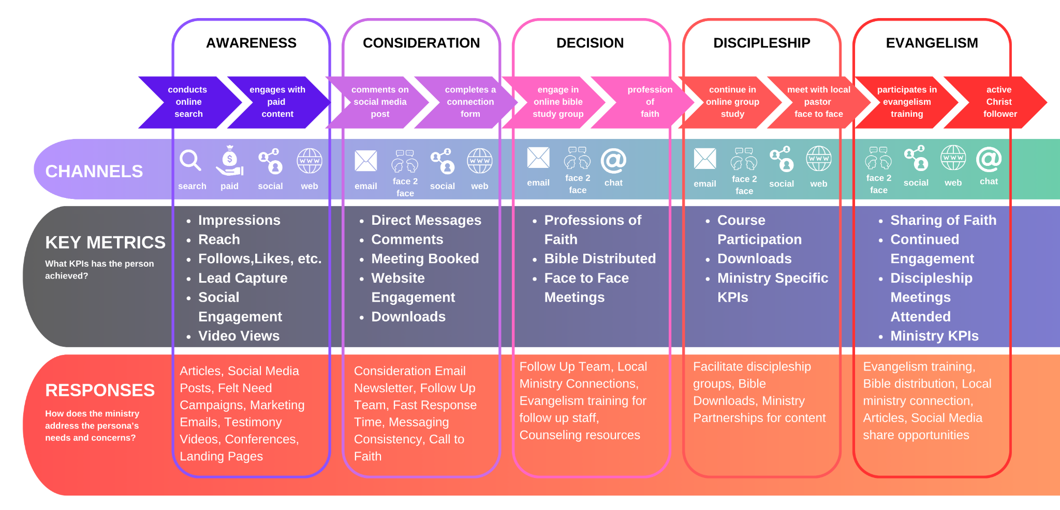

Slide 6
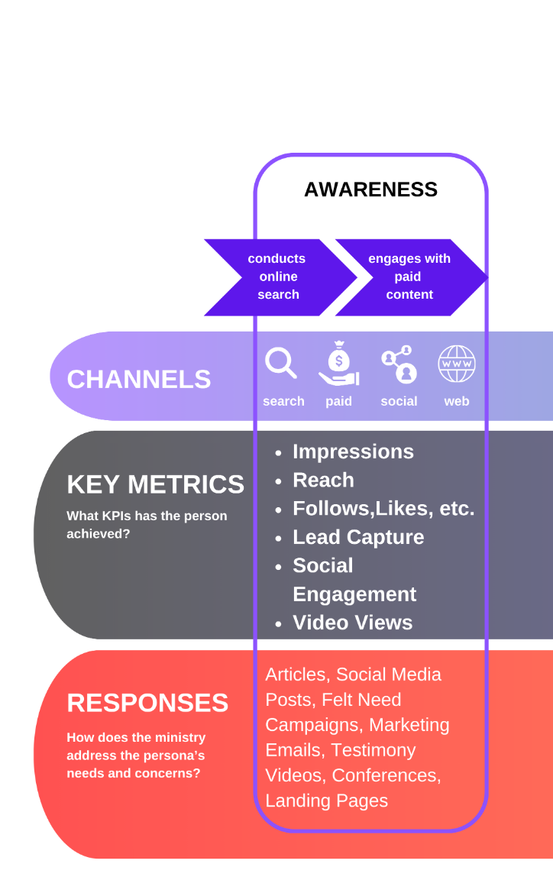

Slide 7
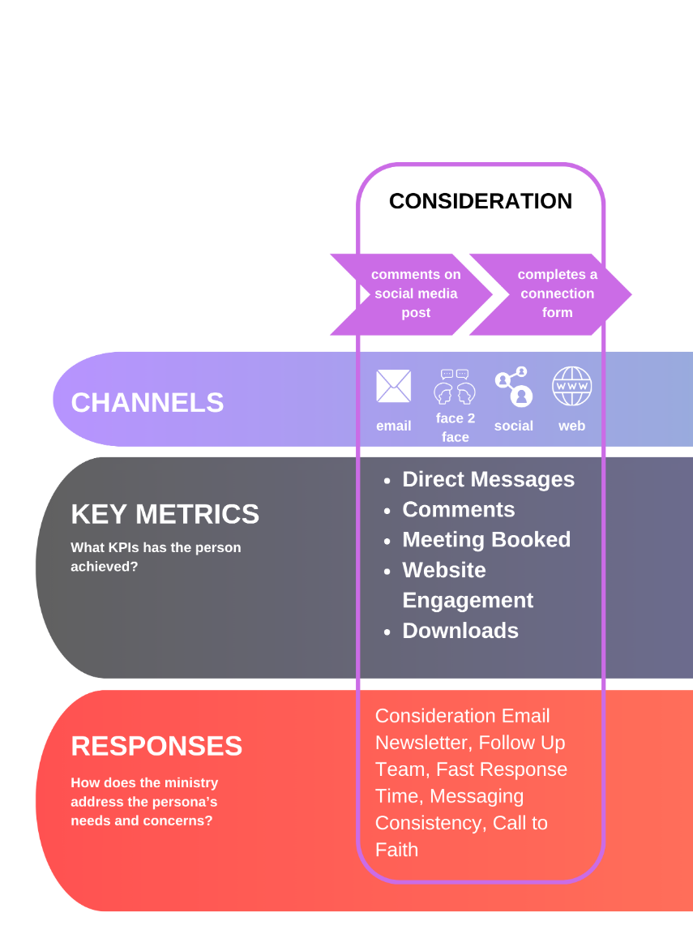

Slide 8
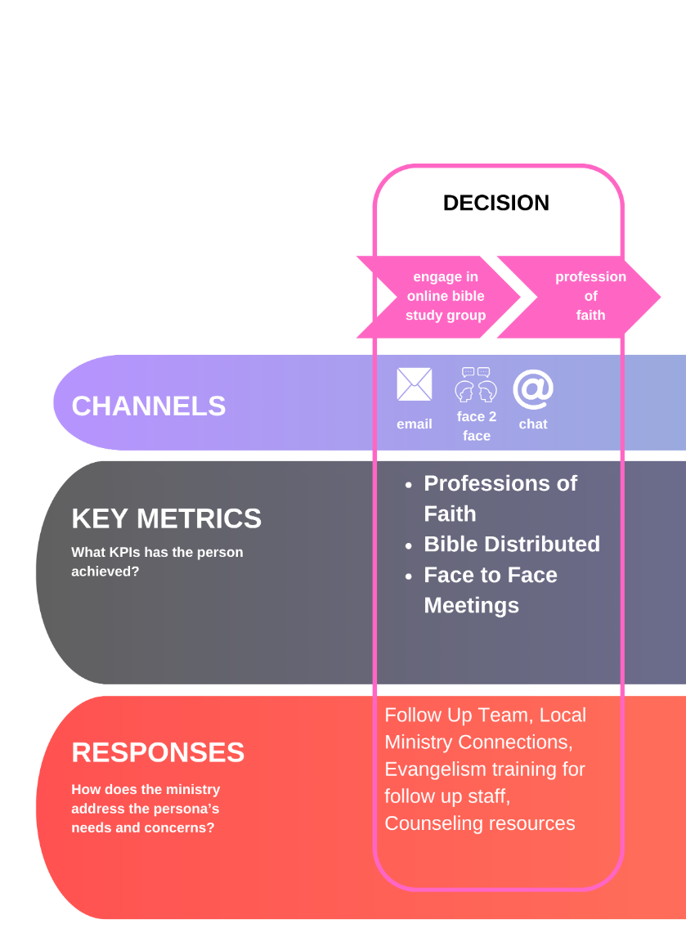

Slide 9
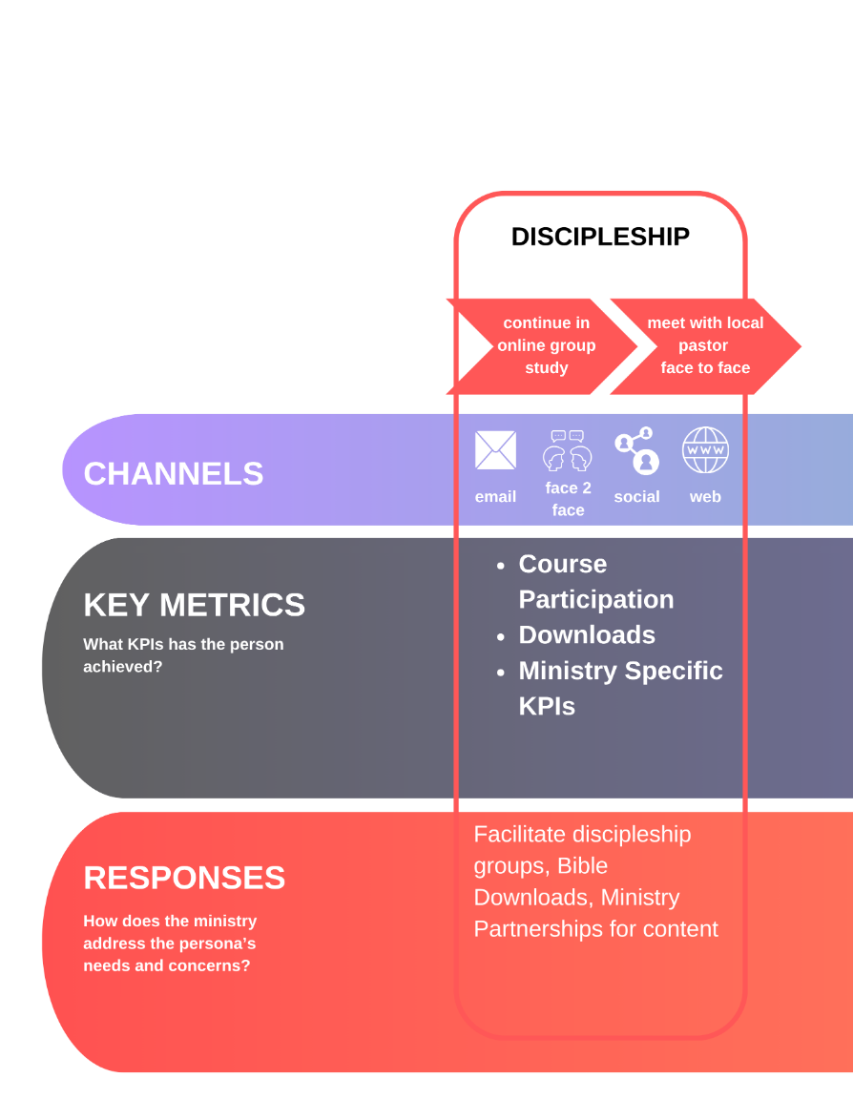

Slide 10


Slide 11

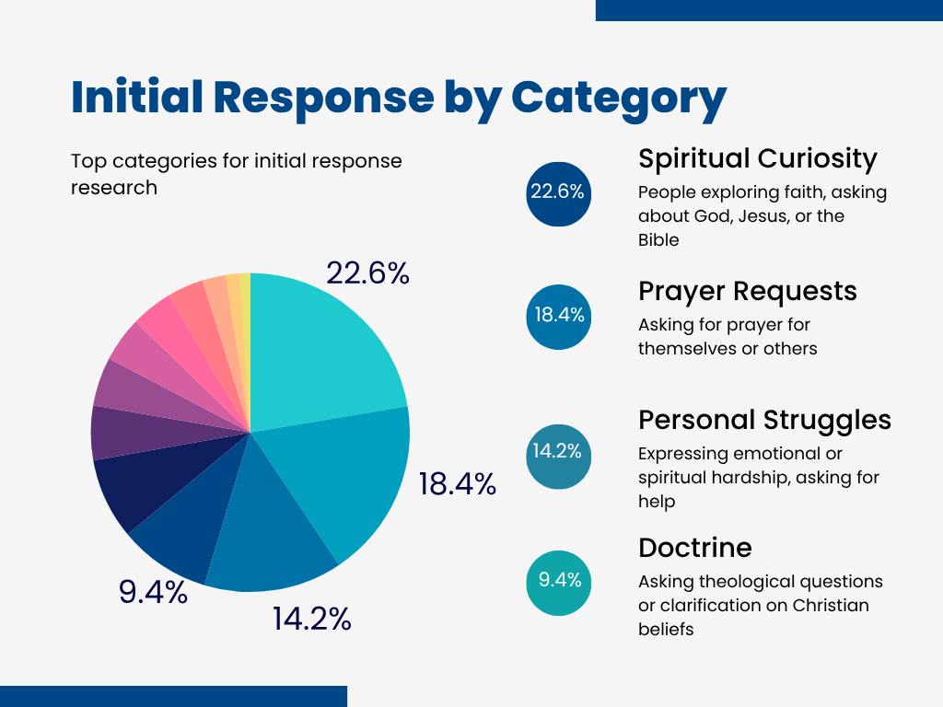
LISTEN WELL

Slide 12
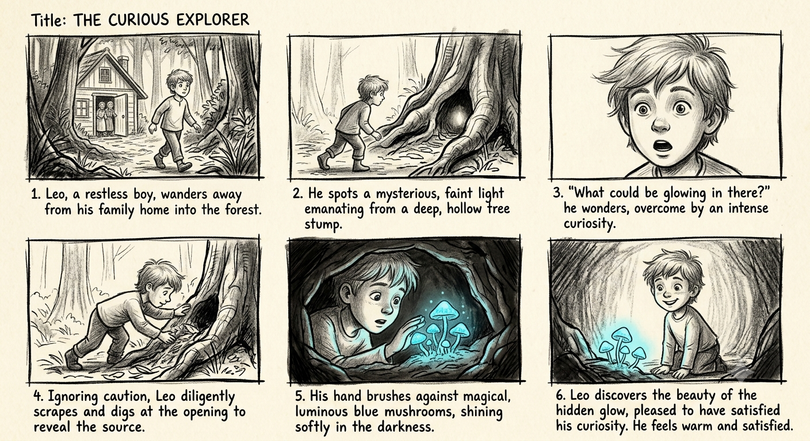
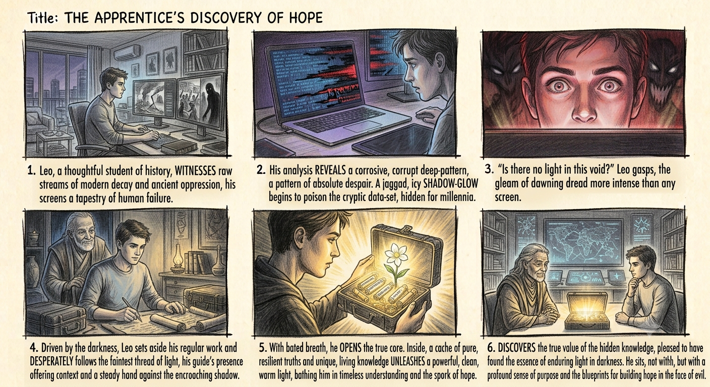
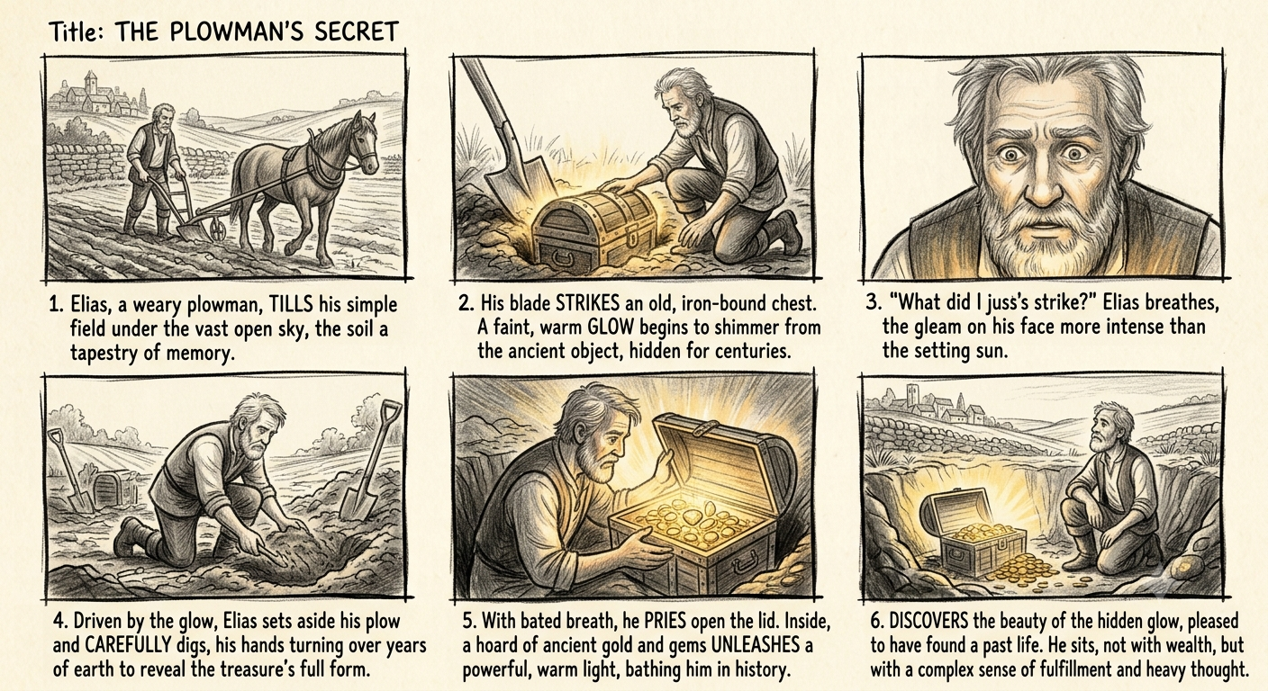
If God is good, why…..?

Slide 13
Option 1: The Narrative & Reflective Angle
It’s easy to feel overwhelmed by the state of the world. When you scroll through the endless noise, history, and current events, the darkness can feel heavy.
But true hope isn’t about ignoring the shadow—it’s about discovering the light that refuses to be extinguished by it.
Hope isn't a passive wish. It’s an active blueprint. It’s the quiet, unshakable strength that tells us evil never gets the final word.
Jesus can give YOU hope in the face of evil.
Option 2: The Direct & Empowering Hook
Evil is loud, but truth is deep.
If you’ve been feeling exhausted by the weight of world events, this is your reminder: Darkness only wins when we forget where our light comes from.
When you seek real spiritual grounding, you realize hope isn't just a feeling—it’s a weapon against despair.
Jesus can give YOU hope in the face of evil.
Option 3: The Philosophical & Question-Driven Angle
Where do you turn when the world feels broken?
Every generation faces the daunting task of confronting evil and decay. Yet, throughout history, the greatest breakthroughs of human spirit haven't come from ignoring the dark—they’ve come from uncovering ancient truths that give us the courage to build something better.
Spiritual hope isn't naive optimism. It’s the profound realization that love, truth, and purpose are far more resilient than any temporary shadow.
Jesus can give YOU hope in the face of evil.

Slide 14


EVIL AND HOPE

Slide 15
IMPACT
VIDEO VIEWS |  | 307,000 / MONTH
ENGAGE |  | 31,000 / MONTH
RESPONSES |  | 921 / MONTH
ENGAGE % |  | 10%
RESPONSE % |  | 3%

Slide 16
IMPACT
VIDEO VIEWS |  | 307,000 / MONTH
ENGAGE |  | 31,000 / MONTH
RESPONSES |  | 921 / MONTH
ENGAGE % |  | 10%
RESPONSE % |  | 3%
Is .3% of Video Views Good or Bad?

Slide 17

CONTENT THAT CONNECTS
LISTEN WELL
TARGET PERSONA
TEST SMALL
RESOURCE OUTCOMES

