Slide 1
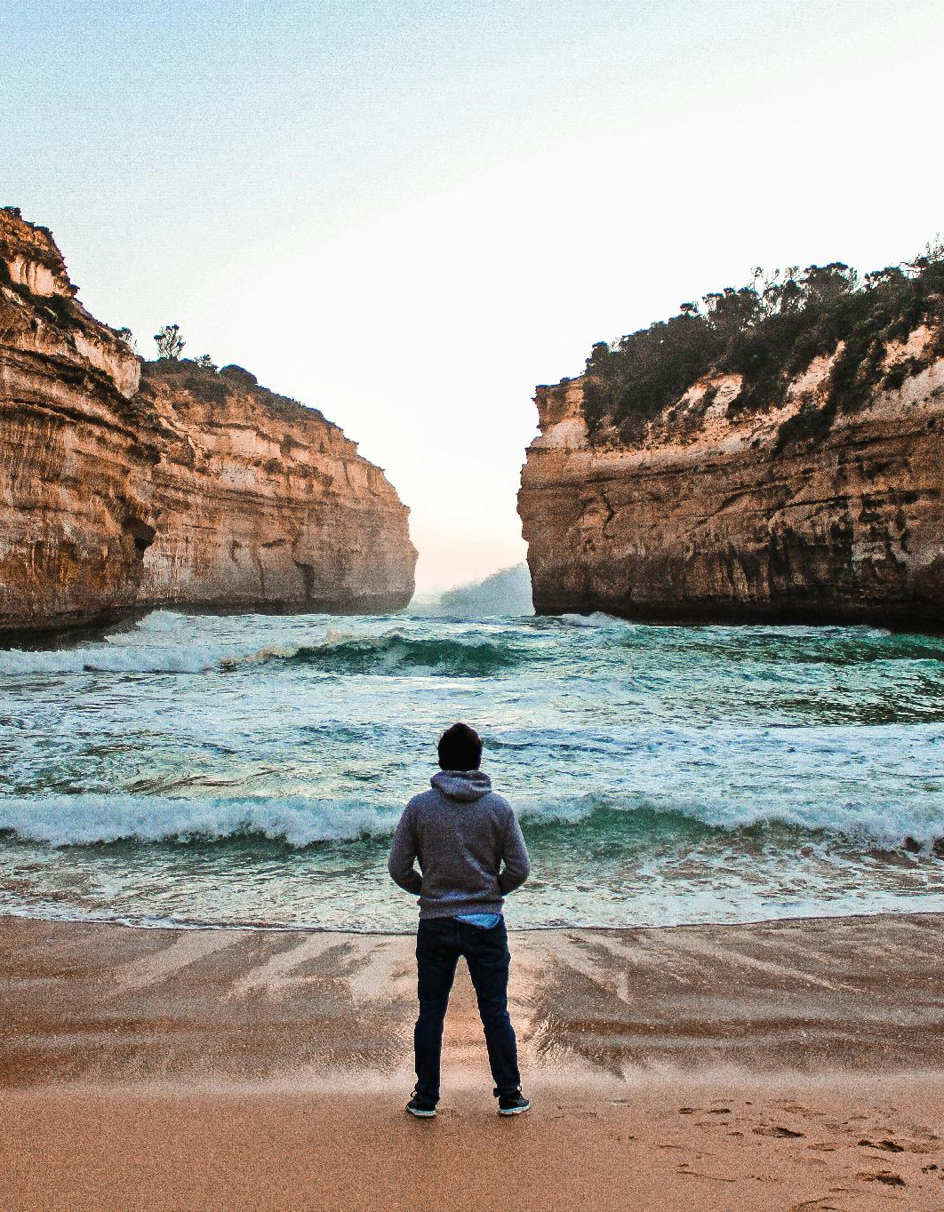

Content
That Works
DANIEL HALL
SAINTS CHURCH · MELBOURNE

Slide 2
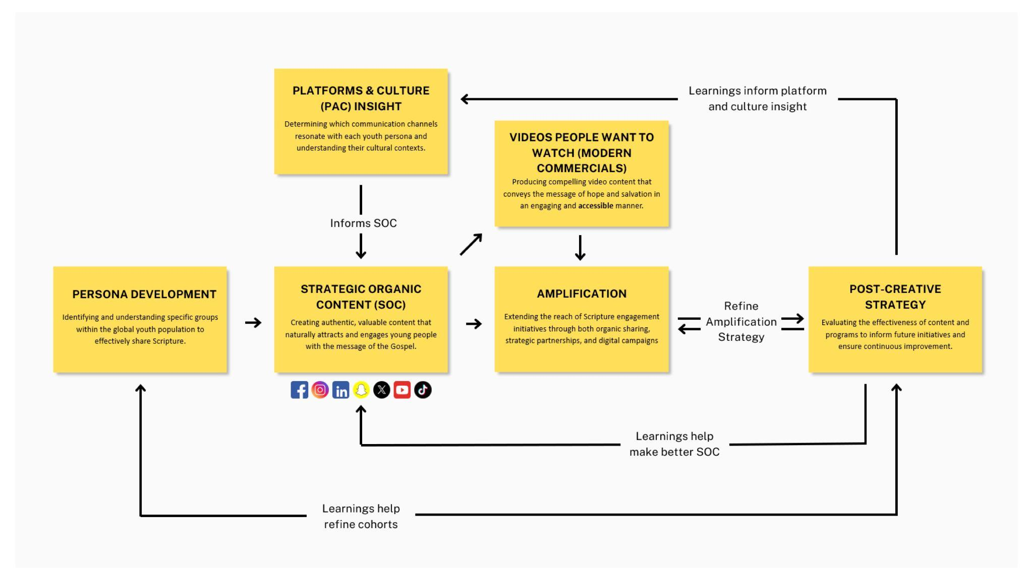

Slide 7
“What is that?”

Slide 8
Liquid Death
Everything is stupid
until it isn’t.
Make entertainment, not marketing.
Be the best thing someone sees that day.
Andy Pearson

Slide 9
Nothing you build is sacred.
The only thing that’s sacred is the person you’re building it for.

Slide 10
Content
That Works
DANIEL HALL
SAINTS CHURCH · MELBOURNE

