Slide 1
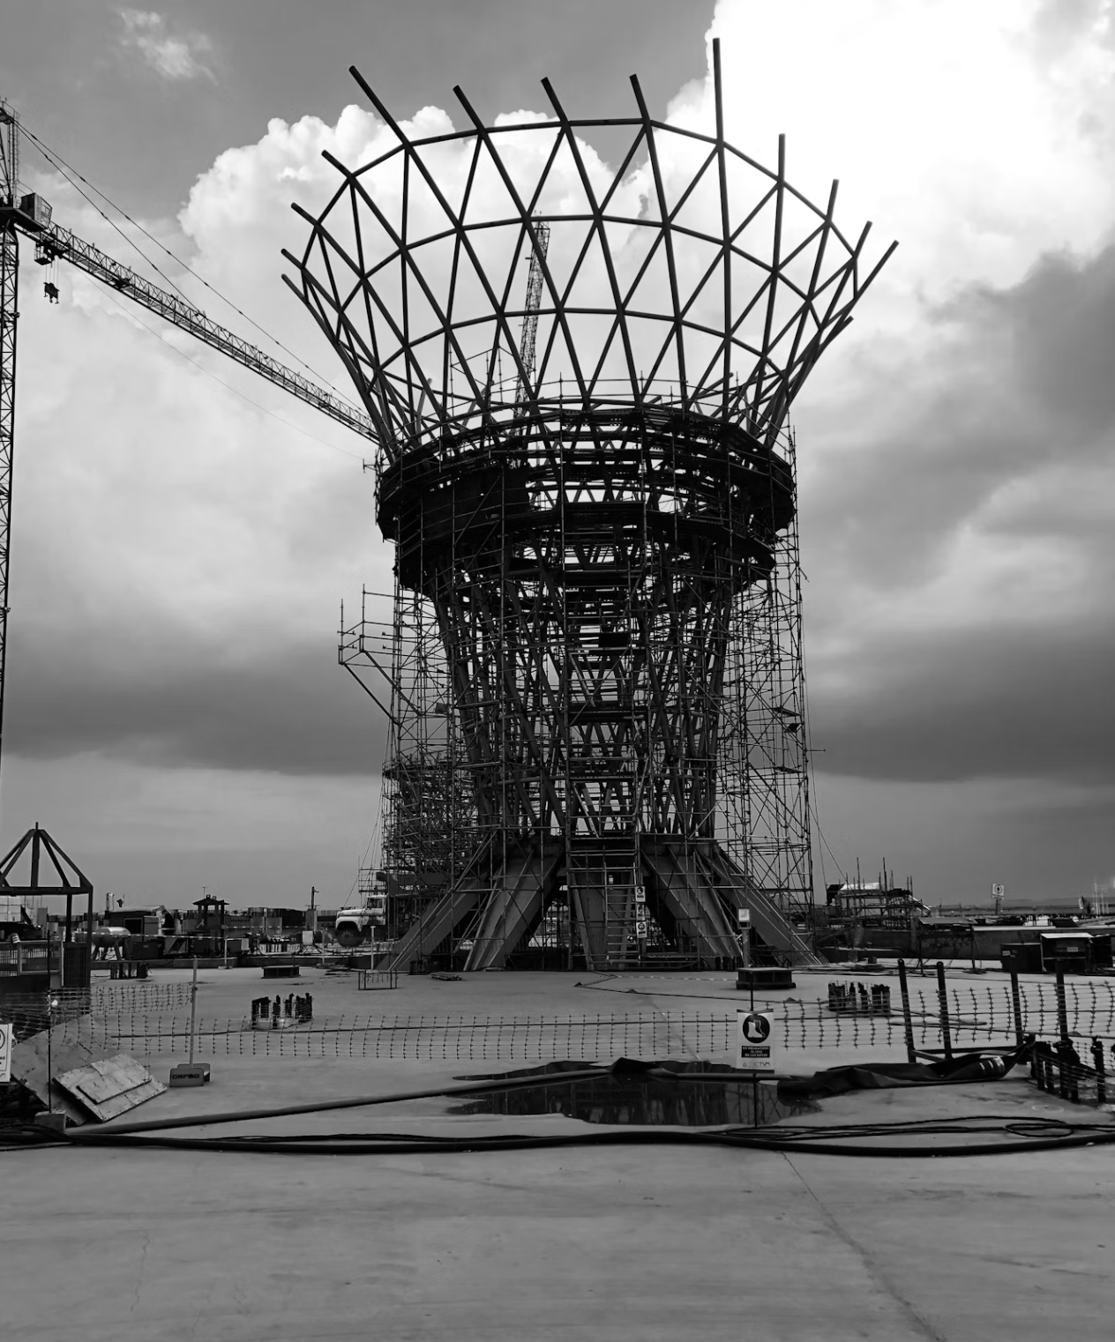
SADDLEBACK'S ONLINE COMMUNITY MODEL
Crowd to Core
Turning a broad audience into a committed core.
CROWD TO CORE
SADDLEBACK ONLINE COMMUNITY
Notes:
Crowd to Core — turning a broad audience into a committed core. I want to share Saddleback's current online church model: not our whole digital strategy, but specifically how we think about our Online Community — the area I've spent the most time building over the last decade.

Slide 2
BEFORE WE START
This isn't a playbook to copy.
It's how we think about doing church online through our Online Community. Take it as inspiration, contextualize it for your church, and revise constantly. Our model keeps shifting — I try to repent quickly when something doesn't work.
CROWD TO CORE
SADDLEBACK ONLINE COMMUNITY
Notes:
This isn't something to copy and paste. It's how we think about doing church online with our Online Community. Contextualize it for your own church's objectives. Our model is constantly being revised — don't be surprised if something has shifted by the time you look at our website. I repent quickly when something doesn't work.

Slide 3
WHY WE DO IT
Three objectives.
01
Try out the church
Let new people experience us online before jumping into a location in person.
02
Never miss a weekend
Keep members and attenders in the loop when they're sick or traveling.
03
Reach the faraway
Engage distant people to start Extensions — the reason we invest in online church.
CROWD TO CORE
SADDLEBACK ONLINE COMMUNITY
Notes:
Three objectives for church online at Saddleback. First, a way for new people to experience the church before coming in person — to audit what we're about. Second, a way for regular attenders and members to stay in the loop and never miss a weekend if they're sick or traveling. Third, and most importantly — the reason we invest — engaging people from faraway locations to eventually start microsites, our Extensions, which can become full-fledged locations of our church.

Slide 4

THE NORTH STAR
It all points to one thing: Extensions.
Microsites that can grow into full locations of our church. That third objective is why online church exists here.
CROWD TO CORE
SADDLEBACK ONLINE COMMUNITY
Notes:
That third objective — Extensions — is the north star. Microsites that could become full-fledged locations long-term. It's why we invest in online church at all.

Slide 5
THE STRUCTURE
Not an Online Campus. An Online Community.
Our physical locations are Campuses. We didn't want a member who's sick or traveling to feel like they'd left their campus for an online one. So online is a Community — the aggregate of everyone at our church.
CROWD TO CORE
SADDLEBACK ONLINE COMMUNITY
Notes:
The structure: online at Saddleback is not set up as an Online Campus — that's the language for our physical locations. It's an Online Community. The idea is everyone engages online in some way, and we didn't want people watching because they're sick or traveling to think they'd become part of a separate Online Campus instead of their local campus. The Online Community is an aggregate of everyone at our church.

Slide 6
HOW IT ROUTES
Two watchers, two paths.
THE LOCAL WATCHER
THE FARAWAY WATCHER
Route them home.
Grow a new core.
—
Lives near one of our locations
—
Lives far from any location
—
The team connects them to that campus
—
Engages solely with the Online Community
—
Online becomes an on-ramp to in person
—
Eventually attends — or starts — an Extension
CROWD TO CORE
SADDLEBACK ONLINE COMMUNITY
Notes:
Two kinds of watchers, two paths. Someone local who starts watching online gets connected by the Online Community Team to their nearby location. Someone far away engages solely with the Online Community and eventually attends or starts an Extension in their city. Those who deeply engage online — you might call them our 'campus' people — are part of an Extension in person.

Slide 7
WHY IT REPORTS WHERE IT DOES
Structured by Objective
The Online Community pastor reports to our campus development team and serves on its leadership. Extensions are locations-in-waiting — and the Online Community represents every one of our locations at once.
CROWD TO CORE
SADDLEBACK ONLINE COMMUNITY
Notes:
Because of this structure, the Online Community pastor reports to our campus development team and serves on its leadership. Extensions are why the Online Community sits at the table with all our in-person locations — and the Online Community also represents all of our locations simultaneously.

Slide 8
THE TEAM'S FOCUS
Everything we do is to launch Extensions.
A compelling weekly worship service, a digital discipleship pathway, next steps at every turn — all of it engineered to move people toward starting an Extension.
CROWD TO CORE
SADDLEBACK ONLINE COMMUNITY
Notes:
The Online Community Team focuses on creating a compelling online worship service that drives next steps of faith, moves people through our discipleship pathway digitally, and launches more Extensions. Everything we do is to launch more Extensions.

Slide 9
EVERY NEXT STEP
Why a weekly service?
—
Digital next-step cards
—
Zoom classes
Turn a viewer into a responder.
Move people toward belonging and membership.
—
Online & in-person groups
—
Follows, likes, newsletter
Build the community that holds them.
Keep the relationship warm between weekends.
—
Meetups
—
Serving
Gather scattered watchers face-to-face.
Turn attenders into owners.
…and all of it drives toward Extensions.
CROWD TO CORE
SADDLEBACK ONLINE COMMUNITY
Notes:
Why do we create a weekly worship service? To get more people to fill out a digital next-step card, into our Zoom classes, into online and in-person small groups, following and liking our socials, on our email newsletter, connecting at a Meetup, and serving in some way — all of which drives toward Extensions.

Slide 10
HOW WE KEEP SCORE
One number runs everything.
We set one big goal for new Extensions each year, plus a five-year goal. Budget, staffing, programming — everything is centered on that objective.
CROWD TO CORE
SADDLEBACK ONLINE COMMUNITY
Notes:
We have one big number goal for how many new Extensions we want to start a year, and a five-year goal as well. Our budget, staffing, programming, and everything else is centered around our objective of Extensions.

Slide 11
A VISION STORY
02
Meet James
CROWD TO CORE
SADDLEBACK ONLINE COMMUNITY
Notes:
Now let me tell it as a story. A boss had me do a vision-story exercise almost ten years ago, and it was surprisingly helpful for visualizing what we needed to build. This is the Online Community vision story — and it's been fulfilled many times over.

Slide 12
THE EXERCISE
Write your vision story.
A boss had me do this almost ten years ago. I laughed at it then. I'm not laughing now — I've met people like James many times over. Here's ours.
CROWD TO CORE
SADDLEBACK ONLINE COMMUNITY
Notes:
I'd highly recommend writing down your vision story. Mine has changed over the years as new programs and objectives were added, but the general idea hasn't. Here's the Online Community vision story.

Slide 13
HOW THE CROWD BECOMES THE CORE
Six moves.
01
Watch
A stranger finds the service and keeps coming back.
02
Respond
They take a first step of faith — digitally.
03
Belong
A class turns interest into membership.
04
Connect
A small group becomes family.
05
Contribute
They start reaching the people around them.
06
Launch
A Meetup becomes an Extension becomes a campus.
CROWD TO CORE
SADDLEBACK ONLINE COMMUNITY
Notes:
Before the story, here's the shape of it — six moves from crowd to core: watch, respond, belong, connect, contribute, and launch. Watch James travel all six.

Slide 14
THE CROWD
James, in San Francisco.
Far from any Saddleback location. Never heard of us. Good career, dating, but a gap he couldn't name — he and his girlfriend wanted their lives to matter, and weren't sure how.
CROWD TO CORE
SADDLEBACK ONLINE COMMUNITY
Notes:
James lives in San Francisco, far from any physical Saddleback location, and has never heard of us. He grew up around Christians but never really knew the faith. Recently graduated, dating, promising careers and money — but a gap. They wanted to make a difference and weren't sure what that meant practically.

Slide 15
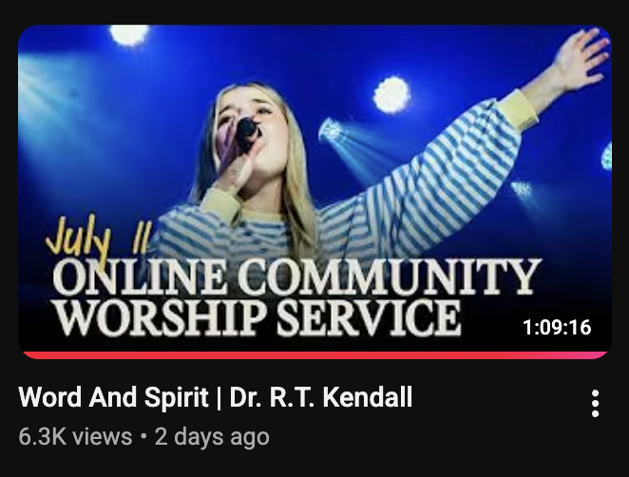
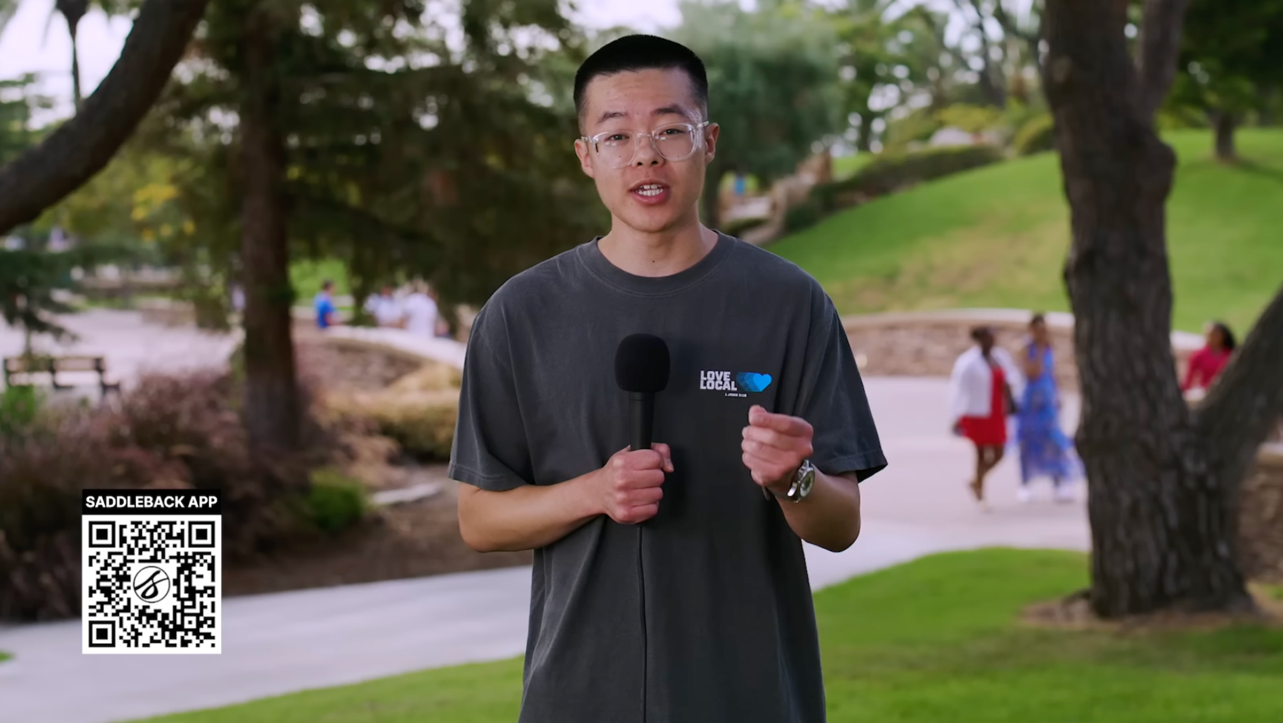
FIRST CONTACT
An Instagram ad.
A YouTube service.
Scrolling Instagram, James taps an ad about a meaningful life. It links to a YouTube worship service — music that fits him, a message that hits what they're wrestling with. He subscribes. They watch every week.
CROWD TO CORE
SADDLEBACK ONLINE COMMUNITY
Notes:
While scrolling Instagram, James sees an ad about having a meaningful life. He clicks it, and it links to a YouTube worship service. He's interested — compelling music that connects to his style, a message relevant to what he and his girlfriend are wrestling with. He subscribes to the channel and they start watching weekly on their own.

Slide 16
THE DECISION
A prayer, then a tap.
After a month, they pray to accept Jesus during a service — and reach for their phones to mark it on the digital next-step card. An email invites them to a Zoom belonging class. They decide to make Saddleback home.
CROWD TO CORE
SADDLEBACK ONLINE COMMUNITY
Notes:
After about a month, they hear the pastor pray a prayer to accept Jesus, and they both realize they prayed it. They pull out their phones and use the digital program to indicate they prayed the prayer. An email is sent about an upcoming Zoom class on belonging — which they'd also heard about from the YouTube hosts. They take the class, learn what it means to follow Jesus and belong to a church family, and decide to make Saddleback their home.

Slide 17
COMMUNITY
A group that became family.
Membership pauses until they can be baptized. Meanwhile they join a Zoom online small group with people all over the world. It's built for transformation, not information — and it quickly becomes vital.
CROWD TO CORE
SADDLEBACK ONLINE COMMUNITY
Notes:
To become members they need to be baptized, but they don't have a pastor near them, so membership is put on pause. They join a Zoom online small group the team recommends. It quickly becomes vital. The group is focused on transformation, not just transferring information — candid questions, honest talk — and they love that members live all over the world. A global community is attractive to them.

Slide 18
TRANSFORMATION
Conviction, then courage.
The group talks honestly about sex and living together. Convicted, James and his girlfriend move out. Friends notice, and ask why — so they start an in-person small group as an outreach to the curious.
CROWD TO CORE
SADDLEBACK ONLINE COMMUNITY
Notes:
One week the group honestly discusses sex before marriage and living together. James and his girlfriend feel convicted — they're living together — and after the group talks it through lovingly, they decide to stop. Friends and family are surprised; James shares it's because of their faith. Some friends start asking faith questions, so James and his girlfriend start an in-person small group with curious local friends, while still meeting in their Zoom group. They see the in-person group as an outreach.

Slide 19
THE SIGNAL
The team spots a cluster.
A growing San Francisco small group. Zoom-class sign-ups from the same area. The Online Community Team sees it — and hosts a Meetup, with the pastor flying out to connect in person.
CROWD TO CORE
SADDLEBACK ONLINE COMMUNITY
Notes:
As the in-person group grows, everyone completes the Zoom classes about growing, serving, and sharing their faith. The Online Community Team notices a growing small group in San Francisco plus Zoom-class participants from the area, and decides to host a Meetup there — promoting it to James's group and to everyone watching online, saying the Online Community pastor will visit and would love to connect.

Slide 20
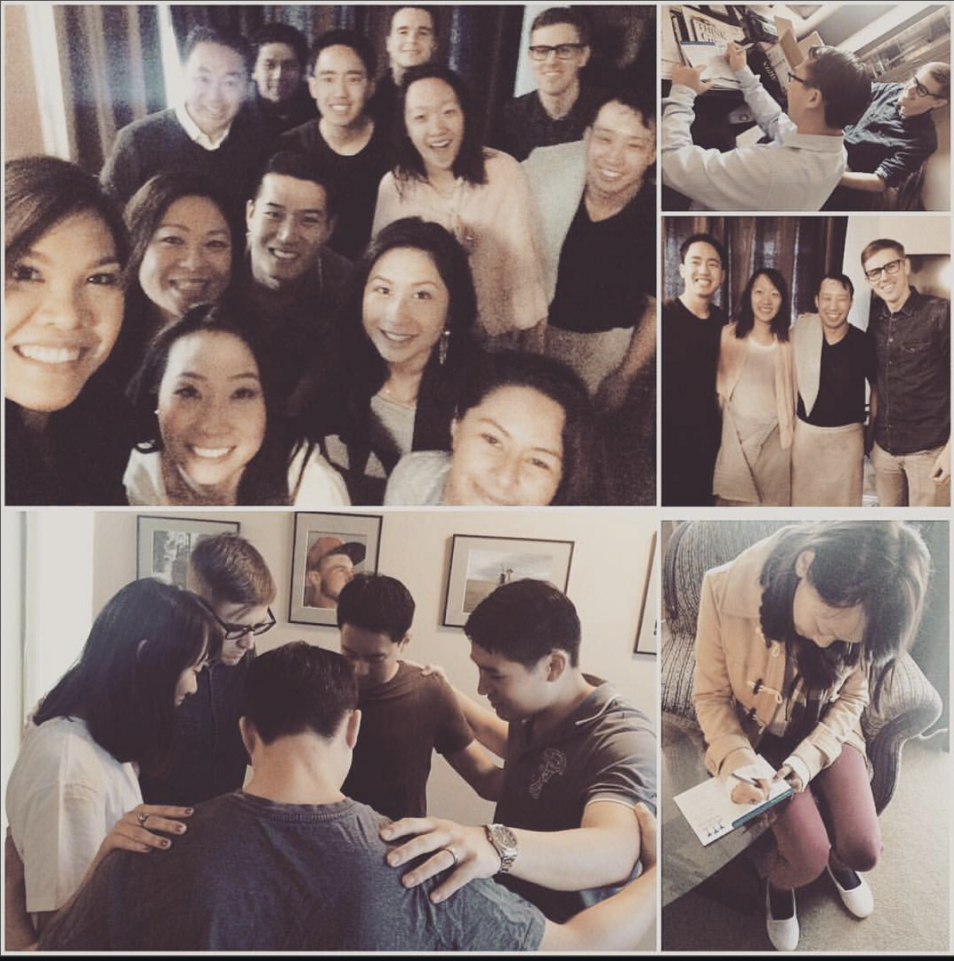
THE CORE
A vision, and a bathtub.
At the Meetup, the pastor casts the Extension vision. James and a few others decide to try it. Someone has a big enough bathtub — and the pastor baptizes James and his girlfriend while the group cheers next door.
CROWD TO CORE
SADDLEBACK ONLINE COMMUNITY
Notes:
The whole group attends the Meetup, connects with the pastor and a few others in the area. The pastor casts a vision for an Extension in San Francisco and explains what it takes. James and his girlfriend and a few others love the idea and decide to try it for a few months. James mentions they still need to be baptized to become members. The pastor asks if anyone has a big enough bathtub — a friend does — and they all travel there, where the pastor baptizes James and his girlfriend while the rest cheer from the other room.

Slide 21
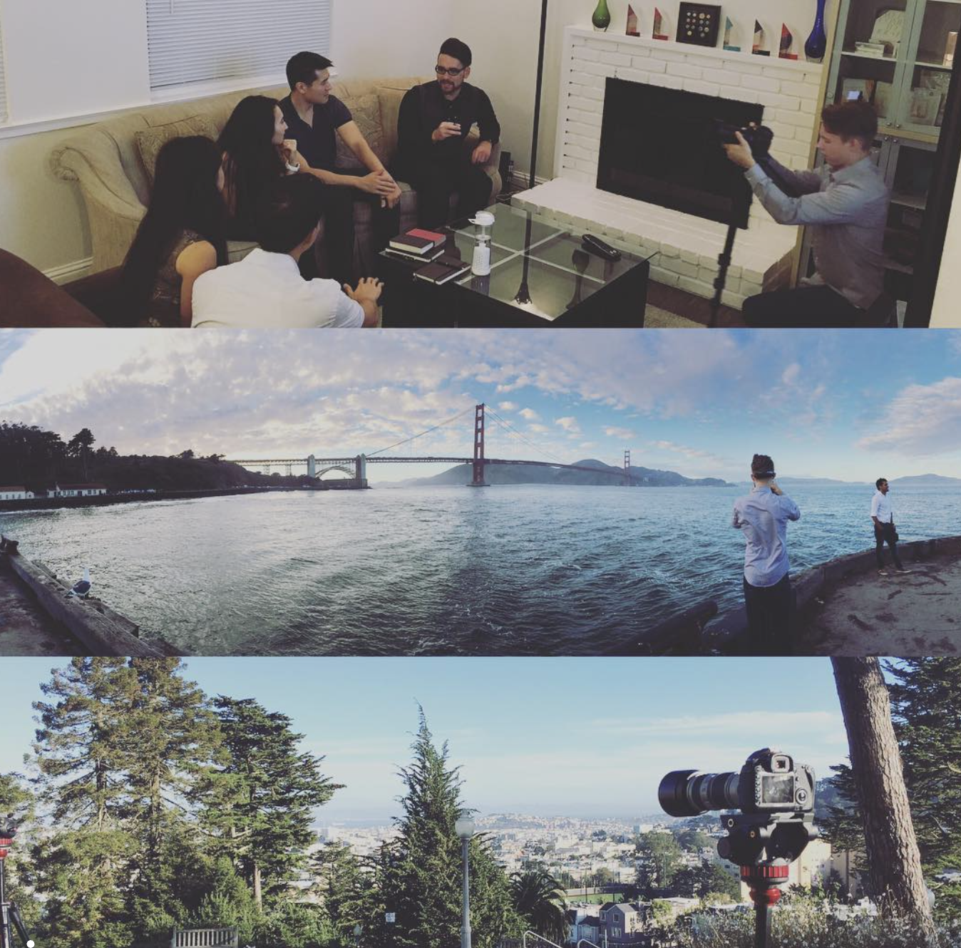
THE EXTENSION LAUNCHES
15 → 20
people, in a living room.
The Bay Area Extension starts in a home for twenty, each leader inviting three. Saddleback promotes it on YouTube, emails the area, and runs an Instagram ad. They gather around a TV; James opens and closes in prayer.
CROWD TO CORE
SADDLEBACK ONLINE COMMUNITY
Notes:
The new Bay Area Extension picks a launch date a month out, starting in a home that fits twenty, and each leader commits to inviting three people. Saddleback promotes the launch on the YouTube service, sends targeted emails to the area, and runs an Instagram ad. The first service has fifteen people; after a few months, twenty. They meet monthly, then twice a month. The service is simple — everyone gathers around a TV playing the YouTube service, and James stands up at the start and end to greet, give announcements, and close in prayer, then they hang out afterward.

Slide 22
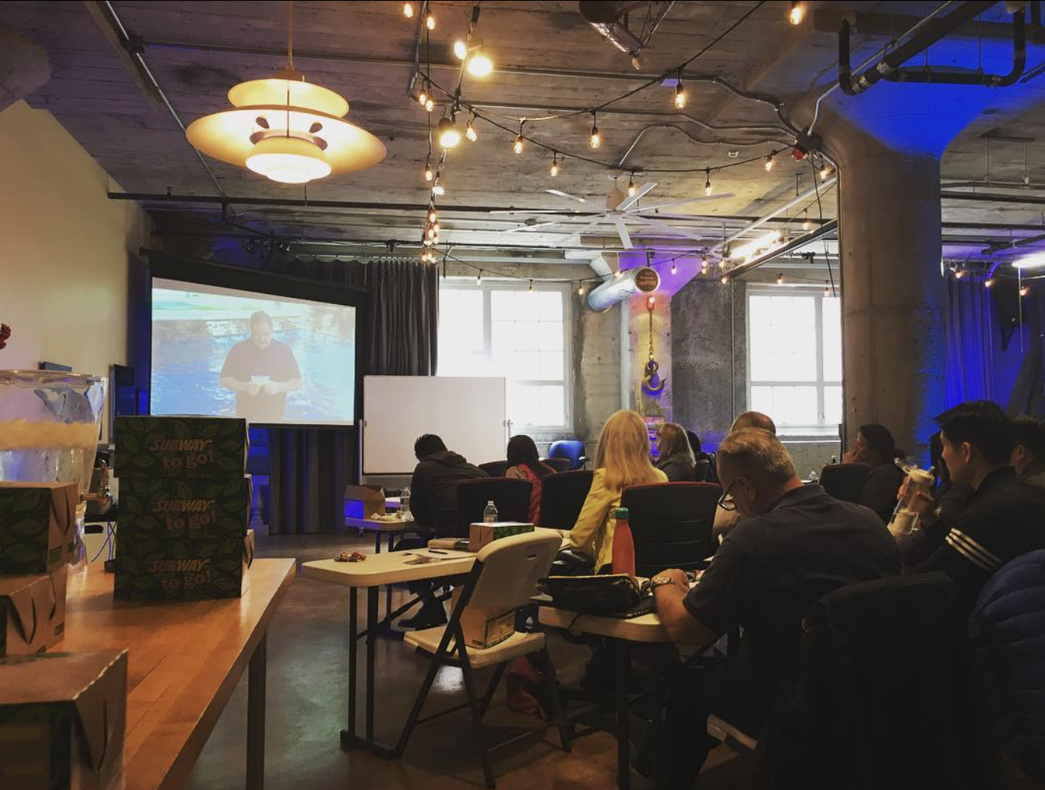
IT MULTIPLIES
Now they baptize others.
Attenders take the Zoom classes and join groups. James baptizes three in that same bathtub. They rent a workspace on Sundays; Saddleback ships banners and pens; volunteer teams form for setup, welcome, and prayer.
CROWD TO CORE
SADDLEBACK ONLINE COMMUNITY
Notes:
Everyone at the Extension is encouraged into a small group and into the Zoom membership classes. A few need baptism, so James throws an Extension baptism party and, after simple training, he and his girlfriend baptize three attenders in that same bathtub the pastor used. The Extension grows and decides to rent a space with their tithes — a new attender has workspace available on Sundays for just cleaning and insurance costs. It's bigger, so they train for a compelling guest experience, and Saddleback ships pens, banners, and other items to warm up the space. New volunteer teams form for setup and teardown, welcome, connecting new people, and prayer, and they look for an acoustic worship leader.

Slide 23
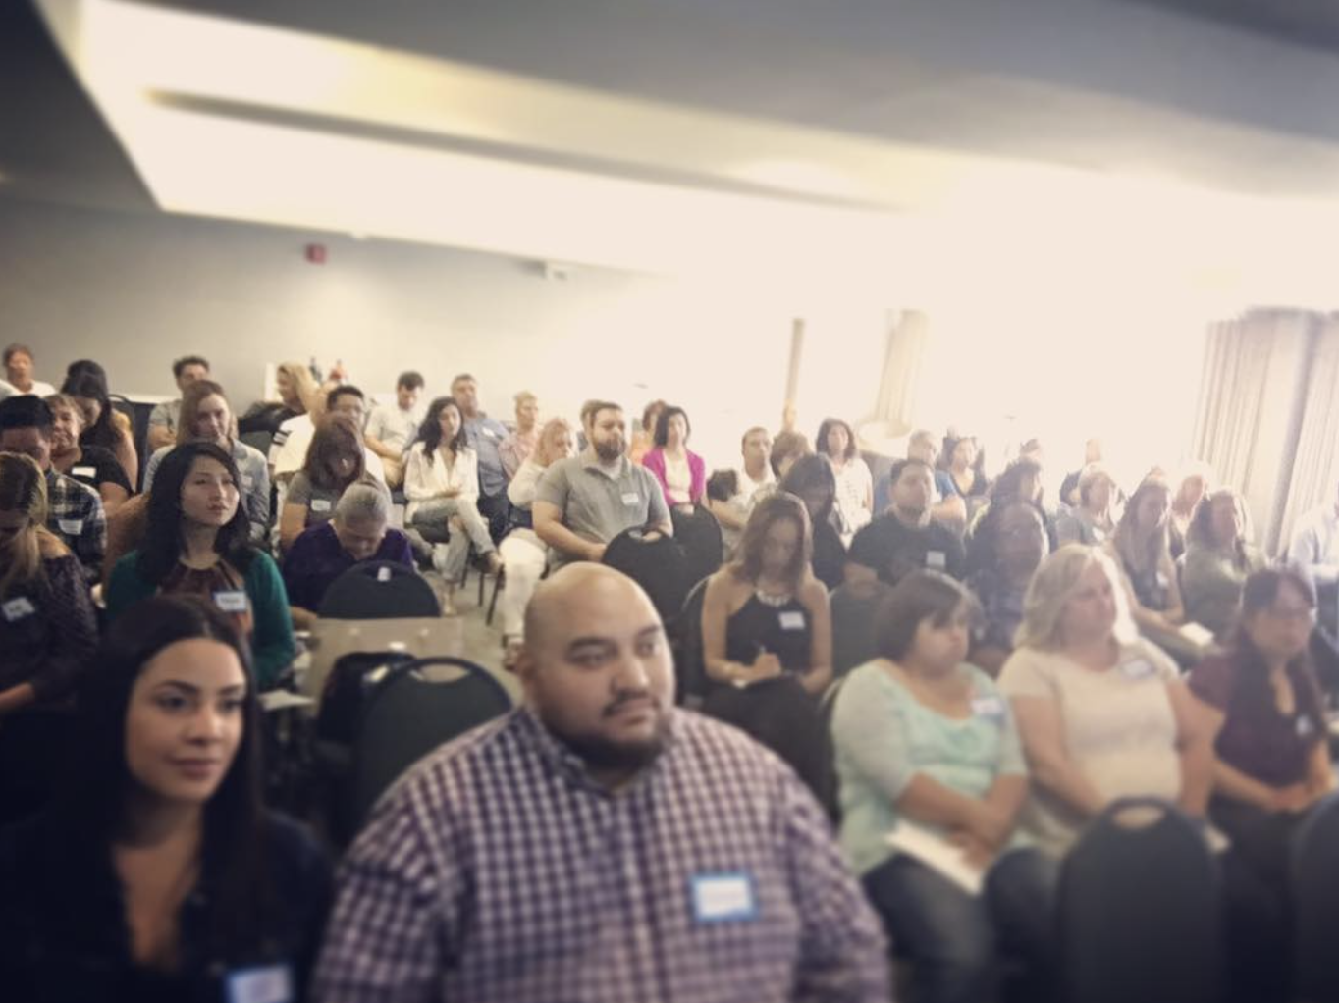
ONE YEAR IN
75
regulars — fully volunteer-led.
Eight small groups connected to the Extension, and classes now hosted in person quarterly. Saddleback starts to ask a bigger question: should this become a campus?
CROWD TO CORE
SADDLEBACK ONLINE COMMUNITY
Notes:
A year later, this fully volunteer-led Extension has seventy-five people regularly in person, eight small groups connected to it, and even hosts classes in person quarterly instead of sending people online. Saddleback starts to explore whether this Extension should become a campus location.

Slide 24
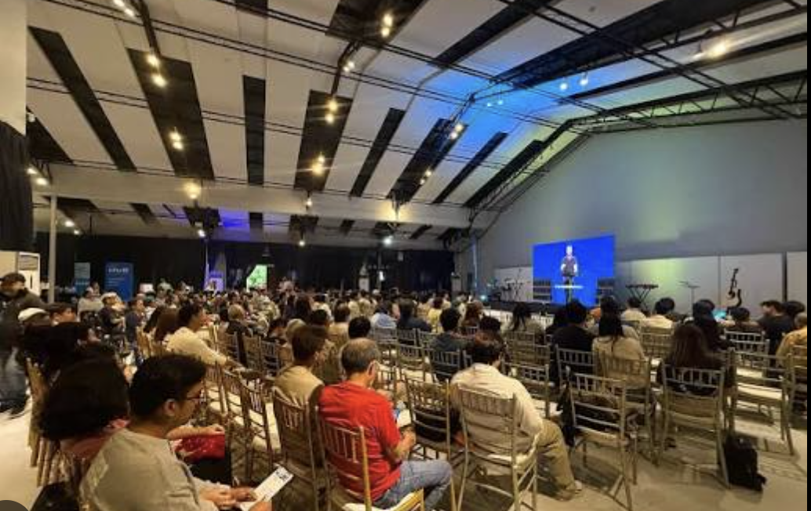
THE CORE, COMPLETE
Saddleback Church Bay Area?
Six months later, we launch a full campus — hiring a pastor, a worship leader, and a kids ministry leader, and moving into a larger space. James, now engaged, will be married there and raise his family at this location.
But Davao…
CROWD TO CORE
SADDLEBACK ONLINE COMMUNITY
Notes:
Six months later, Saddleback Church launches Saddleback Church Bay Area — hiring a pastor, worship leader, and kids ministry leader for family programming, and moving into a larger space to expand the Extension into a full-fledged campus. James and his girlfriend are engaged and plan to have the new campus pastor officiate their wedding, and to raise their family at this location.

Slide 25
THE TAKEAWAY
Write down your vision story.
It kept me anchored to the why. Why Zoom classes? To help James belong. Why online groups? To connect him. Why Meetups? To start an Extension.
Your objectives will differ — but write your story, and go meet your James.
CROWD TO CORE
SADDLEBACK ONLINE COMMUNITY
Notes:
Doesn't that story get you hyped? I wrote a version ten years ago and laughed at it. I'm not laughing now — I've met people like James over the years. The vision-story exercise kept me on track with the why of everything we do online: why Zoom classes — to help James belong; why online small groups — to connect him; why Meetups — to connect him with his area and maybe start an Extension. Your church's objectives will differ, but write out your vision story — and I pray you meet your James very soon.

Slide 26
From the crowd,
a core.
GO MEET YOUR JAMES
CROWD TO CORE
SADDLEBACK ONLINE COMMUNITY
Notes:
From the crowd, a core. That's the whole model — every online step engineered to move one more person from anonymous viewer to committed core, and every committed core toward launching the next Extension. Go meet your James. Thank you.

