Slide 1

DISTRIBUTION & GROWTH
Reaching People
How to stop the scroll, earn attention, and grow organically and with paid.
REACHING PEOPLE
DISTRIBUTION & GROWTH
Notes:
Reaching People — Distribution & Growth. This is about how you actually get in front of people and grow: the organic game and the paid game, and how to do both on purpose.

Slide 2
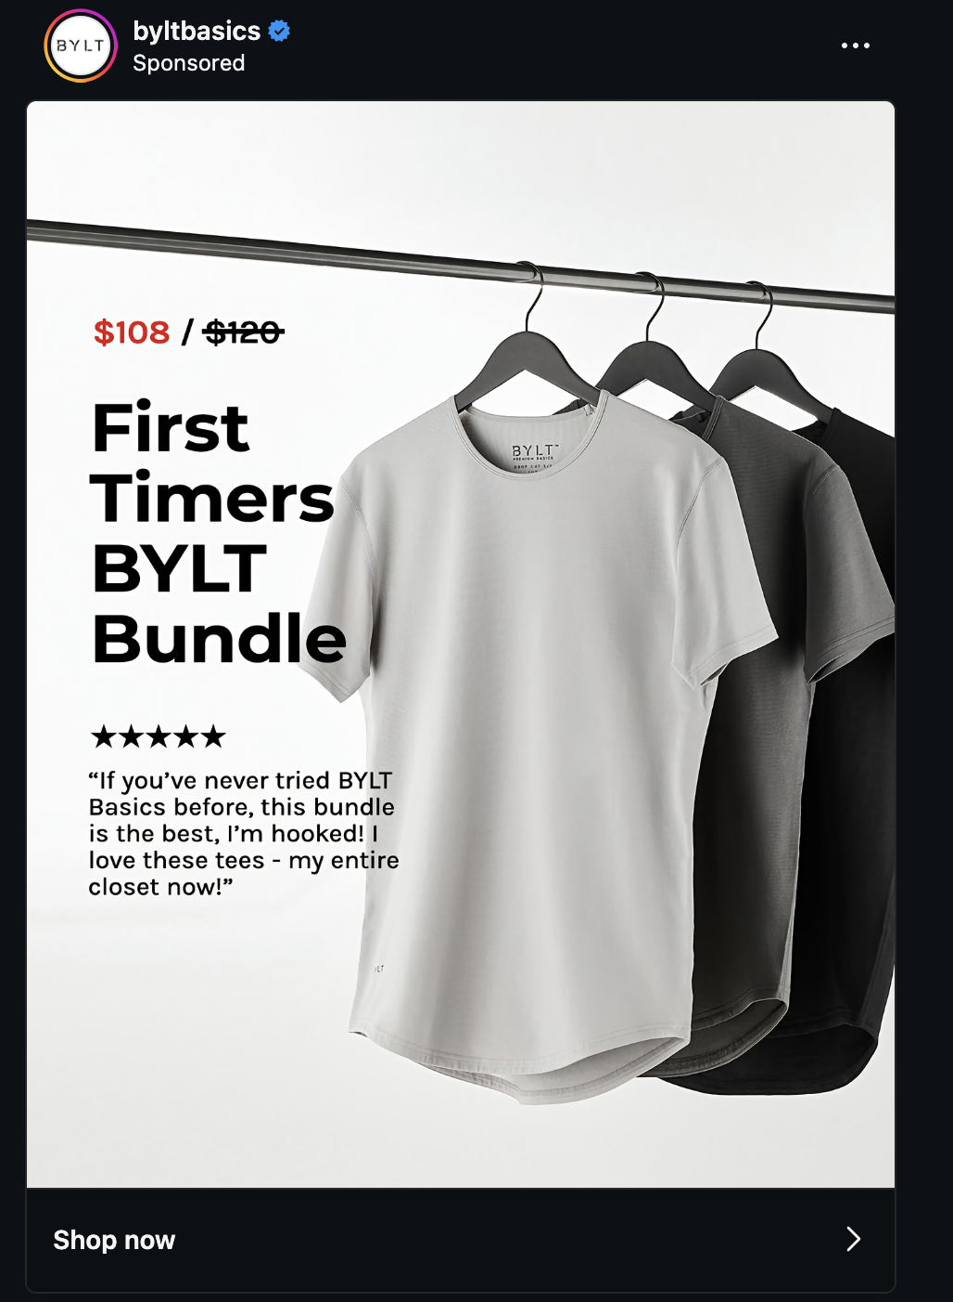
THE WHOLE GAME
Stop the scroll.
Pay attention to what grabs YOU as you scroll then learn to do that on purpose.
REACHING PEOPLE
DISTRIBUTION & GROWTH
Notes:
Stop the scroll — that's the goal. Start by paying attention to what grabs you as you scroll. What made you stop? Reverse-engineer it and learn to do it on purpose.

Slide 3
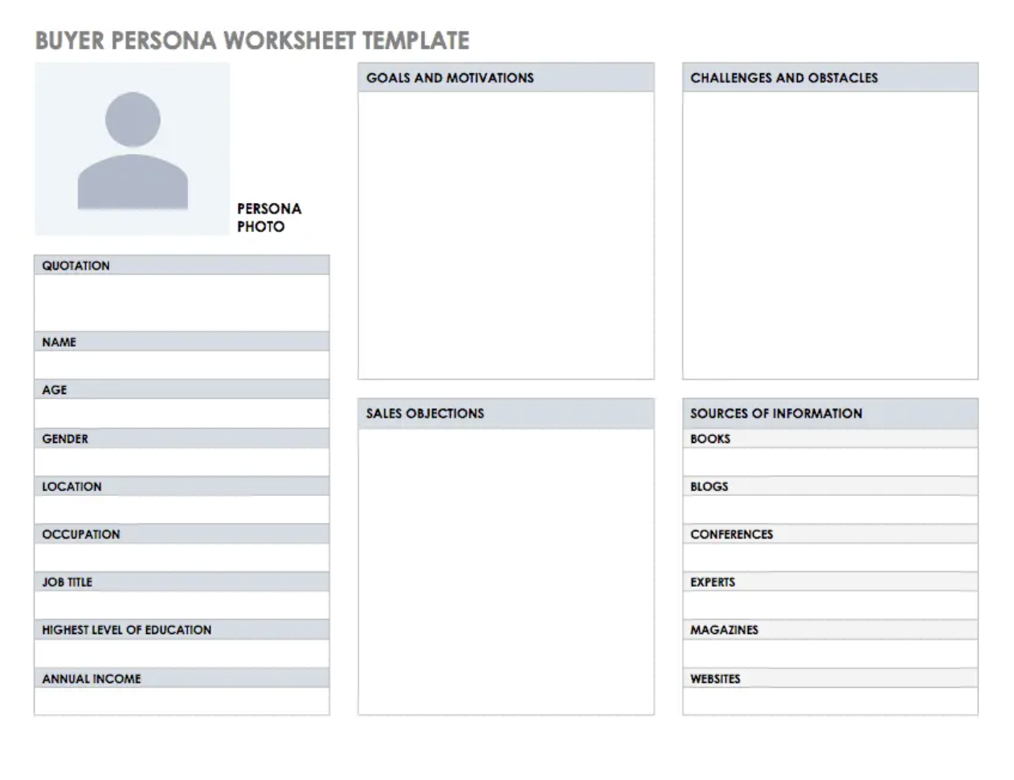
BEFORE ANYTHING ELSE
Start with the persona
Filter every decision through your persona — who they actually are, what they care about, where they already spend time. Use AI to research them fast and get specific.
REACHING PEOPLE
DISTRIBUTION & GROWTH
Notes:
Everything runs through the filter of your persona. Know who they are before you make a single piece of content or spend a dollar. AI is great for researching a persona quickly — demographics, language, the platforms and creators they follow.

Slide 4
Rick Warren
Don’t be surprised when unbelievers act like unbelievers.
Disciple them towards the TRUTH.
REACHING PEOPLE
DISTRIBUTION & GROWTH
Notes:
Everything runs through the filter of your persona. Know who they are before you make a single piece of content or spend a dollar. AI is great for researching a persona quickly — demographics, language, the platforms and creators they follow.

Slide 5
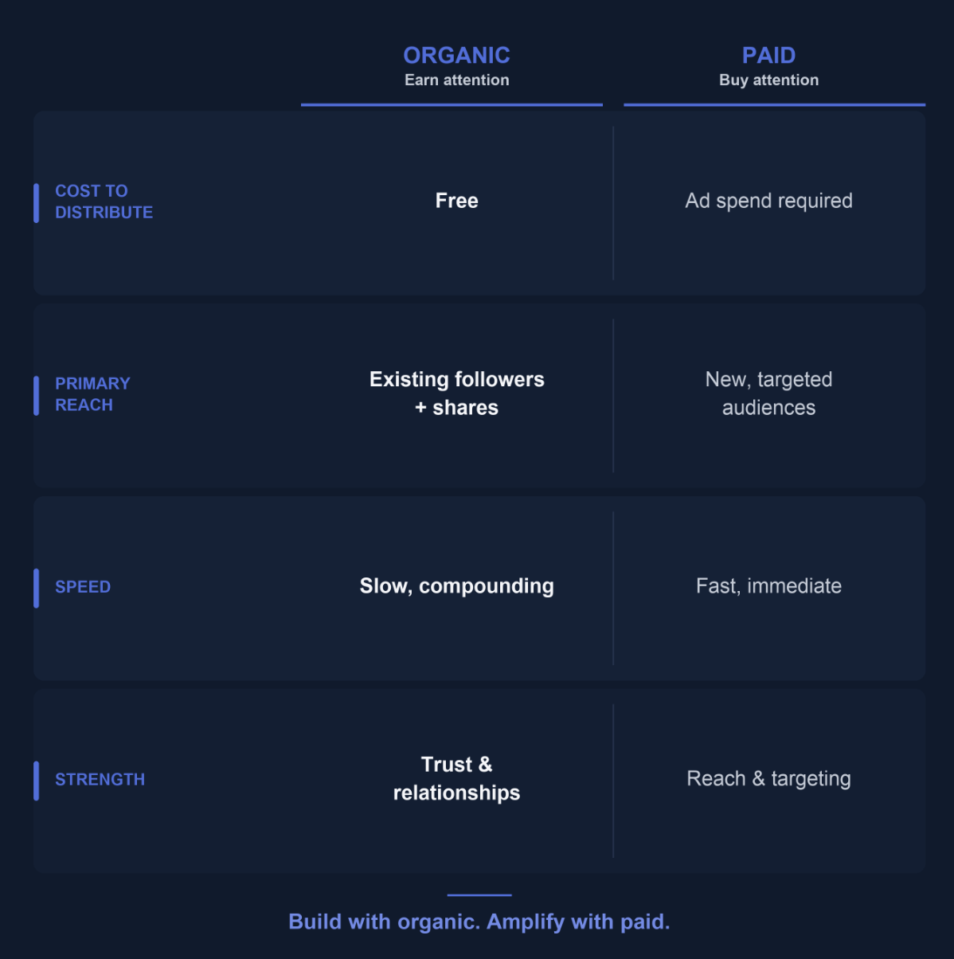
Definitions
REACHING PEOPLE
DISTRIBUTION & GROWTH
Notes:
Two plans for one audience. Organic earns attention slowly through trust and consistency. Paid buys attention fast, but it spends your money quickly. They're different games — build a plan for each.

Slide 6
TWO PLANS, ONE AUDIENCE
Organic & paid do different jobs.
ORGANIC
PAID
Earn attention.
Buy attention.
—
Build trust and reach over time
—
Amplify what already works
—
Cheap to start, slow to compound
—
Fast, but spends money quickly
—
You win with consistency and craft
—
You win with clear objectives
REACHING PEOPLE
DISTRIBUTION & GROWTH
Notes:
Two plans for one audience. Organic earns attention slowly through trust and consistency. Paid buys attention fast, but it spends your money quickly. They're different games — build a plan for each.

Slide 7
EARN ATTENTION
01
Organic
REACHING PEOPLE
DISTRIBUTION & GROWTH
Notes:
Section one: the organic plan — earning attention.

Slide 8
ORGANIC REALITY
Fewer platforms.
Pick one you can win on.
You can't be everywhere, and the pickings are thinner than they used to be. Choose the one platform where you have an unfair advantage — and go deep before you go wide.
REACHING PEOPLE
DISTRIBUTION & GROWTH
Notes:
The organic reality: there are fewer platforms worth your time, and the organic reach is thinner. Don't spread thin. Pick the one platform you can actually win on, and go deep before you go wide.

Slide 9
CREATING CONTENT
A balanced content diet.
INSPIRATION
INFORMATION
Move them.
Teach them.
Stories and moments that stir something and make people feel seen.
Genuinely useful, save-worthy content that earns your authority.
CONNECTION
CELEBRATION
Talk with them.
Honor them.
Conversations and replies — content that invites a response, not just a view.
Wins, milestones, and people — proof that something real is happening.
REACHING PEOPLE
DISTRIBUTION & GROWTH
Notes:
When you create content, keep a balanced diet across four types: Inspiration (move them), Information (teach them), Connection and conversations (talk with them), and Celebration (honor them and show wins). If you only do one, you plateau.

Slide 10
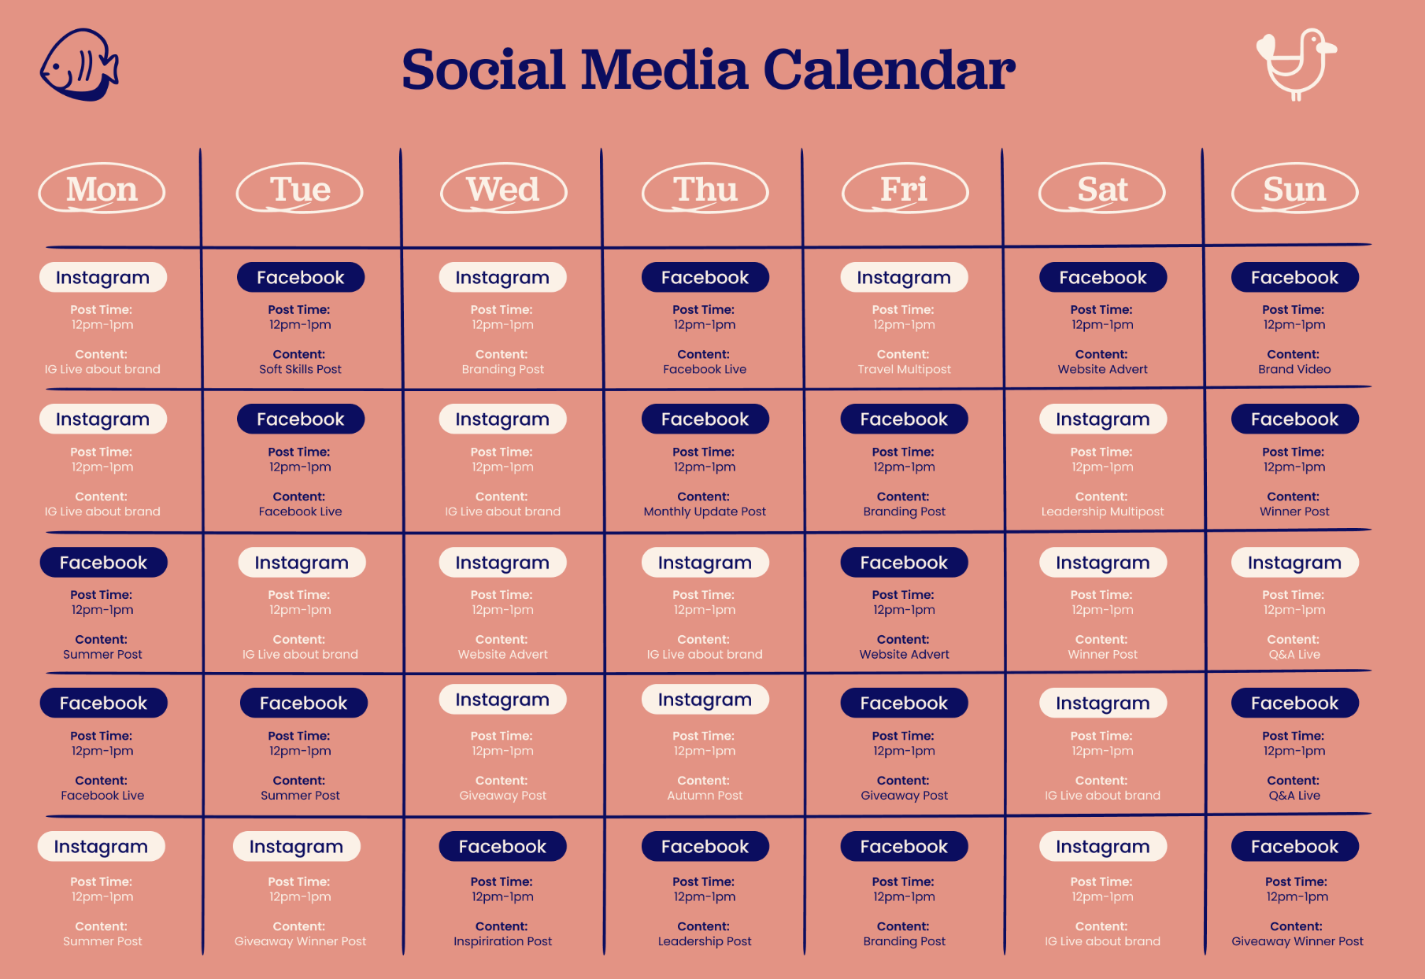
DON'T WING IT
Plan it. Then produce fast.
Map your content ahead of time so you're never posting on empty. Then use tools like Claude.ai/design and Canva to turn ideas into finished posts in minutes.
REACHING PEOPLE
DISTRIBUTION & GROWTH
Notes:
Plan your content out in advance so you're never scrambling. Then produce fast — Claude.ai/design and Canva let you go from idea to finished post in minutes instead of days.

Slide 11
FIT THE PLATFORM
Right format. Right time.
FORMAT
TIMING
Post what the platform rewards.
Post when your people are watching.
—
Match the native format each app pushes
—
Find the windows your audience is active
—
Vertical video, carousels, text — it varies
—
Consistency beats any single perfect time
—
Don't force one format everywhere
—
Let the data tell you, then commit
REACHING PEOPLE
DISTRIBUTION & GROWTH
Notes:
Two levers most people ignore: format and timing. Pick the format each platform actually rewards right now, and post when your specific audience is watching. Consistency matters more than nailing one perfect time.

Slide 12
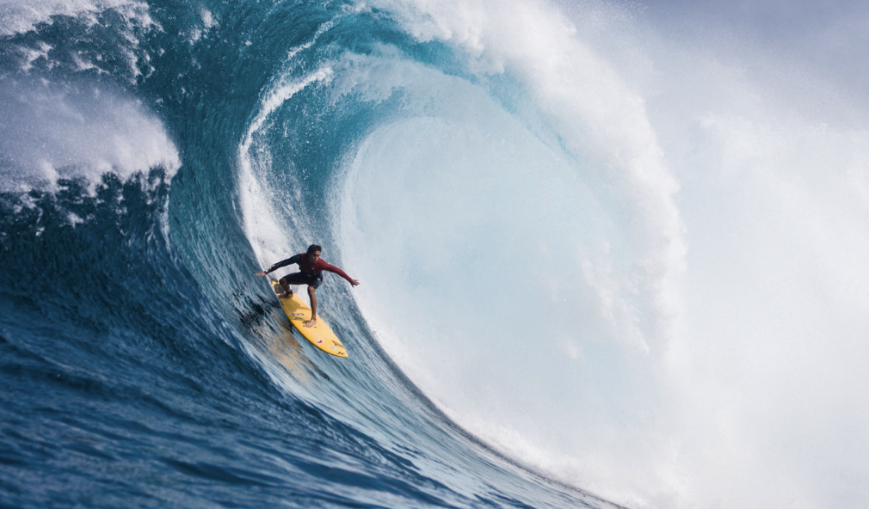
WHEN SOMETHING POPS
Ride the moment —
then pivot.
When a post starts to take off, drop everything and feed it. And when a moment is trending, pivot fast to ride it. Attention is a wave — you catch it or you miss it.
REACHING PEOPLE
DISTRIBUTION & GROWTH
Notes:
When something pops, ride it — make more of what's working while it's hot, and pivot onto trending moments fast. I'll show examples of moments where we popped. Attention is a wave; you catch it or you miss it.

Slide 13
LEARN BY DOING
30 days
of posting a video every single day.
I ran a 30-day video experiment to learn the algorithm by doing — not theorizing. Then I evaluated monthly: double down on what worked, cut what didn't.
REACHING PEOPLE
DISTRIBUTION & GROWTH
Notes:
I did a 30-day video posting experiment — a video every day for a month — to learn by doing instead of theorizing. The real discipline is the monthly evaluation: look at what's working, double down on it, and cut what isn't.

Slide 14
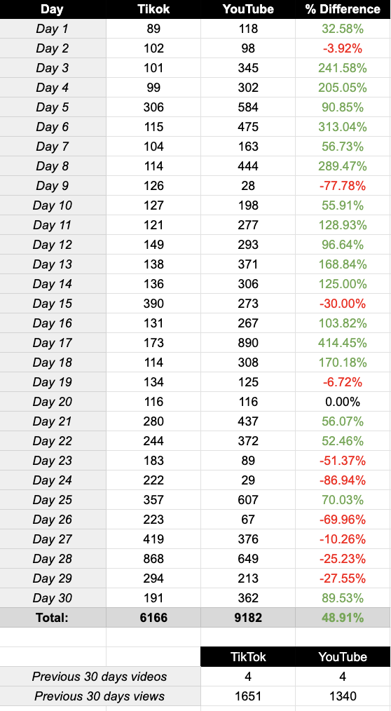
Recap
REACHING PEOPLE
DISTRIBUTION & GROWTH
Notes:
I did a 30-day video posting experiment — a video every day for a month — to learn by doing instead of theorizing. The real discipline is the monthly evaluation: look at what's working, double down on it, and cut what isn't.

Slide 15
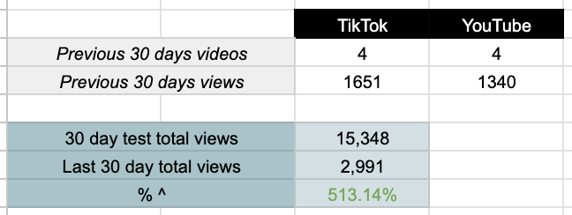
Recap
Post more?
REACHING PEOPLE
DISTRIBUTION & GROWTH
Notes:
I did a 30-day video posting experiment — a video every day for a month — to learn by doing instead of theorizing. The real discipline is the monthly evaluation: look at what's working, double down on it, and cut what isn't.

Slide 16
BUY ATTENTION
02
Paid
REACHING PEOPLE
DISTRIBUTION & GROWTH
Notes:
Section two: the paid plan — buying attention.

Slide 17
FIRST RULE OF PAID
Paid spends your money —
fast.
Connect every dollar to an org objective before you launch.
Spend like it's your own money.
REACHING PEOPLE
DISTRIBUTION & GROWTH
Notes:
First rule of paid: the platforms will spend your money fast. So connect every dollar to a real organizational objective before you launch. Spend like it's coming out of your own pocket.

Slide 18
Warning
Don’t spend until you know
it works organically.
Don’t just spend to get more views, PLEASE!
REACHING PEOPLE
DISTRIBUTION & GROWTH
Notes:
First rule of paid: the platforms will spend your money fast. So connect every dollar to a real organizational objective before you launch. Spend like it's coming out of your own pocket.

Slide 19
PAID · THE MENU
Five kinds of ads.
01
Search / Discover
02
Views
03
Traffic
04
Follows / Likes / Subscribers
05
Messages
REACHING PEOPLE
DISTRIBUTION & GROWTH
Notes:
There are basically five kinds of ads you'll run: search/discover, views, traffic, follows-likes-and-subscribers, and messages. Each one is optimizing for something different.

Slide 20
WHAT YOU'RE REALLY PAYING FOR
Match the ad to the objective.
Views / Search
→
Reach
Follows / Likes
→
Clout
Traffic
→
Clicks
Messages
→
Conversations
REACHING PEOPLE
DISTRIBUTION & GROWTH
Notes:
Here's what each ad type is really buying you: views and search buy reach; follows and likes buy clout; traffic buys clicks; messages buy conversations. Pick based on what you actually need right now.

Slide 21
DECIDE FIRST
What are you trying to do?
Pick the objective first — then the ad type follows. Chasing every metric at once wastes budget. One clear goal per campaign.
REACHING PEOPLE
DISTRIBUTION & GROWTH
Notes:
Before you build an ad, answer one question: what are you trying to do? Pick the objective first and the ad type follows. One clear goal per campaign — don't chase reach, clicks, and conversations all at once.

Slide 22
HOW TO ALLOCATE
Slow drip.
Then turn it up.
Start small to find what works. Then scale the winners. Keep most of your budget on your core objective — reserve a little to keep testing new things.
REACHING PEOPLE
DISTRIBUTION & GROWTH
Notes:
On allocation: slow-drip spend up front while you learn, then turn it up on the winners. Keep the majority of budget on your core objective, and reserve a small slice to keep testing new angles.

Slide 23

A FAVORITE PLAY
The Messenger ad can be
supercharged with AI.
Conversational ads that start a real back-and-forth. Use AI to draft the opener, personalize replies, and respond instantly at scale.
REACHING PEOPLE
DISTRIBUTION & GROWTH
Notes:
One of my favorite plays: the Messenger-type ad, which starts an actual conversation instead of just a click. Use AI to write the opener, personalize responses, and reply instantly at scale. Let's walk through building one and look at real examples of ads that worked.

Slide 24
Reach the right people —
on purpose.
THANK YOU
REACHING PEOPLE
DISTRIBUTION & GROWTH
Notes:
Bringing it home: stop the scroll, know your person, earn attention organically and buy it wisely — and spend like it's your own dollars. Reach the right people, on purpose. Thank you.

