Slide 1
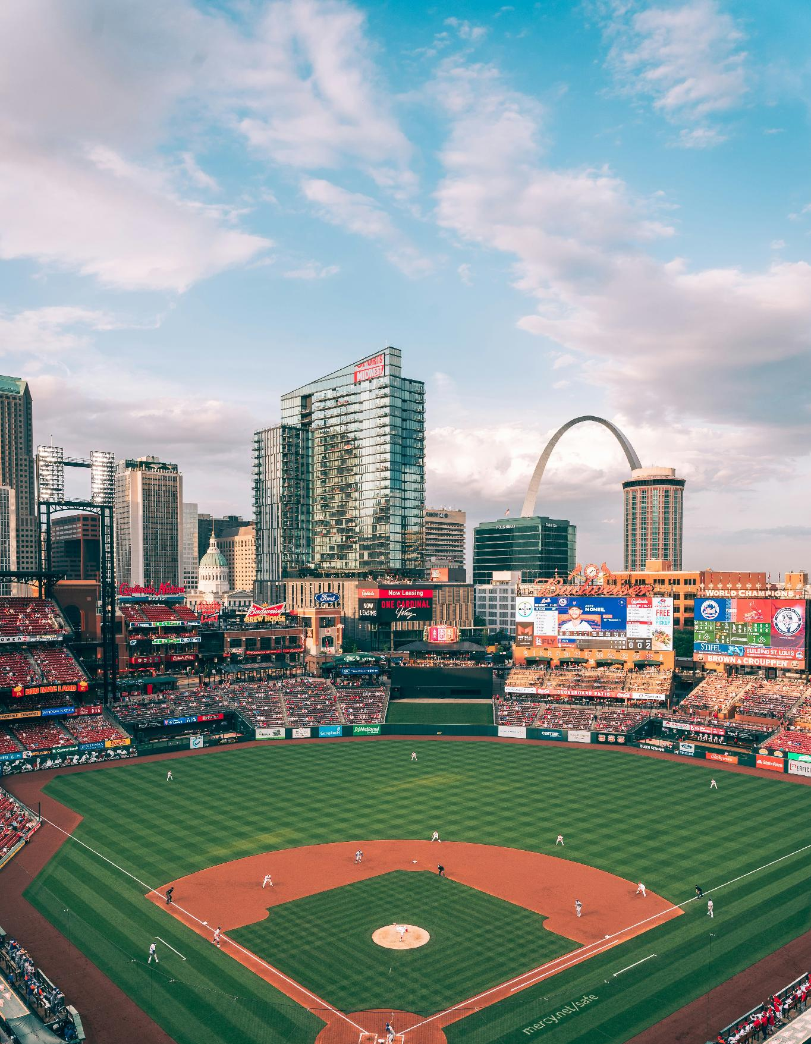

MII AUSTRALIA · 2026 COHORT
AI
AGENTS
The Biggest Shift in The Way We Work
NATCHI LAZARUS · MEDIA IMPACT INTERNATIONAL
Notes:
Welcome. Frame the two days as the entry point to the full MII partnership.

Slide 2

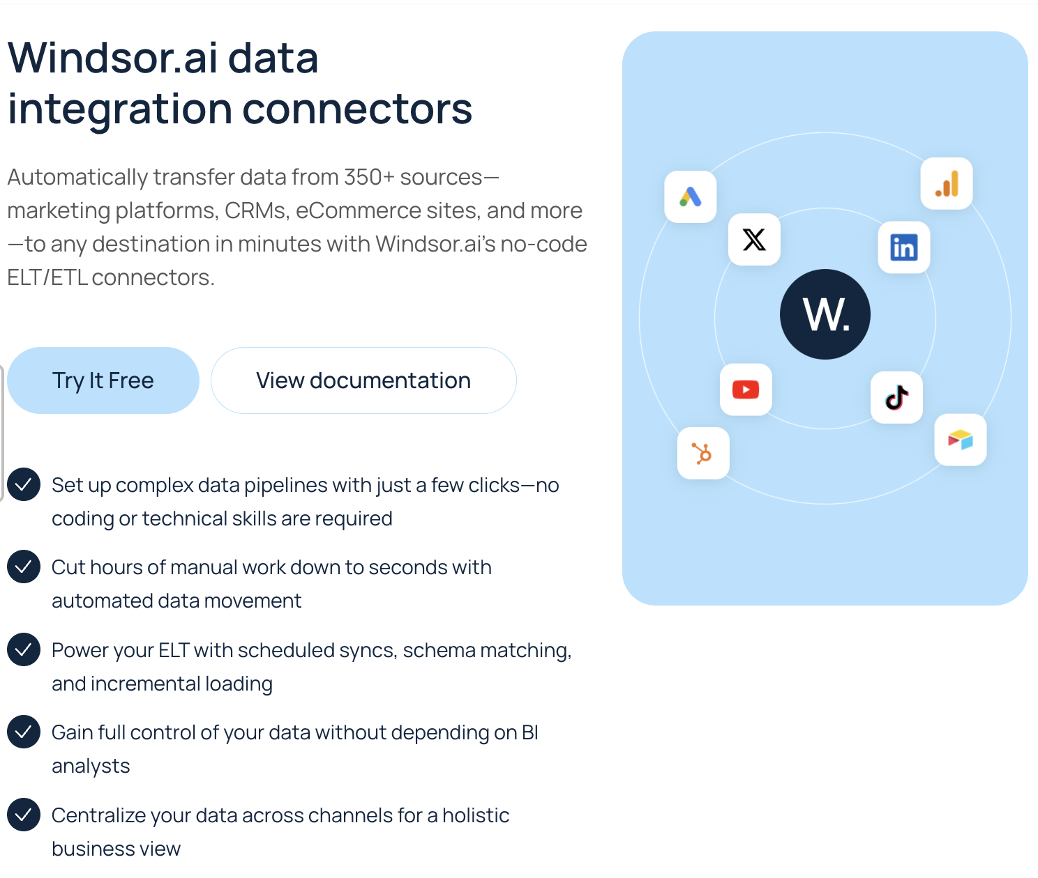

Slide 3
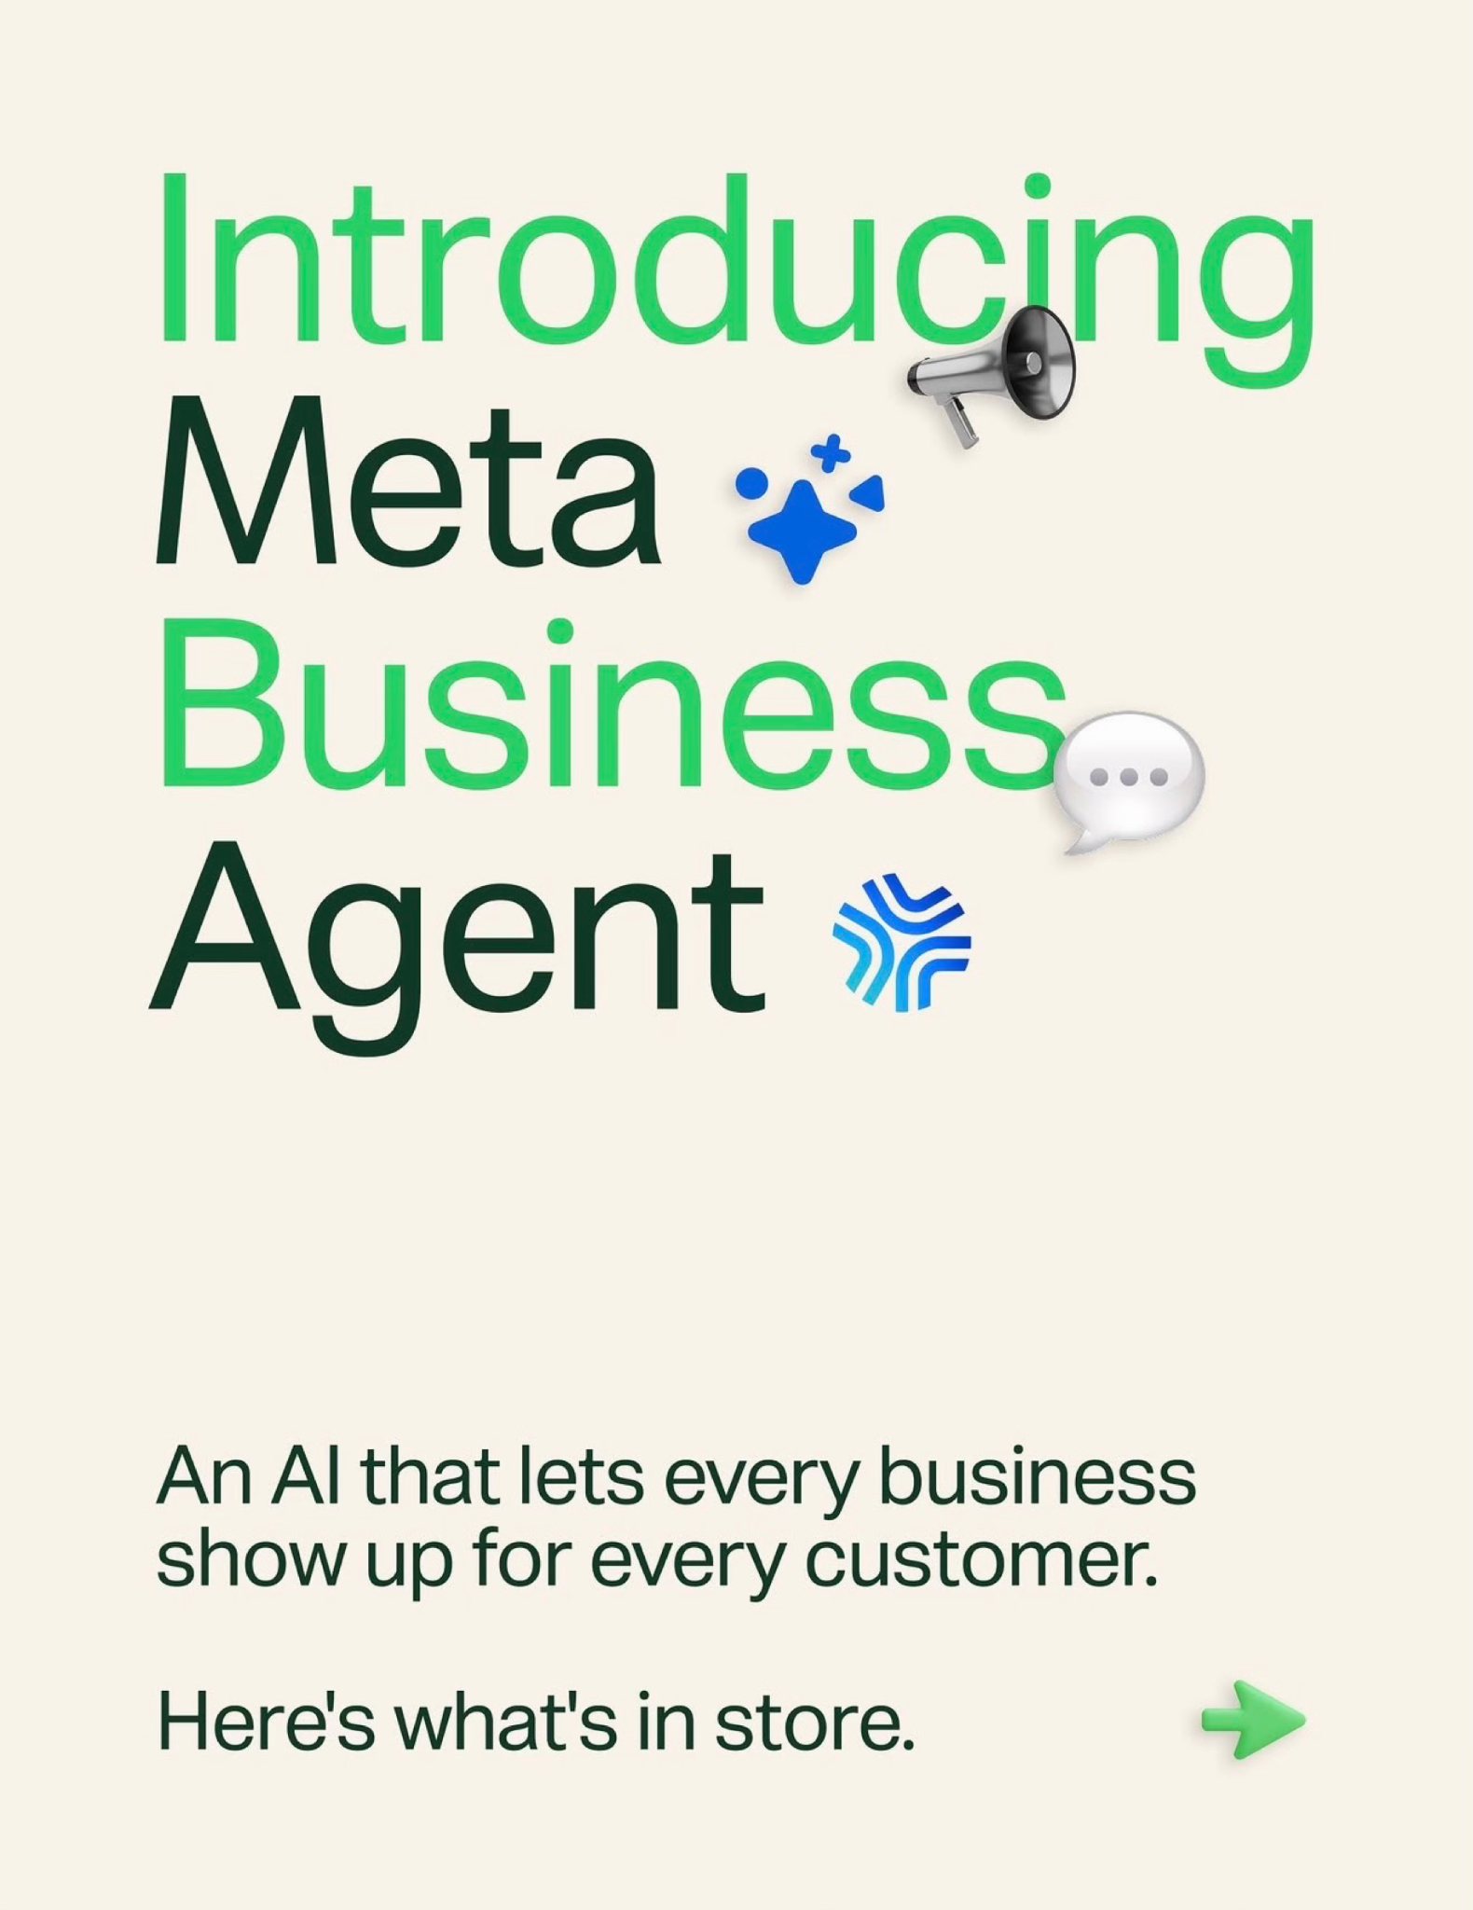

Slide 4
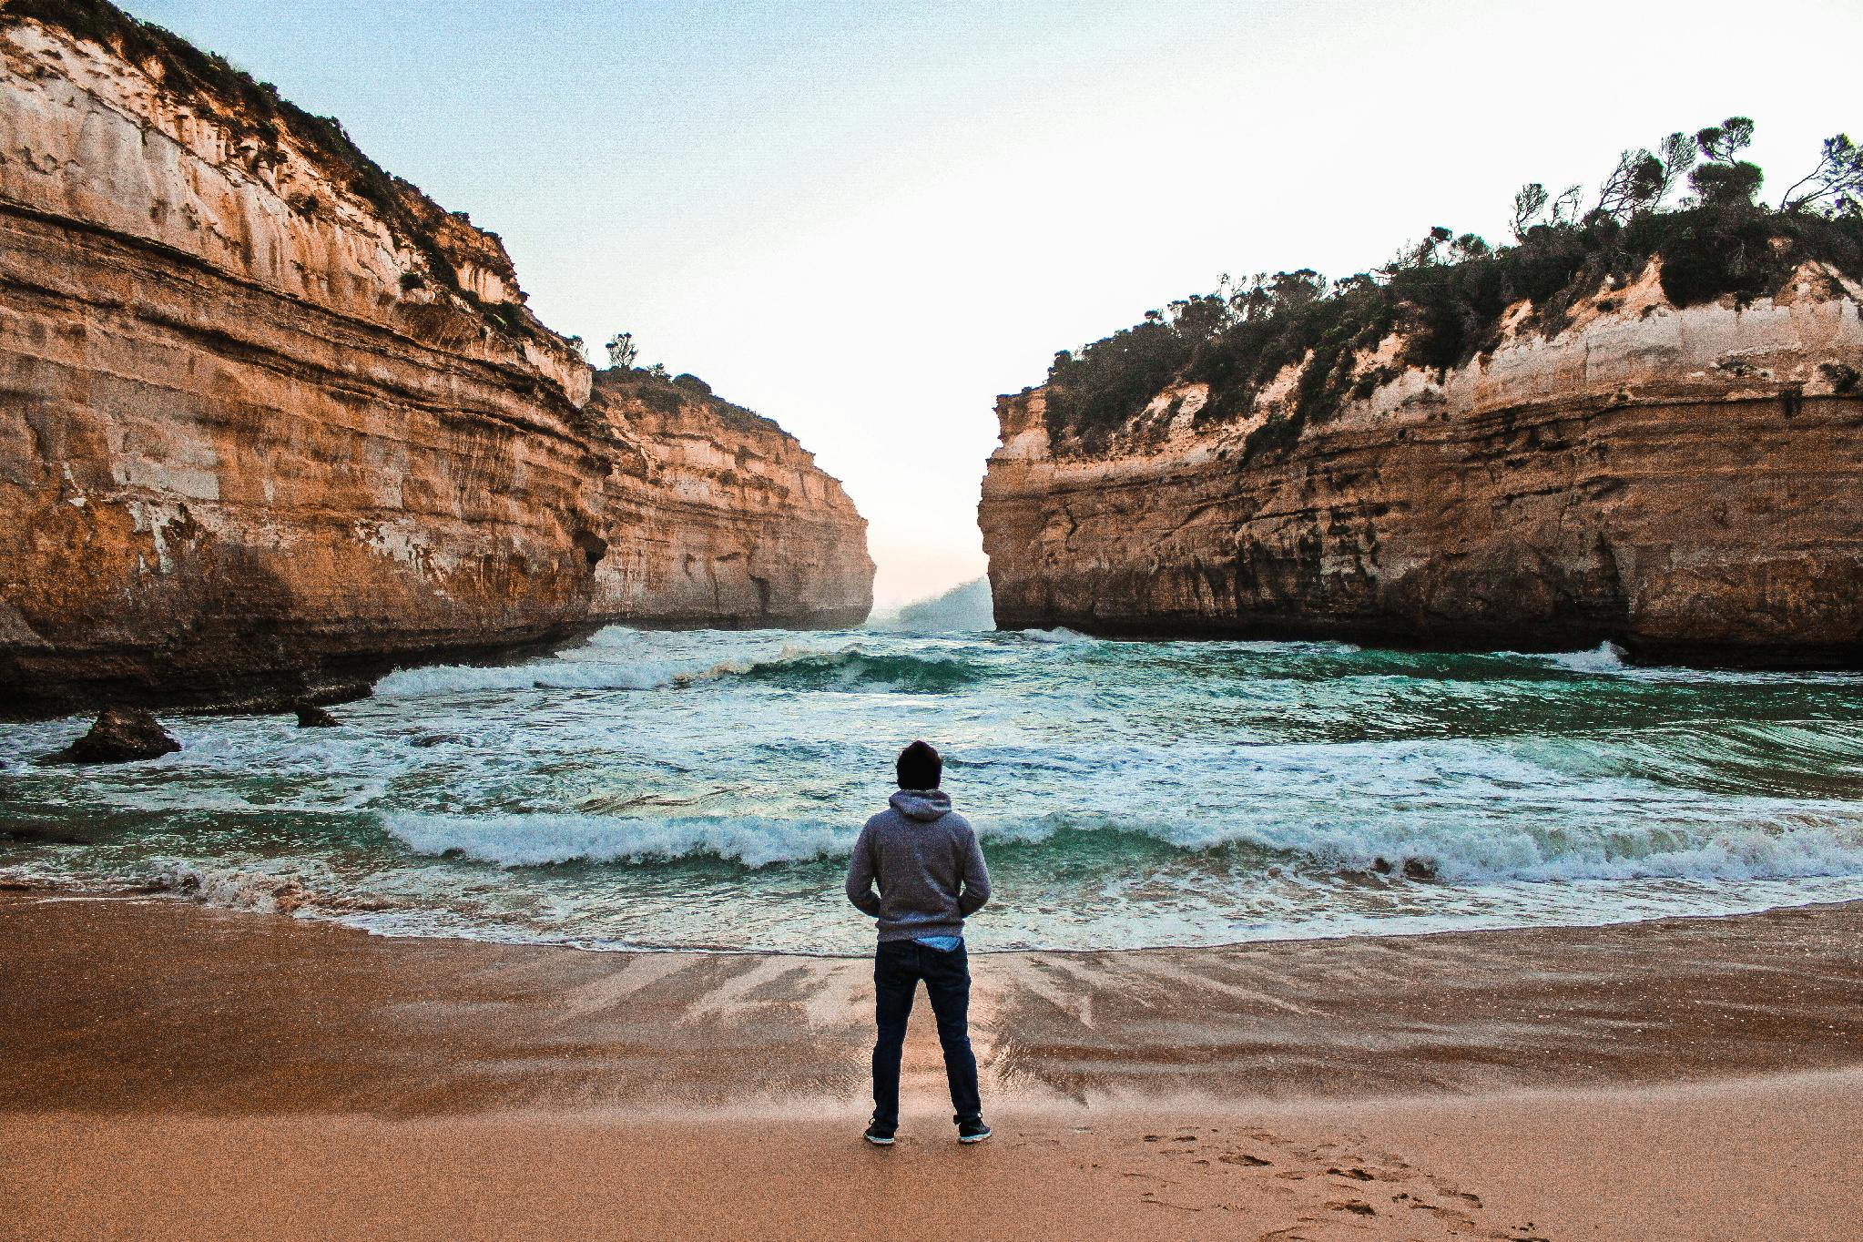
AGENTIC
AI
Notes:
Welcome. Frame the two days as the entry point to the full MII partnership.

Slide 5
I
RESOURCES
2
TIME
3
SKILLS

Slide 6
AI
AGENTS
Notes:
Welcome. Frame the two days as the entry point to the full MII partnership.

Slide 7


Slide 8


Slide 9
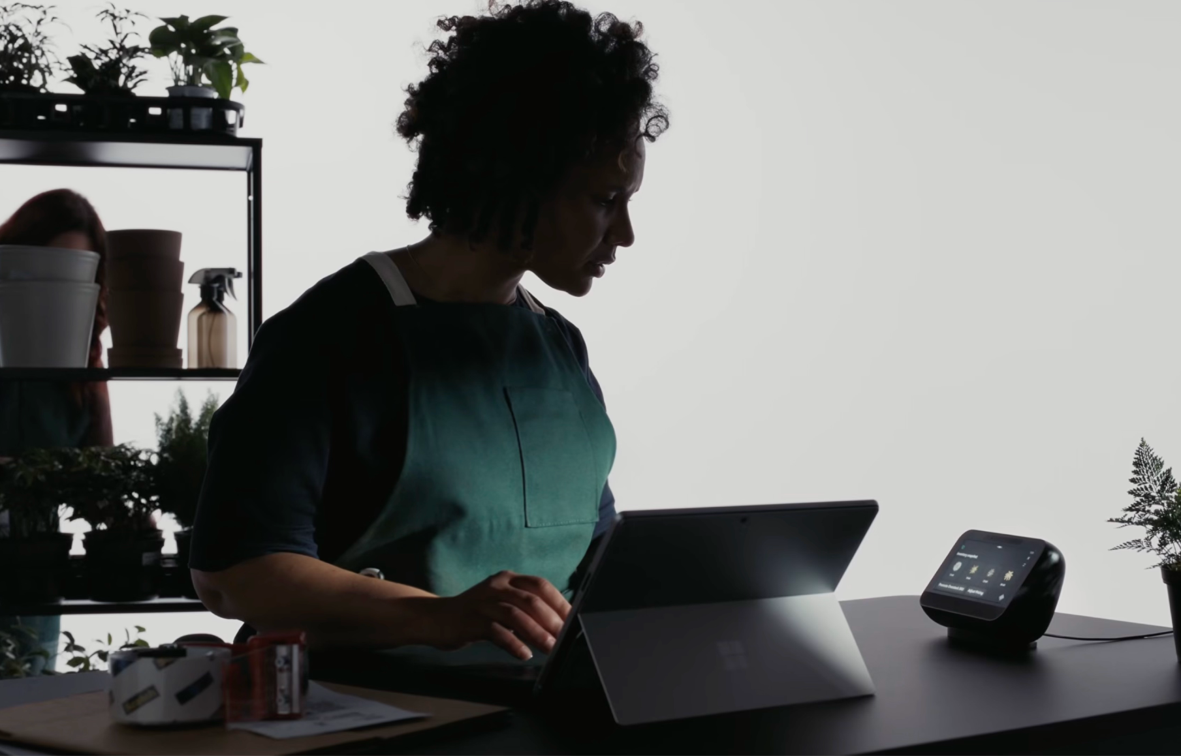

Slide 10
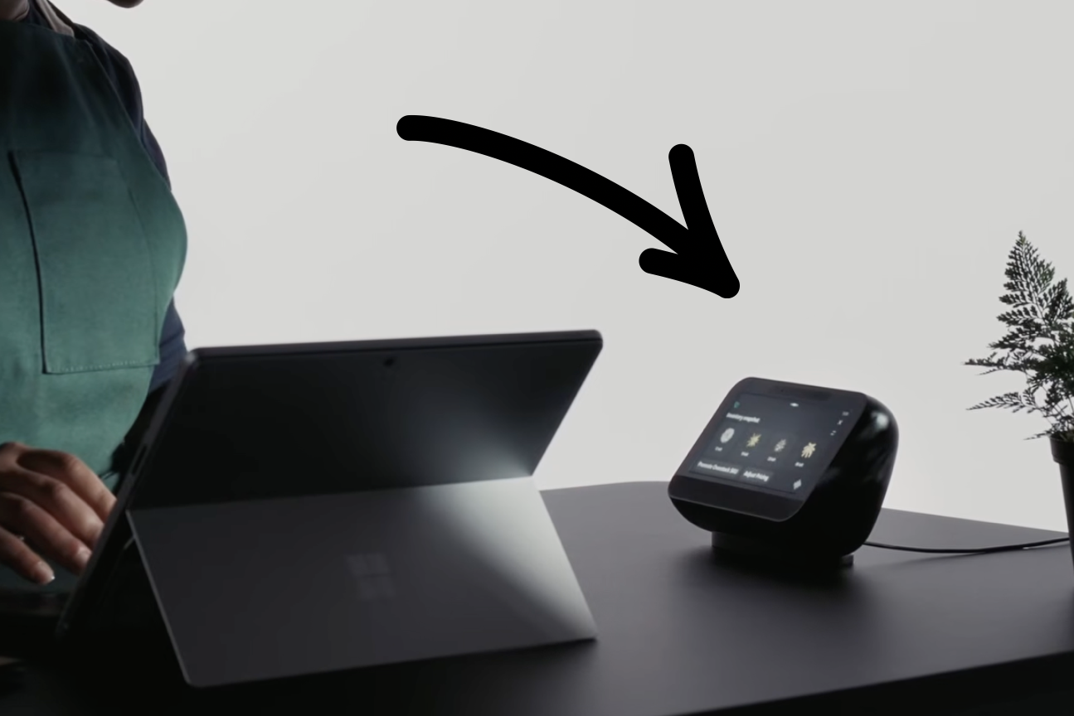

Slide 11
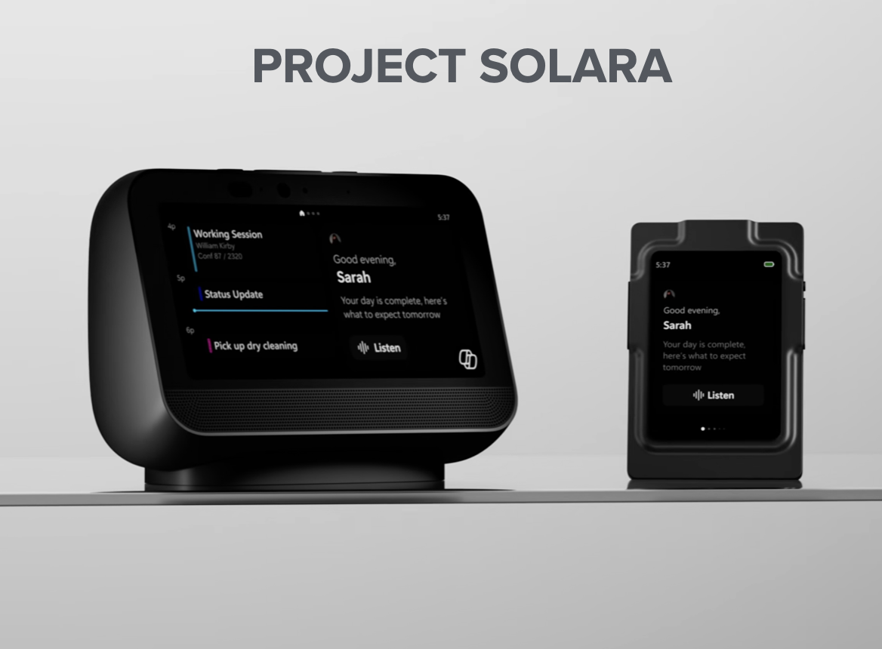

Slide 12
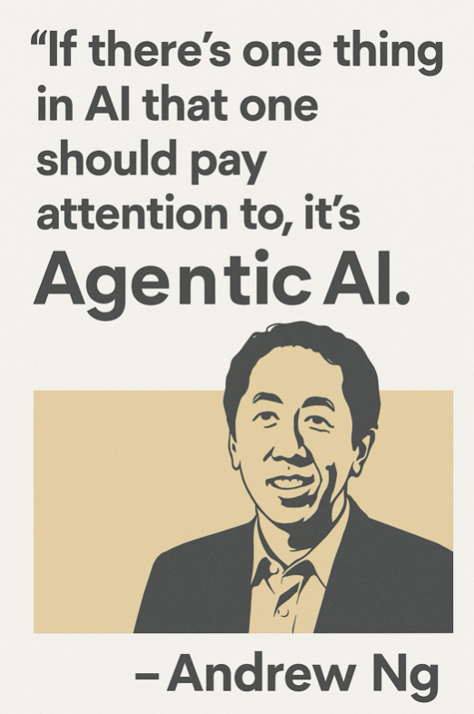

Slide 13
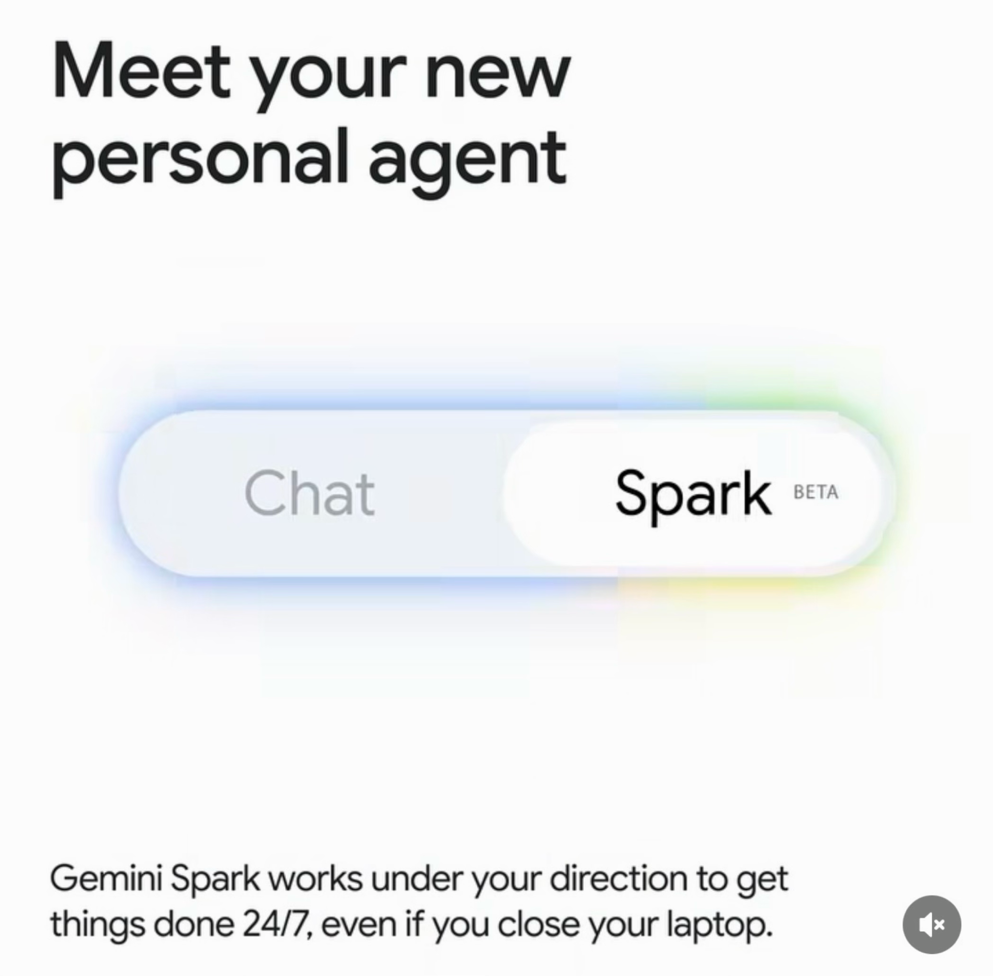

Slide 14
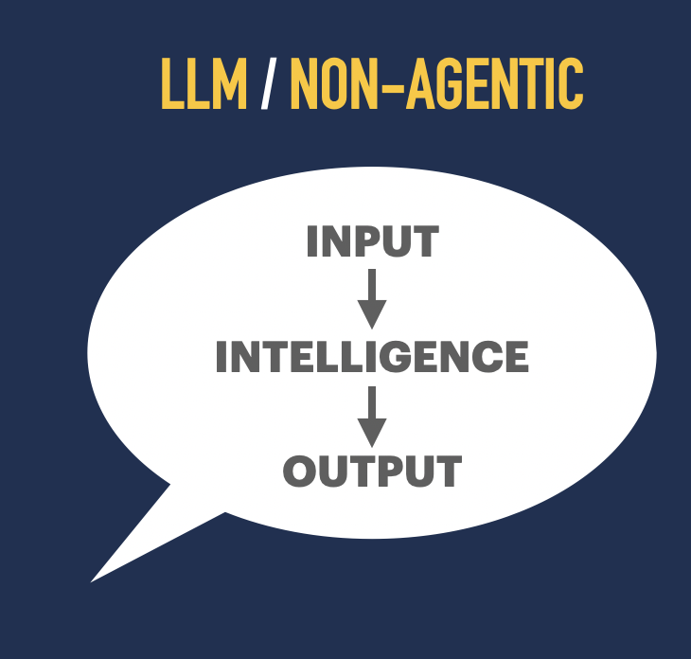
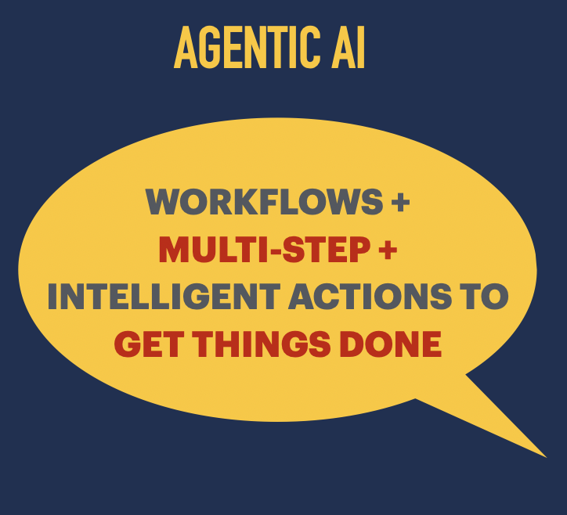

Slide 15
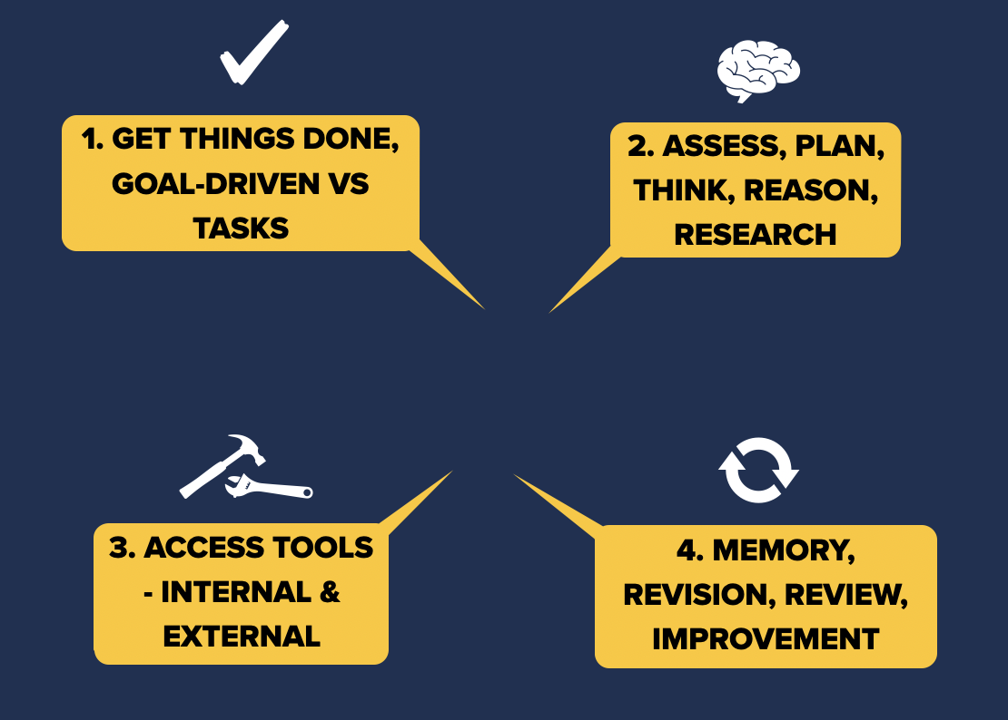

Slide 16
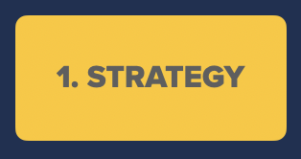
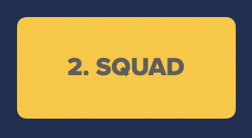
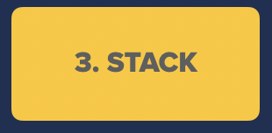

Slide 17
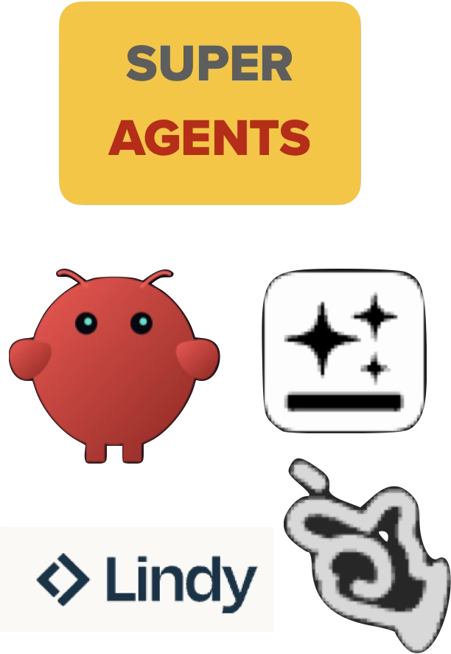

Slide 18
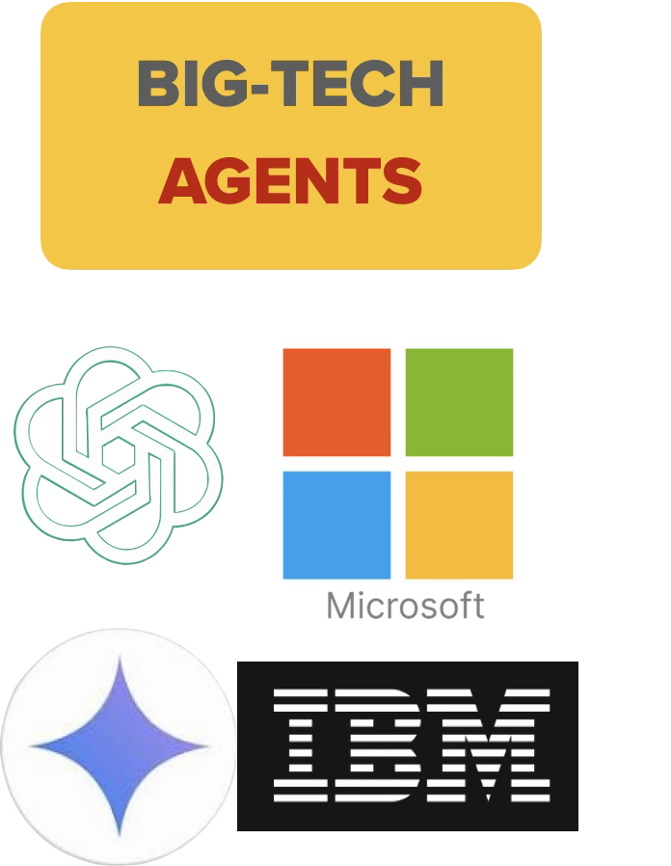

Slide 19
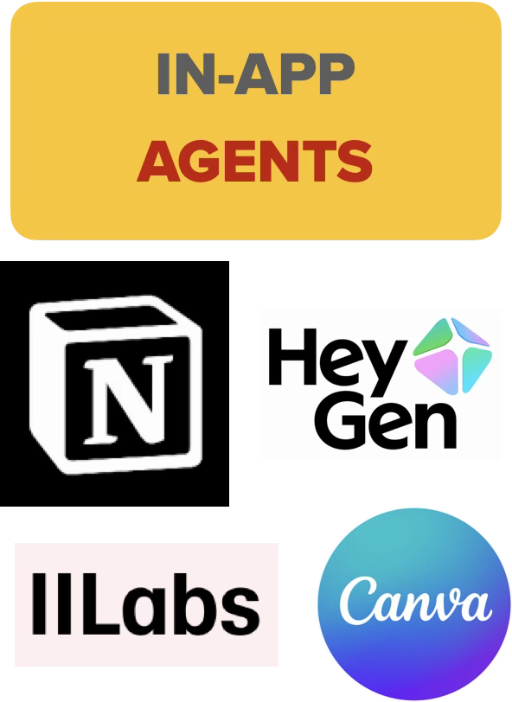

Slide 20




Slide 21
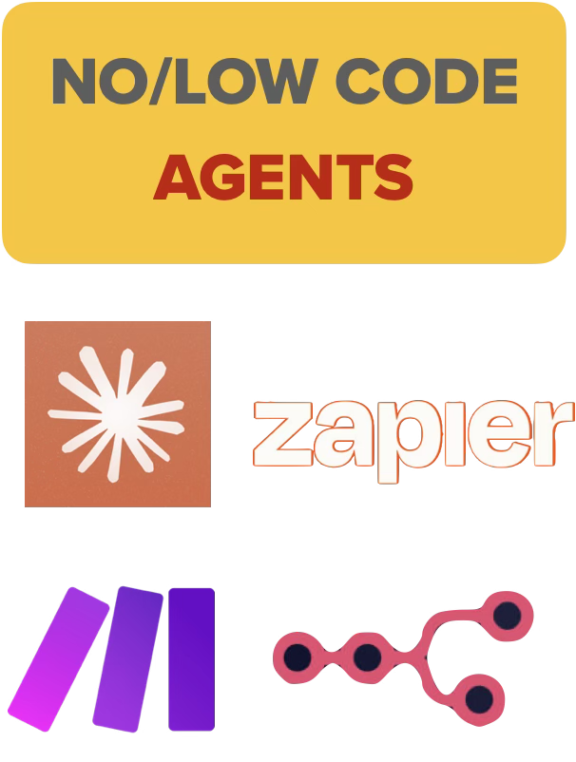

Slide 22


Slide 24
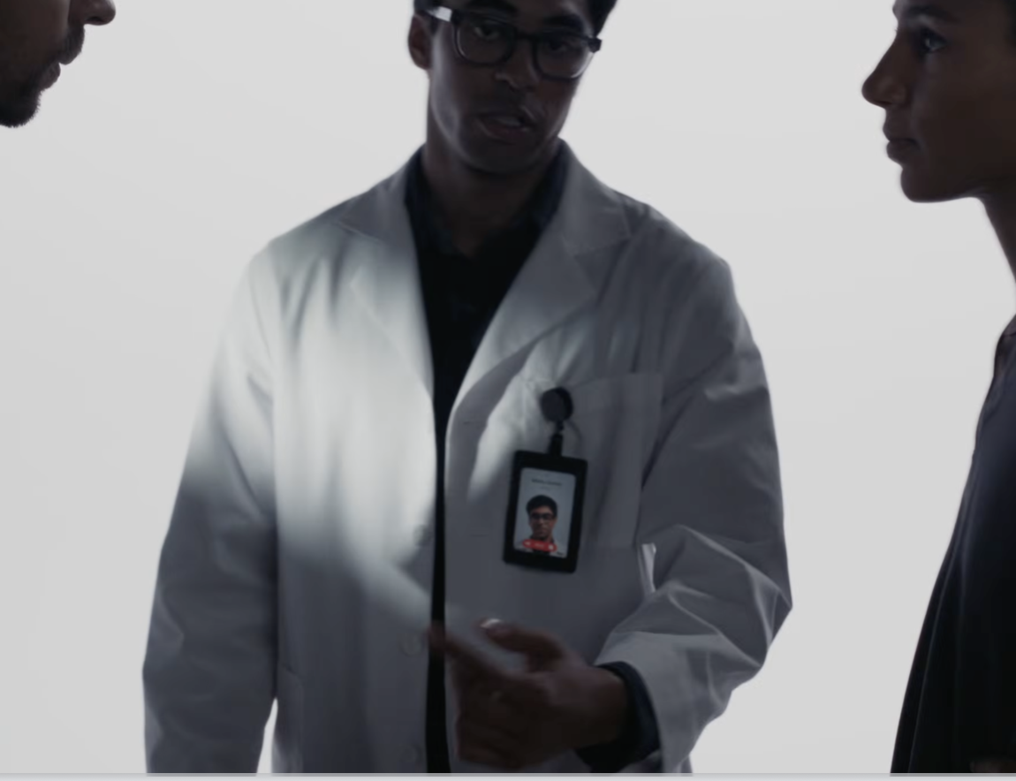

Slide 25
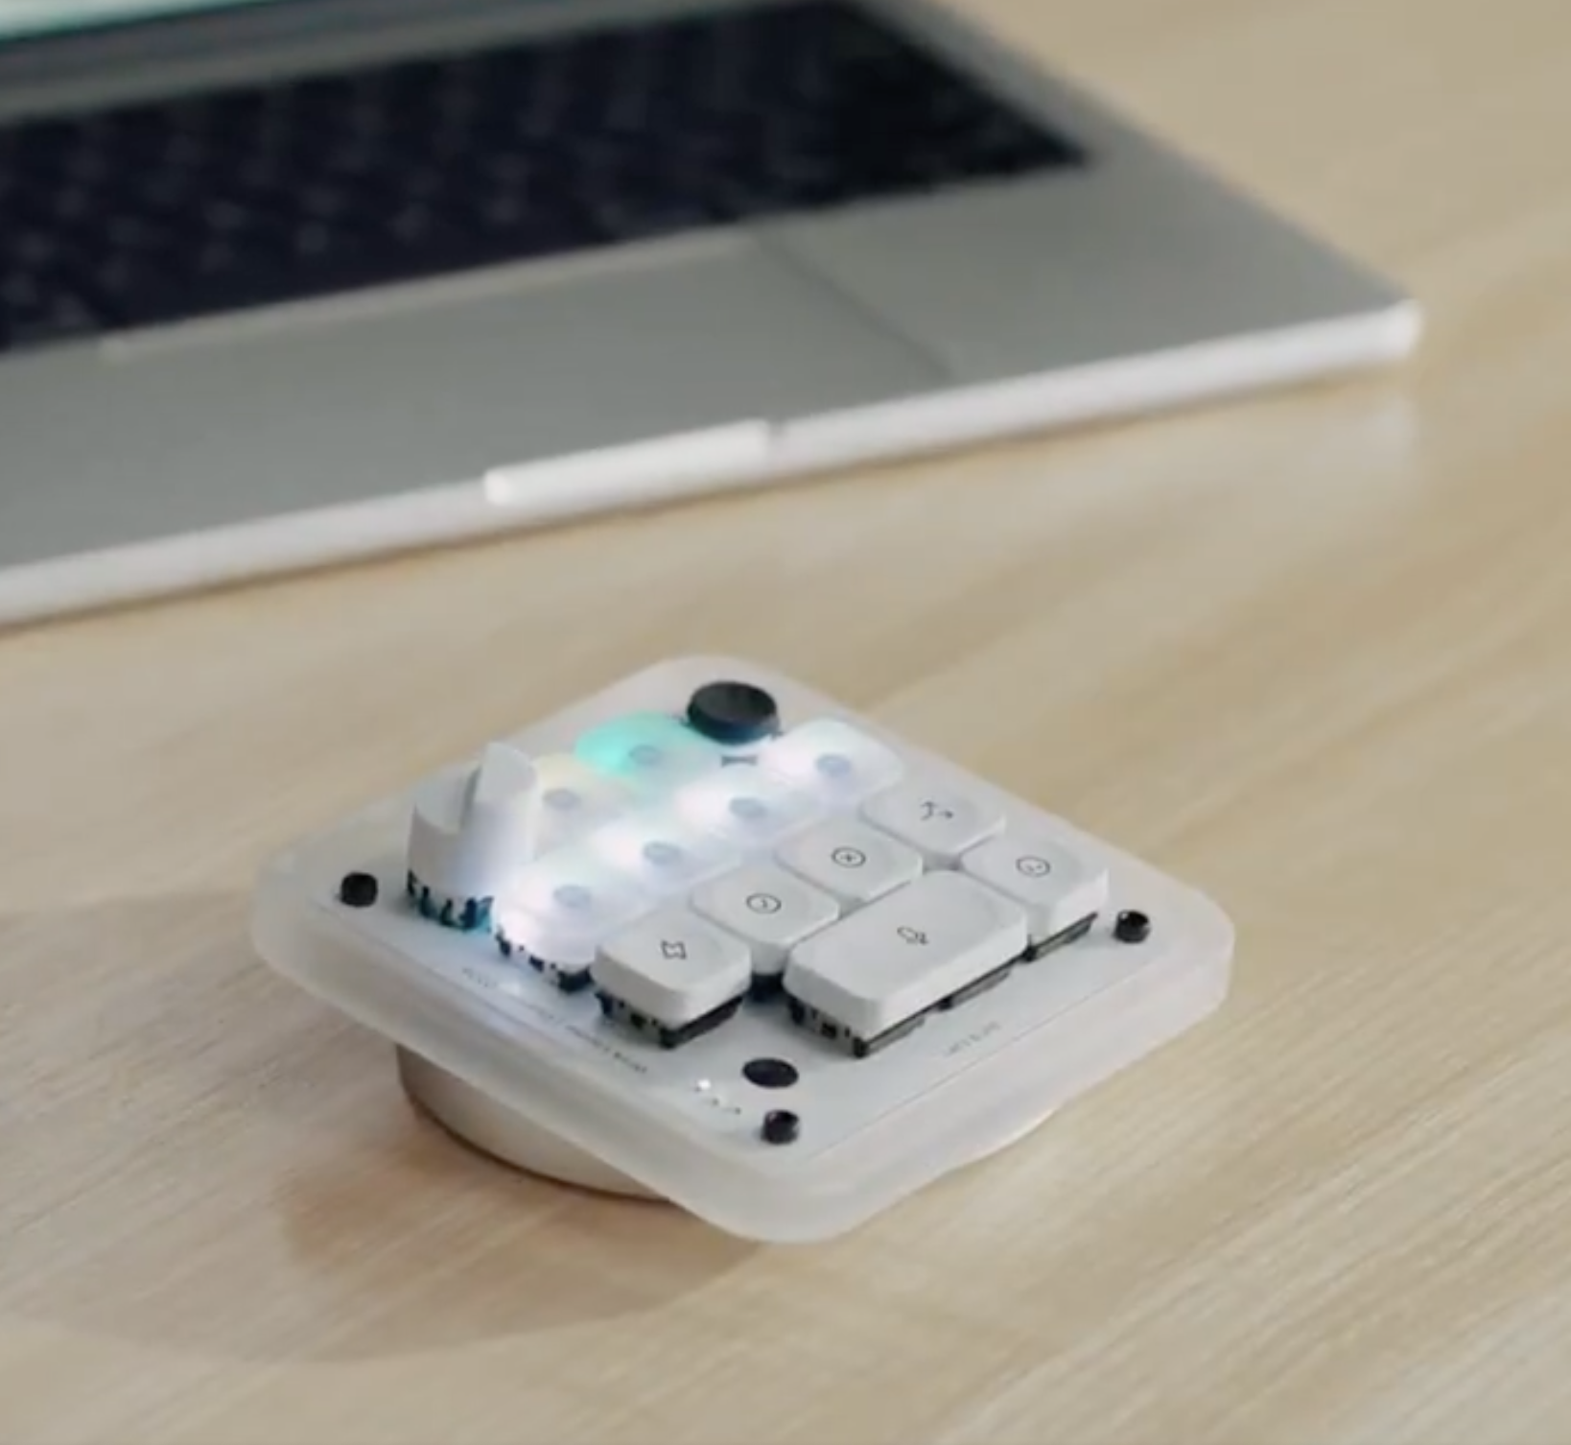

Slide 26
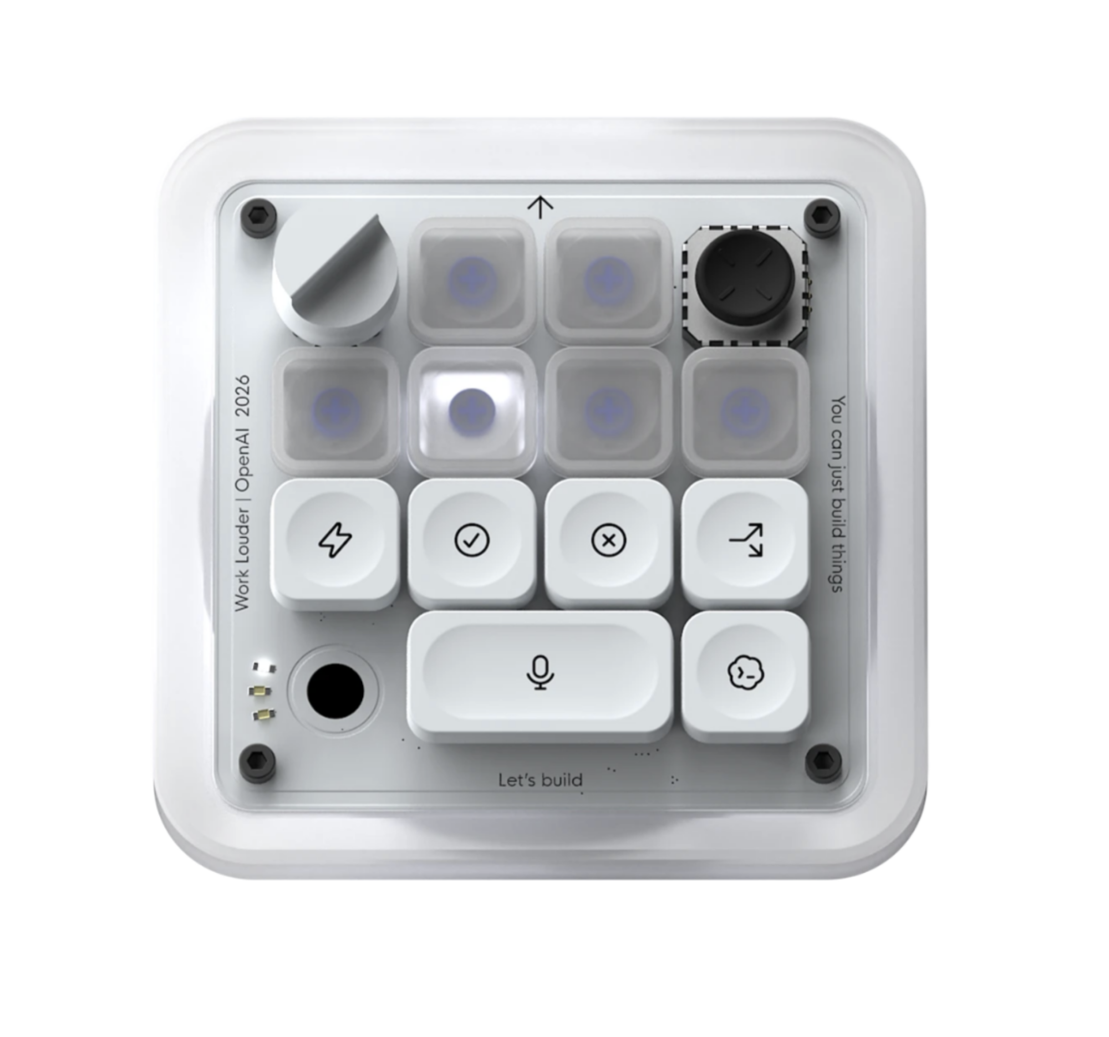

Slide 27
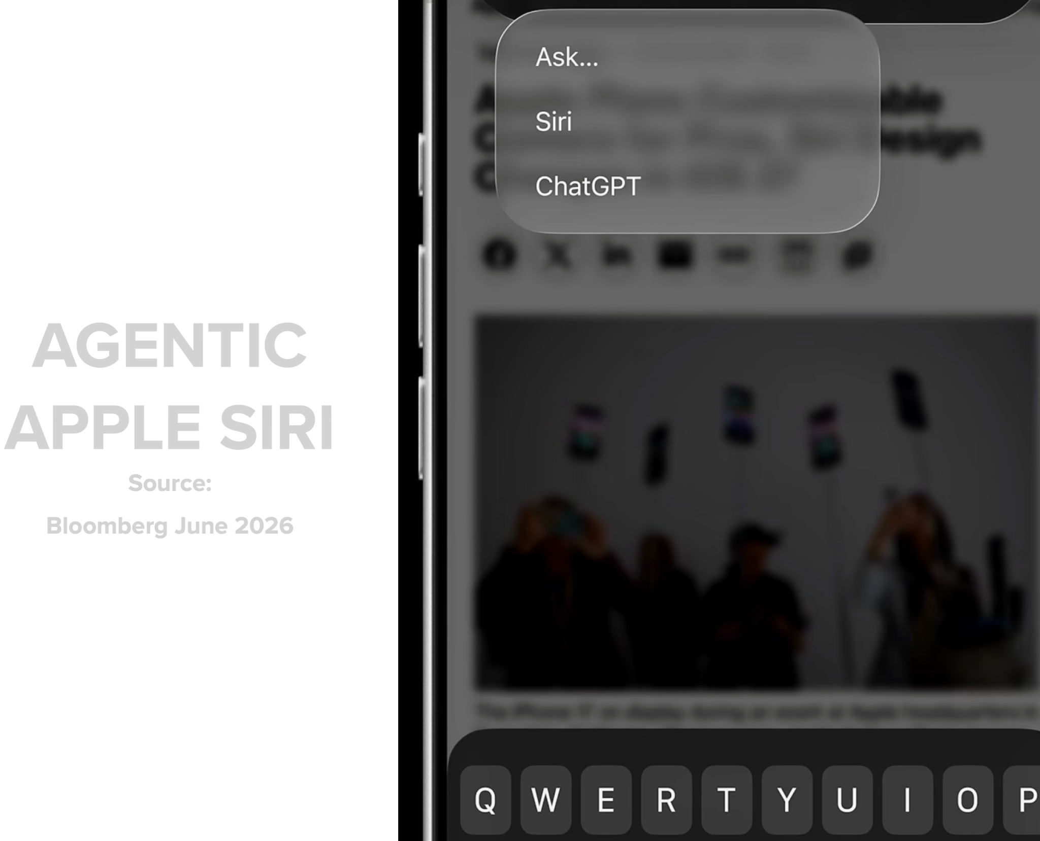

Slide 28
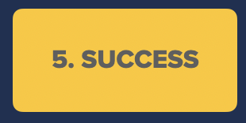
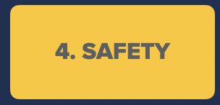
START HERE

Slide 29




Slide 30
MII AUSTRALIA · 2026 COHORT
AI
AGENTS
The Biggest Shift in The Way We Work
NATCHI LAZARUS · MEDIA IMPACT INTERNATIONAL
Notes:
Welcome. Frame the two days as the entry point to the full MII partnership.

Slide 31
MII AUSTRALIA · 2026 COHORT
QUESTIONS?
AI
AGENTS
The Biggest Shift in The Way We Work
NATCHI LAZARUS · MEDIA IMPACT INTERNATIONAL
Notes:
Welcome. Frame the two days as the entry point to the full MII partnership.

