Slide 1

DIGITAL MINISTRY · & ONLINE GROUPS
Creating a
4th Space & online groups
Where people gather, create, and connect — beyond geography and time zones.
THE 4TH SPACE
& ONLINE GROUPS
Notes:
Creating a 4th Space, and online groups. This is about building a digital place where your people gather — and about the online groups that turn watchers into a connected community.

Slide 2
A WAY TO THINK ABOUT DIGITAL
The four S's of digital.
STREAMING
STRENGTHENING
Large gatherings
Small & personal
Your weekend service and the big online moments everyone tunes into.
Small groups, one-on-ones, and self-guided next steps.
SOCIAL
SYSTEMS
Community spaces
The plumbing
The places people gather, post, and talk between the gatherings.
The internal and external tools that make all of it actually run.
THE 4TH SPACE
& ONLINE GROUPS
Notes:
A simple framework — the four S's of digital. Streaming: large gatherings. Strengthening: small gatherings, one-on-one, and self-guided. Social: community spaces. Systems: internal and external systems. Most churches over-invest in one and neglect the others.

Slide 3
AN HONEST AUDIT
?
How would you rate
your digital S's?
Score each one, one to ten — Streaming, Strengthening, Social, Systems. Your lowest number is your next focus. Today we're going deep on the two most neglected: Social and Strengthening.
THE 4TH SPACE
& ONLINE GROUPS
Notes:
Take a second and rate yourself: how would you rate your digital S's — Streaming, Strengthening, Social, and Systems — on a scale of one to ten? Your lowest score is where to focus next. Today we'll dig into Social (your 4th space) and Strengthening (online groups).

Slide 4
WHERE PEOPLE GATHER
We all live in four spaces.
01
First space — Home
Where you live and rest.
02
Second space — Work or school
Where you spend your days.
03
Third space — A community spot
The coffee shop, church, or park where people gather.
04
Fourth space — Digital
Where people gather, create, and connect — no matter where they are.
Notes:
Sociologists talk about spaces. First space is your home. Second space is work or school. Third space is a community gathering spot — a coffee shop, a church, a park. The fourth space is new: a digital space where people gather, create, and connect, unrestricted by geography or time zones.

Slide 5
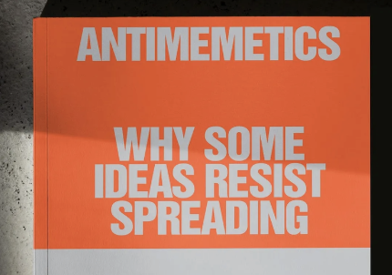
THE BIG IDEA
The 4th Space.
A digital place where your people gather, create, and connect — unrestricted by geography or time zone. Not a broadcast. A room they can walk into any time.
THE 4TH SPACE
& ONLINE GROUPS
Notes:
The fourth space is a digital space where people gather, create, and connect, unrestricted by geography or time zones. It's not a broadcast you watch — it's a room your people can walk into any time.

Slide 6

THE QUESTION THAT MATTERS
?
What is your 4th space?
Most churches have a streaming plan but no gathering place. Where do your people actually hang out, talk, and belong between weekends?
THE 4TH SPACE
& ONLINE GROUPS
Notes:
So here's the question that matters: what is your 4th space? Most churches have a way to stream but no digital place for people to actually gather and belong between weekends. Where do your people connect?

Slide 7
WHERE YOU COULD BUILD IT
Platform options.
—
WhatsApp
—
Discord
Ubiquitous and simple — ideal for smaller, tight-knit groups.
Channels and voice — great for younger, always-on communities.
—
Slack
—
Mighty Networks
Familiar and organized — threaded conversations by topic.
A branded, all-in-one community home you control.
—
YouTube Communities?
—
Signal / Telegram
Meet people right where they're already watching.
Private, fast messaging for tighter circles.
The best platform is the one your people already open.
THE 4TH SPACE
& ONLINE GROUPS
Notes:
There are lots of platform options: WhatsApp, Discord, Slack, Mighty Networks, YouTube Communities, Signal or Telegram — and newer ones like the Apollos app. Don't overthink it. The best platform is the one your people already open every day.

Slide 8
PICK THE RIGHT SHAPE
Under 50, or over 50?
MESSAGE SPACES · UNDER 50
FEED SPACES · 50+
A group chat.
A community feed.
—
Everyone sees every message
—
Posts, topics, and threads
—
Feels personal and high-trust
—
Scales without overwhelming people
—
WhatsApp, Signal, a text thread
—
Discord, Slack, Mighty Networks
THE 4TH SPACE
& ONLINE GROUPS
Notes:
One practical rule: size changes the shape. Under about fifty people, a message space — a group chat where everyone sees everything — works best and feels personal. Over fifty, you want a feed-type space with posts and topics so people aren't buried in notifications.

Slide 9
YOUR TURN
?
Do you have a 4th
space yet?
If not — what's one you could try in the next 30 days? Pick a platform, invite ten people, and start a single conversation. That's the whole first step.
THE 4TH SPACE
& ONLINE GROUPS
Notes:
So — do you have any 4th spaces? And what ideas could you try out in the next 30 days? Start small: pick a platform, invite ten people, and start one conversation. That's the whole first step.

Slide 10
STRENGTHENING
02
Online Groups
THE 4TH SPACE
& ONLINE GROUPS
Notes:
That's the Social S — your 4th space. Now the Strengthening S: online groups.

Slide 11
WHY THEY MATTER
Why online groups are gold.
01
A front door
Often the very first step someone takes at your church.
02
A safe taste
A low-risk way to reach people who are hurting.
03
No more excuses
Nobody can say they can't get to a group.
04
A launchpad
They help start more face-to-face small groups.
Notes:
Why are online groups so valuable? They're often the first step for people at your church — a front door. They're a way to reach people who are hurting and give them a safe taste of your church. They remove every excuse for not being in a group. And they help launch more face-to-face small groups.

Slide 12
THE STRATEGY
On-demand, or in real time.
Groups can watch a study individually on their own time, or together live. People are opinionated about technology — and that's okay. Meet them where they're comfortable.
THE 4TH SPACE
& ONLINE GROUPS
Notes:
A strategy note on video: groups can watch a study on-demand individually, or in real time together. And people are opinionated about technology — that's okay. Don't fight it; meet them where they're comfortable.

Slide 13

MEET THEM WHERE THEY'RE COMFORTABLE
Move people up the ladder.
Text→ Audio→ Video→ Face-to-face
Each step is a little more vulnerable — and a little more connected. Start wherever someone is willing, and gently move up.
THE 4TH SPACE
& ONLINE GROUPS
Notes:
There's a natural progression of connection: text, then audio, then video, then face-to-face. Each step is more vulnerable and more connected than the last. Start wherever a person is willing, and gently help them move up the ladder over time.

Slide 14
EVERY GROUP NEEDS TWO
A home base and a meeting space.
HOME BASE
MEETING SPACE
Where the group lives.
Where the group meets.
—
The always-on thread between meetings
—
The live, face-to-face gathering
—
Prayer, check-ins, encouragement
—
Real-time discussion and prayer
—
Facebook group, a text thread, WhatsApp
—
Zoom, Skype, or Google Meet
THE 4TH SPACE
& ONLINE GROUPS
Notes:
Every online small group interacts in two ways. A Home Base — a Facebook group, text thread, or WhatsApp — where the group lives between meetings. And a Meeting Space — Zoom, Skype, or Google Meet — where they gather live face-to-face.

Slide 15
THE MEETING, STEP BY STEP
Anatomy of an online group.
01
Welcome everyone
02
Warm up the group
03
Optional: watch the study
04
Discuss the questions
05
Share prayer requests
06
End with prayer
Notes:
Here's the simple flow of an online group meeting: welcome everyone, warm up the group, optionally watch a study together, discuss the questions, share prayer requests, and end with prayer. Same rhythm every time so it's easy to lead and easy to join.

Slide 16
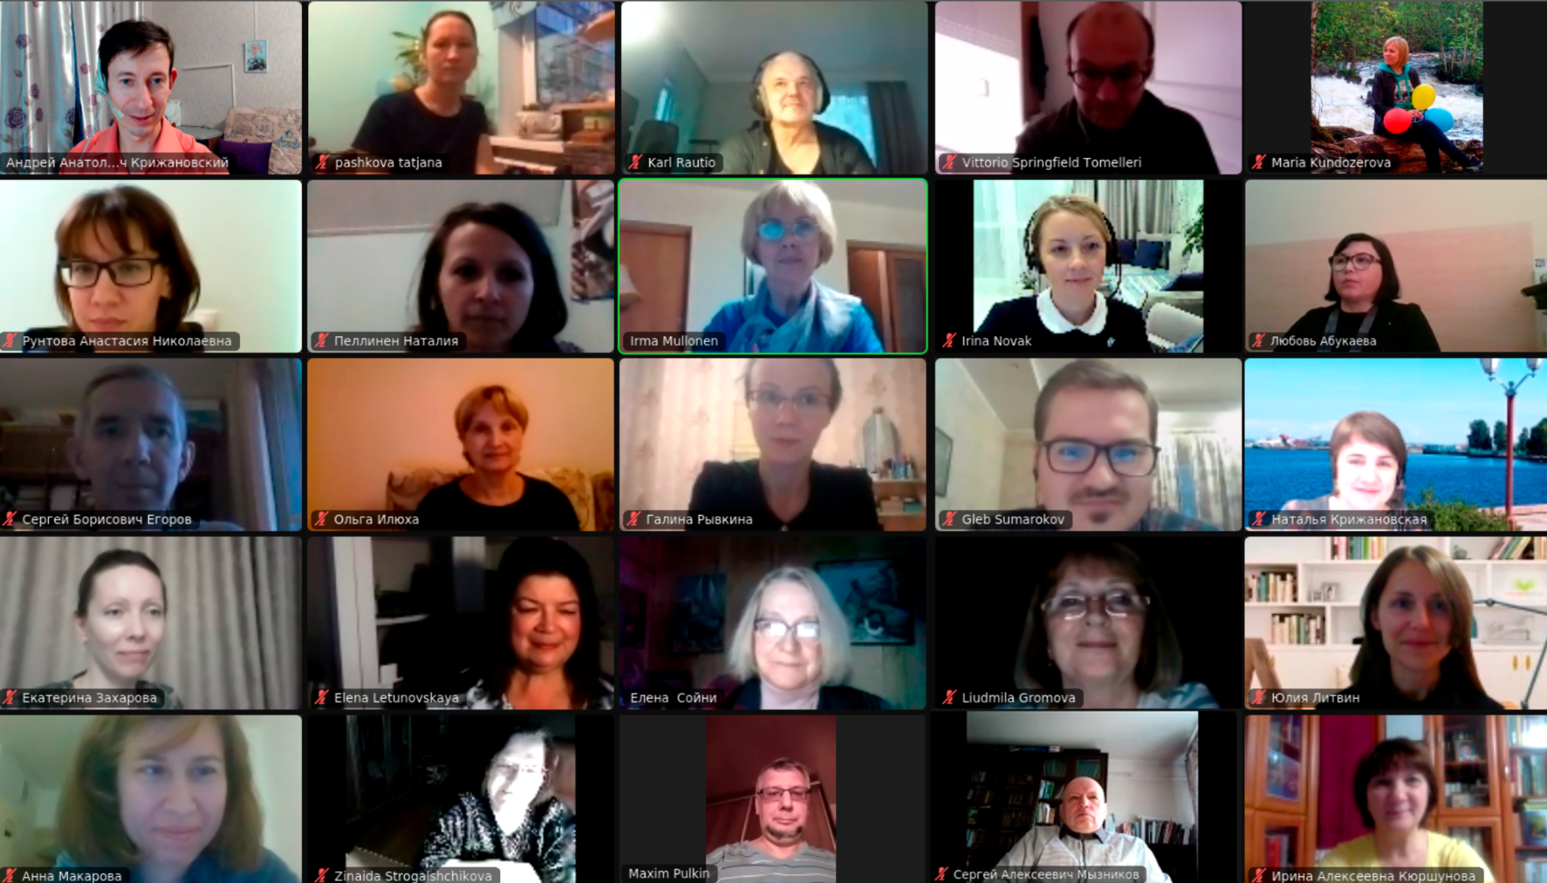
A REPEATABLE MODEL
An easy way to launch groups.
You don't need a perfect system to start. Here's a simple 4-to-6-week model that turns one big room into several self-sustaining groups.
THE 4TH SPACE
& ONLINE GROUPS
Notes:
Here's an easy, repeatable way to launch online groups — a simple four-to-six-week model that takes one big room and spins out several groups that keep going on their own.

Slide 17
THE 4–6 WEEK PLAYBOOK
Run the play.
01
Gather a large group (~30)
Open it up and let people pour in.
02
Two weeks to join, then close it
Lock the WhatsApp group so it becomes a real community.
03
Meet weekly on Zoom
Use breakout rooms once you're past about fifteen people.
04
Keep talking midweek
Ask questions in the WhatsApp group between meetings.
05
Pitch them to keep going
At the end, send them out to keep meeting on their own.
Notes:
The play: meet for four to six weeks with a large group of about thirty. Give two weeks for people to join, then close the WhatsApp group so it becomes a real community. Meet weekly on Zoom, using breakout rooms if more than fifteen attend. During the week, keep the conversation going with questions in the WhatsApp group. And after the group ends, pitch everyone to keep meeting on their own — that's how you multiply.

Slide 18
THE CHALLENGE
?
Can you test this
in 60 days?
One 4th space. One online group. Two months to try. You'll learn more from one real attempt than from any amount of planning.
THE 4TH SPACE
& ONLINE GROUPS
Notes:
So here's my challenge: can you test this out over the next 60 days? Start one 4th space and run one online group. You'll learn more from a single real attempt than from months of planning.

Slide 19
Build the space.
Then fill it.
GO CREATE YOUR 4TH SPACE
THE 4TH SPACE
& ONLINE GROUPS
Notes:
Two moves: create a 4th space where people can gather, and fill it with online groups that strengthen them. Build the space, then fill it. Go create your 4th space. Thank you.

