Slide 1


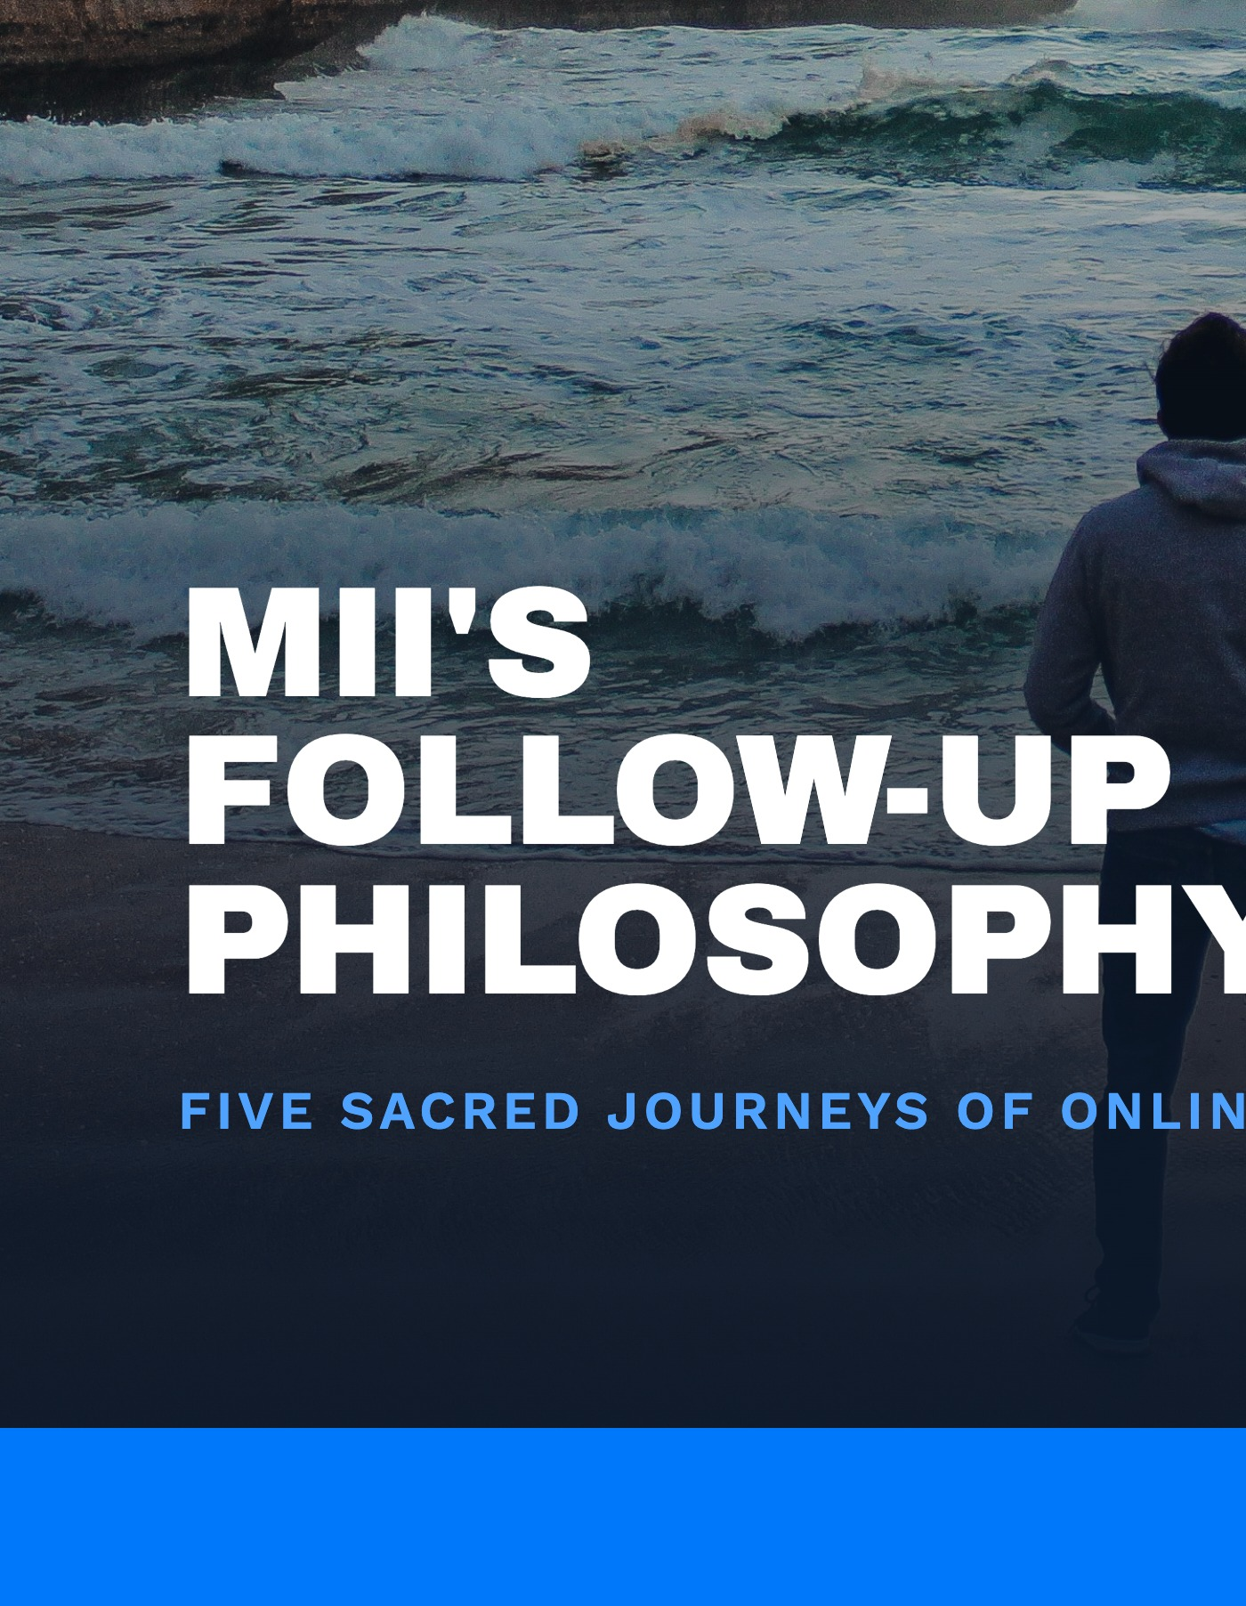
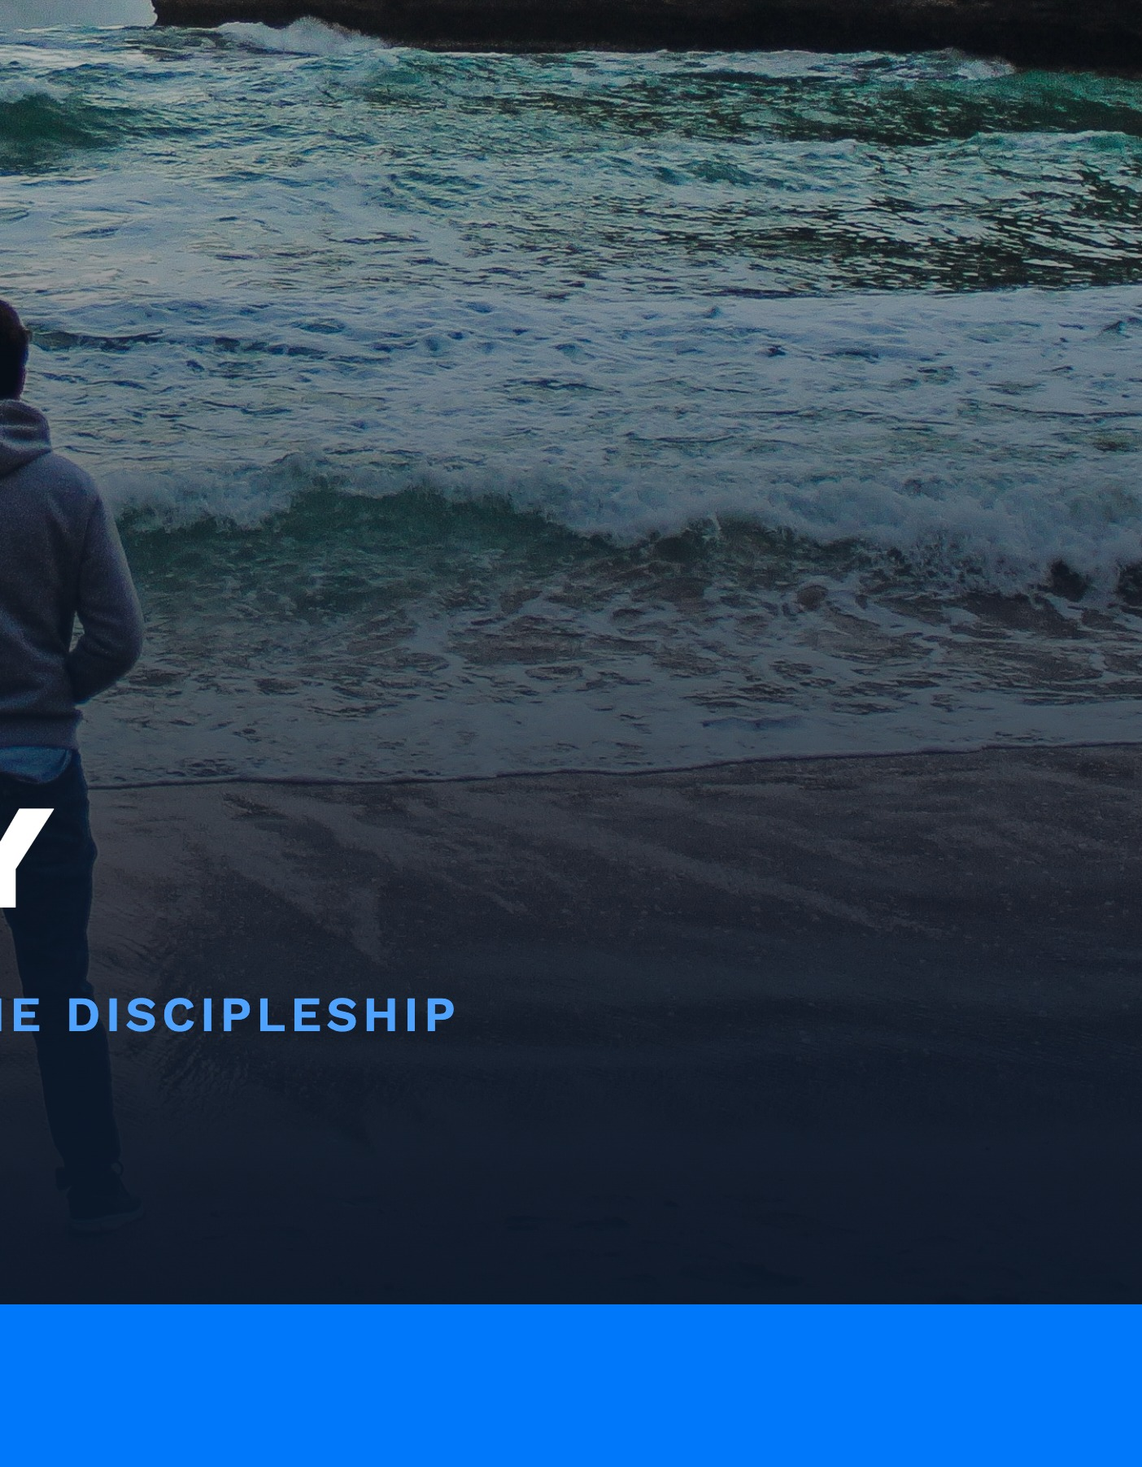
Notes:
Welcome everyone. Today I want to walk you through MII's Follow-Up Philosophy. In other regions, frontline Christian ministries running media campaigns have run into a chronic problem: they get a wave of responses, but not enough capacity to follow up with everyone one-on-one. That experience is what shaped the follow-up model I'll share today. Here in Australia we're starting fresh, so we get the chance to build this well from day one, learning from what's worked elsewhere without being boxed in by it. At its heart, this is lifestyle evangelism -- just online. Let's get into it.

Slide 2
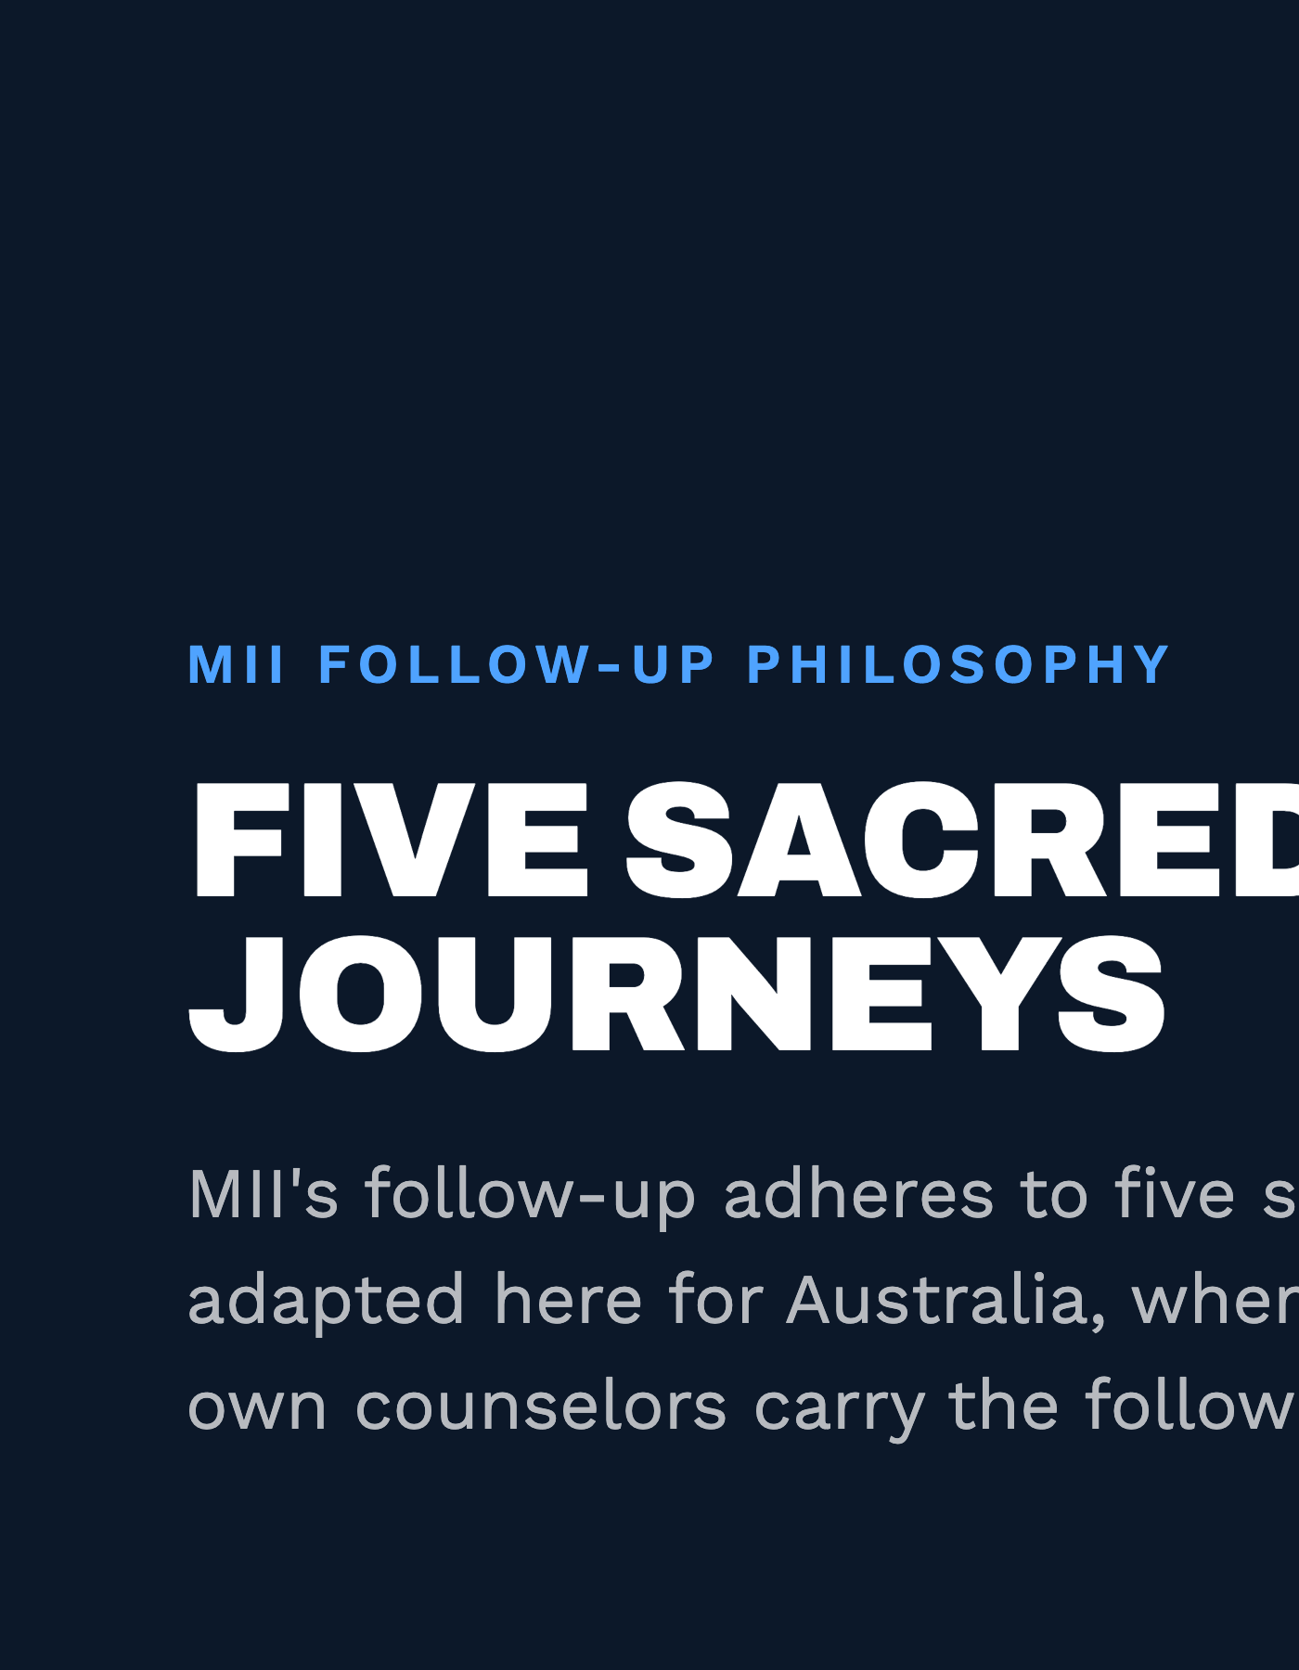

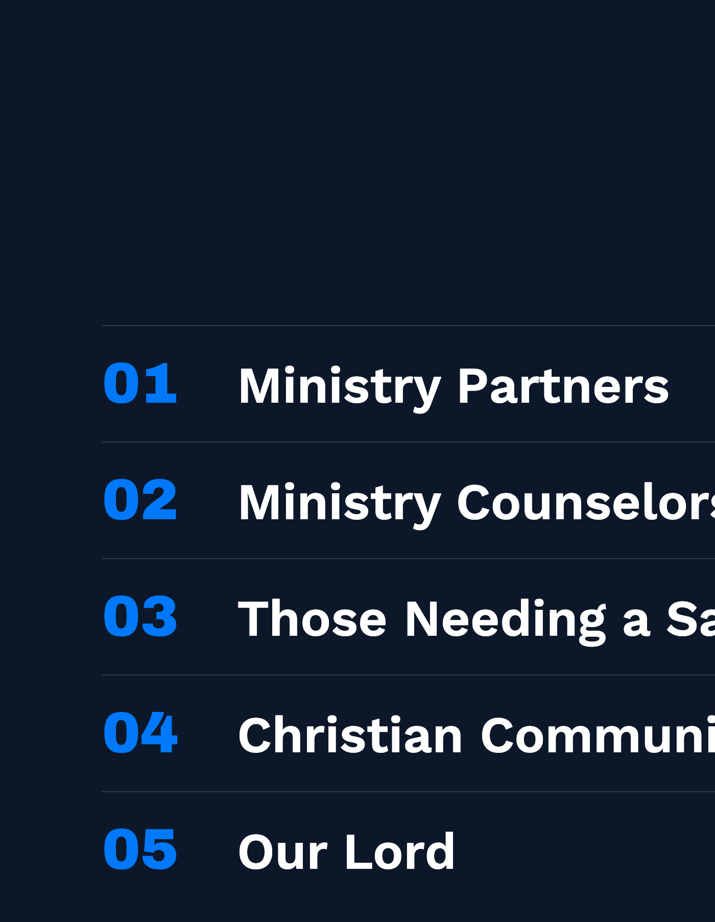
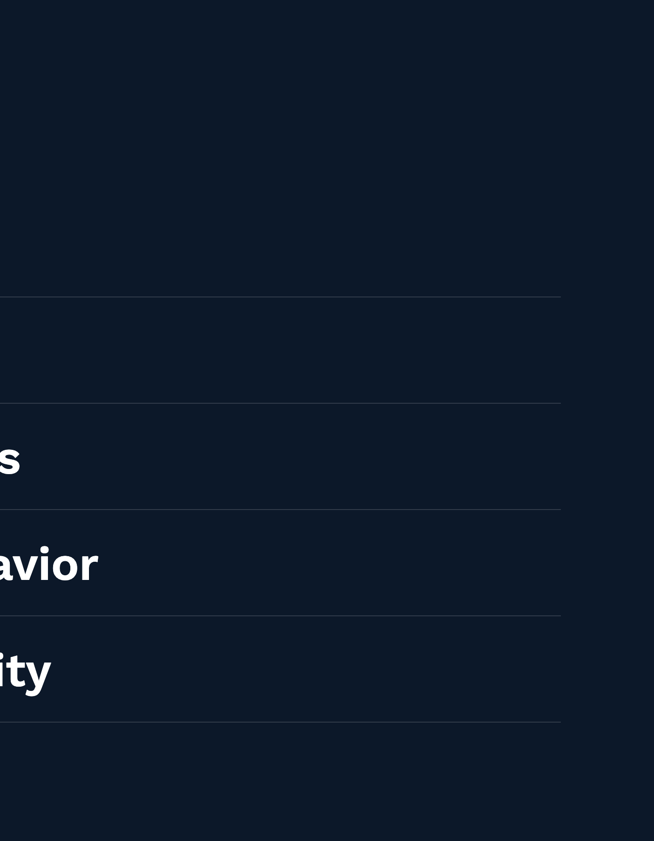
Notes:
So, MII's follow-up philosophy adheres to five sacred journeys, and I'll take you through each one in turn. Quick preview so you know where we're headed: (1) our journey with the Ministry Partners who send seekers our way, (2) our journey with the Ministry Counselors who respond to them, (3) our journey with the responders themselves, who are coming to us needing a Savior, (4) our journey into Christian Community, and (5) our journey with our Lord, who makes all of this worthwhile. One thing worth flagging early: Australia will work a little differently to how MII operates in other regions -- and I'll point that out as we go, because this is new ground for us, and we get to shape it around what actually fits here.

Slide 3


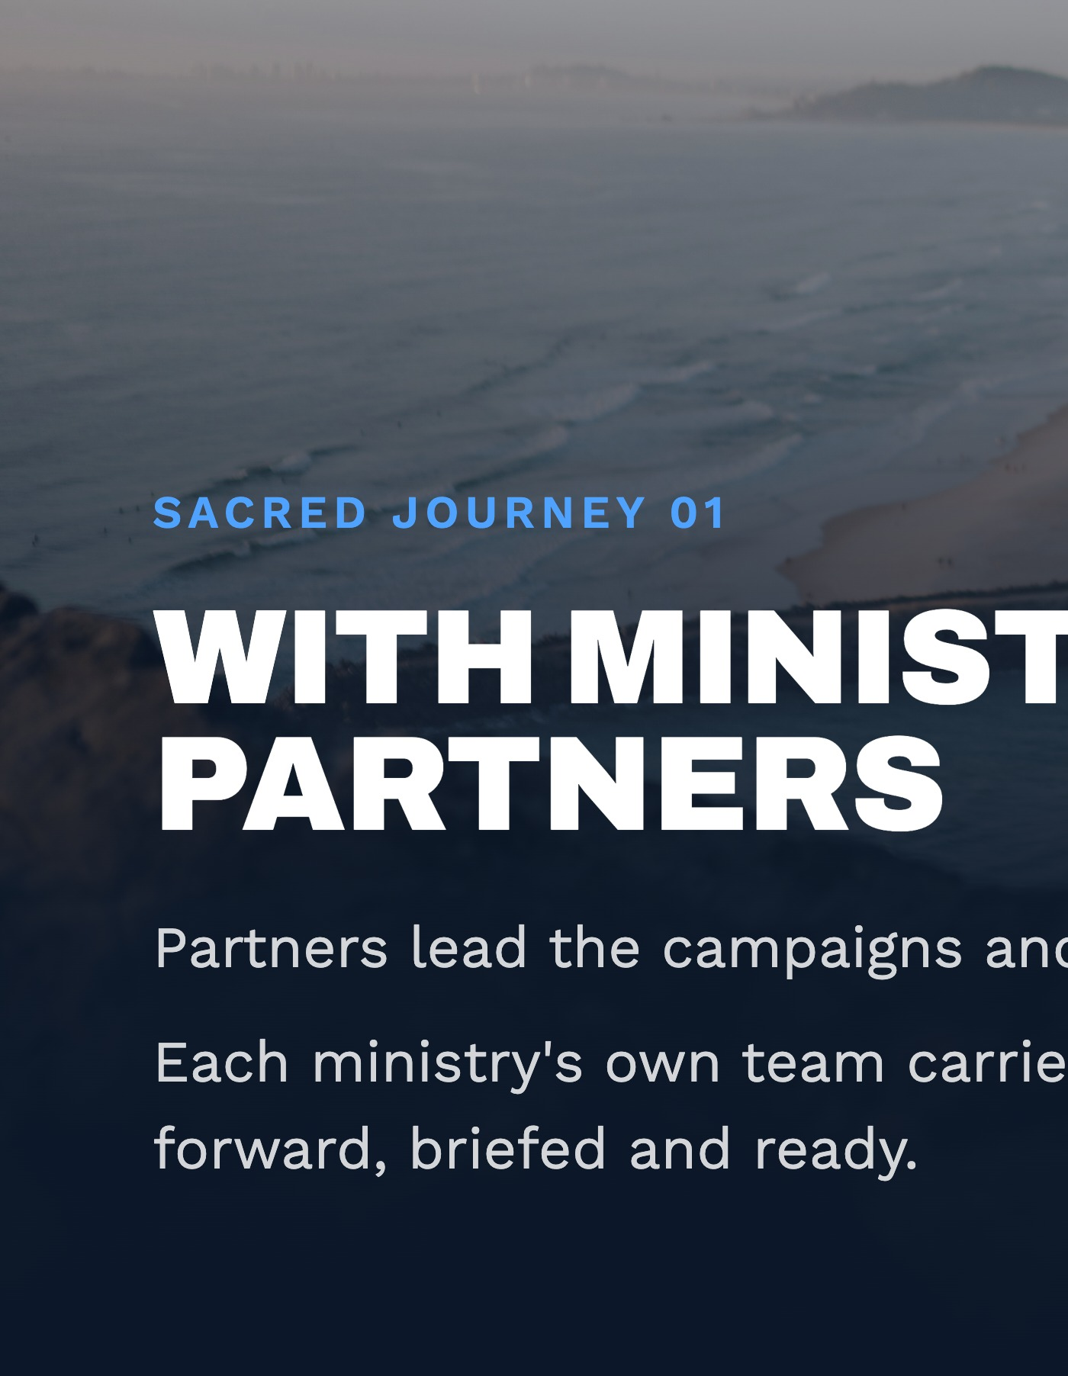

Notes:
Let's start with the first journey: our journey with Ministry Partners. MII supports campaigns aimed at evangelism as well as discipleship -- so we help people come to Christ, and we help people already following Christ grow toward replication and real church involvement. Here's the basic division of labor: the partner ministry owns the marketing and content, and briefs us ahead of time on their calendar of campaigns, using some simple forms we provide. In our other regions, MII's own team picks up the conversations from there. Here in Australia it works a little differently -- each ministry runs its own response with its own people, and MII's role is to help them do that well. So this partnership is really about equipping each ministry, not MII taking the conversations over. We still stay close through regular reporting and check-ins, so everyone's aligned. One nuance worth mentioning wherever we work: the best campaigns lead with a felt or practical need rather than an overt 'this is Christian' label up front -- naming it too early can push people away. It's lifestyle evangelism -- meet the practical need first, build trust, and let the Holy Spirit guide the Gospel conversation from there.

Slide 4


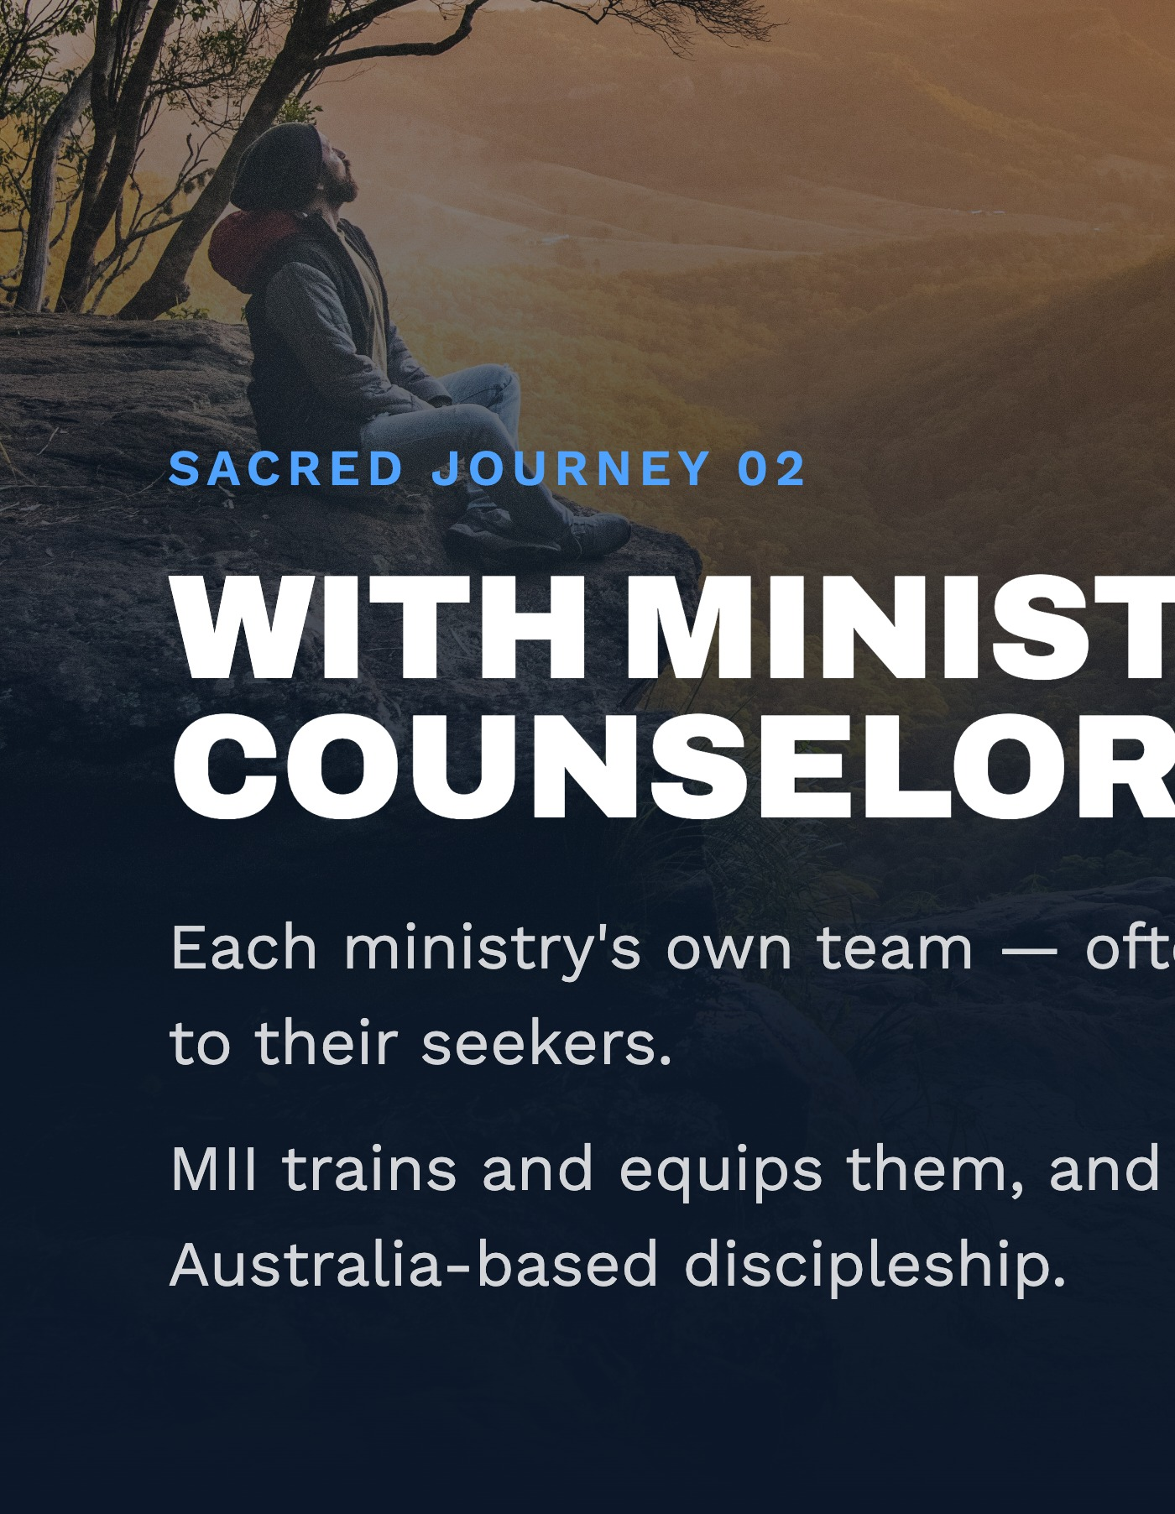
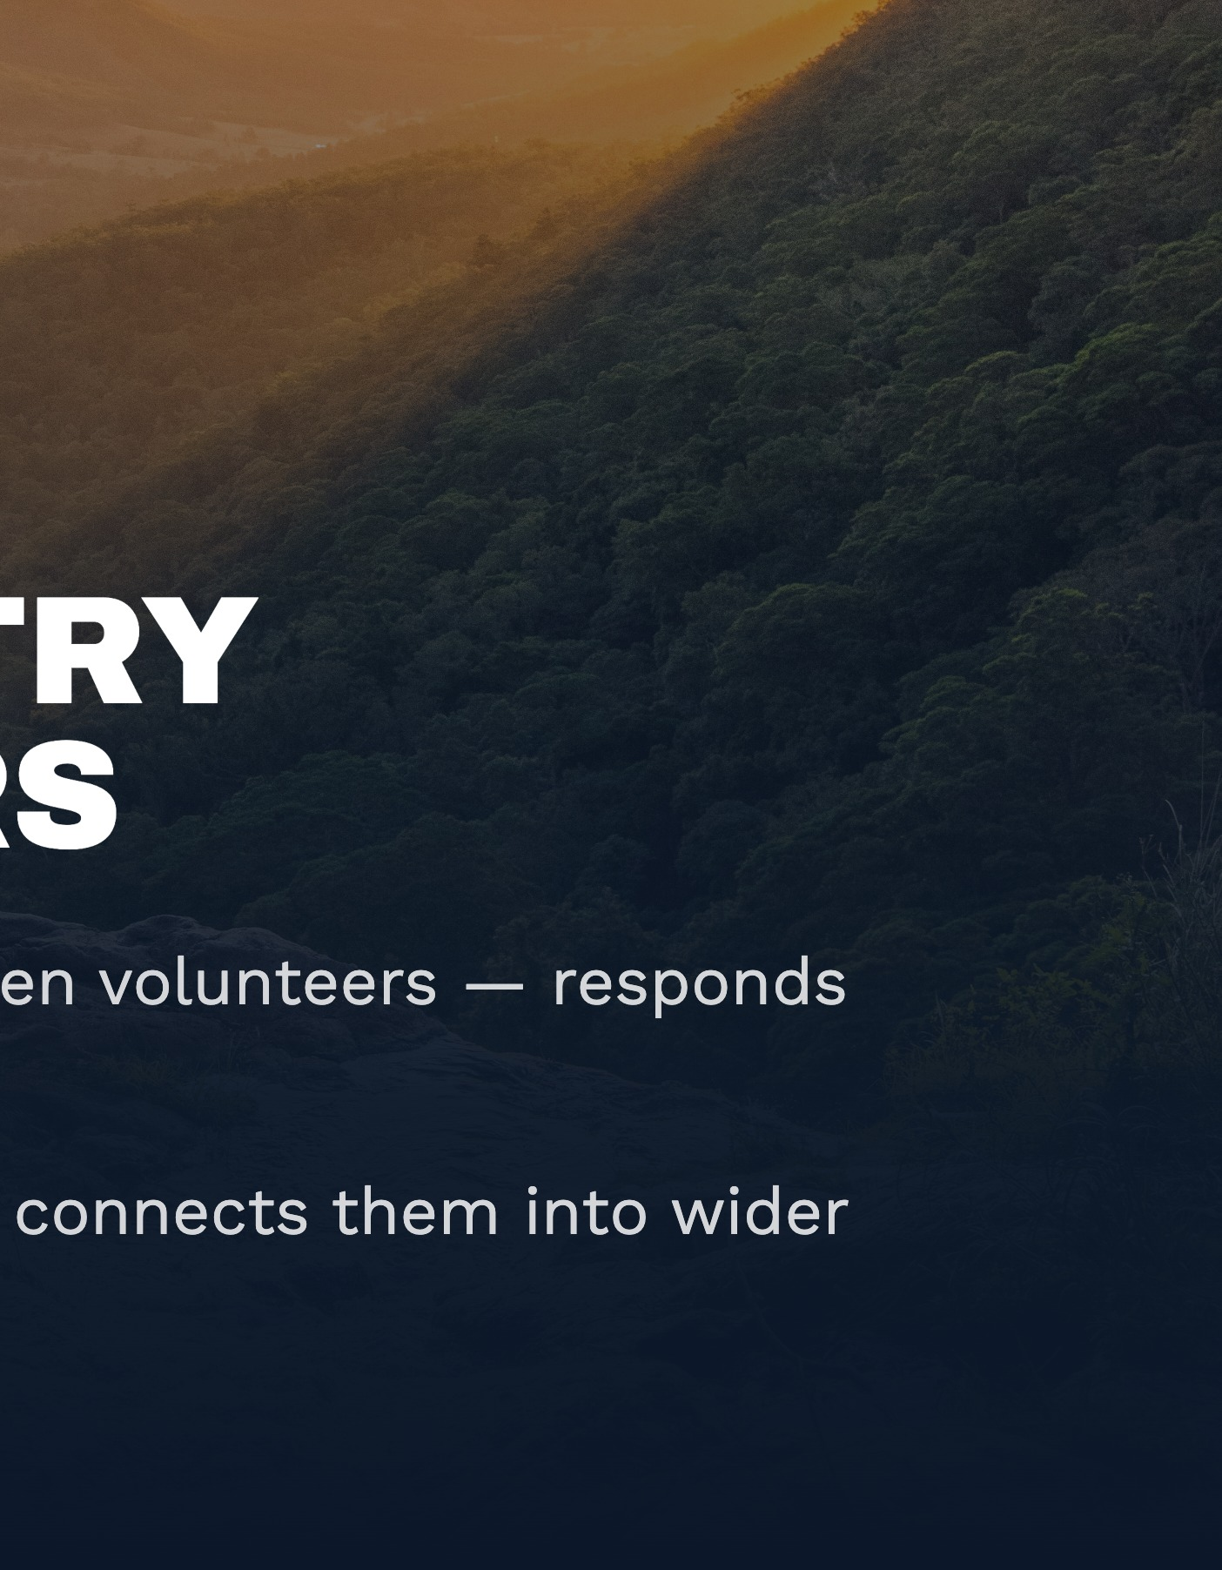
Notes:
Which brings us to the second journey: with our Ministry Counselors. This is the one I flagged earlier as looking different here -- and that's by design, not a compromise. In other regions, MII employs its own paid counselors who do the follow-up directly. Here in Australia, it's each ministry's own counselors, likely volunteers, who respond to their own seekers. MII's role shifts to training and equipping them, not taking over that relationship. It's worth naming something too: this work takes a real emotional toll, so caring for these counselors' wellbeing has to be a genuine priority, not an afterthought. What we want them moving toward, over time, is a sequence: sending Bibles or Christian materials, sharing a Gospel presentation, inviting a decision to follow Christ, walking through that decision, connecting the person to Christian community, discipling them, and ultimately supporting them toward baptism and multiplying the cycle themselves. And beyond training, MII connects these counselors into a wider Australia-based discipleship network, so no one's working in isolation. It's a long obedience, not a single transaction.

Slide 5


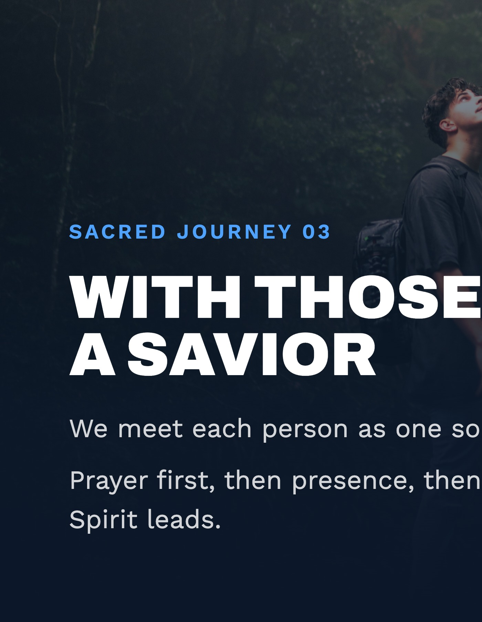
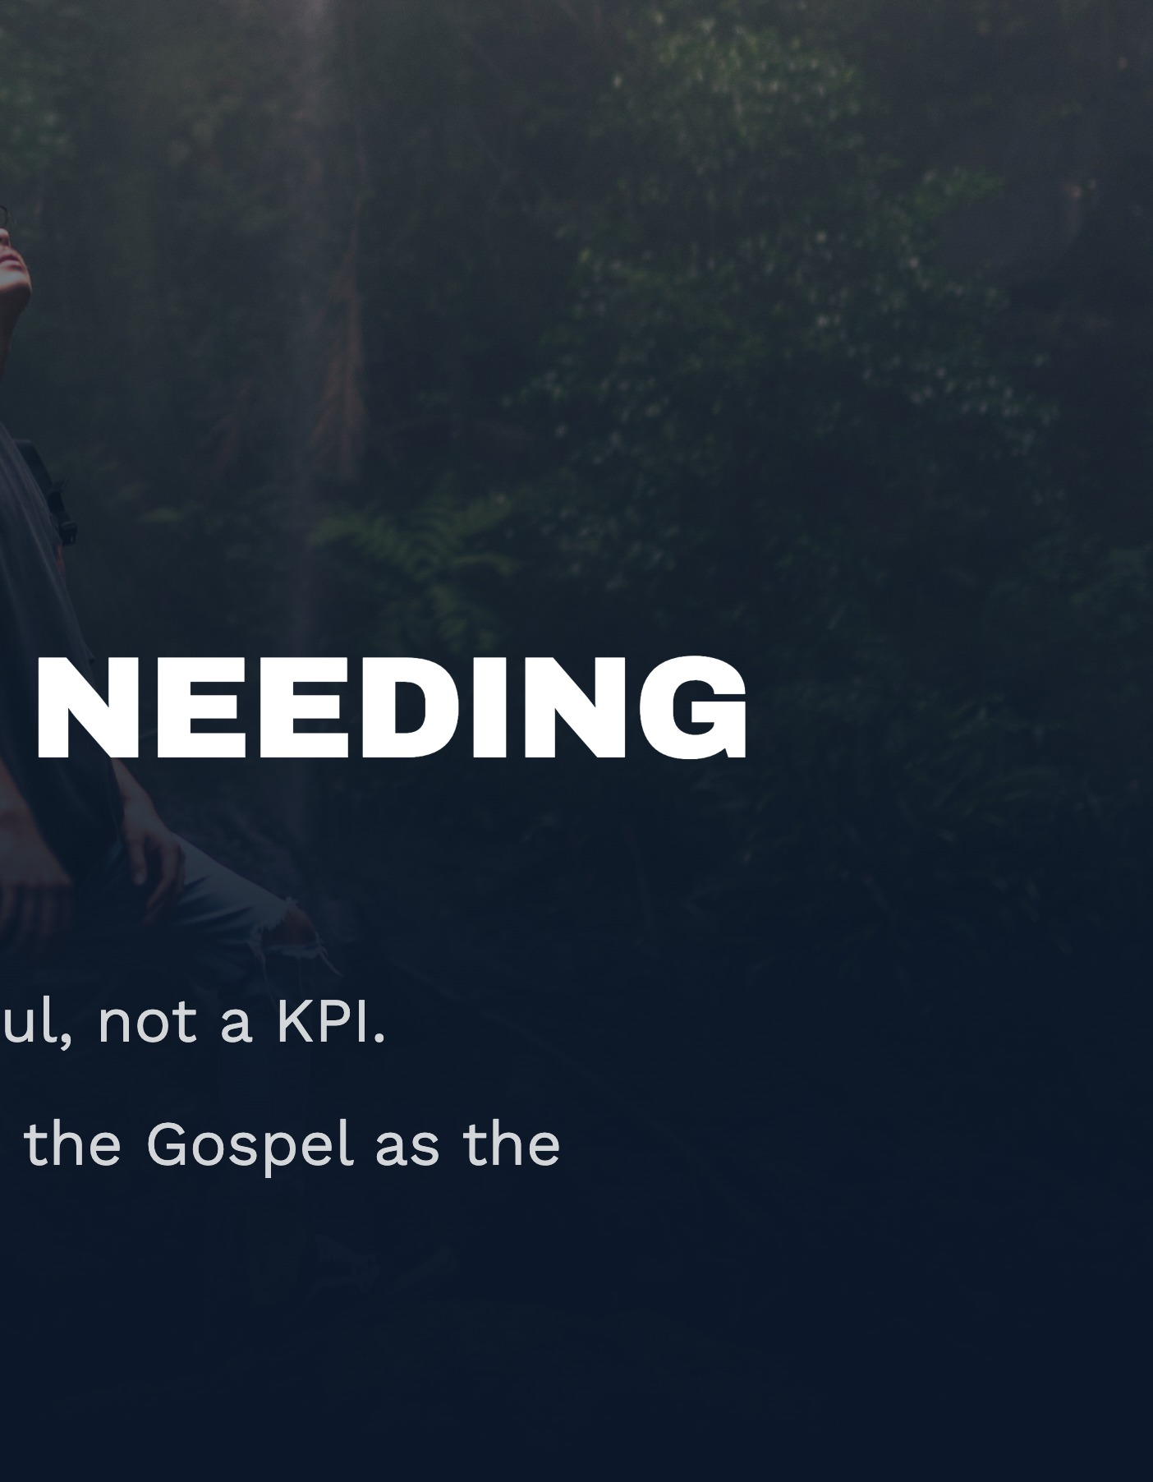
Notes:
Third journey: with the Responders themselves -- the people coming to us needing a Savior, needing to be discipled, or needing care in some area of brokenness. The posture we ask of every ministry counselor is to pour their life into each individual person, not chase numbers -- we've found the harvest is actually greater when the goal is serving one soul well. Counselors are asked to pray and stay tuned to the Holy Spirit on the 'what' and 'when' of each conversation. A key principle here is limited handoffs: ideally, a responder's first counselor stays their contact right through until that counselor personally introduces them to a Christian community leader -- every handoff costs trust and relationship, so we minimize them, even knowing it's not always fully practical. Practically, this means treating each conversation as sacred: praying for the responder, praying with them, and keeping careful notes. And we don't just walk people to a decision and stop there -- we keep supporting new believers afterward, through ongoing conversation, answering questions, and pointing them to good material: online Bibles, content suited to their stage of the journey, and pathways into discipleship groups.

Slide 6


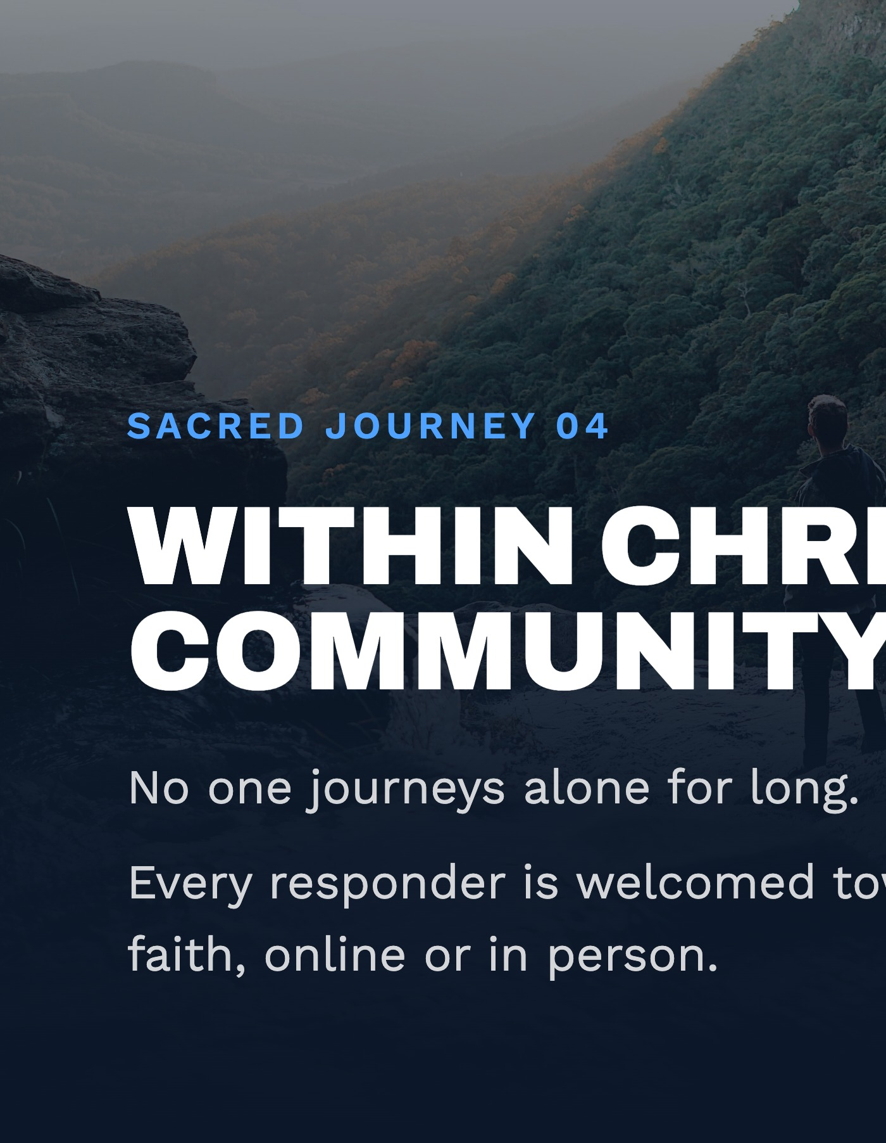
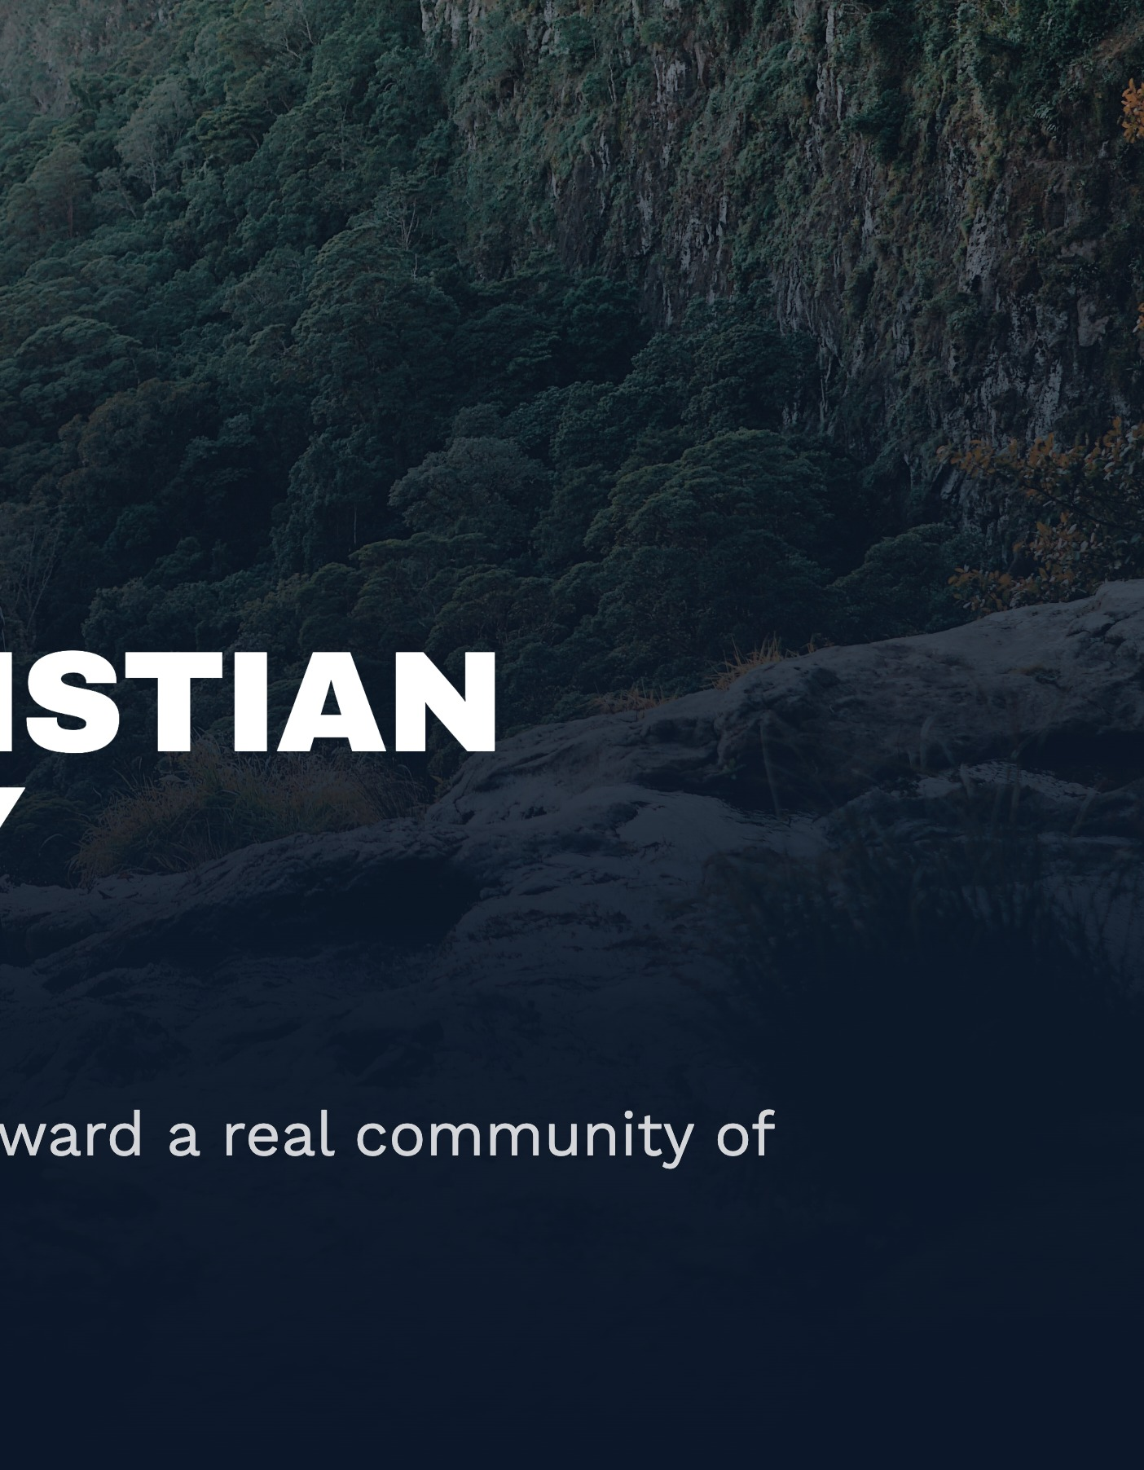
Notes:
Fourth journey: into Christian Community. The lens here is simple -- wherever we serve, we want to see a growing number of reproducing disciples, leading to more sustainable, mature local churches. Practically, that means we're committed to encouraging every responder into Christian community, whether that's in person or online. There's a whole spectrum of fellowship and discipleship groups to meet people wherever they are in their faith journey -- from 'Alpha'-style groups for pre-faith seekers, right through to full discipleship groups for believers taking real steps of growth. That matters especially for people who can't easily get to a physical church. Whoever's doing the follow-up stays intentional about referring people onward -- toward face-to-face engagement, a local church, or a fellowship group -- and ideally that handoff is a three-way conversation, where the counselor personally introduces the responder to the community leader they'll be joining.

Slide 7


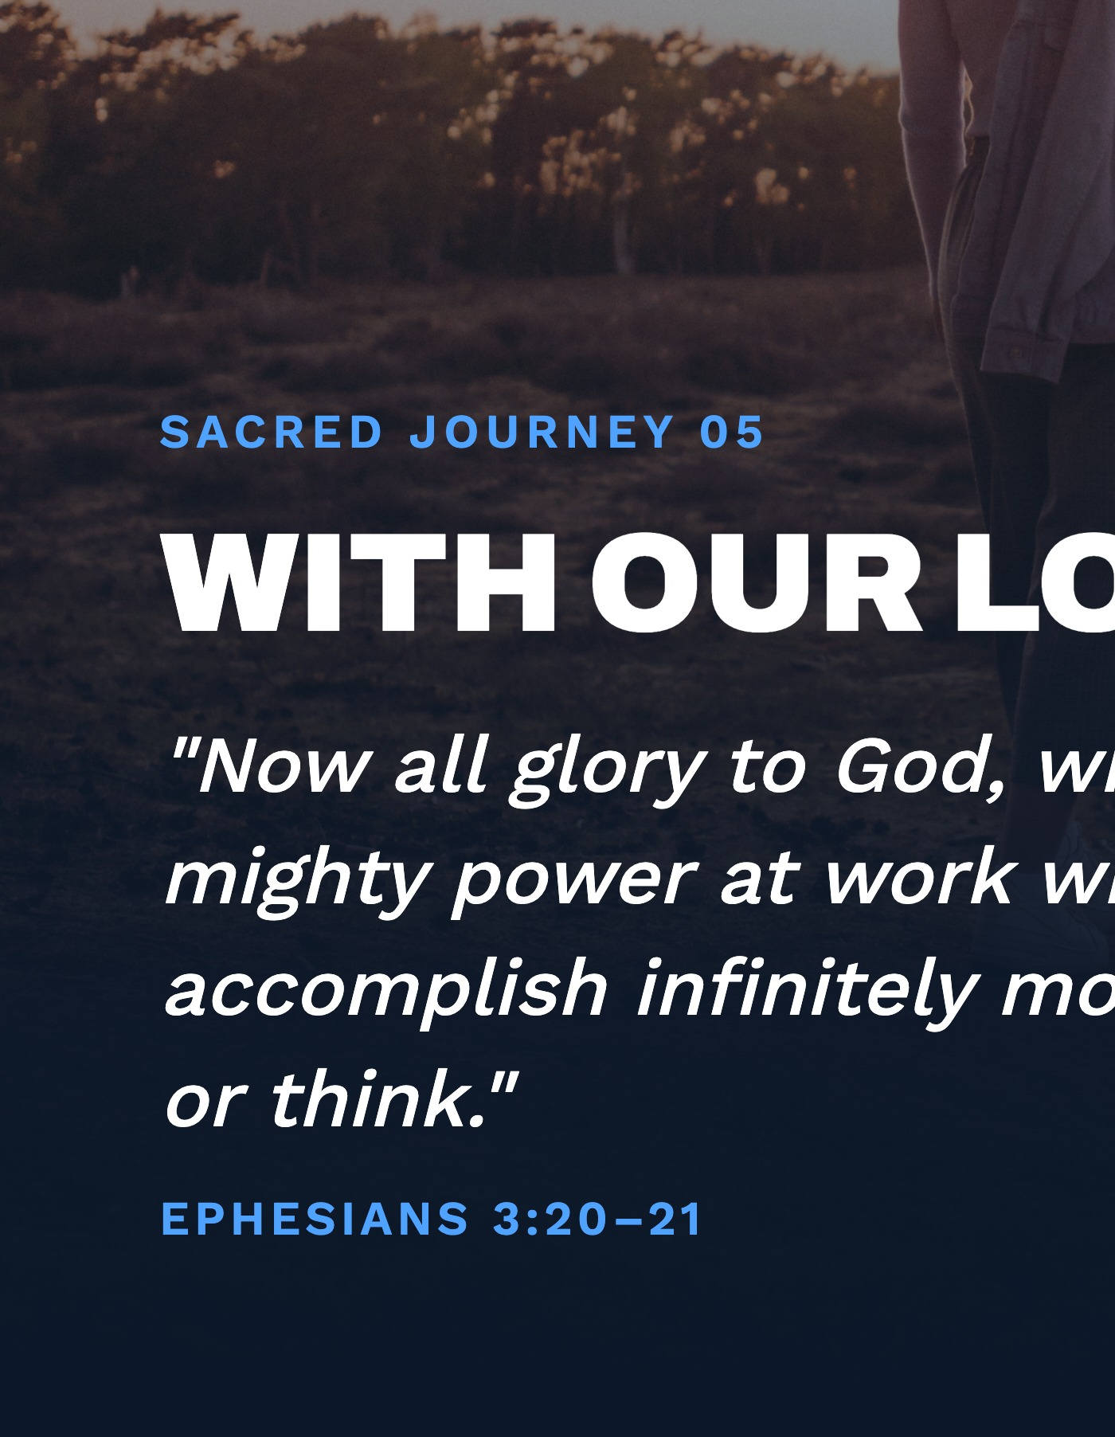
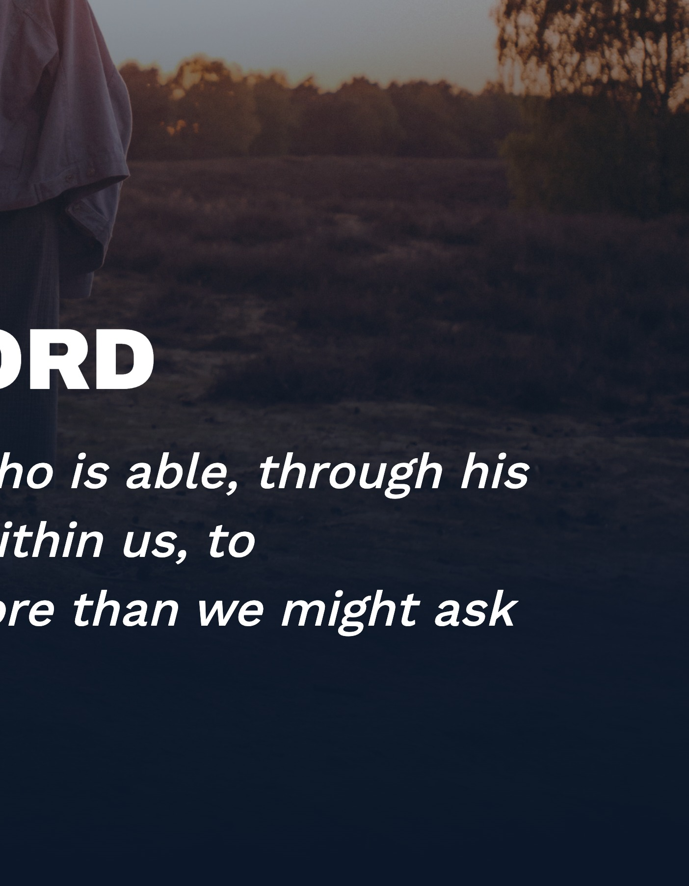
Notes:
Which brings us to the fifth and final journey: with Our Lord, who makes all of this worthwhile. I want to slow down here -- this isn't a performance metric, it's worship. Ephesians reminds us that God is able to accomplish infinitely more than we could ask or imagine, through his power at work in us -- glory to him in the church and in Christ Jesus, through all generations, forever. That's the posture behind everything on the previous slides: prayer, dependence, and trust that the fruit belongs to him, not to our own strategy. Feel free to pause here for a moment before moving on.

Slide 8




Notes:
So to bring it all together: this is MII's Follow-Up Philosophy -- lifestyle evangelism, practiced online, through five sacred journeys: with our Ministry Partners, our Ministry Counselors, the Responders themselves, the Christian Community we welcome them into, and ultimately with our Lord. Australia is fresh ground for this, and we get to build it well from here. Thank you for taking this in with me today -- happy to take any questions.

