Slide 1
Presented by: Sameer Date: October 31, 2024
Hotel Bookings Analysis and
Cancellation Prediction

Slide 2
Dataset Information
This data set contains booking information for a city hotel and a resort hotel and includes information such as when the booking was made, length of stay, the number of adults, children, and/or babies, and the number of available parking spaces, among other things. All personally identifying information has removed from the data.

Slide 3
Preprocessing
Imported dataset was about 119390 rows in which we found the 4 columns [ children, country , agent , company ] had missing values.
but as The columns country ,agent ,children had a less number of missing values. We w removed the missing values.But when it came to The columns “company” it had a high number of missing values, we dropped the column,as there were no duplicates we found our data ready for EDA

Slide 4
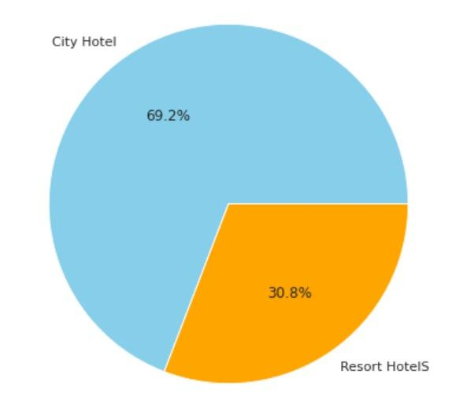
Exploratory Analysis
Out of total hotels 71181 were City Hotel
Resort Hotel were less as compare to city hotels precisely 31713 hotels
approx. 69.2 % People were booking city hotels which was more than Resort hotels.

Slide 5
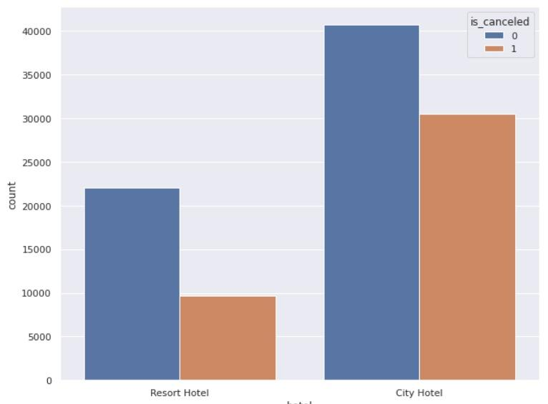
Feature is_canceled
According to the bar graph, around 40000 of bookings from city hotel and around 23000 bookings from Resort hotel were not canceled

Slide 6
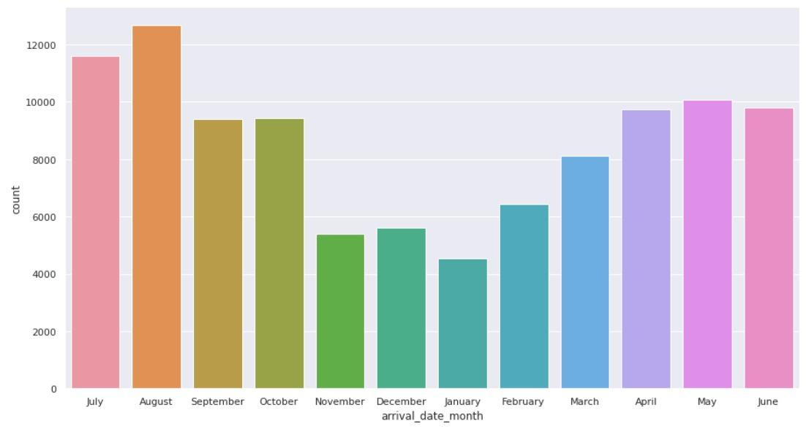
Feature arrival date month
AS you can see traffic in the january and November is less as compare to the other months

Slide 7
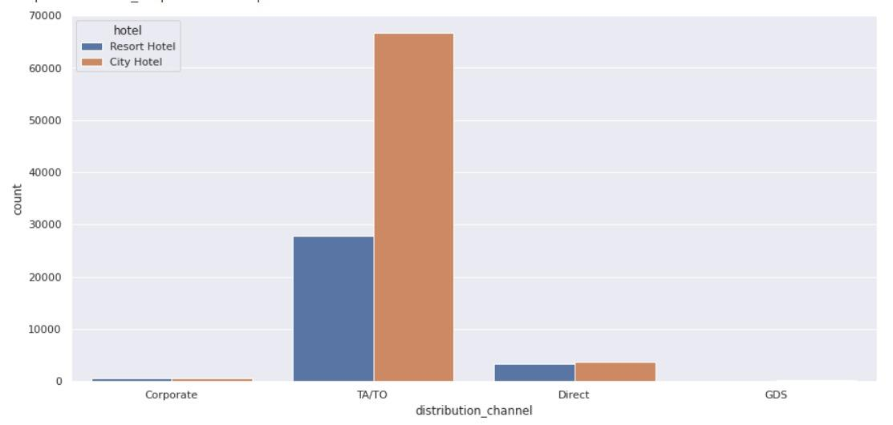
Feature distribution channel
Bookings through Travel Agents,Tour Operators is preferred by most of the people
approx. 70000 city hotels are book by Travel Agents & Tour Operators
approx. 30000 resort hotels are book by Travel Agents & Tour Operators

Slide 8
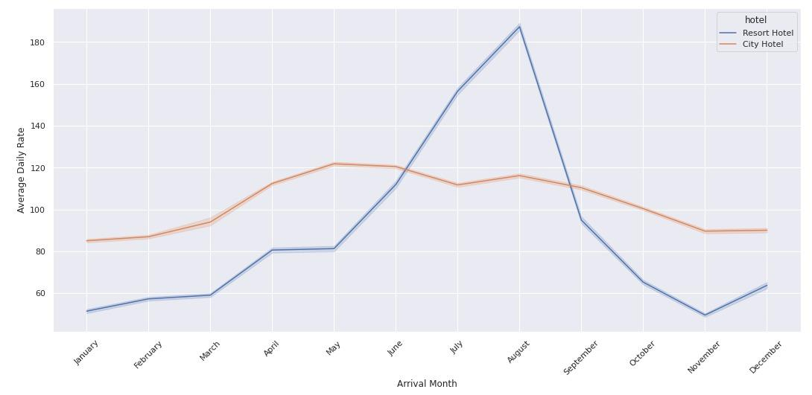
Relation between prices and month
For resort hotels, the average daily rate is more expensive during august, july and september.
For city hotels, the average daily rate is more expensive during august, july, june and may.

Slide 9
Hypothesis Testing Results
1. Hypothesis
H0 (Null Hypothesis):
Customers booking more than 6 months in advance have the same cancellation rate as those booking 6 months or less
H1 (Alternative Hypothesis):
Customers booking more than 6 months in advance are more likely to cancel
.Result: With a p-value < 0.05, we reject the null hypothesis, indicating a significant difference in cancellation rates between early and standard bookings

Slide 10
Hypothesis 2
H0 (Null Hypothesis):
Weekday bookings have the same average daily rate (ADR) as weekend bookings.
H1 (Alternative Hypothesis):
Weekday bookings have a higher average daily rate (ADR).
Result: With a p-value of 2.48e-265 (significantly less than 0.05), we reject the null hypothesis, concluding that weekday bookings generally have a higher ADR than weekends.

Slide 11
Predictive Modeling for Hotel Cancellations
Data Preparation and Splitting
Features Selected: Lead time, ADR, special requests, previous cancellations, booking changes, repeated guest status, and car parking spaces.
Target Variable: Cancellation (is_canceled)
Data Split:
80% Training Data
20% Test Data
Scaling: StandardScaler was used to standardize numerical features.

Slide 12
Models Used and Performance Metrics
1.Logistic Regression Model We built a Logistic Regression model to predict hotel booking cancellations.
Accuracy Achieved: 72.08% – indicating moderate prediction strength.
Detailed Performance:
Precision: 70.29% – proportion of true positive cancellations among all predicted cancellations.
Recall: 49.88% – captures around half of all true cancellations.
F1 Score: 58.35% – a balance between precision and recall.

Slide 13
Random Forest Model We implemented a Random Forest model to improve predictive accuracy for cancellations. Accuracy Achieved: 80.13% – showing a stronger prediction capability compared to Logistic Regression. Detailed Performance: Precision: 76.41% – a high rate of correctly predicted cancellations among all predicted cancellations. Recall: 71.37% – effectively captures the majority of true cancellations. F1 Score: 73.80% – demonstrates a well-rounded balance between precision and recall.

Slide 14
Conclusion
From our EDA, we have observed that the top most important patterns in the data set which will helps in Hotel booking business
Reasons for booking cancellations across various parameters
Almost 35% of bookings were canceled and that's great number to concern.
Approx 30% bookings were cancelled by guests with no deposit type & 50% bookings were cancelled by guests with Refundable policy
the guests with no modifications cancelled bookings Around 42%
AS highest ADR in August may be it could be one of the reasons for more canceled bookings in August

Slide 15
Strategies to Counter High Cancellations at the Hotel
Encourage Direct bookings by offering special discounts
Monitor where the cancellations are coming from such as High ADR , Deposit type, etc.
Set Non-refundable Rates, Collect deposits, and implement more rigid cancellation policies
Best time to book hotel
Couple (or 2 adults) is the most popular accommodation type. So hotels can make arrangement plans accordingly
Most bookings were made from July to August. And the least bookings were made at the start and end of the year
More than 60% of the population booked the City hotel.
The majority of guests come from western europe countries.Portugal, the UK, and France, Spain and Germany are the top countries from most guests come, more than 80% come from these 5 countries.

