Slide 1

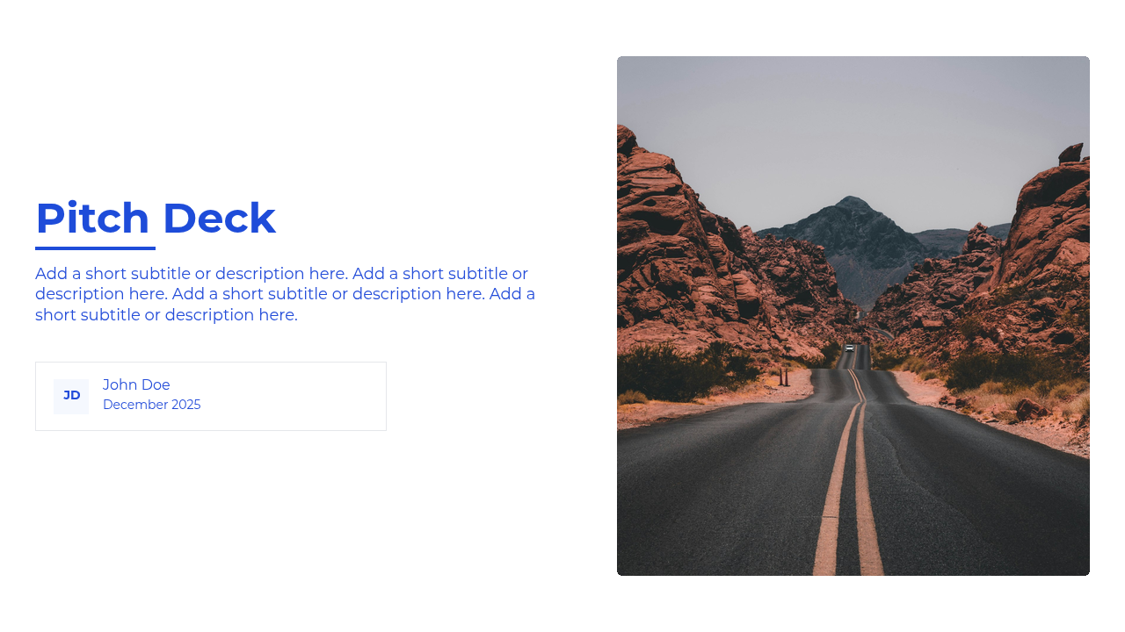
Pitch Deck
Add a short subtitle or description here. Add a short subtitle or description here. Add a short subtitle or description here. Add a short subtitle or description here.
JD
John Doe
December 2025

Slide 2
Table Of Contents
1
Section 1
2
Section 2
Brief description for this section.
Brief description for this section.
3
Section 3
4
Section 4
Brief description for this section.
Brief description for this section.
5
Section 5
6
Section 6
Brief description for this section.
Brief description for this section.
7
Section 7
8
Section 8
Brief description for this section.
Brief description for this section.
9
Section 9
10
Section 10
Brief description for this section.
Brief description for this section.

Slide 3
Businesses struggle
Market
Industry
Innovative and widely accepted.
Based on sound market decisions.
Show that we offer a solution that solves the problems previously described and identified. Make sure that the solutions we offer uphold the values of effectiveness, efficiency, and are highly relevant to the market situation and society is here and what is hsd sdksdf klfdslkf lkflkfsldkf.

Slide 4
Inefficiency
Businesses struggle to find digital tools that meet their needs, causing operational slowdowns.
Problem
High Costs
Outdated systems increase expenses, while small businesses struggle to expand their market reach.
A problem needs to be discussed further and in detail because this problem is the main foundation in the initial development of a product, service, and decision making. Without a well-defined problem, it will have an impact on a job that is unfocused, unmanaged, and less relevant.
Inefficiency
Businesses struggle to find digital tools that meet their needs, causing operational slowdowns.
Inefficiency
Businesses struggle to find digital tools that meet their needs, causing operational slowdowns.

Slide 5
Data Table or Chart
Present structured information in a flexible table or visualize it with a chart.

Slide 6
Market Size
Total Available Market (TAM)
1.4 Billion
In the TAM Section, we can fill in the potential of any person who can buy an offer or the maximum amount of revenue a business can earn by selling their offer.
Serviceable Available Market (SAM)
194 Million
It is a part of TAM that has the potential to become a target market for the company by considering the type of product, technology available and geographical conditions.
Market size is the total amount of all sales and customers that can be seen directly by stakeholders. This technique is usually calculated at the end of the year, the market size can be used by companies to determine the potential of their market and business in the future. This is very useful, especially for new companies that will offer services to those who are interested in our services.

