Slide 1
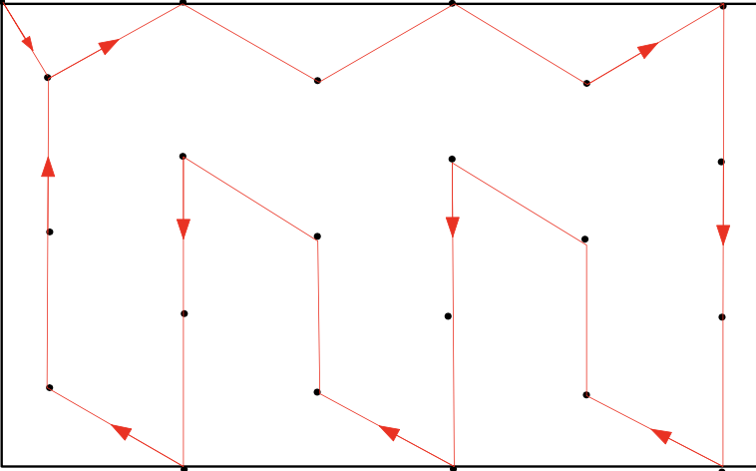
drone1
Start Point
drone2

Slide 2
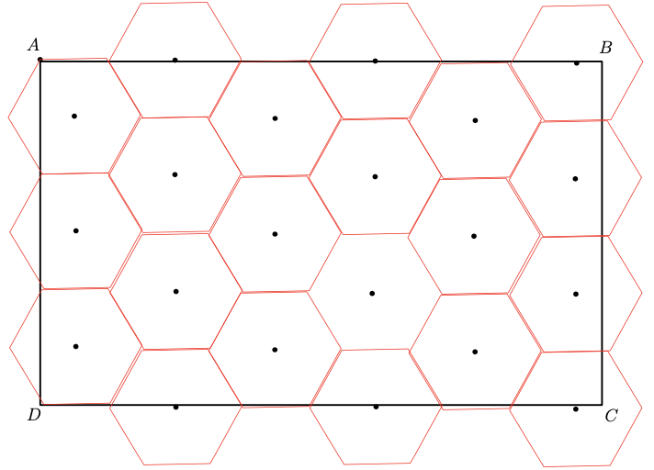
drone1
Start Point
drone2

