Slide 1


NINA HESSE
BOARDROOM EDITION
EXECUTIVE GOVERNANCE SUITE
PROJECT INSTANCE
RELEASE DATE
PROJECT ALPHA
JUNE 2026
PROPRIETARY GOVERNANCE INTELLIGENCE PRODUCT

Slide 2


01
EXECUTIVE GOVERNANCE SUMMARY
NINA HESSE GOVERNANCE SUITE
92%
-2%
DELIVERY CONFIDENCE
94%
SCHEDULE
BUDGET
OVERALL HEALTH: GREEN
88%
5
GOVERNANCE
HIGH RISKS
EXECUTIVE OBSERVATION
COMMITTEE ATTENTION
"Programme remains on track. Delivery confidence remains high. No executive intervention required beyond decisions identified within this pack."
Q3 Resource Allocation Approval
Phase 2 Integration Strategy Sign-off
Critical Vendor Performance Review
PROJECT ALPHA | BOARDROOM EDITION
PAGE 01
PROPRIETARY GOVERNANCE PRODUCT

Slide 3


02
RISKS & ISSUES GOVERNANCE
NINA HESSE GOVERNANCE SUITE
67.5%
12
4
18
24
GOVERNANCE EXPOSURE
RISKS
ISSUES
ASSUMPTIONS
DEPENDENCIES
TOP GOVERNANCE RISKS
CRITICAL DELIVERY ISSUES
Resource Constraints
CRITICAL
Reporting Performance
CRITICAL
Mitigation: Active external recruitment drive.
Status: Database optimization in progress.
Third Party Dependency
WARNING
UAT Defect Backlog
CRITICAL
Mitigation: Weekly executive vendor reviews.
Status: Extended testing cycles approved.
GOVERNANCE COMMENTARY
"Risk profile remains stable. No material increase in exposure. Mitigations remain effective across all critical workstreams."
PROJECT ALPHA | BOARDROOM EDITION
PAGE 02
PROPRIETARY GOVERNANCE PRODUCT

Slide 4


03
EXECUTIVE FINANCIAL DASHBOARD
NINA HESSE GOVERNANCE SUITE
$2.5M
$2.45M
-2%
3.4x
TOTAL BUDGET
FORECAST SPEND
VARIANCE
ROI FORECAST
Spent to Date
$1,100,000 (44%)
TOTAL
Committed Spend
$800,000 (32%)
$2.5M
Remaining Budget
$600,000 (24%)
Contingency Reserve
$300,000 (12%)
EXECUTIVE FINANCIAL OBSERVATION
"Programme remains within approved tolerances. Forecast variance remains favourable. Benefits realisation remains on track with 3.4x ROI projected."
PROJECT ALPHA | BOARDROOM EDITION
PAGE 03
PROPRIETARY GOVERNANCE PRODUCT

Slide 5
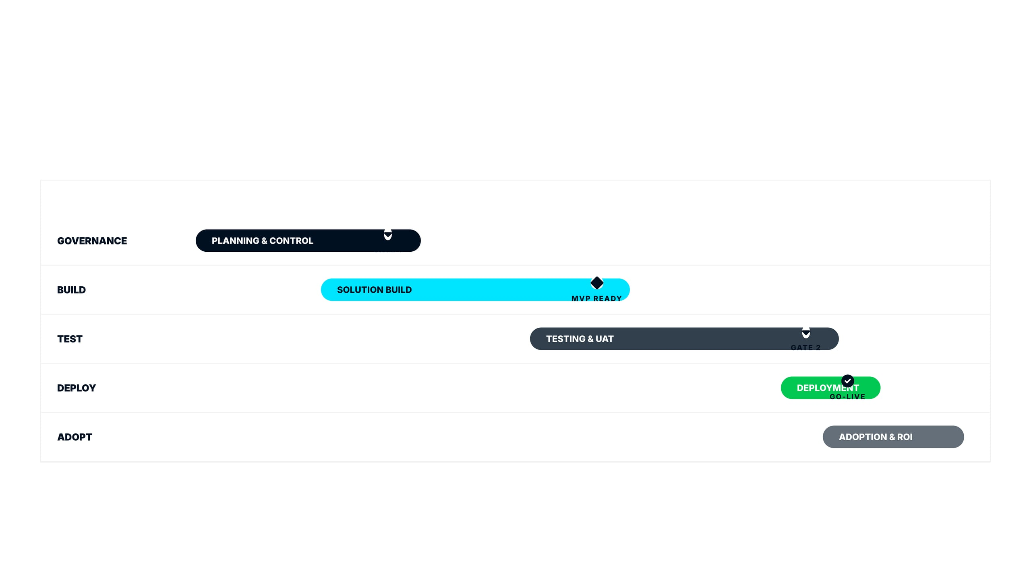
04
STRATEGIC PROGRAMME ROADMAP
NINA HESSE GOVERNANCE SUITE
"Strategic milestones are aligned with business objectives. Phase 2 integration is the critical path for Q3 delivery velocity and benefits realization."
MAY
JUN
JUL
AUG
SEP
OCT
NOV
KEY MILESTONE
DECISION GATE
STRATEGIC DELIVERABLE
PROJECT ALPHA | BOARDROOM EDITION
PAGE 04
PROPRIETARY GOVERNANCE PRODUCT

Slide 6


05
STRATEGIC DECISIONS REQUIRED
NINA HESSE GOVERNANCE SUITE
"Timely executive decisions on these four items will ensure Phase 2 delivery velocity and maintain alignment with strategic objectives."
PRIORITY
DECISION
IMPACT
RECOMMENDATION
HIGH
Approve integration resources
Critical Path Velocity
Approve 2 additional integration specialists to maintain timeline.
30 May 2025
PRIORITY
DECISION
IMPACT
RECOMMENDATION
HIGH
Approve budget reallocation
Financial Compliance
Reallocate $150K from contingency to training workstream.
30 May 2025
PRIORITY
DECISION
IMPACT
RECOMMENDATION
MEDIUM
Approve timeline extension
Quality Assurance
Extend UAT phase by 2 weeks to ensure quality sign-off.
13 June 2025
PRIORITY
DECISION
IMPACT
RECOMMENDATION
LOW
Approve change adoption plan
User Readiness
Approve proposed change adoption and communication approach.
30 May 2025
Decisions made today keep us on track for a successful delivery and benefits realization.
PROJECT ALPHA | BOARDROOM EDITION
PAGE 05
PROPRIETARY GOVERNANCE PRODUCT

